Slide 1

VitalLink Telehealth Solutions
Remote Patient Monitoring Optimization
Improving Patient Response Care SLAs & Monitoring Telehealth Fleet Stability
Healthcare Technology
Tableau Analytics
Prepared by POD 3
Lead Healthcare Data Analyst

Slide 2
Company & Project Background
Why this analysis matters for a remote patient monitoring provider
Who is VitalLink?
How the service works
Why action is urgent
VitalLink is a remote patient monitoring technology provider serving hospital networks, chronic disease clinics and home-health providers. Its devices support clinical monitoring for conditions such as Diabetes and Hypertension.
Patient wearables collect vital readings such as Blood Pressure, Glucose, Pulse and Oxygen. When readings trigger alerts, clinicians review them and decide whether intervention is needed.
Rising alert volumes and delayed intervention complaints indicate visibility gaps in alert queues, SLA performance and device-warning behaviour.

Slide 3
Key Terms & Abbreviations
Remote Patient Monitoring (RPM)
Service Level Agreement (SLA)
Key Performance Indicator (KPI)
Technology used to monitor patient health remotely using connected devices.
The required response-time standard for reviewing patient alerts.
A measurable value used to track clinical or operational performance.
Registered Nurse (RN)
Medical Doctor (MD)
Identifier (ID)
A qualified nursing professional involved in reviewing or managing patient alerts.
A qualified physician involved in clinical review and patient-care decisions.
A unique code used to distinguish records such as patients, clinicians, devices and alerts.
Approach: each abbreviation is written in full the first time it appears, then the short form is used afterwards.

Slide 4
Business Problem
The problem is not lack of data — it is lack of operational visibility
Alert Overload
SLA Blind Spots
Device Status Disconnect
Critical and non-critical alerts are mixed in one queue, increasing the risk of alarm fatigue and missed prioritisation.
Management cannot quickly see which hubs, clinicians or alert types are missing the 2-hour target for high-priority reviews.
Limited visibility into model, battery and connectivity patterns makes it hard to identify whether device issues are creating unnecessary warning alerts.
Business risk: slower clinical response → compliance exposure → patient safety risk → client dissatisfaction

Slide 5
Project Objective & Analyst Role
Project Objective
Our Role
Identify the drivers of alert overload, evaluate clinician response performance against the 2-hour SLA, and determine whether device health is contributing to excessive warning alerts.
• Model patient, clinician, device and alert data
• Build SLA and response-time calculations
• Analyse patient-risk and alert patterns
• Evaluate hub and clinician performance
• Build a 2-page interactive Tableau dashboard
• Present insights and recommendations

Slide 6
Data Model & Analytical Approach
Alert Records
Patients
Clinicians
Devices
Period
10,500
5,000
12
40
Jan 2026
Patient Dimension
Alert Fact Table
Clinician Dimension
Device Dimension
PatientID
PatientAge
PatientCity
Primary Condition
AlertID
AlertDate
VitalType
AlertSeverity
Response Time Hrs
ClinicianID
ClinicianName
Grade
Hub Region
DeviceID
Model Name
Connectivity
Battery Status

Slide 7
Dashboard Structure
Page 1 — Patient Alert Profile
Page 2 — Clinical SLA & Device Health
Purpose: Understand alert volume, severity and patient-risk concentration.
KPIs: Total Alerts, Critical Alerts, Critical %, Warning Alerts, Patients with Alerts.
Charts: Severity Distribution, Vital Type, Age Group & Condition, Critical Alerts by City.
Purpose: Measure response efficiency and test whether devices are contributing to warning-alert load.
KPIs: Overall Response, Overall SLA %, SLA Breaches, Critical SLA %, Warning Rate.
Charts: Critical Response by Hub, Clinician Workload, Warning Rate by Model, Battery vs Warning Rate.

Slide 8
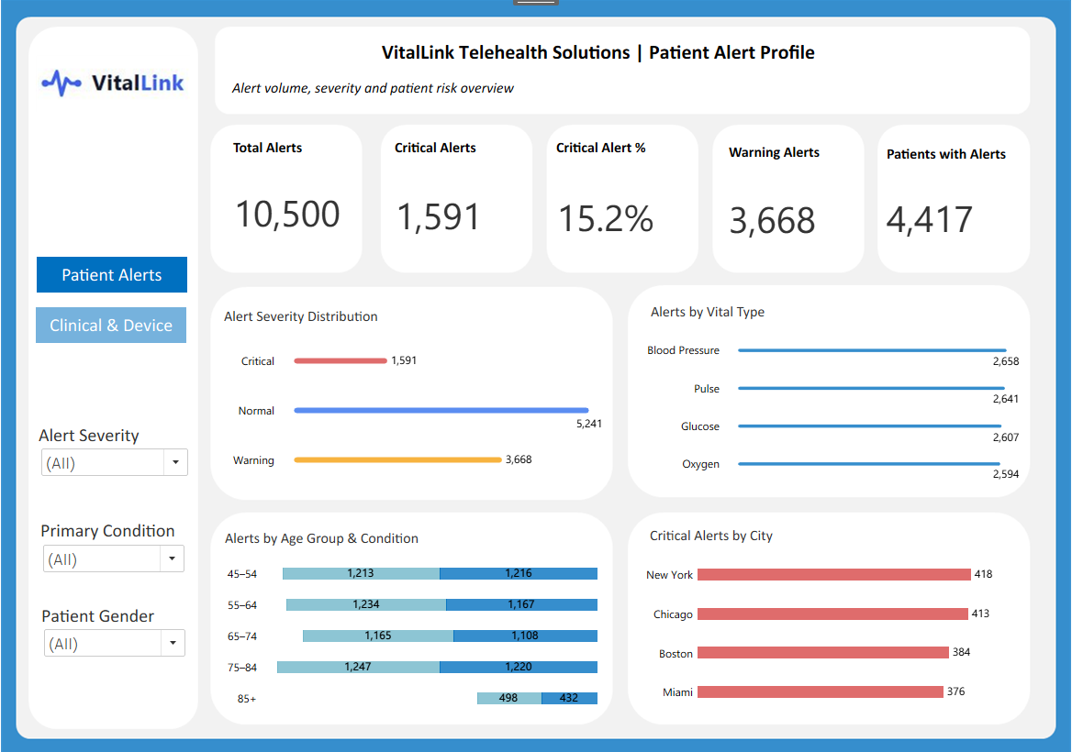
Patient Alert Findings
Page 1 insights: severity, vital signs and patient-risk concentration
Key Findings
• 10,500 alerts were generated in January 2026.
• 1,591 alerts were Critical, representing 15.2% of total workload.
• Warning alerts accounted for 34.9% of all alerts.
• Blood Pressure generated the highest alert count, but the spread across vital types was narrow.
• New York recorded the most Critical alerts, closely followed by Chicago.

Slide 9
Clinical SLA & Workforce Findings
Page 2 insights: response timing, SLA compliance and clinician workload
Operational Findings
Interpretation
• Overall SLA compliance is low at 19.8% because Normal alerts take much longer to close.
• Critical alerts are responded to faster: hub averages sit below the 2-hour target.
• Critical SLA compliance is 54.2%, meaning almost half of Critical alerts still miss the SLA.
• North Hub performs best at 57.1%; West Hub is weakest at 51.6%.
The response problem is not only about average time. Although Critical alerts have an average response below 2 hours, the compliance rate shows many individual Critical cases still exceed the target. This suggests VitalLink needs tighter real-time SLA monitoring and escalation, not just summary response-time reporting.

Slide 10
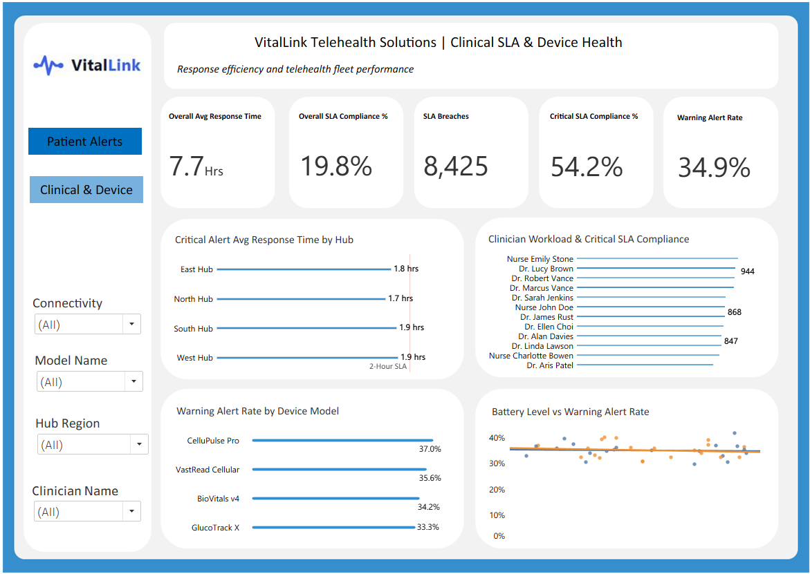
Device Health Findings
Testing the hypothesis that device issues are driving warning-alert volume
Device Investigation Results
• CelluPulse Pro has the highest Warning Alert Rate at 37.0%.
• GlucoTrack X has the lowest at 33.3%.
• The model spread is modest, so no single model appears to dominate the issue.
• Battery level shows little visible relationship with Warning Alert Rate.
• Bluetooth and Cellular devices follow similar patterns.
Conclusion: device condition may contribute in specific cases, but battery and connectivity are unlikely to be the main drivers of warning-alert volume.

Slide 11
Recommendations & Business Impact
Actions the Clinical Operations Board can take from the analysis
1
Separate priority queues
2
Monitor Critical SLA in real time
Create a Critical-alert queue and escalation rule so high-priority cases are not buried among Normal and Warning alerts.
Track Critical SLA compliance by hub and clinician daily, with alerts when compliance drops below target.
3
Review workload distribution
4
Target device review, not blanket replacement
Use clinician workload and SLA performance together to identify staffing pressure, training needs or process bottlenecks.
Prioritise review of higher-warning models such as CelluPulse Pro but avoid assuming low battery/connectivity is the main cause without stronger evidence.

Slide 12
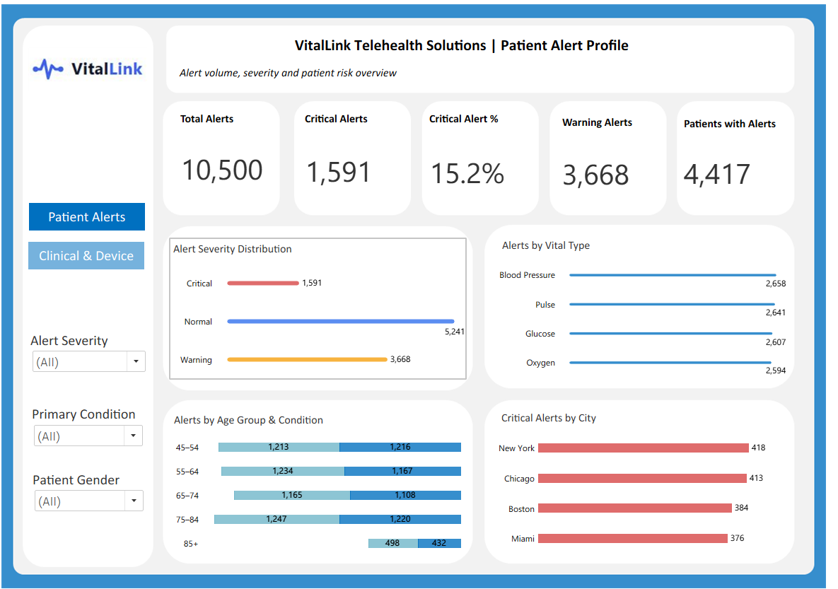
Final Tableau Dashboard Screenshots
Page 1 — Patient Alert Profile
Page 2 — Clinical SLA & Device Health

