Slide 1
Machine Learning · Burnout Prediction · 2026
Predicting Remote
Work Burnout
Using Machine Learning to Flag At-Risk Employees Early
Eman Sarhan · Yasmeen Nofal · Joud Hijaz · Nada Tabib · Maymona Khanfar
IBT × GGateway | Data Science & ML Bootcamp
1 / 15
Notes:
Introduce yourselves and the project. Say: "Our project uses machine learning to predict which remote employees are at risk of burnout — before the damage is done. We built a complete pipeline from raw data to a deployed Streamlit app, and today we'll walk you through the full story."

Slide 2
The Problem
12 hrs
9.9/10
5 hrs
Avg work/day
for High-Risk employees
Peak self-reported
fatigue score
Avg sleep at
highest burnout
Root Causes
Business Impact
Remote work erases work-life boundaries
No face-to-face interaction deepens isolation
Prolonged stress leads to emotional exhaustion
Companies detect burnout only after damage
Higher turnover and recruitment costs
Reduced productivity and rising absenteeism
2 / 15
Notes:
"The three numbers come directly from our dataset — they're not estimates." "High-Risk employees average 12-hour days, report fatigue near 10/10, and sleep only 5 hours." "The core problem: by the time a company notices, it's too late — the employee is already burned out." Transition: "So what exactly are we trying to predict?"

Slide 3
Project Goal & Target Variable
🎯 Predict each employee's burnout risk: Low, Medium, or High
51%
42%
7%
Low Risk
Medium Risk
High Risk
1,019 employees
843 employees
138 employees
of dataset
of dataset
of dataset
3 / 15
Notes:
"Our target variable is burnout_risk — a 3-class label from the dataset." "The class distribution is highly imbalanced: only 7% of employees are High-Risk." "That 7% is exactly the group we care most about — and the hardest to predict correctly." "Note: burnout_score was excluded from the model because it directly encodes the target — keeping it would give fake 100% accuracy. This is data leakage, which we'll explain." Transition: "Let's look at the dataset we worked with."

Slide 4
Data Source & Features
Dataset Overview
All 12 Features Used
★ = top 2 predictors from Random Forest
Source:
Kaggle — Remote Work & Wellbeing
Feature
Description
fatigue_score
★ Self-reported fatigue (0–10)
Records:
2,000 employee observations
isolation_index
★ Social isolation level
sleep_hours
Hours of sleep per night
Columns:
14 total · 12 used as features
work_hours
Hours worked per day
screen_time_hours
Daily screen time (hours)
Target:
burnout_risk: Low / Med / High
task_completion
Task completion rate (0–1)
Missing:
0 — dataset is fully clean
app_switches
Number of app context switches
meetings_count
Meetings attended per day
Imbalance:
Low 51% · Med 42% · High 7%
after_hours_work
Work done outside hours
breaks_taken
Number of breaks taken
day_type
Weekday vs Weekend
4 / 15
Notes:
"2,000 records, 14 columns — we used 12 as features." "Two columns were excluded: user_id (non-informative) and burnout_score (data leakage)." "The starred features — fatigue_score and isolation_index — turned out to be our two strongest predictors, as confirmed by the Random Forest feature importance chart coming up." Transition: "Let's explore the data before modeling."

Slide 5
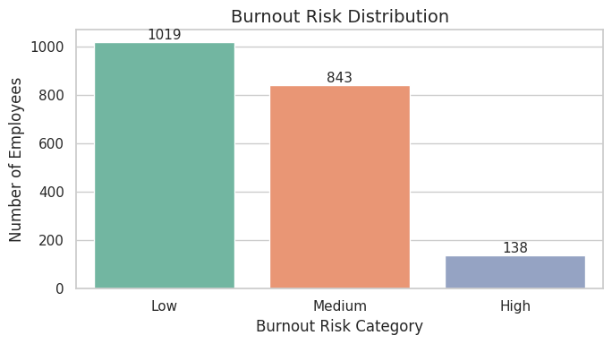
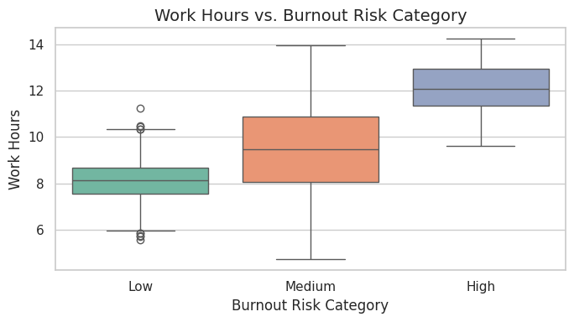
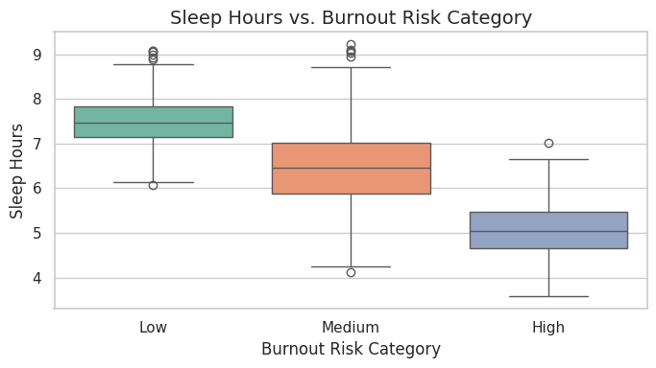
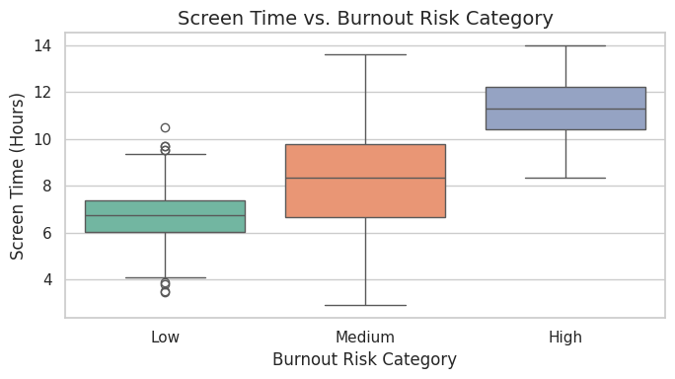
Key EDA Insights
Real charts from our notebook — each one informed a modeling decision
Burnout Risk Distribution
Work Hours vs. Risk
Class imbalance: 138 High-Risk (7%) vs 1,019 Low. Requires class weighting strategy.
High-Risk employees work 12+ hrs/day median. Clear separation from Low-Risk group.
Sleep Hours vs. Risk
Screen Time vs. Risk
High-Risk: median ~5h sleep. Low-Risk: ~7.5h. Strong inverse relationship confirmed.
Screen time closely mirrors work hours — both rise steeply for High-Risk group.
5 / 15
Notes:
Walk through each chart: "Top-left: class distribution — only 7% High-Risk. This drove our decision to use class weighting." "Top-right: work hours — High-Risk employees work 12+ hours. There's clear separation." "Bottom-left: sleep hours — the lower the sleep, the higher the risk. Median for High is around 5 hours." "Bottom-right: screen time — mirrors work hours closely, which the correlation heatmap confirms later." Transition: "Now let's look at which features matter most."

Slide 6
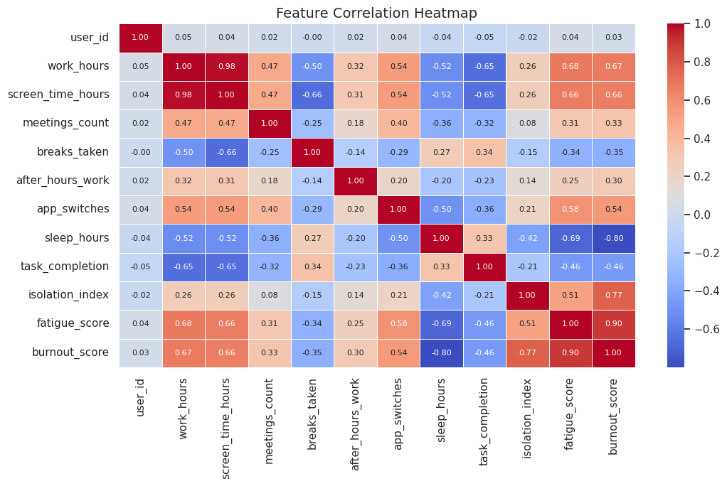
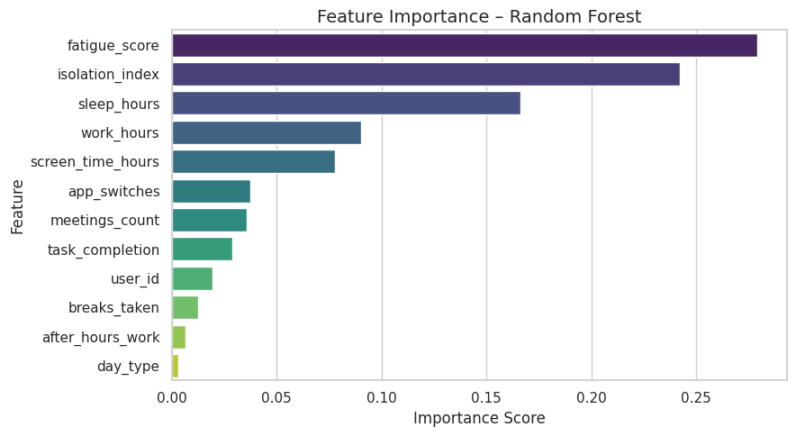
Correlation & Feature Importance
Feature Correlation Heatmap
Feature Importance (Random Forest)
fatigue_score (28%) · isolation_index (24%) · sleep_hours (17%) · work_hours (9%) · burnout_score EXCLUDED (data leakage)
6 / 15
Notes:
"Two charts that explain our feature selection decisions." "Left — the correlation heatmap: burnout_score has 0.90 correlation with fatigue_score and 0.77 with isolation_index — it's nearly a linear combination of other features AND the target. This is why we removed it." "Right — Random Forest feature importance: fatigue_score is #1 at 28%, isolation_index #2 at 24%, sleep_hours #3 at 17%. Work hours is only 9% — burnout is multidimensional." "Key insight: work hours alone do NOT predict burnout. Fatigue and social isolation matter far more." Transition: "With this understanding, let's look at our pipeline."

Slide 7
ML Pipeline — Step by Step
1
Data Collection
2
Data Cleaning
3
Feature Engineering
4
Class Imbalance
Kaggle · 2,000 rows · 14 columns
0 missing · 0 duplicates · verify dtypes
Encode day_type · Drop burnout_score (leakage)
138 High-Risk → class_weight='balanced'
5
Train / Test Split
6
Feature Scaling
7
Train 3 Models
8
Evaluate & Deploy
80% / 20% stratified · 1,600 / 400 rows
StandardScaler for Logistic Regression
Decision Tree · Random Forest · Logistic Reg.
Best model saved with joblib → Streamlit app
⚠️ Key decision: burnout_score removed — correlation 0.90 with fatigue_score and near-perfect with target = data leakage confirmed by heatmap
7 / 15
Notes:
Walk through all 8 steps clearly, explaining the WHY behind each: "Step 3 is the most important decision: we dropped burnout_score. The heatmap showed it has 0.90 correlation with the target. Keeping it = fake accuracy." "Step 4: 138 High-Risk samples out of 2,000 is a serious imbalance. class_weight='balanced' gives minority class proportionally more training weight." "Step 5: Stratified split ensures all three classes appear proportionally in both train and test sets." "Step 6: StandardScaler is required for Logistic Regression to converge properly." Transition: "After running all three models, here's what we got."

Slide 8
Models Tried
Three models — same 80/20 stratified split (400-sample test set)
Baseline
Ensemble
★ WINNER
Decision Tree
Random Forest
Logistic Regression
Accuracy: 93.25% | F1: 0.91
Accuracy: 97.00% | F1: 0.94
Accuracy: 97.50% | F1: 0.96
Strengths
Strengths
Strengths
Simple & interpretable
No scaling needed
Good starting floor
Strong performance
Handles non-linearity
Built-in feature importance
Highest accuracy
Best F1 & macro avg
Fast & interpretable
Weaknesses
Weaknesses
Weaknesses
Prone to overfitting
Less stable on new data
Slower inference
Less interpretable
Assumes linear boundary
Needs scaled features
Best Model
8 / 15
Notes:
"We tested three models in order of complexity." "Decision Tree: 93.25% accuracy — good baseline but overfits." "Random Forest: 97.00% — big jump. 200 trees, stable." "Logistic Regression: 97.50% — highest score with the simplest model." "The accuracy gap between RF and LR is small, but LR wins on F1 macro average (0.96 vs 0.94) — which matters more because of class imbalance." Transition: "Let's look at the numbers in detail and see the confusion matrices."

Slide 9
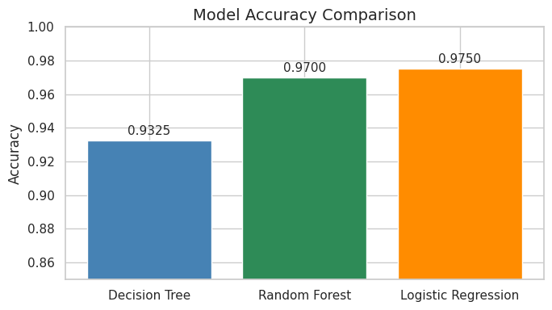
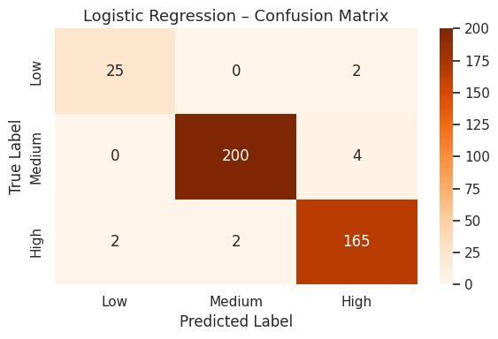
Results & Evaluation
All models evaluated on the same stratified 20% test set (400 samples)
Logistic Regression
Confusion Matrix
97.50%
Accuracy
0.96
F1 Macro
0.93
Low Recall
0.98
High Recall
9 / 15
Notes:
"The bar chart on the left is taken directly from our notebook — these are the real accuracy numbers: 93.25%, 97.00%, 97.50%." "The confusion matrix on the right is Logistic Regression's actual output. Look at the diagonal: 25 Low, 200 Medium, 165 High correctly predicted." "Errors: only 4 Medium cases misclassified as High, and 2 High cases missed. For an HR tool, that's excellent." "Recall for High-Risk is 0.98 — we're catching 98% of the actual high-risk cases. That's the most important number." Transition: "So why did Logistic Regression win?"

Slide 10
Why Logistic Regression Won
The simplest model outperformed the most complex — here's the explanation
01
02
Clean, Well-Structured Data
Near-Linear Feature Relationships
0 missing values, 0 duplicates, low noise — the ideal environment for a linear model to excel.
The EDA boxplots confirmed monotonic trends: fatigue↑ → risk↑, sleep↓ → risk↑. LR captures this perfectly.
03
04
Class Weighting Worked
Interpretability for HR Teams
class_weight='balanced' gave proper training weight to the 138 High-Risk samples, preventing LR from ignoring the minority.
HR needs to explain decisions. LR coefficients are directly readable — Random Forest is a black box by comparison.
10 / 15
Notes:
"Why would the simplest model win? This is the most common panel question — here's the answer." "Reason 1: Our data is clean. No noise, no missing values. Linear models love this." "Reason 2: The EDA confirmed the relationships ARE linear-ish. Random Forest's tree-splitting complexity was unnecessary overhead." "Reason 3: class_weight='balanced' is what made LR competitive on the minority class. Without it, LR would ignore the 7%." "Reason 4: HR cannot use a black box. They need to say 'this person is flagged because their fatigue is 9.5 and sleep is 4.5 hours.' LR's coefficients make this possible." Panel question: "Why not XGBoost?" → "Fair point — that's listed as future work. Our data's linear structure made LR sufficient and superior here."

Slide 11
The Application
App Features
Streamlit Demo
Input Panel
12 sliders for employee metrics
Instant Prediction
Returns Low/Med/High immediately
Risk Distribution
Live chart of class spread
Feature Weights
Shows top contributing factors
Model Used
Logistic Regression · saved as model.pkl
No-Code UI
Built for non-technical HR teams
11 / 15
Notes:
"This is the final deliverable — a Streamlit app powered by our Logistic Regression model." "The model is saved as model.pkl and loaded by the app on startup. The scaler is also exported as scaler.pkl." "An HR team member enters the 12 metrics for any employee and gets an instant prediction." "The feature weights shown are from our Random Forest feature importance analysis — they help explain the result." "If you can run the app live, this is the moment to do it. It demonstrates the full pipeline end-to-end."

Slide 12
Key Insights & Findings
#1
Fatigue is the top predictor
#2
Social isolation amplifies burnout
#3
Sleep is a reliable early warning
28% feature importance. Employees at 9+ fatigue are almost always High-Risk. The strongest single signal.
24% importance. Remote workers with high isolation_index are 3× more likely to be High-Risk.
17% importance. Below 5.5h correlates strongly with burnout escalation across all three models.
#4
Work hours alone are insufficient
#5
Simple models can outperform complex ones
Only 9% importance. Burnout is multidimensional — high hours without recovery time is the real problem.
LR at 97.5% beat RF at 97.0%. When data is clean and relationships are linear, complexity adds no value.
12 / 15
Notes:
"Let's step back and ask: what did we actually learn?" "#1: Fatigue at 9+ is nearly deterministic for High-Risk. If a company could track one metric, it's this." "#2: Social isolation is underrated. Remote work policies often focus on productivity but ignore loneliness." "#3: Sleep below 5.5 hours is a trackable, measurable signal. Companies can monitor this via wearables or surveys." "#5: Screen time and work hours are 0.98 correlated. They measure the same thing essentially." "#6: The Occam's Razor finding — simpler is sometimes better. This is a real lesson from the data."

Slide 13
Limitations & Ethical Considerations
⚠️ Limitations
🛡️ Ethical Considerations
Synthetic Dataset
Support, Not Surveillance
Kaggle data is artificially generated — may not capture real cultural dynamics.
Predictions are recommendations — a human must review each flagged case.
No Penalization
Small High-Risk Group
Must NEVER be used for termination or promotion decisions.
138 High-Risk records. Good results, but rare patterns may still be missed.
Transparency & Consent
Limited Features
Employees must know if this system is deployed in their organization.
No manager quality, salary satisfaction, or personal life stressors.
GDPR & Privacy
All data must be anonymized. Access restricted to authorized HR only.
Generalization Risk
Bias Monitoring
A model trained on synthetic data may not transfer to specific industries.
Regular audits needed to catch unintentional demographic bias.
13 / 15
Notes:
"A rigorous project is honest about its limits. Here are ours." "The most important: our data is synthetic. Before any real deployment, the model must be validated on actual anonymized HR data." "We know about each limitation and we have a mitigation path for every one." "Ethics: This tool is protective, not punitive. High-Risk = 'this person needs support.' Not 'fire this person.'" "GDPR is non-negotiable for any HR deployment in the EU or similar jurisdictions." Panel question: 'Could this be misused?' → 'Yes — which is exactly why we listed five explicit guardrails. The technology is only as ethical as the people deploying it.'"

Slide 14
Conclusion & Future Work
97.50%
0.96
2,000
98%
Best
Accuracy
F1
Macro
Records
Analyzed
High-Risk
Recall
What We Achieved
Future Work
End-to-end ML pipeline from raw data to deployed app
97.5% accuracy with an interpretable, fast model
Handled class imbalance for the 7% minority group
Identified fatigue & isolation as key burnout drivers
Delivered a usable no-code HR tool via Streamlit
Validate on real anonymized employee data
Add features: manager ratings, salary, commute
Explore XGBoost and SVM for comparison
Integrate with HR systems for automated alerts
Longitudinal tracking: monitor burnout change over time
14 / 15
Notes:
Wrap up strongly: "In summary: we built a working ML system achieving 97.5% accuracy, deployed it as a usable HR tool, and discovered that fatigue and social isolation are the two strongest predictors of burnout — more powerful than work hours alone." "Our model catches 98% of actual High-Risk employees. For an HR tool, that's the number that matters most." "The biggest next step is real-world validation. The methodology is solid." Open for Q&A.

Slide 15
Thank You
Questions & Discussion
Eman Sarhan · Yasmeen Nofal · Joud Hijaz · Nada Tabib · Maymona Khanfar
IBT × GGateway | Data Science & ML Bootcamp | 2026
15 / 15
Notes:
ANTICIPATED PANEL QUESTIONS: Q: "Why did LR beat Random Forest?" A: "Clean linear data — LR's assumptions matched our data structure. RF's tree complexity added no benefit." Q: "How did you handle class imbalance?" A: "class_weight='balanced' in scikit-learn. It weights the 138 High-Risk samples proportionally higher during training." Q: "Why remove burnout_score?" A: "The correlation heatmap shows 0.90 correlation with fatigue_score and it directly encodes the target. Data leakage." Q: "Is Recall more important than Precision?" A: "Yes — missing a High-Risk employee (false negative) is far more costly than a false alarm (false positive)." Q: "Could this be used to fire employees?" A: "Absolutely not. This is a support and intervention tool only. Ethical deployment requires human review of every prediction." Q: "What's the accuracy on each class individually?" A: "Low: 93% recall. Medium: 98%. High: 98%. High-Risk detection is our strongest result." Q: "Why not try XGBoost?" A: "Future work. Given our data's clean linear structure, LR was sufficient and outperformed RF. XGBoost may help further."

