Slide 1

OCTIS
Online Covid Ticketing System
An Initiative by Team Andromeda

Slide 2

Vision
Created in conjunction with the Code Innovation Series, OCTIS aims to simplify the covid testing process, making it safe for all.

Slide 3


1. Intro
Everyday, approximately 60,000 people test for covid in kerala. 10-15 percent of these people are tested positive.
Situation Surprisingly each and every one of them or their relatives are required to go in person to the hospital to get a token.
Problem This increases the chance of spreading.This problem is due to the lack of a proper booking system.
Solution
Introducing OCTIS, the one stop online covid ticketing system

Slide 4
Octis provides a non-contact booking system
which collects patient
Information, and allows them to book according to their convenience.

Slide 5
Let’s take a look at
features of Octis.

Slide 6
Just go to Octis.com*, and click Book Now to start booking.
Enter your details, choose a convenient date and preferred hospital,
Press Submit and you’re done!
*Available when deployed

Slide 7
How does OCTIS work?
Octis utilises a virtual queue system in order to store and manage user information.
Patients get a receipt upon successful booking, which they are required to bring with them to the hospital.
Hospitals can use the administrative login to extract patient data.

Slide 8
HOME PAGE
Octis Home Page allows users to get started with the registration process and also view booking availability with hospital list.
It also features a photo gallery.
Check out next slide for Home page!

Slide 9
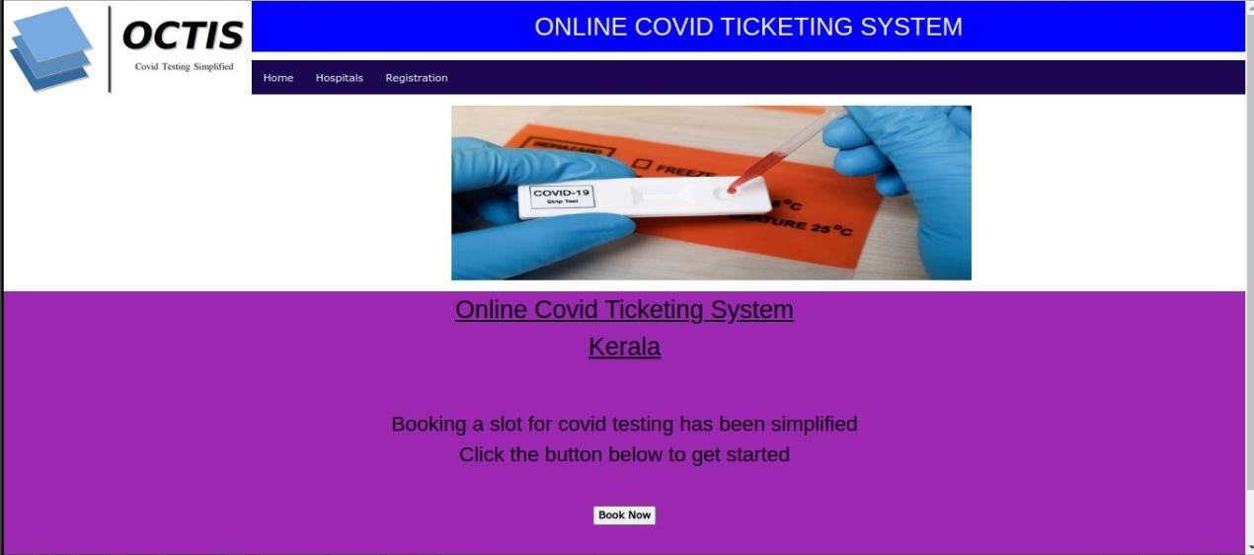

Slide 10
Registrations...
Enter your details, choose a date, and click submit!
Check out next slide for Registration page!

Slide 11
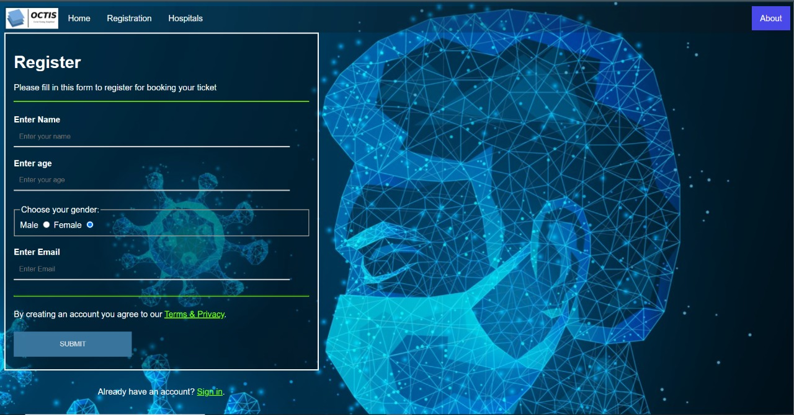

Slide 12
Thus, Octis will help us fight this covid-19 pandemic efficiently, smartly and safely.

Slide 13
Team Andromeda Members !
Arjun S
Jagannath E shahi
Adil A
Mayon Francis

Slide 14


