Slide 1

Mc3020: Discrete Probability Distributions
Dr T. Mayooran,
Senior Lecturer,
Department of Interdisciplinary Studies,
Faculty of Engineering,
University of Jaffna.
Email: mayooran@eng.jfn.ac.lk

Slide 2
Discrete Probability Distributions
Definitions
Discrete Probability Distributions
Mean or Expected Value of a Discrete Random Variable
Variance and Standard Deviation

Slide 3
Definitions
Random Variable:
A random variable is a quantitative variable whose values are determined by chance.
We use capital letter , like X, to denote the random variable and use small letter to list the possible values of the random variable.

Slide 4
Example:
Suppose we toss a coin twice. Let X be the (random variable) number of heads
Sample space
S={TT, TH, HT, HH}.
S | X
TT | 0
TH | 1
HT | 1
HH | 2
We also associate a probability with X attaining that value.

Slide 5
Example continue….
S | Prob | X
TT | 1/4 | 0
TH | 1/4 | 1
HT | 1/4 | 1
HH | 1/4 | 2
X | P(X=x)
0 | 1/4
1 | 1/2
2 | 1/4

Slide 6


Types of Random Variables Examples:
Discrete random variables
Number of sales
Number of calls
Shares of stock
People in line
Mistakes per page
Continuous random variables
Length
Depth
Volume
Time
Weight

Slide 7
Introduction to Probability Distributions
Random
Variables
Discrete
Random Variable
Continuous
Random Variable

Slide 8
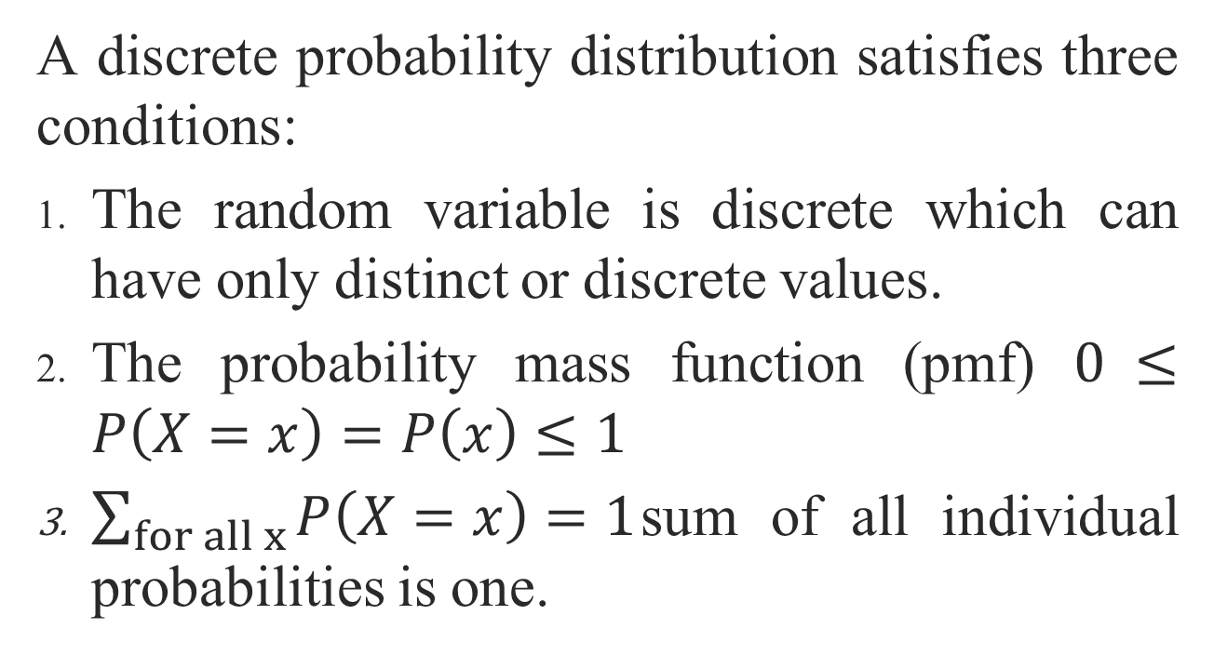
Discrete Probability Distribution:
A discrete probability distribution satisfies three conditions:
The random variable is discrete which can have only distinct or discrete values.
The probability mass function (pmf) $0 ≤P\left(X=x\right)=P\left(x\right)≤1$
$\sum_{for all x}{P\left(X=x\right)=1}$sum of all individual probabilities is one.

Slide 9
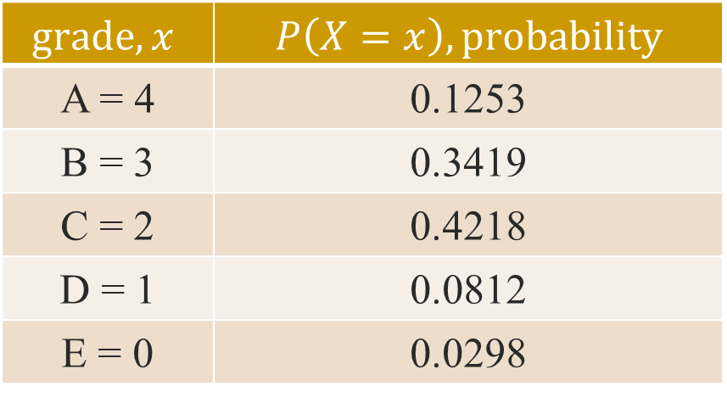
Example 1:
In a typical elementary statistics course the grade distribution (after drops and withdrawals) is as follows:
$$grade,x$$ | $$P\left(X=x\right), probability$$
A = 4 | 0.1253
B = 3 | 0.3419
C = 2 | 0.4218
D = 1 | 0.0812
E = 0 | 0.0298

Slide 10
Discrete Probability Distributions
In this Section, we will discuss following four Discrete Distributions,
Bernoulli Distribution
Binomial Distribution
Poisson Distribution
Hypergeometric Distribution

Slide 11
Bernoulli Distribution

Slide 12
Bernoulli Distribution:
When a procedure is performed, if there are only two possible outcomes, this procedure is called a Bernoulli experiment or Bernoulli trial.
We choose one of the two outcomes as “success” and the other one as “failure”. X is defined as the number of the successes.

Slide 13
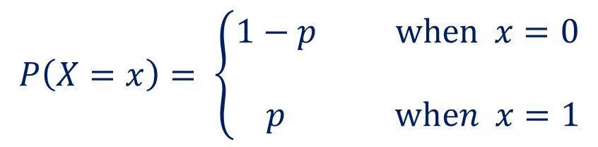
Bernoulli Distribution continue….
It can have only two possible values 0 for ‘failure’ and 1 for ‘success’ and their probabilities are fixed but usually unknown.
Then the distribution of X , with the probability mass function,
$$P\left(X=x\right)= \left\{\begin{aligned}1−p when x=0 \\ \\ p when x=1\end{aligned}\right.$$

Slide 14

Bernoulli Distribution continue….
Where $0<p<1$is the probability of success and $1−p$is the probability of failure, is known as the Bernoulli probability distribution. X is called a Bernoulli random variable.
Example 4.2:
Typical Bernoulli trials include tossing a coin, rolling a die, passing a test or not, etc.
Example: A fair die is tossed. Let X = 1 only if the first toss shows a “4” or “5”. Then X follows Bernoulli(1/3)

Slide 15
Binomial Distribution

Slide 16
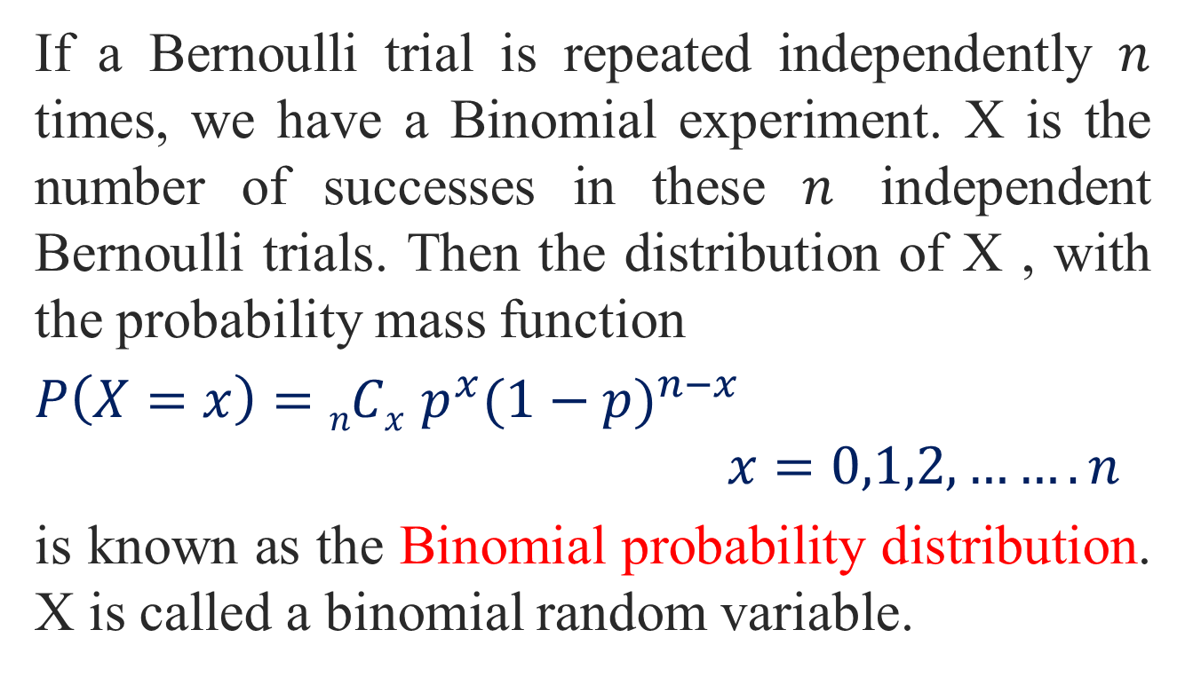
Binomial Distribution:
If a Bernoulli trial is repeated independently $n$ times, we have a Binomial experiment. X is the number of successes in these $n$ independent Bernoulli trials. Then the distribution of X , with the probability mass function
$P\left(X=x\right)=nCx p^{x}{(1−p)}^{n−x}$
$$x=0,1,2,…….n$$
is known as the Binomial probability distribution. X is called a binomial random variable.

Slide 17
The acronym BINS can be used to help remember Binomial Distribution:
Criteria (BINS):
(Bivariate) Two mutually exclusive and collectively exhaustive categories
Generally called ‘success’ and ‘failure’
Observations are Independent
The outcome of one observation does not affect the outcome of the other
A fixed Number of observations, or trials, n
E.g. 15 tosses of a coin; ten light bulbs taken from a warehouse
Constant probability of Success, p, for each observation
E.g. Probability of getting a tail is the same each time we toss the coin
Notes:
-There are four criteria to work out if something is Binomial or not.
-The acronym BINS can be used to help remember.
B: Bivariate:
- e.g. head or tail in each toss of a coin;
- Note that ‘Success’ doesn’t have to be a positive thing, it can be the number of failures of something, and that would be defined as a `success’.

Slide 18

Question
Which of the following could be binomially distributed?
The number of cows in a herd with tuberculosis.
A seed from a given packet of n seeds germinates or not.
Number of boars in piglet litters of size n.
A tree within a forest of n trees is infected with a disease or not.
Notes:
Answer:
(These questions are a little bit harder)
NOT Binomial as the independence criteria is not satisfied (e.g. if one cow has tuberculosis it is likely it will effect the other cows as it is contagious).
IS Binomial (could argue it is not Binomial as it may be likely that if one seed in the pack germinates, they all do, and if one doesn’t none of them do, so not independent)
IS Binomial
NOT Binomial as the independence criteria is not satisfied, as if one tree is infected with a fungus, it is likely to infect the tree next to it.

Slide 19

Binomial Distribution continue….
A Binomial Random Variable
n identical trials
Two outcomes: Success or Failure
P(S) = p; P(F) = q = 1 – p
Trials are independent
x is the number of S’s in n trials
Flip a coin 3 times
Outcomes are Heads or Tails
P(H) = 0.5; P(T) = 1-0.5 = .5
A head on flip i doesn’t change P(H) of flip i + 1

Slide 20
Binomial Distribution continue….
The number of ways of getting the desired results
The probability of getting the required number of successes
The probability of getting the required number of failures

Slide 21
Example:
Say 40% of the class is female.
What is the probability that 6 of the first 10 students walking in will be female?

Slide 22
Example 3:
In the manufacture of no deposit- no-return bottles, 5 percent of the bottles are defective. What is the probability in a sample of 7 bottles that there are,
No defectives.
3 defectives.
More than 3 defectives.

Slide 23
Examples 4:
You are conducting a case-control study of smoking and lung cancer. If the probability of being a smoker among lung cancer cases is 0.6, what’s the probability that in a group of 8 cases you have:
Less than 2 smokers?
More than 5?

Slide 24
Exercises:
In your course tutorial exercises,
Question no. 05
Question no. 06
Question no. 07
Question no. 16

Slide 25
Poisson Distribution

Slide 26
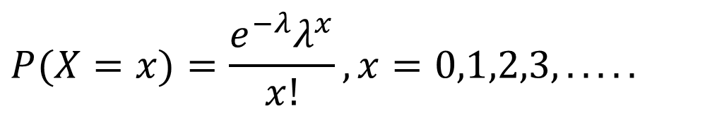
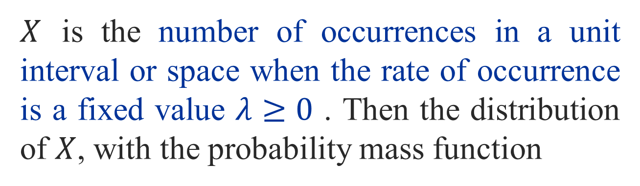
Poisson Distribution:
$X$ is the number of occurrences in a unit interval or space when the rate of occurrence is a fixed value $λ≥0$ . Then the distribution of $X$, with the probability mass function
$$P(X=x)=\frac{e^{−λ}λ^{x}}{x!},x=0,1,2,3,.....$$
is known as the Poisson probability distribution. X is called a Poisson random variable.

Slide 27
Poisson Distribution:
Criteria:
The variable is the number of events that occur in an interval of a given size.
The average number of events per unit is λ, where λ is fixed.
Events occur at random in continuous space or time
Events occur singly.
Events occur independently.
Notes:
-The Poisson distribution has five criteria that must hold.
4: that is, the probability of two events occurring simultaneously is zero.
5: That is, the probability of an event occurring in any small interval is independent of the probability of the event occurring in any other small interval.

Slide 28
Note:
x = Number of occurrences of event in a given time period
The probability an event occurs in the interval is proportional to the length of the interval.
An infinite number of occurrences are possible.
Events occur independently at a rate λ.

Slide 29
Poisson Distribution:
Which of the following could be Poisson distributed?
Number of Takahe nests per hectare in regions where the bird is found.
Number of wet days in a year.
Number of rabbit burrows per acre.
Number of weeds per 5m² of lawn.
Notes:
Answers:
Possibly Poisson, assuming the independence criteria is satisfied. (Although can argue that independence does not hold, as Takahe are often quite territorial so if a nest is on a location, there may not be many other nests around it. If assume it is independent then the Poisson would hold).
NOT Poisson, one wet day is likely to be followed by another so the independence criteria is not satisfied.
Probably NOT Poisson as the independence criteria is probably not satisfied.
Possibly Poisson, assuming the independence criteria is satisfied.

Slide 30

Example 5 :
Some examples of Poisson random variables are:
The number of people arriving at bus stop within an hour.
The number of patients visiting a clinic on a given day.
The number of meteorites hitting a specific area per year.

Slide 31

Example 6 :
Births in a hospital occur randomly at an average rate of 1.8 births per hour. What is the probability of observing 4 births in a given hour at the hospital?( )
What is the probability of observing at least 2 births in a given hour at the hospital?
What is the probability of observing 2 births in a given day at the hospital?
Ans:0.0723

Slide 32
Example 7 :
The transportation system at a new large airport is designed so that it will have one failure every ten days. What is the probability that it will not fail on the “Grand Opening Day”?

Slide 33
Example 8 :
Airline passengers arrive randomly and independently at the passenger-screening facility at a major international airport. The mean arrival rate is 10 passengers per minute. What is the probability that three or fewer passengers will arrive in a 30 second period?

Slide 34
Exercises:
In your course tutorial exercises,
Question no. 08
Question no. 09
Question no. 17

Slide 35
Hypergeometric Distribution

Slide 36
The Hypergeometric Distribution
Randomly draw n elements from a set of N elements, without replacement. Assume there are r successes and N-r failures in the N elements.
The hypergeometric random variable is the number of successes, x, drawn from the r available in the n selections.

Slide 37
The Hypergeometric Distribution
where
N = the total number of elements
r = number of successes in the N elements
n = number of elements drawn
x = the number of successes in the n elements

Slide 38
The Hypergeometric Distribution
The hypergeometric distribution has the following characteristics:
There are only two possible outcomes.
The probability of a success is not the same on each trial.
It results from a count of the number of successes in a fixed number of trials.

Slide 39
Example 9 :
Different computers are checked from 10 in the department. 4 of the 10 computers have illegal software loaded. What is the probability that 2 of the 3 selected computers have illegal software loaded?
Ans : 0.3

Slide 40
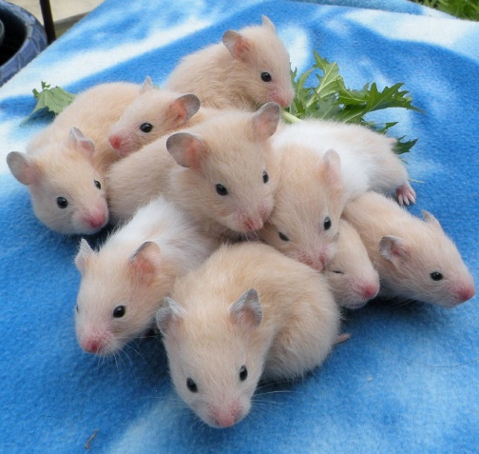
Example 10 :
Suppose a customer at a pet store wants to buy two hamsters for his daughter, but he wants two males or two females (i.e., he wants only two hamsters in a few months)
If there are ten hamsters, five male and five female, what is the probability of drawing two of the same sex? (With hamsters, it’s virtually a random selection.)

Slide 41

Example 11 :
A box contains 100 marbles. Five of the marbles are purple, and the rest are green. If 8 marbles are drawn without replacement, what is the probability of obtaining exactly 2 purple marbles?
Solution: Since the drawings are without replacement, the composition of the box changes after each draw, so it is not a binomial experiment.

Slide 42
Let be the number of purple marbles in a sample of 8 items. The probability can be computed as
This computation also could be done using the combination formula given in Chapter 3. Alternately,

Slide 43
where P stands for purple and G stands for green, one choice is PPGGGGGG and this choice can happen in different ways. And

Slide 44

Example 12 :
A machine produces output with a fraction defective of 0.06. If a lot consists of 100 items, what is the probability that a sample of 5 items will contain one or fewer defective?
Solution: Let X be the number of defectives in a sample of 5 items. Among 100 items, there are 6 defective items. Then

Slide 45
Alternately,
where G stands for good and D stands for defective, and and ways GGGGG and GGGGD can be arranged, respectively. Then

Slide 46
Exercises:
In your course tutorial exercises,
Question no. 10
Question no. 11
Question no. 15

Slide 47
Mean or Expected Value

Slide 48
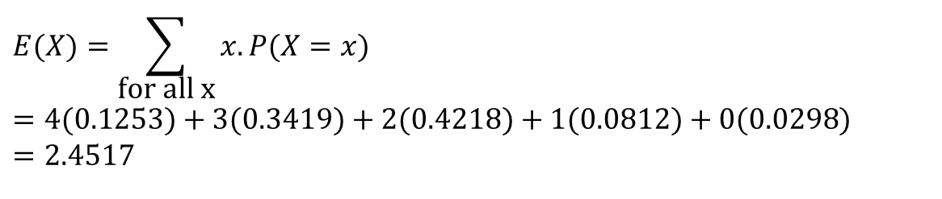
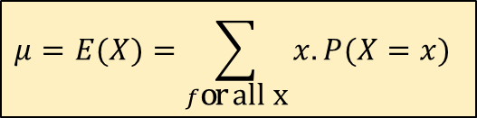
Mean or Expected Value
The population mean or the expected value for a discrete random variable can be computed as:
Example: The population mean of the grade distribution in Example 1 is
$$μ=E(X)=\sum_{f\text{or} \text{all} \text{x}}{x.P(X=x)}$$
$$E(X)=\sum_{\text{for} \text{all} \text{x}}{x.P(X=x)} \\ =4(0.1253)+3(0.3419)+2(0.4218)+1(0.0812)+0(0.0298) \\ =2.4517$$

Slide 49
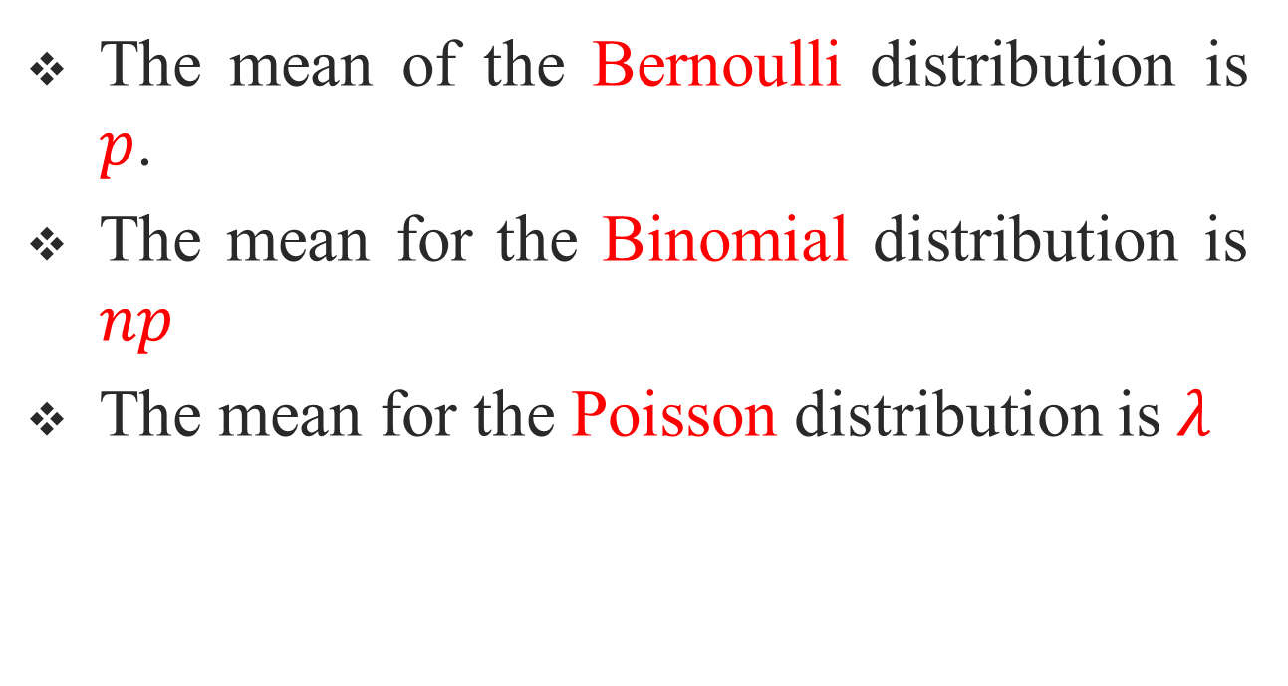
Mean or Expected Value
The mean of the Bernoulli distribution is $p$.
The mean for the Binomial distribution is $np$
The mean for the Poisson distribution is$λ$

Slide 50
Variance and Standard Deviation

Slide 51

Variance
The population variance for a discrete Random variable is
$$Var(X)=σ^{2}=E(X−μ)^{2}=\sum_{\text{for} \text{all} \text{x}}{(x−μ)^{2}.P(X=x)}$$
$$or$$
$$Var(X)=σ^{2}=E(X^{2})−(E(X))^{2} \\ =\sum_{\text{for} \text{all} \text{x}}{x^{2}.P(X=x)}−{\left(\sum_{\text{for} \text{all} \text{x}}{x.P(X=x)}\right)}^{2}$$

Slide 52

Standard Deviation
The population standard deviation $σ$ is given by,
Example : The population variance of the grade distribution in Example 1 is,

Slide 53
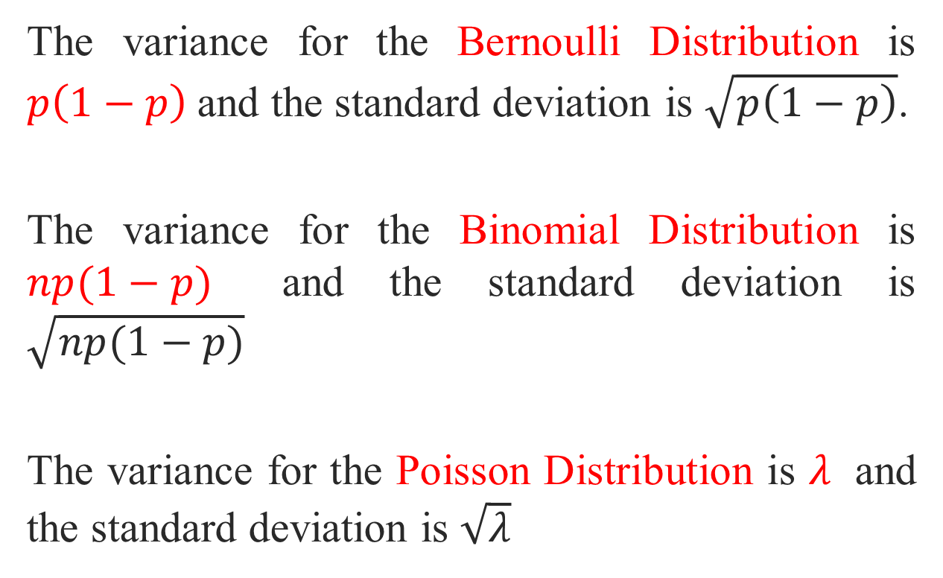
The variance for the Bernoulli Distribution is $p\left(1−p\right)$and the standard deviation is $\sqrt{p\left(1−p\right)}$.
The variance for the Binomial Distribution is $np(1−p)$ and the standard deviation is $\sqrt{np(1−p)}$
The variance for the Poisson Distribution is $λ$ and the standard deviation is $\sqrt{λ}$

Slide 54

Example 13 :
There are six people in an office. Each shows independently for a picture with probability 0.9. Let X be the number of people that show up. What is the expected number of people that show up? What is the standard deviation of the number of people that show up?

Slide 55
Solution:
The expected number of people that show up is,
and the standard deviation of the number of people that show up is,

Slide 56

Example 14 :
On an average in 2010, there were 842 traffic crashes occurred on Jaffna roadways (Road Accident Data by Vehicle type – 2010, http://www.data.gov.lk). (there are 365 days in 2010)
What is the expected number of traffic crashes on any given day of 2010?
What is the standard deviation of the number of the traffic crashes occurred on Jaffna roadways on any given day of 2010?
What is the probability that there were exactly 200 traffic crashes on Jaffna roadways in any given day of 2010?

Slide 57
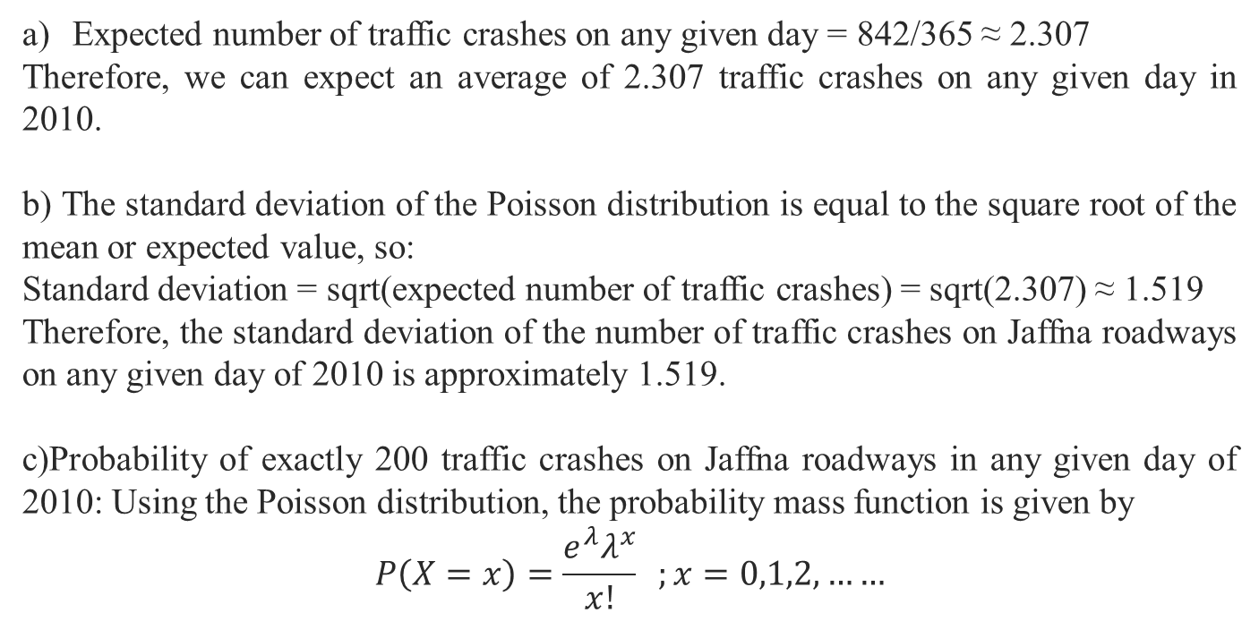
Solutions
Expected number of traffic crashes on any given day = 842/365 ≈ 2.307
Therefore, we can expect an average of 2.307 traffic crashes on any given day in 2010.
b) The standard deviation of the Poisson distribution is equal to the square root of the mean or expected value, so:
Standard deviation = sqrt(expected number of traffic crashes) = sqrt(2.307) ≈ 1.519
Therefore, the standard deviation of the number of traffic crashes on Jaffna roadways on any given day of 2010 is approximately 1.519.
c)Probability of exactly 200 traffic crashes on Jaffna roadways in any given day of 2010: Using the Poisson distribution, the probability mass function is given by
$$P\left(X=x\right)=\frac{e^{λ}λ^{x}}{x!} ;x=0,1,2,……$$

Slide 58
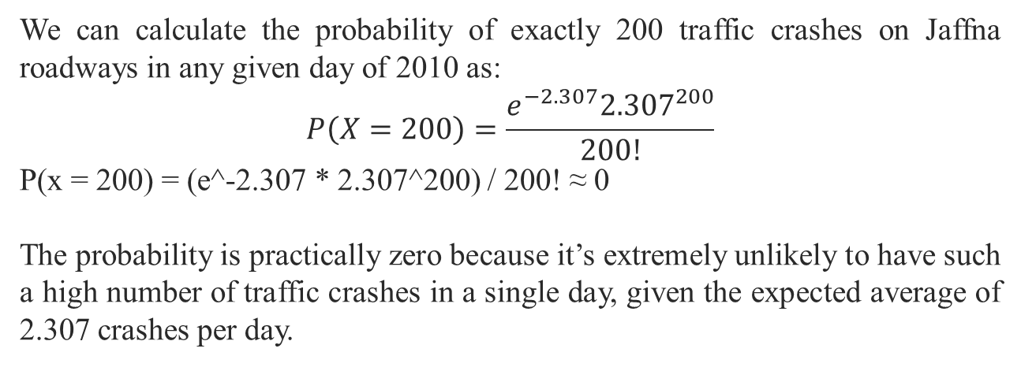
We can calculate the probability of exactly 200 traffic crashes on Jaffna roadways in any given day of 2010 as:
$$P\left(X=200\right)=\frac{e^{−2.307}{2.307}^{200}}{200!}$$
P(x = 200) = (e^-2.307 * 2.307^200) / 200! ≈ 0
The probability is practically zero because it’s extremely unlikely to have such a high number of traffic crashes in a single day, given the expected average of 2.307 crashes per day.

Slide 59
Additional examples:
In the following probability distribution, the random variable represents the number of activities the mother of a 5th grade student is involved in:
Determine the value of C?
Compute the mean and standard deviation of the random variable X?
What is the probability that a randomly selected mother is involved in at least two activities?
x P(X=x)
0 C
1 0.083
2 0.210
3 0.325
4 0.332

Slide 60
Exercises:
In your course tutorial exercises,
Question no. 01
Question no. 03
Question no. 12
Question no. 13

Slide 61

Don’t hesitate to contact us if you have any questions about this course’s teaching contents. Also, don’t forget to check out the course page and Microsoft Team folder,
course page https://mayooran1987.github.io/MC3020/
Microsoft Team folder link

Slide 62
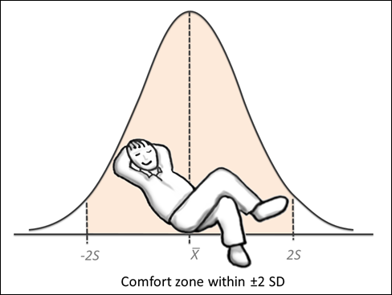
Continuous Probability Distributions
Next Section:

