Slide 1

MC3020 Sampling Distributions and Basic Statistical Inference
Dr T. Mayooran,
Department of Interdisciplinary Studies,
Faculty of Engineering,
University of Jaffna.
Email: mayooran@eng.jfn.ac.lk

Slide 2
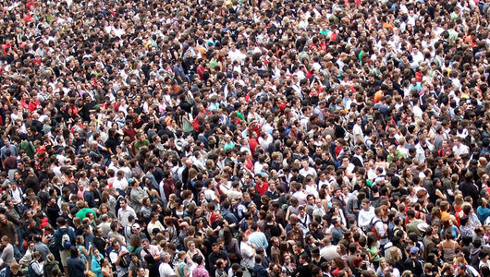
A statistician cannot see the detail of the whole population. They use information from a sample to find out about the population.

Slide 3
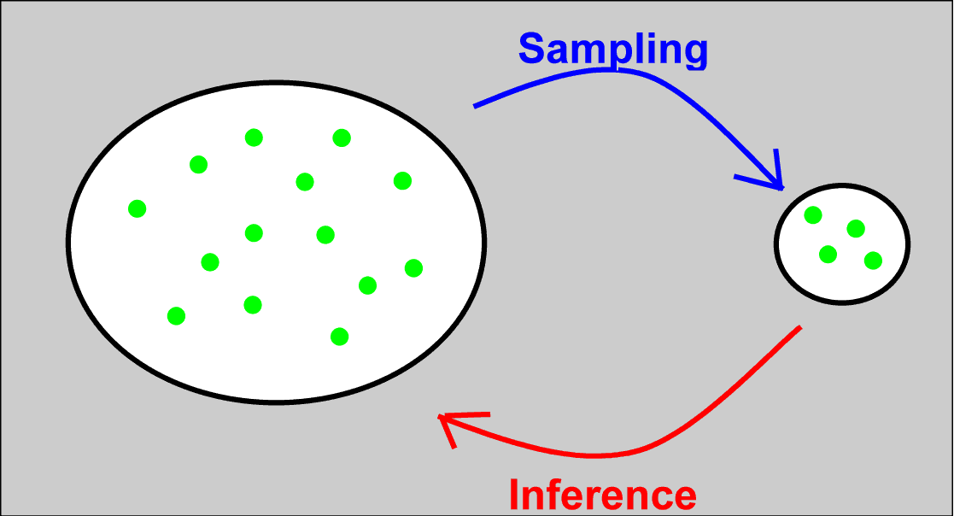
Statistical Inference
Statistical inference involves estimating characteristics of a population (parameters) from a random sample.
The fundamental rule for using data for Inference is that, available data (sample) can be used to make inferences about a much larger group (population), if the data can be considered to be representative with regard to the question(s) of interest.
Notes:
-The fundamental rule is that the sample is representative of the population, otherwise it is not useful e.g. garbage in garbage out.
-From here we are going to do some inference with confidence intervals, hypothesis testing etc. All of these have the condition that the sample is representative of the population. If the sample is not representative of the population then the results can be misleading.

Slide 4
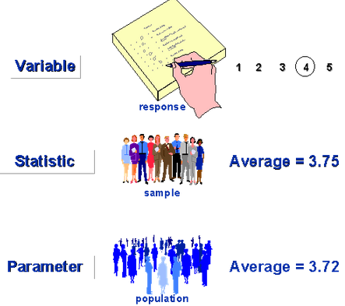
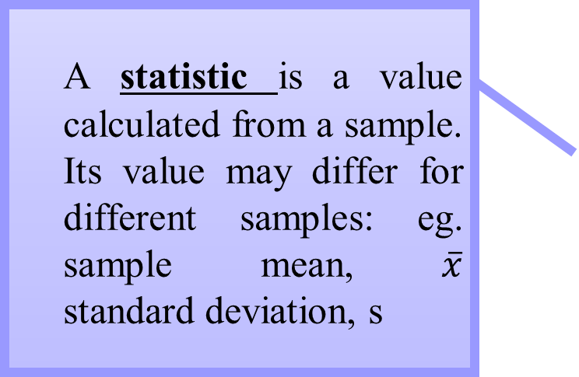
Statistics estimate Parameters
A statistic is a value calculated from a sample. Its value may differ for different samples: eg. sample mean, $\overline{x}$ standard deviation, s
A parameter is a value associated with a population. It is fixed and unchanging: eg. population mean, μ standard deviation, σ
We use statistics to estimate parameters
Notes:
-A parameter is a fixed value, we just don’t know it.
-We use statistics to make inference about the parameter.
-Sample has a statistic.
-Population has a parameter.

Slide 5
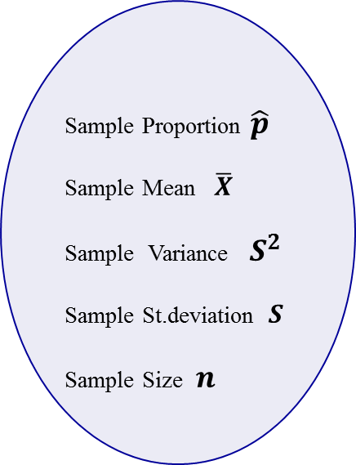
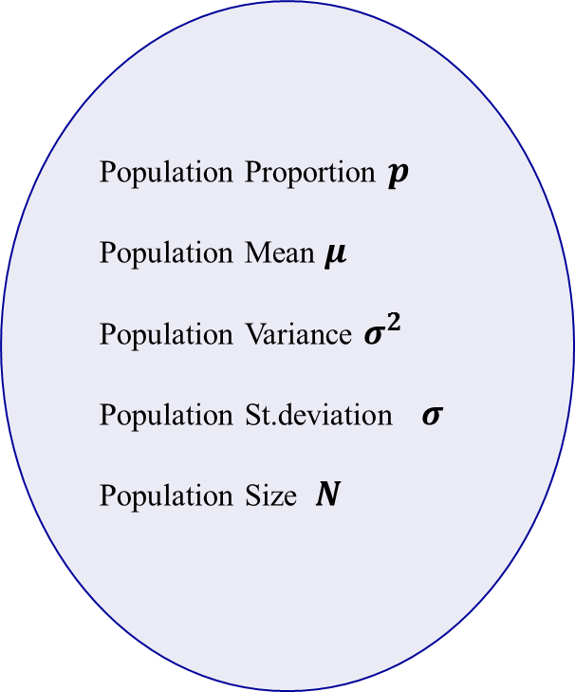
Notations(symbols):
Population Proportion $p$
Population Mean $μ$
Population Variance $σ^{2}$
Population St.deviation $σ$
Population Size $N$
Sample Proportion $\hat{p}$
Sample Mean $\overline{X}$
Sample Variance $S^{2}$
Sample St.deviation $S$
Sample Size $n$
Sample
Population

Slide 6

Estimation Process
Random Sample
I am 95% confident that μ is between 137 & 145ml.
Population
Mean
X = 141
(mean, μ, is unknown)
Sample
Notes:
-When we used the empirical rules, we should say I am approximately 95% confident that the mean amount of juice per orange is between 137ml and 145ml.
-Want to be able to put it in a sentence in context and put a confidence level to it.

Slide 7
Statistics vary from sample to sample
Each sample will be expected to have a different sample mean. How much those sample means vary between samples is the key piece of knowledge we need to be able to say something about the population mean.
We need to know the sampling distribution of the sample statistic that we’re interested in (i.e. If we take lots and lots of samples, what does the distribution of the sample means look like?)
It is important to distinguish between:
Distribution of values within a single sample
and
Distribution of the mean between different samples
Notes:
-We want to know how big or small the variability is.
-We want to try and get the variability as small as possible.
-This is why the sampling distribution is important, e.g. What does it look like? How spread out is it? What is the shape? There are three properties we want to know about each of them.
-We can do this theoretically, but the idea is when we first take our sample we make sure we follow the fundamental rule and end up with something representative of the population. We want to use the information about the sample to get an idea about what is happening in the sampling distribution.
-Word of caution before we begin, we need to make sure we can distinguish between the distribution of the sample and the distribution of the sampling means.

Slide 8
Sampling Distributions
Population
Sample
n
Corresponding Statistic
Parameter
(e.g. μ)
X
X
Sampling
Distribution
X
X
A sampling distribution is a distribution of all of the possible values of a statistic for a given size sample selected from a population
Notes:
-You have a population and take a sample.
-You take a sample and of size n and take the sample mean $\overline{x}$.
-If you keep on taking samples of the same size you will begin to build up your sampling distribution.

Slide 9
Sampling Distributions
One way to explore the sampling distribution is to take many samples from the same population, and compare how the sample mean’s vary.
Eg. Take 1000 samples of a certain size from a particular population. Look at the distribution of the 1000 sample means…
Let’s do this for the 2009 Milk volume data.
Take 1000 random samples of size n = 10 from the population. Calculate the sample mean milk volume for each sample.
Examine the distribution of the 1000 sample means.

Slide 10

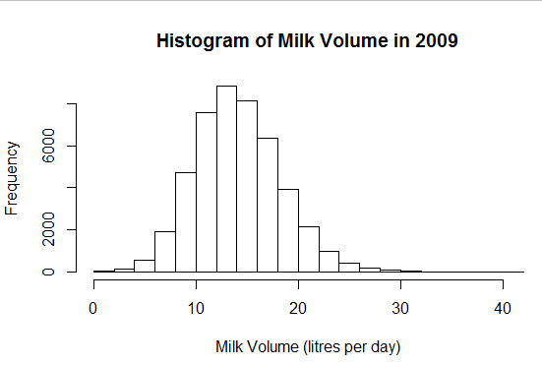
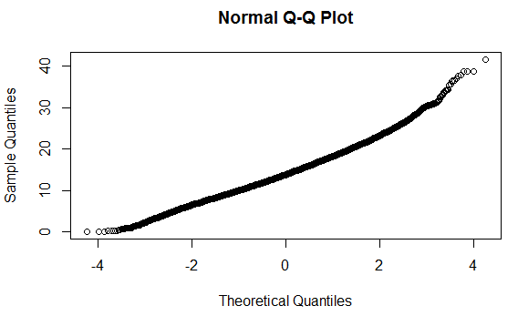

Milk Volume: population distribution
Our population of interest consists of 46180 cows. Let’s explore data on the population milk volume from morning milking. μ = 14.14 litres per day and σ = 4.21 litres per day
Q: Does the distribution appear to be normal?
Notes:
The data can be found in the Excel file MilkVolAM2009.xlsx on Stream. This data is actual part of a larger study on milk production over the period of 2008 to 2010.
Does the distribution appear to be normal?
Roughly, the histogram has that bell shape and the Normal probability plot (aka the Normal Q-Q Plot) shows the points laying in a reasonably straight line. So yes it does appear to be normally distributed.
(Remember it doesn’t have to be completely perfect, because nothing is usually truly perfect, but it looks reasonable enough).

Slide 11

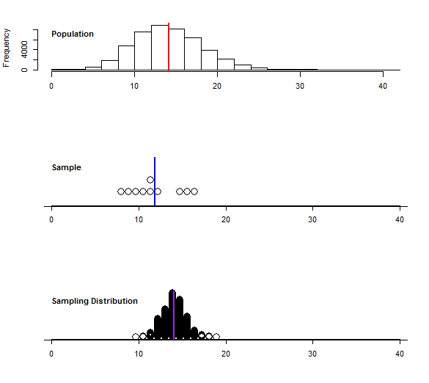
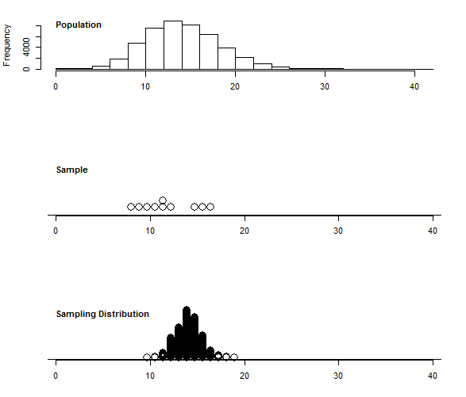


Three distributions for milk volume
There are three distributions:
The distribution of the population
The distribution of the sample
The distribution of the sample means
µ
$$\overline{x}$$
$$μ_{\overline{x}}$$
Notes:
Here we have three distributions: the distribution of the population, the distribution of the sample, and the sampling distribution.
-The sampling distribution at the bottom is made up of the sample means from the 1000 samples taken, each of size 10.
-The sample gives an idea of what the population looks like, as we have just pulled values from the population. But the sampling distribution is all about the sample means.

Slide 12
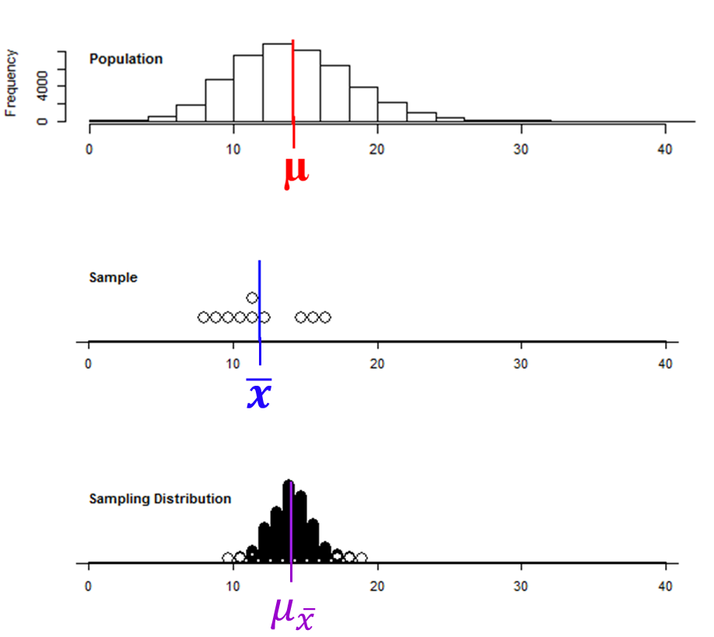
Three distributions for milk volume
Take 1000 random samples of size n = 10 from the population. Calculate sample mean milk volume for each sample.
Compare the means.
Q: Is the mean of the Sampling Distribution the same as the mean of the population?
Notes:
Is the mean of the Sampling Distribution the same as the mean of the population?
YES.
This is the first property of the sampling distribution. The mean of all our sample means gives the population mean.

Slide 13
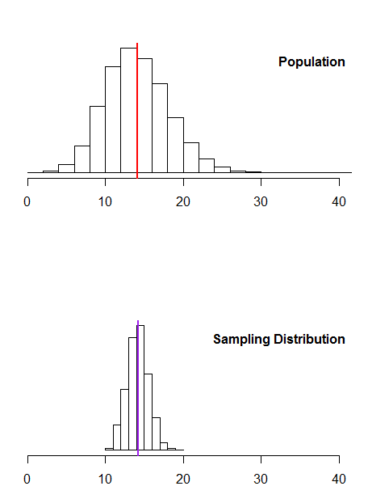

Smpling Distribution Properties (1: Mean)
(i.e. X is unbiased)
µ
(has the same mean)
$$μ_{\overline{x}}$$
Notes:
(So theoretically the mean of all our possible sample means is the population mean).
In notation this looks like $μ_{\overline{x}}=μ$. This means the sample mean is an unbiased estimator.
Which in this case is 14.1438 litres per day

Slide 14
Three distributions for milk volume
Take 1000 random samples of size n = 10 from the population. Calculate sample mean milk volume for each sample.
Q: Does the Sampling distribution appear to have a smaller or larger standard deviation than the population distribution?
Notes:
The second property is about the spread.
Does the Sampling distribution appear to have a smaller or larger standard deviation than the population distribution?
Smaller. The sampling mean is much more compact than the population.

Slide 15
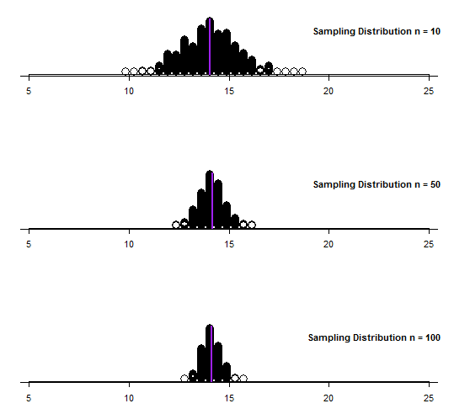

Three Sampling Distributions for milk volume
Take 1000 random samples of sizes n = 10, 50 and 100 from the population. Calculate sample mean milk volume for each sample.
Compare the Sampling distributions.
Q: What happens to the standard deviation of the sampling distribution as the sample size increases?
Notes:
What happens to the standard deviation of the sampling distribution as the sample size increases?
The standard deviation of the sampling distribution decreases as the sample size increases.
This means that in a bigger sample we are more likely to get a sample mean that is closer to the population mean than in a smaller sample.
-Big samples are good, this is one of those situations when bigger is better.
-How do we get from the standard deviation in the sample to the standard deviation in the sampling distribution? Because we aren’t going to go and take all the samples needed to generate the sampling distribution and generate the standard deviation. We want to know a way of being able to relate this to our population or the sample. We do have a formula.

Slide 16
Sampling Distribution Properties (2: Spread)
A measure of the variability in the mean from sample to sample is given by the Standard Error of the Mean
The standard error of the mean is the standard deviation of the sampling distribution of the mean.
Note that the standard error of the mean decreases as the sample size increases
Notes:
-This formula is on the formula sheet.
-Whenever we say “Standard Error” we are talking about the standard deviation of the sampling distribution.
-Note the formula is taking the population standard deviation and dividing by the square root of the sample size. This works really nicely when you know the population standard deviation, however we don’t usually know what the population standard deviation is. Instead we replace the population standard deviation (σ) with the sample standard deviation (s), as this is our best guess of the population standard deviation.

Slide 17
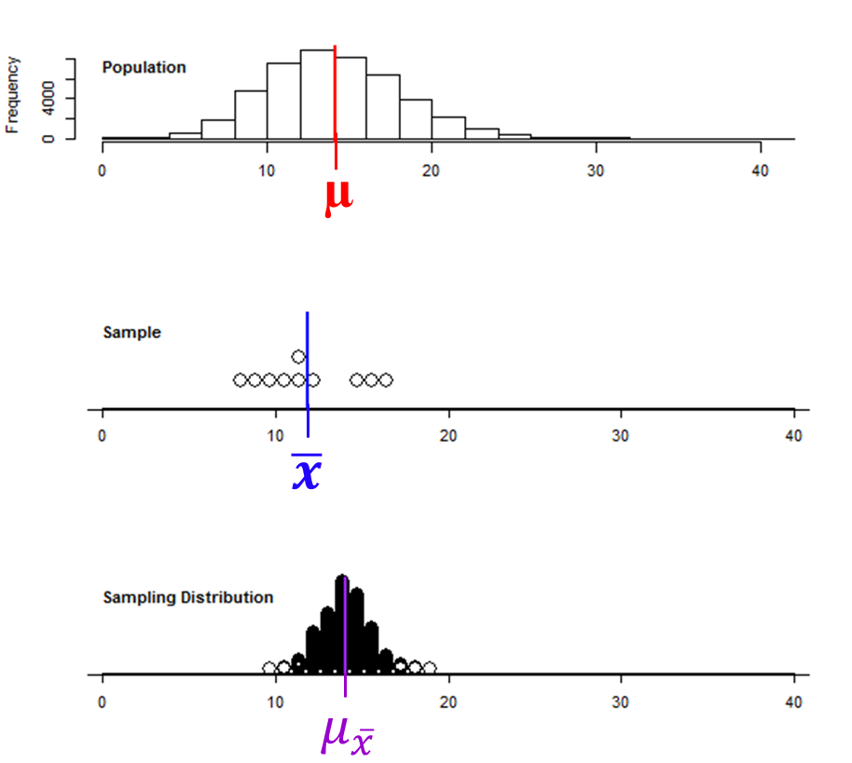
Sampling Distribution Properties (3: Shape)
If the Population Distribution is normal
Then the Sampling Distribution will be normal
Notes:
-The third property of the sampling distribution is if the population is normal, then the sampling distribution will be normal, regardless of sample size.
-However what happens when the population is not normal?

Slide 18

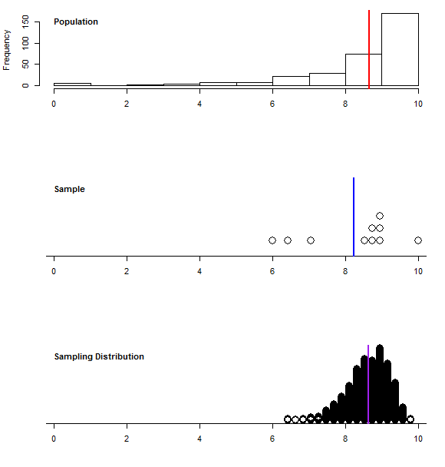


Three distributions for test marks
There are three distributions:
The distribution of the population
The distribution of the sample
The distribution of the sample means
µ
$$\overline{x}$$
$$μ_{\overline{x}}$$

Slide 19

Three distributions for test marks
Take 1000 random samples of size n = 10 from the population. Calculate sample mean test mark for each sample.
Compare the distributions.
µ
Q: Does the Sampling Distribution appear to be normal?
$$\overline{x}$$
$$μ_{\overline{x}}$$
Notes:
Does the Sampling Distribution appear to be normal?
Answer:
NO.
Although it does appear to have the same mean as the population mean, it is still left skewed.

Slide 20
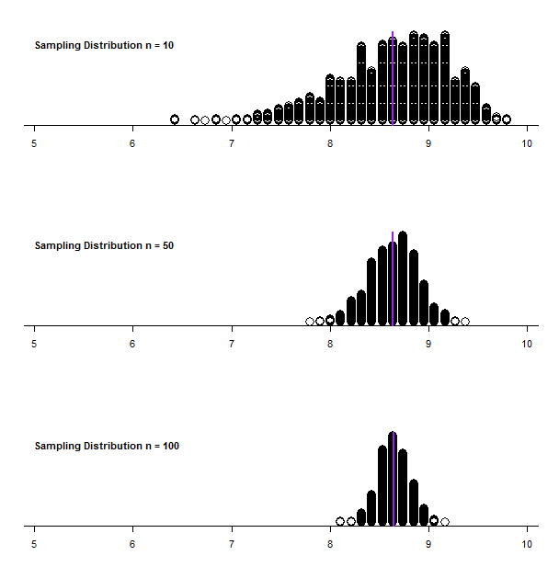
Three Sampling Distributions for test marks
Take 1000 random samples of sizes n = 10, 50 and 100 from the population. Calculate sample mean test mark for each sample.
Compare the Sampling distributions.
Q: What happens to the sampling distribution as the sample size increases?
Notes:
What happens to the sampling distribution as the sample size increases?
Answer:
Shape becomes more normal and the spread decreases.
As the sample size increases, the shape of the distribution becomes more normal, e.g. the sample size of 100 looks normal, even 50 looks normal.
-The sample size to get it looking normal is approximately 30.
This is the Central Limit Theorem in action. As the sample size increases the sampling distribution becomes more normally distributed.

Slide 21
If the Population is not Normal
We can apply the Central Limit Theorem
Even if the population is not normal, sample means from the population will be approximately normal as long as the sample size is large enough
Properties of the sampling distribution
and
Notes:
-The central limit theorem is the only theorem you will have to know.
-How large is large enough….

Slide 22
Sampling Distribution (summary)
A sampling distribution is a distribution of all of the possible values of a statistic for a given size sample selected from a population
Population
n
Sample
Corresponding Statistic
Parameter
(e.g. μ)
X
X
Sampling
Distribution
X
X
Notes:
-Have the population and take a sample and get the sample mean $\overline{X}$.
-If we imagine taking multiple samples, which doesn’t usually happen in practice we get multiple sample means, which are used to make up the sampling distribution.

Slide 23
Sampling Distribution Properties (summary)
Mean:
Spread: The Standard Error
Shape:
Population Normal
Sampling distribution Normal
Sampling Distribution approximately Normal so long and sample size is large (n > 30)
(Central Limit Theorem)
Population Not Normal

Slide 24
What if we only have a single sample?
Estimate the sampling distribution using the sample statistics.
Recall: We can estimate a Population Parameter with a Sample Statistic
Mean:
Standard Error:
Shape:
Sampling Distribution approximately Normal so long and sample size is large (n > 30) (Central Limit Theorem)
Notes:
-We only usually have one sample and don’t know if the population is normal or not.
-This assumes that the sample is representative of the population.

Slide 25
Inferences about Population Parameters
Inferences about Population Proportion
Inferences about Population Mean
Inferences about Population Variance
Testing Hypotheses about Population Proportion
Testing Hypotheses about Population Mean
Testing Hypotheses about Population Variance

Slide 26
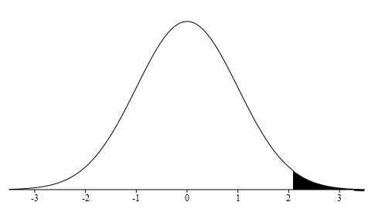




Notations(symbols):
Significance Level $=α$
Confidence Level $=1−α$
Notation of $Z_{α}$
$z_{α}$ is the number on the real line such that the area under the standard normal density function, on the x-axis, and to the right of $z_{α}$ is $α$.
$$1−α$$
$$α$$
$$Z_{α}$$

Slide 27
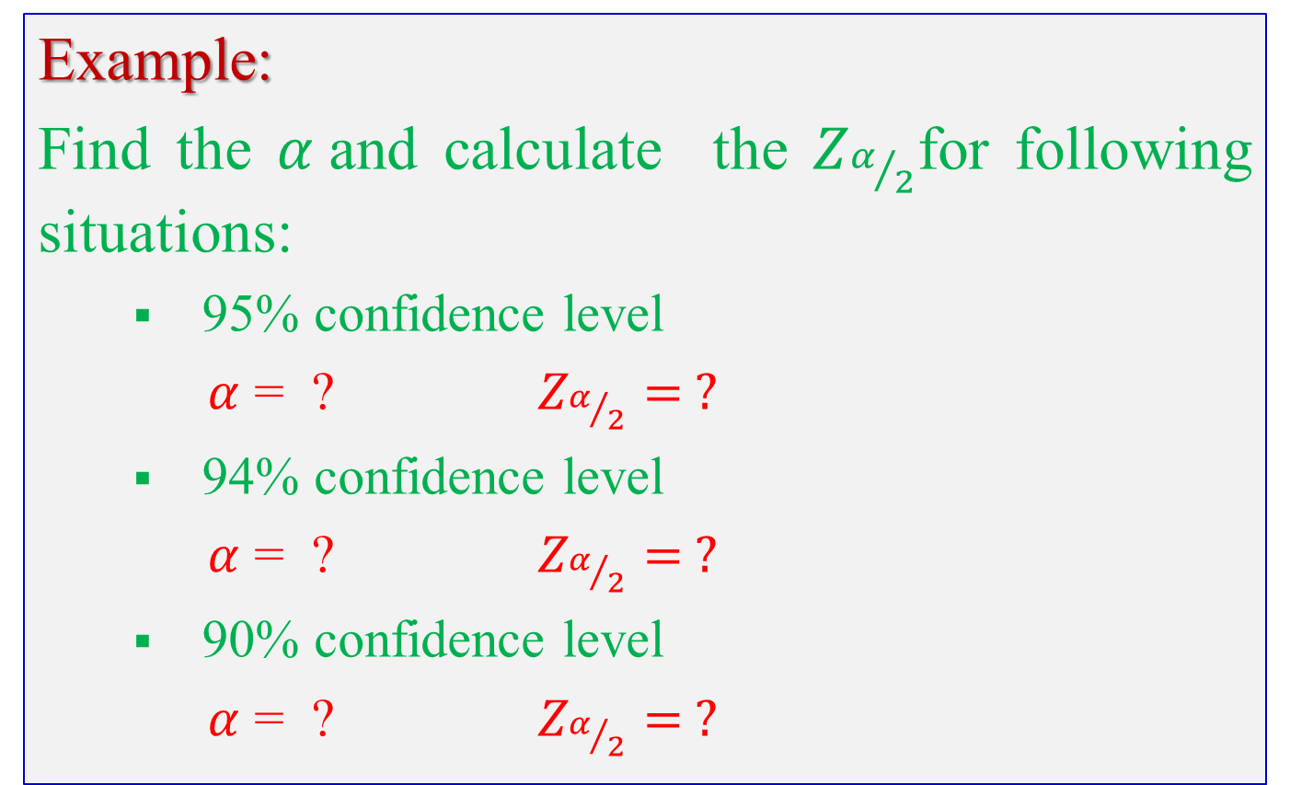
Example:
Find the $α$and calculate the $Z_{α/2}$for following situations:
95% confidence level
$α$ = ? $Z_{α/2}= ?$
94% confidence level
$α$ = ? $Z_{α/2}= ?$
90% confidence level
$α$ = ? $Z_{α/2}= ?$

Slide 28
Use your Calculator:
I hope you can easily calculate from your calculator. Please check your calculator manual or check out following link,
Normal Distribution using the calculator Casio fx-991MS
Calculator to find probabilities for normal distribution easy
You can verify your answers with the manual calculation method (by using a stats table).

Slide 29
Inferences about Population Proportion p

Slide 30
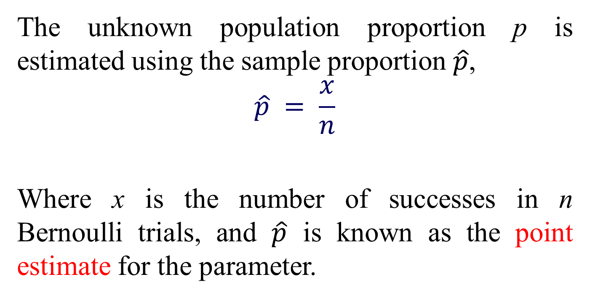
The unknown population proportion p is estimated using the sample proportion $\hat{p}$,
$$\hat{p} = \frac{x}{n}$$
Where x is the number of successes in n Bernoulli trials, and $\hat{p}$ is known as the point estimate for the parameter.

Slide 31
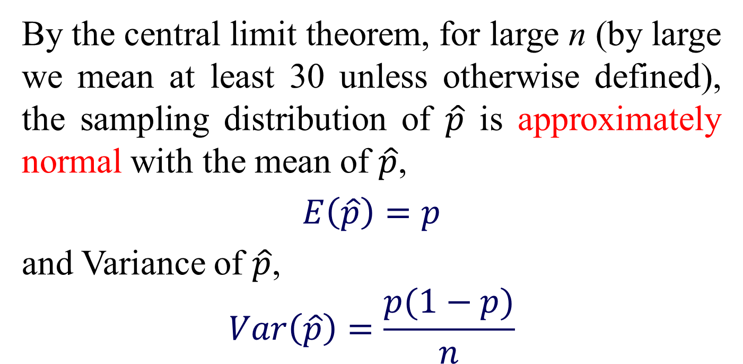
By the central limit theorem, for large n (by large we mean at least 30 unless otherwise defined), the sampling distribution of $\hat{p}$ is approximately normal with the mean of $\hat{p}$,
$E\left(\hat{p}\right)=p$
and Variance of $\hat{p}$,
$$Var\left(\hat{p}\right)=\frac{p(1−p)}{n}$$

Slide 32
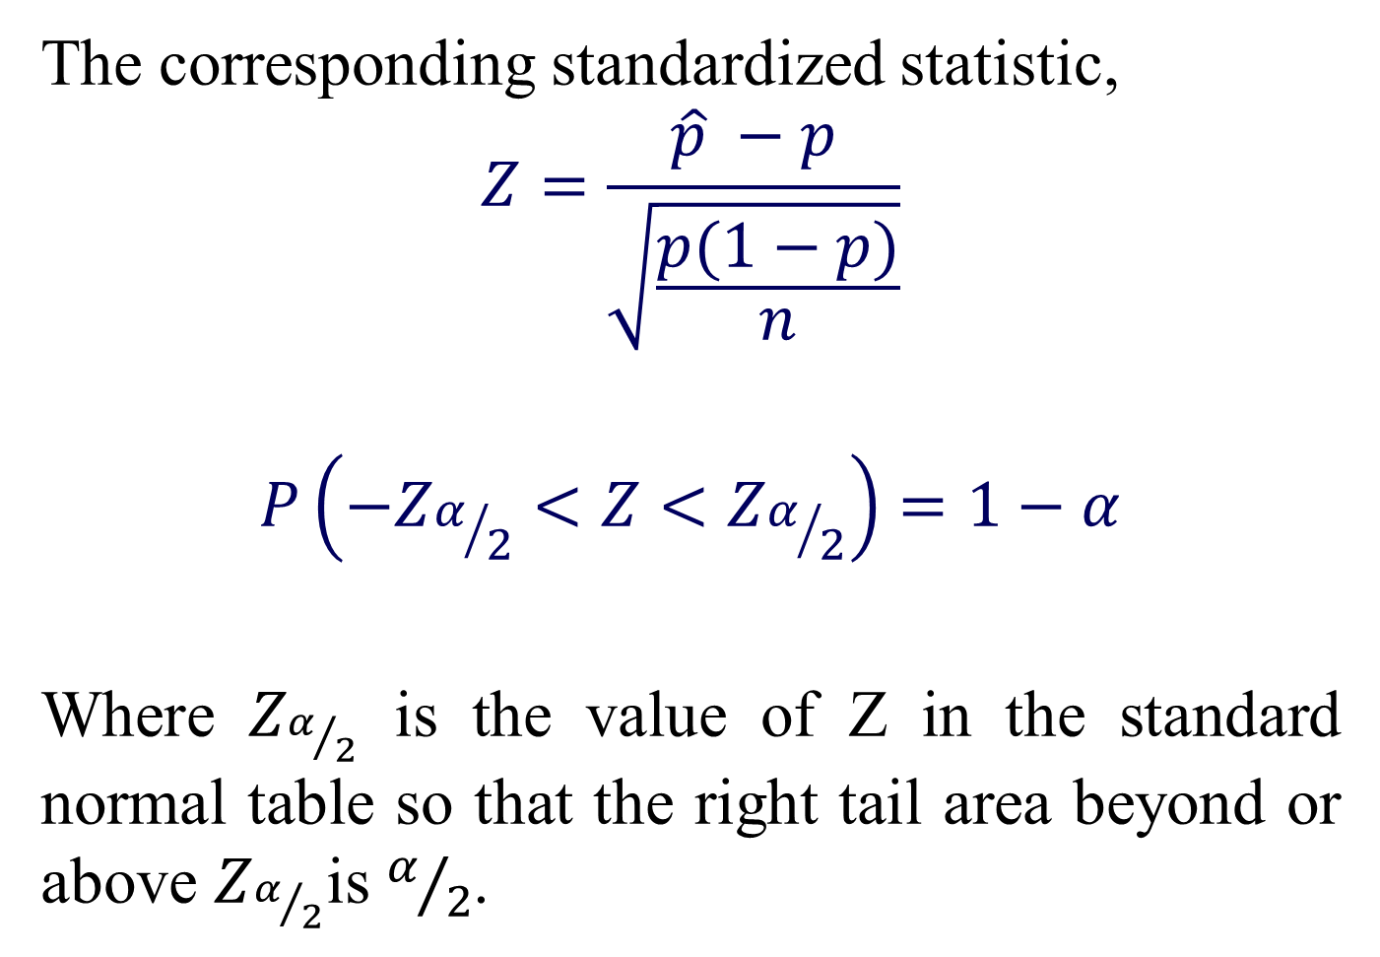
The corresponding standardized statistic,
$$Z=\frac{\hat{p} −p}{\sqrt{\frac{p(1−p)}{n}}}$$
$$P\left(−Z_{α/2}<Z<Z_{α/2}\right)=1−α$$
Where $Z_{α/2}$ is the value of Z in the standard normal table so that the right tail area beyond or above $Z_{α/2}$is $α/2$.

Slide 33
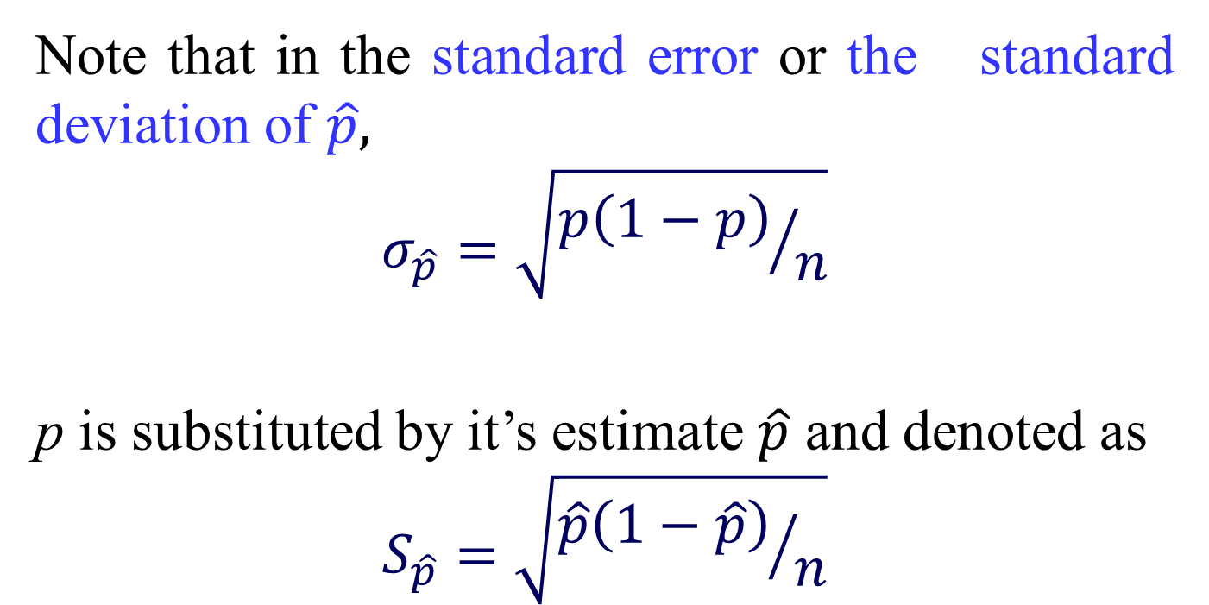
Note that in the standard error or the standard deviation of $\hat{p},$
$$σ_{\hat{p}}=\sqrt{{p\left(1−p\right)}/n}$$
p is substituted by it’s estimate $\hat{p}$ and denoted as
$$S_{\hat{p}}=\sqrt{{\hat{p}\left(1−\hat{p}\right)}/n}$$

Slide 34
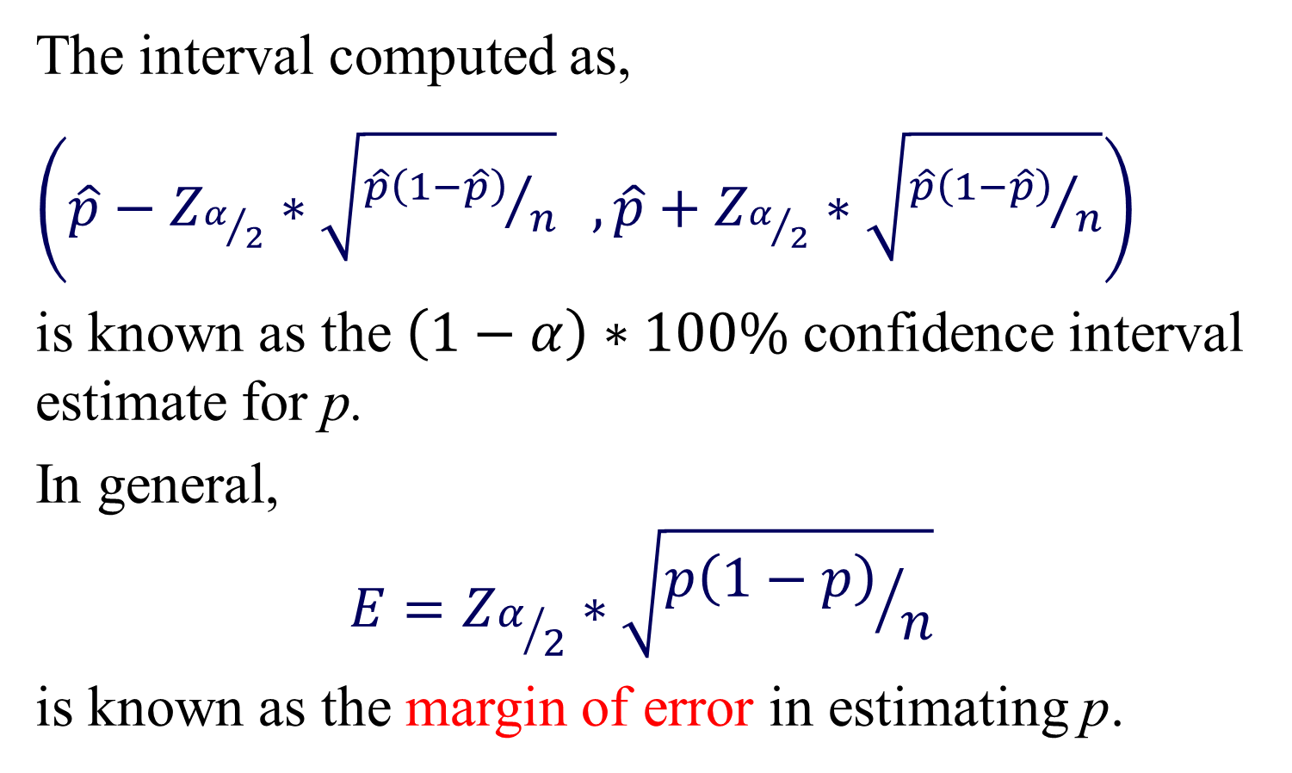
The interval computed as,
$\left(\hat{p}−Z_{α/2}∗\sqrt{{\hat{p}\left(1−\hat{p}\right)}/n} ,\hat{p}+Z_{α/2}∗\sqrt{{\hat{p}\left(1−\hat{p}\right)}/n}\right)$
is known as the $\left(1−α\right)∗100\% \text{confidence}$ interval estimate for p.
In general,
$$E=Z_{α/2}∗\sqrt{{p\left(1−p\right)}/n}$$
is known as the margin of error in estimating p.

Slide 35
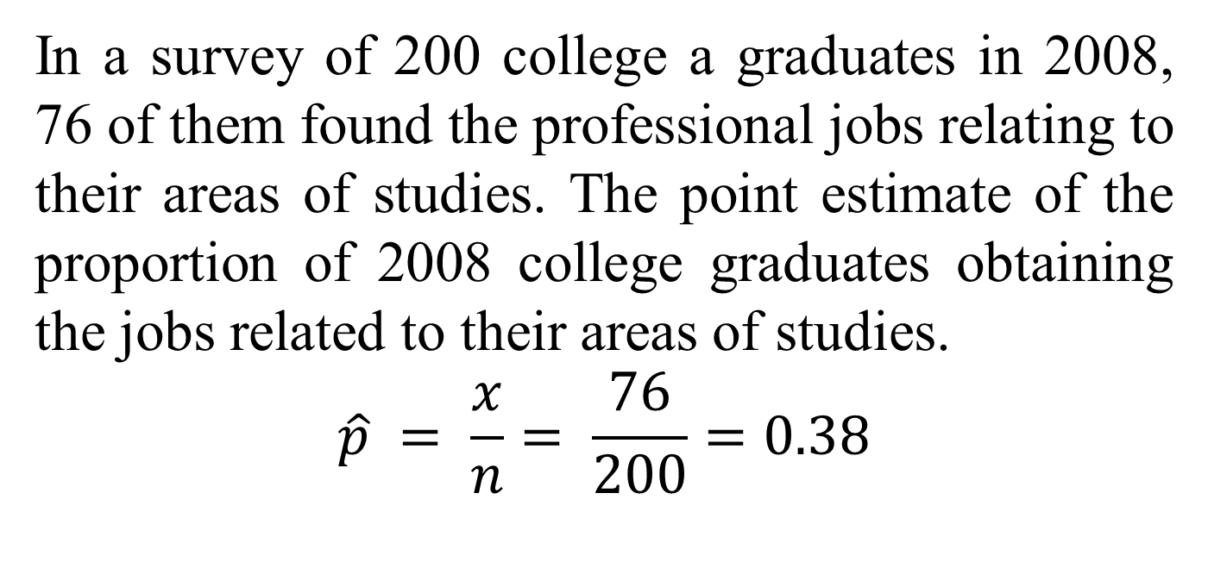
Example:
In a survey of 200 college a graduates in 2008, 76 of them found the professional jobs relating to their areas of studies. The point estimate of the proportion of 2008 college graduates obtaining the jobs related to their areas of studies.
$$\hat{p} = \frac{x}{n}= \frac{76}{200}=0.38$$

Slide 36
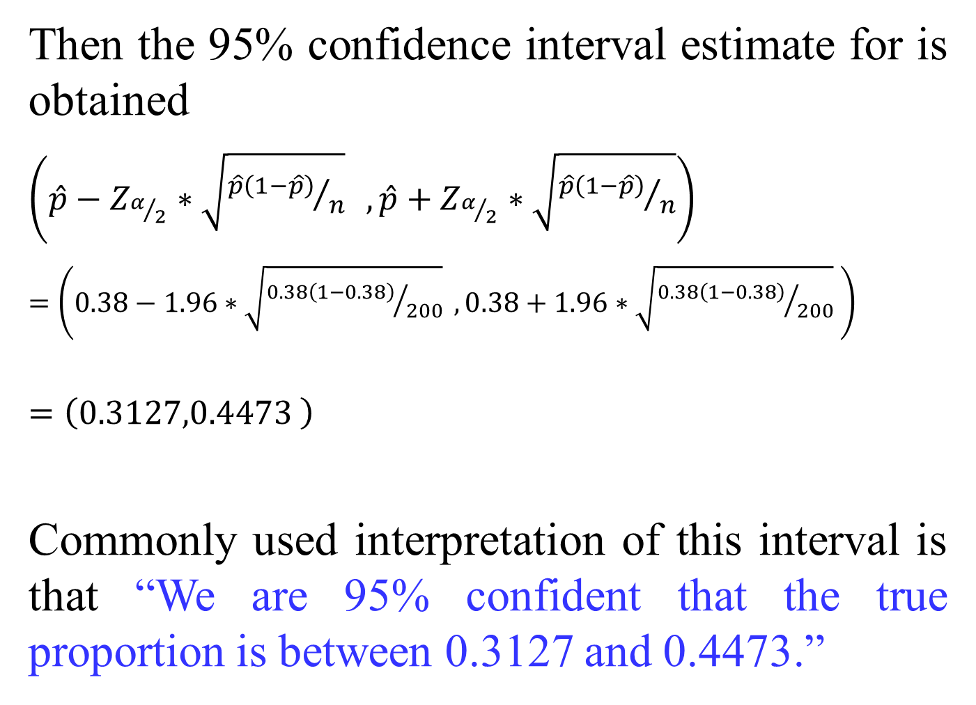
Then the 95% confidence interval estimate for is obtained
$\left(\hat{p}−Z_{α/2}∗\sqrt{{\hat{p}\left(1−\hat{p}\right)}/n} ,\hat{p}+Z_{α/2}∗\sqrt{{\hat{p}\left(1−\hat{p}\right)}/n}\right)$
$=$ $\left(0.38−1.96∗\sqrt{{0.38\left(1−0.38\right)}/{200}} ,0.38+1.96∗\sqrt{{0.38\left(1−0.38\right)}/{200}} \right)$
$$=\left(0.3127,0.4473 \right)$$
Commonly used interpretation of this interval is that “We are 95% confident that the true proportion is between 0.3127 and 0.4473.”

Slide 37
This previous interpretation may give a wrong indication that the interval is fixed but the computation involved a random number, such as, sample proportion.
A more accurate and theoretically sound interpretation is “In repeated sampling, 95% of such constructed intervals would include the true proportion.”

Slide 38
Exercise:
A random sample of 600 workers at a new manufacturing plant showed that 150 favored representation by a union. Find a 94% confidence interval for the proportion of workers that prefer union representation.

Slide 39
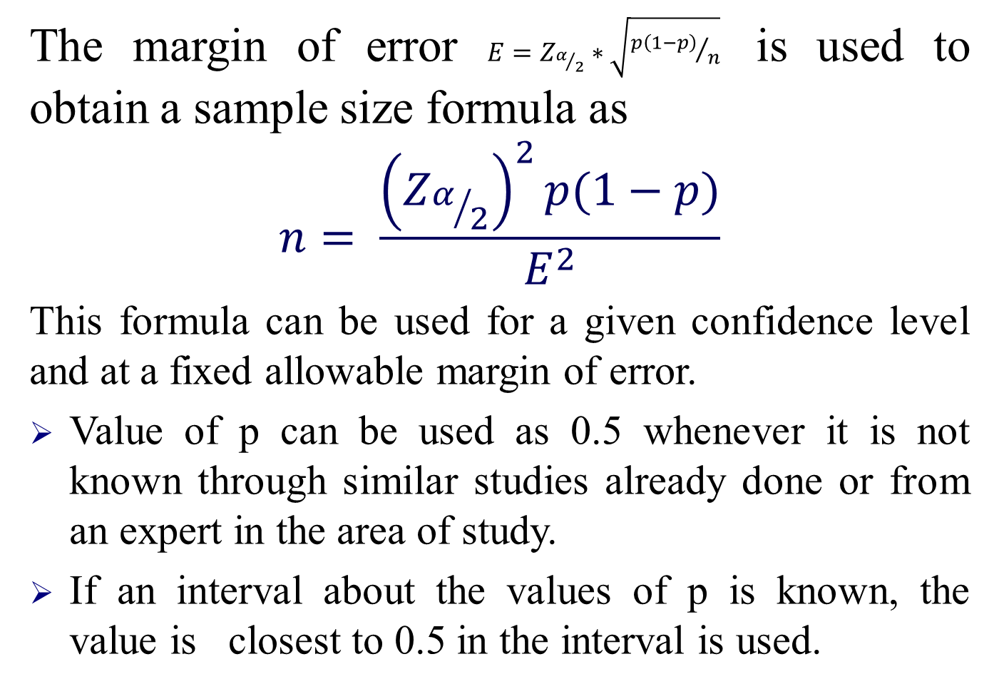
The margin of error $E=Z_{α/2}∗\sqrt{{p\left(1−p\right)}/n}$ is used to obtain a sample size formula as
$$n= \frac{{\left(Z_{α/2}\right)}^{2}p(1−p)}{E^{2}}$$
This formula can be used for a given confidence level and at a fixed allowable margin of error.
Value of p can be used as 0.5 whenever it is not known through similar studies already done or from an expert in the area of study.
If an interval about the values of p is known, the value is closest to 0.5 in the interval is used.

Slide 40
Example:
Let us consider that we want to find out the proportion of college graduates in 2008 has obtained jobs related to their areas of studies, we want to be 95% confident on our estimate and also we want to make sure that our estimate is not off by more than 0.02 from the true value of the desired proportion. Our very first objective is that the sample size to be considered. Here, we will answer the question for three different situations.

Slide 41
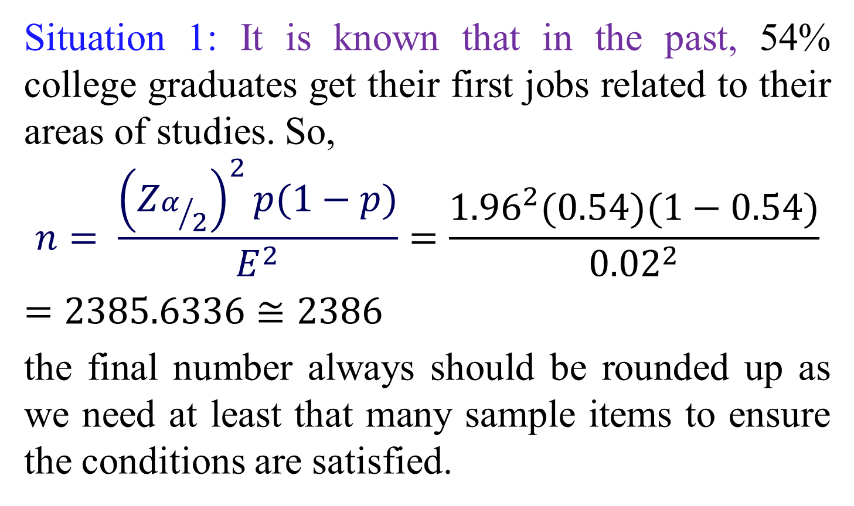
Situation 1: It is known that in the past, 54% college graduates get their first jobs related to their areas of studies. So,
$$n= \frac{{\left(Z_{α/2}\right)}^{2}p(1−p)}{E^{2}}=\frac{{1.96}^{2}(0.54)(1−0.54)}{{0.02}^{2}}$$
$=2385.6336≅2386$
the final number always should be rounded up as we need at least that many sample items to ensure the conditions are satisfied.

Slide 42
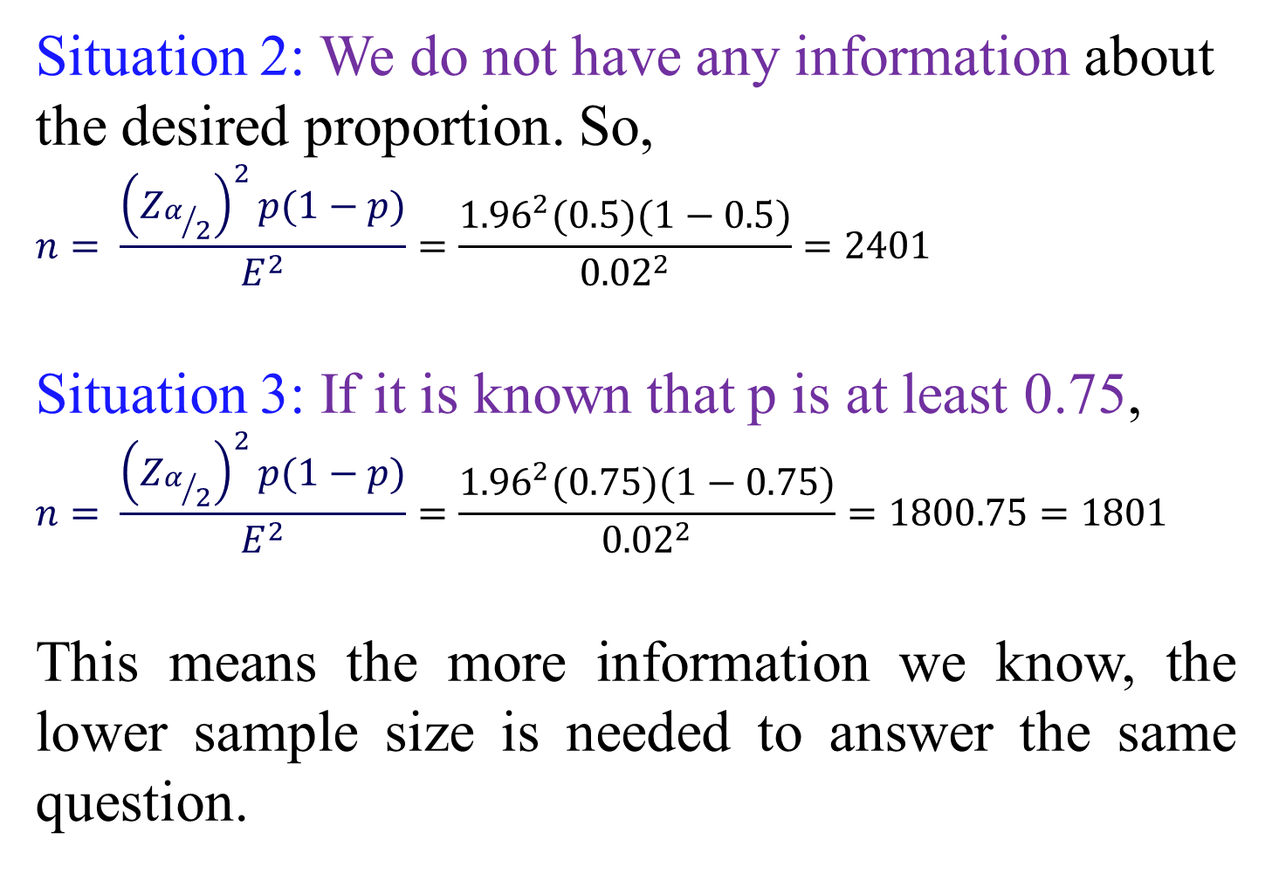
Situation 2: We do not have any information about the desired proportion. So,
$$n= \frac{{\left(Z_{α/2}\right)}^{2}p(1−p)}{E^{2}}=\frac{{1.96}^{2}(0.5)(1−0.5)}{{0.02}^{2}}=2401$$
Situation 3: If it is known that p is at least 0.75,
$$n= \frac{{\left(Z_{α/2}\right)}^{2}p(1−p)}{E^{2}}=\frac{{1.96}^{2}(0.75)(1−0.75)}{{0.02}^{2}}=1800.75=1801$$
This means the more information we know, the lower sample size is needed to answer the same question.

Slide 43
Exercise:
As this book was being written, former New York City mayor Rudolph Giuliani announced that he was a candidate for the presidency of the United States. If you were a campaign worker and needed to determine the percentage of people that recognized his name, how many people you should have surveyed to estimate that percentage? Assume that you wanted to be 90% confident that the sample percentage was in error by no more than two percentage points, and also assume that a recent survey indicated that Giuliani’s name is recognized by 20% of all adults (based on data from a Gallup poll).

Slide 44
Exercises

Slide 45

Inferences about Population Mean $μ$

Slide 46
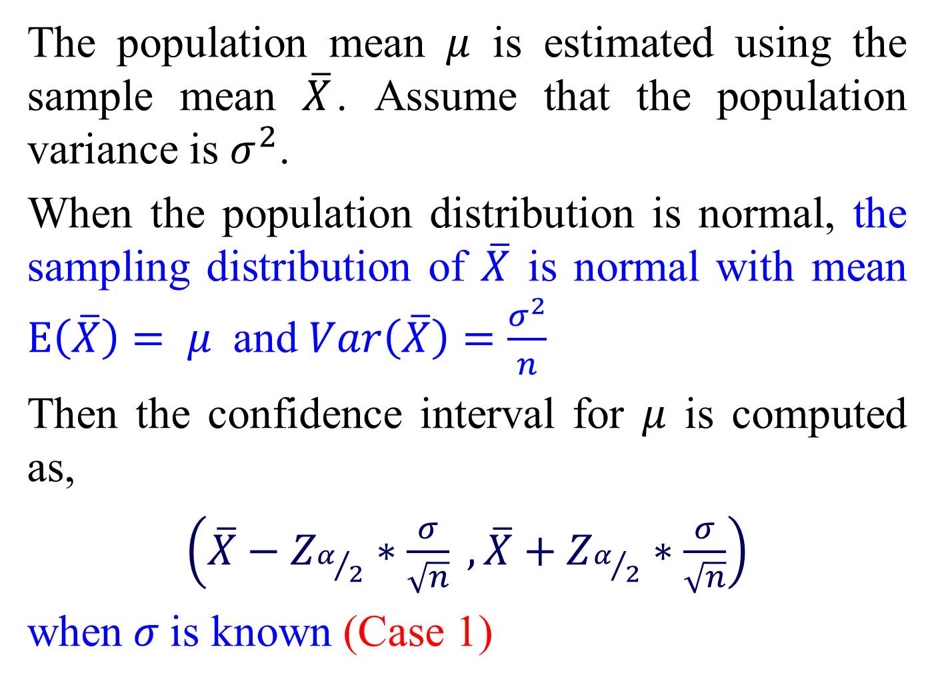
The population mean $μ$ is estimated using the sample mean $\overline{X}$. Assume that the population variance is $σ^{2}$.
When the population distribution is normal, the sampling distribution of $\overline{X}$ is normal with mean $E\left(\overline{X}\right)= μ$ and $Var\left(\overline{X}\right)=\frac{σ^{2}}{n}$
Then the confidence interval for $μ$ is computed as,
$\left(\overline{X}−Z_{α/2}∗\frac{σ}{\sqrt{n}} ,\overline{X}+Z_{α/2}∗\frac{σ}{\sqrt{n}}\right)$
when$σ$is known (Case 1)

Slide 47
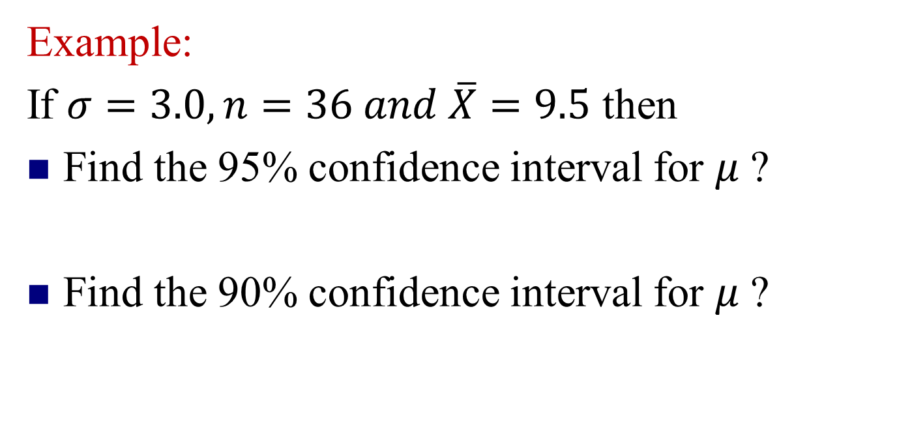
Example:
If $σ=3.0, n=36 and \overline{X}=9.5$ then
Find the 95% confidence interval for 𝜇 ?
Find the 90% confidence interval for 𝜇 ?

Slide 48
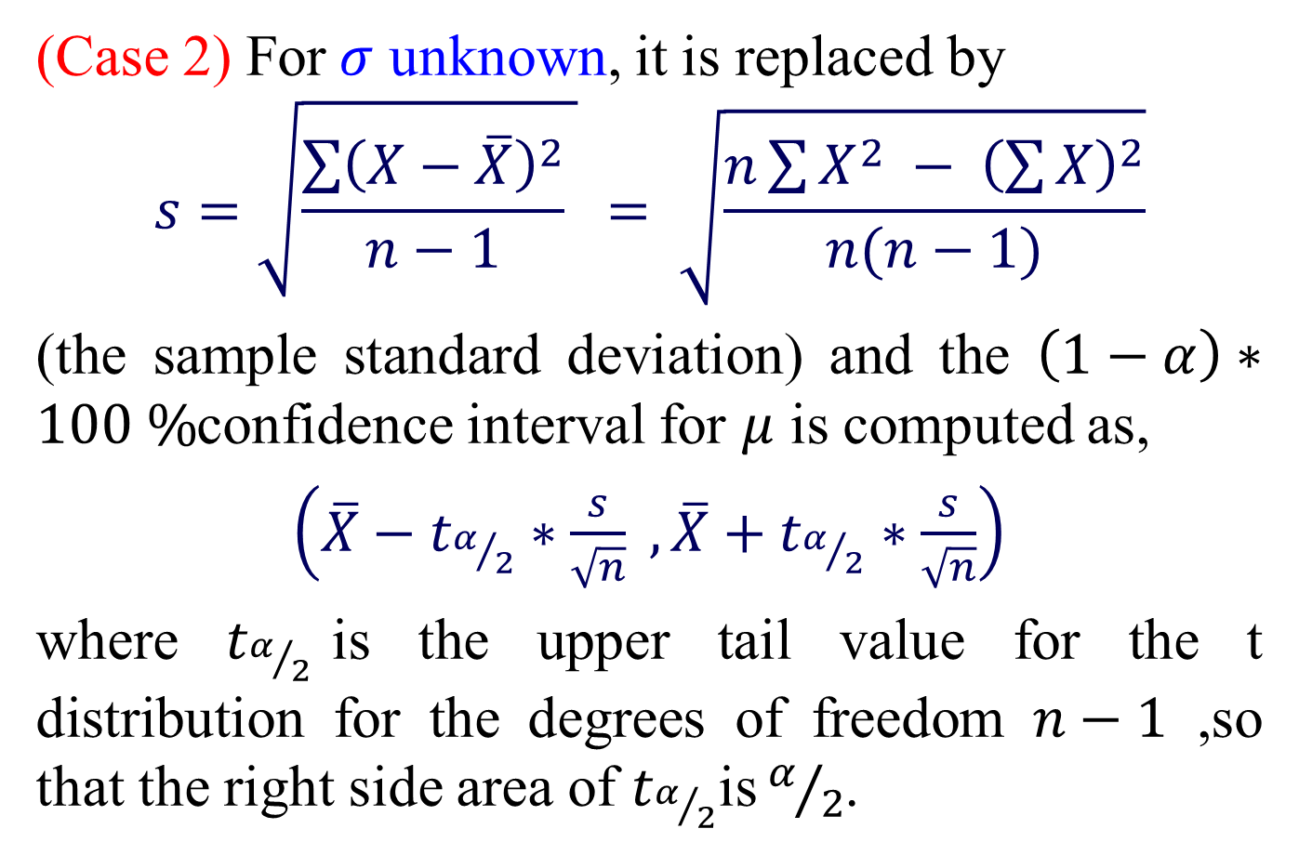
(Case 2) For$σ$ unknown, it is replaced by
$$s=\sqrt{\frac{\sum{{\left(X−\overline{X}\right)}^{2}}}{n−1} } = \sqrt{\frac{n\sum{X^{2} − {\left(\sum{X}\right)}^{2}}}{n(n−1)}}$$
(the sample standard deviation) and the $\left(1−α\right)∗100 \%$confidence interval for $μ$ is computed as,
$\left(\overline{X}−t_{α/2}∗\frac{s}{\sqrt{n}} ,\overline{X}+t_{α/2}∗\frac{s}{\sqrt{n}}\right)$
where $t_{α/2}$is the upper tail value for the t distribution for the degrees of freedom $n−1$ ,so that the right side area of $t_{α/2}$is${ α}/2$.

Slide 49
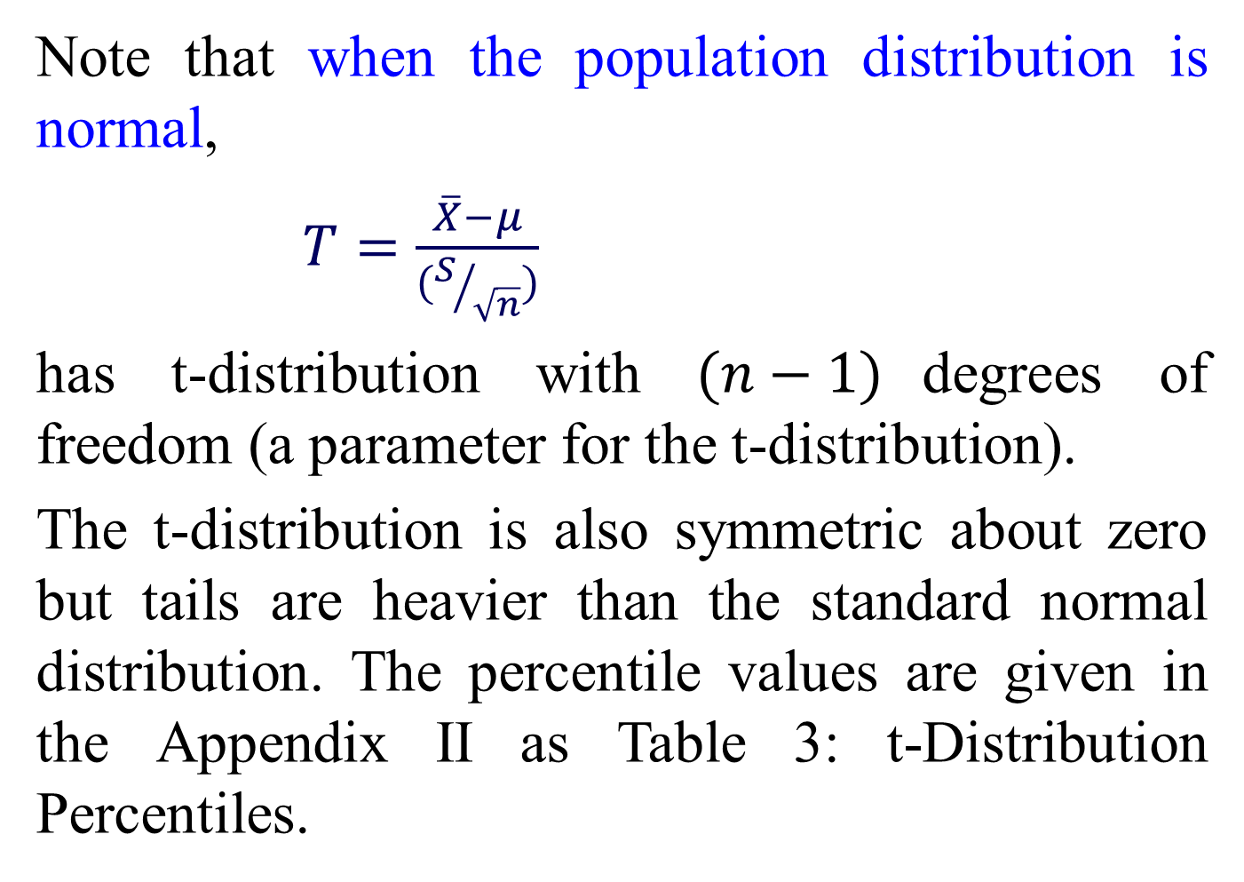
Note that when the population distribution is normal,
$T=\frac{\overline{X}−μ}{(S/{\sqrt{n}})}$
has t-distribution with $(n−1)$degrees of freedom (a parameter for the t-distribution).
The t-distribution is also symmetric about zero but tails are heavier than the standard normal distribution. The percentile values are given in the Appendix II as Table 3: t-Distribution Percentiles.

Slide 50
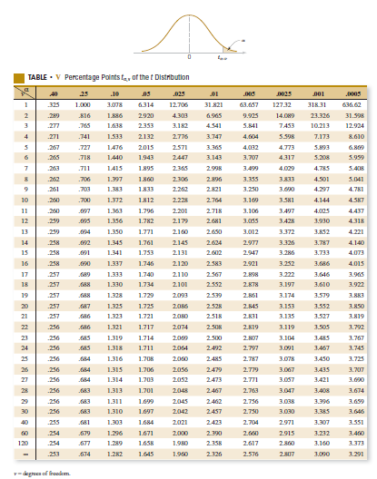

Slide 51
Red line indicated as standard normal distribution and other line t distribution changing versus degrees of freedom.

Slide 52
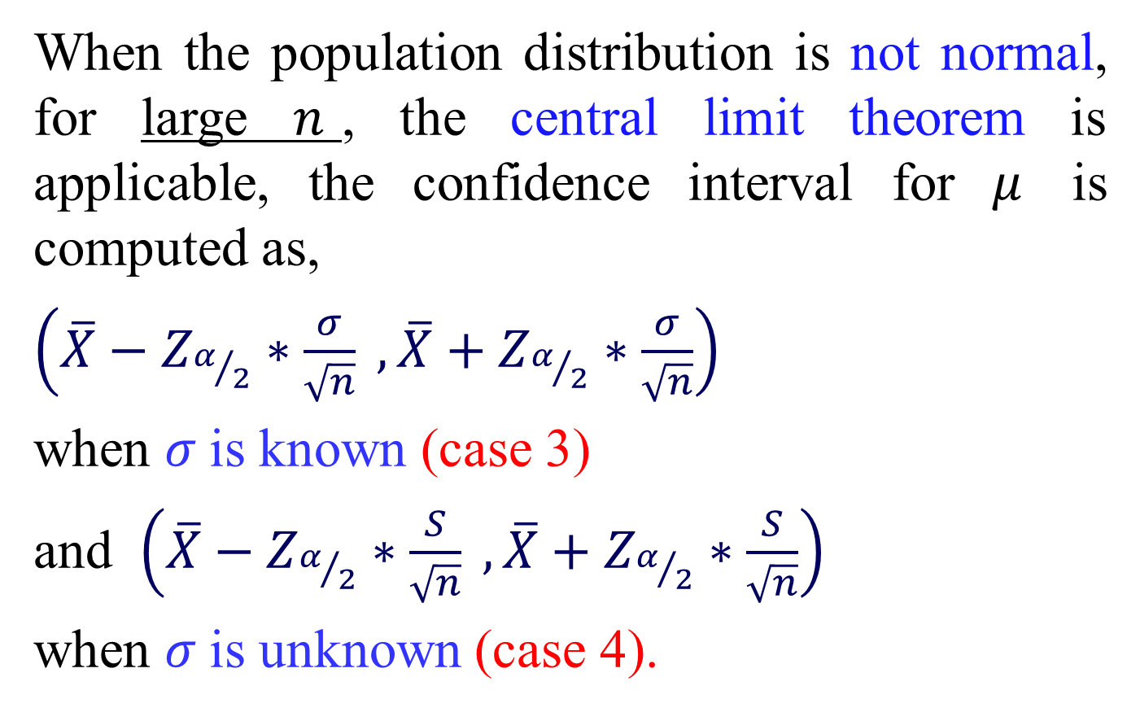
When the population distribution is not normal, for large $n$, the central limit theorem is applicable, the confidence interval for $μ$ is computed as,
$\left(\overline{X}−Z_{α/2}∗\frac{σ}{\sqrt{n}} ,\overline{X}+Z_{α/2}∗\frac{σ}{\sqrt{n}}\right)$
when $σ$is known (case 3)
and $\left(\overline{X}−Z_{α/2}∗\frac{S}{\sqrt{n}} ,\overline{X}+Z_{α/2}∗\frac{S}{\sqrt{n}}\right)$
when $σ$is unknown (case 4).

Slide 53
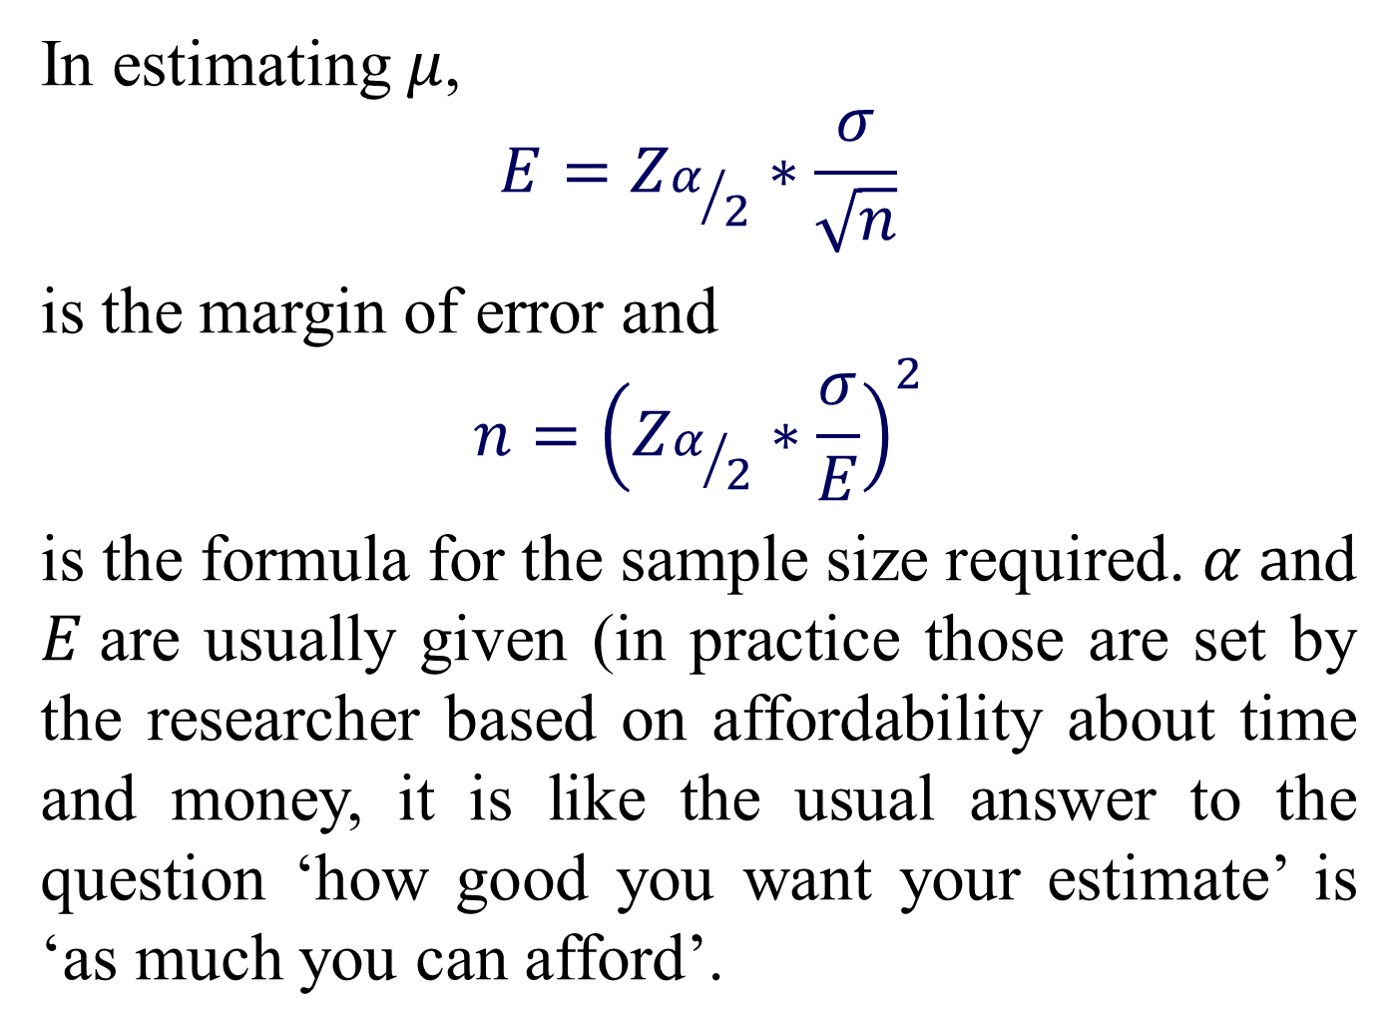
In estimating $μ$,
$$E=Z_{α/2}∗\frac{σ}{\sqrt{n}}$$
is the margin of error and
$$n={\left(Z_{α/2}∗\frac{σ}{E}\right)}^{2}$$
is the formula for the sample size required. $α a$nd $E$are usually given (in practice those are set by the researcher based on affordability about time and money, it is like the usual answer to the question ‘how good you want your estimate’ is ‘as much you can afford’.

Slide 54
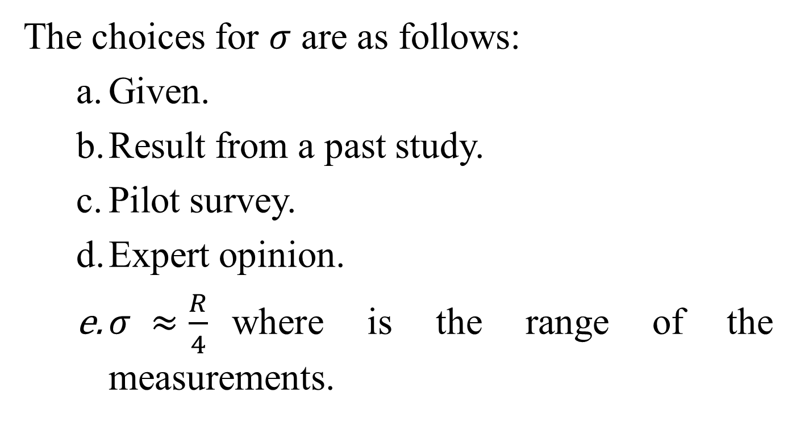
The choices for $σ$ are as follows:
Given.
Result from a past study.
Pilot survey.
Expert opinion.
$σ ≈\frac{R}{4}$where is the range of the measurements.

Slide 55
Example 3:
A survey is to be conducted to determine the average driving in miles by Faculty of Engineering students at Ariviyal Nagar. The investigator wants to know how large the sample should be so that he/she can be 92% confident on the estimate and the estimate is within 1.5 miles of the true average. A similar study was conducted in past and it was found that the standard deviation of the students’ driving distances was 8.2 miles.
Solution:

Slide 56
Example 4:
The foreman of a mining company has computed the average (mean) quantity of ore extracted per shift to be 34.6 tons and the sample standard deviation to be 2.8 tons per shift based on a random sample of 62 shifts. Construct a 93% confidence interval estimate of the true average ore extractions for that company.
Solution:

Slide 57
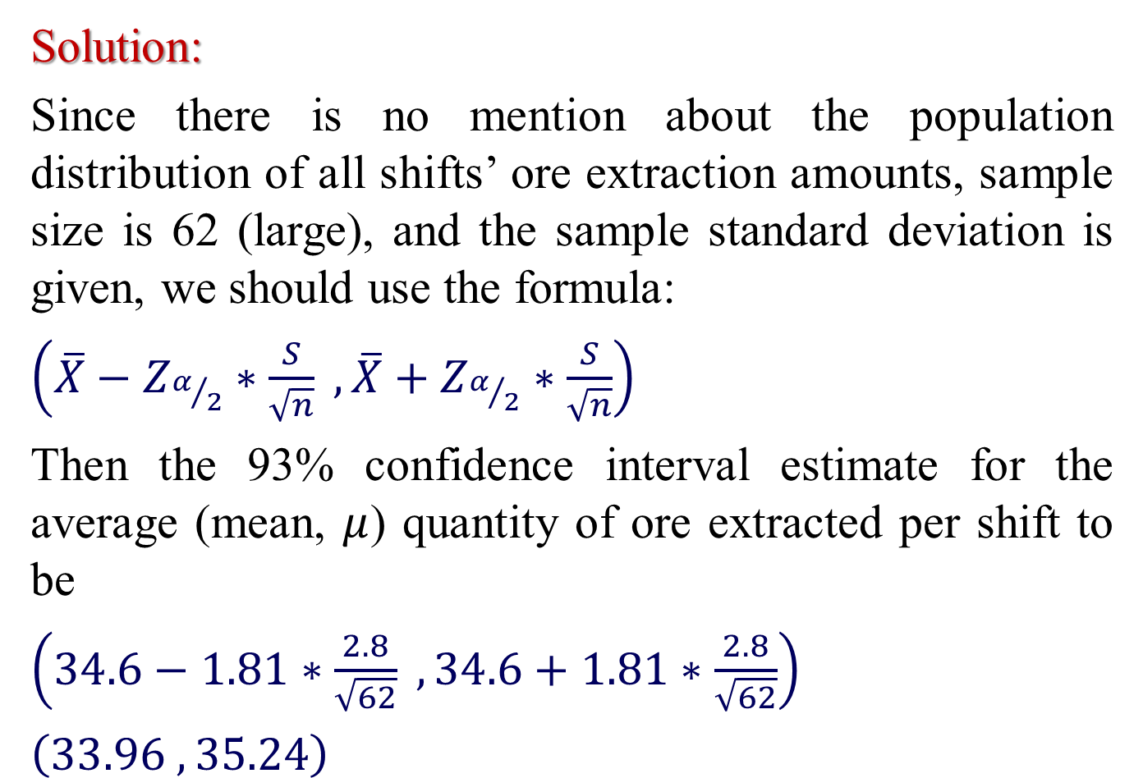
Solution:
Since there is no mention about the population distribution of all shifts’ ore extraction amounts, sample size is 62 (large), and the sample standard deviation is given, we should use the formula:
$\left(\overline{X}−Z_{α/2}∗\frac{S}{\sqrt{n}} ,\overline{X}+Z_{α/2}∗\frac{S}{\sqrt{n}}\right)$
Then the 93% confidence interval estimate for the average (mean, $μ$) quantity of ore extracted per shift to be
$\left(34.6−1.81∗\frac{2.8}{\sqrt{62}} ,34.6+1.81∗\frac{2.8}{\sqrt{62}}\right)$
$\left(33.96 ,35.24\right)$

Slide 58
Commonly used interpretation of this interval is that “We are 93% confident that the true mean is between 33.96 and 35.24.”
This interpretation may give a wrong indication that the interval is fixed but the computation involved a random number, such as, sample proportion.
But a more accurate and theoretically sound interpretation is “In repeated sampling, 93% of such constructed intervals would include the true mean.”

Slide 59
Example 5:
The life (in hours) of a 100 watt bulb is known to be normally distributed with standard deviation of 36 hours. A random sample of 15 bulbs yielded the following results:
Life in hours
2216 2237 2249 2204 2225 2301 2281 2263
2318 2255 2275 2295 2250 2238 2300
Construct a 94% confidence interval estimate for the population mean life of a 100 watt bulb.
Solution:

Slide 60
Example 6:
A fertilizer mixing machine is set to give 12 kg of nitrate for every quintal bag of fertilizer. Ten 100 kg bags are randomly selected and examined. The percentages of nitrate in the sample are as follows:
11 14 13 12 13 12 13 14 11 12
Construct a 99% confidence interval estimate for the mean nitrate content for each 100 kg bag in the company. Assume that the population from which the sample is selected is normal.
Solution:

Slide 61
Example :
In a test of the Atkins weight loss program, 12 individuals participated in a randomized trial with overweight adults. After 12 months, the mean weight loss was found to be 2.5 lb, with a standard deviation 1.8 lb. Construct a 95% confidence interval estimate of the mean weight loss for such subjects. Assume that the sample is from a normally distributed population.

Slide 62
Exercises

Slide 63

Inferences about Population Variance $σ^{2}$

Slide 64
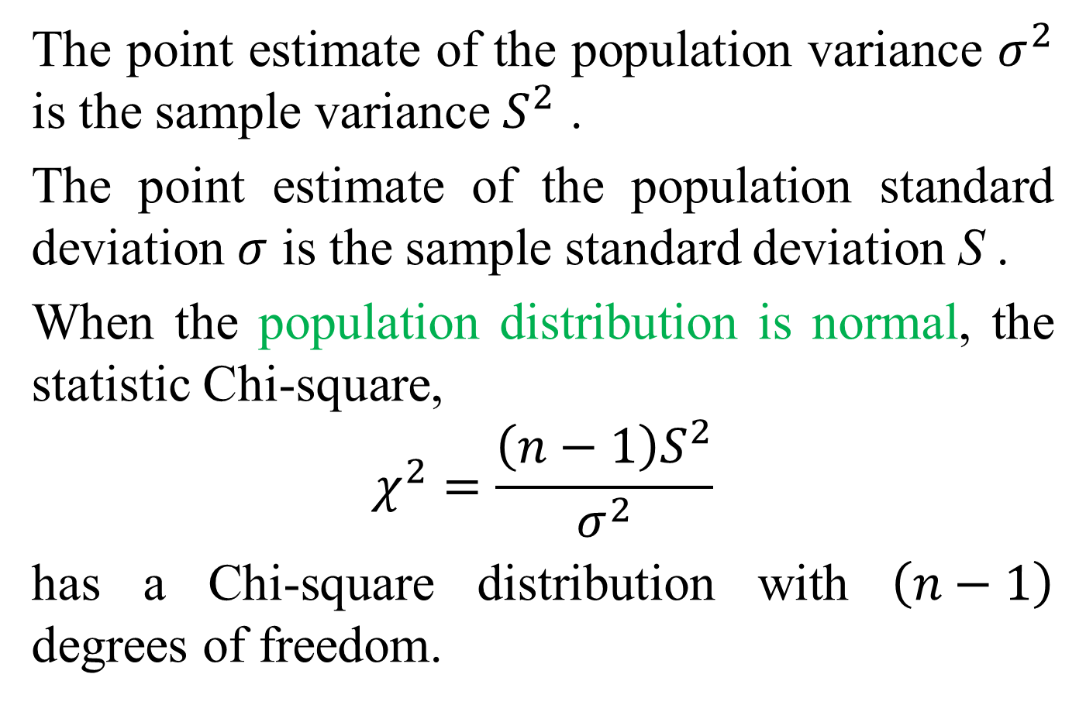
The point estimate of the population variance $σ^{2}$ is the sample variance $S^{2}$ .
The point estimate of the population standard deviation $σ$ is the sample standard deviation S .
When the population distribution is normal, the statistic Chi-square,
$$χ^{2}=\frac{\left(n−1\right)S^{2}}{σ^{2}}$$
has a Chi-square distribution with $\left(n−1\right)$ degrees of freedom.

Slide 65
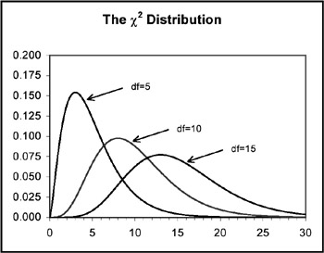
Chi-square distributions for different degrees of freedom

Slide 66
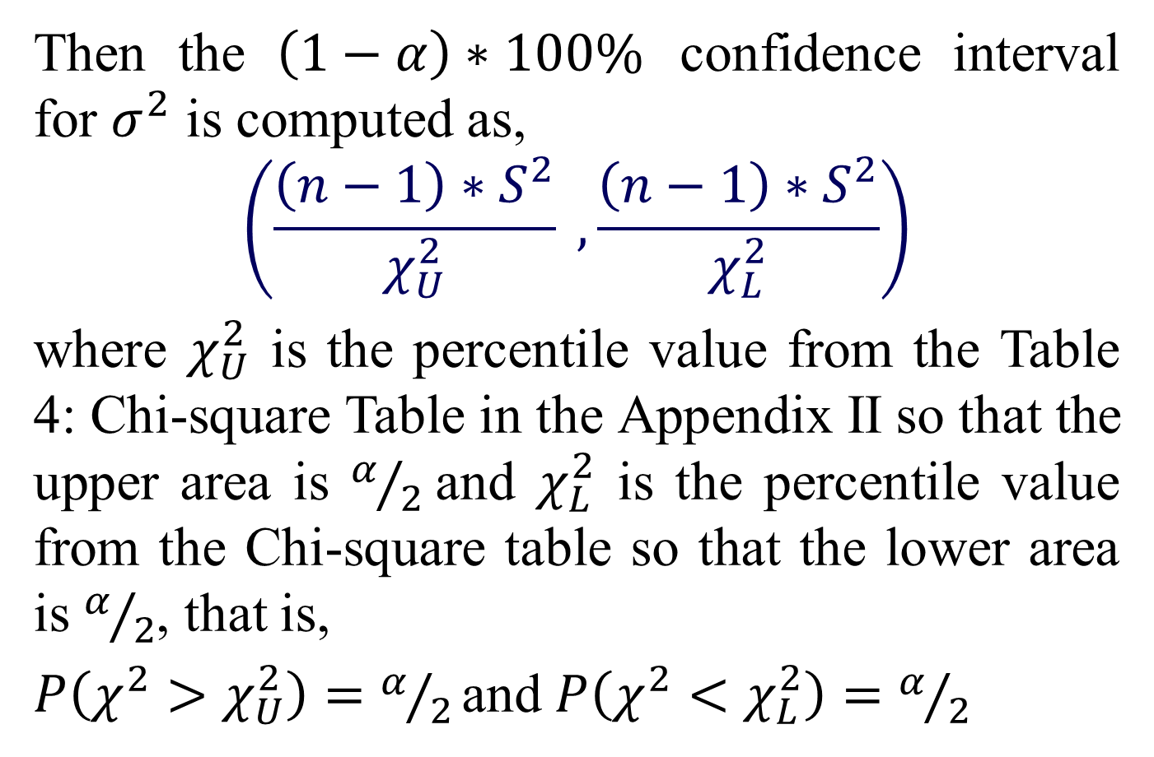
Then the $\left(1−α\right)∗100\%$ confidence interval for $σ^{2}$ is computed as,
$$\left(\frac{\left(n−1\right)∗S^{2}}{χ_{U}^{2}} ,\frac{\left(n−1\right)∗S^{2}}{χ_{L}^{2}}\right)$$
where $χ_{U}^{2}$ is the percentile value from the Table 4: Chi-square Table in the Appendix II so that the upper area is $α/2$and $χ_{L}^{2}$ is the percentile value from the Chi-square table so that the lower area is $α/2$, that is,
$P\left(χ^{2}>χ_{U}^{2}\right)=α/{2 }$and $P\left(χ^{2}<χ_{L}^{2}\right)=α/2$

Slide 67
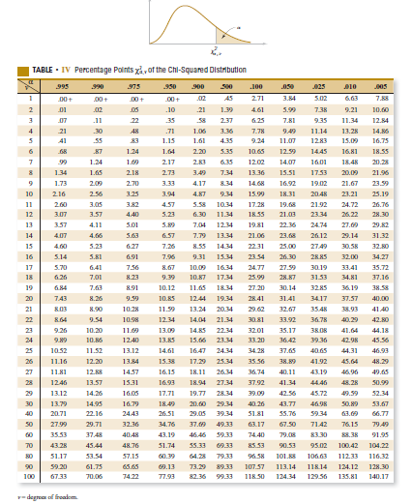

Slide 68
Example 7:
The U.S. Department of Transportation reported the number of miles that residents of metropolitan areas travel per day in a car (1994 Information Please Environmental Almanac). Suppose a simple random sample of 15 residents of Mankato, Minnesota provided the following data on car miles per day.
20 20 28 16 11 17 23 16 22
18 10 22 29 19 32

Slide 69
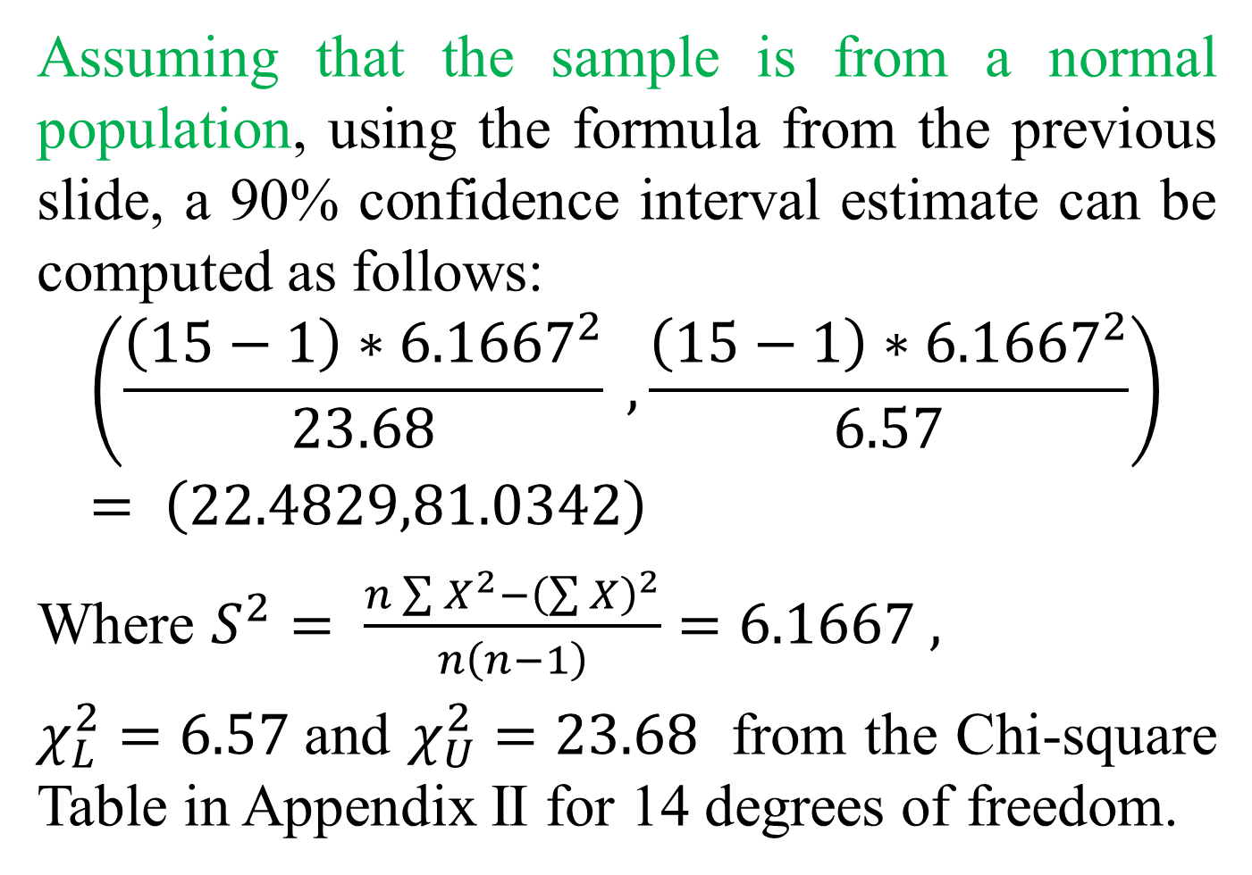
Assuming that the sample is from a normal population, using the formula from the previous slide, a 90% confidence interval estimate can be computed as follows:
$$\left(\frac{\left(15−1\right)∗{6.1667}^{2}}{23.68} , \frac{\left(15−1\right)∗{6.1667}^{2}}{6.57}\right)= \left(\text{22.4829,81.0342}\right)$$
Where $S^{2}= \frac{n\sum{X^{2}}−{\left(\sum{X}\right)}^{2}}{n\left(n−1\right)}=6.1667 ,$
$χ_{L}^{2}=6.57$and $χ_{U}^{2}=23.68$ from the Chi-square Table in Appendix II for 14 degrees of freedom.

Slide 70
Example
The listed values are waiting times (in minutes) of customers at the Jefferson Valley Bank, where customers enter a single waiting line that feeds three teller windows. Construct a 95% confidence interval for the population variance . Assume that the sample is from a normally distributed population.
6.5 6.6 6.7 6.8 7.1 7.3 7.4 7.7 7.7 7.7 5.0

Slide 71
Exercises

Slide 73
Definition: A Statistical Hypothesis is a claim or statement about population parameters such as population proportion or population mean etc.
Hypothesis Testing
In this course, we will discuss two different methods for testing hypothesis
1.Critical value Method /Traditional Method
2. P-Value Method

Slide 74
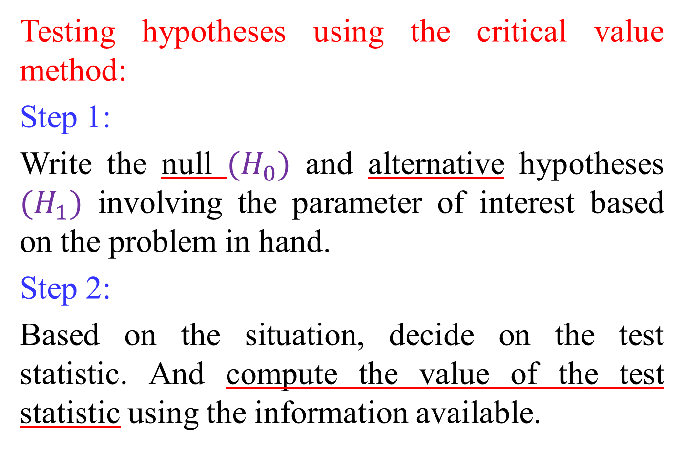
Testing hypotheses using the critical value method:
Step 1:
Write the null ${(H}_{0})$ and alternative hypotheses ${(H}_{1})$ involving the parameter of interest based on the problem in hand.
Step 2:
Based on the situation, decide on the test statistic. And compute the value of the test statistic using the information available.

Slide 75
Step 3:
Find the critical value(s) and the critical region based on the hypotheses.
Step 4:
Compare the test statistic value in step 3 with the critical region in step 2 and decide whether to reject or do not reject the null hypothesis.
Step 5:
Make a conclusion in terms of the original problem based on the decision in step 4.

Slide 76
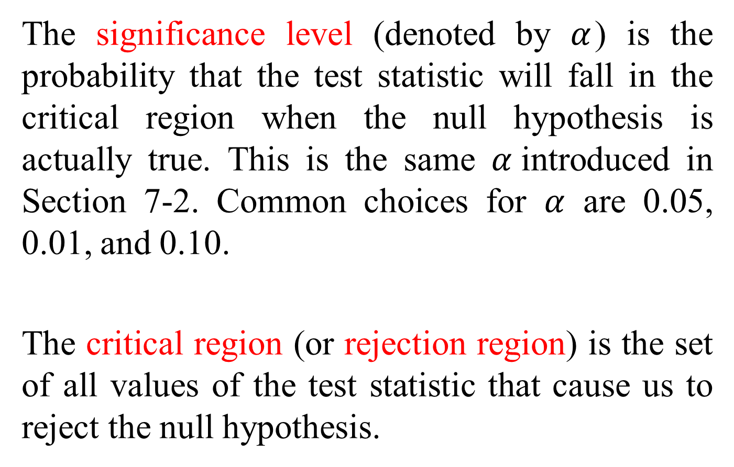
The significance level (denoted by $α$) is the probability that the test statistic will fall in the critical region when the null hypothesis is actually true. This is the same $α$introduced in Section 7-2. Common choices for $α$ are 0.05, 0.01, and 0.10.
The critical region (or rejection region) is the set of all values of the test statistic that cause us to reject the null hypothesis.

Slide 77
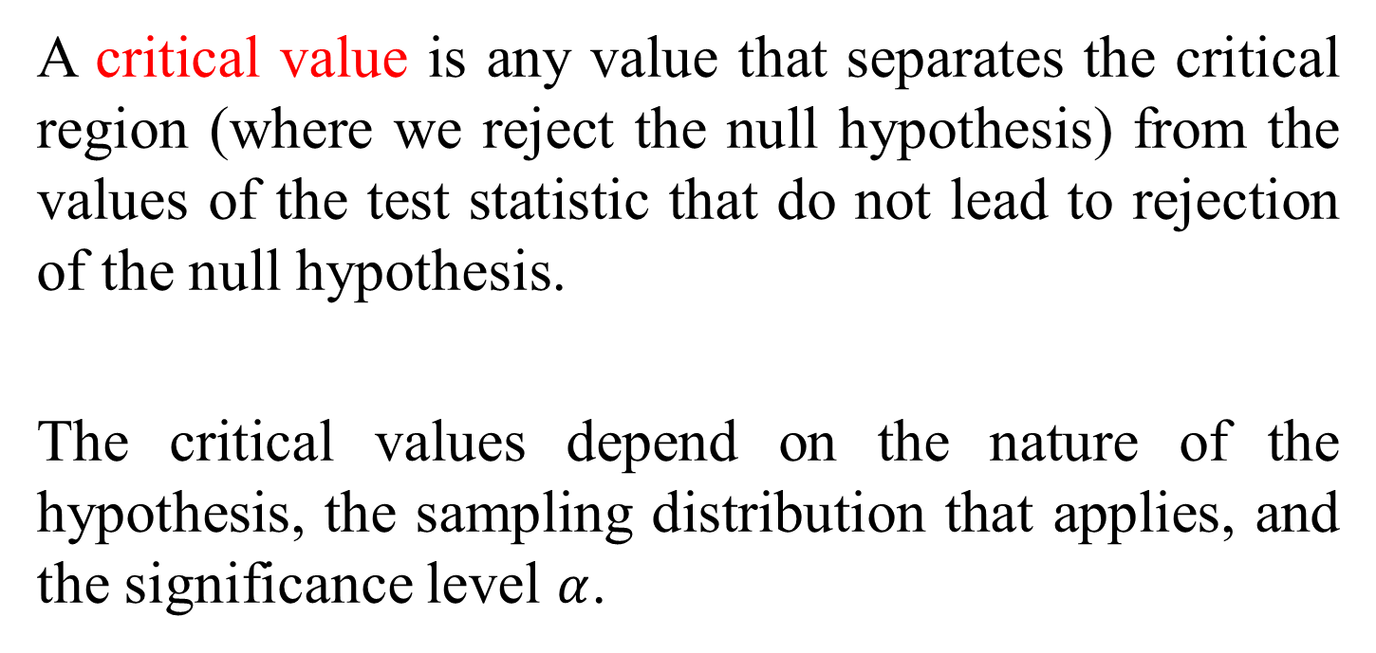
A critical value is any value that separates the critical region (where we reject the null hypothesis) from the values of the test statistic that do not lead to rejection of the null hypothesis.
The critical values depend on the nature of the hypothesis, the sampling distribution that applies, and the significance level $α$.

Slide 78
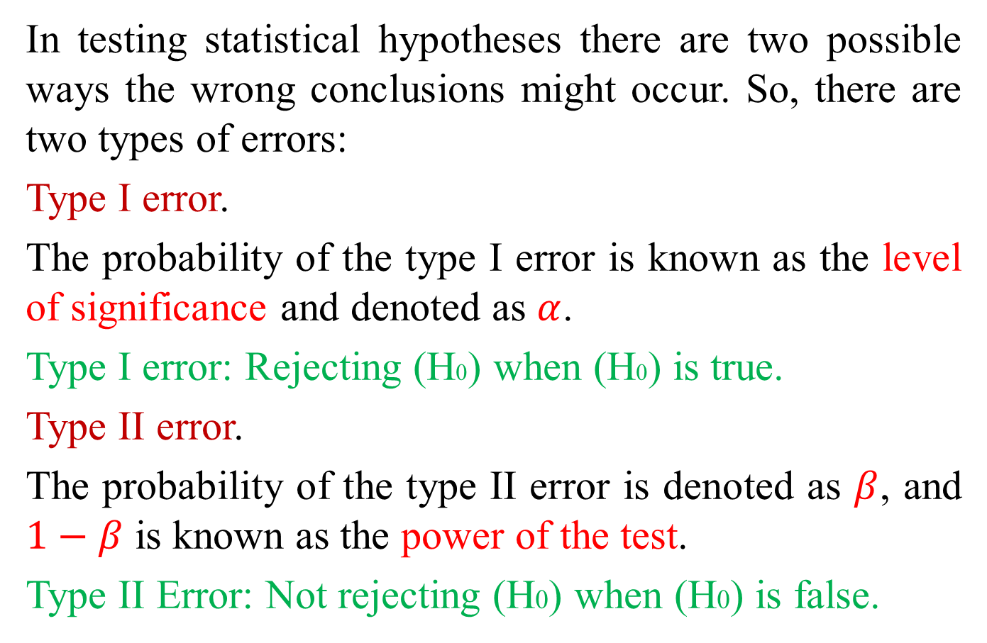
In testing statistical hypotheses there are two possible ways the wrong conclusions might occur. So, there are two types of errors:
Type I error.
The probability of the type I error is known as the level of significance and denoted as $α$.
Type I error: Rejecting (H0) when (H0) is true.
Type II error.
The probability of the type II error is denoted as $β$, and $1−β$ is known as the power of the test.
Type II Error: Not rejecting (H0) when (H0) is false.

Slide 79
Example: In a court case H0 : Defendant is innocent
 | Actually | Actually
Jury's Decision | Innocent | Guilty
Guilty | Type I error | Correct
Innocent | Correct | Type II error

Slide 80
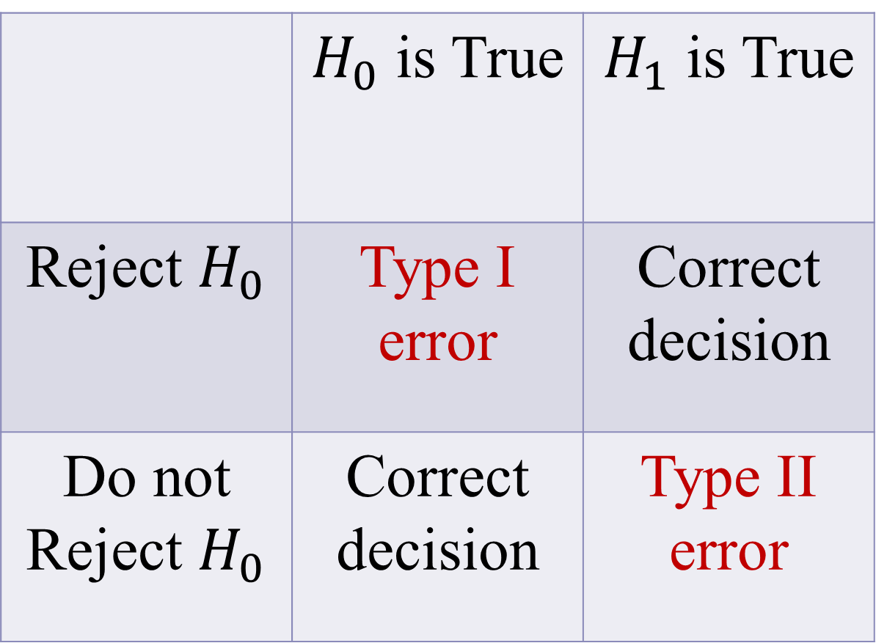
 | $H_{0}$ is True | $H_{1}$ is True
Reject $H_{0}$ | Type I error | Correct decision
Do not Reject $H_{0}$ | Correct decision | Type II error

Slide 81

Testing Hypotheses About Population Mean $μ$

Slide 82
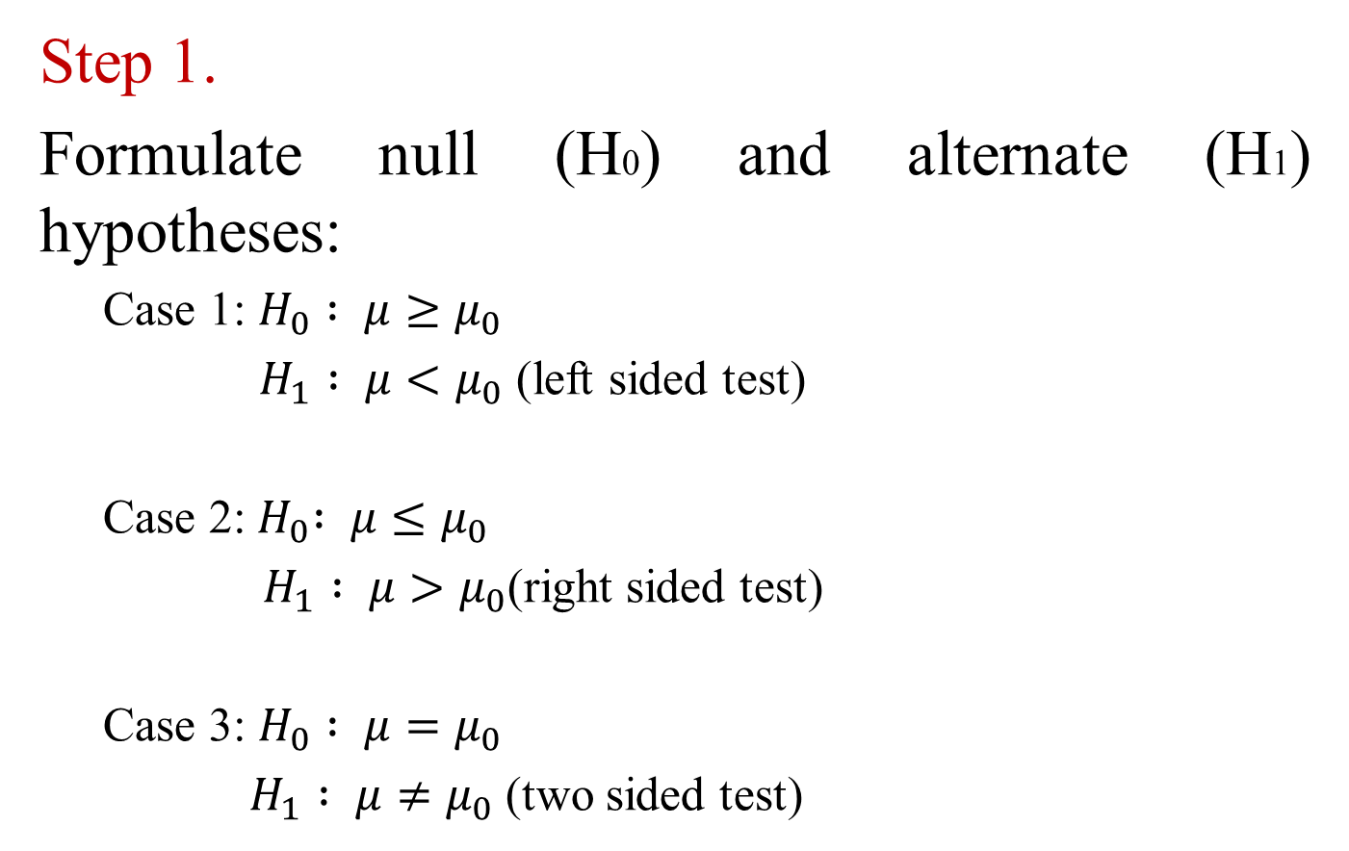
Step 1.
Formulate null (H0) and alternate (H1) hypotheses:
Case 1: $H_{0} : μ≥μ_{0}$
$H_{1} : μ<μ_{0}$ (left sided test)
Case 2:${ H}_{0} : μ≤μ_{0}$
$H_{1} : μ>μ_{0}$(right sided test)
Case 3: $H_{0} : μ=μ_{0}$
$H_{1} : μ≠μ_{0}$ (two sided test)

Slide 83
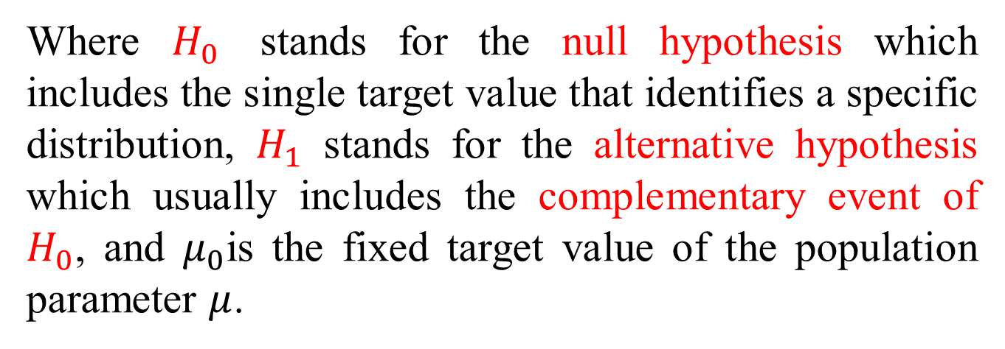
Where $H_{0}$ stands for the null hypothesis which includes the single target value that identifies a specific distribution, $H_{1}$ stands for the alternative hypothesis which usually includes the complementary event of $H_{0}$, and $μ_{0}$is the fixed target value of the population parameter $μ$.
Note:
In hypothesis testing, you can put the claim under H1 and equal to sign is always with H0. one or two sided test depends on H1.

Slide 84

Step 2. Calculate the test value by formula:
The following test statistics are usually used:
1.When the population distribution is normal and the population standard deviation is $σ$known,
$Z=\frac{\overline{X}−μ_{0}}{(σ/{\sqrt{n}})}$ is used.
2.When the population distribution is normal and the population standard deviation $σ$is unknown,
$T=\frac{\overline{X}−μ_{0}}{(S/{\sqrt{n}})}$ is used,
where has a t-distribution with degrees of freedom.

Slide 85

3.When it is not known that the population distribution is normal and the population standard deviation $σ$ is known, then n for large
$Z=\frac{\overline{X}−μ_{0}}{(σ/{\sqrt{n}})}$ is used.
4.When it is not known that the population distribution is normal and the population standard deviation $σ$is unknown, then n for large,
$Z=\frac{\overline{X}−μ_{0}}{(s/{\sqrt{n}})}$ is used.

Slide 86


Step 3.
Calculate the critical value(s) and identify critical region
1. Use a right-tailed test when $H_{1}: μ>μ_{0}$
2. Use a two-tailed test when $H_{1}: μ≠μ_{0}$
3. Use a left-tailed test when $H_{1}: μ<μ_{0}$
It is very similar for t test, just replace z by t.

Slide 87

If the test value is Z in step 2, Find the critical value
$Z_{α}$ if test is one sided.
$Z_{α/2}$if test is two sided.
If the test value is T in step 2, Find the critical value
$t_{α}$ if test is one sided.
$t_{α/2}$if test is two sided.
Step 4.
Make decision: Reject H0 if test value falls in the critical region otherwise do not reject H0.
Step 5. State the conclusion in nontechnical terms.

Slide 88


Example : M & M candies claims that the average weight of M & M candies is greater than 0.8535 g. To test this claim a random sample of 13 M & M candies are taken and a sample mean of 0.8635 g. was found the population standard deviation is known to be 0.0565. Test the claim using traditional approach (critical value method) with $α=5\%$:
Solutions:
Step1 : Hypotheses:
${ H}_{0}: μ ≤0.8535$
${ H}_{1}: μ>0.8535$ (put the claim under H1)
Step2 :Test Statistic value Calculation
Since population standard deviation $σ$ is known. So Test value is given by
$$Z=\frac{\overline{X}−μ_{0}}{(σ/{\sqrt{n}})}=\frac{0.8635−0.8535}{({0.0565}/{\sqrt{13}})}=0.64$$

Slide 89

Step3 :Critical value/identify critical region:
This is right sided test (look at the hypotheses to find one or two sided test) so that the critical value is $Z_{α}$. For $α$= 0.05, from Z-table, critical value $Z_{0.05}$ = 1.645 (when tail area under the Z-curve is 0.05, Z value is 1.645.).
Step4 : Reject or Do not reject H0:
Test value is 0.64 and critical value is 1.645(from Z table). If the test value falls in the shaded region (critical region) we reject H0. But in this example test value falls in acceptance region so we do not reject H0. (0.64 is less than 1.645)
Step5 : Write in nontechnical term:
Average weight of M & M candies is less than or equal to 0.8535 gm and the test is carried out with 95 % confidence.

Slide 90

Example 8:
It is claimed that the average house price in Mankato, Minnesota has fallen in the year 2008 from the average house price of $187,000 of the year 2007. To answer the question, an investigator takes a sample of prices of 42 houses sold in 2008 in Mankato, Minnesota. The sample mean of the 42 houses is $185,540 and the sample standard deviation is $9,582. Test the claim using traditional approach (critical value method) with $α=5\%$:

Slide 91
Example 9:
A fertilizer mixing machine is set to give 12 kg of nitrate for every quintal bag of fertilizer. Ten 100 kg bags are randomly selected and examined. The percentages of nitrate in the
sample are as follows:
11 14 13 12 13 12 13 14 11 12
Test whether the mean percentage of nitrate content is 12 kg in all 100 kg bags for this company. Assume that the population from which the sample is selected is normal. Use 1% level of significance.

Slide 92
Example 10:
The totals of the individual weights of garbage discarded by 70 households in one week have a mean of 30 lb. Assume that the standard deviation of the weights is 15.0 lb. Use a 0.05 significance level to test the claim that the population of households has a mean less than 35 lb, which is the minimum amount that can be handled by the current waste removal system.

Slide 93
Testing hypotheses using the p-value method:
Step 1:
Write the null and alternative hypotheses involving the parameter of interest based on the problem in hand.
Step 2:
Based on the situation, decide on the test statistic. And compute the value of the test statistic using the information available.
Step 3:
Then Compute the p-value based on the hypotheses.

Slide 94


Step 4:
Reject $H_{0}$ if p-value in step 3 is less than or equal to $α$.
Step 5:
Make a conclusion in terms of the original problem based on the decision in step 4.(Where Z0 – Test Statistics value)

Slide 95

Assuming $H_{0}$ is indeed true, the P-value is the probability of observing a value of the test statistic as or more extreme than that observed.
1.For a right-tailed test,
$$P−value = P(Z >Z_{0}).$$
2.For a two-tailed test,
$$P−value = P\left(\left|Z\right| >\left|Z_{0}\right|\right)=2∗P(Z >\left|Z_{0}\right|).$$
3. For a left-tailed test,
$$P−value = P(Z <Z_{0}).$$

Slide 96

In example 8,
$p−value =P\left(Z≤−0.9875\right)$
$≅P\left(Z≤−0.99\right)=0.1611$
from the standard normal probability table, Table 2 in Appendix II. It is not highly unlikely compared to the level of significance 5%. Hence, do not reject $H_{0}$ and we have the same conclusion as before.

Slide 97
Exercises

Slide 98
Testing Hypotheses About Population Proportion p

Slide 99

Step 1.
Formulate null (H0) and alternate (H1) hypotheses:
Case 1: $H_{0} :p≥p_{0}$
$H_{1} :p<p_{0}$ (left sided test)
Case 2:${ H}_{0} :p≤p_{0}$
$H_{1} :p>p_{0}$(right sided test)
Case 3: $H_{0} :p=p_{0}$
$H_{1} :p≠p_{0}$ (two sided test)
Where $p_{0}$ is the fixed target value of the population parameter $p$ .

Slide 100

Step 2: Calculate the test statisics value by formula:
$$Z=\frac{\hat{p}−p_{0}}{\sqrt{\frac{p_{0}(1−p_{0})}{n}}}$$
where $\hat{p}$ is sample proportion. $p_{0}$ is Hypothesis proportion and $n$ is the sample size.
Step 3: Find the critical value and Identify critical region
$Z_{α}$ if test is one sided.
$Z_{α/2}$if test is two sided.
Step 4: Make decision: Reject H0 if test statistics value falls in the critical region (shaded area) do not reject otherwise.
Step 5: State the conclusion in nontechnical terms.

Slide 101

Example : A factory is producing 50,000 pairs of shoes daily. In order to test the claim that substandard shoes produced by the company is not 1 %. A sample of 500 shoes are examined and found that 1.9 % are substandard in the sample. Use 5 % level of significance to test the claim. (write all five steps)
Solutions:
Step 1: Hypotheses
$H_{0} :p=0.01$
$H_{1} :p≠0.01$ (two sided test)
Step 2: Test statistics value:
$$Z=\frac{\hat{p}−p_{0}}{\sqrt{\frac{p_{0}(1−p_{0})}{n}}}=\frac{0.019−0.01}{\sqrt{\frac{0.01 (1−0.01)}{500}}}=2.022$$

Slide 102

Step 3: Critical value calculation and identify Critical region:
This is two sided test (look at the hypotheses to find one or two sided test) so that the critical value is $Z_{α/2}$. For $α$= 0.05, from Z-table, critical value $Z_{α/2}$ = 1.96 (when tail area under the Z-curve is 0.025, Z value is 1.96.)
Step 4: Reject or Do not reject H0:
Test value is 2.022 and critical value is 1.96(from Z table). In this example, test value falls in rejection region so we reject H0. (2.02 is greater than 1.96) so we reject H0.
Step 5: Write in nontechnical term: Proportion of defective shoes is not 1 % and the test is carried out with 95 % confidence.

Slide 103
Example 10:
A factory is producing 50,000 pairs of shoes daily. There is a quality control practice for the company that 1% sub standard quality is acceptable. From a sample of 500 pairs, 1.45% were found to be sub standard quality. Test whether the percentage of sub standard quality in the company is higher than 1% or not. Use a 5% level of significance.

Slide 104
Exercises

Slide 105

Testing Hypotheses About Population Variance $σ^{2}$

Slide 106

Step 1.
Formulate null (H0) and alternate (H1) hypotheses:
Case 1: $H_{0} :σ^{2}≥σ_{0}^{2}$
$H_{1} :σ^{2}<σ_{0}^{2}$ (left sided test)
Case 2:${ H}_{0} :σ^{2}≤σ_{0}^{2}$
$H_{1} :σ^{2}>σ_{0}^{2}$ (right sided test)
Case 3: $H_{0} :σ^{2}=σ_{0}^{2}$
$H_{1} :σ^{2}≠σ_{0}^{2 }$(two sided test)
Where $σ_{0}^{2}$ is the fixed target value of the population parameter variance.

Slide 107

Statistical testing regarding the population standard deviation can be performed by just performing the tests for the population variance $σ^{2}$, because the hypotheses are equivalent as:
Case 1:$H_{0} :σ≥σ_{0} ≡ H_{0} :σ^{2}≥σ_{0}^{2}$
$H_{1} :σ<σ_{0} H_{1} :σ^{2}<σ_{0}^{2}$
Case 2:${{ H}_{0} :σ≤σ_{0} ≡ H}_{0} :σ^{2}≤σ_{0}^{2}$
$H_{1} :σ>σ_{0} H_{1} :σ^{2}>σ_{0}^{2}$
Case 3: $H_{0} :σ=σ_{0} ≡ H_{0} :σ^{2}=σ_{0}^{2}$
$H_{1} :σ≠σ_{0} H_{1} :σ^{2}≠σ_{0}^{2}$

Slide 108

Step 2:
Calculate the test statisics value by formula:
$$T.S=χ^{2}= \frac{\left(n−1\right)s^{2}}{σ_{0}^{2}}$$
where $s^{2}$ is sample variance.${ σ}_{0}^{2}$ is Hypothesis variance and $n$ is the sample size.
Step 3:
Find the critical value and Identify critical region (If you use critical Value Method)
or
Calculate the P-Value region (If you use P- Value Method)

Slide 109

The critical value(s) and p-value can be found as follows(assuming the significance level is $α$):
Case 1:$H_{0} :σ^{2}≥σ_{0}^{2}$
$H_{1} :σ^{2}<σ_{0}^{2}$ the critical value is $χ_{1−α}^{2}$ and
$$p−value= P(χ^{2}<T.S)$$
Case 2:$H_{0} :σ^{2}≤σ_{0}^{2}$
$H_{1} :σ^{2}>σ_{0}^{2}$ the critical value is $χ_{α}^{2}$ and
$$p−value= P(χ^{2}>T.S)$$
Case 3: $H_{0} :σ^{2}=σ_{0}^{2}$
$H_{1} :σ^{2}≠σ_{0}^{2}$the critical value is $χ_{\left({1−α}/2\right)}^{2}$ and $χ_{\left(α/2\right)}^{2}$
$p−value=2∗P\left(χ^{2}>T.S\right)$or $2∗P\left(χ^{2}<T.S\right)$
(make sure the p-value is smaller than 1)

Slide 110
Step 4: Make decision: Reject H0 if test statistics value falls in the critical region (shaded area) do not reject otherwise.
Step 5: State the conclusion in nontechnical terms.

Slide 111
Example 11:
A fertilizer mixing machine is set to give 12 kg of nitrate for every quintal bag of fertilizer. Ten 100 kg bags are randomly selected and examined. The percentages of nitrate in the sample are as follows:
11 14 13 12 13 12 13 14 11 12
To contain the variability at a low number, the company maintains a target that the standard deviation of the nitrate contents should not be more than 1 kg. Test whether the standard deviation of nitrate contents is significantly higher than 1 kg. Assume that the population from which the sample is selected is normal. Use 5% level of significance.

Slide 112
Exercises!

Slide 113

Don’t hesitate to contact us if you have any questions about the course content. Also, don’t forget to check out the course page and the Microsoft Teams folder.
Course page Link: https://mayooran1987.github.io/MC3020_E24/
Microsoft Teams folder

