Slide 1

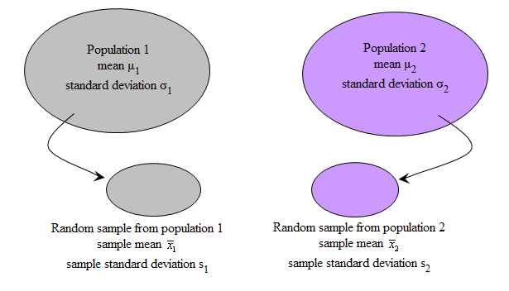
MC3020 - Comparing Two Population Parameters
Dr T. Mayooran,
Department of Interdisciplinary Studies,
Faculty of Engineering,
University of Jaffna.
Email: mayooran@eng.jfn.ac.lk

Slide 2

Comparing two population parameters
Comparing Two Population Proportions.
Comparing Two Independent Population Means.
Comparing Two Dependent or Matched Population Means.
Comparing Two Independent Population Variances.

Slide 3
Comparing Two Population
Proportions

Slide 4
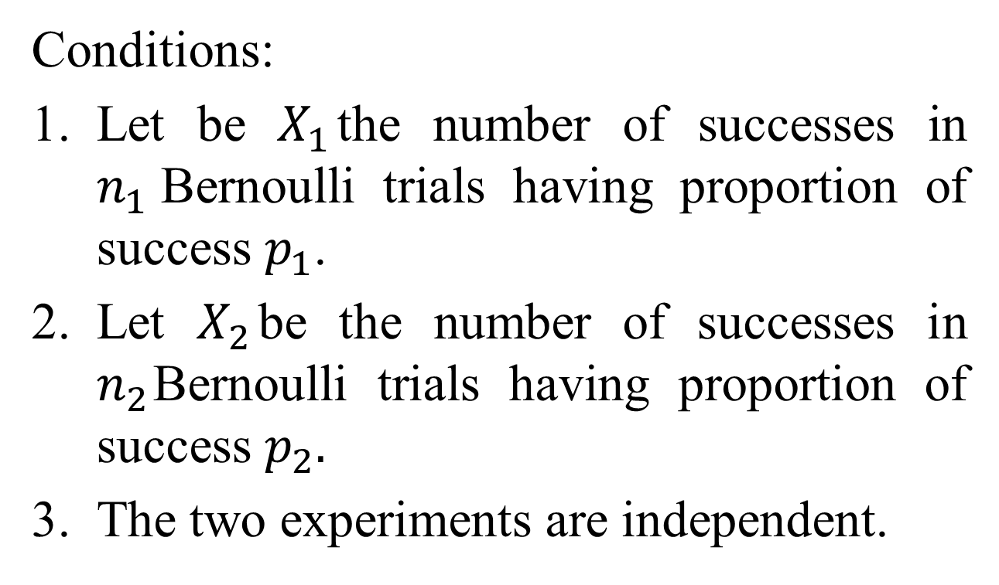
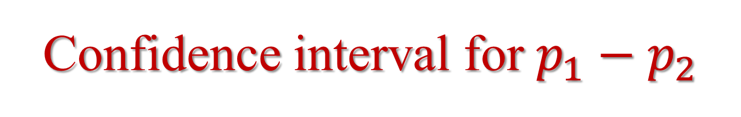
Confidence interval for $p_{1}−p_{2}$
Conditions:
Let be $X_{1}$the number of successes in $n_{1}$Bernoulli trials having proportion of success $p_{1}$.
Let $X_{2}$be the number of successes in $n_{2}$Bernoulli trials having proportion of success $p_{2}.$
The two experiments are independent.

Slide 5
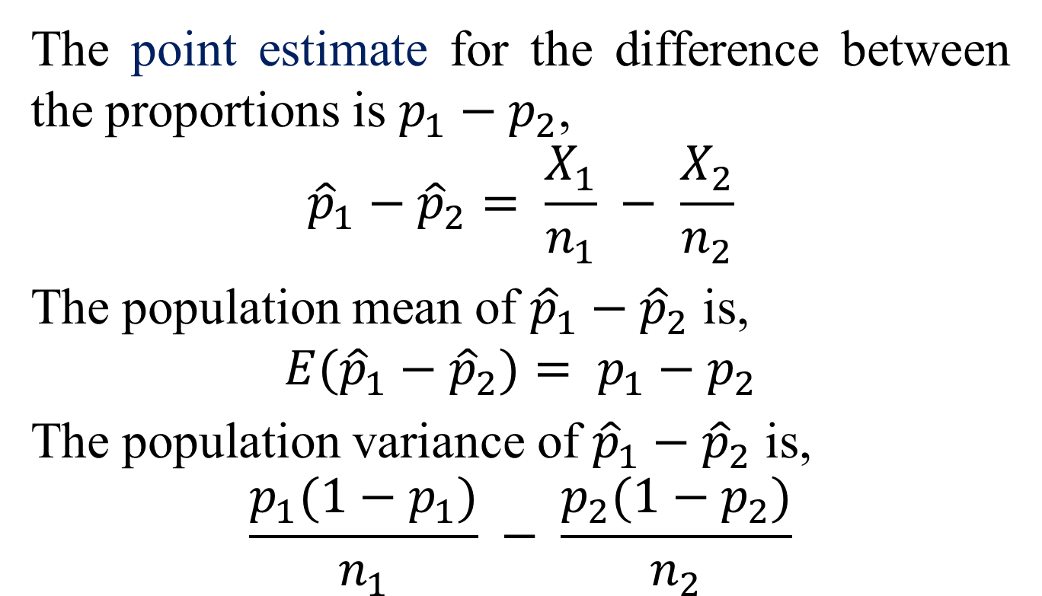
The point estimate for the difference between the proportions is $p_{1}−p_{2}$,
$${\hat{p}}_{1}−{\hat{p}}_{2}= \frac{X_{1}}{n_{1}} − \frac{X_{2}}{n_{2}}$$
The population mean of ${\hat{p}}_{1}−{\hat{p}}_{2}$ is,
$${E(\hat{p}}_{1}−{\hat{p}}_{2})= p_{1}−p_{2}$$
The population variance of ${\hat{p}}_{1}−{\hat{p}}_{2}$ is,
$$\frac{p_{1}(1−p_{1})}{n_{1}} − \frac{p_{2}(1−p_{2})}{n_{2}}$$

Slide 6
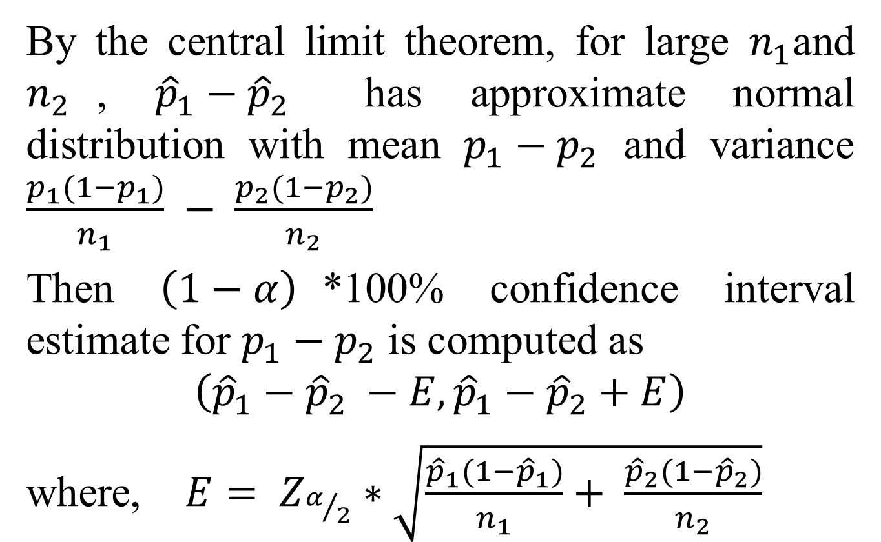
By the central limit theorem, for large $n_{1}$and $n_{2}$, ${\hat{p}}_{1}−{\hat{p}}_{2}$ has approximate normal distribution with mean $p_{1}−p_{2}$ and variance $\frac{p_{1}(1−p_{1})}{n_{1}} − \frac{p_{2}(1−p_{2})}{n_{2}}$
Then $\left(1−α\right)$*100% confidence interval estimate for $p_{1}−p_{2}$ is computed as
$$\left({\hat{p}}_{1}−{\hat{p}}_{2} −E,{\hat{p}}_{1}−{\hat{p}}_{2}+E\right)$$
where, $E= Z_{α/2}∗\sqrt{\frac{{\hat{p}}_{1}(1−{\hat{p}}_{1})}{n_{1}}+ \frac{{\hat{p}}_{2}(1−{\hat{p}}_{2})}{n_{2}}}$

Slide 7
Example 1:
It is claimed that in the 2008 Democratic Presidential Nomination Primaries in USA, Senator Barack Obama was preferred by the black voters. To test the claim, a research firm sampled 600 black democrats and found that 384 support the senator and in another sample of 720 non-black democrats 417 support the senator. Construct a 97% confidence interval for the difference between the two populations proportions.

Slide 8
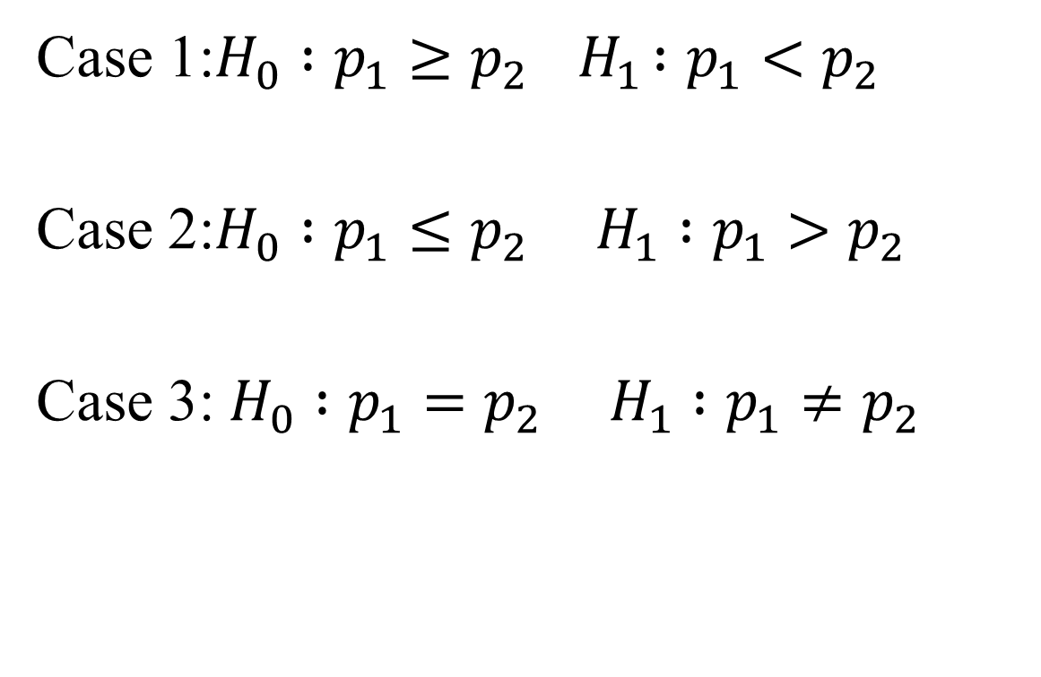
Testing for the difference between two independent population proportions
Case 1:$H_{0} :p_{1}≥p_{2}{ H}_{1} :p_{1}<p_{2}$
Case 2:$H_{0} :p_{1}≤p_{2} H_{1} :p_{1}>p_{2}$
Case 3: $H_{0} :p_{1}=p_{2} H_{1} :p_{1}≠p_{2}$

Slide 9
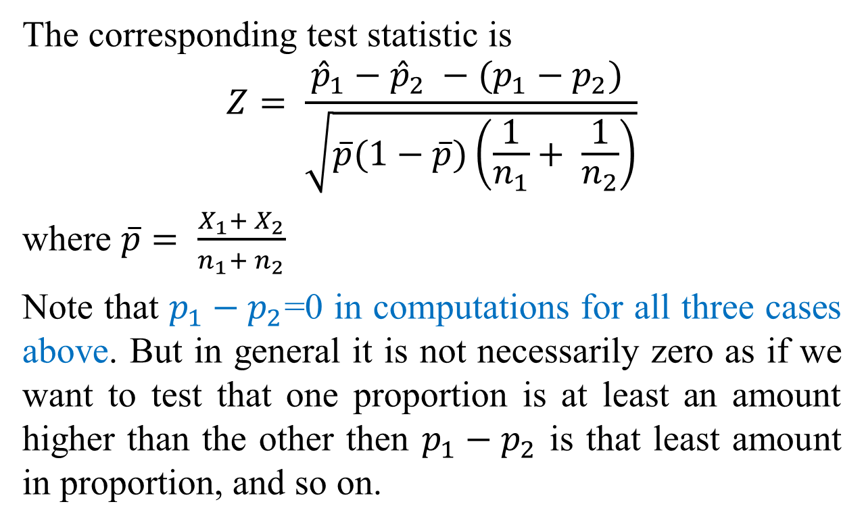
The corresponding test statistic is
$$Z= \frac{{\hat{p}}_{1}−{\hat{p}}_{2} −(p_{1}−p_{2}) }{\sqrt{\overline{p}(1−\overline{p})\left(\frac{1}{n_{1}}+ \frac{1}{n_{2}}\right)}}$$
where $\overline{p}= \frac{X_{1}+ X_{2}}{n_{1}+ n_{2}}$
Note that $p_{1}−p_{2}$=0 in computations for all three cases above. But in general it is not necessarily zero as if we want to test that one proportion is at least an amount higher than the other then $p_{1}−p_{2}$ is that least amount in proportion, and so on.

Slide 10
Example 2:
It is claimed that in the 2008 Democratic Presidential Nomination Primaries in USA, Senator Barack Obama was preferred by the black voters. To test the claim, a research firm sampled 600 black democrats and found that 384 support the senator and in another sample of 720 non-black democrats 417 support the senator. Test the claim using 5% level of significance.

Slide 11
Exercises

Slide 12
Comparing Two Independent Population Means

Slide 13
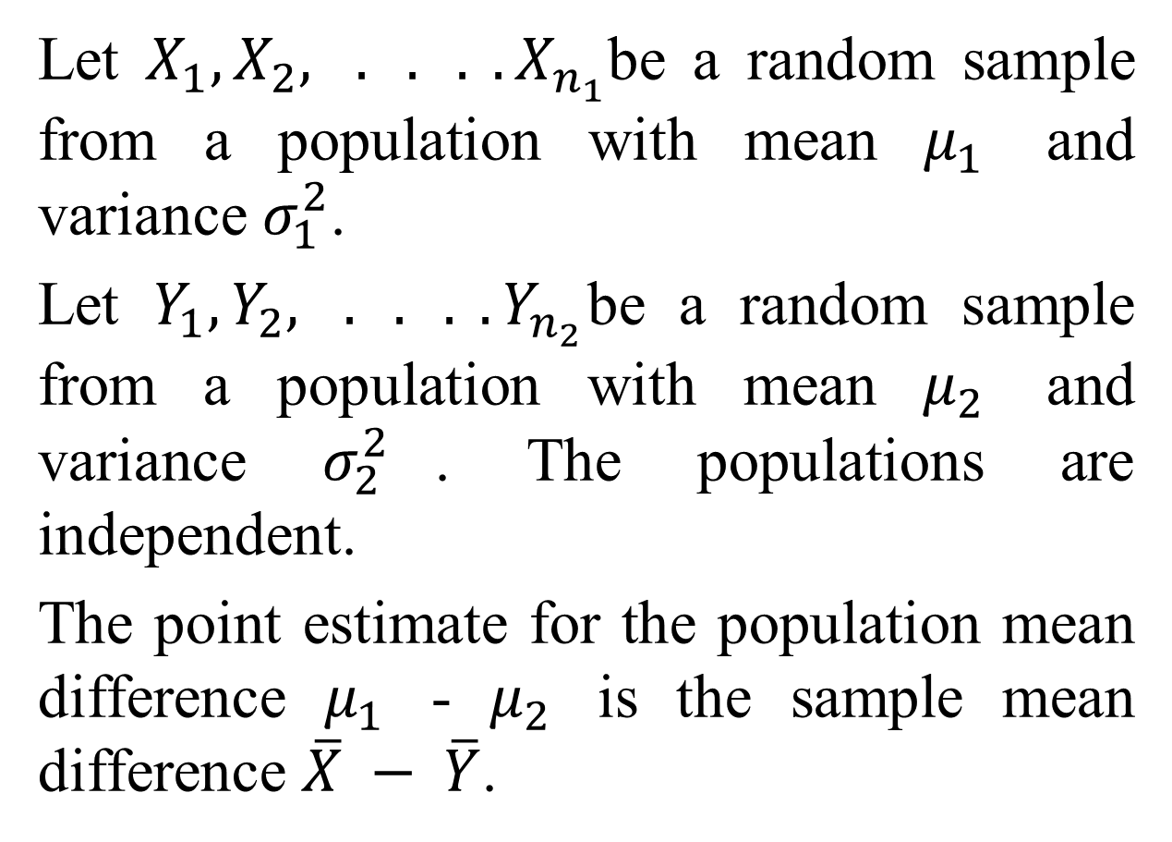
Let $X_{1},X_{2}, . . . .X_{n_{1}}$be a random sample from a population with mean $μ_{1}$ and variance $σ_{1}^{2}$.
Let $Y_{1},Y_{2}, . . . .Y_{n_{2}}$be a random sample from a population with mean $μ_{2}$ and variance $σ_{2}^{2}$. The populations are independent.
The point estimate for the population mean difference $μ_{1}$ - $μ_{2}$ is the sample mean difference $\overline{X} − \overline{Y}$.

Slide 14
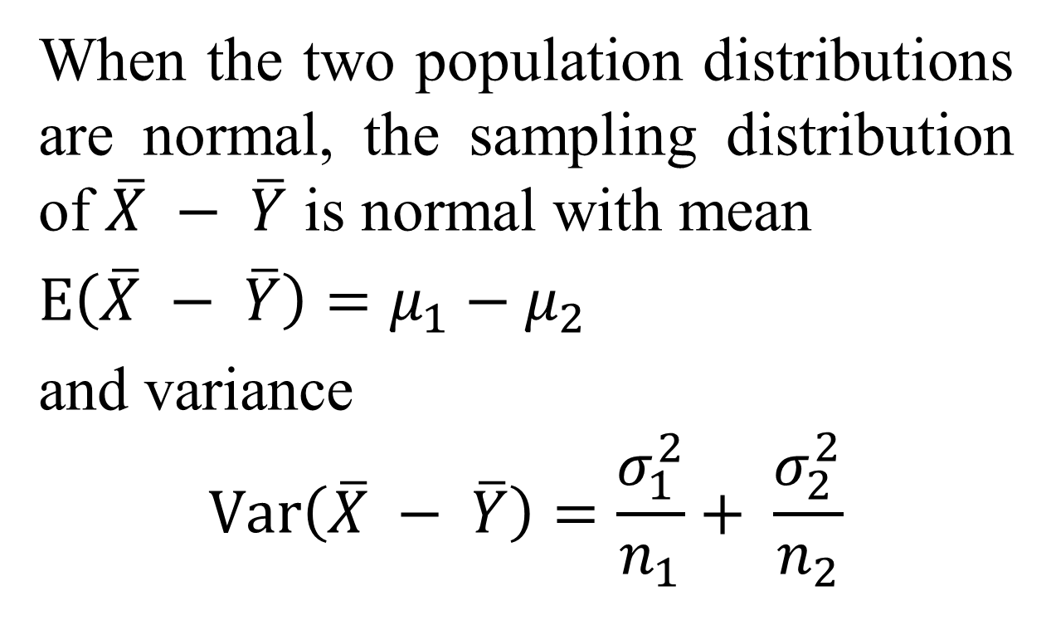
When the two population distributions are normal, the sampling distribution of $\overline{X} − \overline{Y}$ is normal with mean
$E\left(\overline{X} − \overline{Y}\right)=μ_{1}−μ_{2}$
and variance
$$Var\left(\overline{X} − \overline{Y}\right)=\frac{σ_{1}^{2}}{n_{1}}+ \frac{σ_{2 }^{2}}{n_{2}}$$

Slide 15
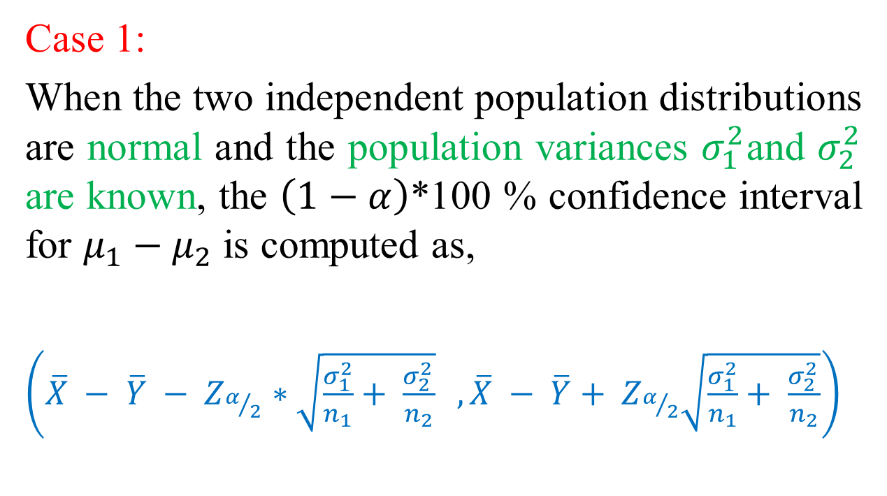
The confidence interval for the difference between the two-population means is computed as follows:
Case 1:
When the two independent population distributions are normal and the population variances $σ_{1}^{2}$and $σ_{2}^{2}$ are known, the $\left(1−α\right)$*100 % confidence interval for $μ_{1}−μ_{2}$ is computed as,
$\left(\overline{X} − \overline{Y} − Z_{α/2}∗\sqrt{\frac{σ_{1}^{2}}{n_{1}}+ \frac{σ_{2 }^{2}}{n_{2}}} ,\overline{X} − \overline{Y}+ Z_{α/2}\sqrt{\frac{σ_{1}^{2}}{n_{1}}+ \frac{σ_{2 }^{2}}{n_{2}}}\right)$

Slide 16
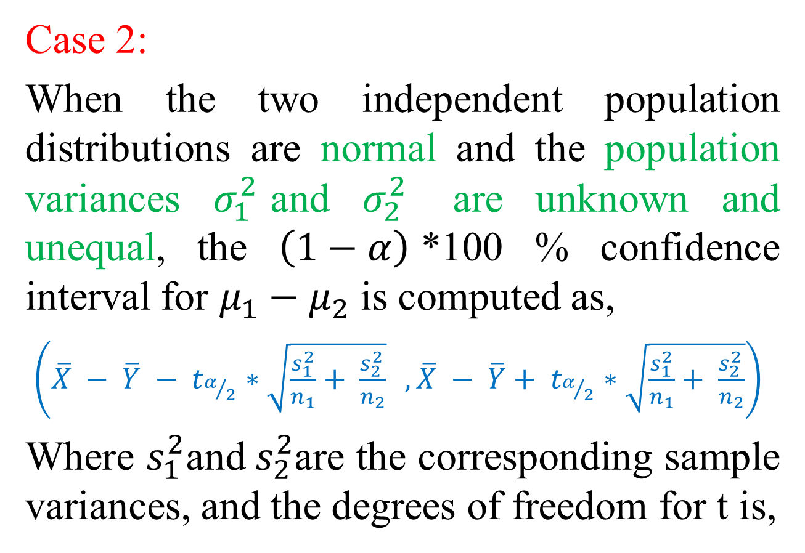
Case 2:
When the two independent population distributions are normal and the population variances $σ_{1}^{2}$and $σ_{2}^{2}$ are unknown and unequal, the $\left(1−α\right)$*100 % confidence interval for $μ_{1}−μ_{2}$ is computed as,
$\left(\overline{X} − \overline{Y} − t_{α/2}∗\sqrt{\frac{s_{1}^{2}}{n_{1}}+ \frac{s_{2 }^{2}}{n_{2}}} ,\overline{X} − \overline{Y}+ t_{α/2}∗\sqrt{\frac{s_{1}^{2}}{n_{1}}+ \frac{s_{2 }^{2}}{n_{2}}}\right)$
Where $s_{1}^{2}$and${ s}_{2}^{2}$are the corresponding sample variances, and the degrees of freedom for t is,

Slide 17
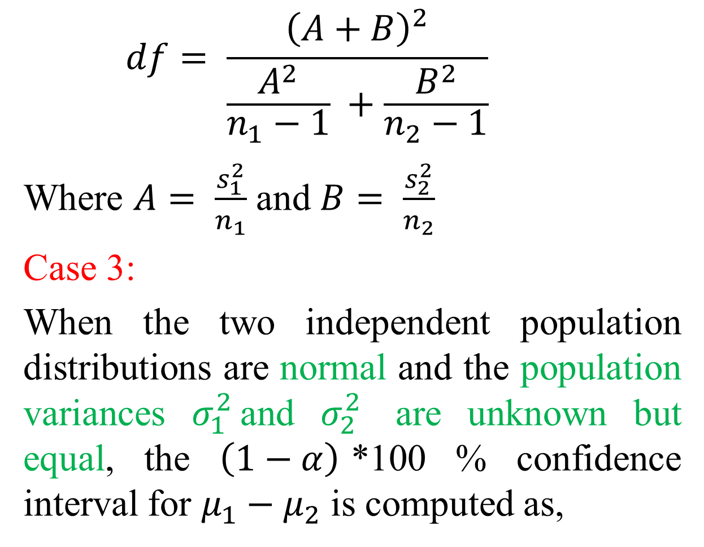
$$df= \frac{{\left(A+B\right)}^{2}}{\frac{A^{2}}{n_{1}−1} +\frac{B^{2}}{n_{2}−1}}$$
Where $A= \frac{s_{1}^{2}}{n_{1}}$ and $B= \frac{s_{2}^{2}}{n_{2}}$
Case 3:
When the two independent population distributions are normal and the population variances $σ_{1}^{2}$and $σ_{2}^{2}$ are unknown but equal, the $\left(1−α\right)$*100 % confidence interval for $μ_{1}−μ_{2}$ is computed as,

Slide 18
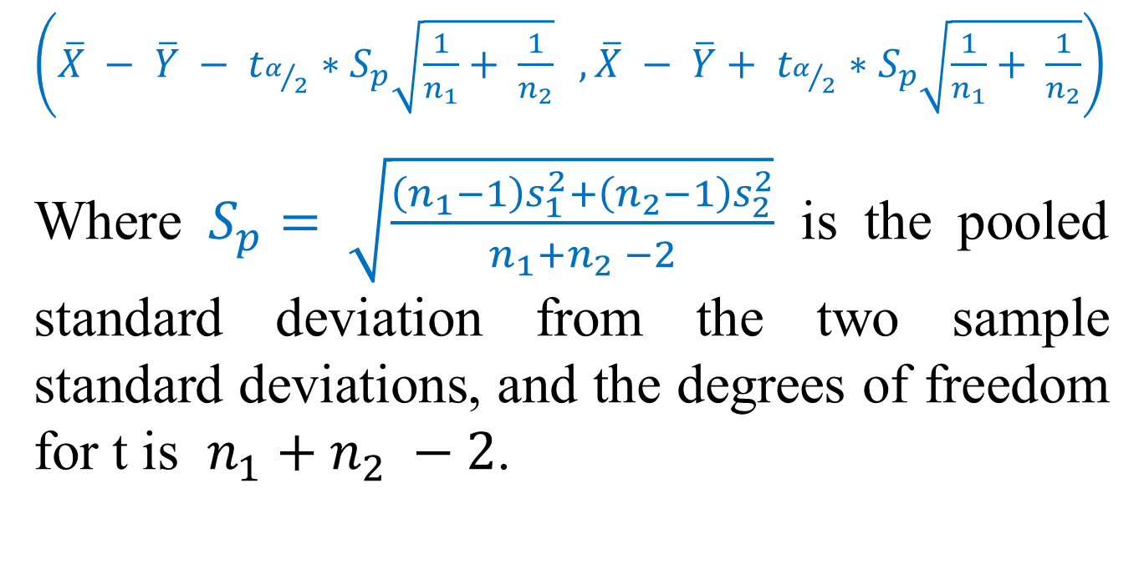
$\left(\overline{X} − \overline{Y} − t_{α/2}∗S_{p}\sqrt{\frac{1}{n_{1}}+ \frac{1}{n_{2}}} ,\overline{X} − \overline{Y}+ t_{α/2}∗S_{p}\sqrt{\frac{1}{n_{1}}+ \frac{1}{n_{2}}}\right)$
Where $S_{p}= \sqrt{\frac{\left(n_{1}−1\right)s_{1}^{2}+\left(n_{2}−1\right)s_{2}^{2}}{n_{1}+n_{2} −2}}$ is the pooled standard deviation from the two sample standard deviations, and the degrees of freedom for t is $n_{1}+n_{2} −2$.

Slide 19
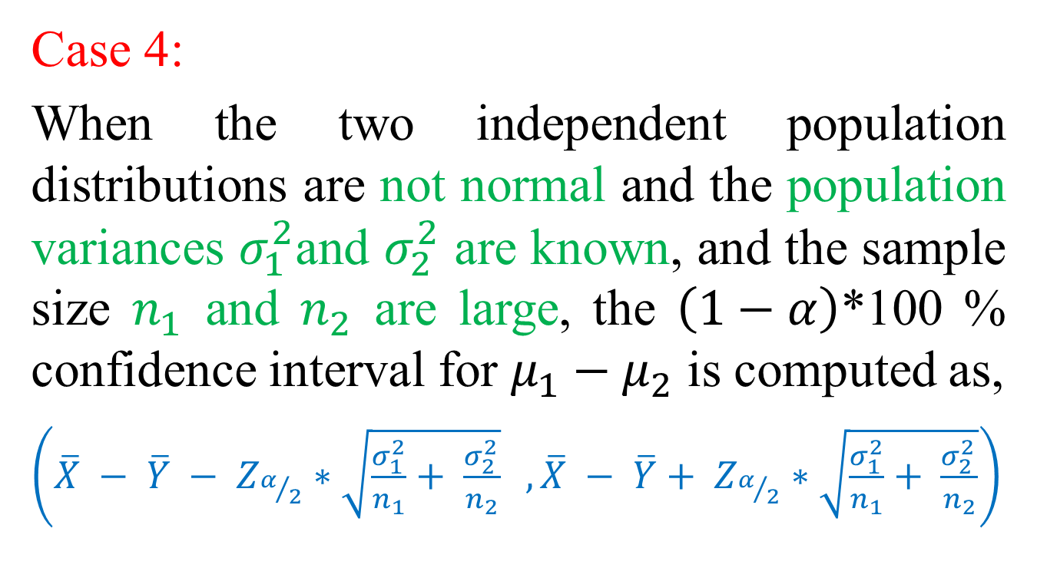
Case 4:
When the two independent population distributions are not normal and the population variances $σ_{1}^{2}$and $σ_{2}^{2}$ are known, and the sample size $n_{1}$ and $n_{2}$ are large, the $\left(1−α\right)$*100 % confidence interval for $μ_{1}−μ_{2}$ is computed as,
$\left(\overline{X} − \overline{Y} − Z_{α/2}∗\sqrt{\frac{σ_{1}^{2}}{n_{1}}+ \frac{σ_{2 }^{2}}{n_{2}}} ,\overline{X} − \overline{Y}+ Z_{α/2}∗\sqrt{\frac{σ_{1}^{2}}{n_{1}}+ \frac{σ_{2 }^{2}}{n_{2}}}\right)$

Slide 20
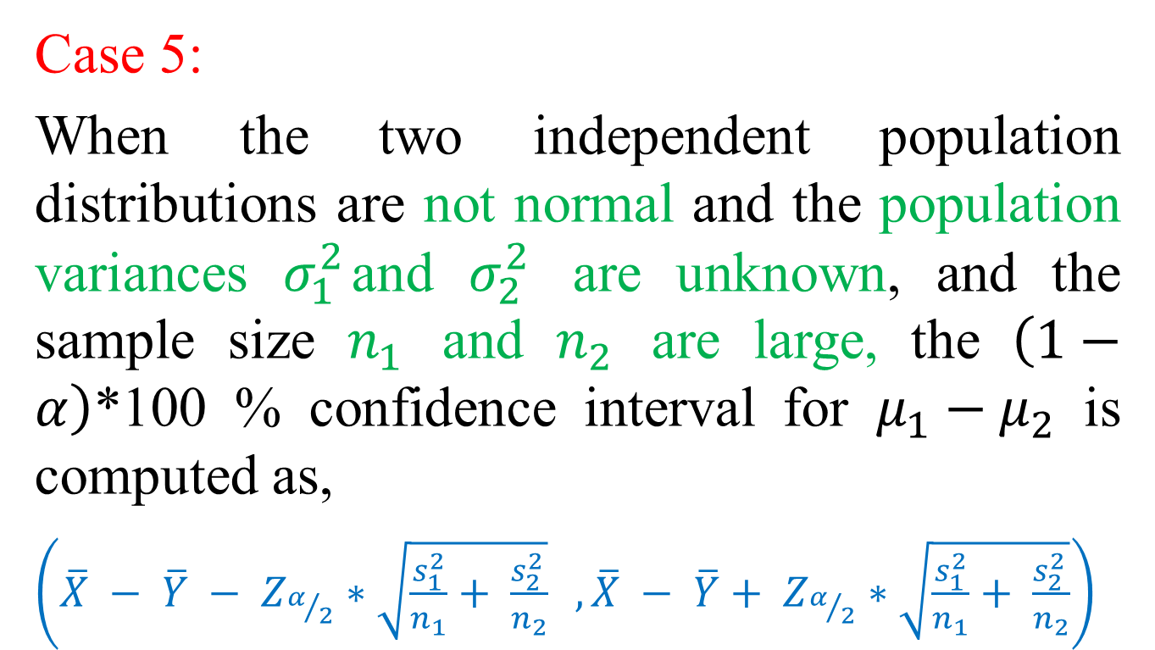
Case 5:
When the two independent population distributions are not normal and the population variances $σ_{1}^{2}$and $σ_{2}^{2}$ are unknown, and the sample size $n_{1}$ and $n_{2}$ are large, the $\left(1−α\right)$*100 % confidence interval for $μ_{1}−μ_{2}$ is computed as,
$\left(\overline{X} − \overline{Y} − Z_{α/2}∗\sqrt{\frac{s_{1}^{2}}{n_{1}}+ \frac{s_{2 }^{2}}{n_{2}}} ,\overline{X} − \overline{Y}+ Z_{α/2}∗\sqrt{\frac{s_{1}^{2}}{n_{1}}+ \frac{s_{2 }^{2}}{n_{2}}}\right)$

Slide 21

Example 3:
Two different types of drugs ‘A’ and ‘B’ are tried on certain patients for increasing weight. Five randomly selected patients were given drug ‘A’, and 7 randomly selected patients were given drug ‘B’. The increases in weight (in pounds) are given below:
Drug ‘A’: 8 12 13 9 3
Drug ‘B’: 10 8 12 15 6 8 11
Assume that the population distributions of the measurements are normal with equal variances. Construct a 95% confidence interval for the difference between the two means.

Slide 22
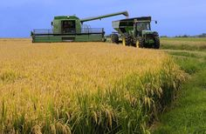
Example 4:
To test effect of a fertilizer on rice production, 64 plots of land having equal areas were chosen. Half of these plots were treated with fertilizer and the other half were untreated. Other conditions were the same. The mean yield of rice on the untreated plots was 4.8 quintals with a standard deviation of 0.4 quintal, while the mean yield on the treated plots was 5.1 quintals with a standard deviation of 0.36 quintal. Construct a 94% confidence interval estimate for the mean difference between the untreated plots and treated plots.

Slide 23
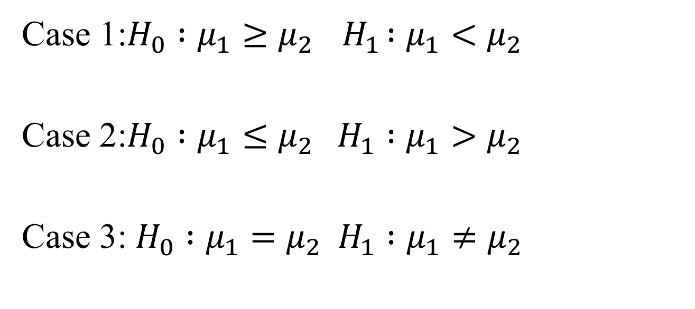
Testing for the difference between two independent population means
Case 1:$H_{0} :μ_{1}≥μ_{2}{ H}_{1} :μ_{1}<μ_{2}$
Case 2:$H_{0} :μ_{1}≤μ_{2} H_{1} :μ_{1}>μ_{2}$
Case 3: $H_{0} :μ_{1}=μ_{2} H_{1} :μ_{1}≠μ_{2}$

Slide 24
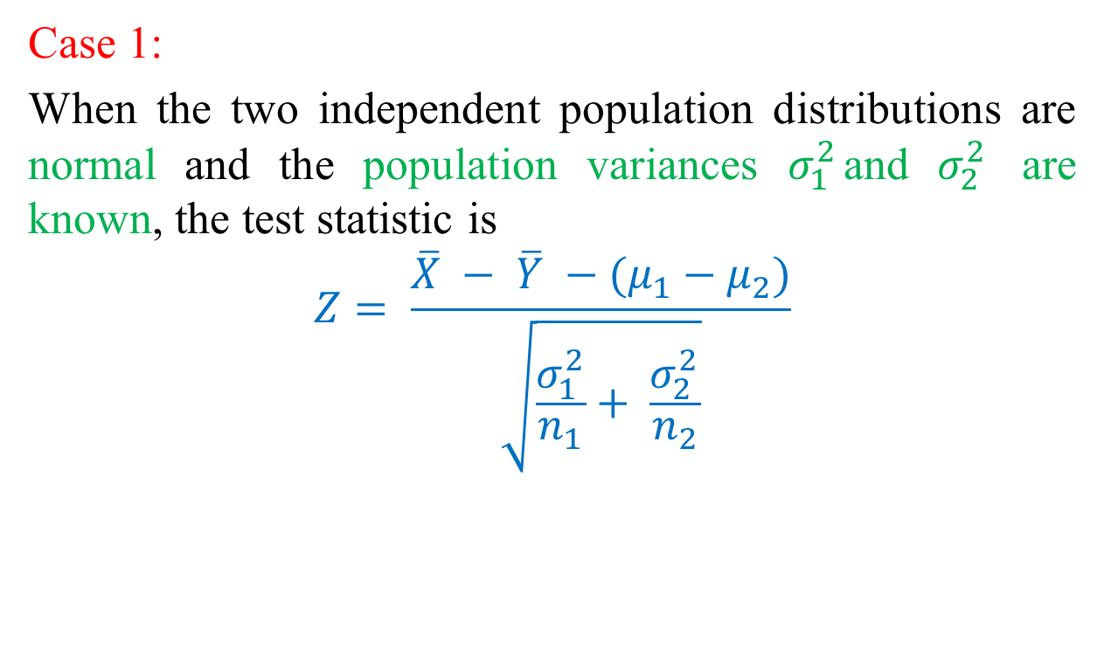
Case 1:
When the two independent population distributions are normal and the population variances $σ_{1}^{2}$and $σ_{2}^{2}$ are known, the test statistic is
$$Z= \frac{\overline{X} − \overline{Y} −(μ_{1}−μ_{2})}{\sqrt{\frac{σ_{1}^{2}}{n_{1}}+ \frac{σ_{2 }^{2}}{n_{2}}}}$$

Slide 25
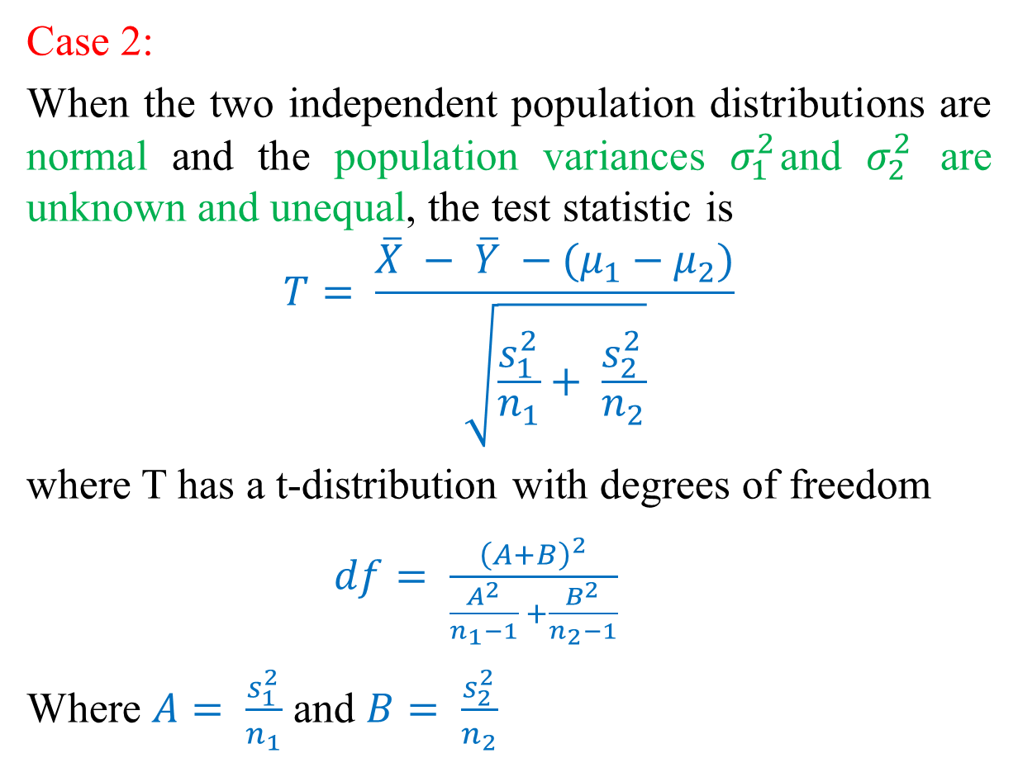
Case 2:
When the two independent population distributions are normal and the population variances $σ_{1}^{2}$and $σ_{2}^{2}$ are unknown and unequal, the test statistic is
$$T= \frac{\overline{X} − \overline{Y} −(μ_{1}−μ_{2})}{\sqrt{\frac{s_{1}^{2}}{n_{1}}+ \frac{s_{2 }^{2}}{n_{2}}}}$$
where T has a t-distribution with degrees of freedom
$df= \frac{{\left(A+B\right)}^{2}}{\frac{A^{2}}{n_{1}−1} +\frac{B^{2}}{n_{2}−1}}$
Where $A= \frac{s_{1}^{2}}{n_{1}}$ and $B= \frac{s_{2}^{2}}{n_{2}}$

Slide 26
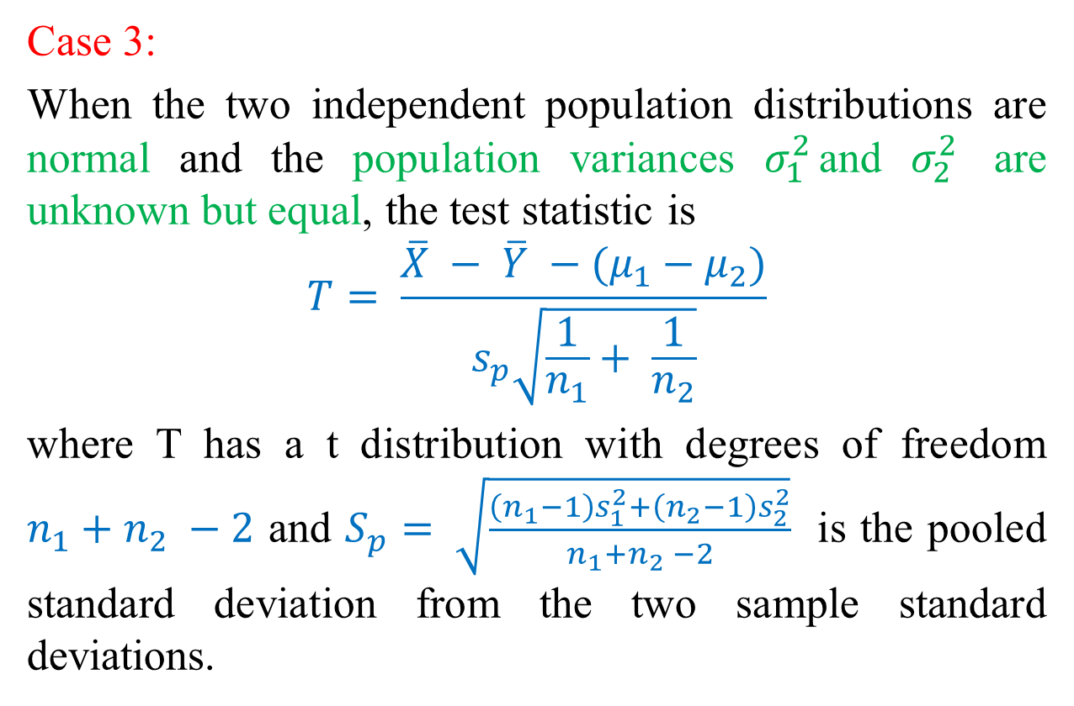
Case 3:
When the two independent population distributions are normal and the population variances $σ_{1}^{2}$and $σ_{2}^{2}$ are unknown but equal, the test statistic is
$$T= \frac{\overline{X} − \overline{Y} −(μ_{1}−μ_{2})}{s_{p}\sqrt{\frac{1}{n_{1}}+ \frac{1}{n_{2}}}}$$
where T has a t distribution with degrees of freedom $n_{1}+n_{2} −2$ and $S_{p}= \sqrt{\frac{\left(n_{1}−1\right)s_{1}^{2}+\left(n_{2}−1\right)s_{2}^{2}}{n_{1}+n_{2} −2}}$ is the pooled standard deviation from the two sample standard deviations.

Slide 27
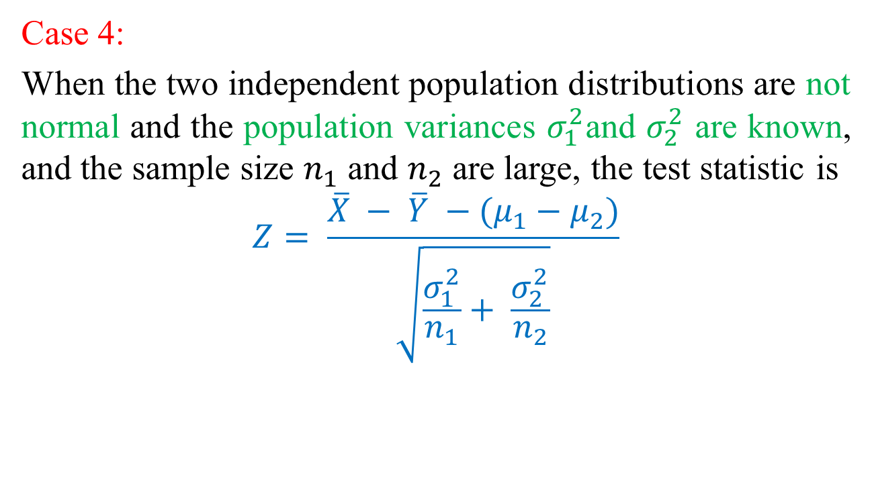
Case 4:
When the two independent population distributions are not normal and the population variances $σ_{1}^{2}$and $σ_{2}^{2}$ are known, and the sample size $n_{1}$ and $n_{2}$ are large, the test statistic is
$$Z= \frac{\overline{X} − \overline{Y} −(μ_{1}−μ_{2})}{\sqrt{\frac{σ_{1}^{2}}{n_{1}}+ \frac{σ_{2 }^{2}}{n_{2}}}}$$

Slide 28
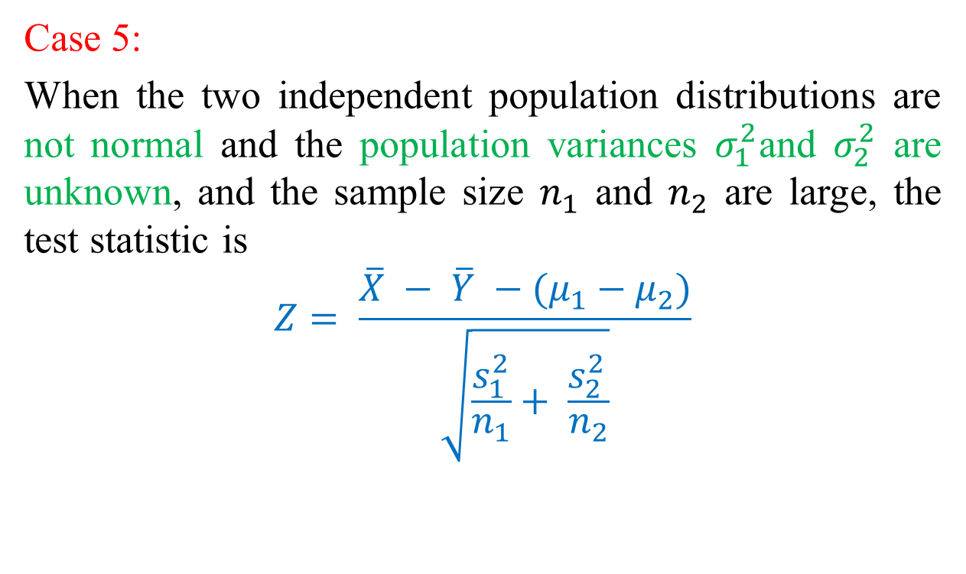
Case 5:
When the two independent population distributions are not normal and the population variances $σ_{1}^{2}$and $σ_{2}^{2}$ are unknown, and the sample size $n_{1}$ and $n_{2}$ are large, the test statistic is
$$Z= \frac{\overline{X} − \overline{Y} −(μ_{1}−μ_{2})}{\sqrt{\frac{s_{1}^{2}}{n_{1}}+ \frac{s_{2 }^{2}}{n_{2}}}}$$

Slide 29
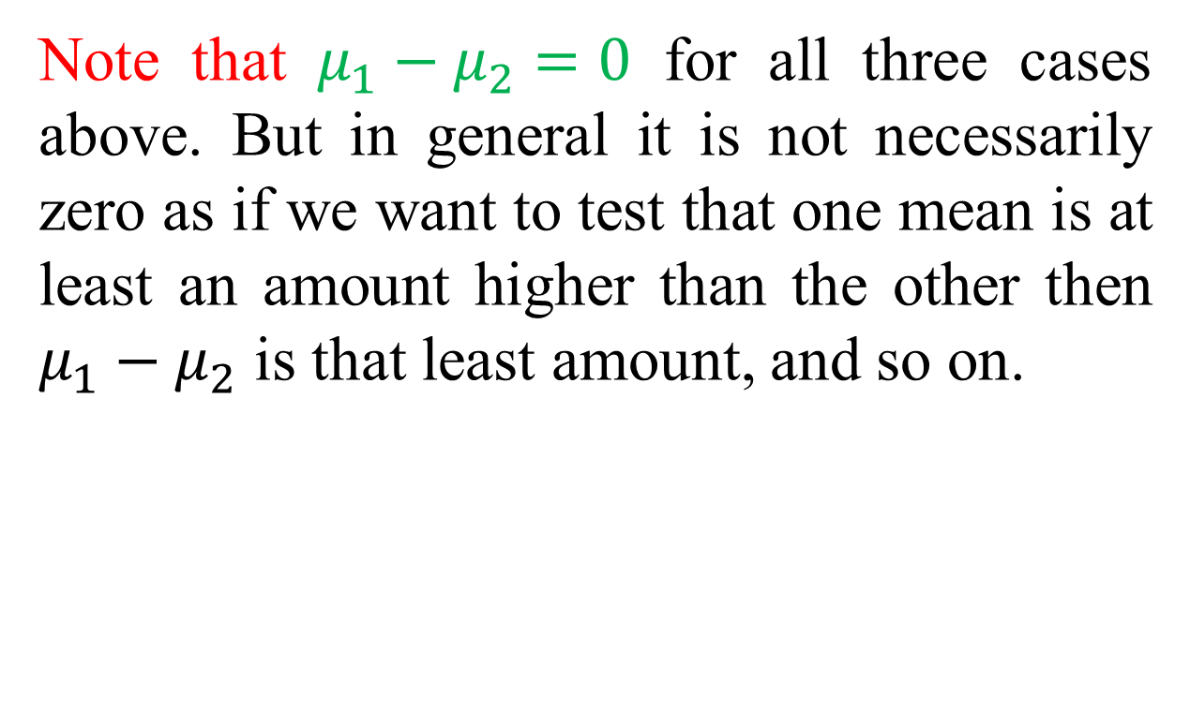
Note that $μ_{1}−μ_{2}=0$ for all three cases above. But in general it is not necessarily zero as if we want to test that one mean is at least an amount higher than the other then $μ_{1}−μ_{2}$ is that least amount, and so on.

Slide 30
Example 5:
Two different types of drugs ‘A’ and ‘B’ are tried on certain patients for increasing weight. Five randomly selected patients were given drug ‘A’ and 7 randomly selected patients were given drug ‘B’. The increases in weight (in pounds) are given below:
Drug ‘A’: 8 12 13 9 3
Drug ‘B’: 10 8 12 15 6 8 11
Assume that the population distributions of the measurements are normal with equal variances. Do the two drugs differ significantly with regard to their effect in increasing weight? Use 0.05 significance level.

Slide 31
Example 6:
To test effect of a fertilizer on rice production, 64 plots of land having equal areas were chosen. Half of these plots were treated with fertilizer and the other half were untreated. Other conditions were the same. The mean yield of rice on the untreated plots was 4.8 quintals with a standard deviation of 0.4 quintal, while the mean yield on the treated plots was 5.1 quintals with a standard deviation of 0.36 quintal. Can we conclude that there is a significant improvement in rice production because of the fertilizer at 4% level of significance?

Slide 32
Example :
An urban economist wanted to determine whether the mean price of a home in Lemont is less than the mean price of a home in Naperville. A random sample of homes sold in each neighborhood results in the following statistics, where the means and standard deviations are in thousands of dollars:
Test the claim that housing is less expensive in Lemont than in Naperville at the 5% level of significance.

Slide 33
Exercises

Slide 34
Comparing Two Dependent or Matched Population Means

Slide 35
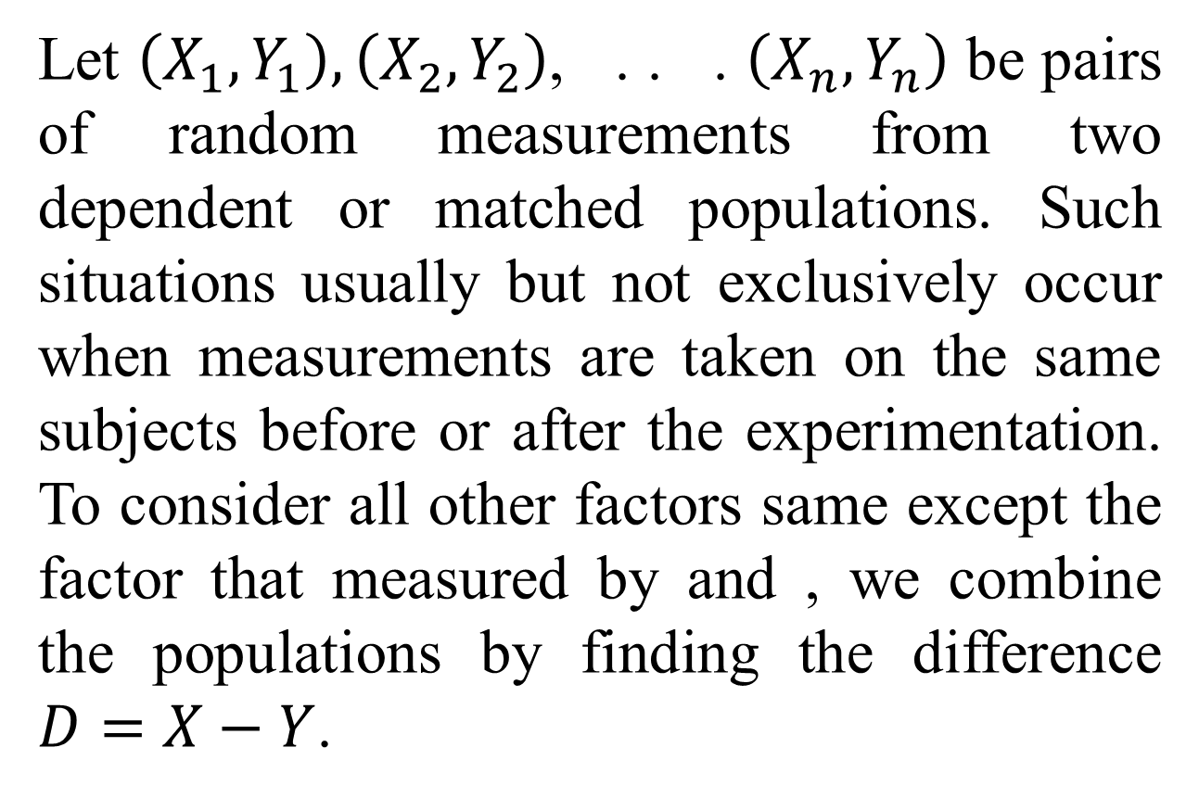
Let $\left(X_{1},Y_{1}\right),\left(X_{2},Y_{2}\right)$, . . . $\left(X_{n},Y_{n}\right)$ be pairs of random measurements from two dependent or matched populations. Such situations usually but not exclusively occur when measurements are taken on the same subjects before or after the experimentation. To consider all other factors same except the factor that measured by and , we combine the populations by finding the difference $D=X−Y$.

Slide 36
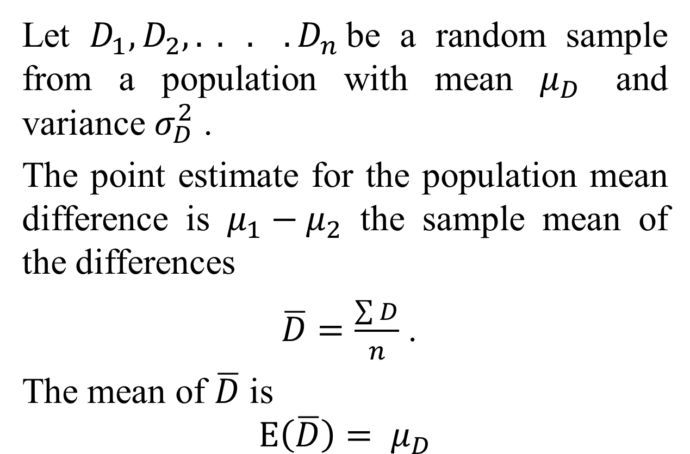
Let $D_{1},D_{2}, . . . .D_{n }$be a random sample from a population with mean $μ_{D}$ and variance $σ_{D}^{2}$ .
The point estimate for the population mean difference is $μ_{1}−μ_{2}$ the sample mean of the differences
$\overline{D}=\frac{\sum{D}}{n}$ .
The mean of $\overline{D}$ is
$$E\left(\overline{D}\right)= μ_{D}$$

Slide 37
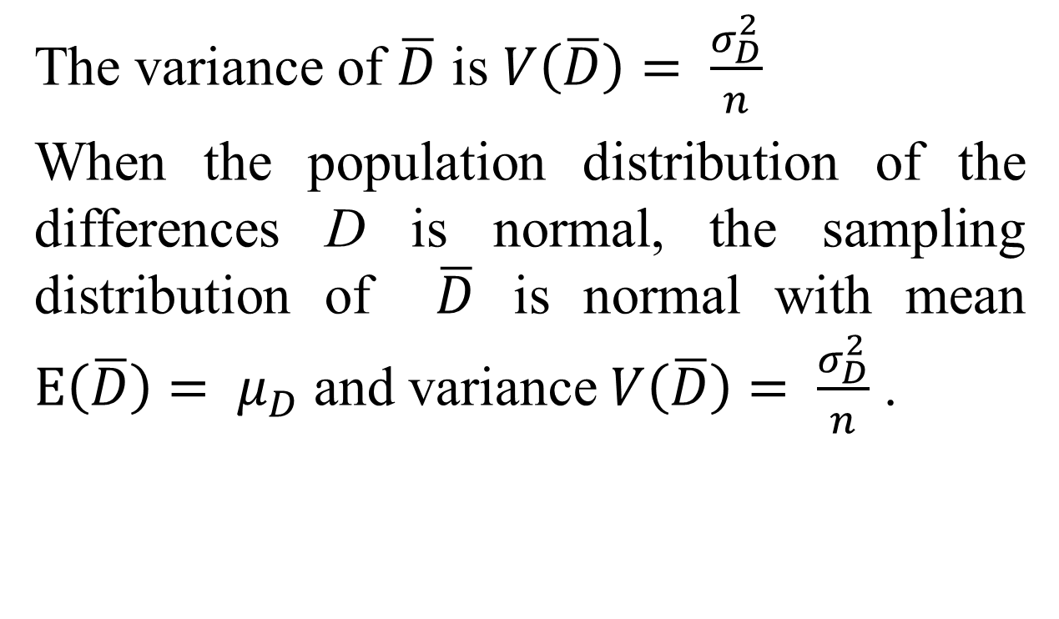
The variance of $\overline{D}$ is $V\left(\overline{D}\right)= \frac{σ_{D}^{2}}{n}$
When the population distribution of the differences D is normal, the sampling distribution of $\overline{D}$ is normal with mean $E\left(\overline{D}\right)= μ_{D}$ and variance $V\left(\overline{D}\right)= \frac{σ_{D}^{2}}{n}$ .

Slide 38
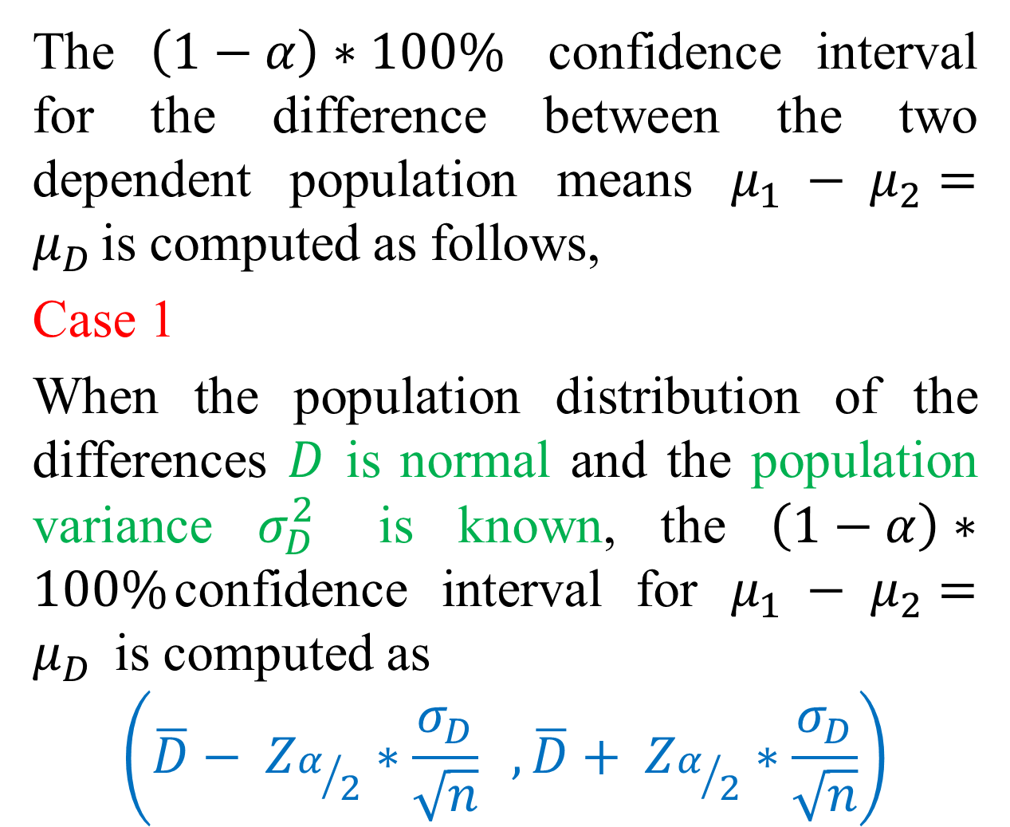
The $\left(1−α\right)∗100\%$ confidence interval for the difference between the two dependent population means $μ_{1} − μ_{2}=μ_{D }$is computed as follows,
Case 1
When the population distribution of the differences $D$ is normal and the population variance $σ_{D}^{2}$ is known, the $\left(1−α\right)∗100\%$confidence interval for $μ_{1} − μ_{2}=μ_{D }$ is computed as
$$\left(\overline{D}− Z_{α/2}∗\frac{σ_{D}}{\sqrt{n}} ,\overline{D}+ Z_{α/2}∗\frac{σ_{D}}{\sqrt{n}}\right)$$

Slide 39
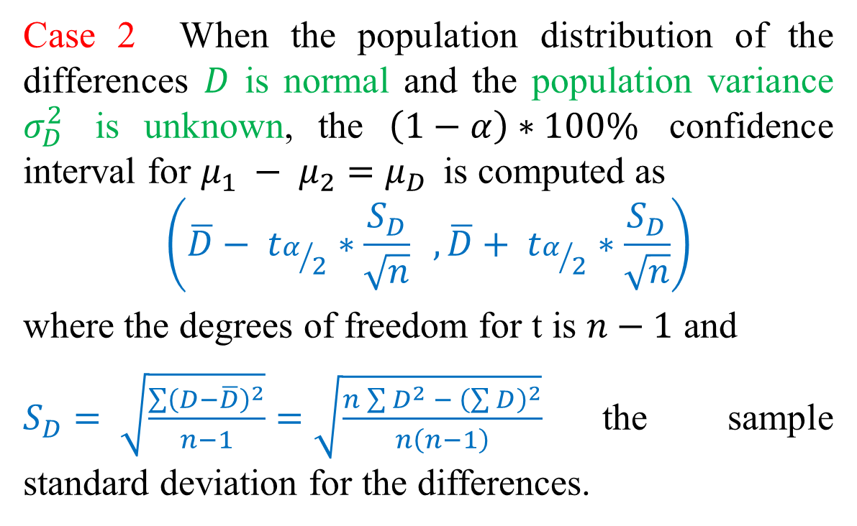
Case 2 When the population distribution of the differences $D$ is normal and the population variance $σ_{D}^{2}$ is unknown, the $\left(1−α\right)∗100\%$ confidence interval for $μ_{1} − μ_{2}=μ_{D }$ is computed as
$$\left(\overline{D}− t_{α/2}∗\frac{S_{D}}{\sqrt{n}} ,\overline{D}+ t_{α/2}∗\frac{S_{D}}{\sqrt{n}}\right)$$
where the degrees of freedom for t is $n−1$ and
$S_{D}= \sqrt{\frac{\sum{{\left(D−\overline{D}\right)}^{2}}}{n−1}}=\sqrt{\frac{n\sum{D^{2} − {\left(\sum{D}\right)}^{2}}}{n\left(n−1\right)}}$the sample standard deviation for the differences.

Slide 40
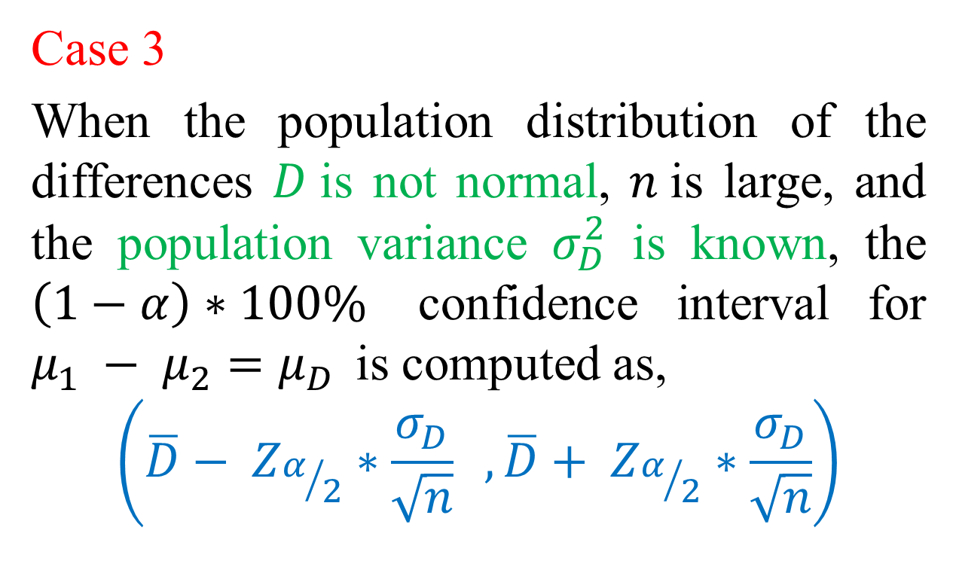
Case 3
When the population distribution of the differences $D$is not normal, $n$is large, and the population variance $σ_{D}^{2}$ is known, the $\left(1−α\right)∗100\%$ confidence interval for $μ_{1} − μ_{2}=μ_{D }$ is computed as,
$$\left(\overline{D}− Z_{α/2}∗\frac{σ_{D}}{\sqrt{n}} ,\overline{D}+ Z_{α/2}∗\frac{σ_{D}}{\sqrt{n}}\right)$$

Slide 41
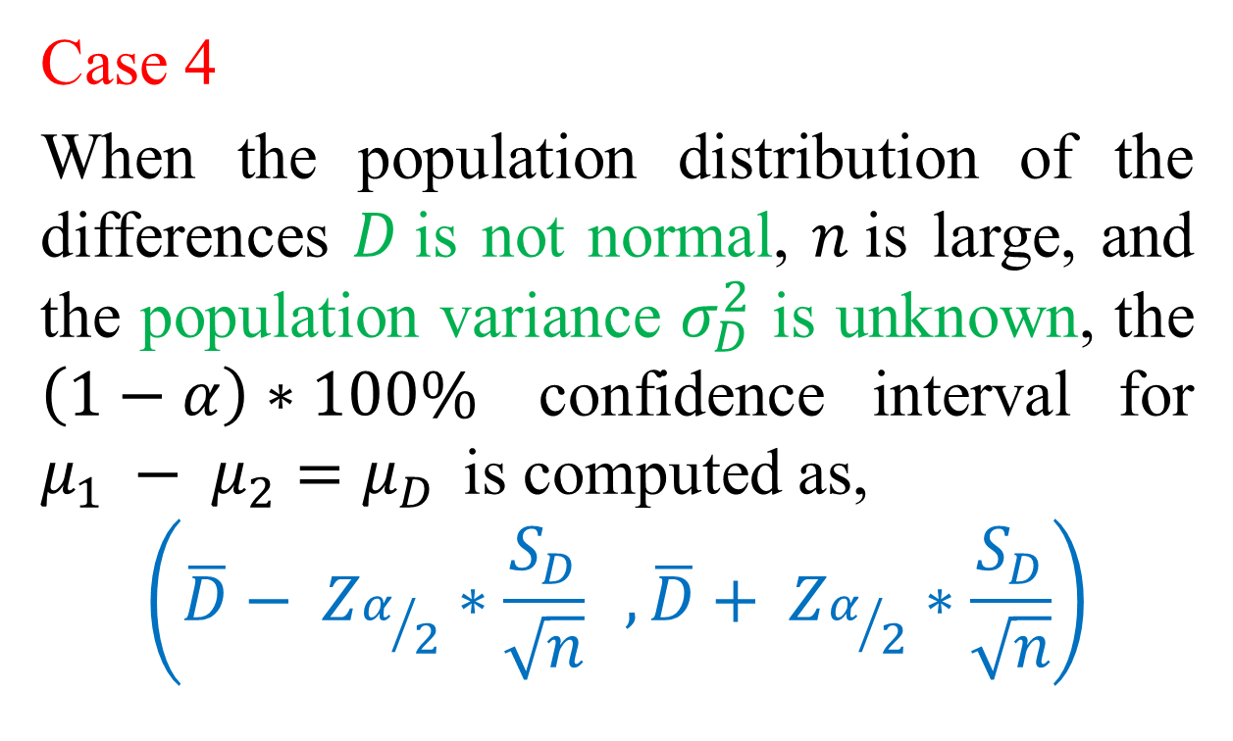
Case 4
When the population distribution of the differences $D$is not normal, $n$is large, and the population variance $σ_{D}^{2}$ is unknown, the $\left(1−α\right)∗100\%$ confidence interval for $μ_{1} − μ_{2}=μ_{D }$ is computed as,
$$\left(\overline{D}− Z_{α/2}∗\frac{S_{D}}{\sqrt{n}} ,\overline{D}+ Z_{α/2}∗\frac{S_{D}}{\sqrt{n}}\right)$$

Slide 42
Note that since the measurements are on the same subjects, if there is no real difference in terms of the factor of interest, the distributions of the differences are often normal. Hence the situation 2 is a very common phenomenon.

Slide 43
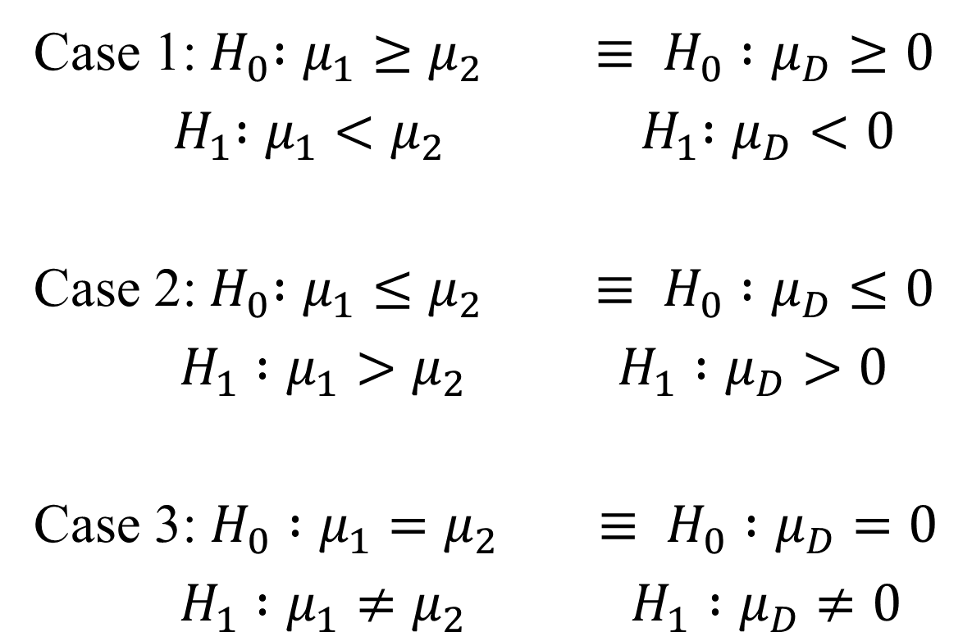
Testing for the difference between two dependent population means
Case 1:${ H}_{0} :μ_{1}≥μ_{2} ≡ H_{0} :μ_{D}≥0$
${ H}_{1} :μ_{1}<μ_{2}$ ${ H}_{1} :μ_{D}<0$
Case 2:${ H}_{0} :μ_{1}≤μ_{2} ≡ H_{0} :μ_{D}≤0$
$H_{1} :μ_{1}>μ_{2}$ $H_{1} :μ_{D}>0$
Case 3: $H_{0} :μ_{1}=μ_{2} ≡ H_{0} :μ_{D}=0$
$H_{1} :μ_{1}≠μ_{2}$ $H_{1} :μ_{D}≠0$

Slide 44
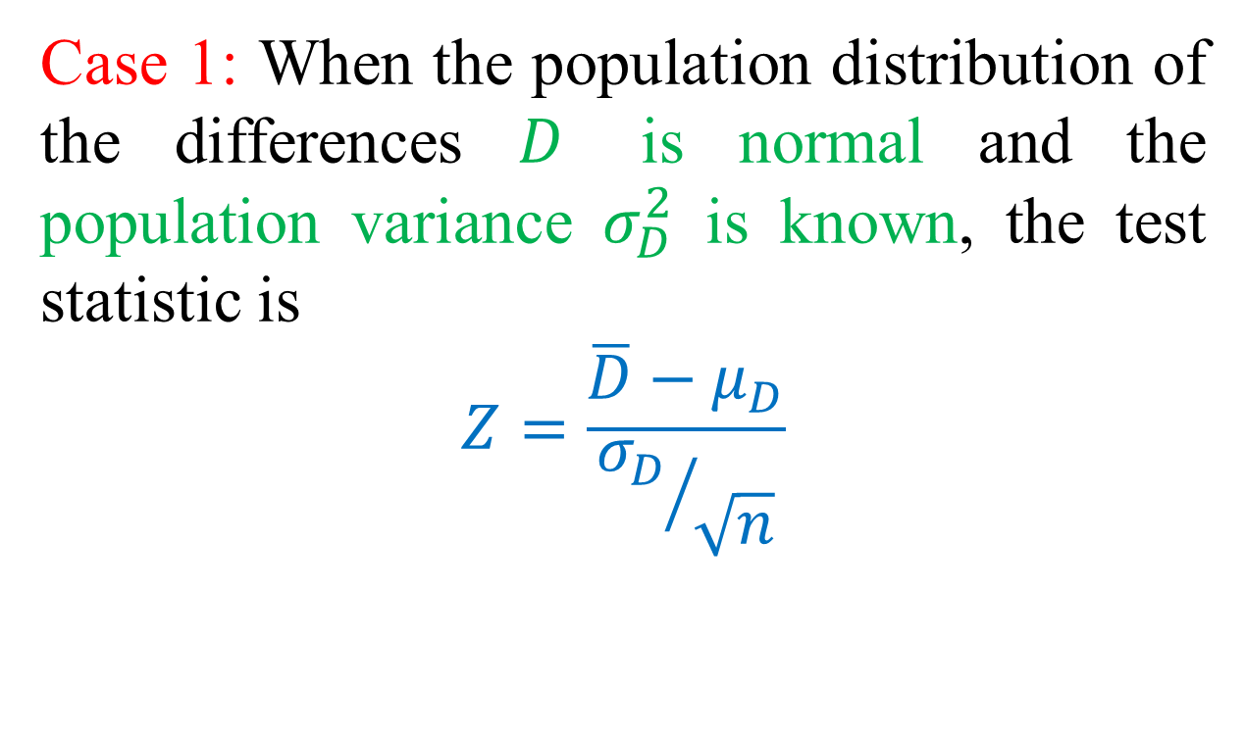
Case 1: When the population distribution of the differences $D$ is normal and the population variance $σ_{D}^{2}$ is known, the test statistic is
$$Z=\frac{\overline{D}−μ_{D}}{{σ_{D}}/{\sqrt{n}}}$$

Slide 45
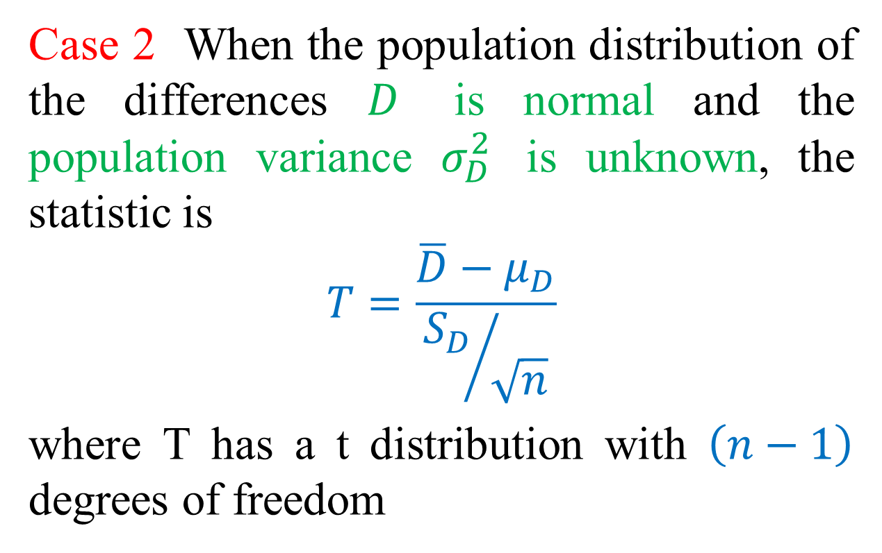
Case 2 When the population distribution of the differences $D$ is normal and the population variance $σ_{D}^{2}$ is unknown, the statistic is
$$T=\frac{\overline{D}−μ_{D}}{{S_{D}}/{\sqrt{n}}}$$
where T has a t distribution with $\left(n−1\right)$ degrees of freedom

Slide 46
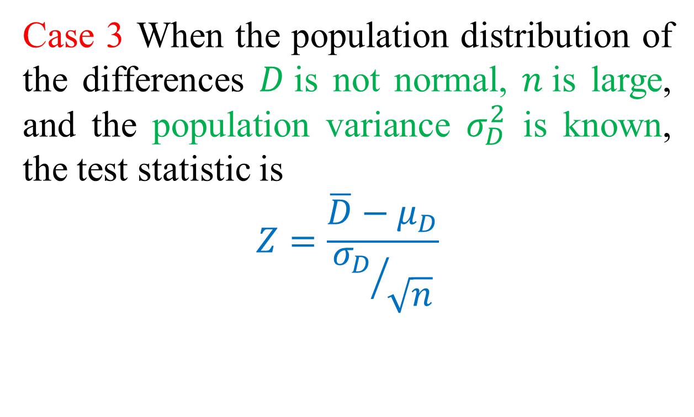
Case 3 When the population distribution of the differences $D$is not normal, $n$is large, and the population variance $σ_{D}^{2}$ is known, the test statistic is
$$Z=\frac{\overline{D}−μ_{D}}{{σ_{D}}/{\sqrt{n}}}$$

Slide 47
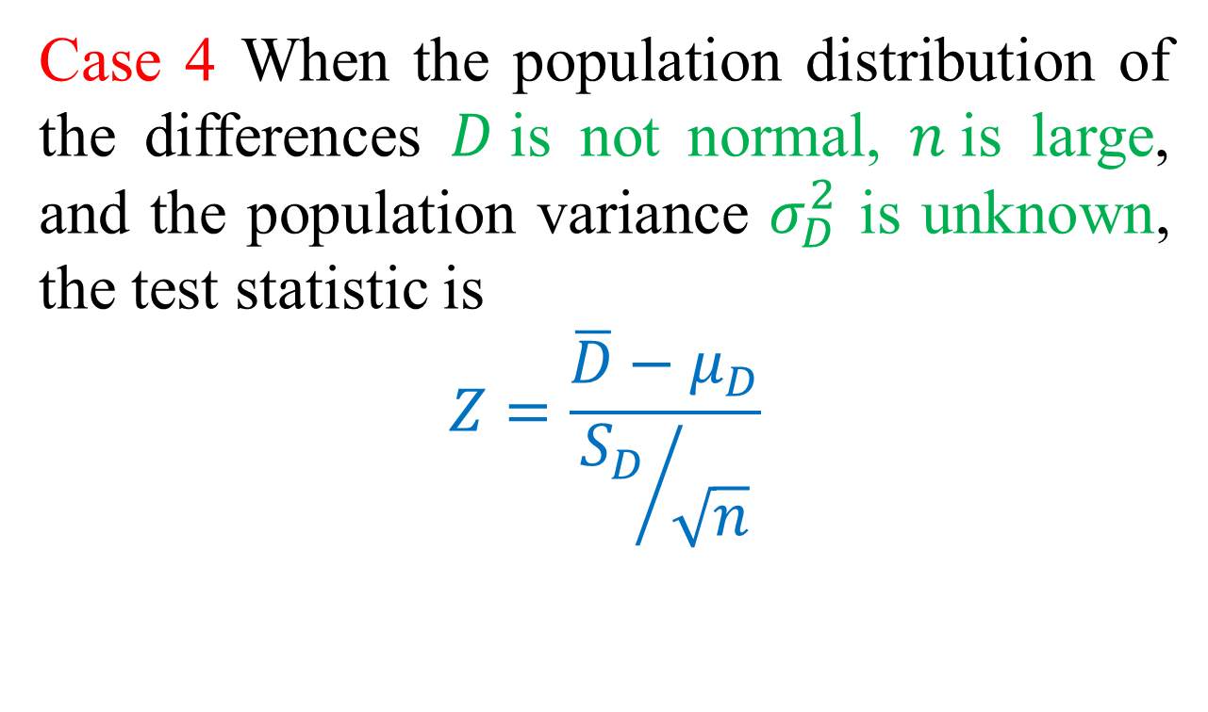
Case 4 When the population distribution of the differences $D$is not normal, $n$is large, and the population variance $σ_{D}^{2}$ is unknown, the test statistic is
$$Z=\frac{\overline{D}−μ_{D}}{{S_{D}}/{\sqrt{n}}}$$

Slide 48
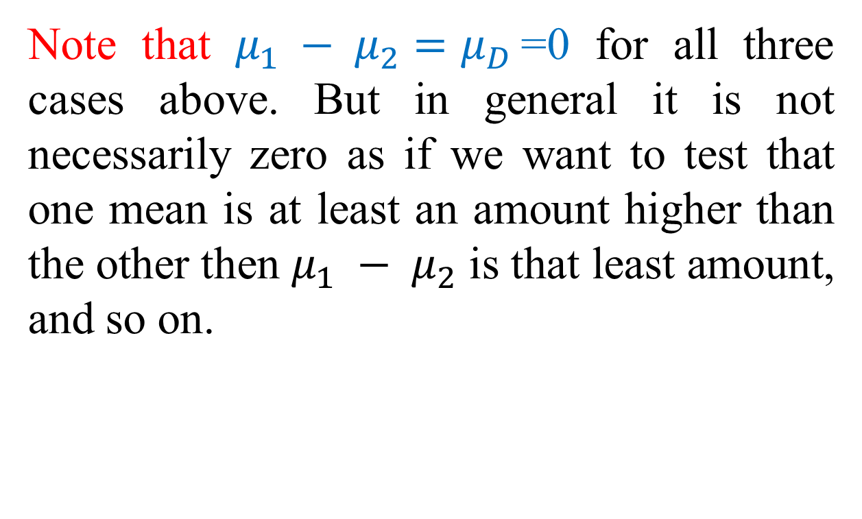
Note that $μ_{1} − μ_{2}=μ_{D }$=0 for all three cases above. But in general it is not necessarily zero as if we want to test that one mean is at least an amount higher than the other then $μ_{1} − μ_{2}$ is that least amount, and so on.

Slide 49
Example 7:
To compare the demand for two different entrees, the manager of a cafeteria recorded the number of purchases for each entrée on seven consecutive days. The data are shown in the next table: Since the cafeteria demands depend on days of the week, the data are considered to be related. Assume that the differences of the measurements follow a normal distribution.
 | Monday | Tuesday | Wednesday | Thursday | Friday | Saturday | Sunday
A | 420 | 374 | 434 | 395 | 637 | 594 | 679
B | 391 | 343 | 469 | 412 | 538 | 521 | 625

Slide 50
Construct a 95% confidence interval for the mean difference.
Test the hypothesis that the demand for item A is higher than the demand for item B. Use 5% level of significance.

Slide 51
Example:
A test preparation company claims that its SAT preparation course improves SAT math scores. The company administers the SAT to 9 randomly selected students and determines their scores. The same students then participate in the course. Upon completion, they retake the SAT. The results are presented below:
Before: 436 431 270 463 528 377 397 413 525
After: 443 429 287 501 522 380 402 450 548
Test the claim that the preparatory course improves SAT math scores at the 10% level of significance. (Assume that the differences between the scores have an approximate normal distribution.)

Slide 52
Exercises

Slide 53
Comparing Two Independent Population Variances

Slide 54
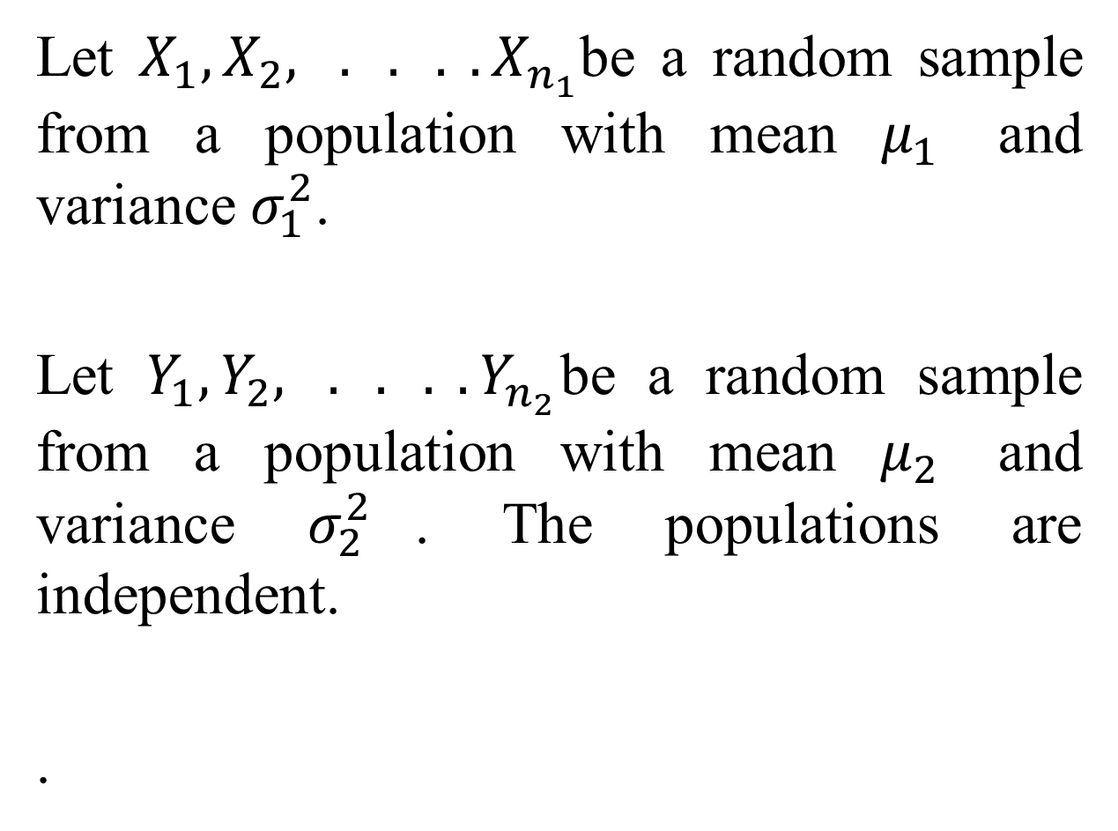
Let $X_{1},X_{2}, . . . .X_{n_{1}}$be a random sample from a population with mean $μ_{1}$ and variance $σ_{1}^{2}$.
Let $Y_{1},Y_{2}, . . . .Y_{n_{2}}$be a random sample from a population with mean $μ_{2}$ and variance $σ_{2}^{2}$. The populations are independent.
.

Slide 55
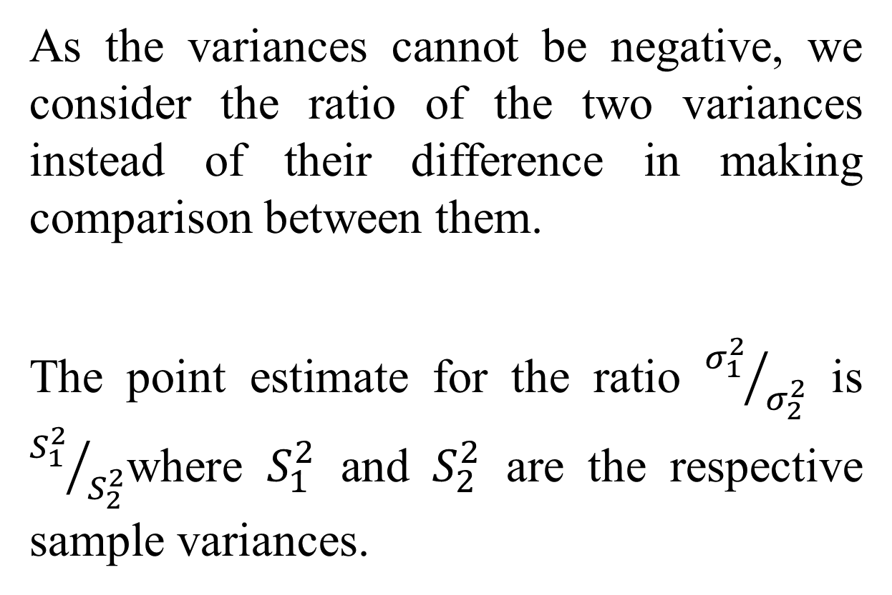
As the variances cannot be negative, we consider the ratio of the two variances instead of their difference in making comparison between them.
The point estimate for the ratio ${σ_{1}^{2}}/{σ_{2}^{2}}$ is ${S_{1}^{2}}/{S_{2}^{2}}$where $S_{1}^{2}$ and $S_{2}^{2}$ are the respective sample variances.

Slide 56
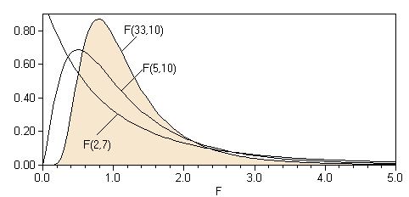
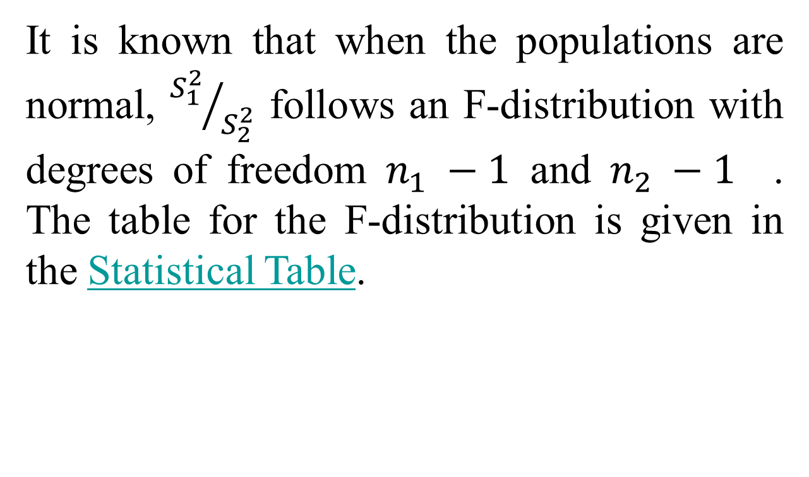
It is known that when the populations are normal, ${S_{1}^{2}}/{S_{2}^{2}}$ follows an F-distribution with degrees of freedom $n_{1} −1$ and $n_{2} −1$ . The table for the F-distribution is given in the Statistical Table.

Slide 57
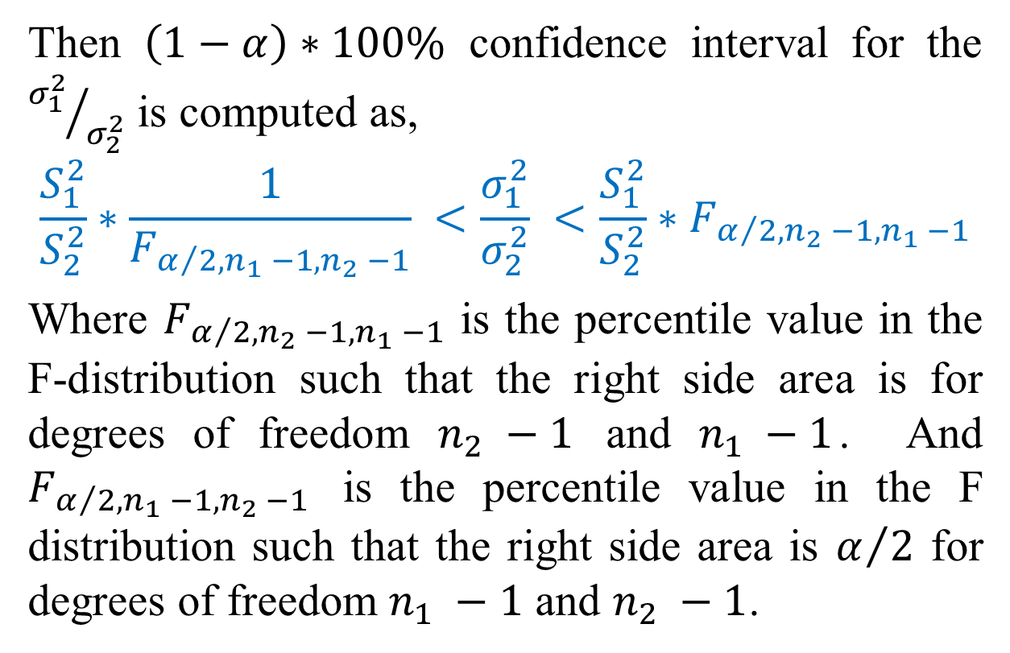
Then $\left(1−α\right)∗100\%$ confidence interval for the ${σ_{1}^{2}}/{σ_{2}^{2}}$ is computed as,
$$\frac{S_{1}^{2}}{S_{2}^{2}}∗\frac{1}{F_{α/2,n_{1} −1,n_{2} −1}} <\frac{σ_{1}^{2}}{σ_{2}^{2}} <\frac{S_{1}^{2}}{S_{2}^{2}}∗F_{α/2,n_{2} −1,n_{1} −1}$$
Where $F_{α/2,n_{2} −1,n_{1} −1}$ is the percentile value in the F-distribution such that the right side area is for degrees of freedom $n_{2} −1$ and $n_{1} −1$. And $F_{α/2,n_{1} −1,n_{2} −1}$ is the percentile value in the F distribution such that the right side area is $α/2$ for degrees of freedom $n_{1} −1$ and $n_{2} −1$.

Slide 58
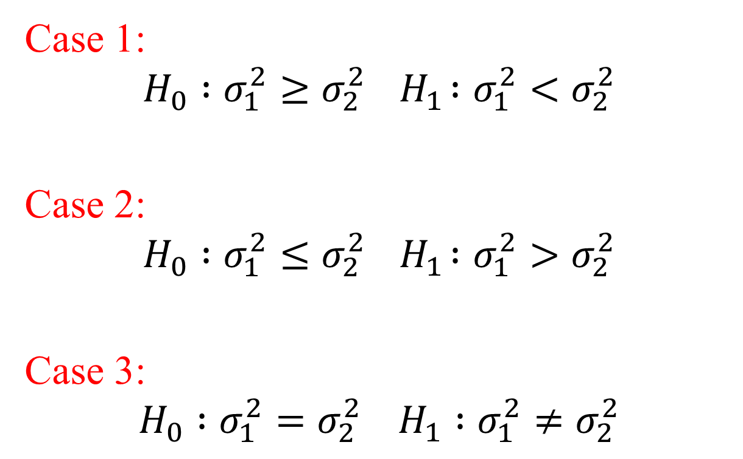
Testing for difference between two independent population variances,
Case 1:
$$H_{0} :σ_{1}^{2}≥σ_{2}^{2}{ H}_{1} :σ_{1}^{2}<σ_{2}^{2}$$
Case 2:
$$H_{0} :σ_{1}^{2}≤σ_{2}^{2}{ H}_{1} :σ_{1}^{2}>σ_{2}^{2}$$
Case 3:
$$H_{0} :σ_{1}^{2}=σ_{2}^{2} H_{1} :σ_{1}^{2}≠σ_{2}^{2}$$

Slide 59
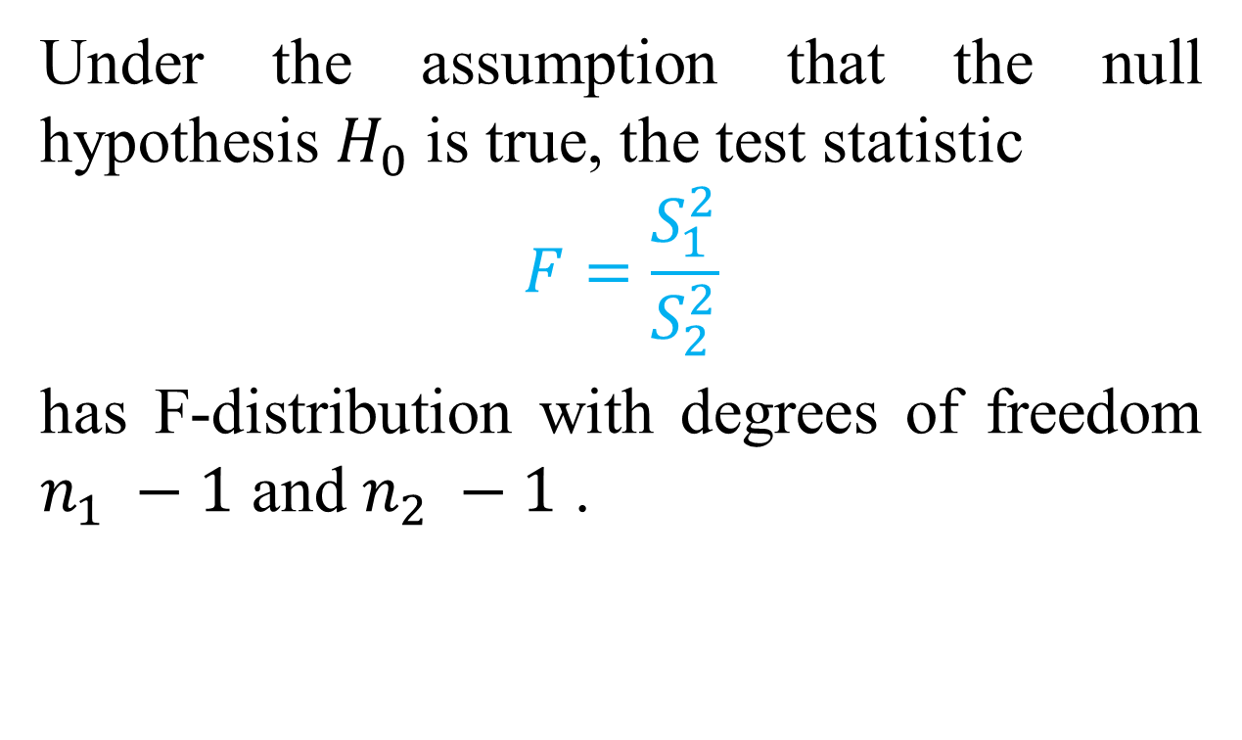
Under the assumption that the null hypothesis $H_{0}$ is true, the test statistic
$$F=\frac{S_{1}^{2}}{S_{2}^{2}}$$
has F-distribution with degrees of freedom $n_{1} −1$ and $n_{2} −1$ .

Slide 60
Example
Let us consider the final scores of the Author’s two different sections of the elementary statistics courses:
Section 1: 38, 88, 91, 84, 97, 78, 51, 90, 72, 73, 73, 55, 83, 72, 97, 33, 78, 91, 93, 65, 86, 81, 87, 81, 28, 74
Section 2: 64, 36, 87, 73, 72, 43, 90, 81, 79, 43, 77, 89, 91, 72, 75, 68, 78, 72, 81, 72, 35, 72, 93, 74, 85.
Assume that the samples are from independent normal populations.

Slide 61
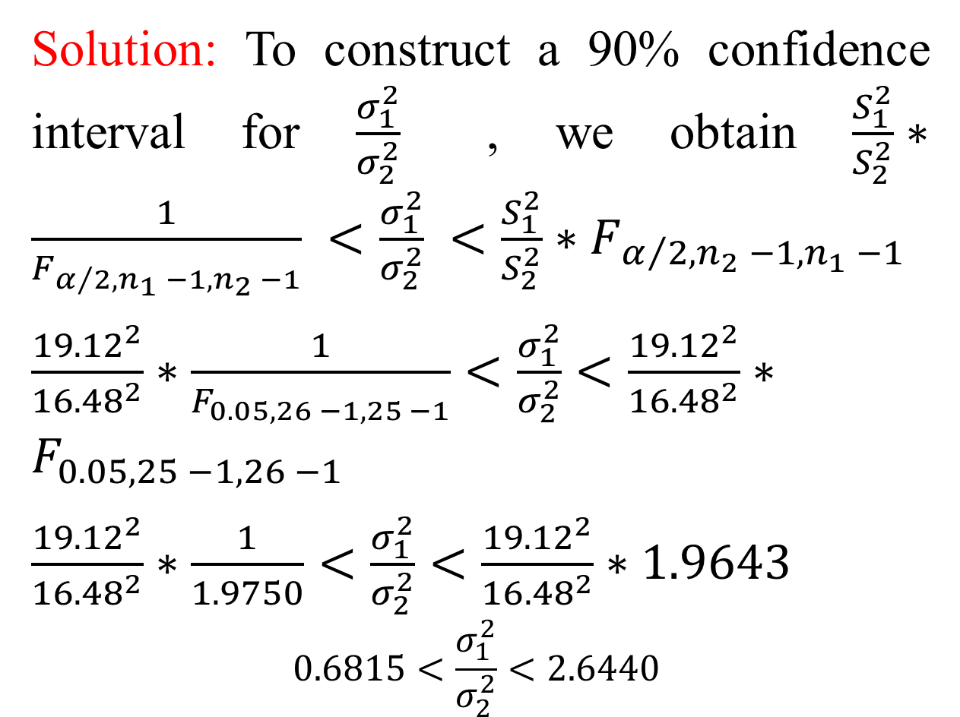
Solution: To construct a 90% confidence interval for $\frac{σ_{1}^{2}}{σ_{2}^{2}}$ , we obtain $\frac{S_{1}^{2}}{S_{2}^{2}}∗\frac{1}{F_{α/2,n_{1} −1,n_{2} −1}} <\frac{σ_{1}^{2}}{σ_{2}^{2}} <\frac{S_{1}^{2}}{S_{2}^{2}}∗F_{α/2,n_{2} −1,n_{1} −1}$
$\frac{{19.12}^{2}}{{16.48}^{2}}∗\frac{1}{F_{0.05,26 −1,25 −1}}<\frac{σ_{1}^{2}}{σ_{2}^{2}}<\frac{{19.12}^{2}}{{16.48}^{2}}∗F_{0.05,25 −1,26 −1}$
$\frac{{19.12}^{2}}{{16.48}^{2}}∗\frac{1}{1.9750}<\frac{σ_{1}^{2}}{σ_{2}^{2}}<\frac{{19.12}^{2}}{{16.48}^{2}}∗1.9643$
$$0.6815<\frac{σ_{1}^{2}}{σ_{2}^{2}}<2.6440$$

Slide 62
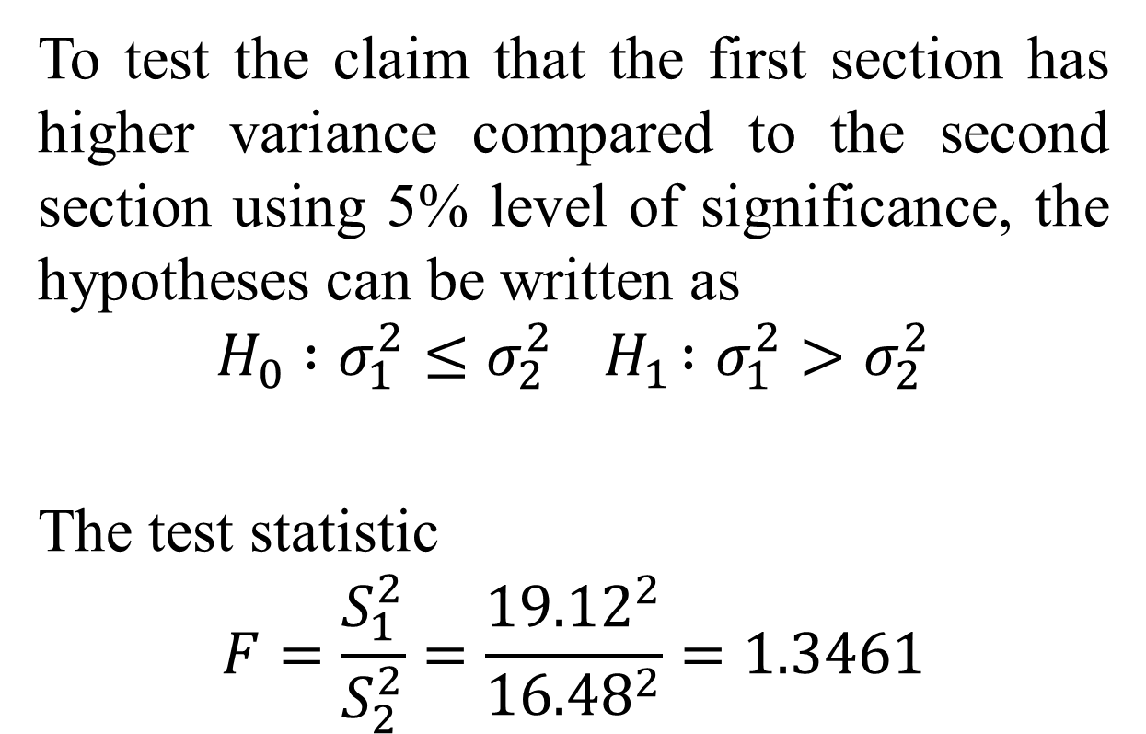
To test the claim that the first section has higher variance compared to the second section using 5% level of significance, the hypotheses can be written as
$$H_{0} :σ_{1}^{2}≤σ_{2}^{2}{ H}_{1} :σ_{1}^{2}>σ_{2}^{2}$$
The test statistic
$$F=\frac{S_{1}^{2}}{S_{2}^{2}}=\frac{{19.12}^{2}}{{16.48}^{2}}=1.3461$$

Slide 63
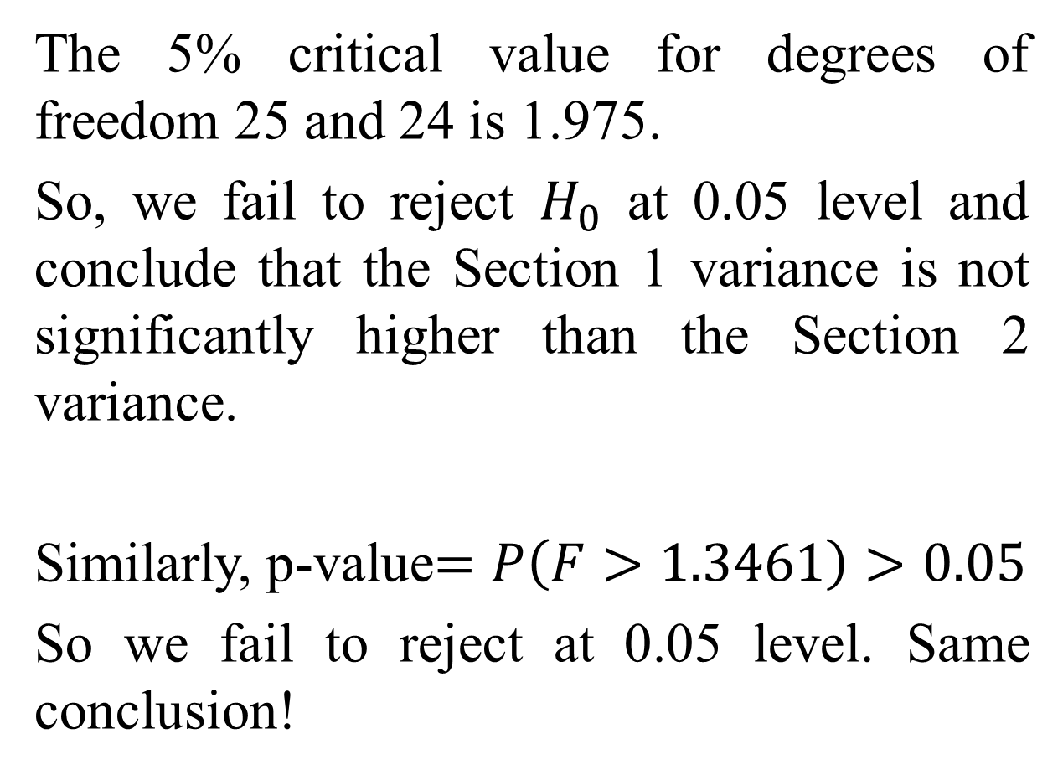
The 5% critical value for degrees of freedom 25 and 24 is 1.975.
So, we fail to reject $H_{0}$ at 0.05 level and conclude that the Section 1 variance is not significantly higher than the Section 2 variance.
Similarly, p-value$=P\left(F>1.3461\right)>0.05$
So we fail to reject at 0.05 level. Same conclusion!

Slide 64
Exercises

Slide 65

Don’t hesitate to contact us if you have any questions about this course’s teaching content. Also, don’t forget to check out the course page and the Microsoft Teams folder,
Course page Link: https://mayooran1987.github.io/MC3020-E23/
Microsoft Teams folder

