Slide 1
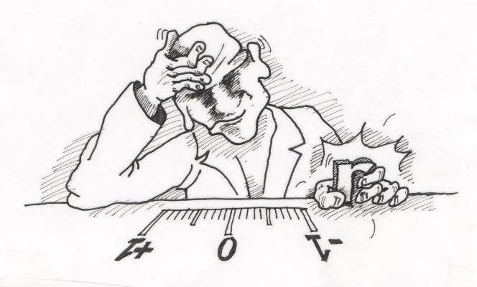
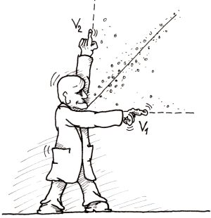
MC3020 – Association between Two Variables
Dr T. Mayooran,
Department of Interdisciplinary Studies,
Faculty of Engineering,
University of Jaffna.
Email: mayooran@eng.jfn.ac.lk

Slide 2
Association between Two Variables
Correlation Coefficient
Liner Regression

Slide 3
General Definitions:
There are two types of relationships between variables:
Simple relationship- Simple linear regression
Multiple relationship - Multiple linear regression
In a simple relationship, there are two variables an independent variable(X), also called an explanatory variable or a predictor variable, and a dependent variable(Y), also called a response variable.
A simple relationship analysis is called simple regression, and there is one independent variable that is used to predict the dependent variable.

Slide 4
For example, a manager may wish to see whether the number of years the salespeople have been working for the company has anything to do with the amount of sales they make. This type of study involves a simple relationship, since there are only two variables—years of experience and amount of sales
In a multiple relationship, called multiple regression, two or more independent variables are used to predict one dependent variable.
For example, an educator may wish to investigate the relationship between a student’s success in college and factors such as the number of hours devoted to studying, the student’s GPA, and the student’s high school background. This type of study involves several variables.

Slide 5
Simple relationships can also be positive or negative. A positive relationship exists when both variables increase or decrease at the same time.
For instance, a person’s height and weight are related; and the relationship is positive, since the taller a person is, generally, the more the person weighs.
In a negative relationship, as one variable increases, the other variable decreases, and vice versa.
For example, if you measure the strength of people over 60 years of age, you will find that as age increases, strength generally decreases.

Slide 6
Scatter Plots and Correlation
A scatter plot is a graph of the ordered pairs (x, y) of numbers consisting of the independent variable x and the dependent variable y.
The independent variable x is plotted on the horizontal axis, and the dependent variable y is plotted on the vertical axis.
The scatter plot is a visual way to describe the nature of the relationship between the independent and dependent variables.

Slide 7
Example
Construct a scatter plot for the data shown for car rental companies in the United
States for a recent year.
Solution
Step 1 Draw and label the x and y axes.
Step 2 Plot each point on the graph, as shown in following slide.
Company | Cars (in ten thousands) | Revenue (in billions)
A | 63.0 | 7.0
B | 29.0 | 3.9
C | 20.8 | 2.1
D | 19.1 | 2.8
E | 13.4 | 1.4
F | 8.5 | 1.5

Slide 8
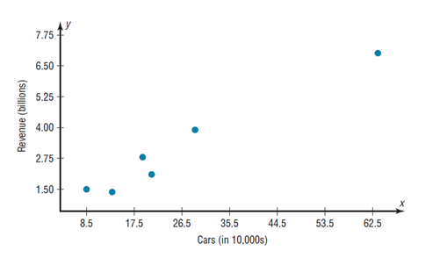

Slide 9
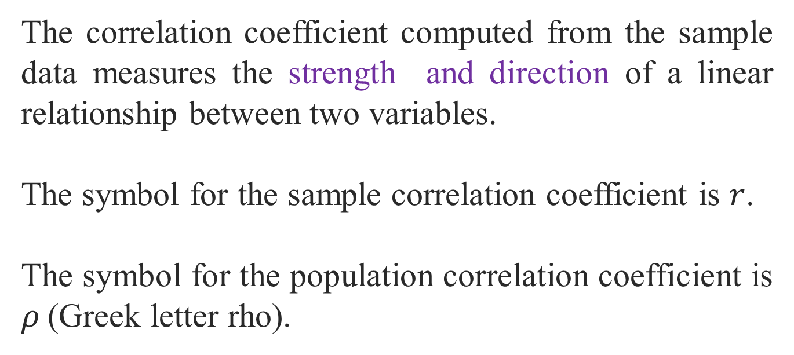
Correlation Coefficient
The correlation coefficient computed from the sample data measures the strength and direction of a linear relationship between two variables.
The symbol for the sample correlation coefficient is $r$.
The symbol for the population correlation coefficient is $ρ$(Greek letter rho).

Slide 10
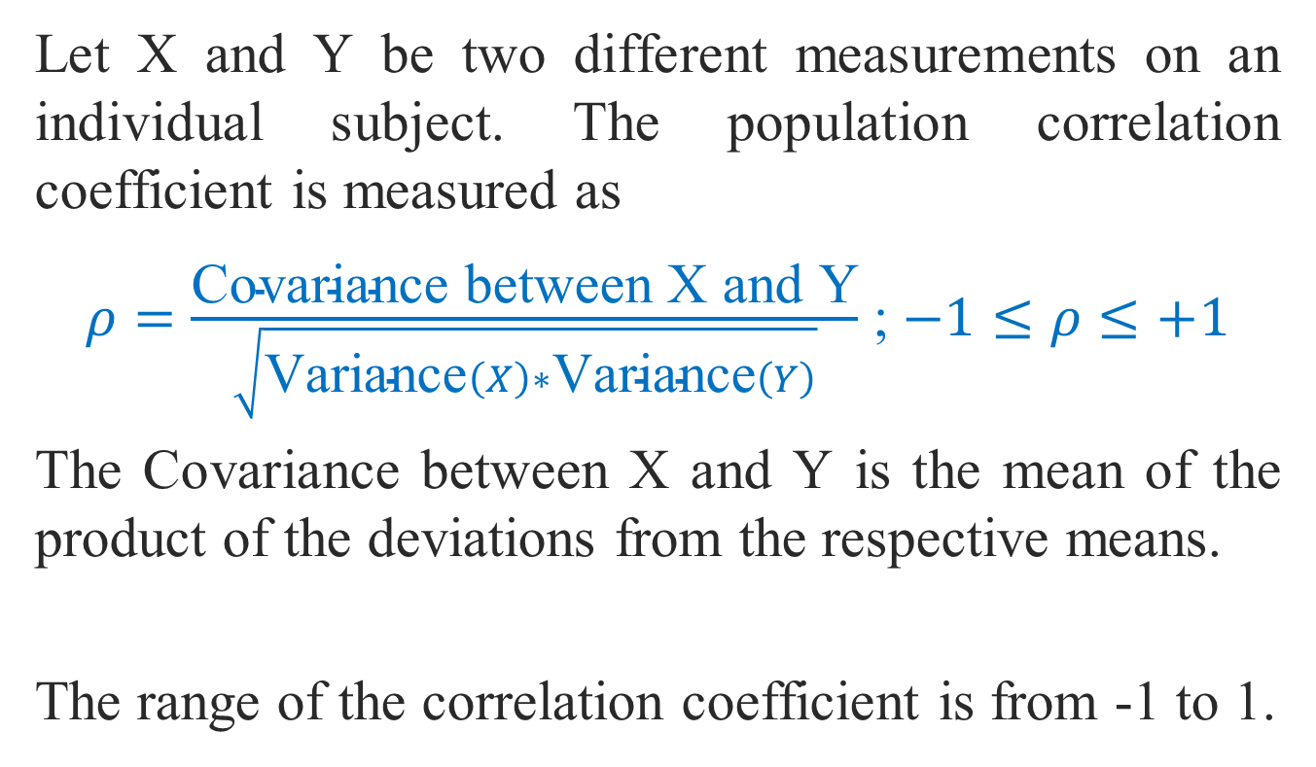
Let X and Y be two different measurements on an individual subject. The population correlation coefficient is measured as
$ρ=\frac{\text{Covariance} \text{between} \text{X} \text{and} \text{Y}}{\sqrt{\text{V}\text{ariance}\left(X\right)∗\text{Variance}\left(Y\right)}}$ ; $−1≤ρ≤+1$
The Covariance between X and Y is the mean of the product of the deviations from the respective means.
The range of the correlation coefficient is from -1 to 1.

Slide 11
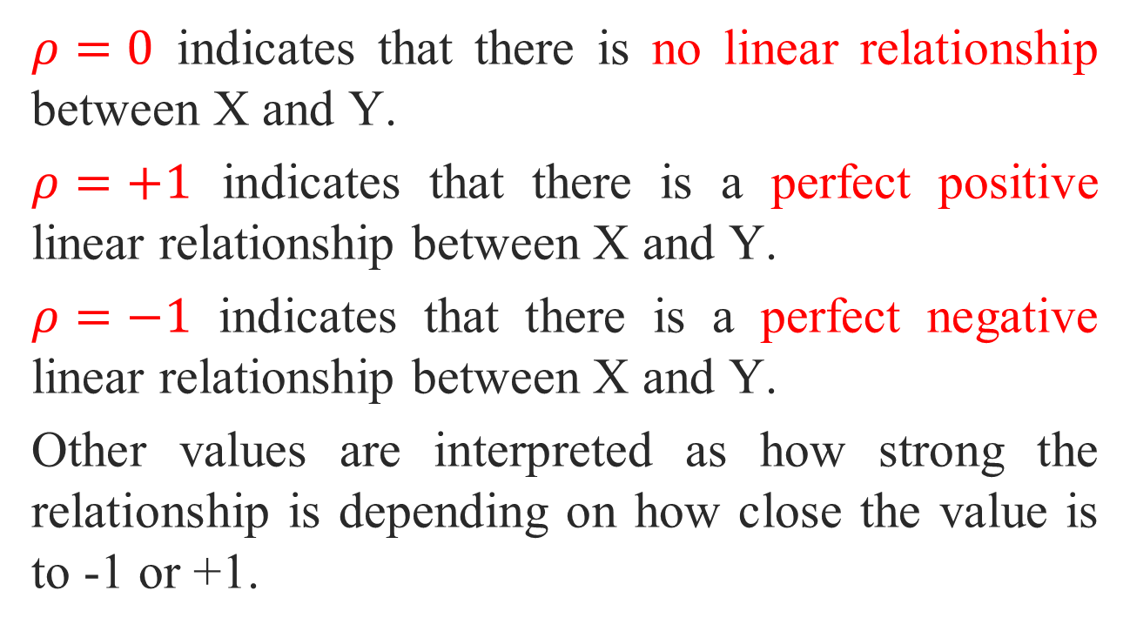
$ρ=0$ indicates that there is no linear relationship between X and Y.
$ρ=+1$ indicates that there is a perfect positive linear relationship between X and Y.
$ρ=−1$ indicates that there is a perfect negative linear relationship between X and Y.
Other values are interpreted as how strong the relationship is depending on how close the value is to -1 or +1.

Slide 12
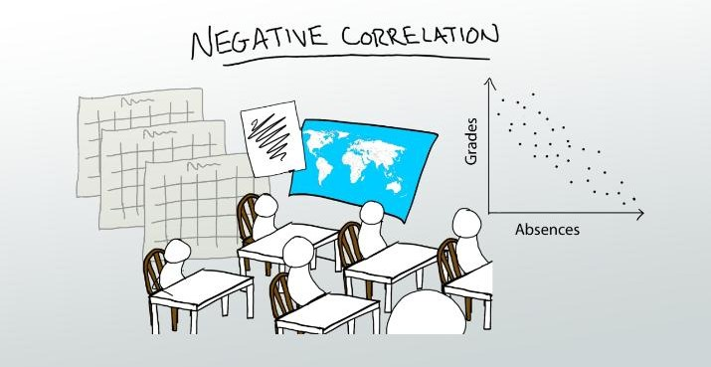
Example:

Slide 13
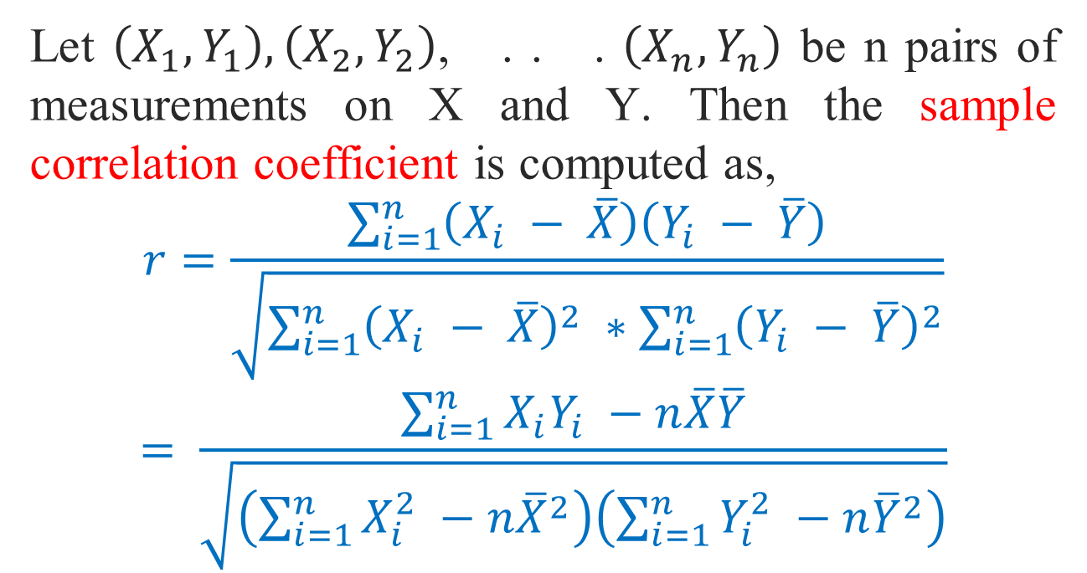
Let $\left(X_{1},Y_{1}\right),\left(X_{2},Y_{2}\right)$, . . . $\left(X_{n},Y_{n}\right)$ be n pairs of measurements on X and Y. Then the sample correlation coefficient is computed as,
$$r=\frac{\sum_{i=1}^{n}{\left(X_{i} − \overline{X}\right)\left(Y_{i} − \overline{Y}\right)}}{\sqrt{\sum_{i=1}^{n}{{\left(X_{i} − \overline{X}\right)}^{2}} ∗\sum_{i=1}^{n}{{\left(Y_{i} − \overline{Y}\right)}^{2}}}}$$
$$= \frac{\sum_{i=1}^{n}{X_{i}Y_{i} −n\overline{X}\overline{Y}}}{\sqrt{\left(\sum_{i=1}^{n}{X_{i}^{2} −n{\overline{X}}^{2}}\right)\left(\sum_{i=1}^{n}{Y_{i}^{2} −n{\overline{Y}}^{2}}\right)}}$$

Slide 14
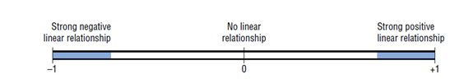
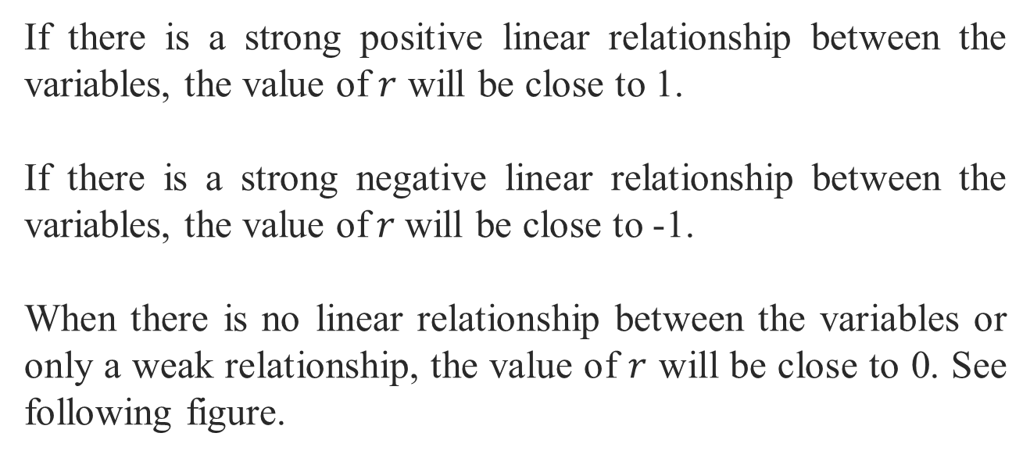
If there is a strong positive linear relationship between the variables, the value of $r$ will be close to 1.
If there is a strong negative linear relationship between the variables, the value of$r$will be close to -1.
When there is no linear relationship between the variables or only a weak relationship, the value of $r$ will be close to 0. See following figure.

Slide 15
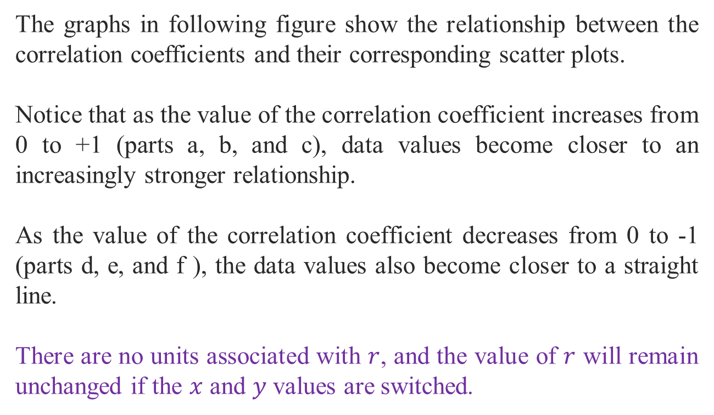
The graphs in following figure show the relationship between the correlation coefficients and their corresponding scatter plots.
Notice that as the value of the correlation coefficient increases from 0 to +1 (parts a, b, and c), data values become closer to an increasingly stronger relationship.
As the value of the correlation coefficient decreases from 0 to -1 (parts d, e, and f ), the data values also become closer to a straight line.
There are no units associated with $r$, and the value of $r$ will remain unchanged if the $x$ and $y$ values are switched.

Slide 16
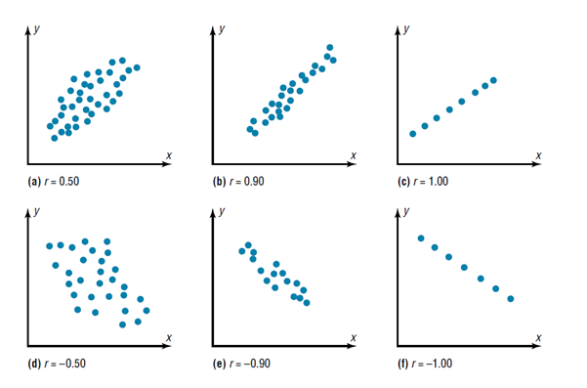

Slide 17
Example 1:
A college administers all its courses a student evaluation questionnaire. For a random sample of 12 courses the accompanying table and the data file student evaluation show both the average student ratings of the instructor (on a scale of 1 to 5), and the average expected grades of the students (on a scale from A = 4 to F = 0). Find the sample correlation coefficient between instructor ratings and expected grades.
Instructor ratings | 2.8 | 3.7 | 4.4 | 3.6 | 4.7 | 3.5 | 4.1 | 3.2 | 4.9 | 4.2 | 3.8 | 3.3
Expected grades | 2.6 | 2.9 | 3.3 | 3.2 | 3.1 | 2.8 | 2.7 | 2.4 | 3.5 | 3 | 3.4 | 2.5

Slide 18
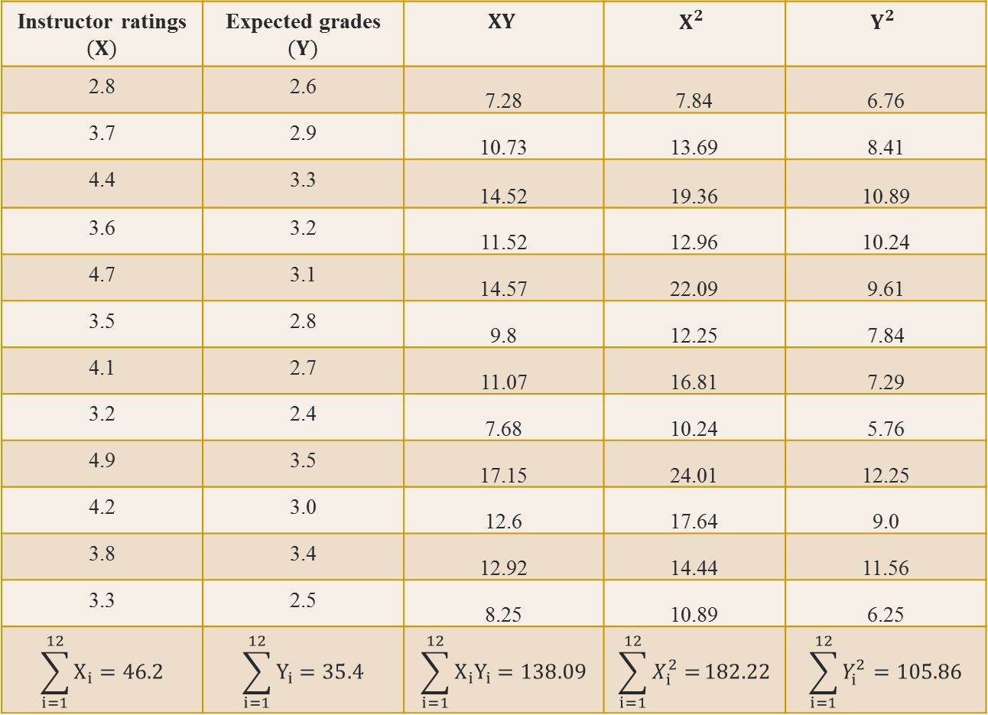
Instructor ratings $(X)$ | Expected grades $(Y)$ | $$XY$$ | $$X^{2}$$ | $$Y^{2}$$
2.8 | 2.6 | 7.28 | 7.84 | 6.76
3.7 | 2.9 | 10.73 | 13.69 | 8.41
4.4 | 3.3 | 14.52 | 19.36 | 10.89
3.6 | 3.2 | 11.52 | 12.96 | 10.24
4.7 | 3.1 | 14.57 | 22.09 | 9.61
3.5 | 2.8 | 9.8 | 12.25 | 7.84
4.1 | 2.7 | 11.07 | 16.81 | 7.29
3.2 | 2.4 | 7.68 | 10.24 | 5.76
4.9 | 3.5 | 17.15 | 24.01 | 12.25
4.2 | 3.0 | 12.6 | 17.64 | 9.0
3.8 | 3.4 | 12.92 | 14.44 | 11.56
3.3 | 2.5 | 8.25 | 10.89 | 6.25
$$\sum_{i=1}^{12}{X_{i}}=46.2$$ | $$\sum_{i=1}^{12}{Y_{i}}=35.4$$ | $$\sum_{i=1}^{12}{X_{i}Y_{i}}=138.09$$ | $$\sum_{i=1}^{12}{X_{i}^{2}=}182.22$$ | $$\sum_{i=1}^{12}{Y_{i}^{2}}=105.86$$

Slide 19

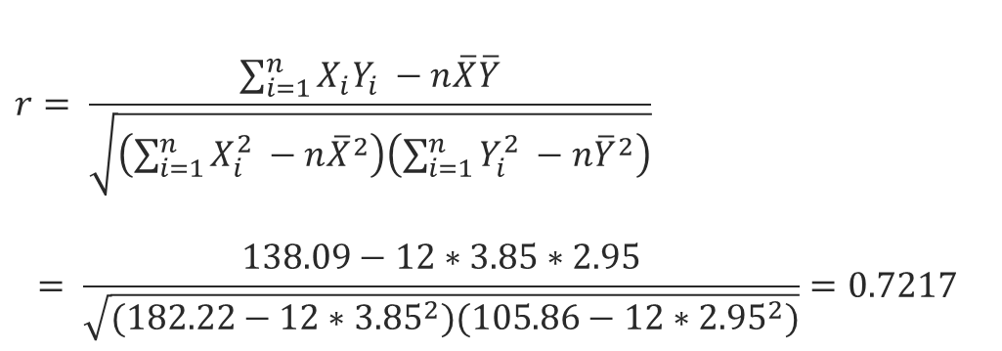

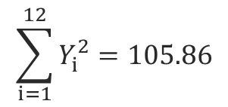
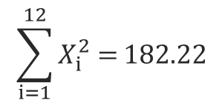
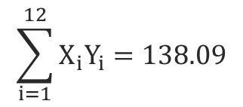
$$\overline{X}=\frac{\sum_{i=1}^{12}{X_{i}}}{12}=\frac{46.2}{12}=3.85$$
$$\overline{Y}=\frac{\sum_{i=1}^{12}{Y_{i}}}{12}=\frac{35.4}{12}=2.95$$
$$\sum_{i=1}^{12}{X_{i}Y_{i}}=138.09$$
$$\sum_{i=1}^{12}{X_{i}^{2}=}182.22$$
$$\sum_{i=1}^{12}{Y_{i}^{2}}=105.86$$
$$r= \frac{\sum_{i=1}^{n}{X_{i}Y_{i} −n\overline{X}\overline{Y}}}{\sqrt{\left(\sum_{i=1}^{n}{X_{i}^{2} −n{\overline{X}}^{2}}\right)\left(\sum_{i=1}^{n}{Y_{i}^{2} −n{\overline{Y}}^{2}}\right)}}$$
$$= \frac{138.09−12∗3.85∗2.95}{\sqrt{(182.22−12∗{3.85}^{2})(105.86−12∗{2.95}^{2})}}=0.7217$$

Slide 20
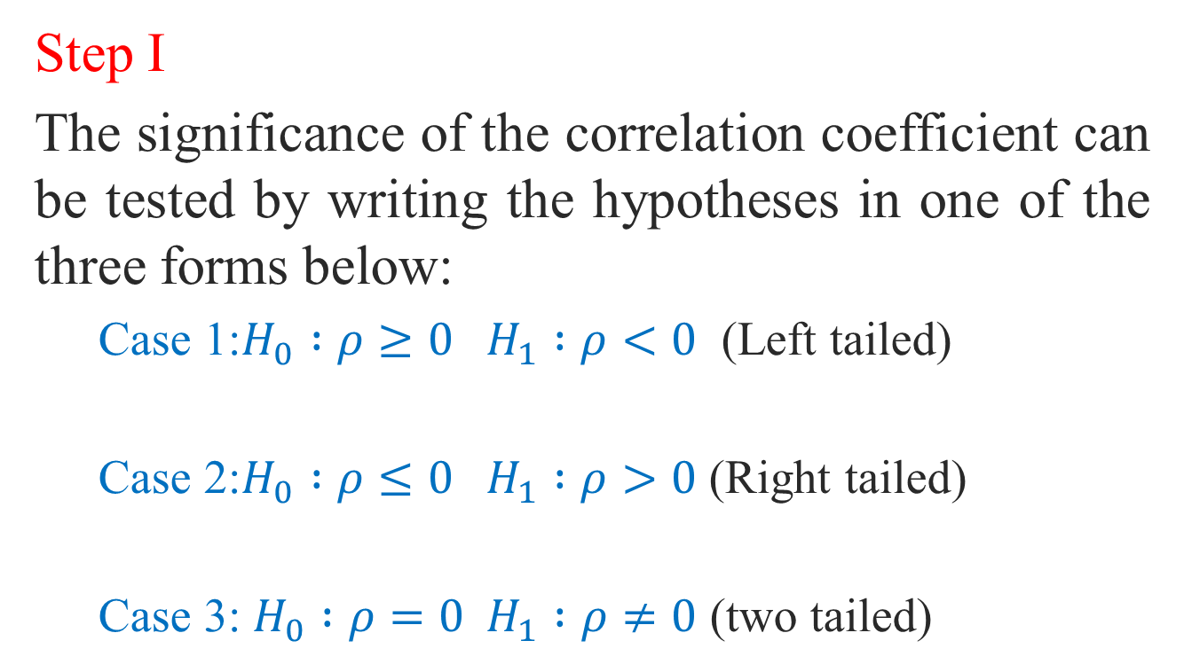
Testing Hypothesis for population correlation:
Step I
The significance of the correlation coefficient can be tested by writing the hypotheses in one of the three forms below:
  Case 1:$H_{0} :ρ≥0{ H}_{1} :ρ<0$ (Left tailed)
  Case 2:$H_{0} :ρ≤0 H_{1} :ρ>0$ (Right tailed)
  Case 3: $H_{0} :ρ=0 H_{1} :ρ≠0$ (two tailed)

Slide 21
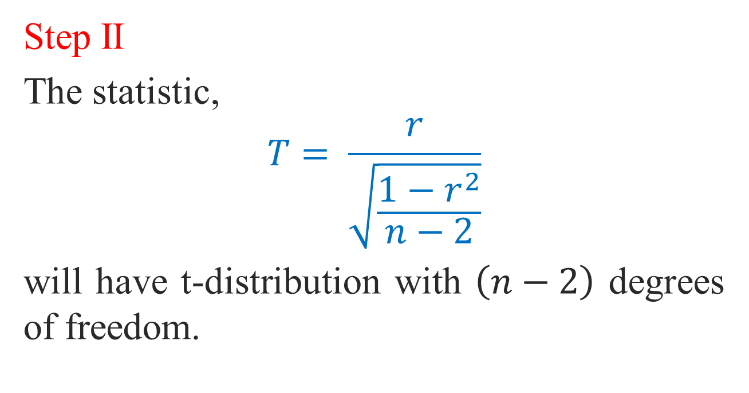
Step II
The statistic,
$$T= \frac{r}{\sqrt{\frac{1−r^{2}}{n−2}}}$$
will have t-distribution with $\left(n−2\right)$ degrees of freedom.

Slide 22
Step III
Calculate the critical values and Identify critical region.
Step IV
Statistical Conclusion- Reject the H0 or Do not reject H0
Step V General Conclusion

Slide 23
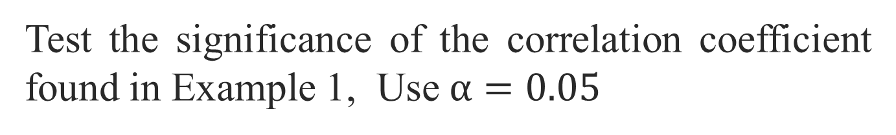
Example 2:
Test the significance of the correlation coefficient found in Example 1, Use $α=0.05$

Slide 24
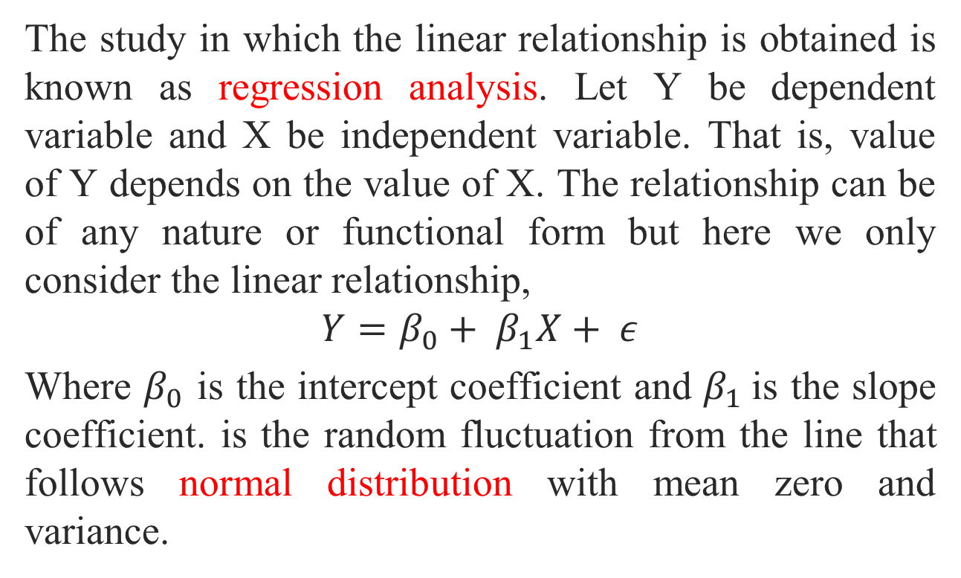
Simple Linear Regression
The study in which the linear relationship is obtained is known as regression analysis. Let Y be dependent variable and X be independent variable. That is, value of Y depends on the value of X. The relationship can be of any nature or functional form but here we only consider the linear relationship,
$$Y=β_{0}+ β_{1}X+ ε$$
Where $β_{0}$ is the intercept coefficient and $β_{1}$is the slope coefficient. is the random fluctuation from the line that follows normal distribution with mean zero and variance.

Slide 25
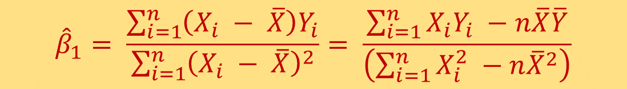
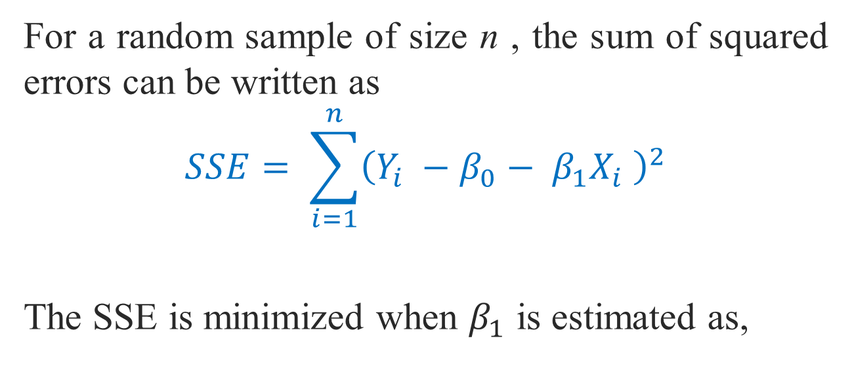
For a random sample of size n , the sum of squared errors can be written as
$$SSE= \sum_{i=1}^{n}{{\left({Y_{i} −β}_{0}− β_{1}X_{i} \right)}^{2}}$$
The SSE is minimized when $β_{1}$ is estimated as,
$${\hat{β}}_{1}= \frac{\sum_{i=1}^{n}{\left(X_{i} − \overline{X}\right)Y_{i}}}{\sum_{i=1}^{n}{{\left(X_{i} − \overline{X}\right)}^{2}}}= \frac{\sum_{i=1}^{n}{X_{i}Y_{i} −n\overline{X}\overline{Y}}}{\left(\sum_{i=1}^{n}{X_{i}^{2} −n{\overline{X}}^{2}}\right)}$$

Slide 26
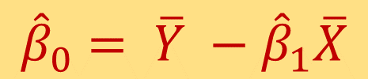
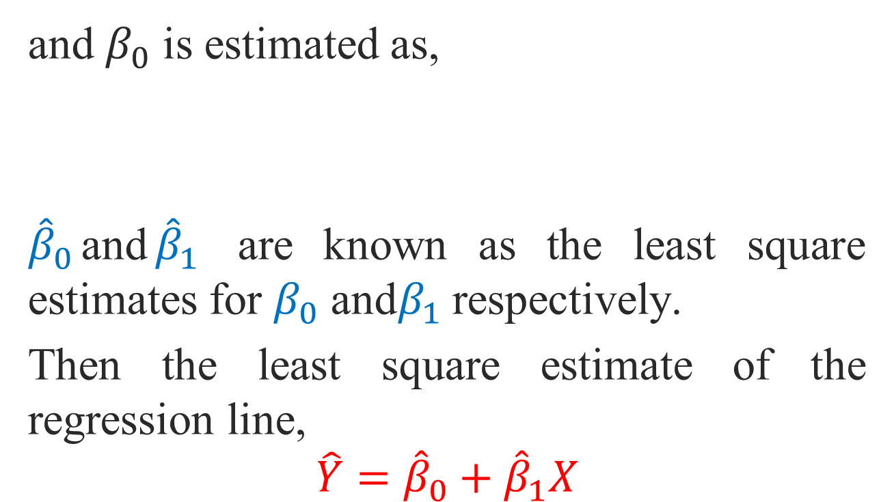
and $β_{0}$ is estimated as,
${\hat{β}}_{0}$and${\hat{β}}_{1}$ are known as the least square estimates for $β_{0}$ and$β_{1}$ respectively.
Then the least square estimate of the regression line,
$${\hat{Y}=\hat{β}}_{0}+{\hat{β}}_{1}X$$
$${\hat{β}}_{0}= \overline{Y} −{\hat{β}}_{1}\overline{X}$$

Slide 27
Example 3:
A college administers all its courses a student evaluation questionnaire. For a random sample of 12 courses the accompanying table and the data file student evaluation show both the average student ratings of the instructor (on a scale of 1 to 5), and the average expected grades of the students (on a scale from A = 4 to F = 0).
Instructor ratings | 2.8 | 3.7 | 4.4 | 3.6 | 4.7 | 3.5 | 4.1 | 3.2 | 4.9 | 4.2 | 3.8 | 3.3
Expected grades | 2.6 | 2.9 | 3.3 | 3.2 | 3.1 | 2.8 | 2.7 | 2.4 | 3.5 | 3 | 3.4 | 2.5

Slide 28
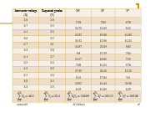
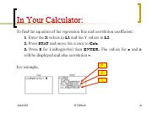
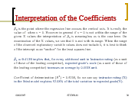
Determine the least-square equation in predicting the Expected grades using their Instructor ratings.
Interpret the slope coefficient in the regression line in the context of the problem.
Use this regression line, predict the Expected grade’s scale for a Instructor rating 4.8.
Use your calculator Casio 991ES/MS, to verify these calculated values.

Slide 29
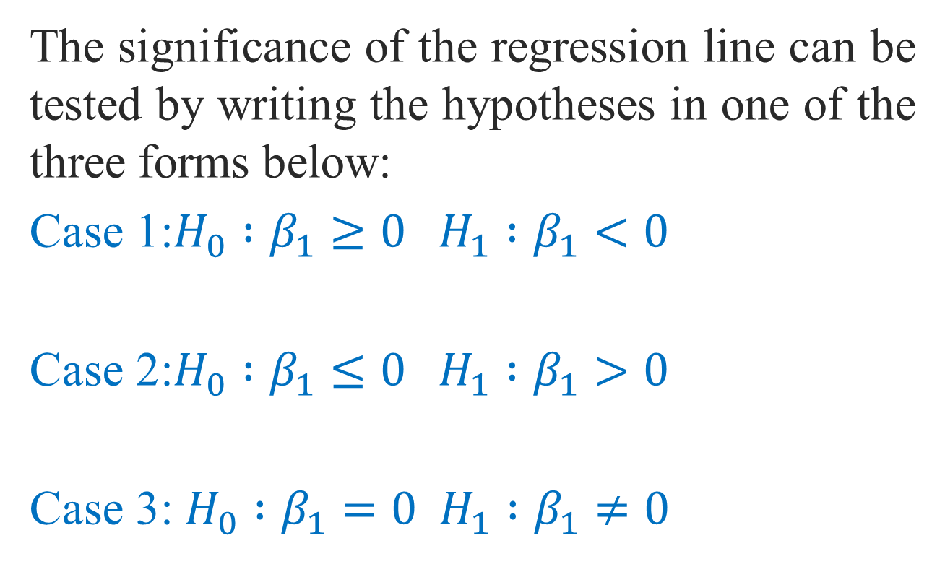
Testing Hypothesis for slope coefficient:
The significance of the regression line can be tested by writing the hypotheses in one of the three forms below:
Case 1:$H_{0} :β_{1}≥0{ H}_{1} :β_{1}<0$
Case 2:$H_{0} :β_{1}≤0 H_{1} :β_{1}>0$
Case 3: $H_{0} :β_{1}=0 H_{1} :β_{1}≠0$

Slide 30

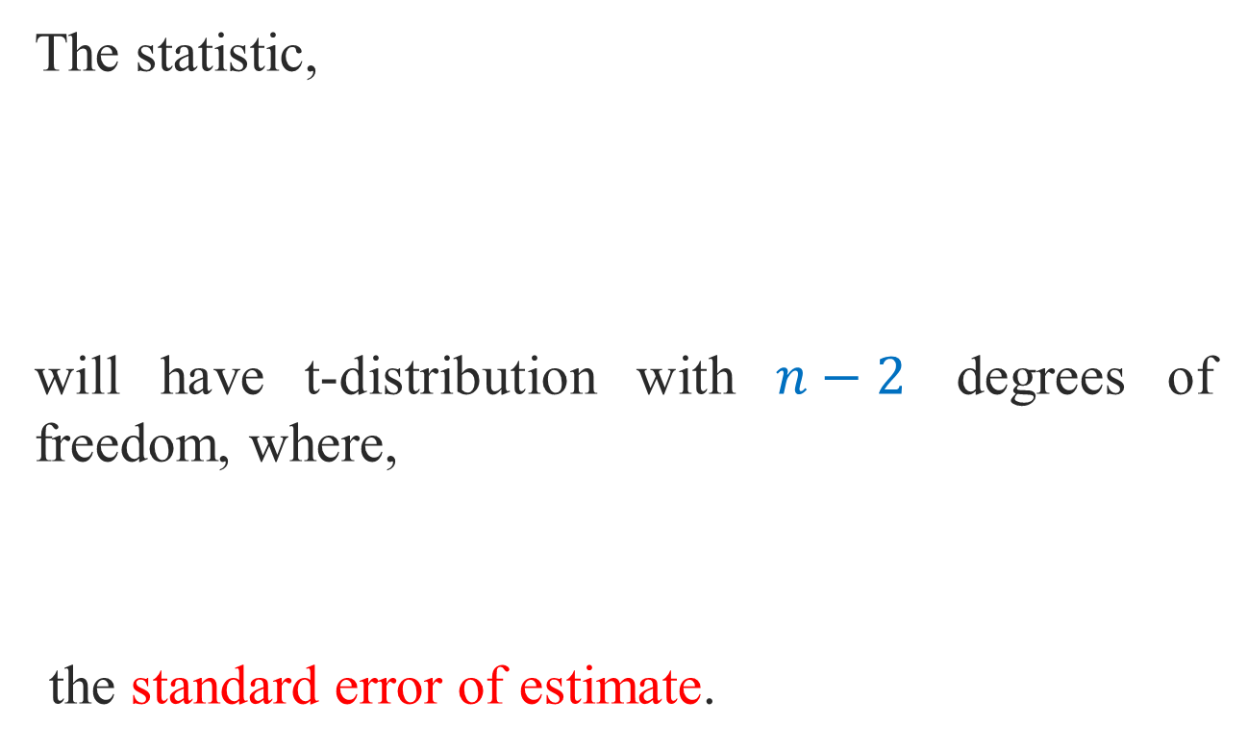

The statistic,
will have t-distribution with $n−2$ degrees of freedom, where,
the standard error of estimate.
$$T= \frac{{\hat{β}}_{1} −0}{{S_{e}}/{\sqrt{\sum_{i=1}^{n}{X_{i}^{2} −n{\overline{X}}^{2}}}}}$$
$$S_{e}=\sqrt{\frac{\sum_{i=1}^{n}{{\left(Y_{i} − {\hat{Y}}_{i}\right)}^{2}}}{n−2}}$$

Slide 31
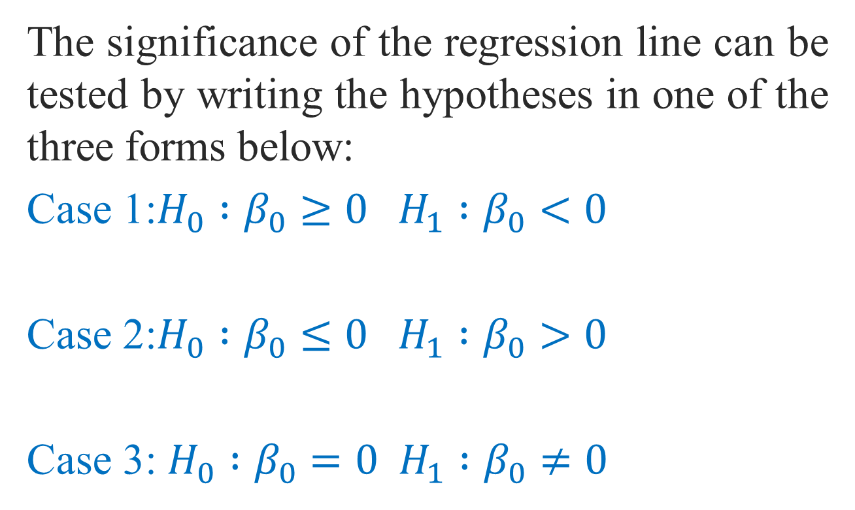
Testing Hypothesis for intercept coefficient:
The significance of the regression line can be tested by writing the hypotheses in one of the three forms below:
Case 1:$H_{0} :β_{0}≥0{ H}_{1} :β_{0}<0$
Case 2:$H_{0} :β_{0}≤0 H_{1} :β_{0}>0$
Case 3: $H_{0} :β_{0}=0 H_{1} :β_{0}≠0$

Slide 32


Similar tests involving , the intercept coefficient can also be obtained. Where the test statistic is used as:
which has t-distribution with $n−2$ degrees of freedom.
$$T= \frac{{\hat{β}}_{0} −0}{S_{e}\sqrt{\frac{1}{n}+ \frac{{\overline{X}}^{2}}{\sum_{i=1}^{n}{X_{i}^{2} −n{\overline{X}}^{2}}}}}$$

Slide 33
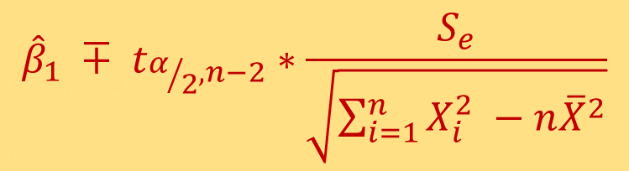

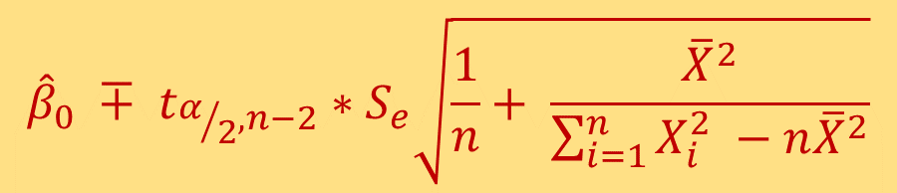
Confidence Interval Estimation:
$\left(1−α\right)∗100 \%$Confidence Interval for $β_{1}$ can be computed as,
$\left(1−α\right)∗100 \%$Confidence Interval for $β_{0}$ can be computed as,
$${\hat{β}}_{1} ∓ t_{α/2,n−2}∗\frac{S_{e}}{\sqrt{\sum_{i=1}^{n}{X_{i}^{2} −n{\overline{X}}^{2}}}}$$
$${\hat{β}}_{0} ∓ t_{α/2,n−2}∗S_{e}\sqrt{\frac{1}{n}+ \frac{{\overline{X}}^{2}}{\sum_{i=1}^{n}{X_{i}^{2} −n{\overline{X}}^{2}}}}$$

Slide 34
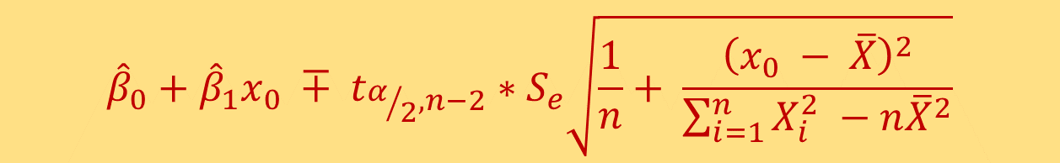

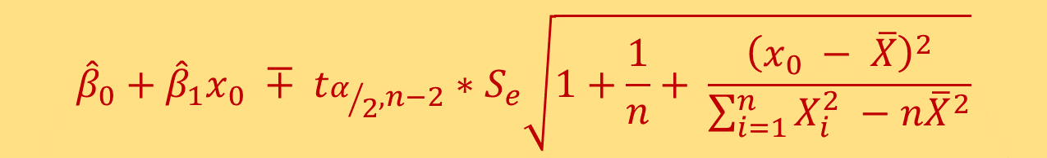
$\left(1−α\right)∗100 \%$Confidence Interval for mean response at $x= x_{0}, y\left(x_{0}\right)= β_{0}+β_{1}x_{0}$can be computed as,
$\left(1−α\right)∗100 \%$Prediction Interval for predicted response at $x= x_{0}, y\left(x_{0}\right)= β_{0}+β_{1}x_{0}$can be computed as,
$${\hat{β}}_{0}+{\hat{β}}_{1}x_{0} ∓ t_{α/2,n−2}∗S_{e}\sqrt{\frac{1}{n}+ \frac{{\left(x_{0} − \overline{X}\right)}^{2}}{\sum_{i=1}^{n}{X_{i}^{2} −n{\overline{X}}^{2}}}}$$
$${\hat{β}}_{0}+{\hat{β}}_{1}x_{0} ∓ t_{α/2,n−2}∗S_{e}\sqrt{1+\frac{1}{n}+ \frac{{\left(x_{0} − \overline{X}\right)}^{2}}{\sum_{i=1}^{n}{X_{i}^{2} −n{\overline{X}}^{2}}}}$$

Slide 35
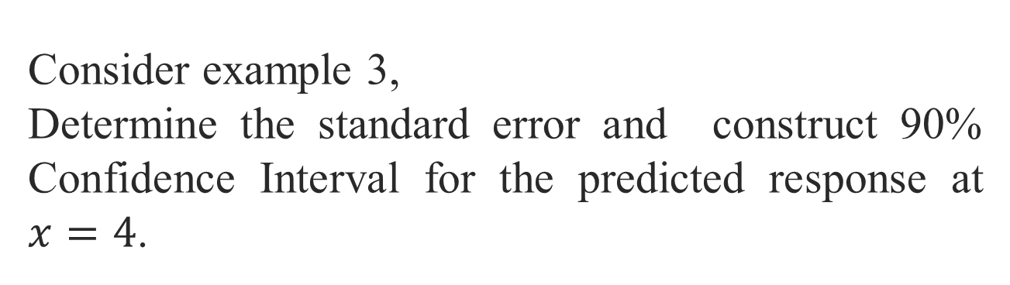
Example:
Consider example 3,
Determine the standard error and construct 90% Confidence Interval for the predicted response at $x=4$.

Slide 36
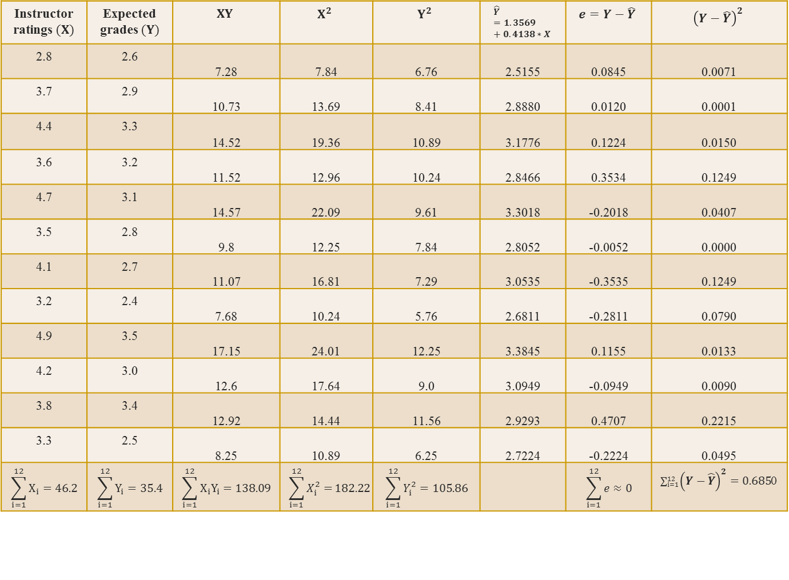
Instructor ratings $(X)$ | Expected grades $(Y)$ | $$XY$$ | $$X^{2}$$ | $$Y^{2}$$ | $$\hat{Y}=1.3569+0.4138∗X$$ | $$e=Y−\hat{Y}$$ | $${\left(Y−\hat{Y}\right)}^{2}$$
2.8 | 2.6 | 7.28 | 7.84 | 6.76 | 2.5155 | 0.0845 | 0.0071
3.7 | 2.9 | 10.73 | 13.69 | 8.41 | 2.8880 | 0.0120 | 0.0001
4.4 | 3.3 | 14.52 | 19.36 | 10.89 | 3.1776 | 0.1224 | 0.0150
3.6 | 3.2 | 11.52 | 12.96 | 10.24 | 2.8466 | 0.3534 | 0.1249
4.7 | 3.1 | 14.57 | 22.09 | 9.61 | 3.3018 | -0.2018 | 0.0407
3.5 | 2.8 | 9.8 | 12.25 | 7.84 | 2.8052 | -0.0052 | 0.0000
4.1 | 2.7 | 11.07 | 16.81 | 7.29 | 3.0535 | -0.3535 | 0.1249
3.2 | 2.4 | 7.68 | 10.24 | 5.76 | 2.6811 | -0.2811 | 0.0790
4.9 | 3.5 | 17.15 | 24.01 | 12.25 | 3.3845 | 0.1155 | 0.0133
4.2 | 3.0 | 12.6 | 17.64 | 9.0 | 3.0949 | -0.0949 | 0.0090
3.8 | 3.4 | 12.92 | 14.44 | 11.56 | 2.9293 | 0.4707 | 0.2215
3.3 | 2.5 | 8.25 | 10.89 | 6.25 | 2.7224 | -0.2224 | 0.0495
$$\sum_{i=1}^{12}{X_{i}}=46.2$$ | $$\sum_{i=1}^{12}{Y_{i}}=35.4$$ | $$\sum_{i=1}^{12}{X_{i}Y_{i}}=138.09$$ | $$\sum_{i=1}^{12}{X_{i}^{2}=}182.22$$ | $$\sum_{i=1}^{12}{Y_{i}^{2}}=105.86$$ |  | $$\sum_{i=1}^{12}{e}≈0$$ | $\sum_{i=1}^{12}{{\left(Y−\hat{Y}\right)}^{2}=0.685}$0

Slide 37
Coefficient of Determination (R²)
The proportion of the total variation in the dependent variable (Y) that is explained or accounted for, by the variation in the independent variable (X).
It is the square of the coefficient of correlation.
It ranges from 0 to 1.
It does not give any information on the direction of the relationship between the variables.

Slide 38
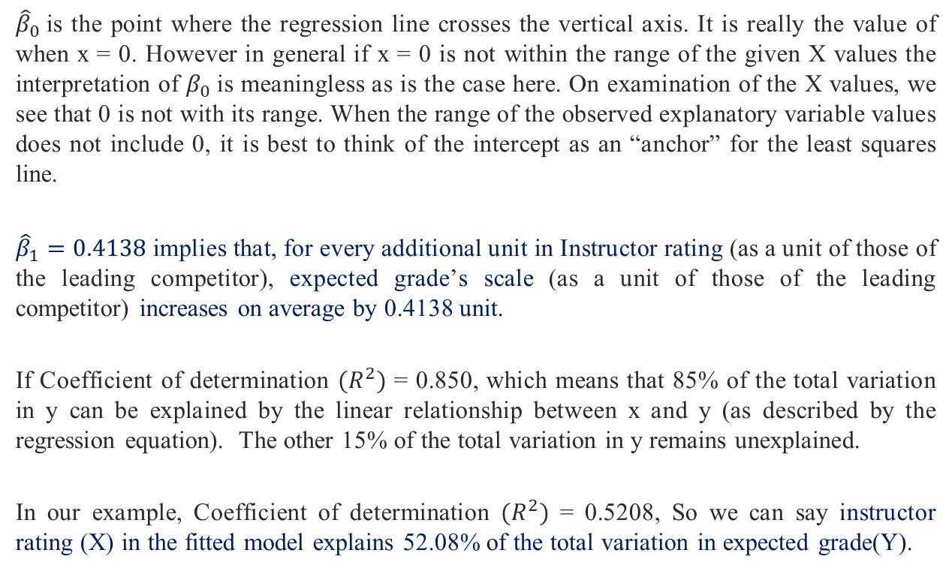
Interpretation of the Coefficients
${\hat{β}}_{0}$is the point where the regression line crosses the vertical axis. It is really the value of when x = 0. However in general if x = 0 is not within the range of the given X values the interpretation of $β_{0}$is meaningless as is the case here. On examination of the X values, we see that 0 is not with its range. When the range of the observed explanatory variable values does not include 0, it is best to think of the intercept as an “anchor” for the least squares line.
${\hat{β}}_{1}=0.4138$implies that, for every additional unit in Instructor rating (as a unit of those of the leading competitor), expected grade’s scale (as a unit of those of the leading competitor) increases on average by 0.4138 unit.
If Coefficient of determination $(R^{2})$ = 0.850, which means that 85% of the total variation in y can be explained by the linear relationship between x and y (as described by the regression equation). The other 15% of the total variation in y remains unexplained.
In our example, Coefficient of determination $(R^{2})$ = 0.5208, So we can say instructor rating (X) in the fitted model explains 52.08% of the total variation in expected grade(Y).

Slide 39
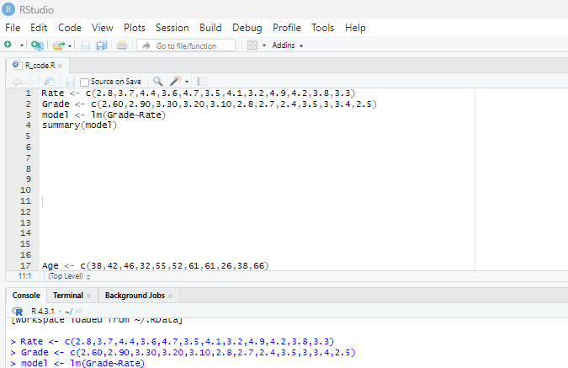
In R program

Slide 40
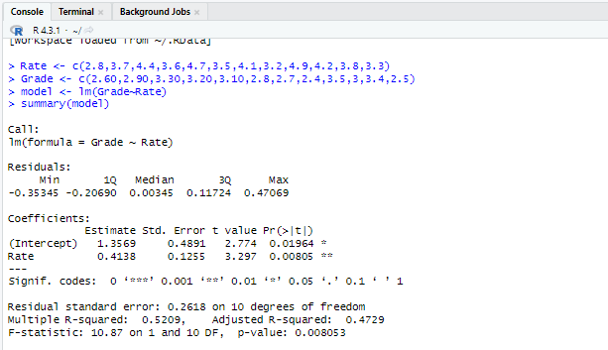


$$\hat{Y}= β_{0}+ β_{1}X=1.357+0.414X$$
$$R^{2}=0.5210$$

Slide 41
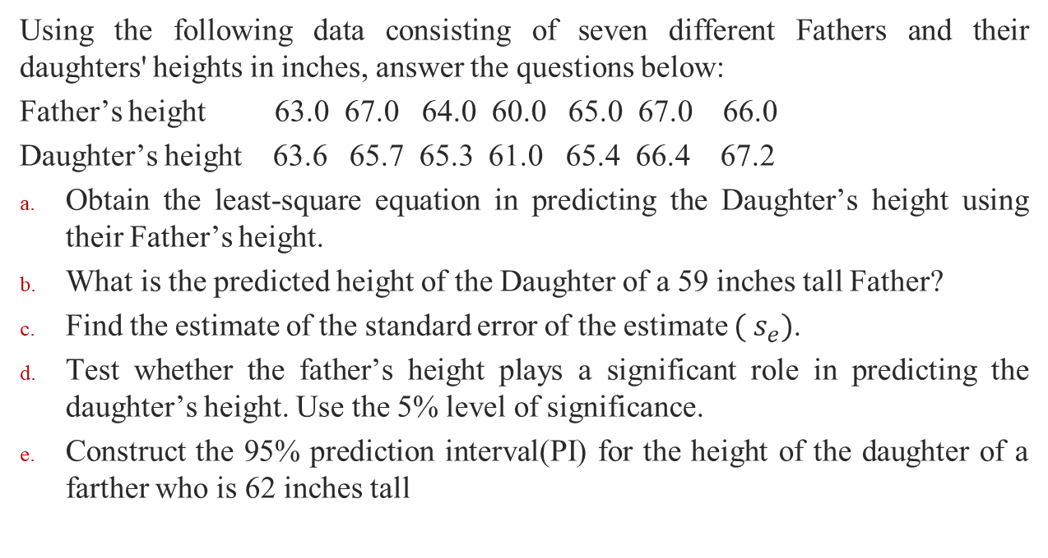
Example:
Using the following data consisting of seven different Fathers and their daughters' heights in inches, answer the questions below:
Father’s height 63.0 67.0 64.0 60.0 65.0 67.0 66.0
Daughter’s height 63.6 65.7 65.3 61.0 65.4 66.4 67.2
Obtain the least-square equation in predicting the Daughter’s height using their Father’s height.
What is the predicted height of the Daughter of a 59 inches tall Father?
Find the estimate of the standard error of the estimate $( s_{e})$.
Test whether the father’s height plays a significant role in predicting the daughter’s height. Use the 5% level of significance.
Construct the 95% prediction interval(PI) for the height of the daughter of a farther who is 62 inches tall

Slide 42
Example:
Based on Previous Example,
Compute the linear correlation coefficient between Daughter’s height and Father’s height.
Use a 0.05 significance level to test for a linear correlation between Daughter’s height and Father’s height positive or not.

Slide 43
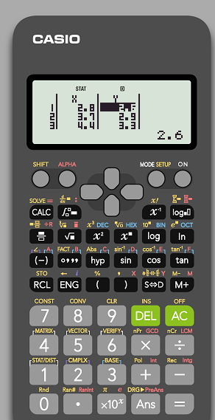
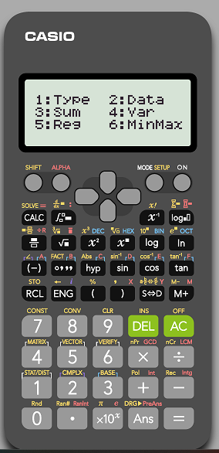
In Your Calculator:
To find the equation of the regression line and correlation coefficient:

Slide 44
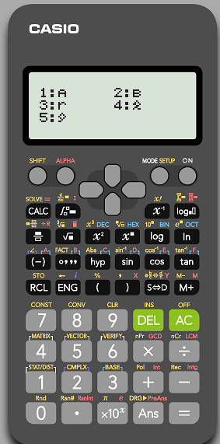




$${\hat{β}}_{1}$$
$${\hat{β}}_{0}$$
$$r$$

Slide 45

To find the fitted values($\hat{Y}$) of the regression:
Enter the X values in X and the Y values in Y.
Press SHIFT and press 1 and move to cursor to
Type your regression equation (Example Y=1.3569+0.4138*L1)
After press ENTER then you can find

Slide 46
Multiple Linear regression
R program-based discussions

Slide 47
Multiple Regression Model
The equation that describes how the dependent variable y is related to the independent variables x₁, x₂, . . . x_{p} and an error term is:
y = β₀ + β₁x₁ + β₂x₂ + . . . + β_{p}x_{p} + ε
where:
β₀, β₁, β₂, . . . , β_{p} are the parameters, and
ε is a random variable called the error term

Slide 48
Multiple Regression Equation
The equation that describes how the mean value of y is related to x₁, x₂, . . . x_{p} is:
E(y) = β₀ + β₁x₁ + β₂x₂ + . . . + β_{p}x_{p}

Slide 49


Estimated Multiple Regression Equation
^
y = ${\hat{β}}_{0}$ + ${\hat{β}}_{1}$x₁ + ${\hat{β}}_{2}$x₂ + . . . + ${\hat{β}}_{p}$x_{p}
A simple random sample is used to compute sample statistics ${\hat{β}}_{0},{\hat{β}}_{1}$…… ${\hat{β}}_{p}$that are used as the point estimators of the parameters β₀, β₁, β₂, . . . , β_{p}.

Slide 50

Least Squares Method
Computation of Coefficient Values
The formulas for the regression coefficients
${\hat{β}}_{0},{\hat{β}}_{1}$…… ${\hat{β}}_{p}$involve the use of matrix algebra.
We will rely on computer software packages to
perform the calculations.

Slide 51
Multiple Regression Model
Example: Progarammer Salary Survey
A software firm collected data for a sample of 20 computer programmers. A suggestion was made that regression analysis could be used to determine if salary was related to the years of experience and the score on the firm’s programmer aptitude test.
The years of experience, score on the aptitude test, and corresponding annual salary ($1000s) for a sample of 20 programmers is shown on the next slide.

Slide 52
Multiple Regression Model
Exper.
Score
Salary
Exper.
Score
Salary
4
7
1
5
8
10
0
1
6
6
78
100
86
82
86
84
75
80
83
91
24.0
43.0
23.7
34.3
35.8
38.0
22.2
23.1
30.0
33.0
9
2
10
5
6
8
4
6
3
3
88
73
75
81
74
87
79
94
70
89
38.0
26.6
36.2
31.6
29.0
34.0
30.1
33.9
28.2
30.0

Slide 53
Multiple Regression Model
Suppose we believe that salary (y) is
related to the years of experience (x₁) and the score on
the programmer aptitude test (x₂) by the following
regression model:
y = β₀ + β₁x₁ + β₂x₂ + ε
where
y = annual salary ($1000)
x₁ = years of experience
x₂ = score on programmer aptitude test

Slide 54

Solving for the Estimates of β₀, β₁, β₂
Least Squares
Output
Input Data
x₁ x₂ y
4 78 24
7 100 43
. . .
. . .
3 89 30
Computer
Package
for Solving
Multiple
Regression
Problems
${\hat{β}}_{0}$=
${\hat{β}}_{1}$ =
${\hat{β}}_{2}$ =
R² =
etc.

Slide 55

R codes

Slide 56

Solving for the Estimates of β₀, β₁, β₂

Slide 57
Estimated Regression Equation
SALARY = 3.174 + 1.404(EXPER) + 0.251(SCORE)
Note: Predicted salary will be in thousands of dollars.

Slide 58

Interpreting the Coefficients
In multiple regression analysis, we interpret each
regression coefficient as follows:
${\hat{β}}_{i}$ represents an estimate of the change in y
corresponding to a 1-unit increase in x_{i} when all
other independent variables are held constant.

Slide 59

Interpreting the Coefficients
${\hat{β}}_{1}$ = 1.404
Salary is expected to increase by $1,404 for
each additional year of experience (when the variable
score on programmer attitude test is held constant).

Slide 60

Interpreting the Coefficients
${\hat{β}}_{2}$ = 0.251
Salary is expected to increase by $251 for each
additional point scored on the programmer aptitude
test (when the variable years of experience is held
constant).

Slide 61
Multiple Coefficient of Determination
Relationship Among SST, SSR, SSE
SST = SSR + SSE
=
+
where:
SST = total sum of squares
SSR = sum of squares due to regression
SSE = sum of squares due to error

Slide 62


Slide 63


Slide 64
Multiple Coefficient of Determination
R² = SSR/SST
R² = 500.3285/599.7855 = .83418

Slide 65
Adjusted Multiple Coefficient
of Determination

Slide 66
Assumptions About the Error Term ε
The error ε is a random variable with mean of zero.
The variance of ε , denoted by σ ², is the same for all
values of the independent variables.
The values of ε are independent.
The error ε is a normally distributed random variable
reflecting the deviation between the y value and the
expected value of y given by β₀ + β₁x₁ + β₂x₂ + . . + β_{p}x_{p}.

Slide 67
Testing for Significance
In simple linear regression, the F and t tests provide
the same conclusion.
In multiple regression, the F and t tests have different
purposes.

Slide 68
Testing for Significance: F Test
The F test is used to determine whether a significant
relationship exists between the dependent variable
and the set of all the independent variables.
The F test is referred to as the test for overall
significance.

Slide 69
Testing for Significance: t Test
If the F test shows an overall significance, the t test is
used to determine whether each of the individual
independent variables is significant.
A separate t test is conducted for each of the
independent variables in the model.
We refer to each of these t tests as a test for individual
significance.

Slide 70
Testing for Significance: F Test
Hypotheses
H₀: β₁ = β₂ = . . . = β_{p} = 0
H_{a}: One or more of the parameters
is not equal to zero.
Test Statistics
F = MSR/MSE
Rejection Rule
Reject H₀ if p-value < α or if F > F_{α},
where F_{α} is based on an F distribution
with p d.f. in the numerator and
n - p - 1 d.f. in the denominator.

Slide 71

Testing for Significance: t Test
Hypotheses
Test Statistics
$t= \frac{{\hat{β}}_{i}}{S_{{\hat{β}}_{i}}}$
Rejection Rule
Reject H₀ if p-value < α or
if t < -t_{α/2} or t > t_{α/2} where t_{α/2}
is based on a t distribution
with n - p - 1 degrees of freedom.

Slide 72
Using the Estimated Regression Equation
for Estimation and Prediction
The procedures for estimating the mean value of y
and predicting an individual value of y in multiple
regression are similar to those in simple regression.
We substitute the given values of x₁, x₂, . . . , x_{p} into
the estimated regression equation and use the
corresponding value of y as the point estimate.

Slide 73
Qualitative Independent Variables
In many situations we must work with qualitative
independent variables such as gender (male, female),
method of payment (cash, check, credit card), etc.
For example, x₂ might represent gender where x₂ = 0
indicates male and x₂ = 1 indicates female.
In this case, x₂ is called a dummy or indicator variable.

Slide 74
Qualitative Independent Variables
Example: Programmer Salary Survey
As an extension of the problem involving the computer programmer salary survey, suppose that management also believes that the annual salary is related to whether the individual has a graduate degree in computer science or information systems.
The years of experience, the score on the programmer aptitude test, whether the individual has a relevant graduate degree, and the annual salary ($1000) for each of the sampled 20 programmers are shown on the next slide.

Slide 75
Qualitative Independent Variables
Exper.
Score
Degr.
Salary
Exper.
Score
Degr.
Salary
4
7
1
5
8
10
0
1
6
6
78
100
86
82
86
84
75
80
83
91
No
Yes
No
Yes
Yes
Yes
No
No
No
Yes
24.0
43.0
23.7
34.3
35.8
38.0
22.2
23.1
30.0
33.0
9
2
10
5
6
8
4
6
3
3
88
73
75
81
74
87
79
94
70
89
Yes
No
Yes
No
No
Yes
No
Yes
No
No
38.0
26.6
36.2
31.6
29.0
34.0
30.1
33.9
28.2
30.0

Slide 76

Estimated Regression Equation
y = ${\hat{β}}_{0}$+ ${\hat{β}}_{1}$x₁ + ${\hat{β}}_{2}$x₂ + ${\hat{β}}_{3}$x₃
where:
y = annual salary ($1000)
x₁ = years of experience
x₂ = score on programmer aptitude test
x₃ = 0 if the individual does not have a graduate degree
1 if the individual does have a graduate degree
^
x₃ is a dummy variable

Slide 77


Slide 78


Slide 79
Practice Problem 1
A doctor wanted to determine whether there was a relation between a male’s age and his HDL (so-called “good”) cholesterol. He randomly selected 11 of his patients and determined their HDL cholesterol. He obtained the following data:
Age: 38 42 46 32 55 52 61 61 26 38 66
HDL: 47 54 64 46 45 50 62 58 37 44 62
Use R or any other software to answer the following questions.
Draw a scatter diagram of the data treating age as the predictor variable and HDL as the response variable. What type of relation, if any, appears to exist between age and HDL cholesterol?
Compute the linear correlation coefficient between age and HDL cholesterol. Comment on the strength of the linear relationship using the correlation coefficient.

Slide 80
Find the least-squares regression line treating age as the predictor variable and HDL as the response variable.
Interpret the intercept and the slope coefficient in the regression line in the context of the problem.
Use the regression line and predict HDL for a male of age 43.
Compute the coefficient of determination and interpret the value.

Slide 81
Practice Problem 2
In the questions below use the data in the accompanying table. You may use SPSS output to answer the questions. The data come from a study of ice cream consumption that spanned the springs and summers of three years. The ice cream consumption is in pints per capita per week, price of the ice cream is in dollars, family income of consumers is in dollars per week, and temperature is in degrees Fahrenheit.
Consumption | 0.386 | 0.374 | 0.393 | 0.425 | 0.406 | 0.344 | 0.327 | 0.288 | 0.269 | 0.256
Price | 1.35 | 1.41 | 1.39 | 1.40 | 1.36 | 1.31 | 1.38 | 1.34 | 1.33 | 1.39
Income | 351 | 356 | 365 | 360 | 342 | 351 | 369 | 356 | 342 | 356
Temperature | 41 | 56 | 63 | 68 | 69 | 65 | 61 | 47 | 32 | 24

Slide 82
Part 1
Use a 0.05 significance level to test for a linear correlation between consumption and price.
Find the equation of the regression that expresses consumption in terms of price.
What percentage of the variation in consumption can be explained by the variation in price?
Test whether the linear model in predicting consumption using price as a predicting variable is significant or not. Use 5% level of significance.

Slide 83
Part 2
Find the equation of the multiple regression that expresses consumption in terms of price, income, and temperature.
Identify the significant variables in the equation in 2(a).
What percentage of the variation in consumption can be explained by the variation in price, income, and temperature?
Test whether the model in predicting consumption using price, income, and temperature as a predicting variable is significant or not. Use 5% level of significance.

Slide 84


Don’t hesitate to contact us if you have any questions about this course’s teaching content. Also, don’t forget to check out the course page and the Microsoft Team folder,
Course page Link: https://mayooran1987.github.io/MC3020-E23/
Microsoft Team folder

