Slide 1

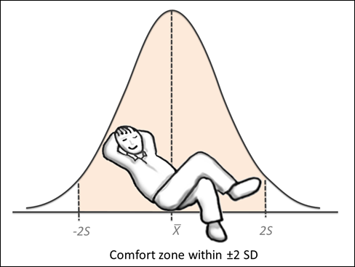
MC3020- Continuous Probability Distributions
Dr T. Mayooran,
Senior Lecturer,
Department of Interdisciplinary Studies,
Faculty of Engineering,
University of Jaffna.
Email: mayooran@eng.jfn.ac.lk

Slide 2
Continuous Probability Distributions
Definitions
Continuous Probability Distributions
Sampling Distributions
Central Limit Theorem
Normal Approximation to the Binomial Distribution
Introduce additional Continuous Probability Distributions

Slide 3
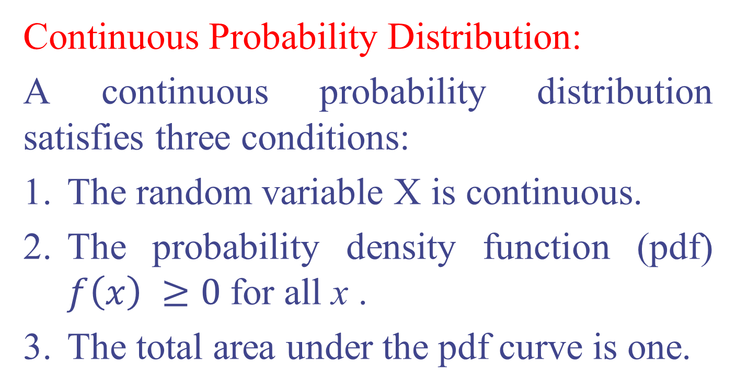
Definitions
Continuous Probability Distribution:
A continuous probability distribution satisfies three conditions:
The random variable X is continuous.
The probability density function (pdf) $f\left(x\right) ≥0$for all x .
The total area under the pdf curve is one.

Slide 4

Continuous Probability Distributions
A continuous random variable is a variable that can assume any value on a continuum (can assume an uncountable number of values)
volume of milk produced in a morning milking
Time required to complete a task
These can potentially take on any value, depending only on the ability to measure accurately

Slide 5
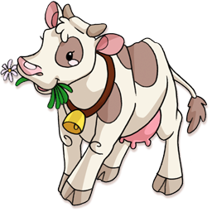
Continuous Probability Distributions
Let X be the volume of milk produced in a morning milking (liter's per day) for NZ cows.
Probability Distribution:
Properties:
Area under the curve gives probability
Total area is 1
Parameters are the mean and standard deviation (normal distribution case)
Notes:
-Probability in a continuous probability distribution is the area under the curve.
-To describe a continuous distribution: we talk about its centre e.g. where is its mean, its spread e.g. standard deviation and its shape.

Slide 6

Continuous Probability Distributions
Let X be the test mark from a mastery test (as a percentage) for first year statistics students.
Probability Distribution:
Properties:
Area under the curve gives probability
Total area is 1
Parameters are the mean and standard deviation (normal distribution case)
Notes:
-This shape is not a bell shape, it is left skewed. Can still focus on the mean and standard deviation.
-Today we will be focusing on symmetric distributions e.g. the normal distribution.

Slide 7
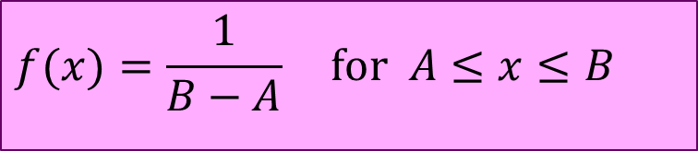
Uniform Distribution:
The general formula for the probability density function (pdf) of the uniform distribution is
A random variable X that follows above pdf is known as a uniform random variable. The mean of X is and the variance of X is,
$$f(x)=\frac{1}{B−A} \text{for} A≤x≤B$$

Slide 8
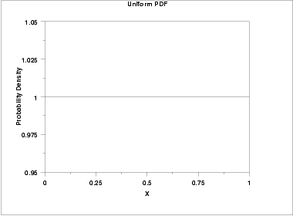
The probability density function for the standard uniform distribution is
The following is the plot of the standard uniform probability density.

Slide 9
Normal Distribution
‘Bell-shaped’
Symmetrical
Mean, median and mode are equal
Location is determined by the mean, μ
Spread is determined by the standard deviation, σ
The random variable has an infinite theoretical range: + ∞ to − ∞
σ
X
μ
Mean
= Median
= Mode

Slide 10
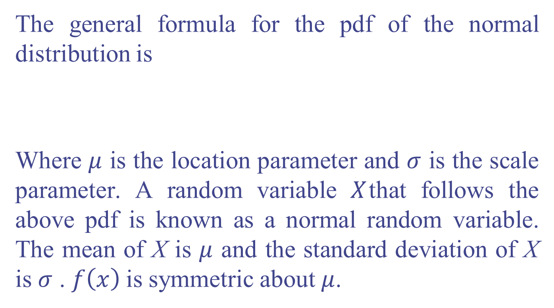
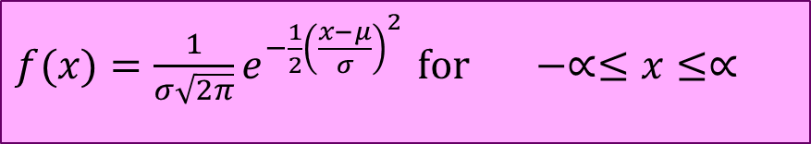
Normal Distribution
The general formula for the pdf of the normal distribution is
Where $μ$ is the location parameter and $σ$ is the scale parameter. A random variable $X$that follows the above pdf is known as a normal random variable. The mean of X is $μ$ and the standard deviation of X is $σ$ . $f\left(x\right)$is symmetric about $μ$.
$f(x)=\frac{1}{σ\sqrt{2π}}e^{−\frac{1}{2}{\left(\frac{x−μ}{σ}\right)}^{2}}$ $\text{for} −∝≤x≤∝$

Slide 11
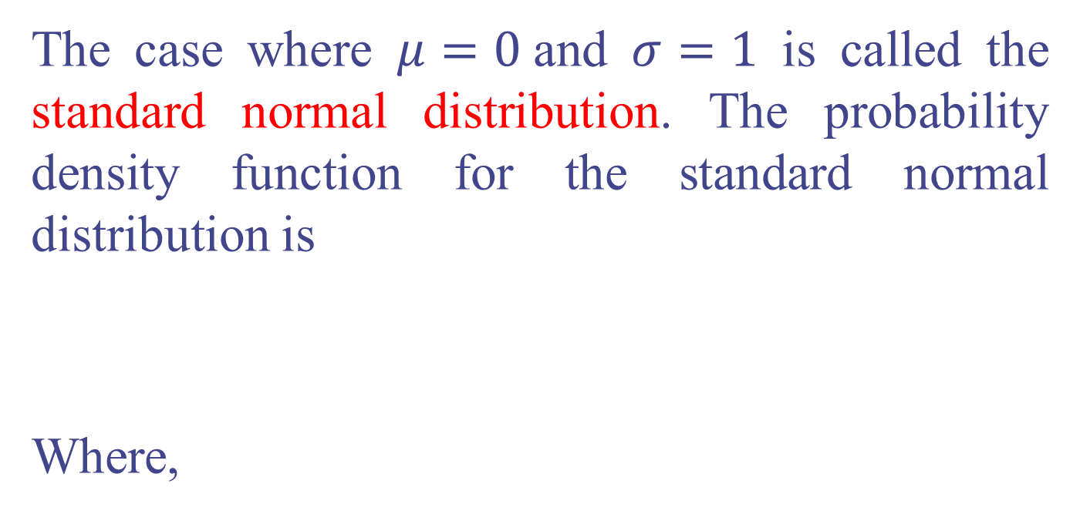
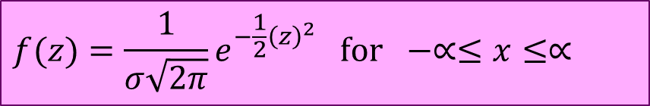
The case where $μ=0$and $σ=1$ is called the standard normal distribution. The probability density function for the standard normal distribution is
Where,
$$f(z)=\frac{1}{σ\sqrt{2π}}e^{−\frac{1}{2}{\left(z\right)}^{2}} \text{for} −∝≤x≤∝$$

Slide 12
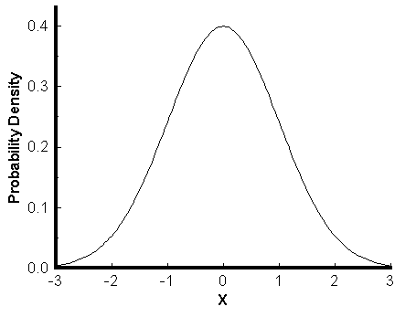
The following is the plot of the standard normal probability density function.
Z

Slide 13
Translation to the Standardised Normal Distribution
Translate from X to the standardised normal (the ‘Z’ distribution) by subtracting the mean of X and dividing by its standard deviation:
The Z distribution always has mean = 0 and standard deviation = 1
Notes:
-This is on the formula sheet.
-X is any value in that distribution
-μ is the mean of the distribution
-σ is the standard deviation of the distribution
-μ and σ in this case are from the normal distribution, that is going to be used to transform to the standard normal distribution.
-Z tells us how many standard deviations we are away from the mean.

Slide 14
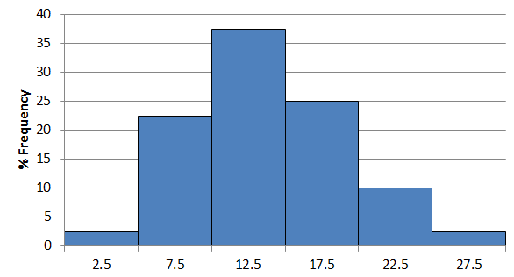
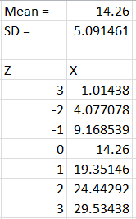
Example 2 :– Weight gain of pigs
Z=-3
Z=-2
Z=-1
Z=0
Z=1
Z=2
Z=3
Z=0 : typical
Z=3 : extremely high
Z=1 : bit higher than usual
Z=-1 : bit lower than usual
Z=2 : lot higher than usual
etc.
Notes:
-This shows the distribution of the weight gain of pigs, and transforms this to the standard normal distribution.
-Over half the data lies within 1 standard deviation of the mean (approx. 68%).
-Over 2 standard deviations from the mean is unusual and over 3 standard deviations from the mean is really unusual.

Slide 15


Example 3:– Question
Apples are graded by size before being packed for export or for supplying supermarkets. The supermarket grade of a particular type of apple has mean weight 190 g and standard deviation 12 g. Assume the apple weights have a normal distribution
Calculate the Z value for an apple that weighs 205g.
Write a sentence, in context, describing what this value means
Notes:
Answer:
Z = (X-μ )/σ
Z = (205 – 190)/12 = 1.25
A supermarket grade apple that weighs 205g is 1.25 standard deviations above the mean weight.

Slide 16
Comparing X and Z Units
100
200
X
(μ = 100, σ = 50)
0
2.0
Z
(μ = 0, σ = 1)
Note that the distribution is the same, only the scale has changed. We can express the problem in original units (X) or in standardised units (Z)

Slide 17
Finding Normal Probabilities
Probability is measured by the area under the curve
P
(
≤
≤
)
a
X
b
=
P
(
<
<
)
a
X
b
(Note that the probability of any individual value is zero)
a
b
X
Notes:
-For a continuous distribution it does not matter if you use ≤ or < e.g. it doesn’t matter if you use less than or equal to or less than. Alternatively it doesn’t matter if it you use greater than, or equal to and greater than. In a continuous distribution probability is an area, so the probability of getting exactly “a” is very small, it is practically zero, for example if a is 5, then to get exactly 5 then have to look between 4.9999999999 and so on and 5.0000000001 except to a larger number of dp, so it is a very small probability.
-Therefore P(a≤X≤b) is equivalent to P(a<X<b).

Slide 18
Probability as Area Under the Curve
The total area under the curve is 1.0, and the curve is symmetric, so half is above the mean, half is below
0.5
0.5
μ
X
Notes:
-remember the mean and the median are equal because the distribution is symmetrical.

Slide 19
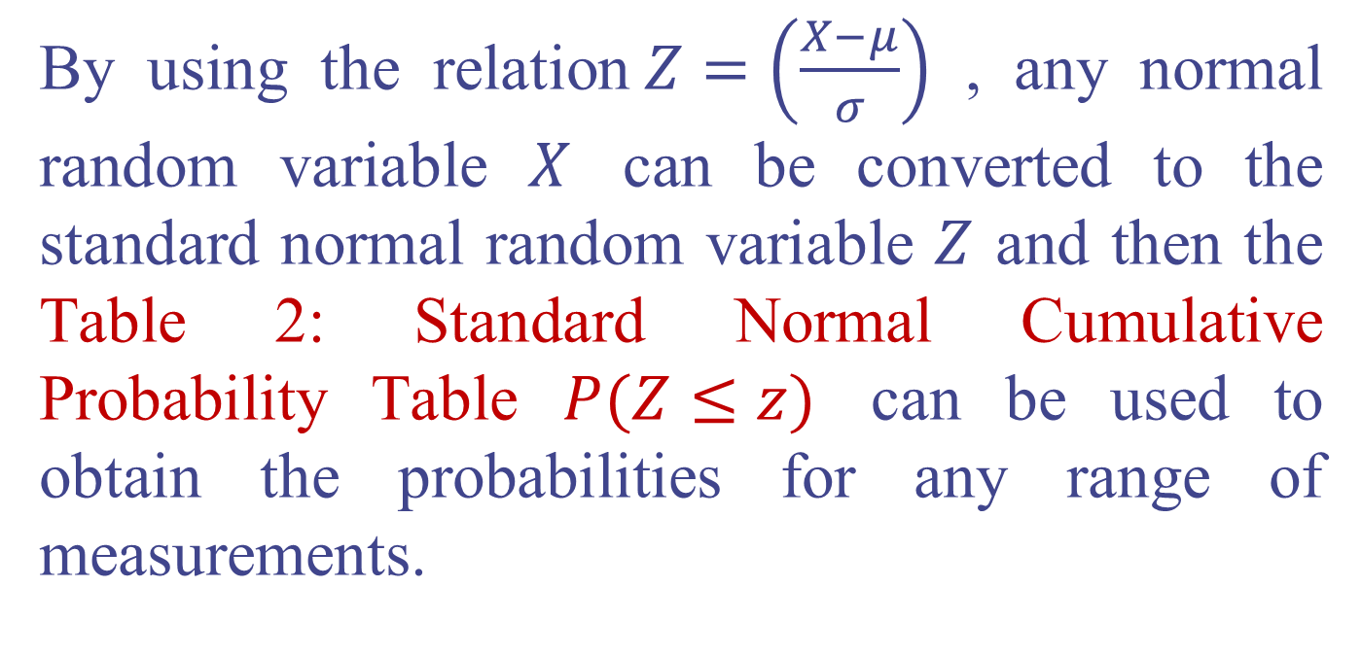
By using the relation$Z=\left(\frac{X−μ}{σ}\right)$ , any normal random variable $X$ can be converted to the standard normal random variable $Z$ and then the Table 2: Standard Normal Cumulative Probability Table $P(Z≤z)$ can be used to obtain the probabilities for any range of measurements.

Slide 20
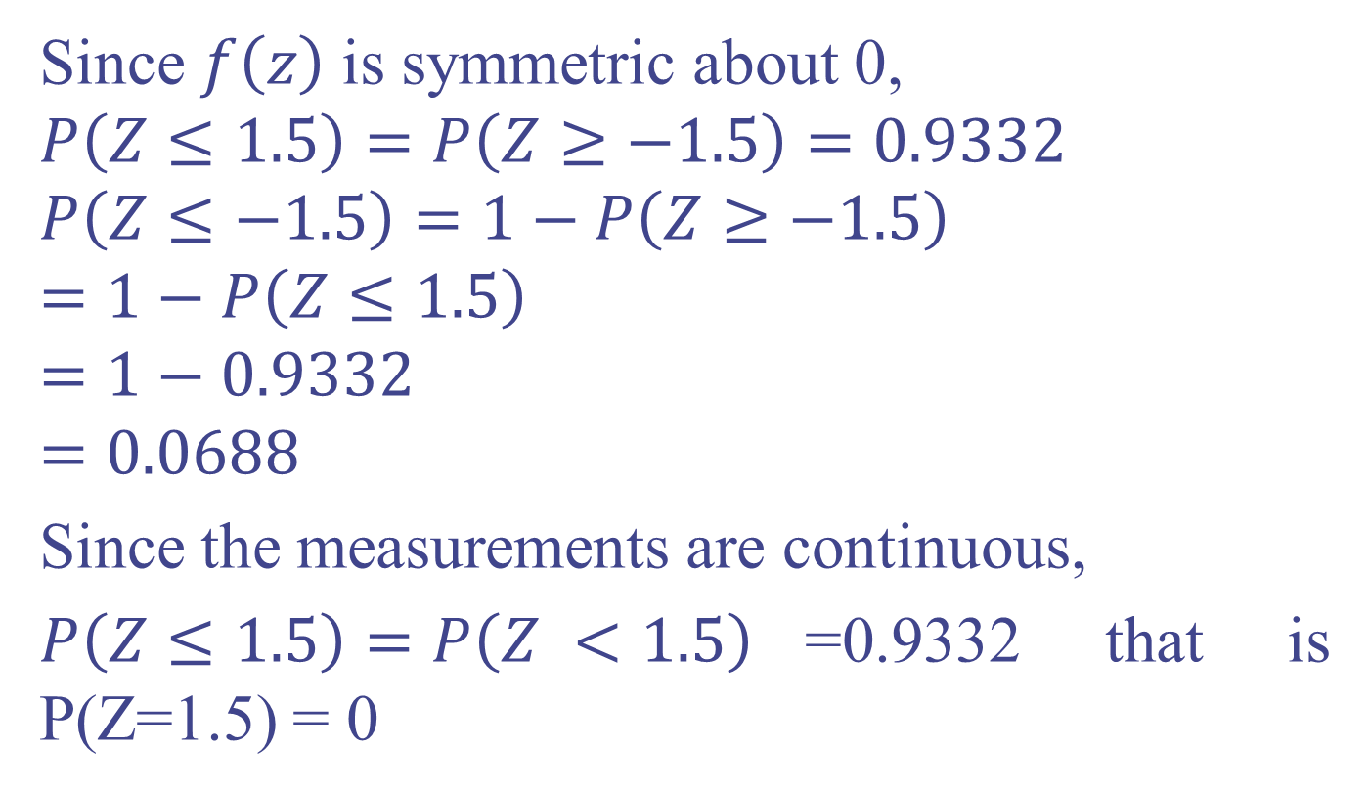
Example 4:
Since $f\left(z\right)$ is symmetric about 0,
$$P\left(Z≤1.5\right)=P\left(Z≥−1.5\right)=0.9332$$
$$P\left(Z≤−1.5\right)=1−P\left(Z≥−1.5\right)=1−P\left(Z≤1.5\right)$$
$$=1−0.9332$$
$$=0.0688$$
Since the measurements are continuous,
$P\left(Z≤1.5\right)=P\left(Z <1.5\right)$=0.9332 that is P(Z=1.5) = 0

Slide 21
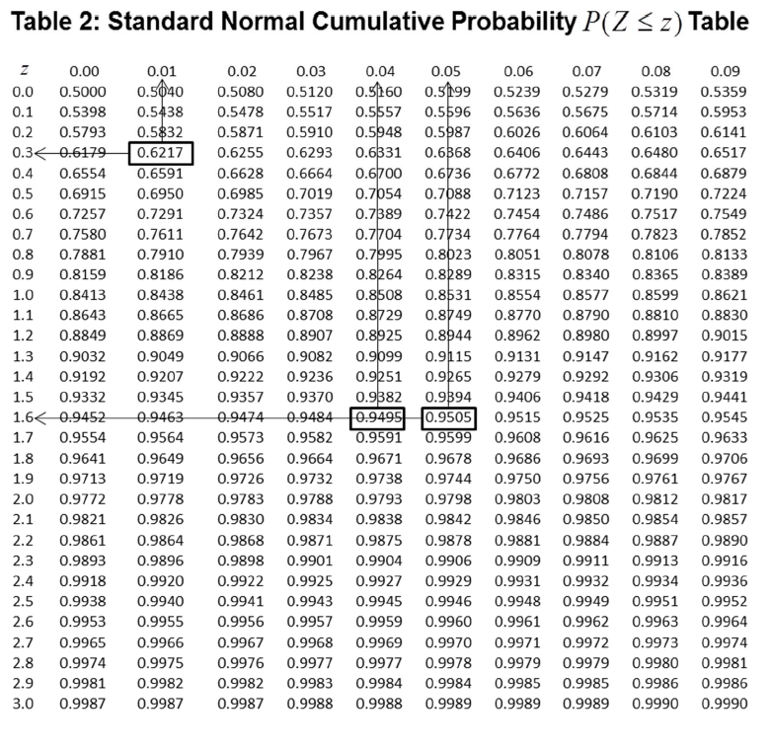

Slide 22
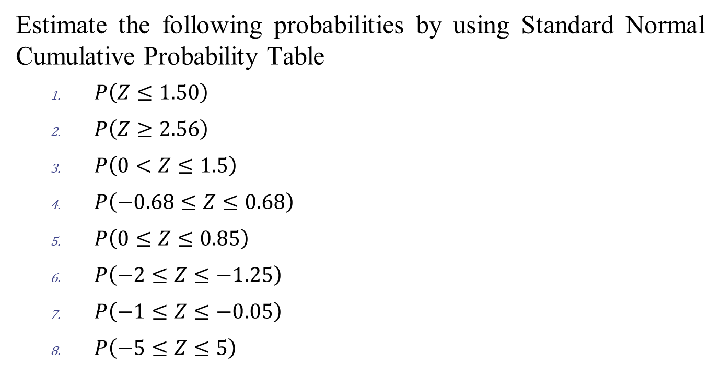
For your practice:
Estimate the following probabilities by using Standard Normal Cumulative Probability Table
$P\left(Z≤1.50\right)$
$P\left(Z≥2.56\right)$
$P\left(0<Z≤1.5\right)$
$P\left(−0.68≤Z≤0.68\right)$
$P\left(0≤Z≤0.85\right)$
$P\left(−2≤Z≤−1.25\right)$
$P\left(−1≤Z≤−0.05\right)$
$P\left(−5≤Z≤5\right)$

Slide 23
Empirical Rule
Any normal random variable has the following three properties:
68.26% of all possible values lie within one standard deviation about the mean.
95.44% of all possible values lie within two standard deviations about the mean.
99.74% of all possible values lie within three standard deviation about the mean.

Slide 24
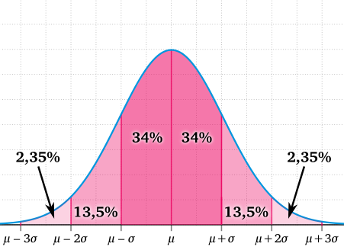
The following figure illustrates these properties listed on the previous page.

Slide 25
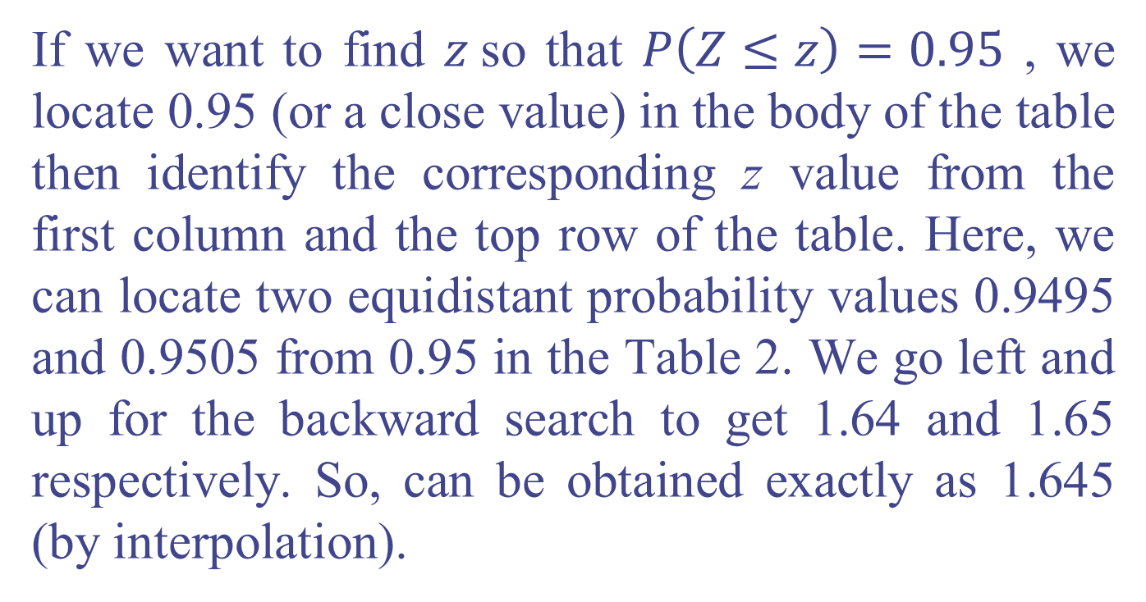
Example 5:
If we want to find $z$so that $P\left(Z≤z\right)=0.95$ , we locate 0.95 (or a close value) in the body of the table then identify the corresponding z value from the first column and the top row of the table. Here, we can locate two equidistant probability values 0.9495 and 0.9505 from 0.95 in the Table 2. We go left and up for the backward search to get 1.64 and 1.65 respectively. So, can be obtained exactly as 1.645 (by interpolation).

Slide 26
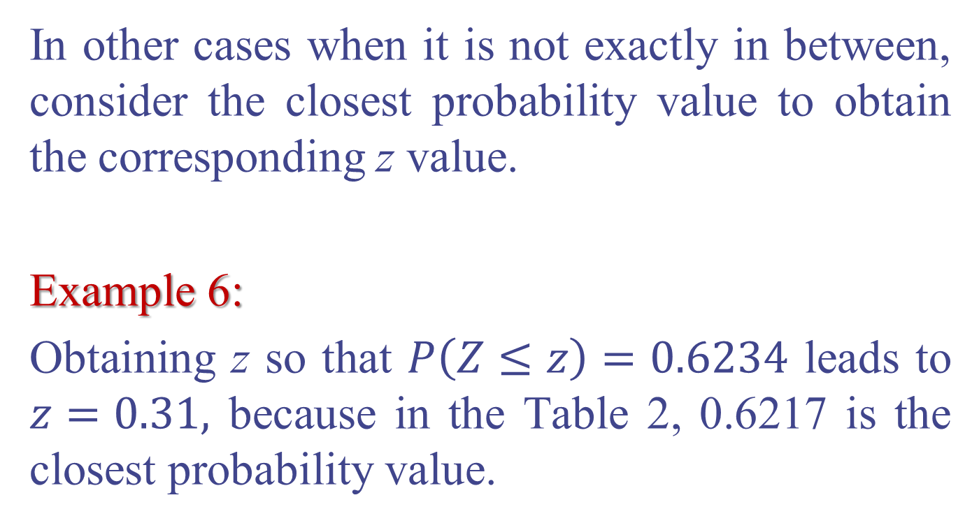
In other cases when it is not exactly in between, consider the closest probability value to obtain the corresponding z value.
Example 6:
Obtaining z so that $P\left(Z≤z\right)=0.6234$ leads to $z=0.31,$ because in the Table 2, 0.6217 is the closest probability value.

Slide 27
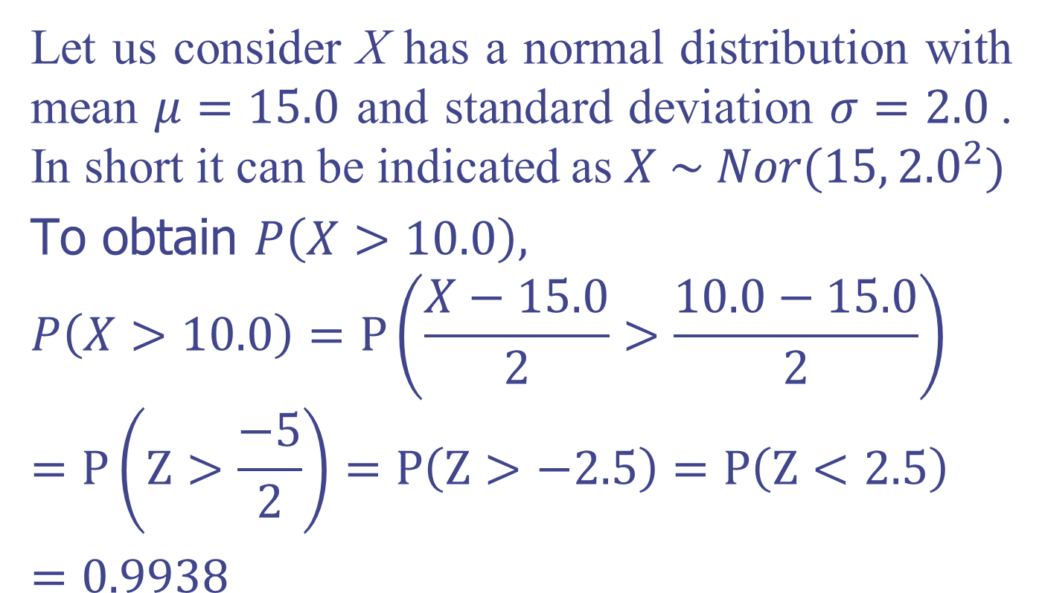
Example 7:
Let us consider X has a normal distribution with mean $μ=15.0$ and standard deviation $σ=2.0$. In short it can be indicated as $X \sim Nor(15,{2.0}^{2})$
To obtain $P\left(X>10.0\right),$
$$P\left(X>10.0\right)=P\left(\frac{X−15.0}{2}>\frac{10.0−15.0}{2}\right)$$
$$=P\left(Z>\frac{−5}{2}\right)=P\left(Z>−2.5\right)=P\left(Z<2.5\right)$$
$=0.9938$

Slide 28
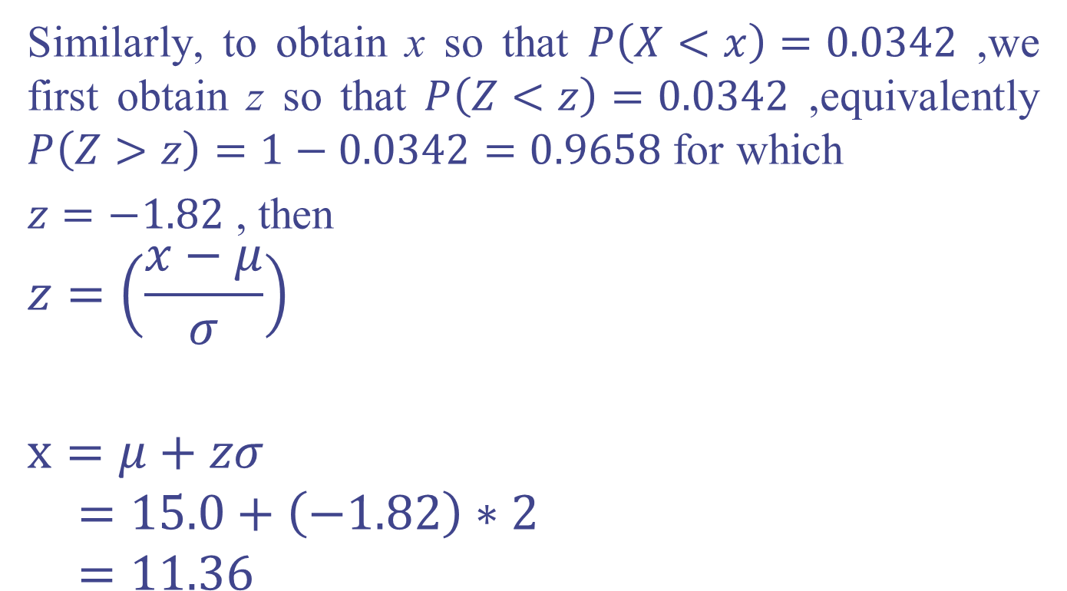
Similarly, to obtain x so that $P\left(X<x\right)=0.0342$ ,we first obtain z so that $P\left(Z<z\right)=0.0342$ ,equivalently $P\left(Z>z\right)=1−0.0342=0.9658$for which
$z=−1.82$ , then
$$z=\left(\frac{x−μ}{σ}\right)$$
$$x=μ+zσ$$
$$=15.0+\left(−1.82\right)∗2$$
$$=11.36$$

Slide 29
Example 8:
The lengths of pregnancies are normally distributed with a mean of 268 days and a standard deviation of 15 days. If we stipulate that a baby is premature if born at least three weeks early (21 Days),
what percentage of babies is born prematurely?
what percentage of babies is born not prematurely?

Slide 30
Example 9:
The serum cholesterol levels in men aged between 18 to 24 are normally distributed with a mean of 120 and a standard deviation of 25. Units are mg/mL, and the data are based on the National Health Survey.
If a man aged 18 to 24 is randomly selected, find the probability that his serum cholesterol is greater than 170.
The Providence Health Maintenance Organization wants to establish a criterion for recommending dietary changes if cholesterol levels are in the top 10%. What is the cut-off for men aged 18 to 24?
Between which two cholesterol levels symmetrically located about the mean are 90% of the scores?

Slide 31
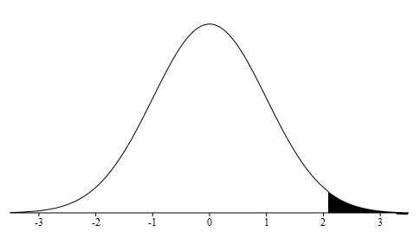
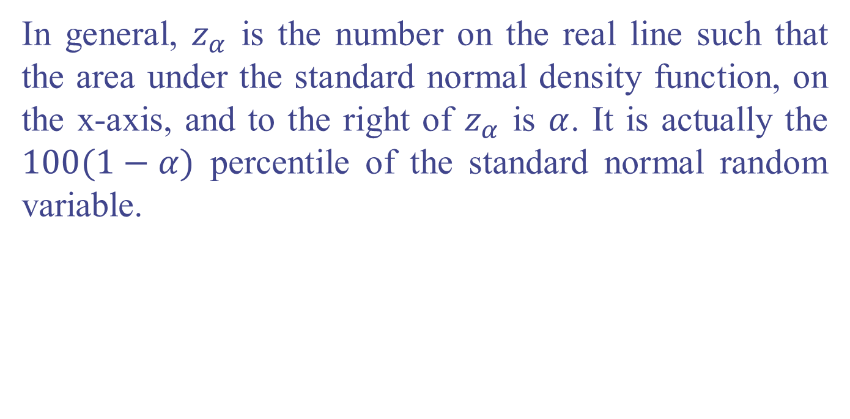




Notation of $Z_{α}$
In general, $z_{α}$ is the number on the real line such that the area under the standard normal density function, on the x-axis, and to the right of $z_{α}$ is $α$. It is actually the $100(1−α)$ percentile of the standard normal random variable.
$$1−α$$
$$α$$
$$Z_{α}$$

Slide 32
Exponential Distribution
Used to model the length of time between two occurrences of an event (the time between arrivals)
Examples:
Time between trucks arriving at an unloading dock
Time between transactions at an ATM Machine
Time between phone calls to the main operator
Describes time or distance between events is the inverse of the Poisson distribution

Slide 33


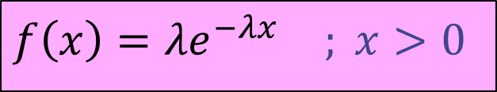
Exponential Distribution
The general formula for the probability density function (pdf) of the exponential distribution is
A random variable X that follows above pdf is known as a exponential random variable. The mean of X is and the variance of X is,
$f\left(x\right)={λe}^{−λx}$ $; x>0$
$$μ=\frac{1}{λ}$$
$$σ^{2}=\frac{1}{λ^{2}}$$

Slide 34
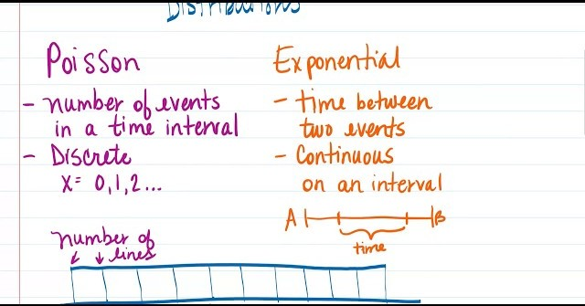

Slide 35
Example 1:
At a police station in a large city, calls come in at an average rate of four calls per minute. Assume that the time that elapses from one call to the next has the exponential distribution. Take note that we are concerned only with the rate at which calls come in, and we are ignoring the time spent on the phone. We must also assume that the times spent between calls are independent. This means that a particularly long delay between two calls does not mean that there will be a shorter waiting period for the next call. We may then deduce that the total number of calls received during a time period has the Poisson distribution.
Find the average time between two successive calls.
Find the probability that after a call is received, the next call occurs in less than ten seconds.
Find the probability that exactly five calls occur within a minute.
Find the probability that less than five calls occur within a minute.
Find the probability that more than 40 calls occur in an eight-minute period.

Slide 36
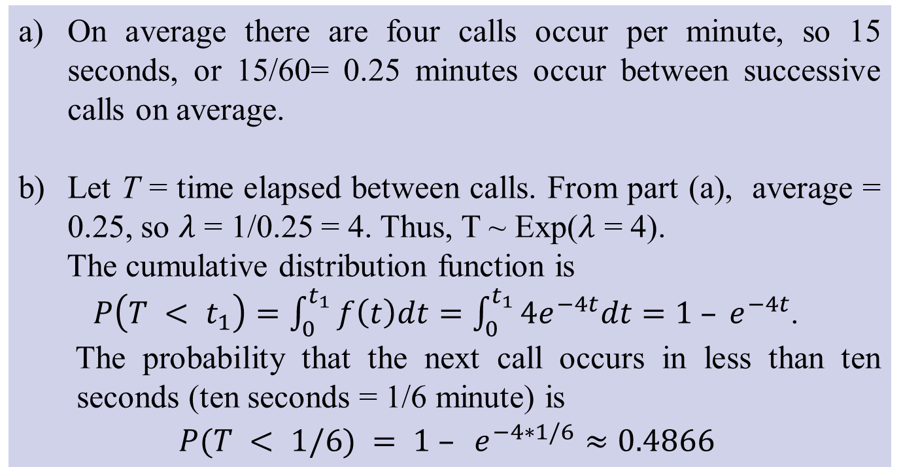
Solution:
On average there are four calls occur per minute, so 15 seconds, or 15/60= 0.25 minutes occur between successive calls on average.
Let T = time elapsed between calls. From part (a), average = 0.25, so $λ$ = 1/0.25 = 4. Thus, T ~ Exp($λ$ = 4).
The cumulative distribution function is
$P\left(T < t_{1}\right)=\int_{0}^{t_{1}}{f\left(t\right)dt}=\int_{0}^{t_{1}}{4e^{−4t}dt}=1 – e^{−4t}$.
The probability that the next call occurs in less than ten seconds (ten seconds = 1/6 minute) is
$$P(T < 1/6) = 1 – e^{−4∗1/6}≈0.4866$$

Slide 37
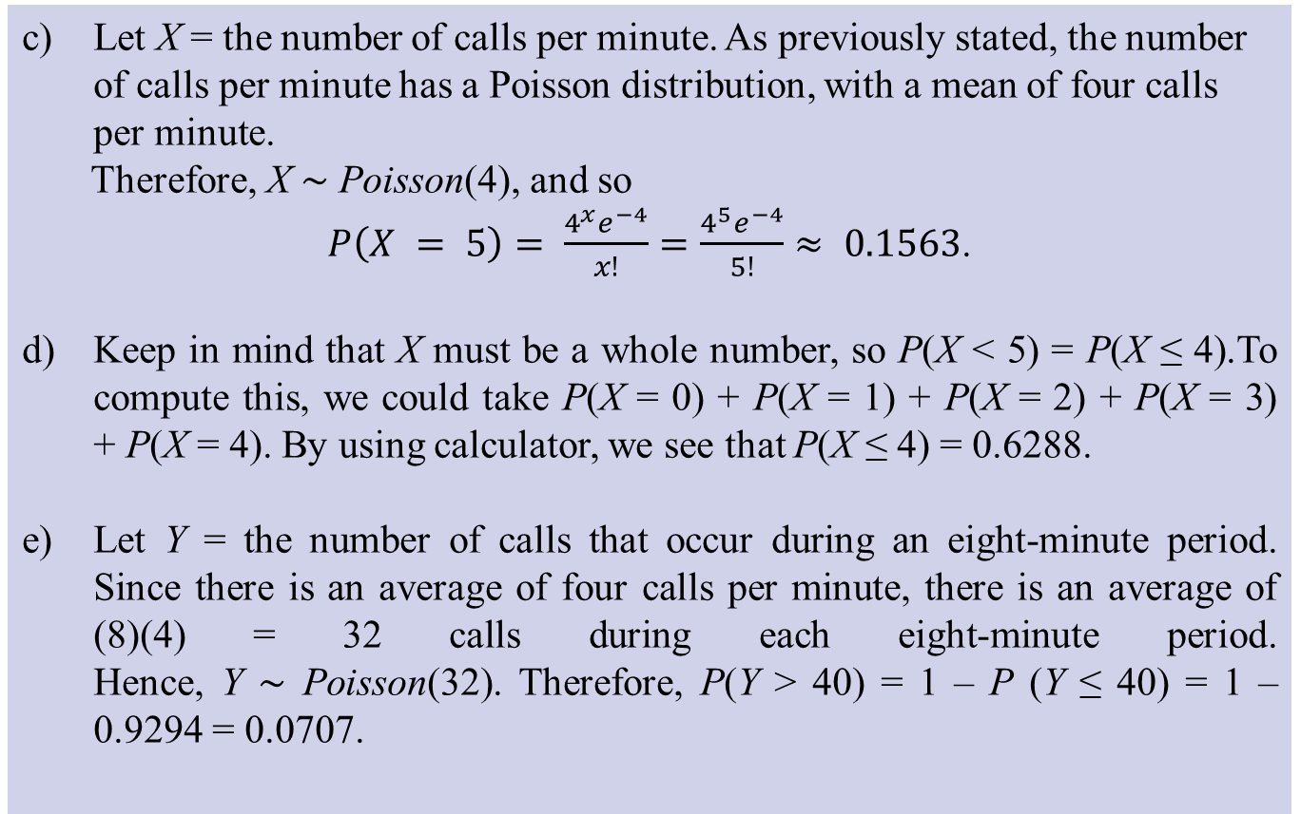
Solution :
Let X = the number of calls per minute. As previously stated, the number of calls per minute has a Poisson distribution, with a mean of four calls per minute.
Therefore, X ∼ Poisson(4), and so
$P\left(X = 5\right)= \frac{4^{x}e^{−4}}{x!}=\frac{4^{5}e^{−4}}{5!}≈ 0.1563$.
Keep in mind that X must be a whole number, so P(X < 5) = P(X ≤ 4).To compute this, we could take P(X = 0) + P(X = 1) + P(X = 2) + P(X = 3) + P(X = 4). By using calculator, we see that P(X ≤ 4) = 0.6288.
Let Y = the number of calls that occur during an eight-minute period. Since there is an average of four calls per minute, there is an average of (8)(4) = 32 calls during each eight-minute period. Hence, Y ∼ Poisson(32). Therefore, P(Y > 40) = 1 – P (Y ≤ 40) = 1 – 0.9294 = 0.0707.

Slide 38
Exercises:

Slide 39
Sampling Distributions Introduction
In real life, calculating parameters of populations is usually impossible because populations are very large.
Rather than investigating the whole population, we take a sample, calculate a statistic related to the parameter of interest, and make an inference.
The sampling distribution of the statistic is the tool that tells us how close the statistic is to the parameter.

Slide 40
Statistic and Parameter
A parameter is a number that describes some aspect of a population.
A statistic is a number that is computed from data in a sample.
We usually have a sample statistic and want to use it to make inferences about the population parameter

Slide 41
The Big Picture
Population
Sampling
PARAMETERS
Sample
STATISTICS
Statistical Inference

Slide 42
Sampling Distributions
Let us consider T be a statistic (a function of a sample), the distribution of T is known as the sampling distribution of T .

Slide 43
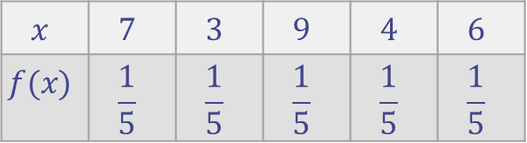
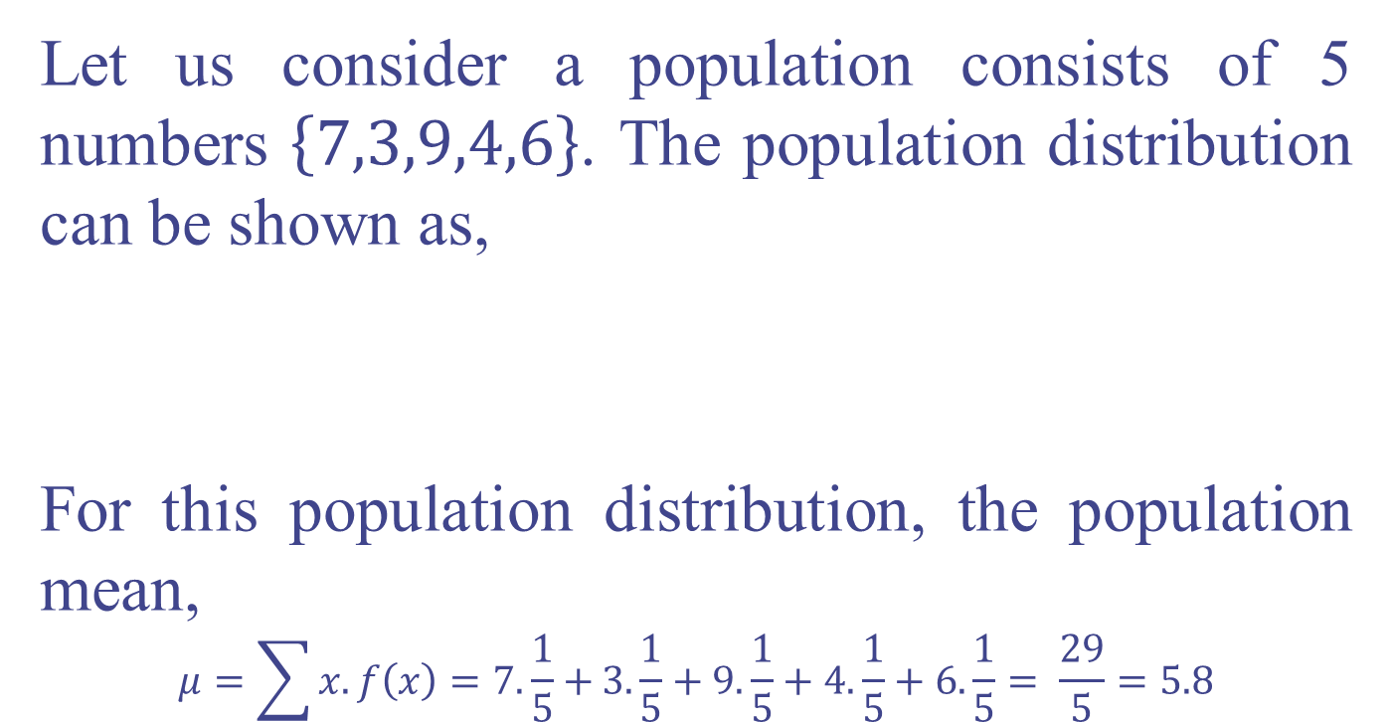
Example 10:
Let us consider a population consists of 5 numbers $\left\{7,3,9,4,6\right\}$. The population distribution can be shown as,
For this population distribution, the population mean,
$$μ=\sum{x.f\left(x\right)=7.\frac{1}{5}+}3.\frac{1}{5}+9.\frac{1}{5}+4.\frac{1}{5}+6.\frac{1}{5}= \frac{29}{5}=5.8$$
$$x$$ | $$7$$ | $$3$$ | $$9$$ | $$4$$ | $$6$$
$$f(x)$$ | $$\frac{1}{5}$$ | $$\frac{1}{5}$$ | $$\frac{1}{5}$$ | $$\frac{1}{5}$$ | $$\frac{1}{5}$$

Slide 44
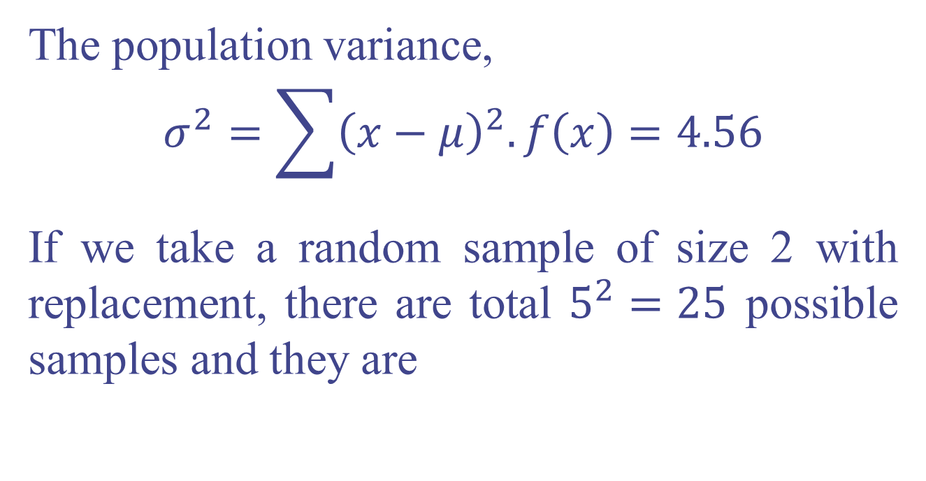
The population variance,
$$σ^{2}=\sum{{\left(x−μ\right)}^{2}.f\left(x\right)}=4.56$$
If we take a random sample of size 2 with replacement, there are total $5^{2}=25$ possible samples and they are

Slide 45
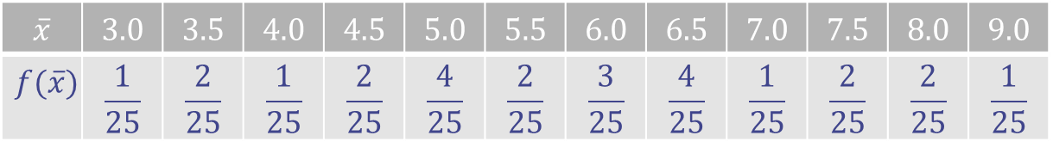
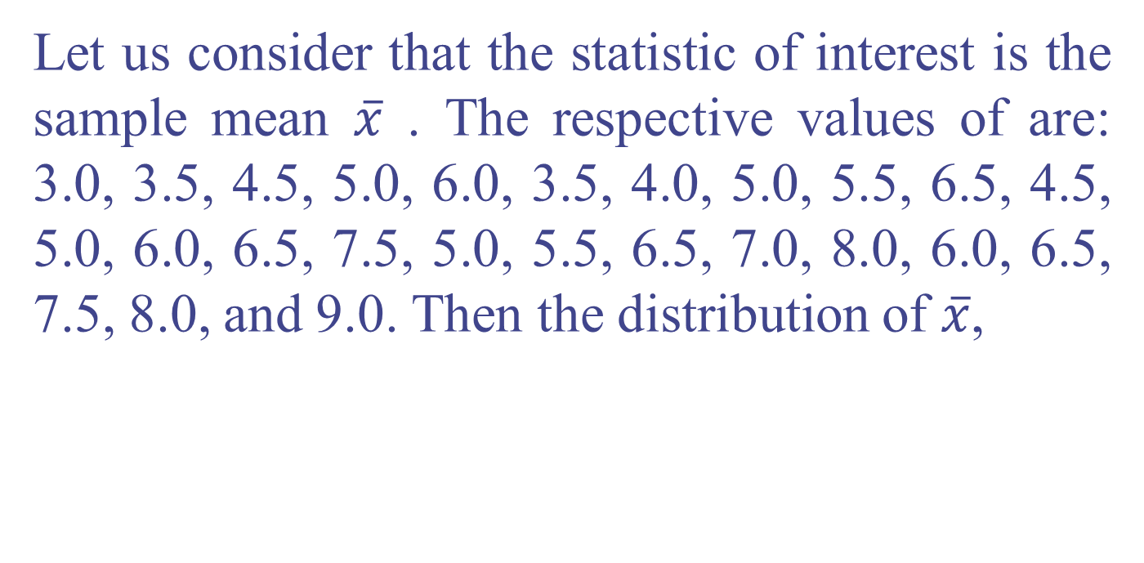
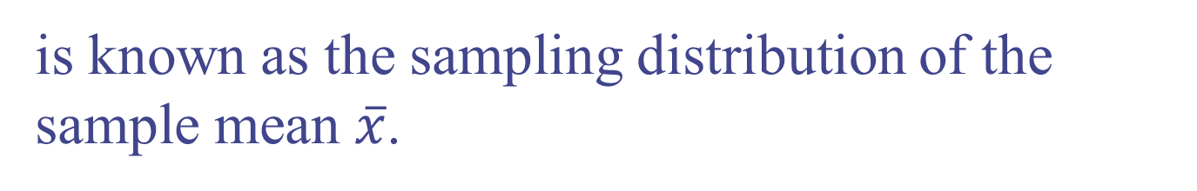
Let us consider that the statistic of interest is the sample mean $\overline{x}$ . The respective values of are: 3.0, 3.5, 4.5, 5.0, 6.0, 3.5, 4.0, 5.0, 5.5, 6.5, 4.5, 5.0, 6.0, 6.5, 7.5, 5.0, 5.5, 6.5, 7.0, 8.0, 6.0, 6.5, 7.5, 8.0, and 9.0. Then the distribution of $\overline{x}$,
$$\overline{x}$$ | $$3.0$$ | $$3.5$$ | $$4.0$$ | $$4.5$$ | $$5.0$$ | $$5.5$$ | $$6.0$$ | $$6.5$$ | $$7.0$$ | $$7.5$$ | $$8.0$$ | $$9.0$$
$$f(\overline{x})$$ | $$\frac{1}{25}$$ | $$\frac{2}{25}$$ | $$\frac{1}{25}$$ | $$\frac{2}{25}$$ | $$\frac{4}{25}$$ | $$\frac{2}{25}$$ | $$\frac{3}{25}$$ | $$\frac{4}{25}$$ | $$\frac{1}{25}$$ | $$\frac{2}{25}$$ | $$\frac{2}{25}$$ | $$\frac{1}{25}$$
is known as the sampling distribution of the sample mean $\overline{x}$.

Slide 46
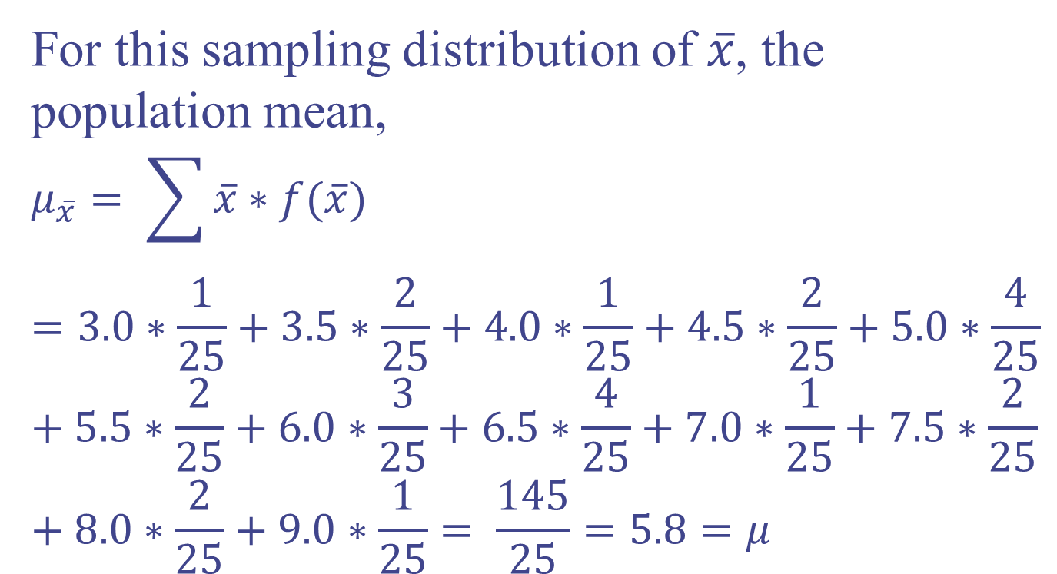
For this sampling distribution of $\overline{x}$, the population mean,
$$μ_{\overline{x}}= \sum{\overline{x}∗f(\overline{x})}=3.0∗\frac{1}{25}+3.5∗\frac{2}{25}+4.0∗\frac{1}{25}+4.5∗\frac{2}{25}+5.0∗\frac{4}{25}+5.5∗\frac{2}{25}+6.0∗\frac{3}{25}+6.5∗\frac{4}{25}+7.0∗\frac{1}{25}+7.5∗\frac{2}{25}+8.0∗\frac{2}{25}+9.0∗\frac{1}{25}= \frac{145}{25}=5.8=μ$$

Slide 47
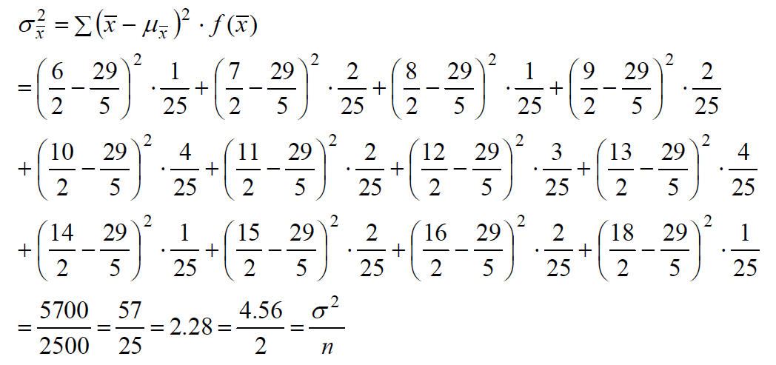

For this sampling distribution of $\overline{x}$, The
population variance,

Slide 48
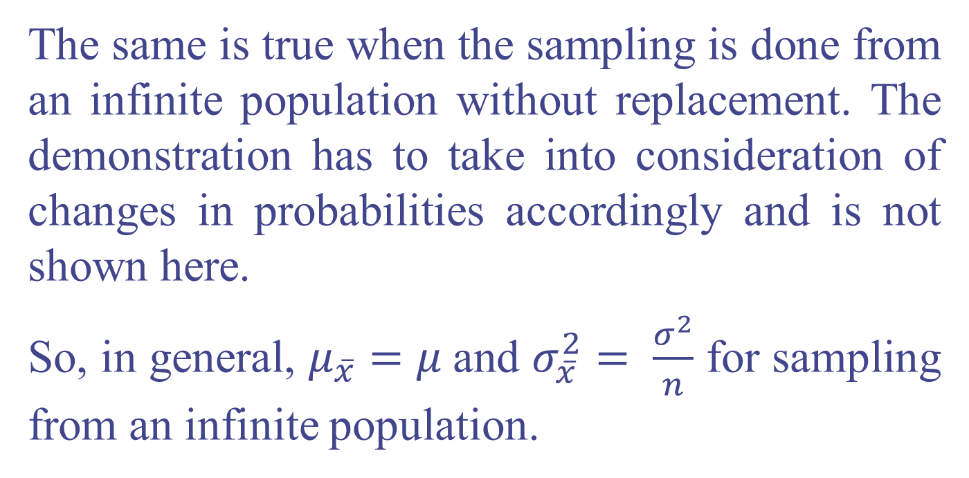
The same is true when the sampling is done from an infinite population without replacement. The demonstration has to take into consideration of changes in probabilities accordingly and is not shown here.
So, in general, $μ_{\overline{x}}=μ$and $σ_{\overline{x}}^{2}= \frac{σ^{2}}{n}$ for sampling from an infinite population.

Slide 49
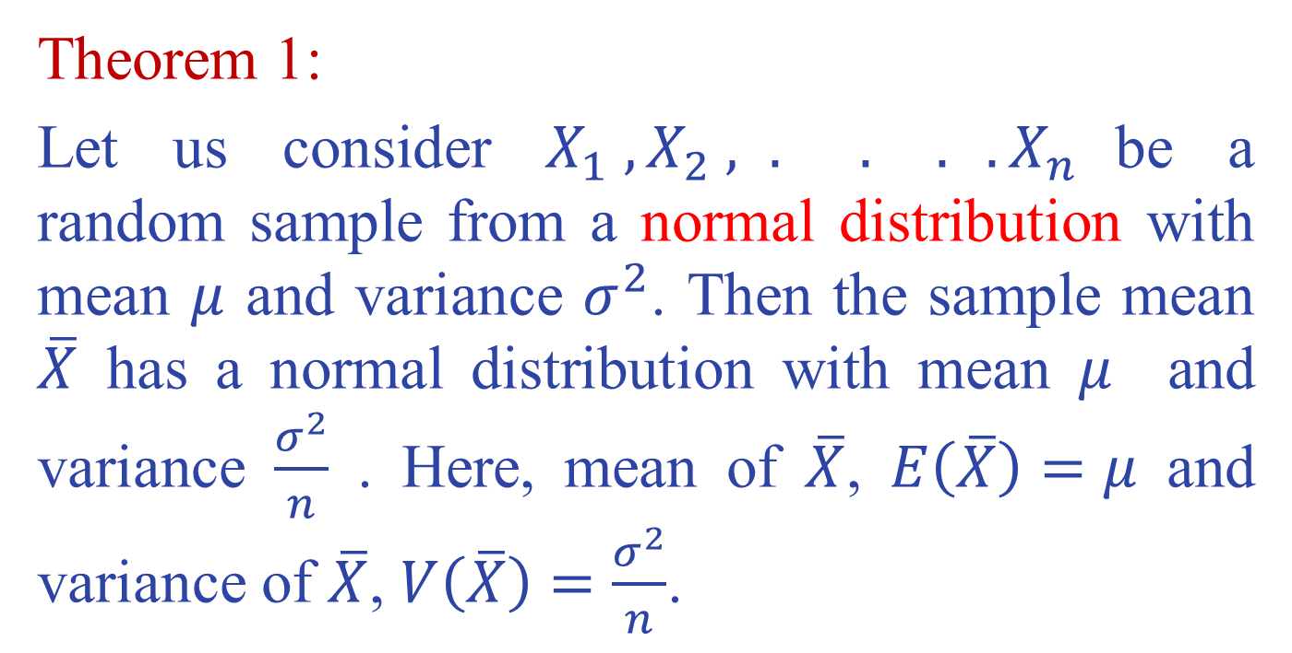
The Central Limit Theorem
Theorem 1:
Let us consider $X_{1} , X_{2} , . . . .X_{n}$be a random sample from a normal distribution with mean $μ$ and variance $σ^{2}$. Then the sample mean $\overline{X}$ has a normal distribution with mean $μ$ and variance $\frac{σ^{2}}{n}$ . Here, mean of $\overline{X}$, $E\left(\overline{X}\right)=μ$ and variance of $\overline{X}$, $V\left(\overline{X}\right)=\frac{σ^{2}}{n}$.

Slide 50
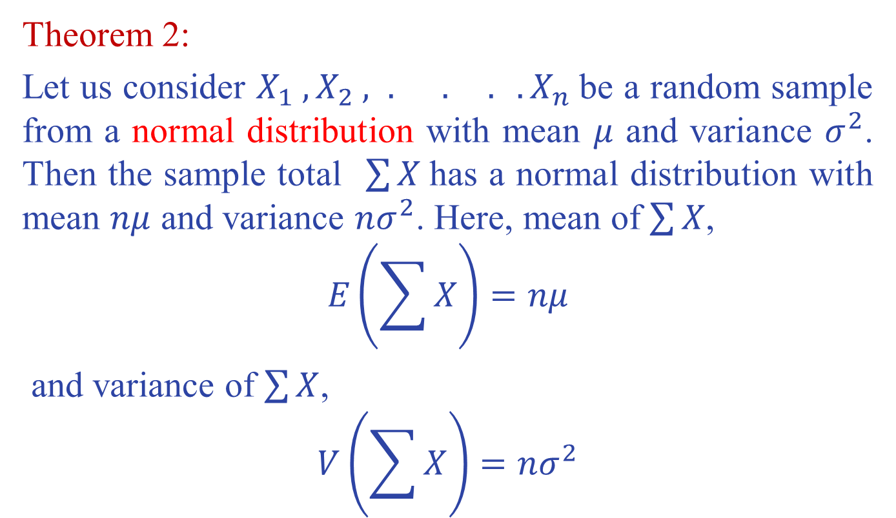
Theorem 2:
Let us consider $X_{1} , X_{2} , . . . .X_{n}$be a random sample from a normal distribution with mean $μ$ and variance $σ^{2}$. Then the sample total $\sum{X}$has a normal distribution with mean $nμ$ and variance $nσ^{2}$. Here, mean of $\sum{X}$,
$$E\left(\sum{X}\right)=nμ$$
and variance of $\sum{X}$,
$$V\left(\sum{X}\right)=nσ^{2}$$

Slide 51
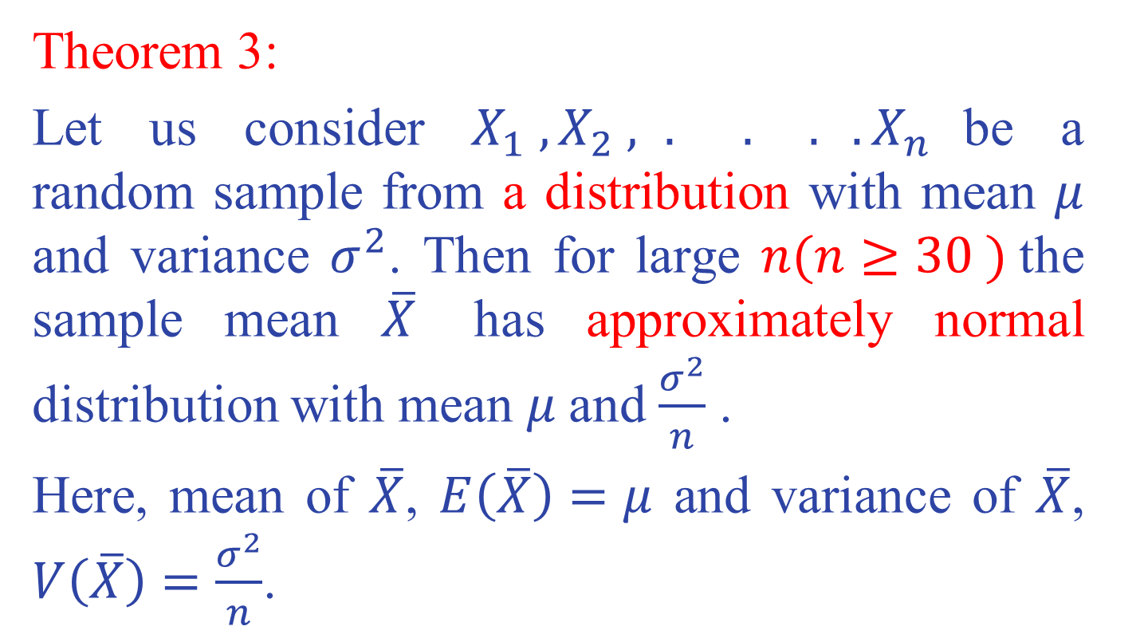
Theorem 3:
Let us consider $X_{1} , X_{2} , . . . .X_{n}$be a random sample from a distribution with mean $μ$ and variance $σ^{2}$. Then for large $n(n≥30 )$the sample mean $\overline{X}$ has approximately normal distribution with mean $μ$and $\frac{σ^{2}}{n}$ .
Here, mean of $\overline{X}$, $E\left(\overline{X}\right)=μ$ and variance of $\overline{X}$, $V\left(\overline{X}\right)=\frac{σ^{2}}{n}$.

Slide 52
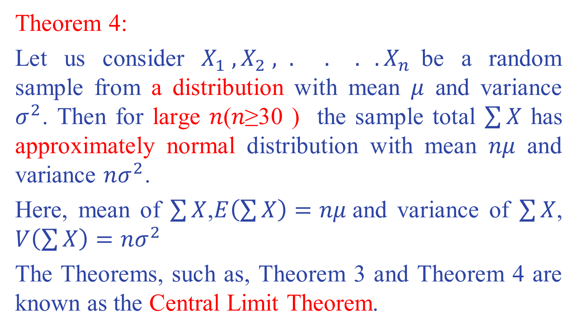
Theorem 4:
Let us consider $X_{1} , X_{2} , . . . .X_{n}$be a random sample from a distribution with mean $μ$ and variance $σ^{2}$. Then for large 𝑛(𝑛≥30 ) the sample total $\sum{X}$ has approximately normal distribution with mean 𝑛𝜇 and variance $nσ^{2}$.
Here, mean of $\sum{X}$,$E\left(\sum{X}\right)=nμ$and variance of $\sum{X}$, $V\left(\sum{X}\right)=nσ^{2}$
The Theorems, such as, Theorem 3 and Theorem 4 are known as the Central Limit Theorem.

Slide 53
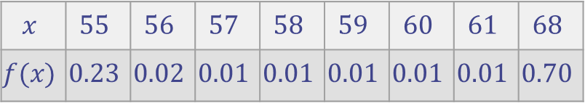

Example 11:
Let us consider a population consists of 8 numbers $\left\{55, 56, 57, 58, 59, 60, 61, 68\right\}$. The population distribution can be shown as
$$x$$ | $$55$$ | $$56$$ | $$57$$ | $$58$$ | $$59$$ | $$60$$ | $$61$$ | $$68$$
$$f(x)$$ | $$0.23$$ | $$0.02$$ | $$0.01$$ | $$0.01$$ | $$0.01$$ | $$0.01$$ | $$0.01$$ | $$0.70$$

Slide 54
Obviously, this is not a Normal probability distribution. It is not even a continuous distribution. Let us generate random samples from this population and study the sample means. The next slide figure of the histograms of the sample means shows that, when the sample size gets larger, the sampling distribution of the sample means becomes more and more like a Normal distribution.

Slide 55
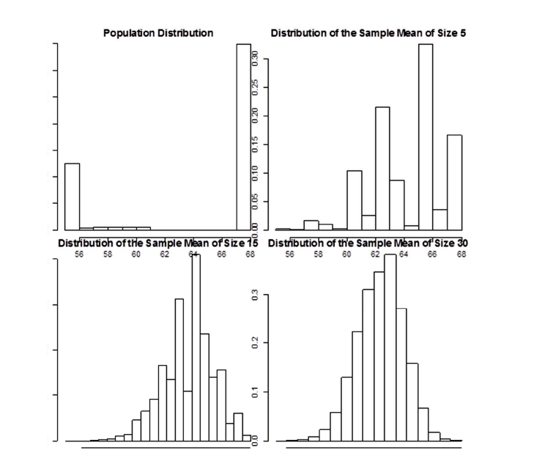

Slide 56
Example

Slide 57
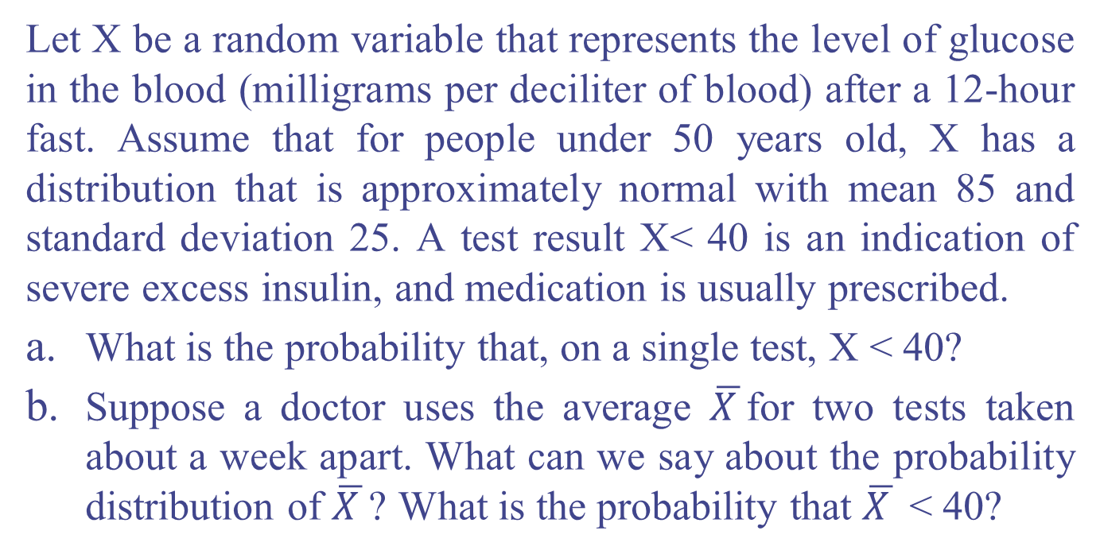
Example 12:
Let X be a random variable that represents the level of glucose in the blood (milligrams per deciliter of blood) after a 12-hour fast. Assume that for people under 50 years old, X has a distribution that is approximately normal with mean 85 and standard deviation 25. A test result X< 40 is an indication of severe excess insulin, and medication is usually prescribed.
What is the probability that, on a single test, X < 40?
Suppose a doctor uses the average $\overline{X }$for two tests taken about a week apart. What can we say about the probability distribution of $\overline{X }$? What is the probability that $\overline{X }$ < 40?

Slide 58
Example 13:
A bottle of 5000ml wine was served at an end of semester party. There were total 48 guests attending the party. Assume the amount of wine consumed by each guest followed some specific distribution with mean 100ml and standard deviation 32ml. We also assume that the guests drank the wine independently. What is the probability that the bottle was still not empty after all 48 guests had the wine?

Slide 59
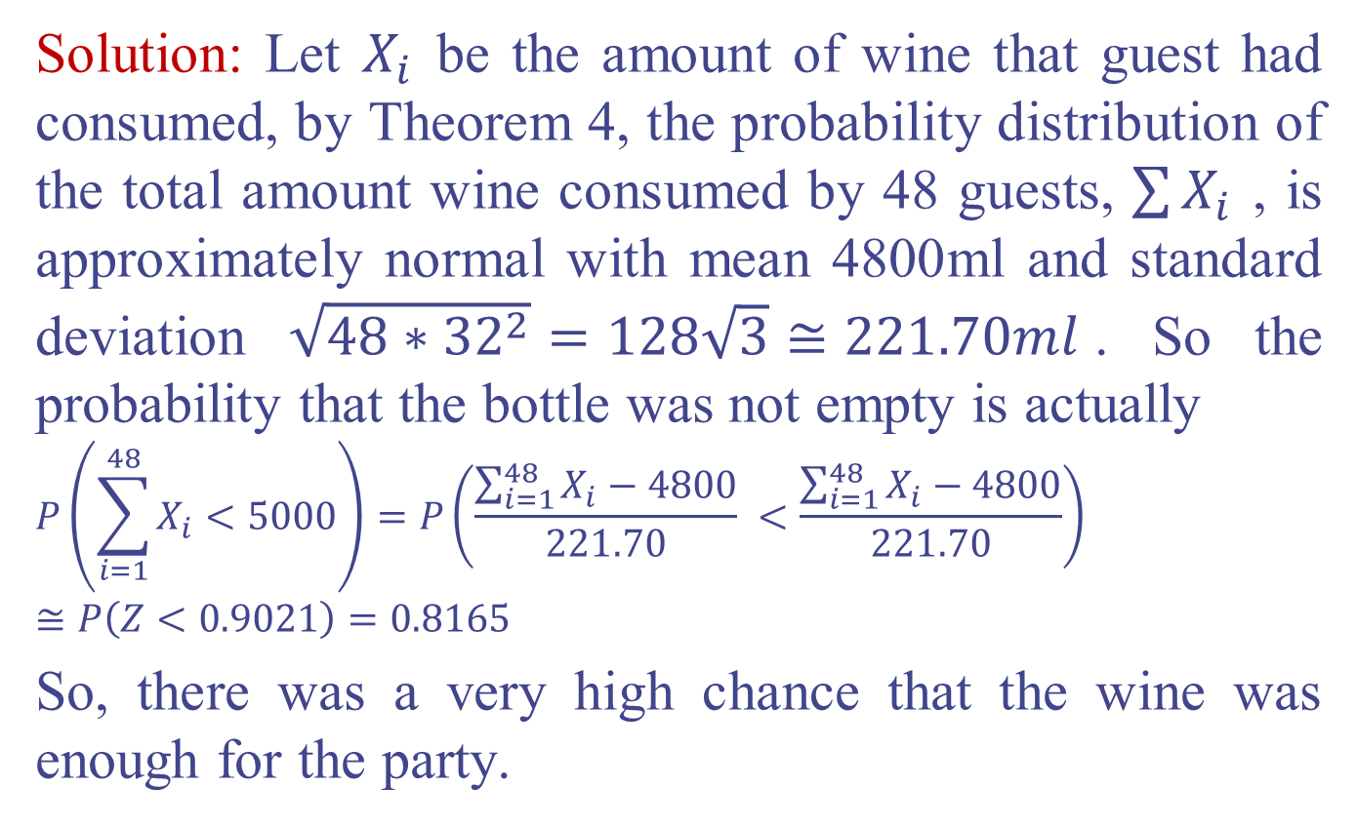
Solution: Let $X_{i}$ be the amount of wine that guest had consumed, by Theorem 4, the probability distribution of the total amount wine consumed by 48 guests, $\sum{X_{i}}$ , is approximately normal with mean 4800ml and standard deviation $\sqrt{48∗{32}^{2}}=128\sqrt{3}≅221.70ml$. So the probability that the bottle was not empty is actually
$$P\left(\sum_{i=1}^{48}{X_{i}}<5000\right)=P\left(\frac{\sum_{i=1}^{48}{X_{i}}−4800}{221.70} <\frac{\sum_{i=1}^{48}{X_{i}}−4800}{221.70}\right)$$
$$≅P\left(Z<0.9021\right)=0.8165$$
So, there was a very high chance that the wine was enough for the party.

Slide 60
Exercises:

Slide 61
Normal Approximation to the Binomial Distribution
The Central Limit Theorem concept can also be applied to approximate discrete probability events by using continuous distribution such as the normal distribution.
For example, the binomial probabilities can be approximated using the normal distribution.

Slide 62
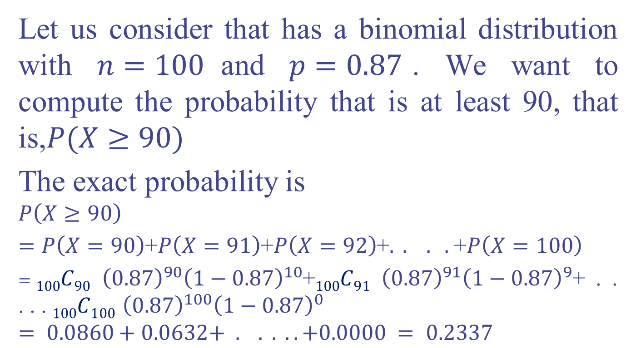
Example 14:
Let us consider that has a binomial distribution with $n=100$and $p=0.87$. We want to compute the probability that is at least 90, that is,$P(X≥90)$
The exact probability is
$$P\left(X≥90\right)$$
$=P\left(X=90\right)$+$P\left(X=91\right)$+$P\left(X=92\right)$+$. . . .$+$P\left(X=100\right)$
$=100C90$ ${\left(0.87\right)}^{90}{\left(1−0.87\right)}^{10}$+$100C91$ ${\left(0.87\right)}^{91}{\left(1−0.87\right)}^{9}$+ . . . . . $100C100$ ${\left(0.87\right)}^{100}{\left(1−0.87\right)}^{0}$
$$= 0.0860+0.0632+ . . . . .+0.0000 = 0.2337$$

Slide 63
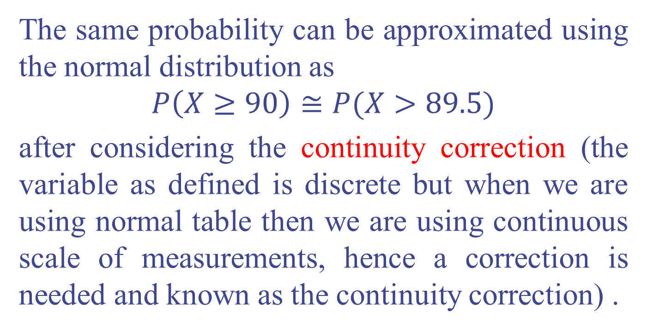
The same probability can be approximated using the normal distribution as
$$P\left(X≥90\right)≅P(X>89.5)$$
after considering the continuity correction (the variable as defined is discrete but when we are using normal table then we are using continuous scale of measurements, hence a correction is needed and known as the continuity correction) .

Slide 64

Here, follows approximate normal distribution with mean $μ=np$ and standard deviation$σ=\sqrt{np\left(1−p\right)}$
Then, $P\left(X>89.5\right)=P\left(\frac{X−100∗0.87}{\sqrt{100∗0.87∗0.13}} >\frac{89.5−100∗0.87}{\sqrt{100∗0.87∗0.13}}\right)$
$$≅P\left(Z>0.74\right)=1−P\left(Z≤0.74\right)$$
$$=1−0.7704=0.2296$$
is close to the exact value 0.2337. The normal approximation to the binomial probabilities are suggested when $np≥5$ and $n\left(1−p\right)≥5.$

Slide 65
Normal Quantile Plot (QQ Plot)
Used to check weather your Data is normal.
We can make a QQ plot by using any statistical software (R, SAS, MINITAB, SPSS, MSEXCEL, etc)
If the data distribution is close to normal, the plotted points will lie close to a sloped straight line on the QQ plot. (The normal plot is approximately a straight line, so we conclude that the original dataset is close to normally distributed.)

Slide 66


Slide 67


Slide 68
Introduce Chi-square and F distributions (Children of the Normal)

Slide 69
Questions
What is the chi-square distribution? How is it related to the Normal?
How is the chi-square distribution related to the sampling distribution of the variance?

Slide 70

Chi-square Distribution
z score
z score squared
Make it Greek
What would its sampling distribution look like?
Minimum value is zero.
Maximum value is infinite.
Most values are between zero and 1;
most around zero.

Slide 71
Chi-square
What if we took 2 values of z² at random and added them?
Same minimum and maximum as before, but now average should be a bit bigger.
Chi-square is the distribution of a sum of squares. Each squared deviation is taken from the unit normal: N(0,1). The shape of the chi-square distribution depends on the number of squared deviates that are added together.

Slide 72

Chi-square
The distribution of chi-square depends on 1 parameter, its degrees of freedom (df or v). As df gets large, curve is less skewed, more normal.

Slide 73
Chi-square
The expected value of chi-square is df.
The mean of the chi-square distribution is its degrees of freedom.
The expected variance of the distribution is 2df.
If the variance is 2df, the standard deviation must be sqrt(2df).
There are tables of chi-square so you can find 5 or 1 percent of the distribution.
Chi-square is additive.

Slide 74
Distribution of Sample Variance
Sample estimate of population variance (unbiased).
Multiply variance estimate by N-1 to get sum of squares. Divide by population variance to stadnardize. Result is a random variable distributed as chi-square with (N-1) df.
We can use info about the sampling distribution of the variance estimate to find confidence intervals and conduct statistical tests.

Slide 75
The F Distribution
The F distribution is the ratio of two variance estimates:
Also the ratio of two chi-squares, each divided by its degrees of freedom:
In our applications, v₂ will be larger than v₁ and v₂ will be larger than 2. In such a case, the mean of the F distribution (expected value) is
v₂ /(v₂ -2).

Slide 76
The F Distribution
F depends on two parameters: v₁ and v₂ (df₁ and df₂). The shape of F changes with these. Range is 0 to infinity. Shaped a bit like chi-square.
F tables show critical values for df in the numerator and df in the denominator.
F tables are 1-tailed; can figure 2-tailed if you need to (but you usually don’t).

Slide 77
A Look Ahead
The F distribution is used in many statistical tests
Test for equality of variances.
Tests for differences in means in ANOVA.
Tests for regression models (slopes relating one continuous variable to another like SAT and GPA).

Slide 78
Relations among Distributions – the Children of the Normal
Chi-square is drawn from the normal. N(0,1) deviates squared and summed.
F is the ratio of two chi-squares, each divided by its df. A chi-square divided by its df is a variance estimate, that is, a sum of squares divided by degrees of freedom.
F = t². If you square t, you get an F with 1 df in the numerator.

Slide 79
Student’s t-Distribution
In 1908, William Sealy Gosset from Guinness Breweries discovered the t-distribution. His pen-name was Student, and thus it is called the “Student's t-distribution.”
When the population standard deviation σ in the Z-score above is replaced by the sample standard deviation s, this score follows the t-distribution.
It is bell-shaped, just like the normal distribution with mean 0. It is more spread out than the standard normal distribution. In other words, the two tails are heavier than those of the standard normal distribution.

Slide 80
The t-distribution has a parameter called degrees of freedom (df). In most applications, it is a function of the sample size; however, the specific formula depends on the particular problem.
The t-distribution is in fact a ratio of a standard normal distribution to a chi-square distribution.
When degrees of freedom increase, the t-distribution approaches the standard normal distribution.

Slide 81


Slide 82


Slide 83


Don’t hesitate to contact us if you have any questions about this course’s teaching content. Also, don’t forget to check out the course page and Microsoft Team folder.
Course page Link: https://mayooran1987.github.io/MC3020_E24/
Course page’s QR code
Microsoft Team folder

