Slide 1
Introduction to Time Series Analysis
Dr T. Mayooran,
Senior Lecturer,
Department of Interdisciplinary Studies,
Faculty of Engineering,
University of Jaffna.
Email: mayooran@eng.jfn.ac.lk

Slide 2
Module objectives
Introduce time series
Components of time series
Deseasonalising a time series

Slide 3
What is a time series?
Essentially, Time Series is a sequence of numerical data obtained at regular time intervals.
Occurs in many areas: economics, finance, environment, medicine and Engineering.
The aims of time series analysis are
to describe and summarize time series data,
fit models, and make forecasts

Slide 4
Why are time series data different from other data?
Data are not independent
Much of the statistical theory relies on the data being independent and identically distributed
Large samples sizes are good, but long time series are not always the best
Series often change with time, so bigger isn’t always better

Slide 5
What Are Users Looking for in an Economic Time Series?
Important features of economic indicator series include
Direction
Turning points
In addition, we want to see if the series is increasing/decreasing more slowly/faster than it was before
Notes:
Econometric models require seasonally adjusted data.

Slide 6
When should time series analysis best be used?
We do not assume the existence of deterministic model governing the behaviour of the system considered.
Instances where deterministic factors are not readily available and the accuracy of the estimate can be compromised on the need..(be careful!)
We will only consider univariate time series

Slide 7
Forecasting Horizons
Long Term
5+ years into the future
R&D, plant location, product planning
Principally judgement-based
Medium Term
1 season to 2 years
Aggregate planning, capacity planning, sales forecasts
Mixture of quantitative methods and judgement
Short Term
1 day to 1 year, less than 1 season
Demand forecasting, staffing levels, purchasing, inventory levels
Quantitative methods

Slide 8
Examples of Time series data
Number of babies born in each hour
Daily closing price of a stock.
The monthly trade balance of Japan for each year.
GDP of the country, measured each year.

Slide 9
Time Series example
How the data (x) and time (t) is recorded and presented
Exports, 1989-1998
t
Year
x=Value
1
1989
44,320
2
1990
52,865
3
1991
53,092
4
1992
39,424
5
1993
34,444
6
1994
47,870
7
1995
49,805
8
1996
59,404
9
1997
70,214
10
1998
74,626

Slide 10
Time Series
Coordinates (t,x) is established in the 2 axis
(1, 44,320)
(2, 52,865)
(3, 53,092)
etc..

Slide 11
Time Series
A graphical representation of time series.
We use x as a function of t: x= f(t)
Data points connected by a curve

Slide 12
Importance of time series analysis
Understand the past.
What happened over the last years, months?
Forecast the future.
Government wants to know future of unemployment rate, percentage increase in cost of living etc.
For companies to predict the demand for their product etc.

Slide 13
Time-Series Components
Trend
Cyclical
Time-Series
Seasonal
Random

Slide 14
Components of Time Series
Trend (Tt )
Seasonal variation (St )
Cyclical variation ( Ct )
Random variation (Rt )
or irregular

Slide 15
Components of Time Series Trend (Tt )
Trend: the long-term patterns or movements in the data.
Overall or persistent, long-term upward or downward pattern of movement.
The trend of a time series is not always linear.

Slide 16
Seasonal variation (St )
Components of Time Series
Regular periodic fluctuations that occur within year.
Examples:
Consumption of heating oil, which is high in winter, and low in other seasons of year.
Gasoline consumption, which is high in summer when most people go on vacation.

Slide 17
Components of Time Series
Seasonal variation (St )
Summer
Summer
Winter
Winter

Slide 18
Example

Slide 19
Seasonal Components Removed

Slide 20
Why Do Users Want Seasonally Adjusted Data?
Seasonal movements can make features difficult or impossible to see
Notes:
Econometric models require seasonally adjusted data.

Slide 21
Causes of Seasonal Effects
Possible causes are
Natural factors
Administrative or legal measures
Social/cultural/religious traditions (e.g., fixed holidays, timing of vacations)

Slide 22
Components of Time Series Cyclical variation ( Ct )
Cyclical variations are similar to seasonal variations. Cycles are often irregular both in height of peak and duration.
Examples:
Long-term product demand cycles.
Cycles in the monetary and financial sectors. (Important for economists!)

Slide 23
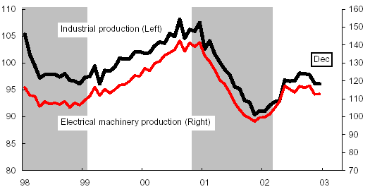
Cyclical Component
Long-term wave-like patterns
Regularly occur but may vary in length
Often measured peak to peak or trough to trough
1 Cycle
Sales
Year

Slide 24
Irregular Component
Unpredictable, random, “residual” fluctuations
Due to random variations of
Nature
Accidents or unusual events
“Noise” in the time series

Slide 25
Causes of Irregular Effects
Possible causes
Unseasonable weather/natural disasters
Strikes
Sampling error
Nonsampling error

Slide 26
Classical Decomposition
One method of describing a time series
Decompose the series into various components
Trend – long term movements in the level of the series
Seasonal effects – cyclical fluctuations reasonably stable in terms of annual timing (including moving holidays and working day effects)
Cycles – cyclical fluctuations longer than a year
Irregular – other random or short-term unpredictable fluctuations

Slide 27
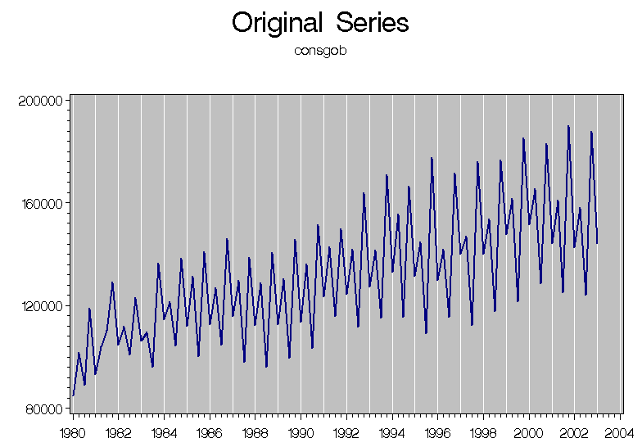
Not easy to understand the pattern!

Slide 28
Our aim
is to understand and identify different variations so that we can easily predict the future variations separately and combine together
Look how the above complicated series could be understood as follows separately

Slide 29
Forecasting
Many methods are available for forecasting a time series.
The appropriateness of the model depends on:
the components which are present
the forecast accuracy required
the 'term' of the forecasting
short term or long term?
the model assumed
linear or exponential trend?
nature of the random factor
etc.
We consider only
long term forecasting
Forecasting with trend
forecasting with trend and seasonality
Notes:
Refer to Section 21.7 Pages 696-698 Selvanathan

Slide 30
Caution !!!
Time series analysis is based on the available observations of the series, that is, based on observations y₁, ......, y_{n}. We forecast future values: y_{n+1}, y_{n+2}, .......
The underlying assumption is that the future is the same as the past.
If we try to forecast too far into the future, this assumption becomes very suspect! So we have to be very careful....

Slide 31
Long-term forecasting Forecasting using Trend only
When a time series exhibits linear trend
(in addition to the inevitable random variation)
use the estimated linear regression equation
to forecast future values of the time series.
Forecast the GDP for 1992.
?
Notes:
Refer to Section 21.9 Page 705 Selvanathan

Slide 32
Forecasting Time Series with Trend
Trend line
Forecast for time t
The trend forecast for 1992 is
108.91 + 27.45*11 = 410.86
As r² = 0.985: excellent linear
fit. So, expect good forecasts.
past

Slide 33
Measuring the Seasonal Effect
Example:
Notes:
Refer to Section 21.6 Pages 688 Selvanathan

Slide 34
Measuring the Seasonal Effect
Obtain seasonal indices by
Using the linear trend equation
Seasonal indices measure the
extent to which the seasons
differ from each other.
The number of seasons depends on the unit of time used.
Eg: Quarterly data – 4 seasons
Monthly data – 12 seasons
Notes:
Refer to Section 21.6 Pages 689-691 Selvanathan

Slide 35
Measuring the Seasonal Effect - Using the Trend Equation [Rationale for the method]
Recall: Multiplicative model:
Use this method if there’s no cyclic effect present.
Model: Y_{t} = T_{t} x S_{t} x R_{t}
Since represents trend T_{t}, we get
omitted
Averaging is then used to remove the random component,
leaving S_{t}

Slide 36
Measuring the Seasonal Effect - Using the Trend Equation
Fit a trend (regression) equation to the original time series.
Obtain a trend value for each observed time period.
Calculate the ratio of each value of the time series to the corresponding trend value.
For each type of season (e.g. quarter, month), calculate the
average of the ratios.
Seasonal indices are the averaged ratios, adjusted to ensure that the sum of the indices is equal to the number of seasons in the year.

Slide 37
Measuring the Seasonal Effect - Using the Trend Equation
Example :

Slide 38
Measuring the Seasonal Effect - Using the Trend Equation
EXCEL output
The Trend (regression) equation is (from Excel)

Slide 39
Measuring the Seasonal Effect - Using the Trend Equation
Part of EXCEL output
The Trend (regression) equation is (from Excel)
Computation of trend values Yt(hat):
for t = 1,
5755.63 + 40.73 (1) = 5796.36

Slide 40
Measuring the Seasonal Effect - Using the Trend Equation
Unadjusted
Adjusted
Adjusted value
= 4*(unadjusted value)/(Total of unadjusted values)
Ex: 4*(0.986036)/3.99992 = 0.986056 = 0.9861
We use 4 here because there are 4 seasons in this example

Slide 41
Measuring the Seasonal Effect Interpreting the Seasonal Index
4. Unadjusted
On average the number of tourist arrivals for
1st quarter (March): 1.39% below the trend line projection [100*(0.9861 - 1)]
2nd quarter (June): 4.95% below the trend line projection
3rd quarter (Sept.): 5.97% above the trend line projection [100*(1.0597 - 1)]
4th quarter (Dec.): 0.38% above the trend line projection
Notes:
Adjust the seasonal indexex so that they sum to the number of seasons (quarters = 4, month = 12 etc.)
Adjusted season index
= (seasonal index./ sum of all seasonal indexes.) x number of seasons

Slide 42
Forecasting Time Series with Trend and Seasonality
Long-term forecasting
Derive the trend component
Derive the seasonal component
Multiply trend and seasonal components together to get forecasts.
Notes:
Refer to Section 21.9 Pages 705 - 710 Selvanathan

Slide 43
Forecasting with Trend and Seasonality
Multiply trend and seasonal components together to get forecasts. F_{t} = T_{t} * S_{t}
ignore the random component, as it cannot be calculated.
Notes:
Refer to Section 21.9 Pages 705 - 710 Selvanathan

Slide 44
Forecasting with Trend and Seasonality
?
?

Slide 45
Trend value: for t = 21, is 5755.63 + 40.73(21) =6610.96

Slide 46
Adjusted value
= 4*(unadjusted value)/ (Total of unadjusted values)
Unadjusted
Adjusted
The relevant seasonal index = 0.9861
because we are forecasting for a March quarter.

Slide 47
Forecasting with Trend and Seasonality
Q Forecast the number of tourist arrivals for March quarter 1992.
Trend value T_{t} = 5755.63 + 40.73x21 = 6610.96
Seasonal index S_{t} = 0.9861
So, forecast F_{t} = F_{t} = T_{t} * S_{t}
= 6610.96x0.9861 = 6519.068 (,000 arrivals)
Notes:
Refer to Section 21.9 Pages 705 - 710 Selvanathan

Slide 48
Forecasting with Trend and Seasonality
Forecast with trend and seasonal index = 6519.07
[lower than the forecast with the trend only]

Slide 49
Forecasting with Trend and Seasonality
The model looks reasonably good... (though it does not model the varying size of the seasonal peaks very well)

Slide 50
Smoothing techniques
Smoothing helps to see overall patterns in time series data.
Smoothing techniques smooth or “iron” out variation to get the overall picture.
There are several smoothing techniques of time series.

Slide 51
Smoothing techniques
We will study :
Moving average.
Exponential smoothing

Slide 52
Smoothing the Annual Time Series
Calculate moving averages to get an overall impression of the pattern of movement over time
Moving Average: averages of consecutive
time series values for a
chosen period of length L

Slide 53
Moving Averages
Used for smoothing
A series of arithmetic means over time
Result dependent upon choice of L (length of period for computing means)
Examples:
For a 3 year moving average, L = 3
For a 5 year moving average, L = 5
Etc.

Slide 54
Smoothing techniques: Moving Average (MA)
Odd number of points. Points (k) – length for computing MA
k=3
and so on.

Slide 55
Smoothing techniques: Moving Average (MA) k=3

Slide 56
Smoothing techniques: Moving Average (MA)

Slide 57
Smoothing techniques: Moving Average (MA) k=5

Slide 58
Smoothing techniques: Moving Average (MA)

Slide 59
Smoothing techniques: Moving Average (MA)
We need even numbered MA s for seasonal adjustments
eg: 4 – quarterly data
12 – monthly data

Slide 60
Smoothing techniques: Moving Average (MA)
Even number of points.
Two stages:
1. Obtain MA, centered halfway between t and t-1.
2. To get a trend take the average of two successive estimates. Estimate centered halfway between t and t-1.

Slide 61
Smoothing techniques: Moving Average (MA)
for k=4.
Stage 1.
Stage 2.
and so on.

Slide 62
Smoothing techniques: Moving Average (MA)
Series
MA stage 1
MA stage 2:
MA Centered
Observation
1
5
MA1,1
#NA
MA1,2
2
6
#NA
6.5
3
7
7.1
4
8
9.0
5
10
10.3
6
11
#NA
7
12
#NA

Slide 63
Measuring the seasonal effect
To measure seasonal effect construct seasonal indices.
Seasonal indices is a degree to which the seasons differ from one another.
Requirement: time series should be sufficiently long to allow to observe seasonal fluctuations.

Slide 64
Measuring the seasonal effect
Computation:
Calculating MA.
Set the number of periods equal to the number of types of season.
Use multiplicative model:
MA remove St and Rt

Slide 65
Measuring the seasonal effect
Calculate (step 1)
Compute the ratio (step 2):
For each type of season calculate the average of the ratios (step 3).
The seasonal indices are the average ratios from ratios step 3 adjusted.

Slide 66
Step 1
Step 2
Step 3
(calculation see next slide)

Slide 67
Calculating seasonal index
Example:
Seasonal index for Quarter 1 = 0.889/3.974*4.000=0.895

Slide 68
Negative trend is also a trend..

Slide 69
Exercise
Plot the time series in unemployment.xls
Compute quarterly (seasonal) indices. .
Plot components separately and show them in one graph

Slide 70
Summary of Time Series Lectures
Time series as opposed to snapshot data
Components
Trend Analysis
Measuring the Seasonal Effect
Forecasting time series with
trend
trend and seasonality

