Slide 1
MC4010- Discrete Mathematics Basic Structures: Sets, Functions, Sequences, Sums, and Matrices – 2 Dr T. Mayooran, Department of Inter-Disciplinary Studies, Faculty of Engineering, University of Jaffna

Slide 2
Definition of Functions
Let A and B be nonempty sets. A function f from (or “mapping”) A to B is an assignment of exactly one element of B to each element of A. We write f (a) = b if b is the unique element of B assigned by the function f to the element a of A. If f is a function from A to B, we write f: A → B.

Slide 3
Graphical Representations
Functions can be represented graphically in several ways:
f
A
B
•
•
f
•
•
•
•
•
y
a
b
•
•
•
•
x
A
B
Graph
Plot
Like Venn diagrams

Slide 4
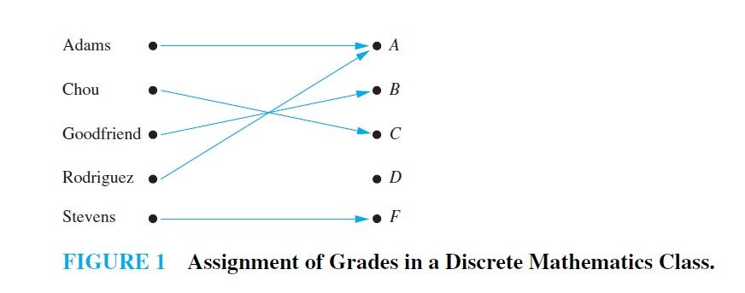
For example, suppose that each student in a discrete mathematics class is assigned a letter grade from the set {A, B, C, D, F}. And suppose that the grades are A for Adams, C for Chou, B for Goodfriend, A for Rodriguez, and F for Stevens. This assignment of grades is illustrated in Figure 1.
This assignment is an example of a function.

Slide 5
Definition of Functions (cont’d)
Formally: given f:A→B
“x is a function” :≡ (¬∃x,y: x=y ∧ f(x) ≠ f(y)) or
“x is a function” :≡ (∀ x,y: ¬(x=y) ∨ ¬(f(x) ≠ f(y))) or
“x is a function” :≡ (∀ x,y: ¬(x=y) ∨ (f(x) = f(y))) or
“x is a function” :≡ (∀ x,y: (x=y) → (f(x) = f(y))) or
“x is a function” :≡ (∀ x,y: (f(x) ≠ f(y)) → (x ≠ y))

Slide 6
Some Function Terminology
If f:A→B, and f(a)=b (where a∈A & b∈B), then:
A is the domain of f.
B is the codomain of f.
b is the image of a under f.
a is a pre-image of b under f.
In general, b may have more than one pre-image.
The range R⊆B of f is {b | ∃a f(a)=b }.

Slide 7
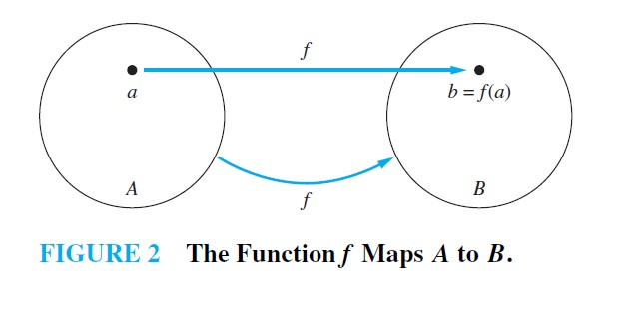

Slide 8
Range vs. Codomain - Example
Suppose that: “f is a function mapping students in this class to the set of grades {A,B,C,D,E}.”
At this point, you know f’s codomain is: __________, and its range is ________.
Suppose the grades turn out all As and Bs.
Then the range of f is _________, but its codomain is __________________.
{A,B,C,D,E}
unknown!
{A,B}
still {A,B,C,D,E}!

Slide 9
Function Addition/Multiplication
We can add and multiply functions
f,g:R→R:
(f + g):R→R, where (f + g)(x) = f(x) + g(x)
(f × g):R→R, where (f × g)(x) = f(x) × g(x)

Slide 10

Example:
Let f and g be functions from R to R such that $f(x) = x^{2}$and $g(x) = x − x^{2}$.
What are the functions f + g and fxg?

Slide 11
Images of Sets under Functions
Given f:A→B, and S⊆A,
The image of S under f is simply the set of all images (under f) of the elements of S. f(S) :≡ {f(s) | s∈S} :≡ {b | ∃ s∈S: f(s)=b}.
Note the range of f can be defined as simply the image (under f) of f’s domain!

Slide 12
One-to-One and Onto Functions

Slide 13
One-to-One Functions
A function is a one-to-one (1-1), or injective, or an injection, iff every element of its range has only one pre-image.
A function f is said to be one-to-one or an injunction if and only if f (a) = f (b) implies that a = b for all a and b in the domain of f. A function is said to be injective if it is one-to-one.
Only one element of the domain is mapped to any given one element of the range.
Domain & range have same cardinality. What about codomain?
May Be
Larger

Slide 14
One-to-One Functions (cont’d)
Formally: given f:A→B
“x is injective” :≡ (¬∃x,y: x≠y ∧ f(x)=f(y)) or
“x is injective” :≡ (∀ x,y: ¬(x≠y) ∨ ¬(f(x)=f(y))) or
“x is injective” :≡ (∀ x,y: ¬(x≠y) ∨ (f(x) ≠ f(y))) or
“x is injective” :≡ (∀ x,y: (x≠y) → (f(x) ≠ f(y))) or
“x is injective” :≡ (∀ x,y: (f(x)=f(y)) → (x =y))

Slide 15
One-to-One Illustration
Graph representations of functions that are (or not) one-to-one:
•
•
•
•
•
•
•
•
•
•
•
•
•
•
•
•
•
•
•
•
•
•
•
•
•
•
•
Not one-to-one
Not even a function!
One-to-one

Slide 16

Examples:
Determine whether the function $f (x) = x^{2}$from the set of integers to the set of integers is one-to-one.
Determine whether the function $f (x) = x + 1$from the set of real numbers to itself is one-to-one.

Slide 17
Sufficient Conditions for 1-1ness
Definitions (for functions f over numbers):
f is strictly (or monotonically) increasing iff x>y → f(x)>f(y) for all x,y in domain;
f is strictly (or monotonically) decreasing iff x>y → f(x)<f(y) for all x,y in domain;
If f is either strictly increasing or strictly decreasing, then f is one-to-one.
e.g. f(x)=x³

Slide 18
Onto (Surjective) Functions
A function f:A→B is onto or surjective or a surjection iff its range is equal to its codomain (∀b∈B, ∃a∈A: f(a)=b).
An onto function maps the set A onto (over, covering) the entirety of the set B, not just over a piece of it.
e.g., for domain & codomain R, x³ is onto, whereas x² isn’t. (Why not?)

Slide 19
Illustration of Onto
Some functions that are or are not onto their codomains:
•
•
•
•
•
•
•
•
•
•
•
•
•
•
•
•
•
•
•
•
•
•
•
•
•
•
•
•
•
•
•
•
•
•
•
Onto (but not 1-1)
Not Onto (or 1-1)
Both 1-1 and onto
1-1 but not onto

Slide 20

Examples:
Let f be the function from {a, b, c, d} to {1, 2, 3} defined by f (a) = 3, f (b) = 2, f (c) = 1, and f (d) = 3. Is f an onto function?
Is the function $f (x) = x^{2}$from the set of integers to the set of integers onto?
Is the function $f (x) = x + 1$from the set of integers to the set of integers onto?

Slide 21

Bijections
A function f is a one-to-one correspondence, or a bijection, or reversible, or invertible, iff it is both one-to-one and onto.
Examples:
Let f be the function from {a, b, c, d} to {1, 2, 3, 4} with f (a) = 4, f (b) = 2, f (c) = 1, and f (d) = 3. Is $f$ a bijection?

Slide 22
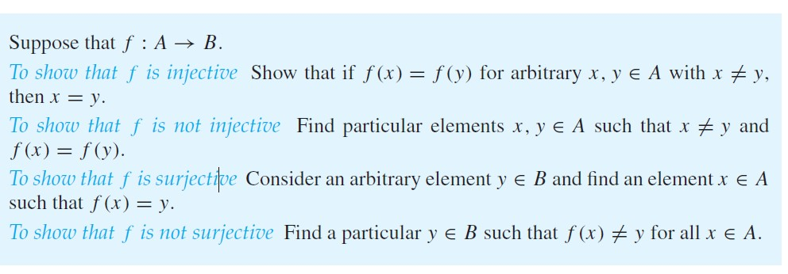
Summary/ Hints

Slide 23
Function Composition
For functions g:A→B and f:B→C, there is a special operator called compose (“○”).
It composes (i.e., creates) a new function out of f,g by applying f to the result of g.
(f○g):A→C, where (f○g)(a) = f(g(a)).
Note g(a)∈B, so f(g(a)) is defined and ∈C.
The range of g must be a subset of f’s domain!!
Note that ○ (like Cartesian ×, but unlike +,∧,∪) is non-commuting. (In general, f○g ≠ g○f.)

Slide 24
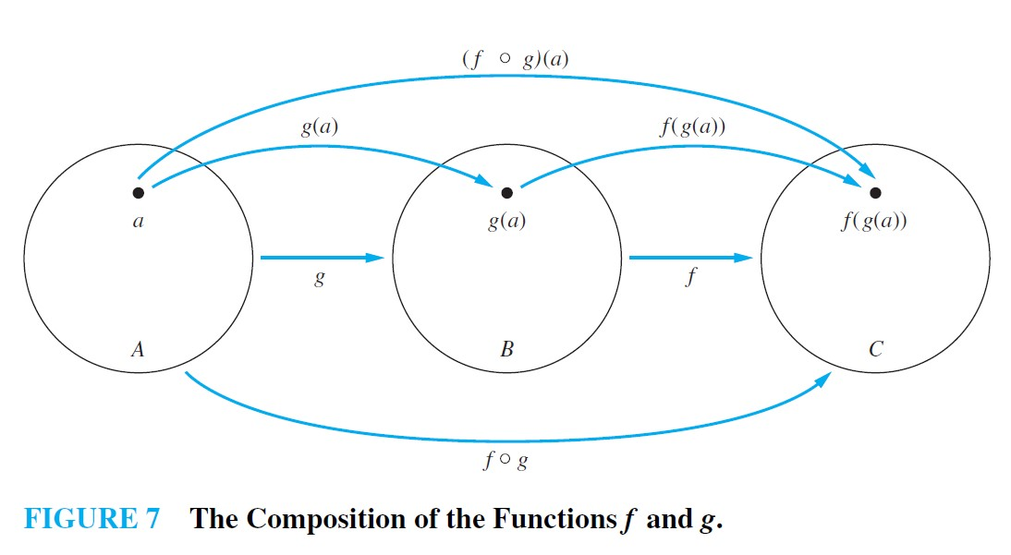
Function Composition

Slide 25
Examples:
Let f and g be the functions from the set of integers to the set of integers defined by f (x) = 2x + 3 and g(x) = 3x + 2. What is the composition of f and g? What is the composition of g and f ?
Remark: Note that even though f ◦ g and g ◦ f are defined for the functions f and g in above Example, f ◦ g and g ◦ f are not equal. In other words, the commutative law does not hold for the composition of functions.

Slide 26
Inverse of a Function
For bijections f:A→B, there exists an inverse of f, written f ⁻¹:B→A, which is the unique function such that:
Remark: Be sure not to confuse the function f−1 with the function 1/f , which is the function that assigns to each x in the domain the value 1/f (x). Notice that the latter makes sense only when f (x) is a non-zero real number.

Slide 27
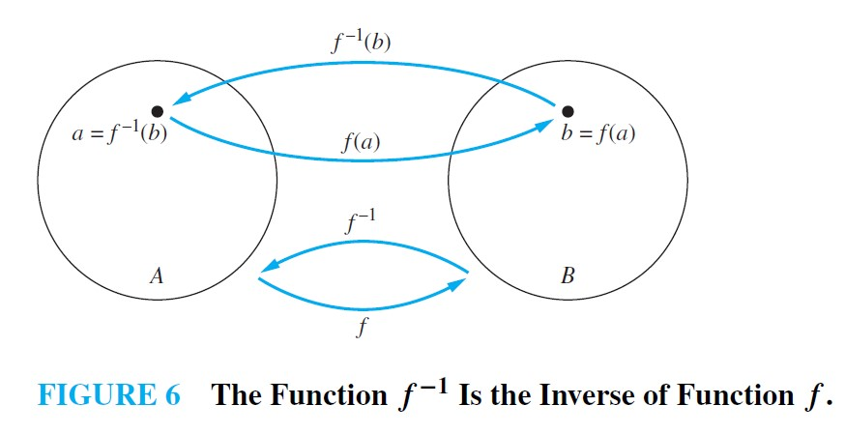
Inverse of a function (cont’d)

Slide 28
Invertible
A one-to-one correspondence is called invertible because we can define an inverse of this function. A function is not invertible if it is not a one-to-one correspondence, because the inverse of such a function does not exist.

Slide 29
Examples:
Let f be the function from {a, b, c} to {1, 2, 3} such that f (a) = 2, f (b) = 3, and f (c) = 1. Is f invertible, and if it is, what is its inverse?
Let f : Z → Z be such that f (x) = x + 1. Is f invertible, and if it is, what is its inverse?

Slide 30
The Identity Function
For any domain A, the identity function I:A→A (variously written, I_{A}, 1, 1_{A}) is the unique function such that ∀a∈A: I(a)=a.
Some identity functions you’ve seen:
∧ing with T, ∨ing with F, ∪ing with ∅, ∩ing with U.
Note that the identity function is both one-to-one and onto (bijective).

Slide 31
Identity Function Illustrations
The identity function:
•
•
•
y
•
•
•
•
•
•
Domain and range
x

Slide 32
Graphs of Functions
We can represent a function f:A→B as a set of ordered pairs {(a,f(a)) | a∈A}.
Note that ∀a, there is only one pair (a, f(a)).
For functions over numbers, we can represent an ordered pair (x,y) as a point on a plane. A function is then drawn as a curve (set of points) with only one y for each x.

Slide 33
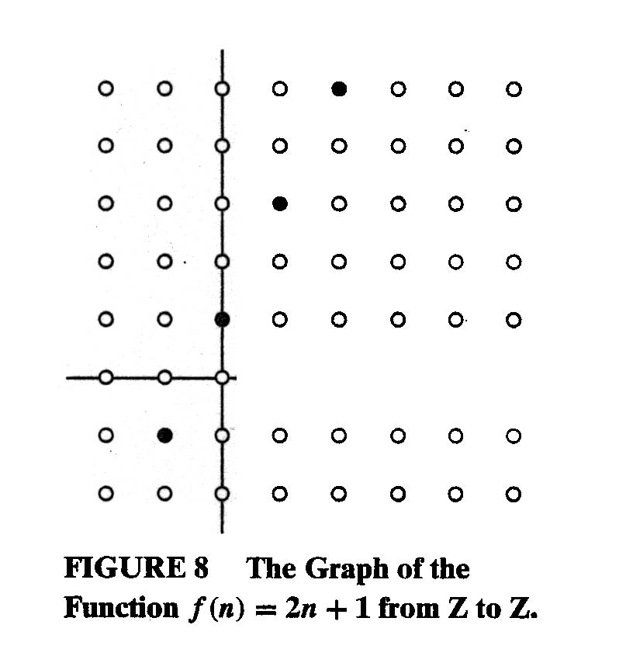
Graphs of Functions

Slide 34
A Couple of Key Functions
In discrete math, we frequently use the following functions over real numbers:
⎣x⎦ (“floor of x”) is the largest integer ≤ x.
⎡x⎤ (“ceiling of x”) is the smallest integer ≥ x.

Slide 35
Visualizing Floor & Ceiling
Real numbers “fall to their floor” or “rise to their ceiling.”
Note that if x∉Z, ⎣−x⎦ ≠ − ⎣x⎦ & ⎡−x⎤ ≠ − ⎡x⎤
Note that if x∈Z, ⎣x⎦ = ⎡x⎤ = x.
3
.
2
⎡1.6⎤=2
.
1.6
.
1
⎣1.6⎦=1
0
.
−1
⎡−1.4⎤= −1
.
−1.4
.
−2
.
.
.
⎣−1.4⎦= −2
−3
−3
⎡−3⎤=⎣−3⎦= −3

Slide 36
Plots with floor/ceiling: Example
Plot of graph of function f(x) = ⎣x/3⎦:
f(x)
Set of points (x, f(x))
+2
−3
+3
x
−2

Slide 37

Examples:
Prove that if x is a real number, then
$$\left\lfloor 2x\right\rfloor = \left\lfloor x\right\rfloor + \left\lfloor x+\frac{1}{2}\right\rfloor .$$
Prove or disprove that $\left\lfloor x+y\right\rfloor =\left\lfloor x\right\rfloor +\left\lfloor y\right\rfloor$ for all real numbers x and y.

Slide 38
Next Section:
Sequences and Summations!

Slide 39

Don’t hesitate to contact us if you have any questions about this course’s teaching contents. Also don’t forget to check out the course page and Microsoft Team folder,
• course page https://mayooran1987.github.io/MC4010_E21/

