Slide 1

Monte Carlo Simulation Dr T. Mayooran, Department of Inter-Disciplinary Studies, Faculty of Engineering, University of Jaffna

Slide 2
What is Monte Carlo simulation?
Monte Carlo simulation: A computer-based method for modelling complex systems by running numerous random experiments to estimate outcomes and make predictions, commonly used in computer engineering for optimizing system performance under uncertainty.

Slide 3
Efficient Code Testing with Monte Carlo Simulation!
Suppose you're a software engineer developing a program, and you want to estimate how many lines of code need testing to ensure software reliability.
Instead of reviewing every line individually, you employ Monte Carlo simulation. Randomly selecting subsets of code for testing, you simulate different testing scenarios. By repeating these simulations, you can estimate the average number of lines that typically need testing.
This approach helps in optimizing testing resources without the need for testing every line of code manually, making the software development process more efficient. Monte Carlo simulation in computer engineering proves useful for predicting testing requirements and streamlining development workflows.

Slide 4

Monte Carlo In A Nutshell
Using a large number of simulated trials in order to approximate a solution to a problem
Generating random numbers
Computer not required, though extremely helpful

Slide 5

A Brief History
Earliest well-documented use of Monte Carlo:
Late 18th Century France
Comte de Buffon performed an experiment involving the repeated tossing of a needle onto a plane
Wanted to determine the probability of a needle intersecting a string

Slide 6
Modern Monte Carlo Method
Named after Monte Carlo Casino in 1940’s by a group of men working on the nuclear bomb
John von Neumann, Stanislaw Ulam and Nicholas Metropolis
Ulam’s Uncle supposedly often frequented this Casino

Slide 7
Monte Carlo Method
While convalescing from an illness in 1946, Stanislaw Ulam was playing solitaire. It then occurred to him to try to compute the chances that a particular solitaire laid out with 52 cards would come out successfully (Eckhard, 1987). After attempting exhaustive combinatorial calculations, he decided to go for the more practical approach of laying out several solitaires at random and then observing and counting the number of successful plays. This idea of selecting a statistical sample to approximate a hard combinatorial problem with a much simpler problem is at the heart of modern Monte Carlo simulation. Stanislaw Ulam soon realized that computers could be used in this fashion to answer questions
of neutron diffusion and mathematical physics.
From An Introduction to MCMC for Machine Learning
by: C, Andrieu, N, de Freitas, A, Doucet, M, I. Jordan
Machine Learning, Vol. 50, No. 1. pp. 5-43, 2003.

Slide 8
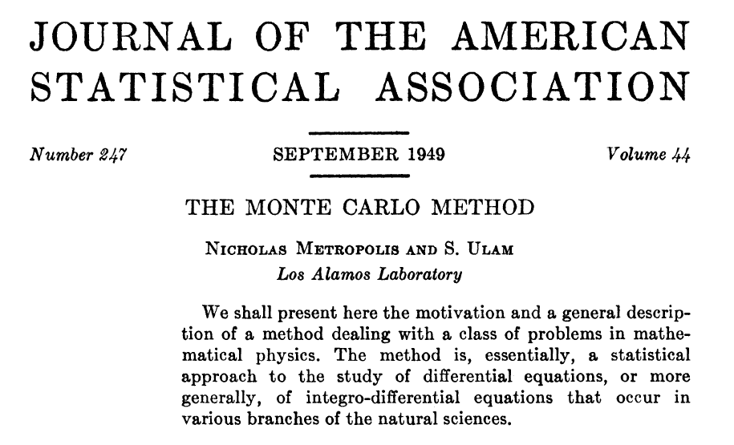

Slide 9
Onset of Computers
Invention and popularization of computer
Much more practical to implement Monte Carlo
Popularity has taken off since 1950’s

Slide 10
Random Numbers
Key aspect of computers: allow us to quickly generate thousands of “random” numbers.
Food for thought:
Computers are ultimately deterministic devices
How then can the numbers be “random?”
We will leave this thought for the philosophers and assume that we do actually have random numbers

Slide 11
A Simple Example
Using Monte Carlo to approximate pi
Will give us a better understanding of how to implement and analyze a Monte Carlo Simulation
Obviously, there are more efficient ways to figure out digits of pi
This example will help build a conceptual understanding before looking at another example

Slide 12
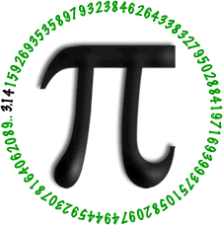
What is the exact value of pi?

Slide 13

Consider a unit circle inscribed within a square
The ratio of the area of the circle to the area of the square is π/4
We will use this key fact in order to estimate π by randomly selecting points with the square, and checking whether they are within the circle

Slide 14
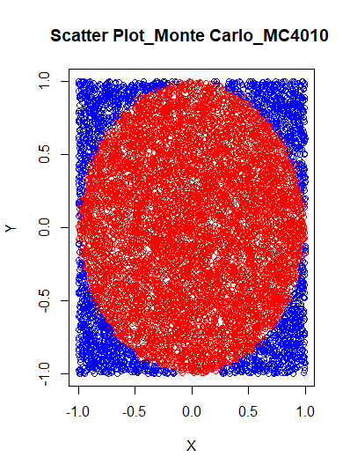
The idea is to simulate random (x, y) points in a 2-D plane with the domain as a square of side 2r units centred on (0,0). Imagine a circle inside the same domain with same radius r and inscribed into the square. We then calculate the ratio of the number of points that lay inside the circle and the total number of generated points. Refer to the image below: the same radius, r,

Slide 15
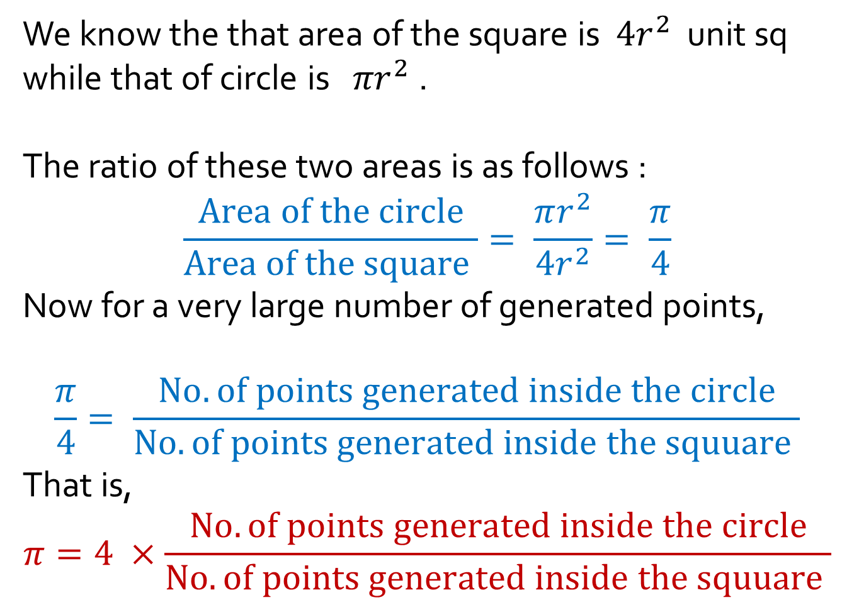
We know the that area of the square is $4r^{2}$ unit sq
while that of circle is ${πr}^{2}$ .
The ratio of these two areas is as follows :
$$\frac{Area of the circle}{Area of the square }= \frac{πr^{2}}{4r^{2}}= \frac{π}{4}$$
Now for a very large number of generated points,
$$\frac{π}{4}= \frac{No. of points generated inside the circle}{No. of points generated inside the squuare }$$
That is,
$$π=4 ×\frac{No. of points generated inside the circle}{No. of points generated inside the squuare }$$

Slide 16
Algorithm: Monte Carlo Pi Estimation
Input:
- NO_OF_ITERATIONS: Number of iterations for the Monte Carlo simulation
Output:
- estimated_pi: Estimated value of Pi
1. Initialize circle_points, square_points, and interval to 0.
2. while interval < NO_OF_ITERATIONS:
a. Generate random point x.
b. Generate random point y.
c. Calculate d = x * x + y * y.
d. If d <= 1, increment circle_points.
e. Increment square_points.
3. Calculate pi = 4 * (circle_points / square_points).
4. Terminate.

Slide 17


Can you write R codes to execute this Algorithm?

Slide 18
Example Codes and Validation of the answer!

Slide 19

We will generate n points uniformly distributed within the square
Let X denote a binomial random variable which takes the value 1 if a randomly generated point falls within the circle and 0 if the point falls outside of the circle
X is a Bernoulli R.V. with p = π/4
Notice: E(X) = π/4 → E(4X) = π
For convenience, let Y = 4X. Now, we estimate π with

Slide 20
The Simulation:
This simulation can easily be programmed into a computer:
I used R code to write a short function to run our simulation
We input n, number of trials, and function will repeatedly select points uniformly distributed within the square and determine how many fall within the circle
Function computes sample mean and returns our estimate for π :

Slide 21
R Codes:

Slide 22

How accurate is this method?
Consider the variance of our estimate:
Since X is a Bernoulli R.V. with p = π/4, Var(X) = (π/4)(1- π/4), however we will assume we don’t know π. Hence, we shall compute the sample variance of X.

Slide 23


Sample Variance of X
We can calculate this retrospectively, since X is a Bernoulli R.V:
Ex: When n = 1000, we estimate pi to be 3.188. That is,
Hence, 797 of our points fell within the circle, making x = 1 for 797 of our trials, and zero for the other 203
Now, can be easily calculated

Slide 24


Confidence Intervals
Central limit theorem: tells us that is approximately normal (for large n)
Then,
the (1 – α) Confidence Interval is given by
where is the inverse of the standard normal cumulative distribution function

Slide 25


A note on variance
The variance of our estimate decreases with n, since
As n changes, we have
For large n, this gets very small
What are the implications for Monte Carlo?

Slide 26
Results
For n = 10,000,000 our estimate is accurate to three decimal places when compared with π
Not exactly efficient

Slide 27

Hypothetically…
With this method for estimating π, how many trials are necessary for us to be at least 95% sure that our error is less than 1x10⁻¹⁰?
About 1.036x10²¹

Slide 28


Clearly, Monte Carlo is not best method for figuring out digits of pi
So what is a practical application???

Slide 29
A Real-World Example: Monte Carlo Simulation for Server Response Time Estimation

Slide 30
Example:
Let's consider a computer engineering problem where Monte Carlo simulation can be applied. One common application is in the performance analysis of computer systems. Suppose you want to estimate the average response time of a server system under different load conditions.
Let's create a simple example where we simulate the response time of a server that follows a normal distribution. We'll use a Monte Carlo simulation to estimate the average response time under varying loads.

Slide 31
Example Continue…..
In this example, we simulate the response times of 1000 requests to the server, assuming a normal distribution. The mean and standard deviation of the response times are inputs to the simulation. The average response time is then calculated based on the simulated data.
In practice, such simulations can help computer engineers and system administrators understand how a system might perform under different conditions, allowing them to optimize configurations or allocate resources more effectively.

Slide 32
Algorithm: Monte Carlo Simulation for Server Response Time Estimation
Input:
mean_response_time: Mean response time in milliseconds.
std_dev_response_time: Standard deviation of response time.
n_requests: Number of simulated requests.
Output:
average_response_time: Estimated average response time.
Initialization:
Initialize response_times as an empty array to store simulated response times.

Slide 33
Simulation Loop:
For i from 1 to n_requests:
Generate a random response time response_time_i from a normal distribution with parameters mean_response_time and std_dev_response_time.
Append response_time_i to the response_times array.
Average Calculation:
Calculate the average response time:
average_response_time = Mean of the response_times array.

Slide 34
Output:
Return average_response_time as the estimated average response time for the server.
Example Usage:
Set input parameters:
mean_response_time = 50 milliseconds
std_dev_response_time = 10
n_requests = 1000
Call monte_carlo_response_time(mean_response_time, std_dev_response_time, n_requests) function.

Slide 35
R codes
# Monte Carlo simulation for server response time estimationmonte_carlo_response_time <- function(mean_response_time, std_dev_response_time, n_requests) {
# Simulate response times for n_requests response_times <- rnorm(n_requests, mean = mean_response_time, sd = std_dev_response_time)
# Calculate average response time average_response_time <- mean(response_times) return(average_response_time)}

Slide 36
R codes….
# Example usage
mean_response_time <- 50
# Mean response time in milliseconds
std_dev_response_time <- 10
# Standard deviation of response time
n_requests <- 1000
# Number of simulated request saverage_response_time <- monte_carlo_response_time(mean_response_time, std_dev_response_time, n_requests)
print(paste("Estimated average response time: ", round(average_response_time, 2), "milliseconds"))

Slide 37
Print the estimated average response time rounded to two decimal places.
This algorithm and R codes provide a structured overview of the steps involved in the Monte Carlo simulation, from generating simulated response times to computing the average response time as an estimation for server performance analysis.

Slide 38
Conclusion
Monte Carlo provides a numerical method to obtain an estimate for a solution that needs to be close, but not necessarily exact.
We showed two specific examples, but the applications of Monte Carlo are very diverse

Slide 39
Sources:
Bodie, Zvi, Alex Kane, and Alan Marcus. Essentials of Investments. Eighth Edition. New York: Mcgraw-Hill, 2010.
Kalos, Malvin H., and Paula A. Whitlock. Monte Carlo Methods Volume 1: Basics. New York: John Wiley & Sons, 1986.
McDonald, Robert obert Lynch. Derivatives Markets. 2nd. Boston: Pearson Education Inc., 2006. Print.
Sobol, IIya. A Primer for the Monte Carlo Method. Boca Raton: CRC Press, 1994.

Slide 40

Don’t hesitate to contact us if you have any questions about this course’s teaching contents. Also don’t forget to check out the course page and Microsoft Team folder,
• course page https://mayooran1987.github.io/MC4010_E21/

