Slide 1
BASIC STRUCTURES: SETS, FUNCTIONS, SEQUENCES, SUMS, AND
MATRICES – 1
T. Mayooran,
Department of Inter-Disciplinary Studies, Faculty of Engineering,
University of Jaffna

Slide 2
INTRODUCTION TO SET THEORY
A set is a structure, representing an unordered collection (group, plurality) of zero or more distinct (different) objects.
Set theory deals with operations between, relations among, and statements about sets.

Slide 3
BASIC NOTATIONS FOR SETS
For sets, we’ll use variables S, T, U, …
We can denote a set S in writing by listing all of its elements in curly braces:
  {a, b, c} is the set of whatever 3 objects are denoted by a, b, c.
Set builder notation: For any proposition P(x) over any universe of discourse, {x|P(x)} is the set of all x such that P(x).
e.g., {x | x is an integer where x>0 and x<5 }
Notes:
Discrete Mathematics and its Applications
26年 11月 8日
(c)2001-2002, Michael P. Frank
Read {a, b, c} as “the set whose elements are a, b, and c” or just “the set a, b, c”.

Slide 4
BASIC PROPERTIES OF SETS
Sets are inherently unordered:
  No matter what objects a, b, and c denote,
  {a, b, c} = {a, c, b} = {b, a, c} =
  {b, c, a} = {c, a, b} = {c, b, a}.
All elements are distinct (unequal);
multiple listings make no difference!
  {a, b, c} = {a, a, b, a, b, c, c, c, c}.
  This set contains at most 3 elements!

Slide 5
DEFINITION OF SET EQUALITY
Two sets are declared to be equal if and only if they contain exactly the same elements.
In particular, it does not matter how the set is defined or denoted.
For example: The set {1, 2, 3, 4} =
{x | x is an integer where x>0 and x<5 } =
{x | x is a positive integer whose square
is >0 and <25}

Slide 6
INFINITE SETS
Conceptually, sets may be infinite (i.e., not finite, without end, unending).
Symbols for some special infinite sets:
N = {0, 1, 2, …} The natural numbers.
Z = {…, -2, -1, 0, 1, 2, …} The integers.
R = The “real” numbers, such as 374.1828471929498181917281943125…
Infinite sets come in different sizes!

Slide 7
VENN DIAGRAMS
0
2
4
6
-1
1
8
Even integers from 2 to 9
3
5
7
9
Odd integers from 1 to 9
Positive integers less than 10
Primes <10
Integers from -1 to 9
Notes:
Discrete Mathematics and its Applications
26年 11月 8日
(c)2001-2002, Michael P. Frank
With Venn diagrams, you can see that one set is a subset of another just by seeing that you can draw an enclosure around its members that fits completely inside an enclosure drawn around the larger set’s members.

Slide 8
BASIC SET RELATIONS: MEMBER OF
x∈S (“x is in S”) is the proposition that object x is an ∈lement or member of set S.
  e.g. 3∈N, “a”∈{x | x is a letter of the alphabet}
Can define set equality in terms of ∈ relation:
∀S,T: S=T ↔ (∀x: x∈S ↔ x∈T)
“Two sets are equal iff they have all the same members.”
x∉S :≡ ¬(x∈S) “x is not in S”

Slide 9
THE EMPTY SET
∅ (“null”, “the empty set”) is the unique set that contains no elements whatsoever.
∅ = {} = {x|False}
No matter the domain of discourse,
we have the axiom
¬∃x: x∈∅.

Slide 10
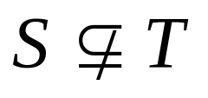
SUBSET AND SUPERSET RELATIONS
S⊆T (“S is a subset of T”) means that every element of S is also an element of T.
S⊆T ⇔ ∀x (x∈S → x∈T)
∅⊆S, S⊆S.
S⊇T (“S is a superset of T”) means T⊆S.
Note S=T ⇔ S⊆T∧ S⊇T.
means ¬(S⊆T), i.e. ∃x(x∈S ∧ x∉T)
Notes:
Discrete Mathematics and its Applications
26年 11月 8日
(c)2001-2002, Michael P. Frank
Note also that FORALL x P(x)->Q(x) can also be understood as meaning “{x|P(x)} is a subset of {x|Q{x}}”. This can help you understand the meaning of implication. For example, if I say, “if a student has a drivers license, then he is over 16,” this is the same as saying “the set of students with drivers licenses is a subset of the set of students who are over 16”, or “every student with a drivers license is over 16.” If no students in the universe of discourse have drivers licenses, then the antecedent is always false, or in other words the set of students with drivers licenses is just the empty set, which is of course a member of every set, and so the statement is vacuously true. Alternatively, if every student in the universe of discourse is over 16, then the consequent is always true, that is, the set of students who are over 16 is the entire universe of discourse, and so every set of students in the u.d. is necessarily a subset of the set of students who are over 16, and so the statement is trivially true. The statement is only false if there exists a student with a drivers license in the u.d. who is under 16 (perhaps the license is fake or from a foreign country), in which case, the set of students with drivers licenses is *not* a subset of the under-16 students.

Slide 11
PROPER (STRICT) SUBSETS & SUPERSETS
S⊂T (“S is a proper subset of T”) means that S⊆T but . Similar for S⊃T.
Example:
{1,2} ⊂
{1,2,3}
S
T
Venn Diagram equivalent of S⊂T
Notes:
Discrete Mathematics and its Applications
26年 11月 8日
(c)2001-2002, Michael P. Frank
We may also say, “S is a strict subset of T”, or “S is strictly a subset of T” to mean the same thing.

Slide 12

SETS ARE OBJECTS, TOO!
The objects that are elements of a set may themselves be sets.
E.g. let S={x | x ⊆ {1,2,3}}
then S={∅,
{1}, {2}, {3},
{1,2}, {1,3}, {2,3},
{1,2,3}}
Note that 1 ≠ {1} ≠ {{1}} !!!!
Very
Important!
Notes:
Discrete Mathematics and its Applications
26年 11月 8日
(c)2001-2002, Michael P. Frank
In general, any kind of object or structure, whether simple or complex, can be a member of a set. In particular, sets themselves (being structures) can be members of sets.
If you don’t understand the distinction between 1, {1}, {{1}}, you’ll make endless silly mistakes. 1 is a number, the number one. {1} is NOT A NUMBER AT ALL! It is a COMPLETELY DIFFERENT TYPE OF OBJECT! Namely, it is a set. What kind of set? It is a singleton set, by which we mean a set that contains exactly one element. In this case, its element happens to be the number 1. Now, what is {{1}}? It is also a set, and also a singleton set, but it is a COMPLETELY DIFFERENT TYPE of singleton set. To see this, notice that {1} is a set of numbers, whereas {{1}} is not a set of numbers at all! It is a SET OF SETS. Its single element is not a number at all, but is a SET. Namely, the set {1}. In other words, {{1}} is the singleton set whose member is the singleton set whose member is 1. Whereas, {1} is just the singleton set whose member is 1. And, 1 is just 1. All of these are distinct objects and you’ve got to learn to keep them separate! Otherwise, you’ll never have a chance of understanding data types in programming languages. For example, in most languages, we can have an array of numbers, or an array of arrays of numbers, etc. These are all completely different types of objects and can never be compatible with each other.

Slide 13
CARDINALITY AND FINITENESS
|S| (read “the cardinality of S”) is a measure of how many different elements S has.
E.g., |∅|=0, |{1,2,3}| = 3, |{a,b}| = 2,
|{{1,2,3},{4,5}}| = ____
We say S is infinite if it is not finite.
What are some infinite sets we’ve seen?
2
N
Z
R

Slide 14
THE POWER SET OPERATION
The power set P(S) of a set S is the set of all subsets of S. P(S) = {x | x⊆S}.
E.g. P({a,b}) = {∅, {a}, {b}, {a,b}}.
Sometimes P(S) is written 2^{S}.
Note that for finite S, |P(S)| = 2^{|S|}.
It turns out that |P(N)| > |N|.
There are different sizes of infinite sets!
Notes:
Discrete Mathematics and its Applications
26年 11月 8日
(c)2001-2002, Michael P. Frank
We’ll get to different sizes of infinite sets later, in the module on functions.

Slide 15
ORDERED N-TUPLES
For n∈N, an ordered n-tuple or a sequence of length n is written (a₁, a₂, …, a_{n}). The first element is a₁, etc.
These are like sets, except that duplicates matter, and the order makes a difference.
Note (1, 2) ≠ (2, 1) ≠ (2, 1, 1).
Empty sequence, singlets, pairs, triples, quadruples, quintuples, …, n-tuples.
Notes:
Discrete Mathematics and its Applications
26年 11月 8日
(c)2001-2002, Michael P. Frank
Sometimes people also define “bags”, which are unordered collections in which duplicates matter. If you have a bag of coins, they are in no particular order, but it matters how many coins of each type you have.

Slide 16
CARTESIAN PRODUCTS OF SETS
For sets A, B, their Cartesian product
A×B :≡ {(a, b) | a∈A ∧ b∈B }.
E.g. {a,b}×{1,2} = {(a,1),(a,2),(b,1),(b,2)}
Note that for finite A, B, |A×B|=|A||B|.
Note that the Cartesian product is not commutative: ¬∀AB: A×B =B×A.
Extends to A₁ × A₂ × … × A_{n}...
Notes:
Discrete Mathematics and its Applications
26年 11月 8日
(c)2001-2002, Michael P. Frank
Usually AxBxC is defined as {(a,b,c) | a is in A and b is in B and c is in C}.

Slide 17
THE UNION OPERATOR
For sets A, B, their union A∪B is the set containing all elements that are either in A, or (“∨”) in B (or, of course, in both).
Formally, ∀A,B: A∪B = {x | x∈A ∨ x∈B}.
Note that A∪B contains all the elements of A and it contains all the elements of B:
∀A, B: (A∪B ⊇ A) ∧ (A∪B ⊇ B)

Slide 18

UNION EXAMPLES
Required Form
{a,b,c}∪{2,3} = {a,b,c,2,3}
{2,3,5}∪{3,5,7} = {2,3,5,3,5,7} ={2,3,5,7}
2
5
3
7

Slide 19
THE INTERSECTION OPERATOR
For sets A, B, their intersection A∩B is the set containing all elements that are simultaneously in A and (“∧”) in B.
Formally, ∀A,B: A∩B≡{x | x∈A ∧ x∈B}.
Note that A∩B is a subset of A and it is a subset of B:
∀A, B: (A∩B ⊆ A) ∧ (A∩B ⊆ B)

Slide 20
INTERSECTION EXAMPLES
∅
{a,b,c}∩{2,3} = ___
{2,4,6}∩{3,4,5} = ______
{4}
3
2
4
6
5

Slide 21
DISJOINTEDNESS
Help, I’ve
been
disjointed!
Two sets A, B are called
disjoint (i.e., unjoined)
iff their intersection is
empty. (A∩B=∅)
Example: the set of even
integers is disjoint with
the set of odd integers.

Slide 22
INCLUSION-EXCLUSION PRINCIPLE
How many elements are in A∪B?
|A∪B| = |A| + |B| − |A∩B|
Example:
{2,3,5}∪{3,5,7} = {2,3,5,3,5,7} ={2,3,5,7}
Subtract out items
in intersection, to
compensate for
double-counting them!
Notes:
Discrete Mathematics and its Applications
26年 11月 8日
(c)2001-2002, Michael P. Frank
We will see this basic counting principle again when we talk about combinatorics.

Slide 23
SET DIFFERENCE
For sets A, B, the difference of A and B, written A−B, is the set of all elements that are in A but not B.
A − B :≡ {x | x∈A ∧ x∉B}
= {x | ¬( x∈A → x∈B ) }
Also called:
The complement of B with respect to A.
Notes:
Discrete Mathematics and its Applications
26年 11月 8日
(c)2001-2002, Michael P. Frank
NOT (x in A -> x in B) = NOT (x not in A or x in B) (defn. of implies) = x in A AND x not in B (DeMorgan’s law).

Slide 24
SET DIFFERENCE EXAMPLES
{1,2,3,4,5,6} − {2,3,5,7,9,11} =
___________
Z − N = {… , -1, 0, 1, 2, … } − {0, 1, … }
= {x | x is an integer but not a nat. #}
= {x | x is a negative integer}
= {… , -3, -2, -1}
{1,4,6}

Slide 25
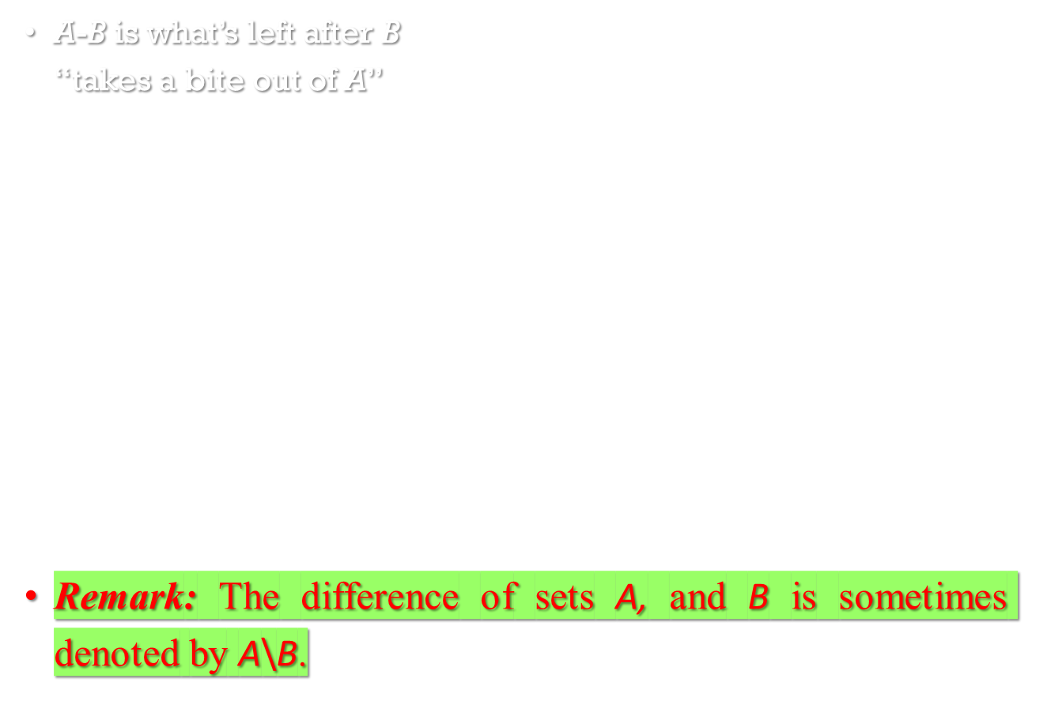
SET DIFFERENCE - VENN DIAGRAM
Chomp!
Set
A−B
Set A
Set B

Slide 26
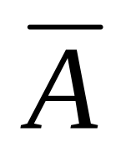
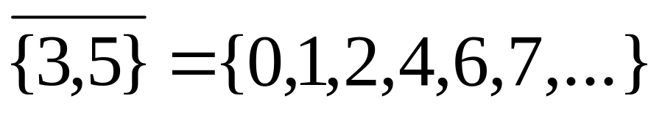
SET COMPLEMENTS
The universe of discourse can itself be considered a set, call it U.
The complement of A, written , is the complement of A w.r.t. U, i.e., it is U−A.
E.g., If U=N,

Slide 27
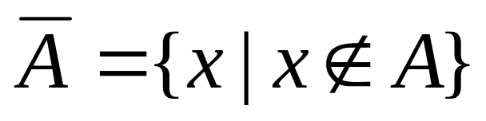
MORE ON SET COMPLEMENTS
An equivalent definition, when U is clear:
A
U
Notes:
Discrete Mathematics and its Applications
26年 11月 8日
(c)2001-2002, Michael P. Frank
Note that set difference and complement do not relate to each other like arithmetic difference and negative. In arithmetic, we know that a-b = -(b-a). But in sets, A-B is not generally the same as the complement of B-A.

Slide 28
PROVING SET IDENTITIES
To prove statements about sets, of the form
E₁ = E₂ (where Es are set expressions), here are three useful techniques:
Prove E₁ ⊆ E₂ and E₂ ⊆ E₁ separately.
Use logical equivalences.
Use a membership table.
Notes:
Discrete Mathematics and its Applications
26年 11月 8日
(c)2001-2002, Michael P. Frank
A membership table is like a truth table.

Slide 29

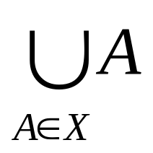
GENERALIZED UNION
Binary union operator: A∪B
n-ary union:
A∪A₂∪…∪A_{n} :≡ ((…((A₁∪ A₂) ∪…)∪ A_{n})
(grouping & order is irrelevant)
“Big U” notation:
Or for infinite sets of sets:

Slide 30
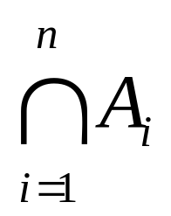
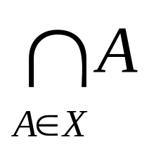
GENERALIZED INTERSECTION
Binary intersection operator: A∩B
n-ary intersection:
A∩A₂∩…∩A_{n}≡((…((A₁∩A₂)∩…)∩A_{n})
(grouping & order is irrelevant)
“Big Arch” notation:
Or for infinite sets of sets:

Slide 31
SET IDENTITIES
Set identities are basic laws on how set operations work
  Many have already been introduced on previous slides
Just like logical equivalences!
  Replace U with ∨
  Replace ∩ with ∧
  Replace ∅ with F
  Replace U with T

Slide 32
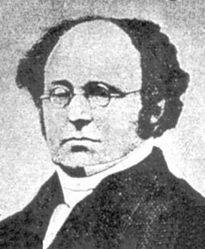
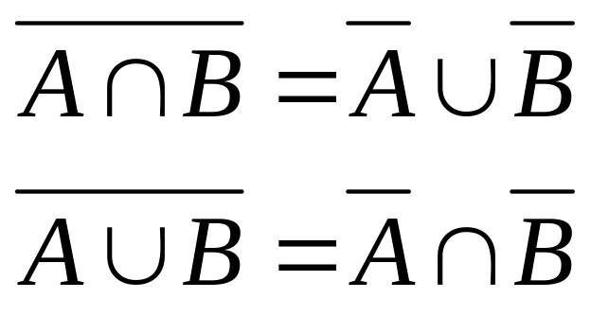
SET IDENTITIES: DEMORGAN AGAIN
These should look
very familiar…

Slide 33
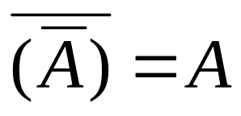
SET IDENTITIES
Identity: A∪∅=A A∩U=A
Domination: A∪U=U A∩∅=∅
Idempotent: A∪A = A = A∩A
Double complement:
Commutative: A∪B=B∪A A∩B=B∩A
Associative: A∪(B∪C)=(A∪B)∪C
A∩(B∩C)=(A∩B)∩C

Slide 34
HOW TO PROVE A SET IDENTITY
For example: A∩B=B-(B-A)
Four methods:
  Use the basic set identities
  Use membership tables
  Prove each set is a subset of each other
    This is like proving that two numbers are equal by showing that each is less than or equal to the other
  Use set builder notation and logical equivalences

Slide 35
WHAT WE ARE GOING TO PROVE…
A∩B=B-(B-A)
A
B
B-(B-A)
A∩B
B-A

Slide 36
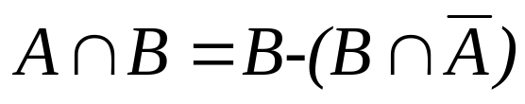
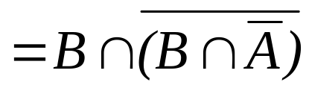
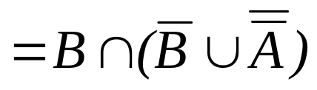
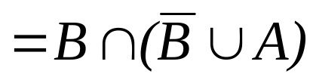
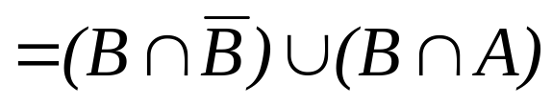



PROOF BY USING BASIC SET IDENTITIES
Prove that A∩B=B-(B-A)
Definition of difference
Definition of difference
DeMorgan’s law
Complementation law
Distributive law
Complement law
Identity law
Commutative law

Slide 37
MUTUAL SUBSETS
Example: Show A∩(B∪C)=(A∩B)∪(A∩C).
Show A∩(B∪C)⊆(A∩B)∪(A∩C).
  Assume x∈A∩(B∪C), & show x∈(A∩B)∪(A∩C).
  We know that x∈A, and either x∈B or x∈C.
    Case 1: x∈B. Then x∈A∩B, so x∈(A∩B)∪(A∩C).
    Case 2: x∈C. Then x∈A∩C , so x∈(A∩B)∪(A∩C).
  Therefore, x∈(A∩B)∪(A∩C).
  Therefore, A∩(B∪C)⊆(A∩B)∪(A∩C).
Show (A∩B)∪(A∩C) ⊆ A∩(B∪C). …

Slide 38
MEMBERSHIP TABLES
Just like truth tables for propositional logic.
Columns for different set expressions.
Rows for all combinations of memberships in constituent sets.
Use “1” to indicate membership in the derived set, “0” for non-membership.
Prove equivalence with identical columns.

Slide 39
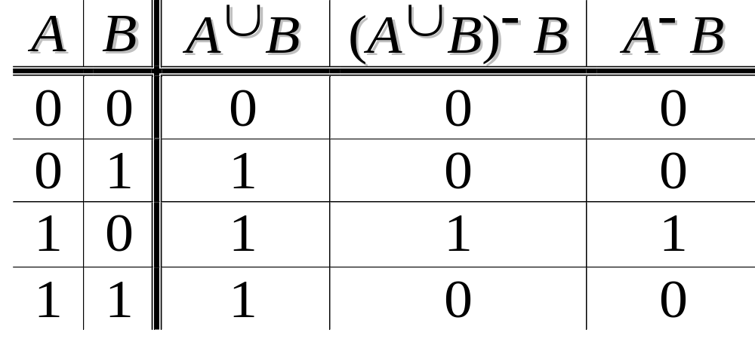
MEMBERSHIP TABLE EXAMPLE
Prove (A∪B)−B = A−B.

Slide 40
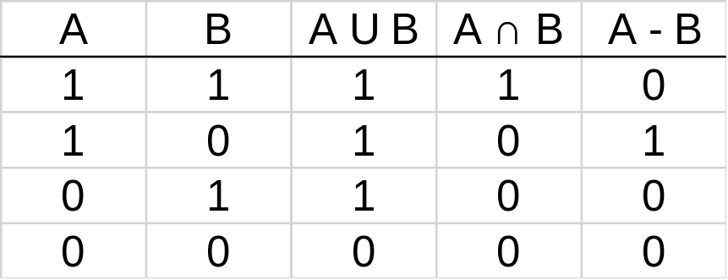
WHAT IS A MEMBERSHIP TABLE
Membership tables show all the combinations of sets an element can belong to
  1 means the element belongs, 0 means it does not
Consider the following membership table:
The top row is all elements that belong to both sets A and B
  Thus, these elements are in the union and intersection, but not the difference

Slide 41
The second row is all elements that belong to set A but not set B
  Thus, these elements are in the union and difference, but not the intersection
The third row is all elements that belong to set B but not set A
  Thus, these elements are in the union, but not the intersection or difference
The bottom row is all elements that belong to neither set A or set B
  Thus, these elements are neither the union, the intersection, nor difference

Slide 42
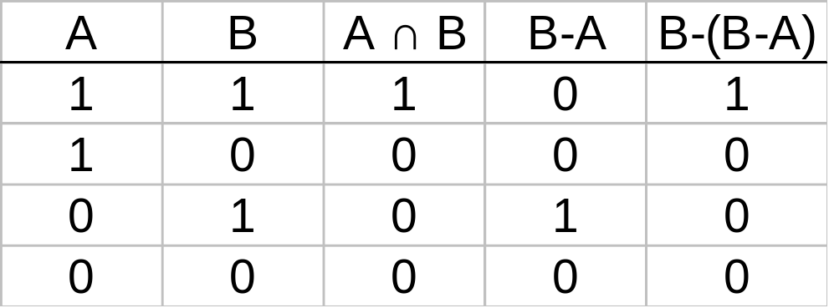
PROOF BY MEMBERSHIP TABLES
The following membership table shows that A∩B=B-(B-A)
Because the two indicated columns have the same values, the two expressions are identical
This is similar to Boolean logic!

Slide 43
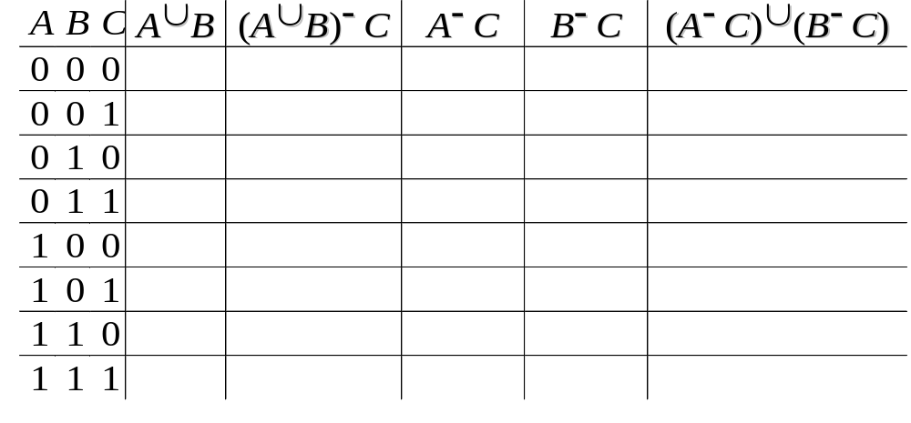
MEMBERSHIP TABLE EXERCISE
Prove (A∪B)−C = (A−C)∪(B−C).

Slide 44
PROOF BY SHOWING EACH SET
IS A SUBSET OF THE OTHER 1
Assume that an element is a member of one of the identities
  Then show it is a member of the other
Repeat for the other identity
We are trying to show:
  (x∈A∩B→ x∈B-(B-A)) ∧ (x∈B-(B-A)→ x∈A∩B)
  This is the biconditional:
  x∈A∩B ↔ x∈B-(B-A)
Not good for long proofs
Basically, it’s an English run-through of the proof

Slide 45
PROOF BY SHOWING EACH SET
IS A SUBSET OF THE OTHER 2
Assume that x∈B-(B-A)
  By definition of difference, we know that x∈B and x∉B-A
Consider x∉B-A
  If x∈B-A, then (by definition of difference) x∈B and x∉A
  Since x∉B-A, then only one of the inverses has to be true (DeMorgan’s law): x∉B or x∈A
So we have that x∈B and (x∉B or x∈A)
  It cannot be the case where x∈B and x∉B
  Thus, x∈B and x∈A
  This is the definition of intersection
Thus, if x∈B-(B-A) then x∈A∩B

Slide 46
PROOF BY SHOWING EACH SET
IS A SUBSET OF THE OTHER 3
Assume that x∈A∩B
  By definition of intersection, x∈A and x∈B
Thus, we know that x∉B-A
  B-A includes all the elements in B that are also not in A not include any of the elements of A (by definition of difference)
Consider B-(B-A)
  We know that x∉B-A
  We also know that if x∈A∩B then x∈B (by definition of intersection)
  Thus, if x∈B and x∉B-A, we can restate that (using the definition of difference) as x∈B-(B-A)
Thus, if x∈A∩B then x∈B-(B-A)

Slide 47
PROOF BY SET BUILDER NOTATION
AND LOGICAL EQUIVALENCES 1
First, translate both sides of the set identity into set builder notation
Then massage one side (or both) to make it identical to the other
  Do this using logical equivalences

Slide 48








PROOF BY SET BUILDER NOTATION
AND LOGICAL EQUIVALENCES 2
Original statement
Definition of difference
Negating “element of”
Definition of difference
DeMorgan’s Law
Distributive Law
Negating “element of”
Negation Law
Identity Law
Definition of intersection

Slide 49
PROOF BY SET BUILDER NOTATION
AND LOGICAL EQUIVALENCES 3
Why can’t you prove it the “other” way?
  I.e. massage A∩B to make it look like B-(B-A)
You can, but it’s a bit annoying
  In this case, it’s not simplifying the statement

Slide 50
PRACTICE PROBLEMS
Let A, B, and C be sets. Show that:
(AUB) ⊆ (AUBUC)
(A∩B∩C) ⊆ (A∩B)
(A-B)-C ⊆ A-C
(A-C) ∩ (C-B) = ∅

Slide 51

Don’t hesitate to contact us if you have any questions about this course’s teaching contents. Also don’t forget to check out the course page and Microsoft Team folder,
• course page https://mayooran1987.github.io/MC4010_E21/

