Slide 1

LITEUP / SECURITY
Safer utility
payments, made
easy to explain.
A short guide to common web risks, safe local checks, and what LiteUp does to reduce them.
Security briefing | October 2026

Slide 2
START HERE
A simple way to think about web security
1 Check the request
2 Protect the action
3 Verify the result
A browser is not a trusted source. Validate every form on the server, even if the page already has required fields.
Use prepared SQL, CSRF tokens, login limits, and role checks before changing accounts or money.
Test only your localhost app and dummy accounts. A protected test should fail safely, without changing real data.
These checks are for your own local LiteUp instance only. Do not test systems you do not own.
LITEUP | LOCAL SECURITY BRIEFING
02

Slide 3
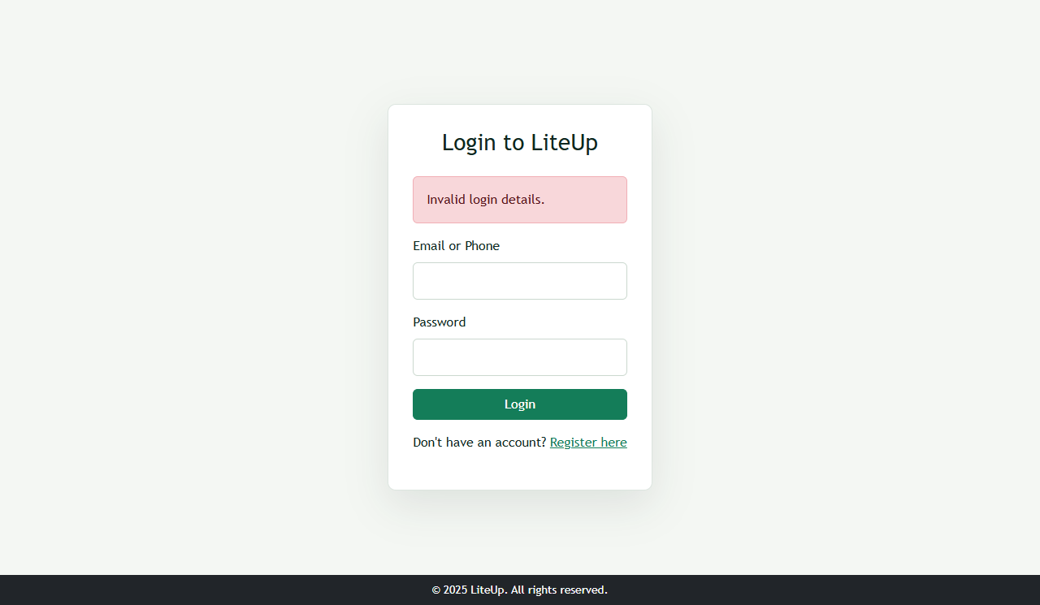
INJECTION
SQL injection and file inclusion
If vulnerable
LiteUp protection
A crafted login could bypass the sign-in check or expose records. A request-chosen file could expose private server files.
Prepared statements bind values separately. PHP includes use fixed application paths; request values do not choose files.
SAFE LOCAL CHECK | sign-in form only
Test identity with a wrong password:
' OR 1=1 --
PROTECTED CODE | public/login.php:18
WHERE email = ? OR phone = ?
$stmt->bind_param("ss", $identity, $identity);
Expected: “Invalid login details”
REAL LOCAL TEST | Rejected; no SQL error or login.
LITEUP | LOCAL SECURITY BRIEFING
03

Slide 4

ACCOUNTS
CSRF and password guessing
CSRF: a forged click
Brute force: repeated guesses
If vulnerable, a site could make your browser submit an action you did not choose. LiteUp checks a session token on POST forms.
If vulnerable, an attacker could keep guessing passwords. LiteUp limits attempts; the local test blocks after five.
SAFE LOCAL CHECKS | PowerShell, from the project folder
php .\test_rate_limiter.php
curl.exe -i http://localhost:8080/liteup_app/public/logout.php
curl.exe -i -X POST http://localhost:8080/liteup_app/public/logout.php
Expected: 1–5 allowed, then blocked (includes/security.php:67). GET = 405; POST without CSRF = 403. Token: hash_equals() at includes/security.php:37.
REAL LOCAL TEST | GET blocked with 405.
LITEUP | LOCAL SECURITY BRIEFING
04

Slide 5
INPUT BOUNDARIES
Safe checks for uploads and request boundaries
File uploads
File inclusion
CORS
Command injection
If vulnerable: a script might run or private files leak.
Test: upload a harmless .txt as a profile picture.
Protected: rejected; image contents, size, and type checked.
Code: profile.php:50.
If vulnerable: private server files could be exposed.
Test: scan include/require paths.
Protected: fixed project paths only; no request-selected file.
Code: includes/auth.php.
If too open: another site may read private responses.
Test locally:
curl -i -H "Origin: https://attacker.invalid" http://localhost:8080/liteup_app/public/login.php
Protected: no allow-origin header.
If vulnerable: input could trigger an OS command.
Scan only; do not run a payload:
Select-String -Path .\public\*.php -Pattern "shell_exec|system|exec|passthru"
Protected: no command sinks found.
LITEUP | LOCAL SECURITY BRIEFING
05

Slide 6
WHAT REMAINS
Good code helps; production also needs good operations
In the application now
Before a company launch
• Prepared SQL · public/login.php:18
• CSRF · includes/security.php:37
• Login throttling · includes/security.php:67
• Upload verification · public/profile.php:50
• Idempotent utility/tamper payments + refunds
• CSP blocks inline JavaScript
• Private proof downloads and escaped output
• HTTPS with a valid certificate
• Least-privilege production database user
• Backups and restore drills
• Provider APIs, settlement and reconciliation
• Central logs, monitoring, incident plan
• Independent penetration test and privacy review
LiteUp uses manual operations today. Airtime/data/electricity are not automatically delivered until provider APIs are integrated.
LITEUP | LOCAL SECURITY BRIEFING
06

