Slide 1

OBDA
Ismail Mayouf

Slide 2
Agenda
Introduction to OBDA
Mapping Translation in OBDA
Scenarios and Challenges in OBDA
Practical Applications and Implications
Conclusions

Slide 3

Introduction to OBDA
Need for ‘self-service’ data access by end-users
Direct data access is challenging
Complex schemata: N- numbers of tables
Conceptual mismatch: user’s view vs DB Schemata
Common Data access Approach
Specialized applications with predefined queries
Not Sufficient: IT Experts have to be involved

Slide 4
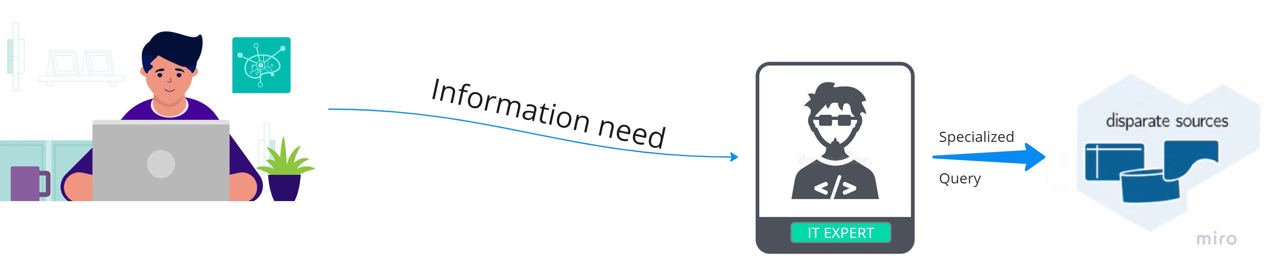
Introduction to OBDA
IT Experts are a bottle-neck of data access

Slide 5
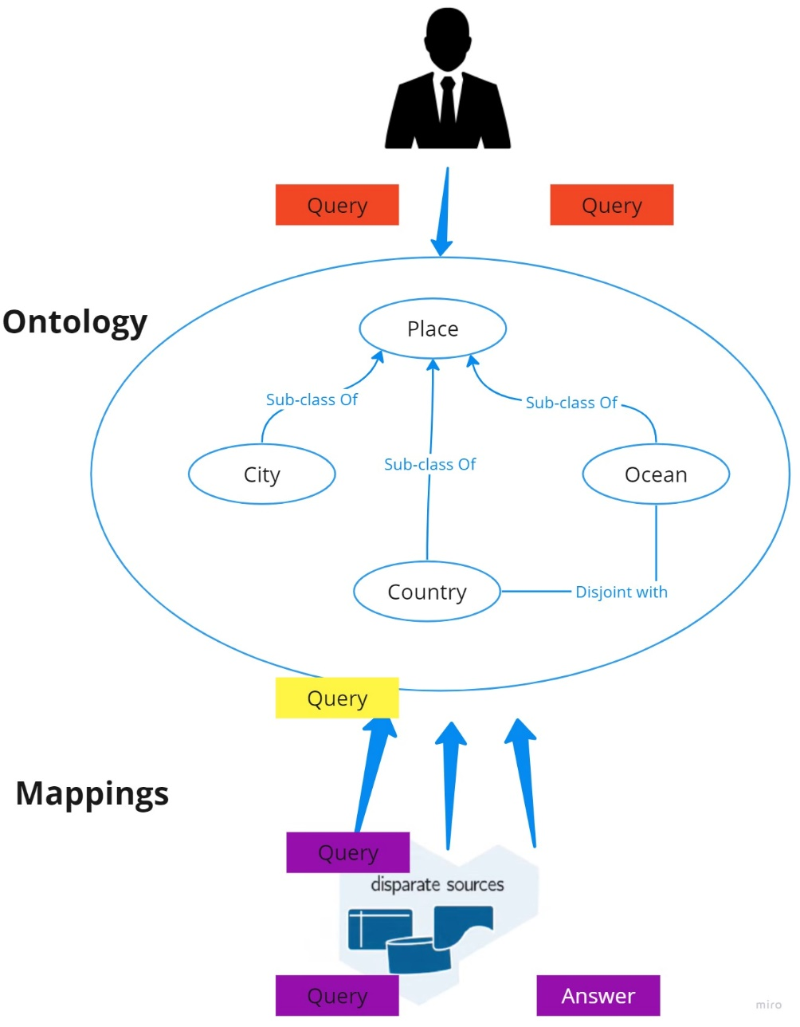
Introduction to OBDA
What is OBDA?
Data Access and integration
Virtual: data stays where it is
Ontology:
Mediates users and data
Formal description of domain in user-oriented terms
Mappings ‘Connect’ ontology to data
Limitations
Expensive startup, maintenance cost
Building and maintaining ontologies and mappings
End-users have to learn a machine-oriented query language

Slide 6
Mapping Translation in OBDA

