Slide 1

SPLUNK INTERFACE Class 3
T.O Analytics

Slide 2



Slide 3
CLASS 2 REVIEW
Indexes
Distributed Search.
Events.
Fields.
Host, Source, Source Type.
Reports.
Dashboards.
System Components
Forwarders.
Indexer.
Search. Head.
Alerts.

Slide 4
Table of Contents
SPL’s. (Commands and Functions)
Creating Alerts.

Slide 5

SPL (Search Processing Language)
Splunk Search Processing Language (SPL) is a powerful query language used for searching, filtering, and analyzing data within Splunk. It enables users to extract meaningful information from vast amounts of machine-generated data. SPL is specifically designed to work with the unique time-series data and event-based data structures that Splunk handles.

Slide 6
Features & Component of Spl’s
Basic Search
Pipes (|)
Filtering Commands
Transforming Commands
Statistical Functions
Time Commands
Lookup Commands
Eval Command
Regular Expressions (rex)
Join and Susearches
Booleans

Slide 7
Basic Search
Explanation
Basic searches in SPL involve entering keywords to retrieve data from Splunk indexes.
By default, Splunk searches across all indexed data unless specified otherwise.
Examples
error “Finds all events containing the word "error””.
index=webserver “Searches within the "webserver" index”.
index=webserver "login failed" “Finds events containing the phrase "login failed" in the "webserver" index”.

Slide 8
PIPE (|)
Explanation
Pipes are used to chain multiple commands together, where the output of one command serves as the input to the next.
This allows for complex data processing in a sequential manner.
Examples
index=webserver | stats count “Counts all events in the "webserver" index”.
index=webserver | where status=404 | stats count “Finds events with a 404 status and counts them”.

Slide 9
Filtering Commands
Explanation
Filtering commands narrow down search results based on specific conditions.
Common filtering commands include where and search.
Examples
index=webserver | where status=404 “Filters events where the status is 404”.
index=webserver | search status=200 AND bytes>1000 “Finds events with a 200 status and more than 1000 bytes”.

Slide 10
Transforming Commands
Explanation
Transforming commands change the structure of search results, often used for aggregation and summarization.
Common transforming commands include stats, chart, and timechart.
Examples
index=webserver | stats count by host “Counts events grouped by host”.
index=webserver | chart avg(bytes) by status “Creates a chart showing the average bytes for each status code”.

Slide 11
Statistical Functions
Explanation
Statistical functions perform calculations on the data to derive insights.
Examples of statistical functions include avg, sum, min, max, and count.
Example
index=webserver | stats avg(response_time): Calculates the average response time.
index=webserver | stats sum(bytes) by host: Sums the bytes for each host.

Slide 12
Booleans
Explanation
Booleans in SPL are used to combine multiple search criteria using logical operators.
The common Boolean operators are AND, OR, and NOT.
Examples
index=webserver error AND status=500 “Finds events containing the word "error" and having a status of 500”.
index=webserver status=200 OR status=404: “Finds events with a status of either 200 or 404”.
index=webserver error NOT status=200 “Finds events containing the word "error" but not having a status of 200”.

Slide 13
Time Commands
Explanation
Time commands are used to analyze and visualize time-based data.
Common time commands include timechart and bucket.
Examples
index=webserver | timechart span=1h count: Creates an hourly time chart of event counts.
index=webserver | bucket span=1d _time | stats count by _time: Groups events into daily buckets and counts them.

Slide 14
Lookup Commands
Explanation
Lookup commands enrich data by adding fields from external sources, such as CSV files or lookup tables.
The lookup command is commonly used for this purpose.
Examples
index=webserver | lookup user_info user_id OUTPUT user_name “Adds the user_name field from the user_info lookup table based on user_id”.
index=webserver | lookup geo_info ip OUTPUT location “Adds location data based on IP addresses”.

Slide 15
Eval Commands
Explanation:
The eval command creates new fields or transforms existing ones using expressions.
It supports various operations, including arithmetic, string manipulation, and conditional logic.
Examples:
index=webserver | eval total_price=quantity * price “Creates a new field total_price by multiplying quantity and price”.
index=webserver | eval status_description=if(status==200, "OK", "Error") “Creates a new field status_description based on the status code”.

Slide 16
Regular Expressions (rex)
Explanation
The rex command extracts fields and data using regular expressions.
It allows for pattern matching and extraction within event data.
Examples
index=webserver | rex field=_raw "user=(?<username>\\w+)” “Extracts the username from raw event data”.
index=webserver | rex field=_raw "status=(?<status_code>\\d{3})” “Extracts the status code from raw event data”.

Slide 17
Join and Subsearches
Explanation
Join and subsearches combine results from multiple searches for complex data analysis.
The join command merges results from different searches based on common fields.
Subsearches allow nested searches within a main search.
Examples
index=webserver error | join type=inner [search index=other_data]. “Performs an inner join with results from another search”.
index=webserver [search index=other_data status=404 | fields session_id] “Uses a subsearch to find session IDs with a 404 status and then searches for those session IDs in the "webserver" index”.

Slide 18

BREAK

Slide 19

Alerts
Alerts are triggered when search results meet specific conditions. You can use alerts on historical and real-time searches. Alerts can be configured to trigger actions such as sending alert information to designated email addresses or posting alert information to a web resource.

Slide 20
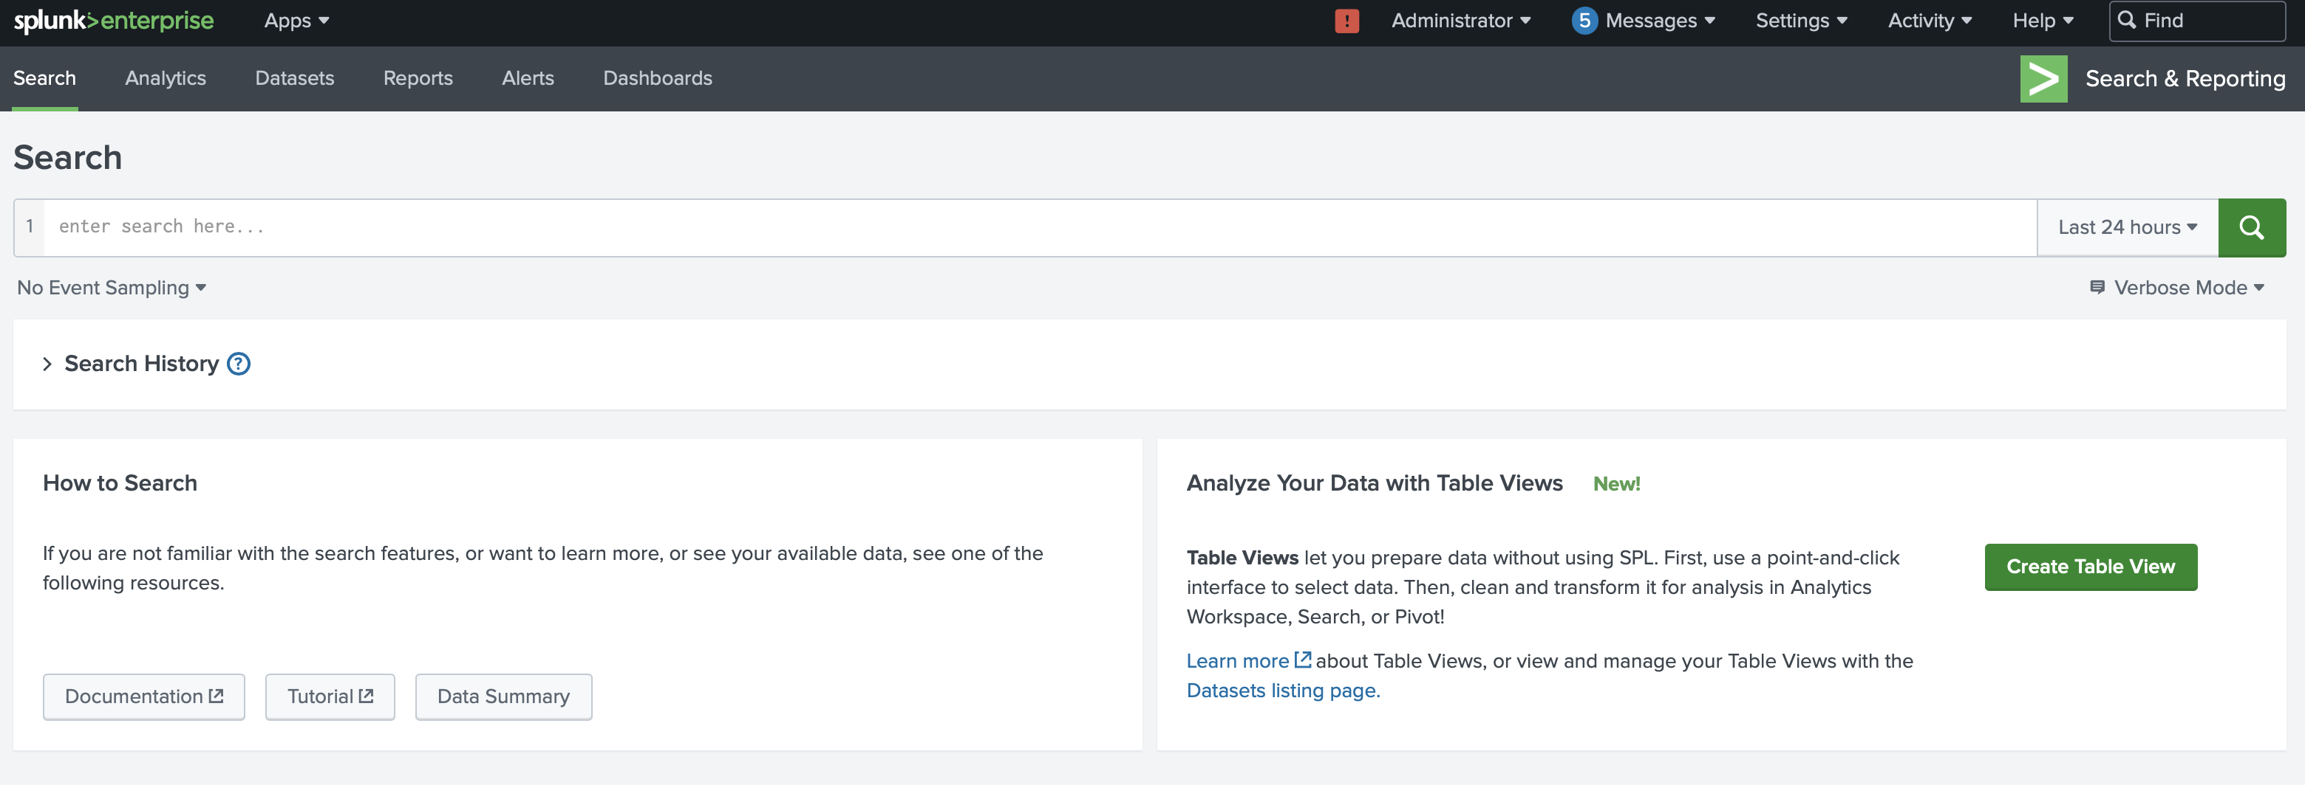
Step-by-Step Guide for Creating Alerts in Splunk
Navigate to Splunk:
Open your web browser and go to the Splunk Enterprise login page.

Slide 21
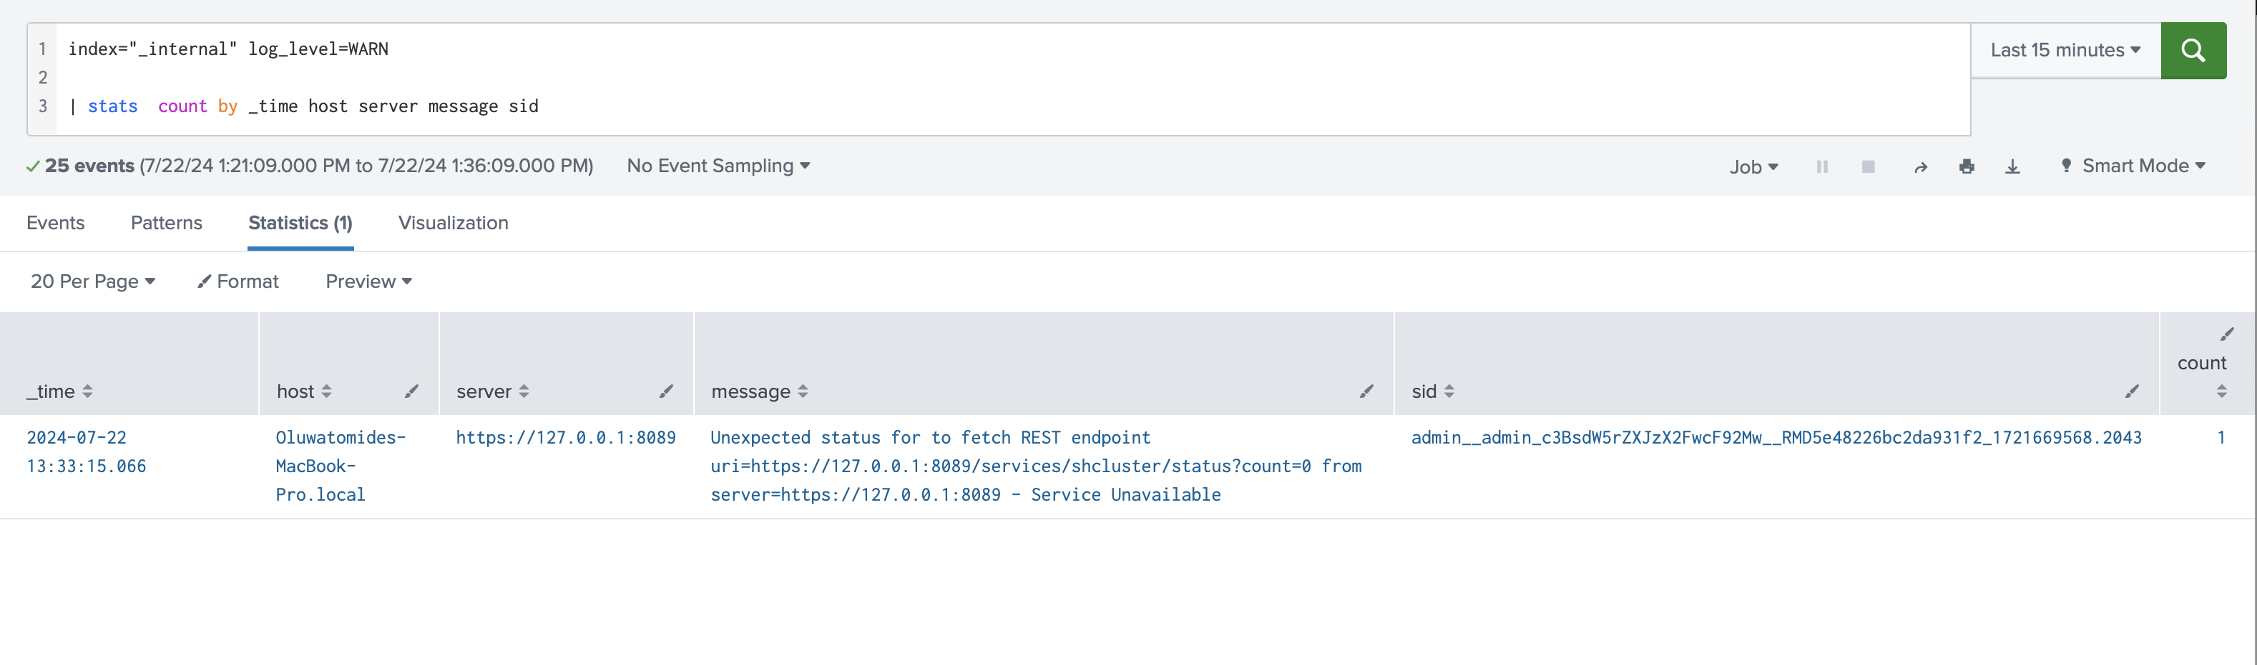
Step-by-Step Guide for Creating Alerts in Splunk
Search for Data
On the Search page, enter the search string you are looking for. For example:plaintextCopy code
Select the three different modes available: Fast Mode, Smart Mode, and Verbose Mode.
Click the green magnifying glass icon to execute the search.

Slide 22
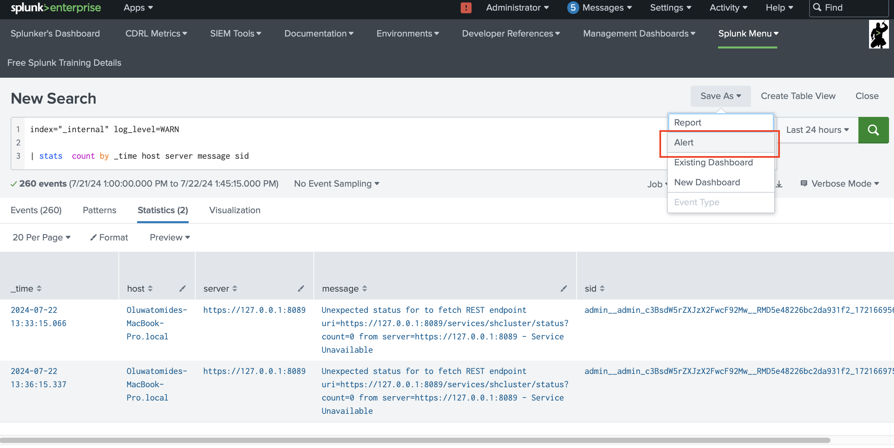
Step-by-Step Guide for Creating Alerts in Splunk
Save Search as an Alert
After your search results are displayed, click on Save As in the top right corner.
Select Alert from the dropdown menu.

Slide 23
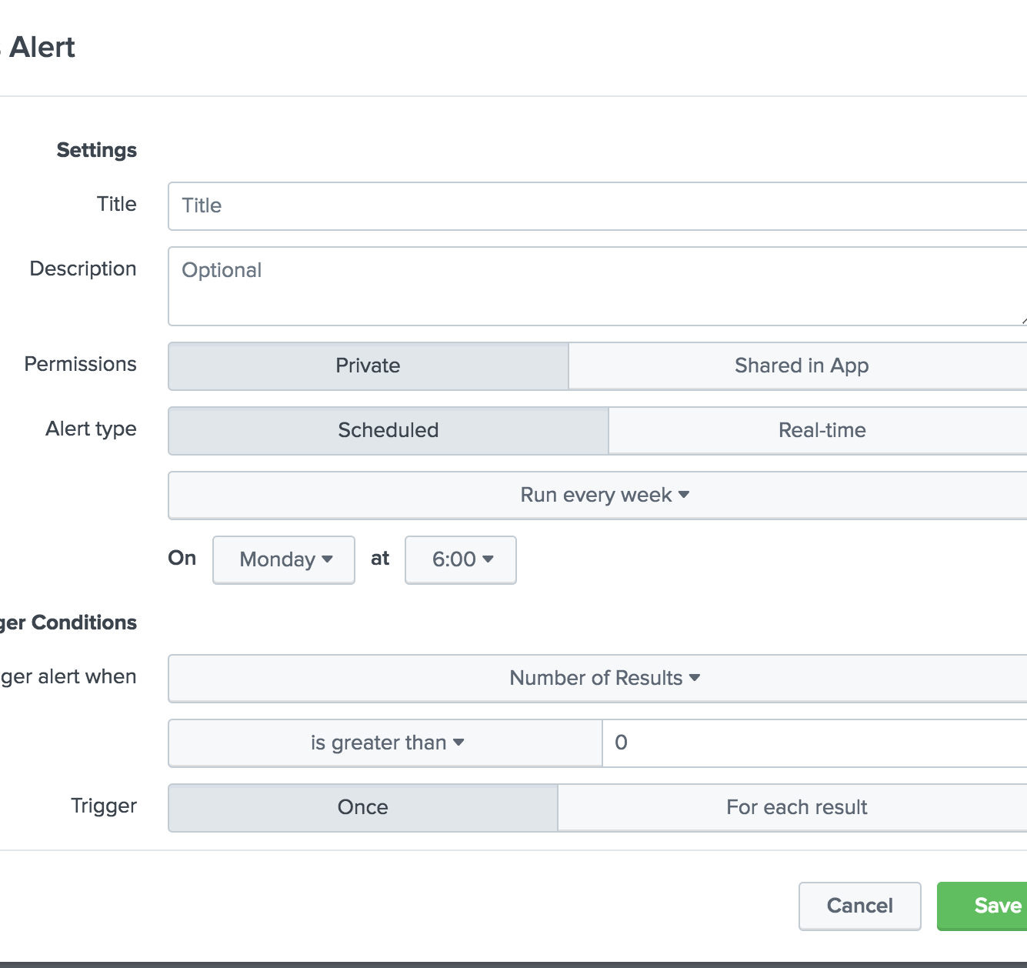
Step-by-Step Guide for Creating Alerts in Splunk
Enter Alert Details:
You will be presented with a screen to enter additional details for the alert.
Title: Enter the name of the alert.
Description: Provide additional details about the alert.
Permissions:
Private: Only you can view and edit the alert.
Shared in App: The alert is visible and potentially editable by other users within the app.

Slide 24
Step-by-Step Guide for Creating Alerts in Splunk
Configure Alert Type:
Alert Type: Choose between Scheduled and Real-time.
Scheduled: Runs on a set schedule.
Select Run on CRON Schedule.
Choose the Time Range for the search query to look at each time the CRON job executes.
Example CRON expression
*/5 * * * * Every 5 minutes.
*/30 * * * * Every 30 minutes.
0 */12 * * * Every 12 hours, on the hour.
*/20 * * * 1-5 Every 20 minutes, Monday through Friday.
0 9 1-7 * * The first 7 days of every month at 9 AM.
Time Range: Select the time range you want the search to cover each time it runs.

Slide 25
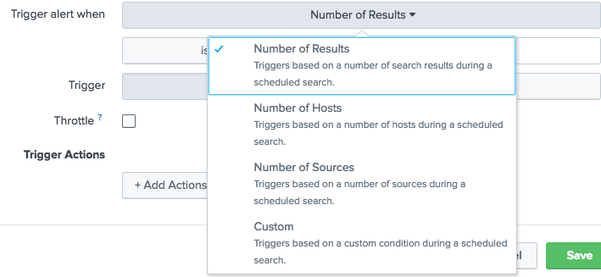
Step-by-Step Guide for Creating Alerts in Splunk
Set Trigger Conditions:
Trigger alert when: Specify the criteria that triggers the alert.
Choose conditions such as the number of results being greater or lesser than a particular value.
Trigger: Determine if the alert should trigger once or every time the criteria is met.
Throttle: Suppress alert triggering for a specific time period to prevent frequent alerts. For example, suppress for 60 seconds to avoid email overload.

Slide 26
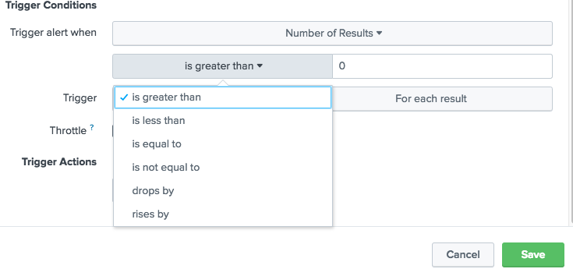
Step-by-Step Guide for Creating Alerts in Splunk
Define Trigger Actions:
Send Email: Configure email notifications.
Use tokens in the subject and body for specificity. For instance, $name$ will be replaced by the name of the search when the alert is sent.
Include information from the trigger search results using tokens like $result.fieldname$.

Slide 27
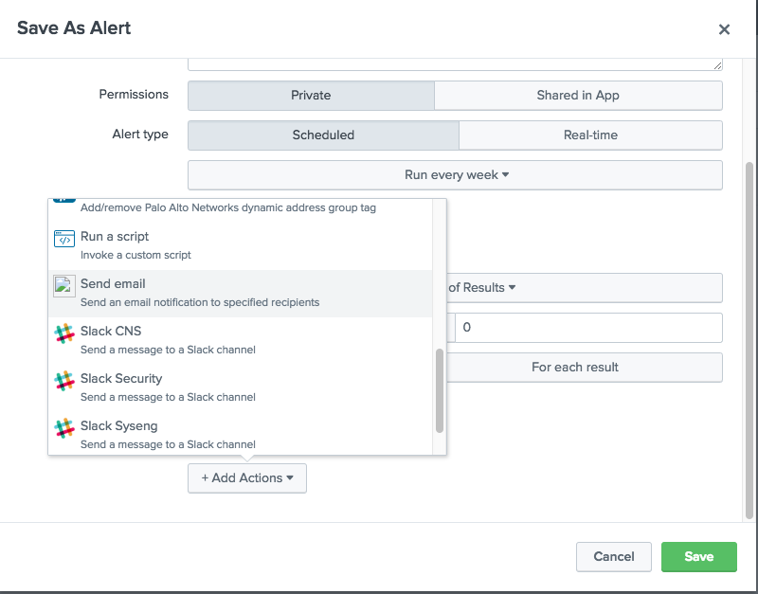
Step-by-Step Guide for Creating Alerts in Splunk
Define Trigger Actions:
Send Email: Configure email notifications.
Use tokens in the subject and body for specificity. For instance, $name$ will be replaced by the name of the search when the alert is sent.
Include information from the trigger search results using tokens like $result.fieldname$.

Slide 28
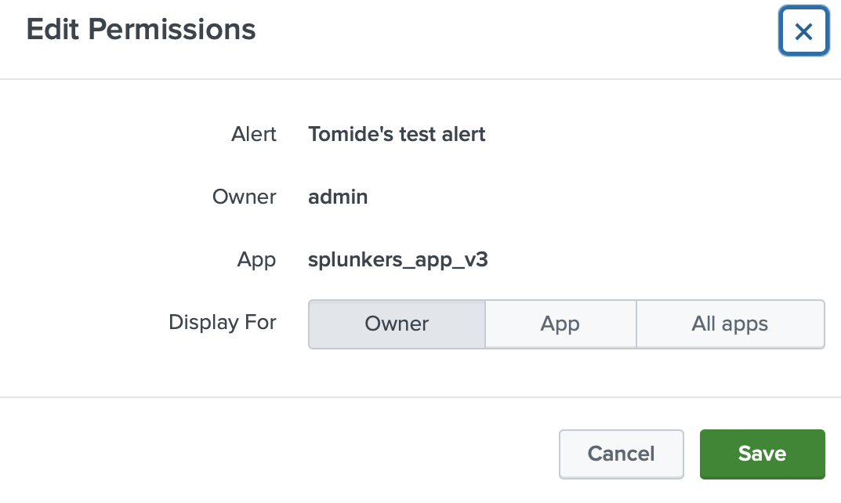
Step-by-Step Guide for Creating Alerts in Splunk
Save the Alert:
After configuring the alert details, click Save.
You will be presented with a screen where you can modify permissions if needed.

Slide 29

Knowledge Checks
What are PIPE Used for In a Search.
What are the three Booleans?
What’s the function of Trigger in Alerts?
Examples of Filtering commands?

Slide 30

Class 4 Overview
Dashboards Classic & Dashboard Studio

Slide 31

Assignment
Save the search below as a Classic Dashboard and add an input and dropdown to filter the data. Search 1 : Use for Table
index="_internal"
| stats earliest(_time) as earliest latest(_time) as latest latest(*message*) count by host log_level
| convert ctime(earliest) as earliest ctime(latest) as latest
Search 2 : Use for Area Chart
index="_internal" log_level=*
| timechart span=2h count by log_level
Define
Smart mode
Verbose mode
Fast mode
Define a cron job

Slide 32
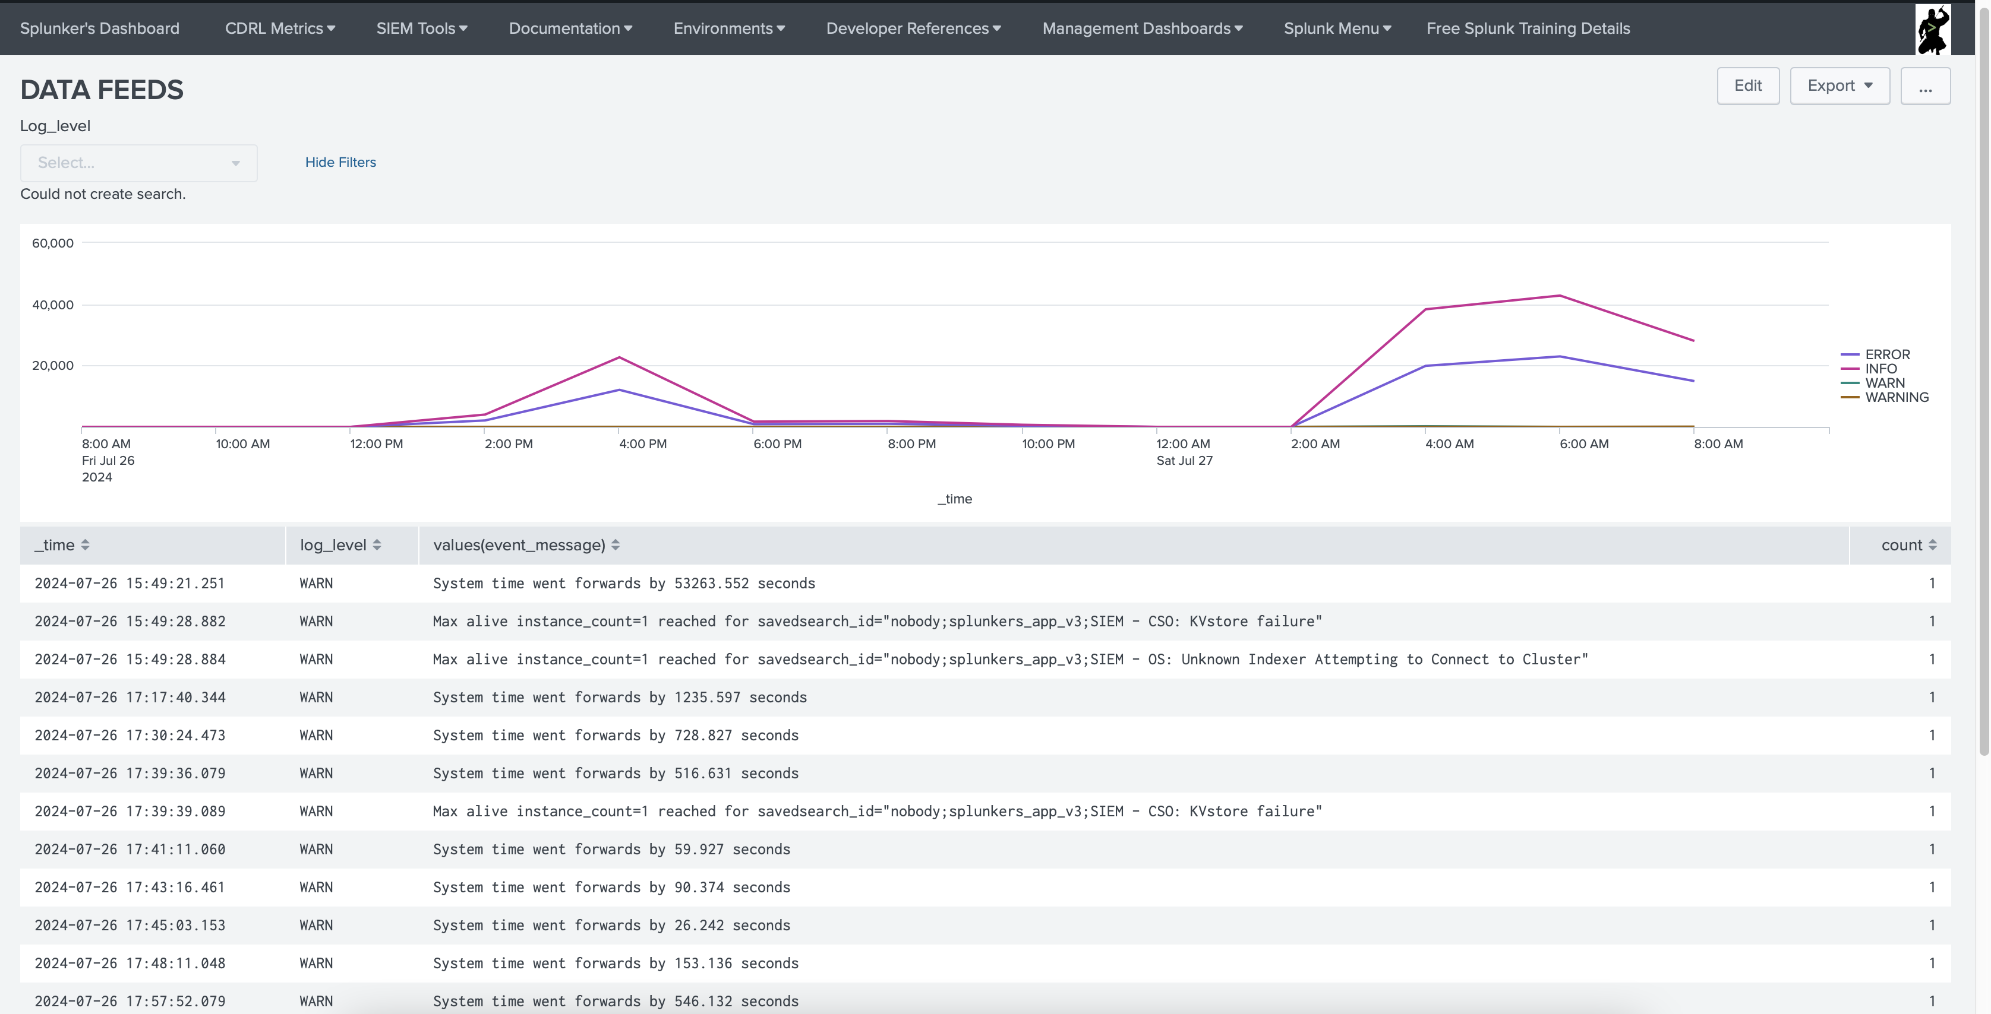
Results

