Slide 1
Base Searches, Macros. And Lookups. Class 5. & Class 6
T.O Analytics

Slide 2
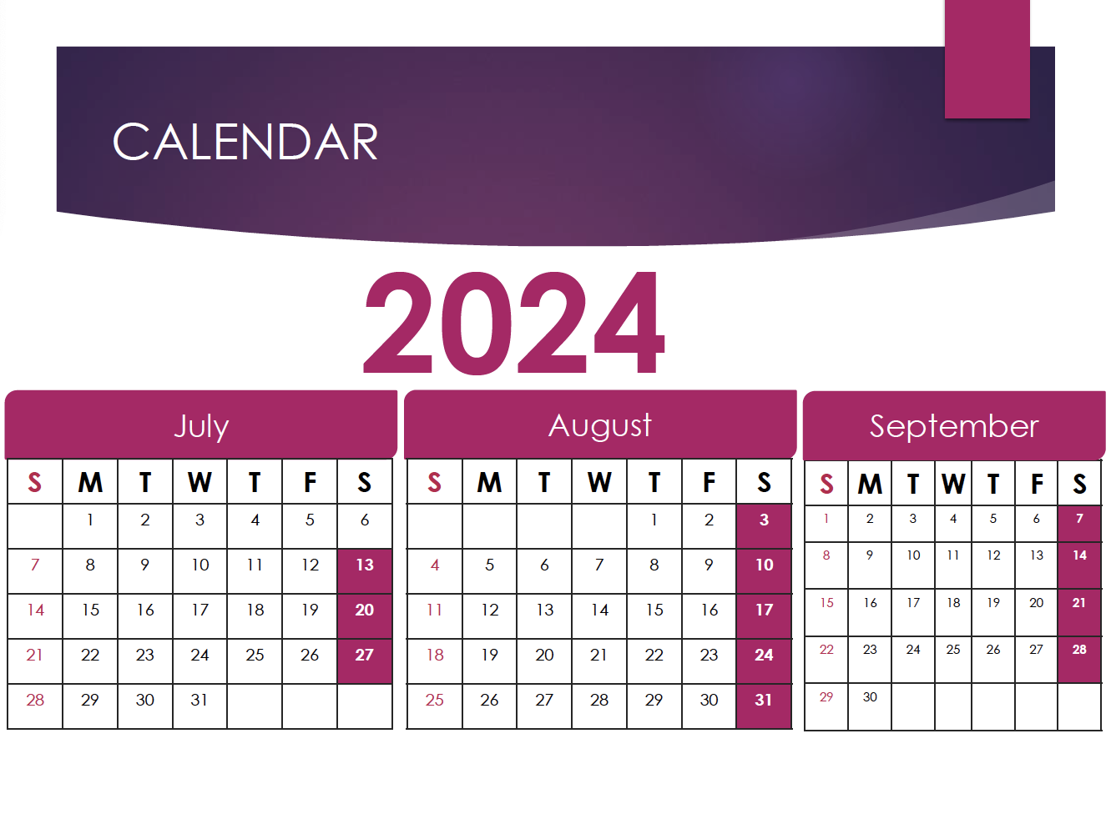


Slide 3

Class 4 Overview
Time Commands
Lookup Commands
Eval Command
Regular Expressions (rex)
Join and Sub searches
Dashboard

Slide 4
Table of Contents
Dashboard Part 2.
Base Searches.
Macros.
Lookups.

Slide 5
DASHBOARD
Splunk dashboards provide a visual representation of search results. They can include various charts, tables, and other visualizations to help monitor and analyze data in real-time. Users can create custom dashboards to meet specific needs.

Slide 6

Classic Dashboard(AKA XML Dashboard)
Simple XML is the source code for Classic Dashboards that you can use to structure and customize dashboards. Simple XML is made up of parent and child elements. Elements can have configuration attributes. Additionally, visualization elements use child elements for formatting and behavior configuration.

Slide 7
Base Search
A base search in Splunk is a search query defined once and then reused or referenced by other searches or panels within a dashboard. This concept is particularly useful in Splunk dashboards to optimize performance and maintain consistency, as it allows multiple panels to share the results of a single search without each panel having to run its own separate search query
Key Characteristics of a Base Search:
Efficiency: By running a single search and reusing its results, base searches reduce the number of searches Splunk needs to execute, leading to faster load times and reduced resource consumption.
Reusability: A base search can be referenced by multiple panels or searches, allowing for different analyses or visualizations to be built from the same underlying data.
Consistency: Since multiple panels or searches use the same base search, the data remains consistent across the dashboard.

Slide 8
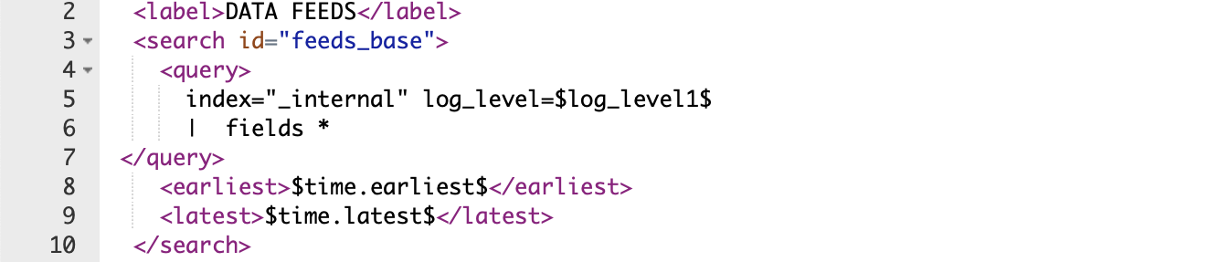
Example of Base Search

Slide 9
Macros
A Splunk macro is a reusable search or a portion of a search that you define once and then use in multiple places within Splunk. Macros help simplify complex queries, promote consistency across searches, and make maintenance easier by centralizing the definition of frequently used search logic.
Macros are especially useful when:
You have complex search logic that you want to reuse in multiple searches.
You want to define a search once and be able to update it in one place if needed.
You need to include conditional logic or arguments in your searches.

Slide 10
How to Create Macros
Step 1: Access the Search Macros Page
In Splunk, navigate to Settings > Advanced Search > Search macros.
Select the app context in which you want to create the macro (e.g., the app where your dashboards or searches reside).
Step 2: Define the Macro
Click on New Search Macro.
Name: Enter a name for your macro. This is how you'll reference the macro in your searches (e.g., my_macro).
Definition: Enter the search string or portion of a search string that you want to reuse. You can include Splunk search commands, fields, functions, and arguments.

Slide 11
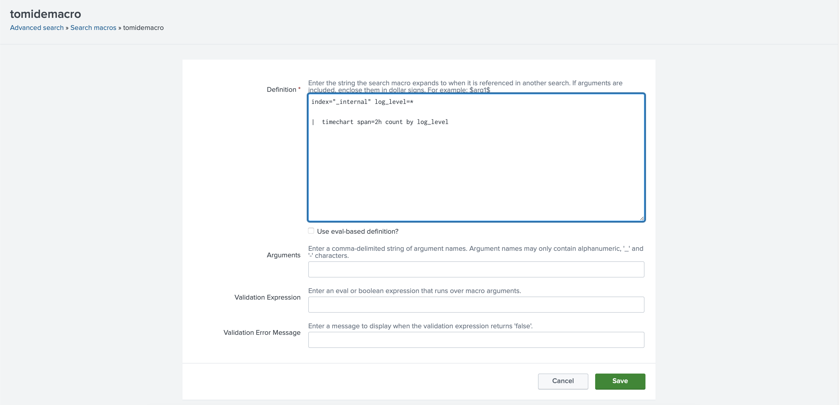
How to Create Macros(Example)

Slide 12
How to Create Macros
Arguments: If your macro includes placeholders like $field$, specify the number of arguments here. In the example above, you would specify 1 argument.
Description: (Optional) Provide a description of what the macro does. This is helpful for documentation purposes.
App: Ensure that the macro is saved in the correct app context (e.g., the app where you plan to use it).
Permissions: Set the appropriate permissions. You can make the macro private, shared within the app, or globally accessible.
Click Save.

Slide 13
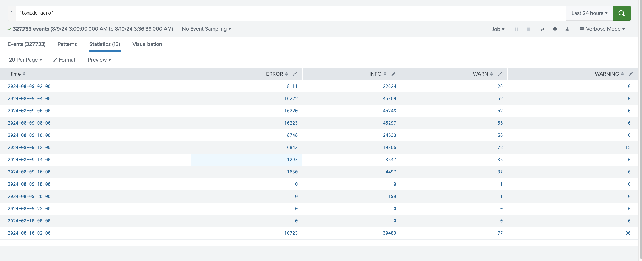
How to Create Macros
Step 3: Use the Macro in Searches
To use the macro in a search, reference it with the backtick (`) character.
You can now use the macro in any search, dashboard, or alert within the app.

Slide 14
Lookups
Lookups enrich your event data by adding field-value combinations from lookup tables. Splunk software uses lookups to match field-value combinations in your event data with field-value combinations in external lookup tables. If Splunk software finds those field-value combinations in your lookup table, Splunk software will append the corresponding field-value combinations from the table to the events in your search.

Slide 15
Types of Lookups
There are four types of lookups:
CSV lookups
External lookups
KV Store lookups
Geospatial lookups

Slide 16
Types of Lookups
CSV Lookups:
These are the most common type of lookups in Splunk. They involve a static CSV file that contains a table of data. The lookup maps fields in your search results to corresponding fields in the CSV file.
Example: You have a CSV file containing a mapping of IP addresses to geographic locations. You can use a CSV lookup to add the location information to events based on the IP address.
KV Store Lookups:
KV Store lookups use a key-value store, which is a Splunk-specific database that allows for dynamic storage of structured data. Unlike CSV files, KV Store data can be updated and managed within Splunk.
Example: You have a dynamic dataset of user IDs and their corresponding roles that can be updated through a dashboard interface. A KV Store lookup can be used to enrich your events with user role information.
External Lookups:
External lookups call an external script or program to perform a lookup. The script can interact with external databases, APIs, or other systems to return data.
Example: You have a Python script that queries a REST API for threat intelligence data. An external lookup can invoke this script to enrich your events with threat information.
Geospatial Lookups:
Geospatial lookups use a KMZ file (a compressed version of KML, which is used for geographic data) to provide geographic context to your data. This is particularly useful for visualizing data on maps.
Example: You have events with latitude and longitude coordinates, and you want to map them to specific regions or polygons on a map.

Slide 17
Lookup Definition
Step 1: Create the Lookup Definition
Navigate to Settings > Lookups > Lookup definitions.
Click New Lookup Definition.
Select the appropriate type of lookup (CSV, KV Store, External).
Fill in the required details:
Name: Give your lookup a descriptive name.
Type: Choose whether it's a file-based (CSV), KV Store, or external lookup.
File Location/Script: For CSV, provide the path to the CSV file. For external lookups, provide the path to the script.

Slide 18
Lookup In a search
You can use a lookup in your search to enrich data. For example:
index=my_index | lookup geo_lookup ip_address AS src_ip OUTPUT location AS src_location
This search applies the geo_lookup to match src_ip from your events with the ip_address in the lookup table, and then outputs the corresponding location into a new field called src_location.
If you’re using a KV Store lookup:
index=my_index | lookup kvstore_lookup user_id OUTPUT role
This search matches user_id from your events with the user_id in the KV Store lookup table and returns the corresponding role.

Slide 19
Managing Lookups
Uploading CSV Files: You can upload CSV files via the Splunk Web interface or place them in the appropriate directory ($SPLUNK_HOME/etc/apps/your_app/lookups/).
Updating KV Store Lookups: You can update KV Store data directly from searches or through Splunk's UI, making it ideal for dynamic or frequently changing datasets.
Permissions: Control who can use and edit lookups by setting appropriate permissions in Splunk.

Slide 20
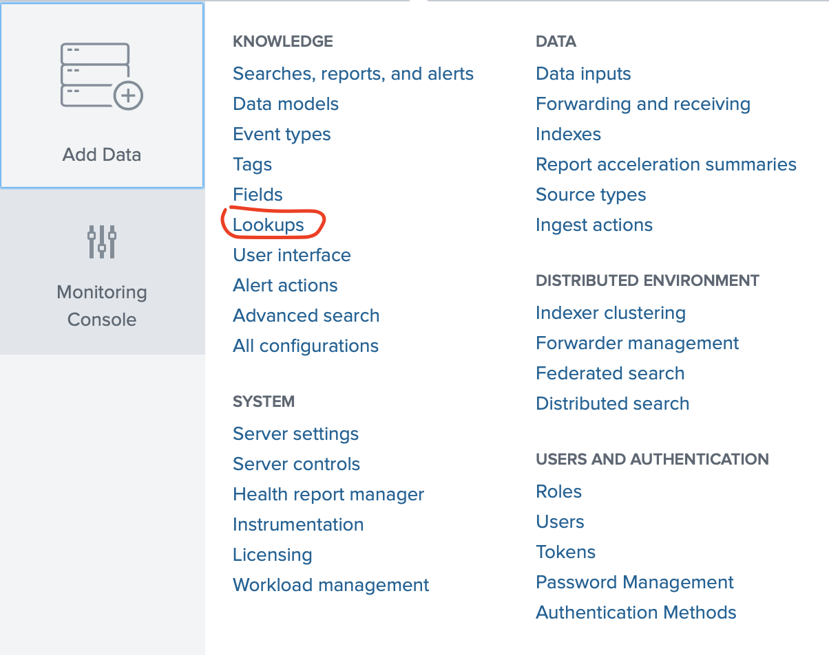
Upload Lookups

Slide 21
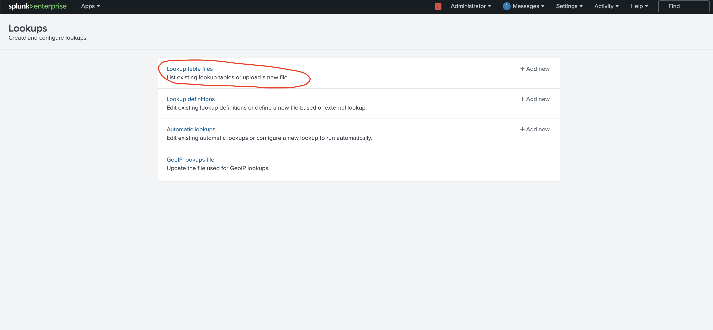
Upload Lookups

Slide 22
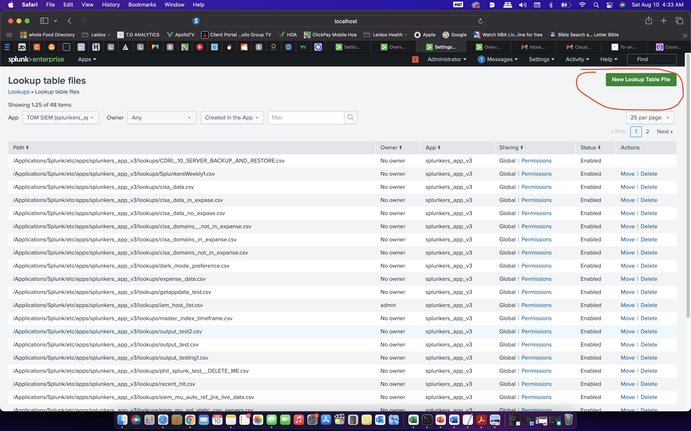
Upload Lookups

Slide 23
Upload Lookups

Slide 24
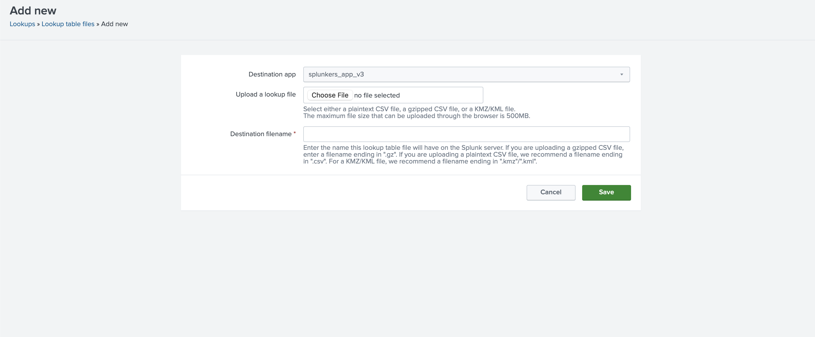
Upload Lookups

Slide 25

BREAK

Slide 26

Knowledge Checks
What are macros.
What’s a base search?
What are lookups?

Slide 27

Class 6 Overview
Tags.
Event Type.
CIM.
Knowledge Objects.
Data models.

Slide 28

Assignment
Create a macro and add it to your dashboard. Search 1 macro search – call it `analytics`
index="_internal" log_level=$log_level1$
| stats earliest(_time) as earliest latest(_time) as latest latest(*message*) count by host log_level
| convert ctime(earliest) as earliest ctime(latest) as latest
Create a Lookup
Call it Splunktest
Upload a CSV into Splunk

