Slide 1

The Team:
Producer:
Juli Gregg
Game Designer:
Luke Conlon
Tech Director:
Dan Muller
Project Manager:
Kaden Nugent

Slide 2
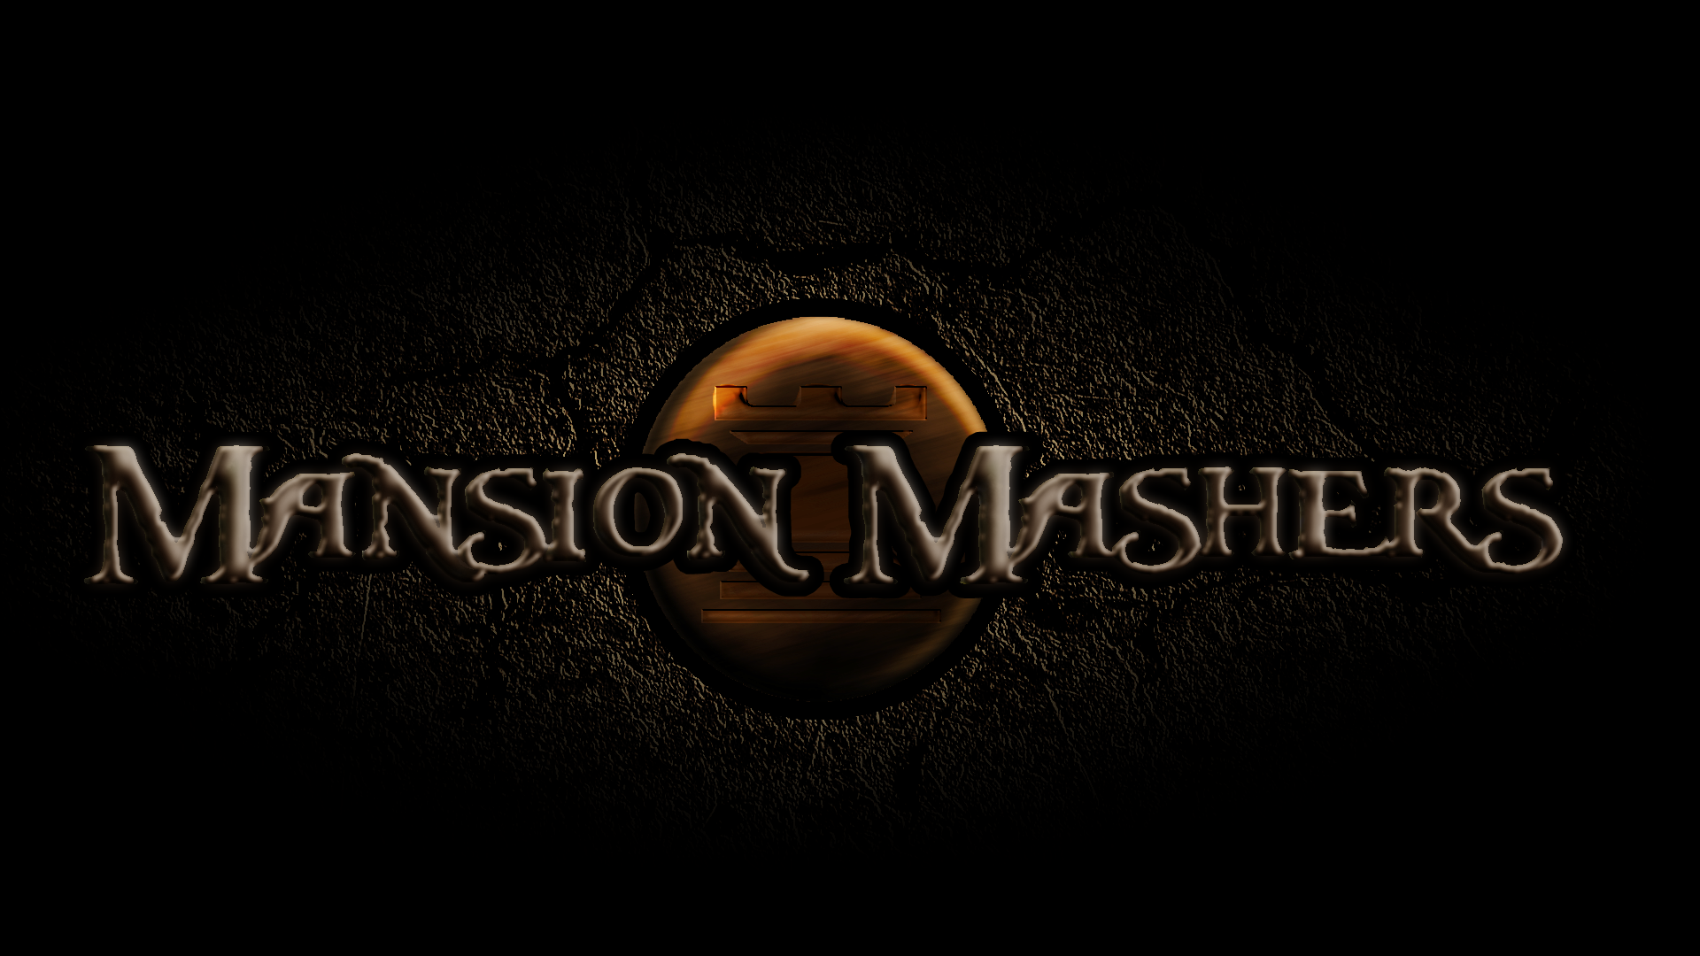

Slide 3


High Concept:
A 2-D dungeon crawler side-scroller hack and slash game.

