Slide 1


SYRIATEL CUSTOMER CHURN ANALYSIS
EXIT
BY: MARY MWANGI

Slide 2

OVERVIEW
INTRODUCTION
EXPLORATORY DATA ANALYSIS
MODELLING
MODEL TUNING
MODEL EVALUATION AND COMPARISON
FINDINGS, RECOMMENDATIONS AND CONCLUSION

Slide 3

INTRODUCTION
BUSINESS UNDERSTANDING
SyriaTel, a leading telecommunications company, is grappling with the challenge of customer churn. Customer churn, is a situation where subscribers discontinue services, posing a significant financial threat to SyriaTel. As the telecom industry evolves, retaining customers becomes paramount for sustaining revenue and growth.

Slide 4
OBJECTIVES
Main Objective
To develop a predictive model that effectively identifies customers at risk of churning for SyriaTel
Specific objectives
-To Identify the primary factors influencing customer churn in the SyriaTel dataset.
-To build a robust machine learning model for binary classification to predict customer churn.
-To extract meaningful insights from the model to guide SyriaTel in implementing effective retention strategies.

Slide 5

EXPLORATORY DATA ANALYSIS
DATA SOURCE AND DESCRIPTION
The dataset has 3333 rows and 21 columns
columns
state, account length, area code, phone number, international plan, voice mail plan, number vmail messages, total day minutes, total day calls, total day charge, total eve minutes, total eve calls, total eve charge, total night minutes, total night calls, total night charge, total intl minutes, total intl calls, total intl charge, customer service calls, churn.

Slide 6

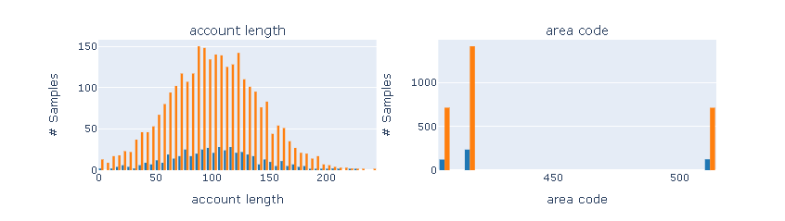
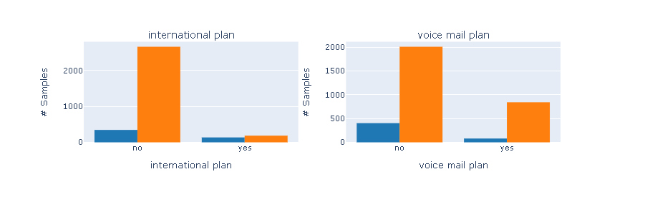
VISUALIZATION
Interactive graphs displaying the distribution of each feature for customers with churn and those without churn
Churn is represented by blue, no churn by orange

Slide 7
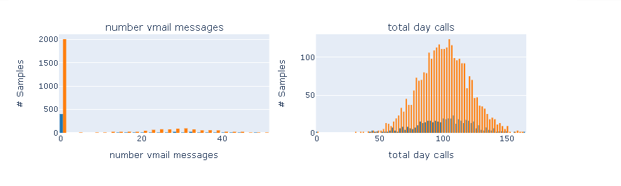
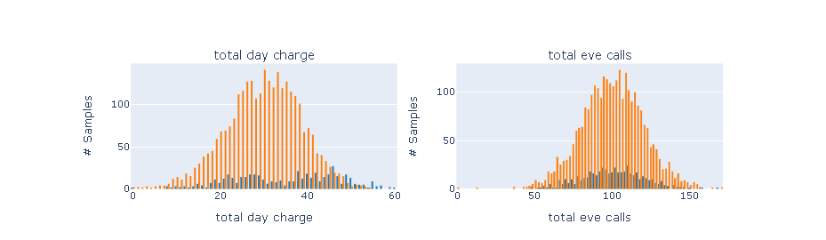

Slide 8
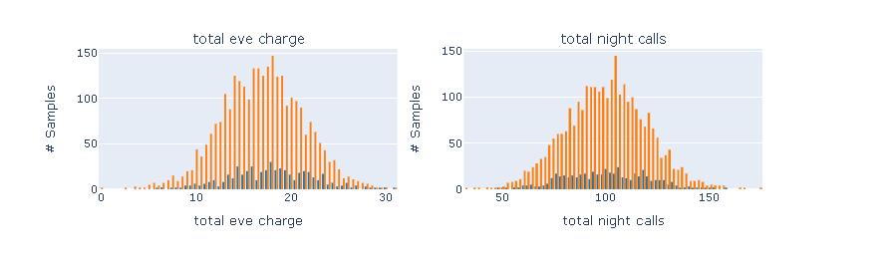
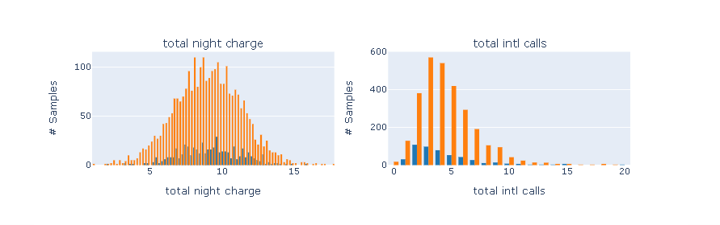

Slide 9
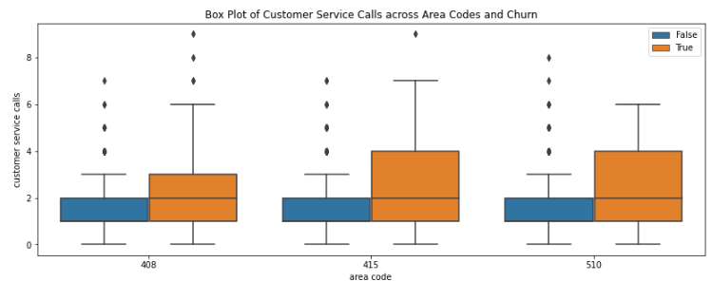
Boxplots showing the distribution of churn across different area codes
This shows that customers who are likely to have stopped doing business with SyriaTel are within the area code 415 and 510

Slide 10
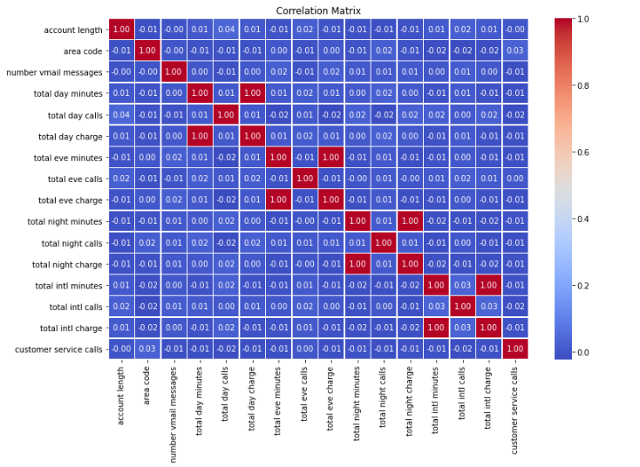
heatmap showing the relationship between different numeric variables
They is a low correlation between most of the features. However, a perfect positive correlation exists between:
-total day charge and total day minutes,
-total evening charge and total evening minutes,
-total night charge and total night minutes,
-total intl charge and total intl minutes

Slide 11
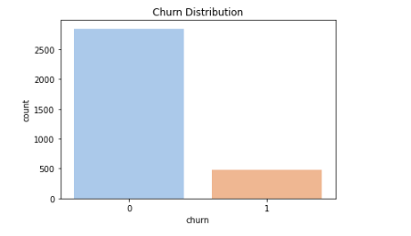
Bar plot showing how churn has been distributed. With 0 representing customer who have not churned, meaning that they have retained or they are still active,
while 1 represents customers who have churned.

Slide 12
MODELLING
 | Logistic Regression | Decision Tree Classifier | K-Nearest Neighbors | Random Forest
precision | 0.37306 | 0.61818 | 0.21429 | 0.83019
Recall | 0.576 | 0.816 | 0.504 | 0.704
F1-score | 0.45283 | 0.70345 | 0.30072 | 0.7619
Accuracy | 0.79137 | 0.89688 | 0.64868 | 0.93405

Slide 13
AFTER HYPERPARAMETER TUNING
 | Logistic Regression | Decision Tree Classifier | K-Nearest Neighbors | Random Forest
precision | 0.37306 | 0.47682 | 0.21612 | 0.85047
Recall | 0.576 | 0.576 | 0.472 | 0.728
F1-score | 0.45283 | 0.52174 | 0.29648 | 0.78448
Accuracy | 0.79137 | 0.84173 | 0.66427 | 0.94005

Slide 14
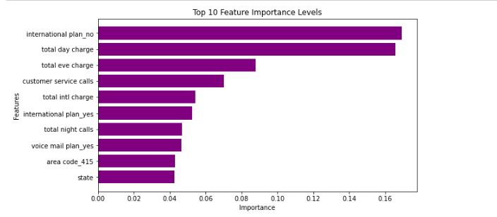
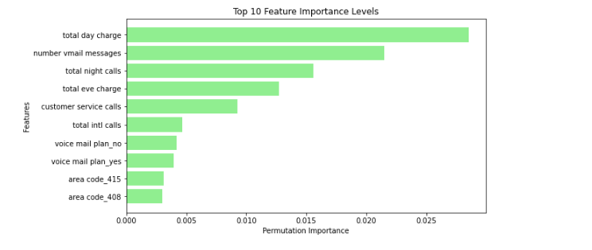
First 10 important features for the Tuned Decision Tree Model
First 10 important features for the Tuned KNN classifier

Slide 15
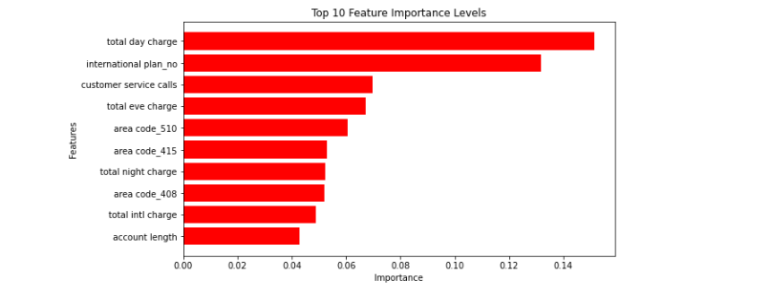
First 10 important features for the Tuned Random forest classifier

Slide 16

MODEL EVALUATION AND COMPARISON
CURVE ANALYSIS USING ROC

Slide 17

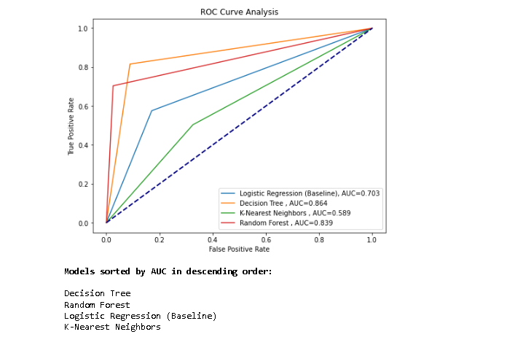
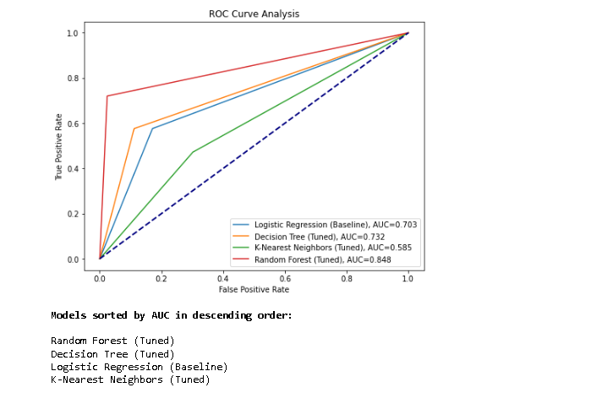
BEFORE MODEL TUNING
AFTER MODEL TUNING

Slide 18
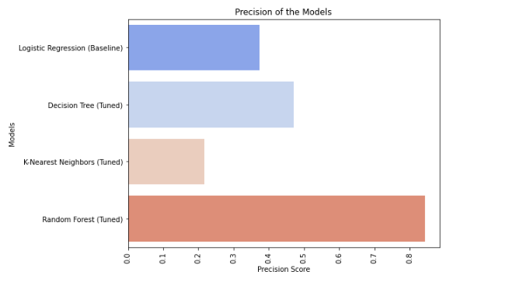
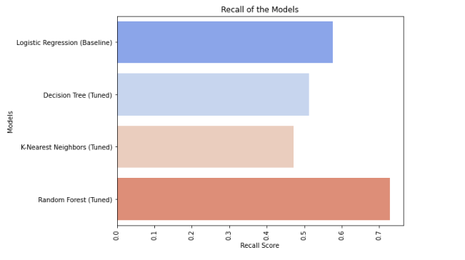
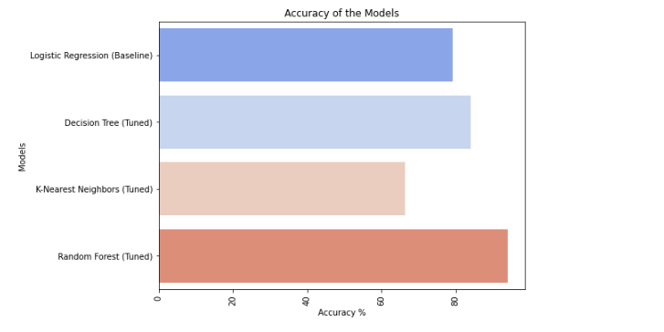
Model comparison using k-fold cross validation
Precision of the models
Recall of the models
Accuracy of the models

Slide 19

Selecting the best model:
The Random Forest model is the most suitable choice due to its strong performance in terms of accuracy, recall, and precision. It achieved an accuracy of 94% and a recall of 0.73, precision of 0.85 indicating its ability to accurately classify instances and achieve a balance between precision and recall.
Findings:
After performing sequential forward selection(SFS), the following features were selected:
number vmail messages, total day charge, total eve charge, total night calls, total night charge, total intl charge, customer service calls, voice mail plan_no, voice mail plan_yes, area code_408

Slide 20
RECOMMENDATIONS
Optimize Daytime and Evening Charges
Address Customer Service Calls
Ensure Fair Nighttime Charges
Enhance Daytime Customer Satisfaction
Tailor Strategies to Each State
Optimize Voicemail Plans
Analyze Churn Patterns in Different Areas
Adapt Marketing Strategies
Monitor Customer Satisfaction
Leverage Predictive Models
CONCLUSION
In the analysis I used different machine learning models to predict if customers might stop using SyriaTel services. Testing many models like Logistic Regression, Random Forest, Decision Tree and K-Nearest Neighbors and comparing their performance . I used measures like accuracy, F1 score, recall, and precision to check how good they are . Out of all the models tested, the Random Forest classifier (after adjusting it) did the best job at figuring out if a customer might stop using the services(churn).

Slide 21



THANK YOU

