Slide 1
Comprehensive Guide to Using the University's Server Cluster: Steps and Helpful Tips

Slide 2
Introduction
The university cluster is a group of interconnected computers or servers that work together to perform tasks more efficiently than a single machine could. They are often used for high-performance tasks like data processing, simulations, or running complex applications.
The cluster provides:
Increased Power: By combining multiple machines, clusters can handle larger and more resource-intensive tasks.
Parallel Processing: Clusters can distribute tasks across multiple machines, speeding up computation and reducing time for large tasks.
Reliability: If one machine fails, the others can take over, ensuring the system continues running smoothly.
Clusters are commonly used in research, universities, and industries where large-scale computing power is required.

Slide 3
Steps
Account Creation via HPC
Setting Up Authentication – GlobalProtect
Installing MobaXterm and Working in Linux
Queues: Creating and Submitting .sh Files and Jobs - slurm - power8
Installing Conda
Connecting via VSCode / PyCharm

Slide 4
Account Creation via HPC
Send a request to the HPC team (from your university email) to create a new user on the TAU cluster. In the request, include the following:
Provide your full name and ID.
Home Directory: Request that the home directory be set to /groups/itay_mayrose within the lab directory.
File Redirection: Request that both the .bashrc and .xauthority files are redirected to the new user’s root.
Access Permissions: Request permission to access Powerlogin(8), Powerslurm, and the Itay Mayrose queues.
CC Itay Mayrose (itaymay@gmail.com), as his approval is required for this process.
HPC team: hpc@tauex.tau.ac.il

Slide 5
Global Protect Authentication
SSH (Secure Shell) is a secure way to connect remotely to a server, allowing you to log in, transfer files, and execute commands as if you were physically at that computer. It’s needed to safely access university clusters and work with their resources. To do so, you need to use GlobalProtect (a VPN tool) to create a secure connection to the university network. The Authenticator app adds an extra layer of security by verifying it’s really you connecting, even if someone else has your login details.
Follow the instructions in order to establish a remote connection:
https://computing.tau.ac.il/helpdesk/remote-access/communication/vpn
Need to use VPN when connecting from home / freeTAU WiFi

Slide 6
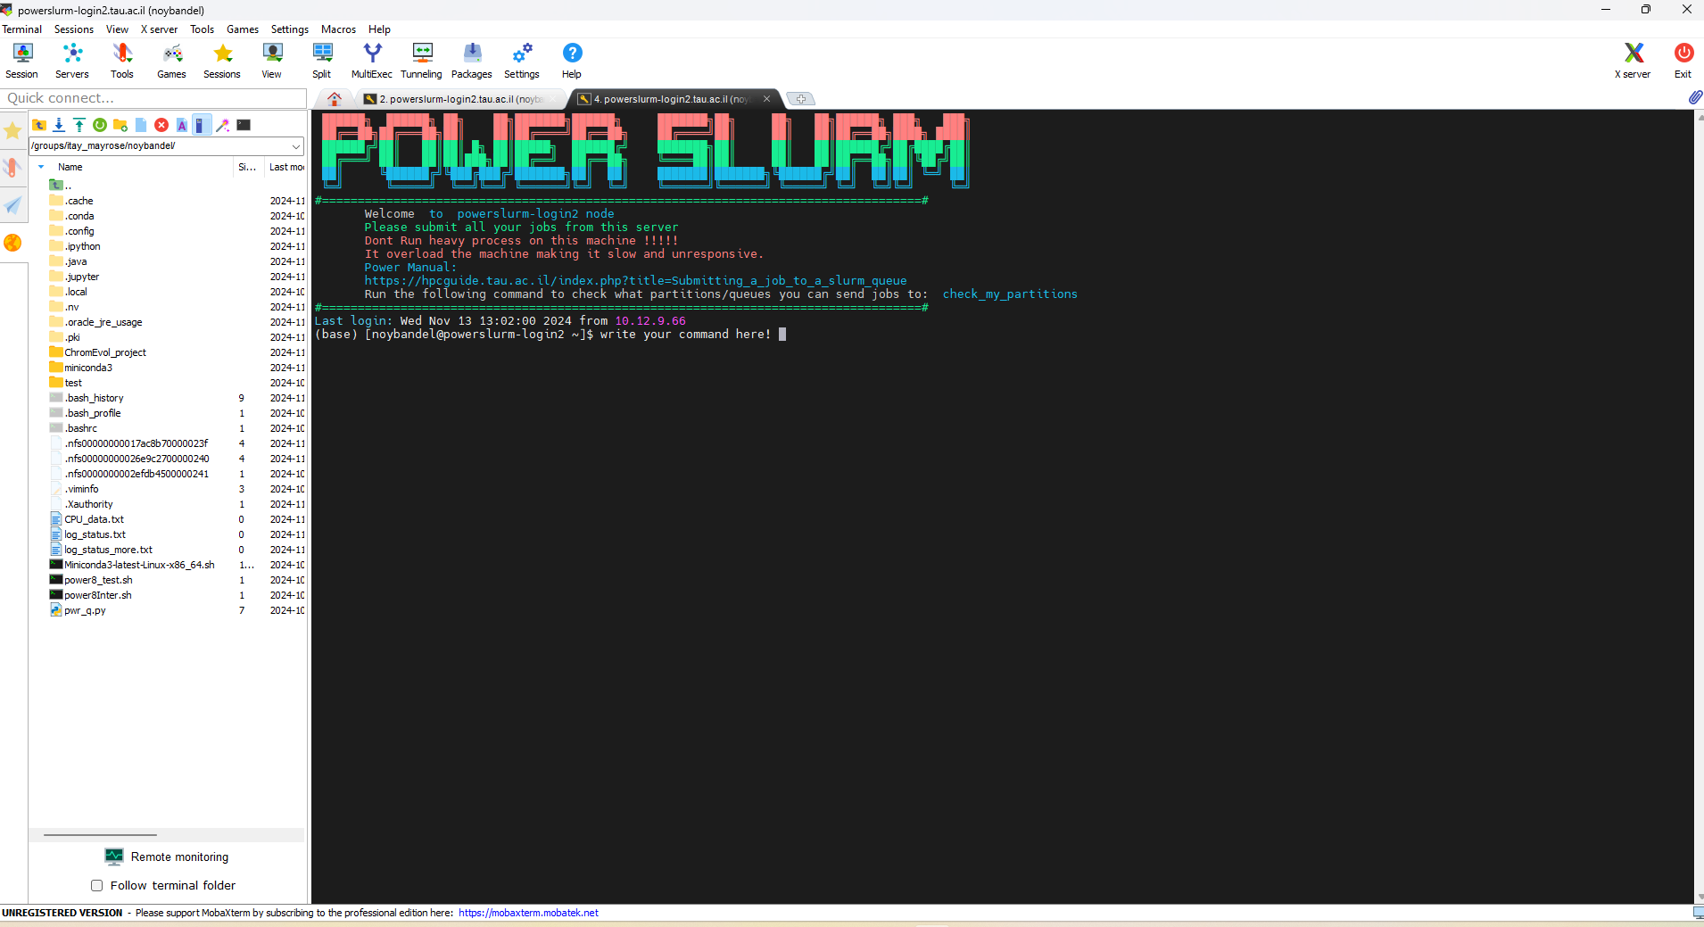
Linux
Linux is an operating system used in our university servers (in contrast to systems like Windows). Communication with this operating system is facilitated through various commands entered into the shell, also known as the "Terminal."
In essence, the shell is a program that takes commands from the user, sends them to the operating system for processing, and displays the output. This tutorial will cover the basic commands frequently used in the Linux shell.

Slide 7
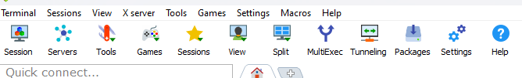
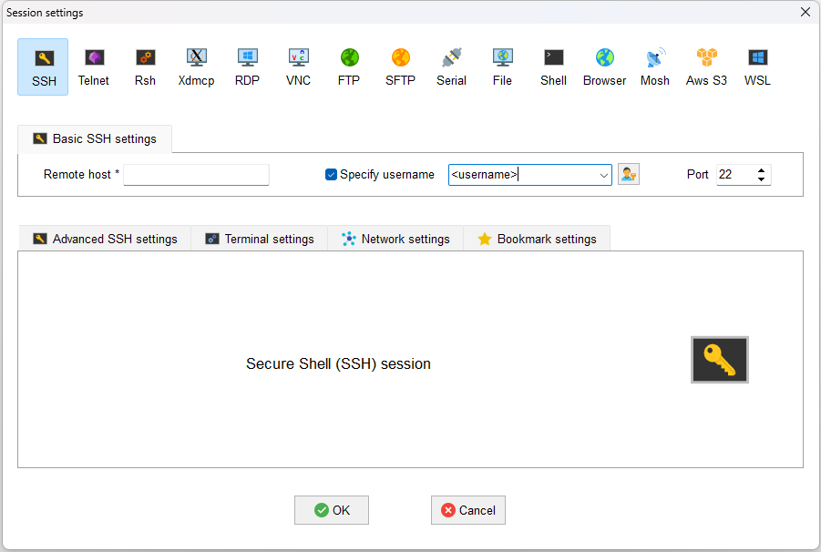
MobaXterm
Connecting to the cluster is done using MobaXterm, a tool that combines a terminal emulator (allowing Windows to act like a Linux terminal) with remote desktop features and SSH support. It’s ideal for accessing and managing Linux servers from Windows, offering a user-friendly interface, file transfer tools, and the ability to run remote graphical applications.
Download MobaXterm from its official site: https://mobaxterm.mobatek.net/download.html
When you try to connect, first establish the remote GlobalProtect connection.
In the Home screen, press ‘Session’.
Select ‘SSH’ and input the remote host address (one of the following): powerlogin.tau.ac.il powerslurm-login.tau.ac.il powerslurm-login2.tau.ac.il Check the box ‘Specify username’ and insert your <username>
Provide your university password when prompted.
Welcome aboard—you are now connected!

Slide 8
Linux basic commands
Description | Command
Navigate the file system | cd, ls, pwd
File operations | cp, mv, rm
View files | cat, less, head, tail
Search and manipulate text | grep, cut, awk
Manage file permissions | chmod

Slide 9
Basic Linux Commands
pwd - Print working directory, shows the absolute path of the directory you are currently in.
ls - Lists files and directories in the current directory. Use ls –a to show hidden files
cd /path/to/directory_name - Navigates you to the specified directory. cd with no arguments returns you to the home directory.
mkdir /path/to/directory_name - Creates a new directory.
rm /path/to/directory_or_file_name - Removes and deletes files or directories. Use rm -r to delete directories and their contents.
touch /path/to/file_name - Create an empty file or updates the timestamp of an existing file.
cp /path/to/source_file /path/to/destination - Copies files or directories from source to destination. Use cp -r for directories, to copy their contents.
mv /path/to/source /path/to/destination - Move files or directories, from source to destination. Can also be used to rename them using mv /path/to/old_name /path/to/new_name
python /path/to/ script_name.py - Run a Python script in the terminal (assuming Python is installed)
For more information: https://hpcguide.tau.ac.il/index.php?title=Linux_basic_commands

Slide 10

Additional Preparations and Tips
To avoid file compatibility issues between Linux and Windows, use MobaTextEditor and click the "Linux penguin" icon to ensure Linux formatting. If you still encounter DOS/UNIX format errors, use the dos2unix command to convert the file: dos2unix filename
In order to copy and paste: copy – ctrl+c, paste – right click.
To copy a file/folder path: right click the file/folder’s graphic presentation and press: copy file path, or copy file path to terminal, as needed.
To Recall a Command You Used Before: Use the Up and Down arrow keys to navigate through your command history.
To Auto-Complete a Command: Start typing the command, then press the Tab key to auto-complete it. If multiple completions are available, press Tab twice to view suggestions.
.bashrc File and Useful alias: In your home directory, create a .bashrc file, a shell script that runs when a new terminal session starts. It customizes the environment by defining variables, creating aliases (shortcuts for commands), and configuring shell behavior. This ensures an efficient, personalized terminal experience. Follow these steps:
In your main directory Create a File named .bashrc
Copy the recommended file content into the file, and replace <YOUR_NAME> with your actual username.
To apply changes, run the command: source ~/.bashrc
Now, the terminal will automatically configure the environment for you every time a new session is started.

Slide 11
Recommended aliases:
# User specific aliases and functions
alias int_job="qsub -I -X -q itaym -N <YOUR_NAME>_interactive"
alias int_job9="qsub -I -X -q itaym -N <YOUR_NAME>_interactive"
alias qu="qstat -u $USER“
alias myslurmjobs='squeue --user=$USER -o "%.18i %.50j %.10u %.10T %.10M" | column -t'
alias qwdel='qselect -s Q -u $USER | xargs qdel'
alias qrdel='qselect -s R -u $USER | xargs qdel'
alias jlab="jupyter lab --no-browser --ResourceUseDisplay.mem_warning_threshold=0.1 --ResourceUseDisplay.track_cpu_percent=True --ip=0.0.0.0 2>&1 | grep -m2 $(hostname) | sed -e 's/$(hostname)/$(ip address | grep '132.66' | awk '{print $2}'| awk -F'/' '{print $1}')/g' | sed '2!d'"
alias jlabh="jupyter lab --no-browser --ip=0.0.0.0 --port=8080 2>&1 | grep -m2 $(hostname) | sed -e 's/$(hostname)/$(ip address | grep '132.66' | awk '{print $2}'| awk -F'/' '{print $1}')/g' | sed '2!d'"
alias sshinter='qsub /groups/itay_mayrose/<YOUR_NAME>/power8Inter.sh'
alias jobinter='srun --ntasks=56 -p power-general -A power-general-users --pty bash’

Slide 12
Recommended aliases:
Start interactive session:
sshinter: In Power8: Submits a job to run a specific script (power8Inter.sh), which runs a job interactively .
jobinter: In PowerSlurm: Runs a job interactively (with 56 tasks on the "power-general" partition).
Manage and follow your submitted jobs:
qu: Displays the status of jobs submitted by the current user.
qwdel: Deletes jobs in the "Q" state (queued).
qrdel: Deletes jobs in the "R" state (running).
int_job: Submits an interactive job to the "itaymaa" queue with your name.
int_job9: Submits an interactive job to the "itaym" queue with your name.
For JUPITER notebook:
jlabh: Launches Jupyter Lab with the same settings as jlab, but on a specific port (8080).
jlab: Launches Jupyter Lab on the current node, with memory and CPU resource warnings enabled. It modifies the hostname with the local IP.
For more information: https://github.com/MayroseLab/MayroseLab/blob/master/New_labmates/useful_alias.md

Slide 13
Queues
The University’s servers are shared resources used by many users simultaneously. Queues are essential to manage and prioritize access to these computational resources efficiently and fairly. A job refers to a task or set of tasks submitted by a user to the server for execution, typically including code, resource requirements (e.g., CPUs, memory, or GPUs), and execution parameters. The queueing system is managed by a job scheduler, such as SLURM or PBS, which organizes jobs into queues and executes them in an orderly manner.
In our lab, we use either the powerlogin or powerslurm job schedulers. These systems share access to the same files and folders but allocate different computational resources (e.g., memory and CPUs). While you can run your jobs on either system, powerslurm is preferred due to its larger resource pool. However, it is advisable to check the availability of both systems before running a job to ensure optimal performance and efficiency.

Slide 14
Interactive Sessions
When starting a session, you are directed to the main node (or login node), the cluster's entry point. A node is a machine in the cluster equipped with resources like CPUs and memory.
Since the main node is shared by all users, avoid running tasks directly on it to prevent overloading. Instead, initiate an Interactive Session on a compute node. This provides real-time access for tasks like testing, debugging, or exploratory work, suitable for short and lightweight tasks.
From the interactive node, you can submit jobs to the queue for larger, automated tasks. The job scheduler then allocates these jobs to compute nodes and manages them efficiently.
To request interactive sessions, use these commands:
Powerslurm: srun --partition=itaym --pty bash
Powerlogin8: qsub -I -X -q itaym -N <YOUR_NAME>_interactive

Slide 15
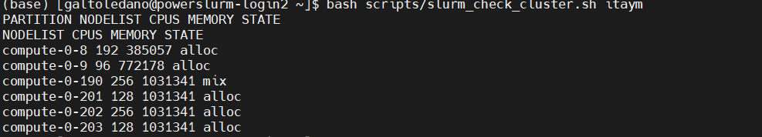
How to Check Node Capacity
Using this command sinfo -p $partition -N -o "%N %c %m %t”
States:
Idle - Node is free and ready to run jobs.
Alloc - Node is fully allocated to running jobs.
Mix - Node is partially allocated.

Slide 16
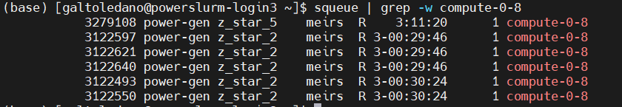
How to Check Node Capacity
To check who runs:
squeue | grep -w compute-0-8

Slide 17
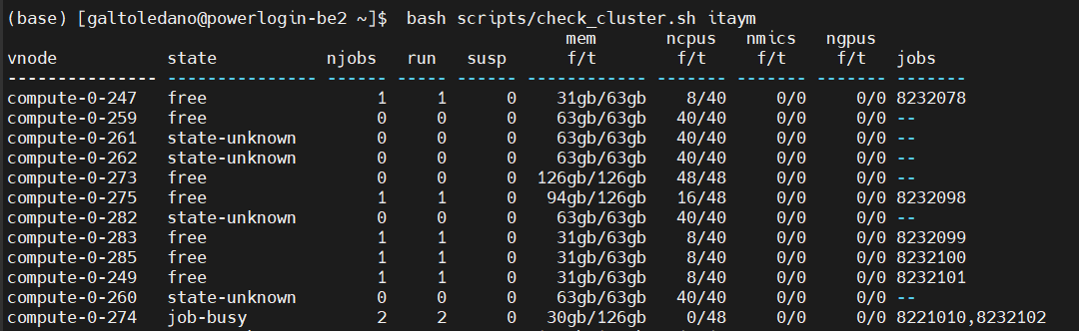
How to Check Node Capacity
Example of similar script on powerlogin:
> pbsnodes -aSj | head -3
> pbsnodes -aSj | grep -E "$(qmgr -c 'p n @d' | grep -i itaym | awk '{print $3}' | uniq | paste -sd '|' -)"

Slide 18
Job Submission and .sh files
In a queue job system, a job is a task (for example, running a Python script) submitted to the cluster for execution, often defined in a .sh (shell script) file. This file specifies resource requirements (e.g., CPUs, memory) and the commands to execute the task.
A job should have only one purpose
When a job is submitted - the job is queued, and executed based on resource availability and priority.
Outputs and errors are logged in specified files, and users can with commands like or. This system ensures efficient resource use and fair scheduling.
A .sh file has a special structure, starting with a shebang line (e.g., #!/bin/bash) to specify the shell interpreter. It includes resource directives (e.g., #SBATCH in Slurm) to define job parameters, followed by the commands to run the task (e.g., python my_script.py). This structured format allows the scheduler to allocate resources and execute the task properly
Submitting, monitoring and managing jobs:
sbatch <.sh file path>
afterwords the job is submitted and the job id is printed
squeue <job_id> scancel <job_id>
squeue –u <your_user_name>
For more information: https://hpcguide.tau.ac.il/index.php?title=Submitting_a_job_to_a_slurm_queue

Slide 19
Job Status
RUNNING (R): The job is currently running.
PENDING (PD): The job is waiting for resources and has not started yet.
COMPLETING (CG): The job is finishing, but not yet fully completed.
COMPLETED (CD): The job has finished successfully.
FAILED (F): The job has failed due to an error.
CANCELLED (CA): The job was manually cancelled by a user or an administrator.

Slide 20
Python script for creating job files(PBS or SLURM):
def create_job_format_for_all_jobs(path: str, job_name: str, memory: str, queue: str, ncpu: int, cmd: str, slurm: int) -> str:
text = ""
text += f"#!/bin/bash\n\n"
if not slurm:
text += f"#PBS -S /bin/bash\n"
text += f"#PBS -r y\n"
text += f"#PBS -q {queue}\n"
text += f"#PBS -v PBS_O_SHELL=bash,PBS_ENVIRONMENT=PBS_BATCH\n"
text += f"#PBS -N {job_name}\n"
text += f"#PBS -e {path}/{job_name}.ER\n"
text += f"#PBS -o {path}/{job_name}.OU\n"
text += f"#PBS -l select=ncpus={ncpu}:mem={memory}\n"
text += f"cd {path}\n"
text += f"{cmd}\n"
else:
text += f"#SBATCH --job-name={job_name}\n"
text += f"#SBATCH --account=power-general-users\n"
text += f"#SBATCH --partition=power-general\n"
text += f"#SBATCH --ntasks={ncpu}\n"
text += f"#SBATCH --cpus-per-task=1\n"
text += f"#SBATCH --time=7-00:00:00\n"
if ncpu > 1:
text += f"#SBATCH --mem-per-cpu=3G\n" # for example 4G
else:
text += f"#SBATCH --mem-per-cpu={memory}\n"
text += f"#SBATCH --output={path}/{job_name}_out.OU\n"
text += f"#SBATCH --error={path}/{job_name}_err.ER\n"
text += f"cd {path}\n"
text += f"{cmd}\n"
return text

Slide 21
Creating a Connection to Jupyter Notebook
jupyter lab --no-browser --ip=0.0.0.0 --port=8080 2>&1 | grep -m2 $(hostname) | sed -e 's/'"$(hostname)"'/'"$(ip address | grep '132.66' | awk '{print $2}'| awk -F'/' '{print $1}')"'/g' | sed '2!d’
Copy the link and paste in your browser

Slide 22
Miniconda
Miniconda is a platform designed for the efficient management of Python environments and packages. It enables users to install only the specific tools and packages they need for their projects, providing flexibility to manage Python workflows independently.
On the university's Linux servers, Miniconda is particularly valuable for creating isolated Python environments tailored to individual projects. Since users typically lack administrative privileges (as sudo commands are restricted to the HPC team), Miniconda allows them to install and manage Python-related packages freely within their user space, avoiding the need for system-wide changes while ensuring compatibility and reproducibility.

Slide 23
Setting Up Miniconda
https://github.com/MayroseLab/MayroseLab/blob/master/create%20conda%20env.pdf

Slide 24
1. Download and Install Miniconda
Login to the Server (PowerSlurm or Power8): Make sure you’re logged into an interactive node.
Go to the Miniconda download page and choose the appropriate installer for Linux operating system and copy it: https://docs.anaconda.com/miniconda/
In the Linux terminal use wget to download the latest Miniconda installer (after you copied the link, just right click in the terminal and it will paste it): wget <the copied installation link>
Execute the downloaded script to start the installation: bash <the miniconda file name>.sh
Follow the Installation Prompts:
Press Enter to scroll through the license agreement, and type yes when asked to accept the terms.
Specify an installation path (e.g., /groups/itay_mayrose/<your_username>/miniconda3) or accept the default.
Allow Conda to initialize by typing yes if prompted.
Run the following command to ensure your shell recognizes Conda: source ~/.bashrc
Open a new terminal and confirm that Conda is installed by running: conda --version

Slide 25
2. Creating and Using Conda Environment
Create a New Environment: Use the following command, replacing <env_name> with your desired environment name: conda create --name <env_name>
Activate the Environment to Use It: conda activate <env_name>
Deactivate the Environment When You’re Done: conda deactivate

Slide 26
Connecting via VSCode
Downloading VS Code:
https://code.visualstudio.com/docs/remote/vscode-server
Create SSH connection:
https://hpcguide.tau.ac.il/index.php?title=Submitting_vscode_job_on_slurm

Slide 27
Connecting via PyCharm
Download pycharm professional and jetbrains using your university user
Create a local folder for which your python project will be
Create a corelative folder on the server
You will be working locally, and the folder will be updated in the server accordingly
Open a python project – not new but… and insert the local project folder path
Define environment (assuming there is a conda environment on the server for your project)
Run – with main and parameters \ without
Debug
Run, debug, deployment – need to be connected to the server

Slide 28
Copilot
Create a university GitHub user
Connect you user to copilot
Install copilot extension in the VScode

Slide 29
Git + Github
Repository (repo) – A place where files go. Usually would be represented by a directory
Local – Your local working environment
Remote – The shared hub where your files will be stored
Conflict – A state where we’re not sure what is the correct file version.

Slide 30
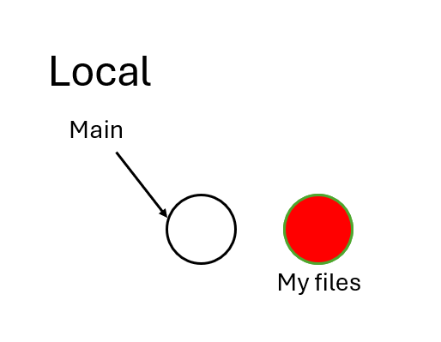
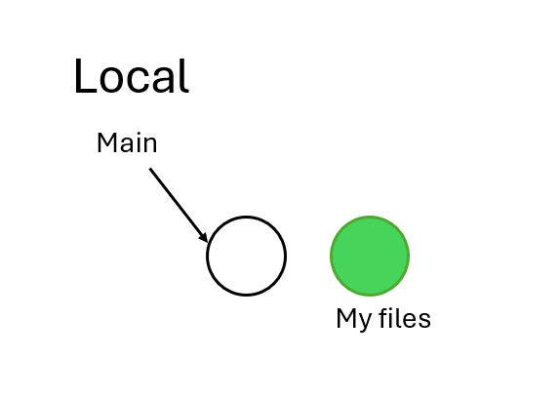
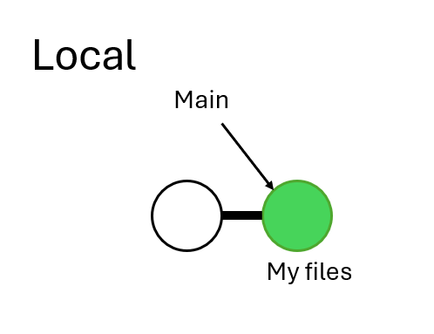
Git + Github
git init
git add
git commit –m “Add files”

Slide 31
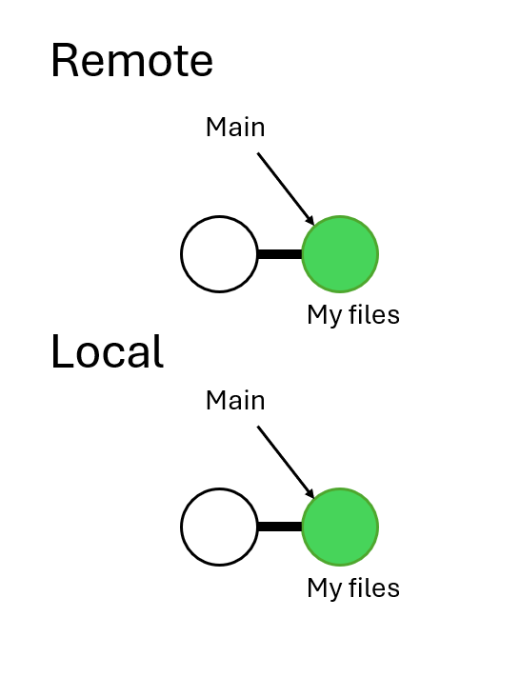
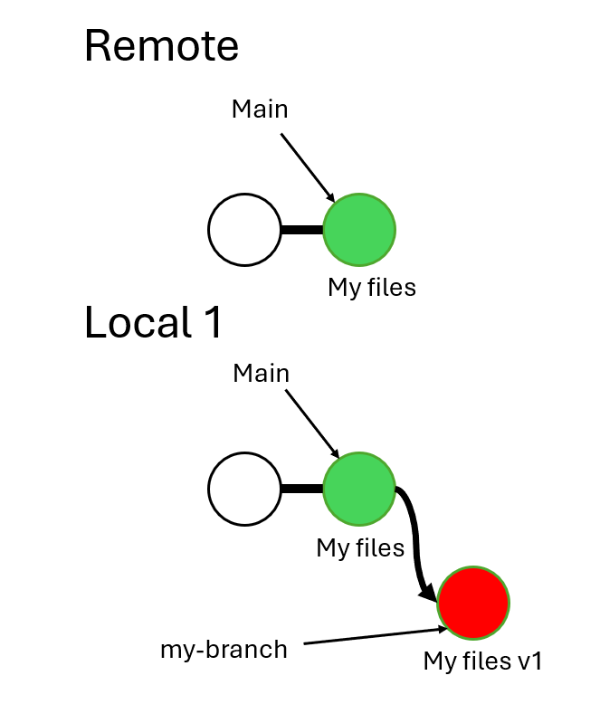
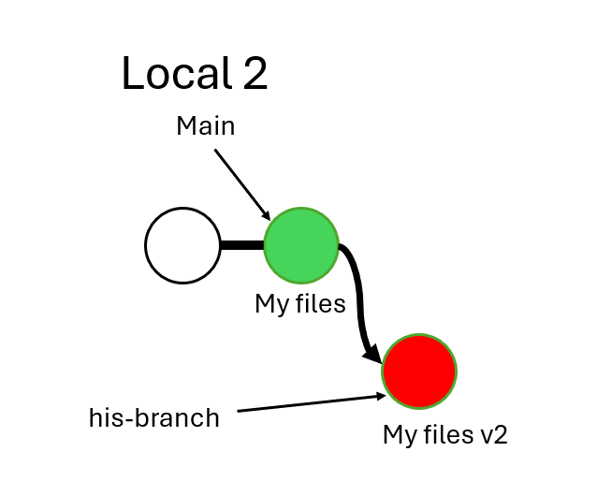
Git + Github
git push
git checkout –b my-branch

