Slide 1
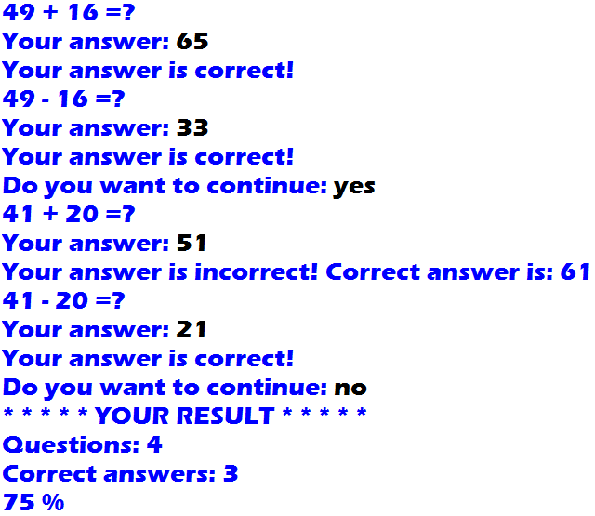

1. Arithmetic Game Program
Output:

