Slide 1

Example: Rock, Paper and Scissors

Slide 2
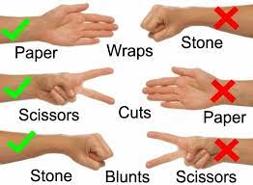
Example: Rock, Paper and Scissors

Slide 3
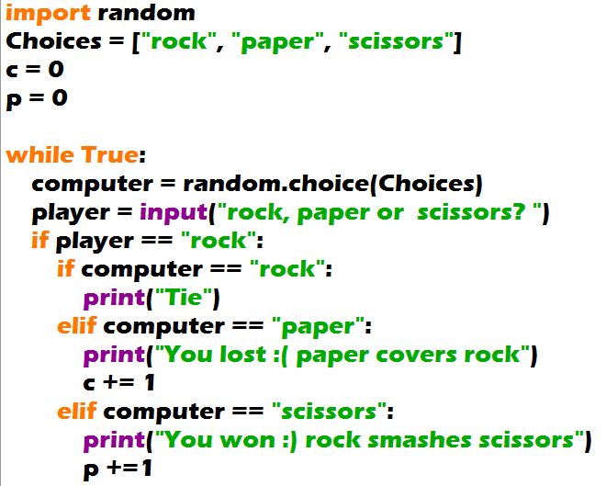
Example: Rock, Paper and Scissors

Slide 4
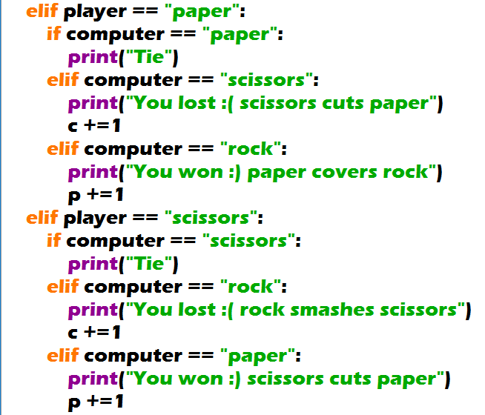
Example: Rock, Paper and Scissors

Slide 5
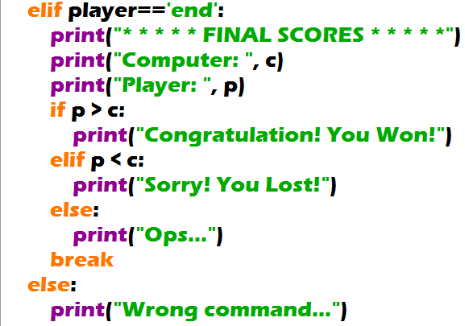
Example: Rock, Paper and Scissors

Slide 6
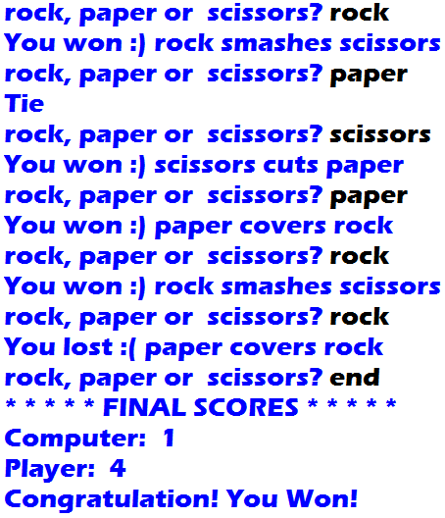
Example: Rock, Paper and Scissors
Output:

