Slide 1

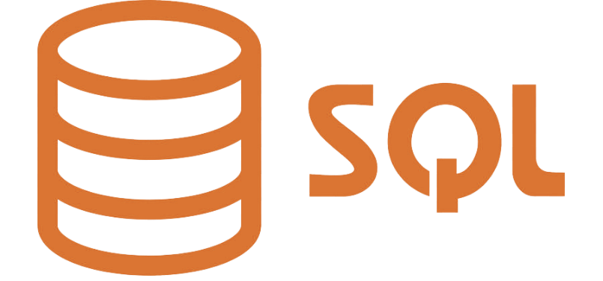
MongoDB vs SQL

Slide 2
Database Model
MongoDB is a Non-Relational Database based on a document-oriented structure that internally is based on a key-value structure
SQL Server is a Relational Database based on relatable structured tables with various rows and columns.

Slide 3
Data Schema
SQL Server has a fixed Schema that is predefined before inserting any data. Fixed schema means schema can’t be changed as data, application, or business requirement evolves.
MongoDB has a flexible dynamic schema that can easily be changed with the evolution of data, application, or business.

Slide 4
Query Language and Scalability
MongoDB uses MongoDB Query Language to query unstructured data from the database.
SQL Server uses SQL Query Language to Create Tables, Insert, Fetch or Update data in the database
MongoDB supports Horizontal Scaling in which data is distributed across clusters.
The Sharding process is used to implement horizontal scaling which results in an always-up server.
SQL Server supports vertical scaling which is the traditional approach.
In vertical scaling, physical or virtual resources are added to the hosting server of the database.

Slide 5
Joins
MongoDB is a non-relational database so it does not support JOINs whereas SQL Server used JOINS to retrieve data from multiple tables which are joined.
XML support
MongoDB doesn’t support XML structured documents.
Documents in MongoDB are stored in BSON format.
SQL Server provides support for XML structured data.
XML support is integrated into all the components of SQL Server

Slide 6
Conclusion
MongoDB is a database that is more advanced and capable of handling big data with dynamic schema features. SQL Server is an RDBMS that is used to manage the relational database system and offers end-to-end business data solutions. In the case of unstructured data MongoDB is a good choice.
Also, MongoDB is open source which makes it readily available.
No doubt SQL Server is going strong for many years but now with the era of Big Data, MongoDB seems to have a bright future. But, that doesn’t mean SQL Server will be completely eradicated. The choice of database between MongoDB and SQL Server is completely specific to the user’s needs.

