Slide 1
Tech Process Solutions Training Presentation
By :
Maysara Hayajneh.

Slide 2
Outline
Introduction
Training Stage: First two week

Slide 3
Introduction
About me
I graduated from TTU (Tafila Technical University).
Electrical Power Engineer
About our Training
We have started our training in TPS on the 4th of June 2024
Our training primarily focused on developing web applications using .NET Core with MVC and Entity Framework.

Slide 4
Training Stage
Revision to SQL.
Solving SQL tasks.
Reading chapters (1-5) in the Book “Pro ASP.NET Core 7.0, Adam Freeman” for:
Understanding ASP.NET Core platform and the Frameworks that are used with it.
Advance Topics in C# that are beneficial to make your web application flexible.
Implementation the project in the chapter three of the book.
Entity Framework (EF) Microsoft tutorial.

Slide 5
Training Stage: SQL Revision
I completed the "SQL basic" tutorial by James Coe. This tutorial introduces me to the definition and types of data base and, the common basic SQL commands that I need when I deal with relational data base.
What is Database:
Database basically, is anything that I can store information (data) in it even if it was a paper, or an Excel sheet, but with the spread of technology the concept of Database has been evolved and the types of data base has been introduced.

Slide 6
Training Stage: SQL Revision
Database:
Relational Database
Non-Relational Database
The tutorial broke down the following commands by giving us tasks to use for retrieving data from the "bike-sharing services" Database that I created.
SQL Commands:
Join
Order By
Aggregate Functions
Group by

Slide 7
Training Stage: SQL Tasks
My task was to create a Database for a company, with a specific requirements, which is a crucial part to be able to make relationships between the entities ("Tables")
Task goals:
Create a stored procedure that retrieve comprehensive data from the Database.
Create a view to retrieve all data from the Database.
Create a trigger that detects changes (update, delete, insert) happens on data in "Employees" table.
Create Index on column "salary" in employee tables

Slide 8
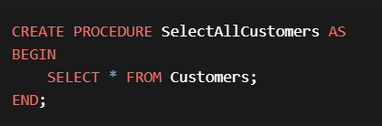
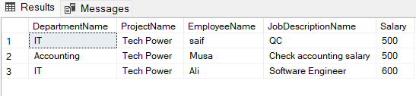
Training Stage: SQL Tasks
Stored Procedure
Stored Procedure is an object in relational-database management system which we use to store a complex queries or, queries that I use frequently. There are many benefits that I get from this approach:
Reusability
Performance
Maintainability
Figure(1): Stored Procedure Syntax
Output (1): Company Db Data.

Slide 9
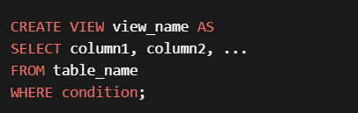
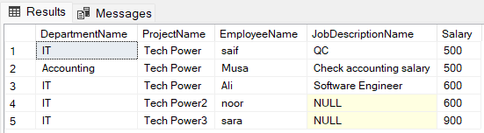
Training Stage: SQL Tasks
View
View is a virtual table that carries data from other tables based on a stored query. There are many benefits that I get from view:
Reusability
Security
Maintainability
Figure(2): View Syntax
Output(2): Company Database Data

Slide 10
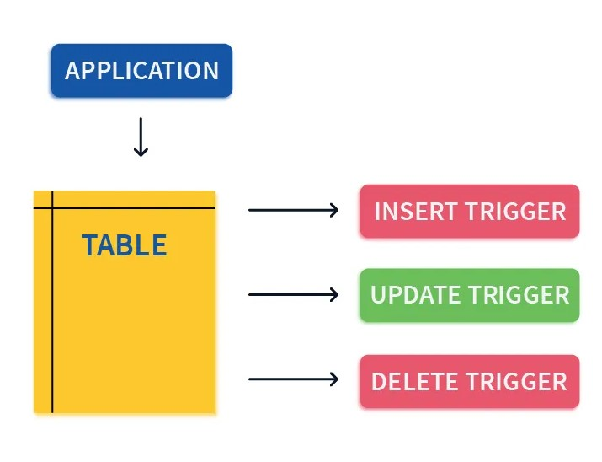
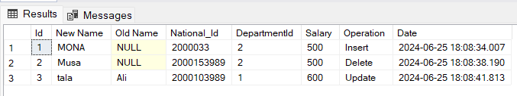
Training Stage: SQL Tasks
Triggers
There are two types of trigger:
DML trigger
DDL trigger
Figure(3): Trigger Goal.
Output(3): Trigger Goal.

Slide 11
Training Stage: SQL Tasks
Indexing in Database:
What is an Index:
a structure in a database.
Speeds up data retrieval,
Index Advantages | Index Disadvantages
Faster data retrieval | Take more space
Retrieving data efficiently | DML operations, are all slowed by indexes
Table(1): Indexing adv/dis.

Slide 12
Training Stage: SQL Tasks
Beside to the tasks I have been asked to read about normalization.
What is normalization
Normalization is a process of organizing data in a way that I can avoid redundant data and ensure data integrity
Why we use normalization:
Avoid data redundancy
Ensures data integrity.
Types of normalization:
First normal form(1NF)
Second normal form(2NF)
Third normal form(3NF)
Description | Normal Form
If a table has no repeated groups, and has an unique column | 1NF
if a table is in 1NF and every non-key attribute is fully dependent on the primary key, then it is in 2N | 2NF
If a table is in 2NF and has no transitive dependencies, it is in 3NF | 3NF
Table(2): Types of Normalization

Slide 13
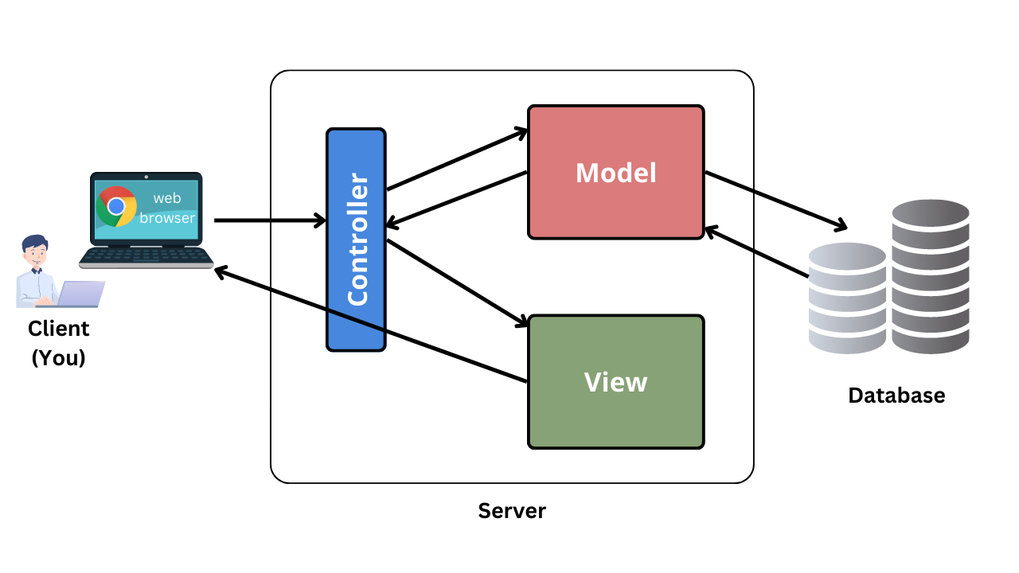
Pro asp.net Core
ASP.NET Core Frameworks :
Application Frameworks:
MVC Framework:
Model
Data Annotation
Table attributes
Navigation properties
View
Tag helpers.
Rendering.
Controller
End points
Routing
Validation
Figure(4): MVC Architecture

Slide 14
Pro asp.net Core
Chapter 3:
Project Purpose:
The project serves as a party registration system.
Guests can register for the party by filling out a form.
The form collects information such as guest name, email, and phone number.
Additionally, guests indicate whether they will attend the party.
Implementation Details:
The project uses ASP.NET MVC architecture.
No Entity Framework is involved; instead, data is stored in a simple list.
The controller includes two actions:
Rsvp form: Handles form submissions, validates input, and adds responses to the list.
List responses: Displays the registered guests.

Slide 15
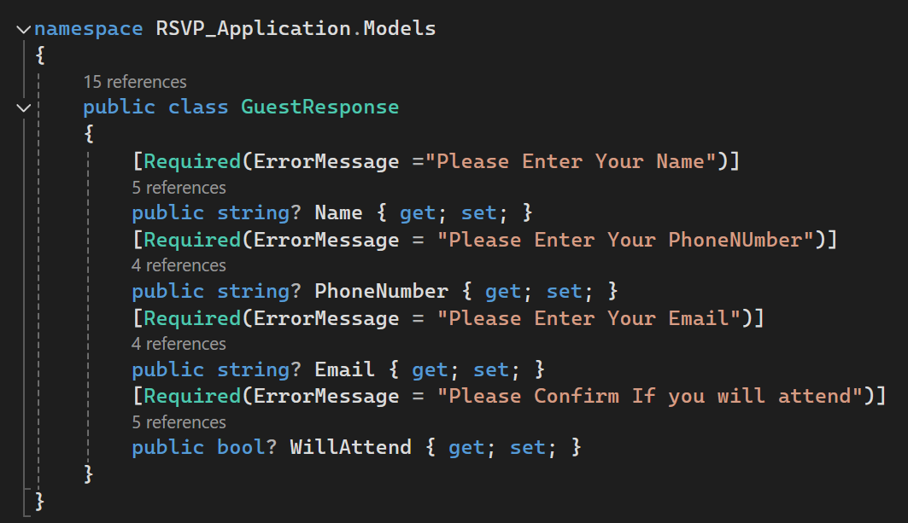
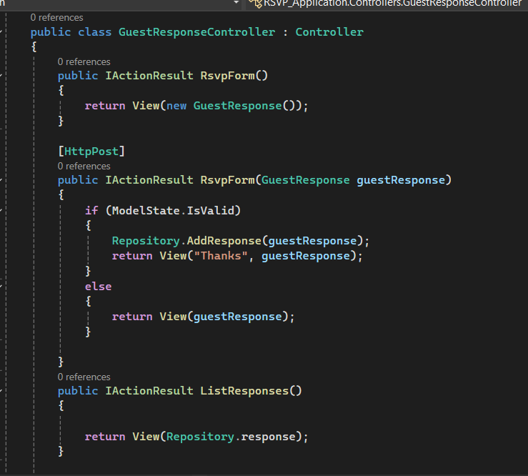
Pro Asp.net Core
Figure(5): Business Logic
Figure(6):Controller

Slide 16
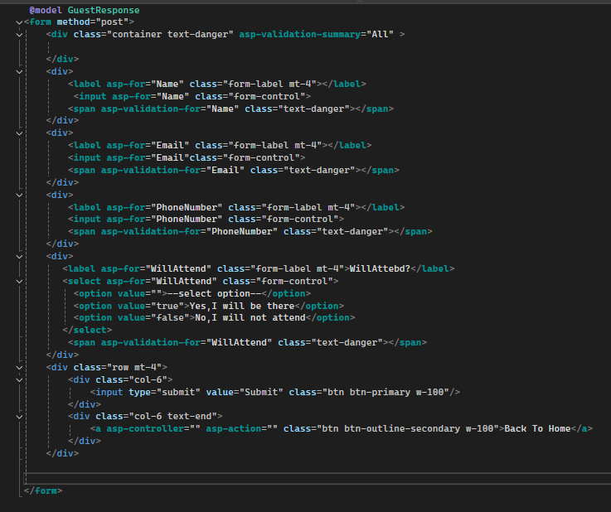
Pro ASP.NET Core
Figure(7): Registration Form

Slide 17
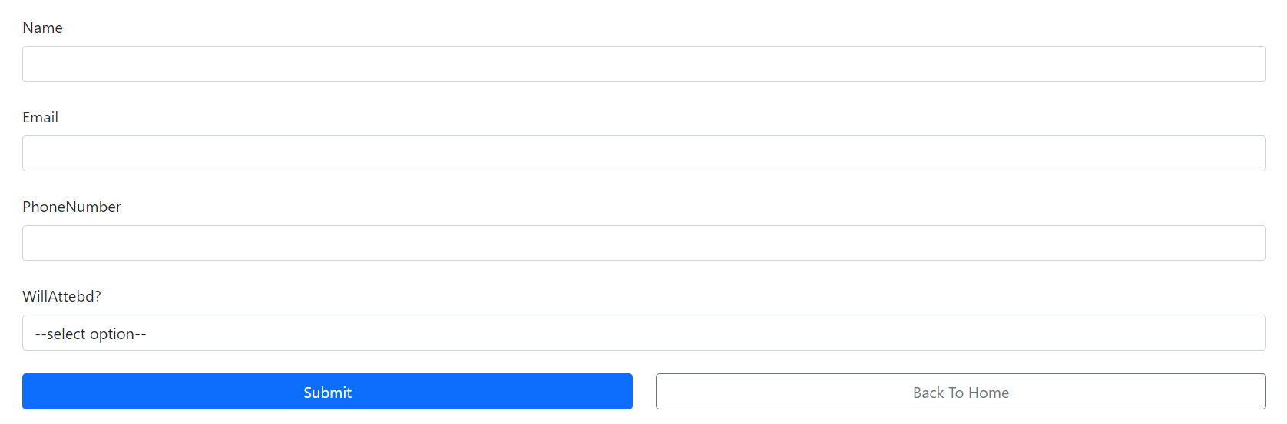
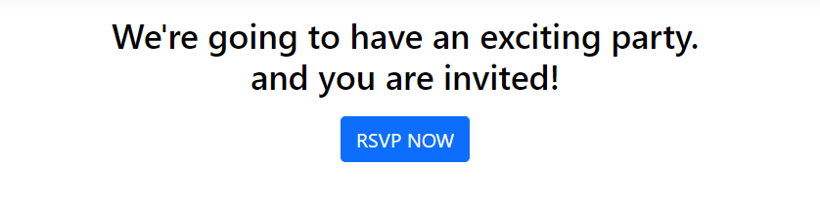
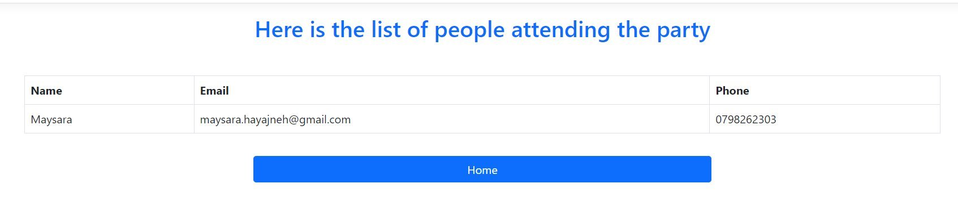
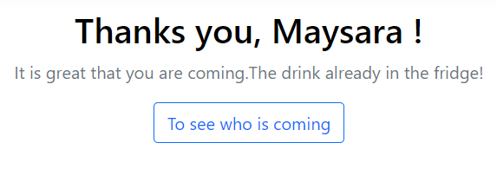
Pro Asp.net Core
User Experience:
Figure(8): Main View
Figure(9): Registration Form
Figure(10): Response Page
Figure(11): List of attending

Slide 18
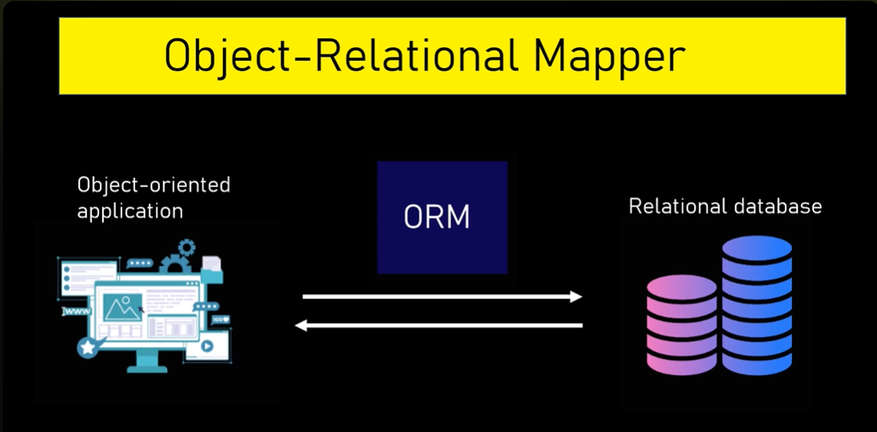
Training Stage: Entity Framework
What is Entity Frameworks:
Entity Framework is Object-Relational Mapper.
It supports multiple database engines.
Figure(12): Object Relational Mapper

Slide 19
Training Stage: Entity Framework
Entity Framework Basic Components (Classes):
DbContext class.
Plays a crucial role to interact with database.
Seeding Tables.
Connection Strings.
Information about the database.
DbSet class.
Responsible of creating tables, in database.
Implementing CRUD operations.

Slide 20
Training Stage: Entity Framework
Migration:
It is a tool to keep track of database changing by using:
add-migration
update-database
Migration basically convert the C# code that is generated in the migration folder, to SQL statements in the Database to track changes.
Contoso University web app:
I implemented "CRUD" Operations.
I implemented sort, and search functionalities to data.
I am going to explain the details in the project.

Slide 21
Thank you All !
Any Questions?

