Slide 1
Programming ‘Java’ {
Tuwaiq Academy
Capston1
[For first Capstone]
// by Maysun
}
Java Bootcamp

Slide 2
01 {
[Rating System]
Tuwaiq Academy
Rating
< Post Rating>
}
Java Bootcamp

Slide 3
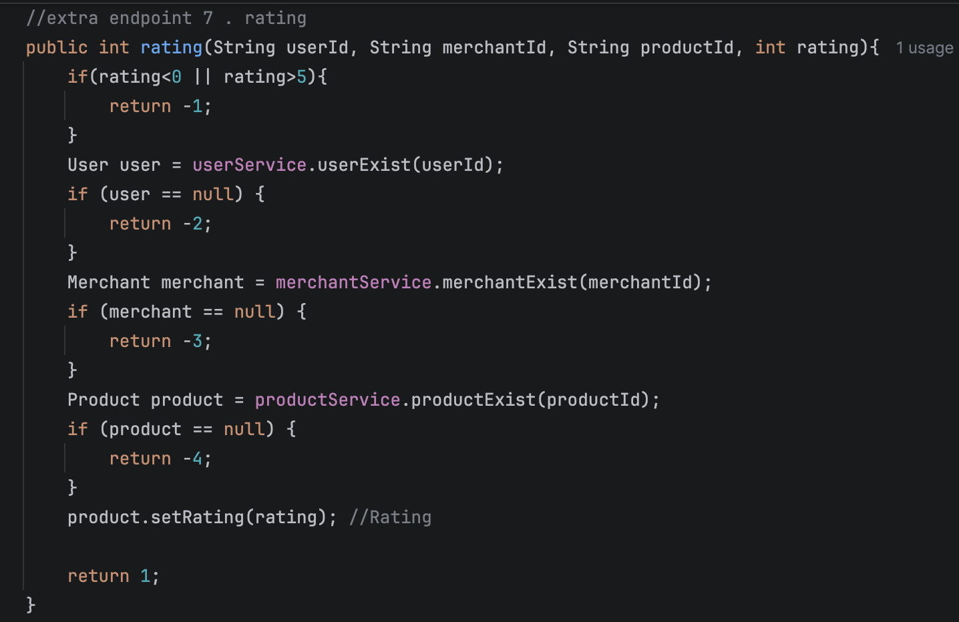
Rating System; {
Tuwaiq Academy
Rating System
}
Java Bootcamp

Slide 4
02 {
[Static System]
Tuwaiq Academy
Static System
< Users + Products + Stock>
}
Java Bootcamp

Slide 5
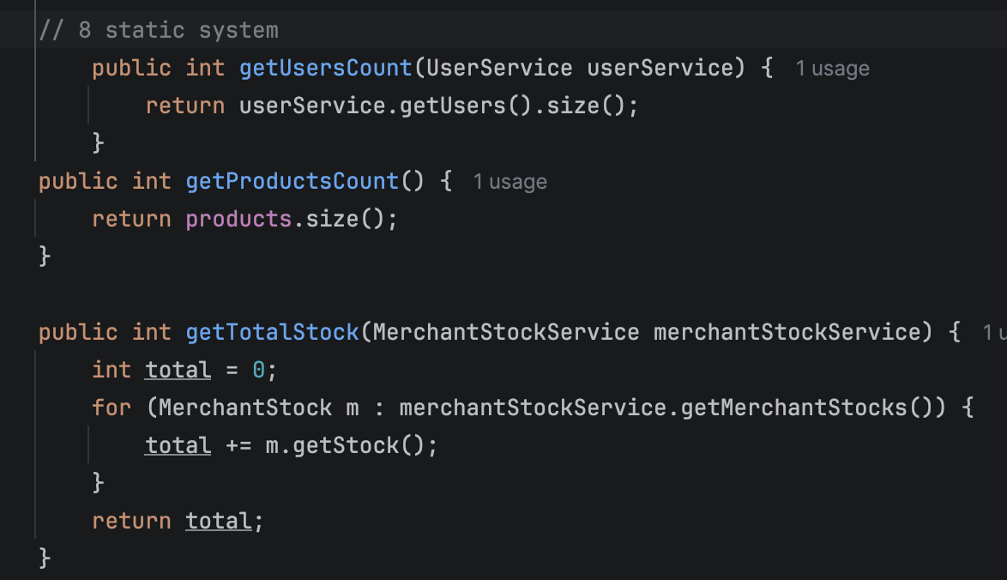
Static System; {
Tuwaiq Academy
Static System
}
Java Bootcamp

Slide 6
03 {
[Filter By Price]
Tuwaiq Academy
Filter By Price
< get Filer by min and max>
}
Java Bootcamp

Slide 7
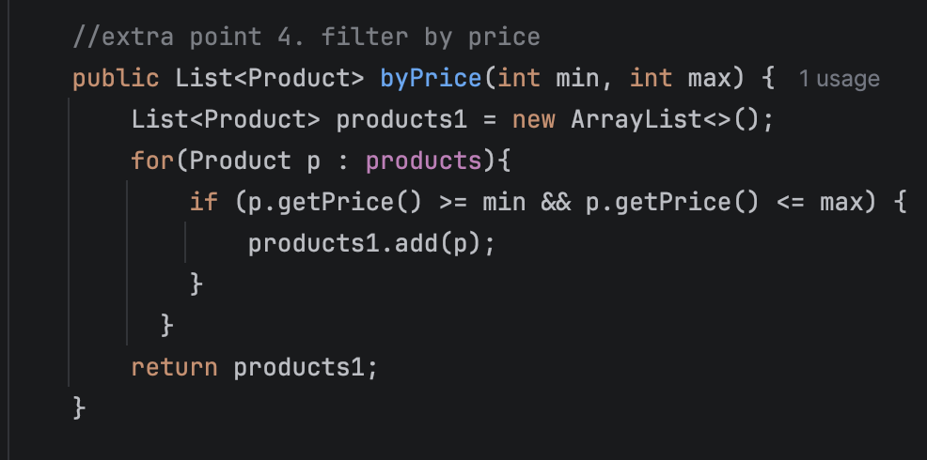
Filter By Price; {
Tuwaiq Academy
Filter By price
}
Java Bootcamp

Slide 8
04 {
[Available Product]
Tuwaiq Academy
Available Product
< get Available product in stock >
}
Java Bootcamp

Slide 9
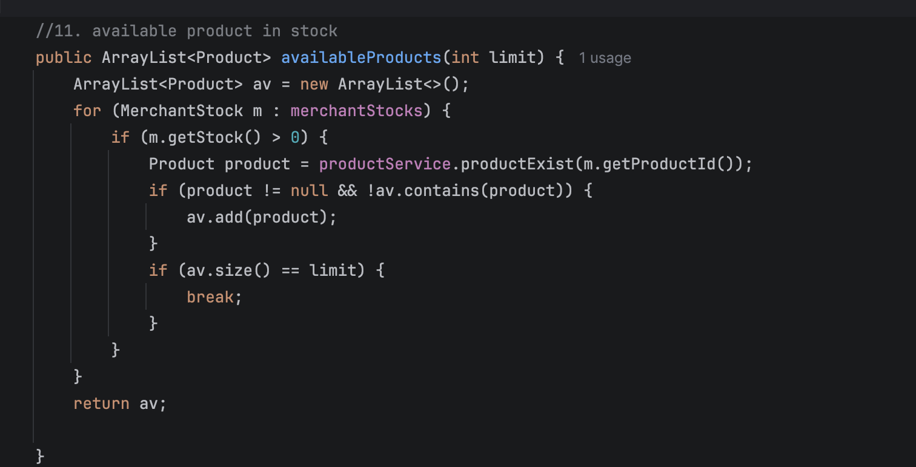
Available Product; {
Tuwaiq Academy
Available Product
}
Java Bootcamp

Slide 10
05 {
[Max Price]
Tuwaiq Academy
Expensive Product System
< get Max Price Product>
}
Java Bootcamp

Slide 11
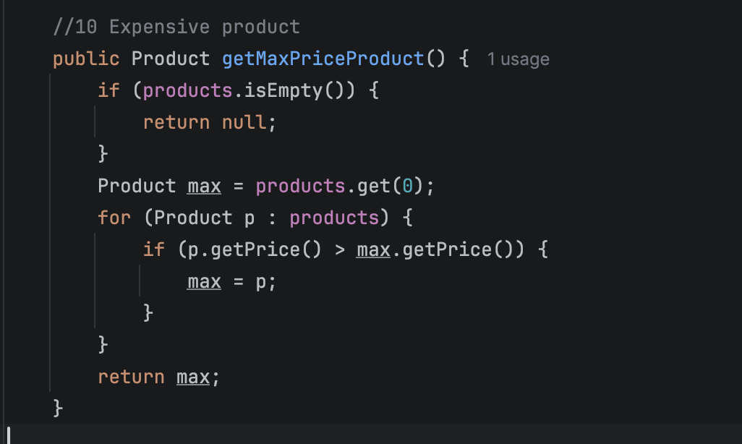
Max Price Product; {
Tuwaiq Academy
Expensive Product System
}
Java Bootcamp

Slide 12
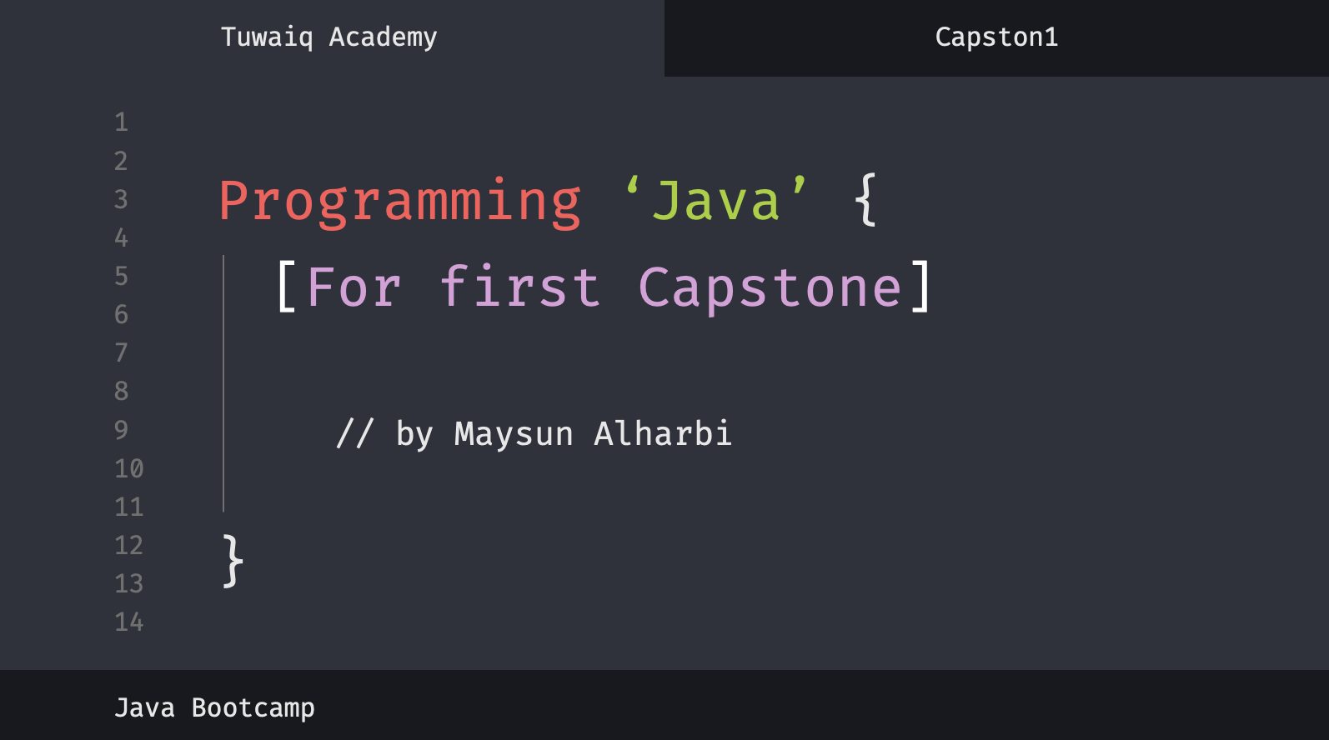
PostMapping(“/theEnd”){
Tuwaiq Academy
The End
public String thank(String Thank, String You){
// Thank you all
}
}
JAVA Bootcamp

