Slide 1



SMART INDIA HACKATHON 2025
TITLE PAGE
Problem Statement ID – 25093
Problem Statement Title- Centralised Digital Platform for Comprehensive student activity record in HEIs
Theme- Smart Education
PS Category- Software
Team ID-
Team Name - Immortals
1

Slide 2
SMART STUDENT HUB
Immortals
Problem Statement:
Despite increasing digitization in education, student achievements ranging from academic excellence to participation in curricular and extracurricular activities remain scattered across various departments or lost in paper-based records, in many colleges and universities.
How It Addresses the Problem:
⚬ Ends Data Fragmentation: It creates a single, secure, digital source of truth, eliminating scattered files and lost paper records, which drastically improves institutional efficiency.
⚬ Streamlines Accreditation: It automates the collection and consolidation of student achievement data, significantly reducing the administrative burden and manual effort required for accreditation reports (NAAC, NBA, etc.).
⚬ Empowers Students for Placements: It provides students with a university-verified, dynamic portfolio, enabling them to effectively showcase their holistic skills and experiences to recruiters and admissions committees.
⚬ Enhances Transparency and Mentorship: Offers real-time visibility into a student's complete profile, empowering faculty with the data needed for more effective, evidence-based mentoring.
Proposed Solution
Smart Student Hub: Centralized platform for all student activities.
ABC ID Integration: Secure login, unique identity, and portability across institutions.
Verified Records: Students upload via ABC ID, faculty verify achievements.
Digital Portfolio: Lifelong, shareable portfolio linked to ABC ID.
Compliance Ready: Auto-generated NAAC/NIRF reports with verified data.
Innovation and Uniqueness:
⚬ Institution-Verified Credibility: Unlike self-reported platforms, every achievement is verified by faculty. This creates an unparalleled level of trust and authenticity for recruiters and admissions committees.
⚬ Purpose-Built for Accreditation: The platform features an analytics engine specifically tailored for compliance reports (NAAC, NIRF), directly automating a complex and manually intensive process for universities.
2
Notes:
2

Slide 3
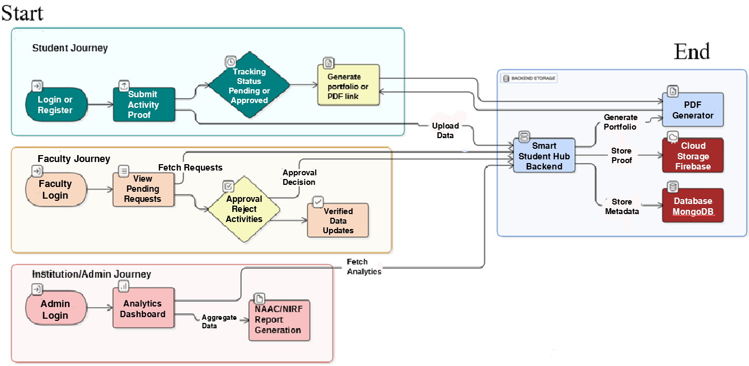


TECHNICAL APPROACH
Immortals
Steps:
User Authentication & Onboarding 🔑: Secure, role-based login for students, faculty, and admins to access their dedicated dashboards.
Activity Submission & Upload ⬆️: Students use a simple form to submit activity details and upload proof (like PDFs or images) to the backend.
Secure & Scalable Data Storage 💾: For efficiency, activity metadata is stored in MongoDB for fast access, while proof files are securely kept in Firebase Cloud Storage.
Faculty Verification Workflow ✅: Submissions enter a queue for faculty to review and then approve or reject them via their dashboard.
Dynamic Portfolio Generation 📄: On-demand, the system generates a shareable digital portfolio from verified records, available as a web link or a downloadable PDF.
Accreditation Analytics & Reporting 📊: An admin dashboard aggregates verified data to automatically generate custom reports and analytics for accreditation bodies like NAAC and NIRF.
Login or Register
Programming Language | Frameworks and libraries | Database /storage
Javascript (node.js), Python | React.js/Next.js, tailwindcss Material UI, Pytorch | Mongo db, firebase
3
Notes:
3

Slide 4
FEASIBILITY AND VIABILITY
Immortals
Feasibility Analysis:
Technical Feasibility:
Built on a mature tech stack (React, Node.js, Firebase).
Cloud-based storage ensures stability and scale.
Scalability: By leveraging the national Academic Bank of Credits (ABC) ID database under NEP 2020, the platform inherits a ready-made, universally unique identity system for all students across India. This eliminates the need to build a separate student registry, drastically cutting onboarding costs.
Operational Feasibility:
Automation and Simplification: Streamlines existing manual workflows.
Reduced operational Burden: Minimizes workload for faculty and staff
User-Centric Design: Built to be intuitive and easy to navigate.
Minimal Training Required: Quick adoption by both students and faculty.
Potential Challenges and Risks:
⚬User Adoption & Change Management:
￭Faculty Hesitation: Faculty may perceive the platform as an additional administrative burden rather than a time-saving tool, leading to slow or inconsistent adoption.
￭Student Engagement: Ensuring students consistently and accurately upload their activities throughout their academic journey, not just during their final year for placements.
⚬Technical & Security:
￭Data Security & Privacy: Handling a large volume of sensitive student data (PII) requires strict adherence to data protection laws and robust safeguards against potential security breaches.
￭Integration Complexity: Many universities utilize older, legacy ERP systems with limited or poorly documented APIs, which can make seamless data integration a significant technical hurdle.
Strategies for Overcoming Challenges:
⚬Driving User Adoption:
￭A mobile-first, intuitive UI/UX focused on ease of use.
⚬Ensuring Robustness & Integration:
￭Implementing a comprehensive security framework from day one, including role-based access control and data encryption.
￭Building a flexible, API-first architecture that allows the platform to function standalone or integrate with other systems via well-documented APIs.
4
Notes:
4

Slide 5
IMPACT AND BENEFITS
Immortals
Impact on Target Audience:
For Students:
Immediate Impact:
Enhanced Employability: Provides a verified, comprehensive portfolio that boosts credibility.
Stronger Higher-Ed Applications: Showcases a holistic profile beyond grades, strengthening applications for postgraduate programs and scholarships.
Future Impact:
AI-Powered Career Guidance: Evolves into a lifelong career companion that actively helps build optimized resumes, and matches them with the right opportunities.
Lifelong Learner Record: A portable record of skills and achievements that can be continuously built upon throughout professional careers.
For Institutions (HEIs):
Immediate Impact:
Reduced Administrative Overhead: Significantly reduces the manual effort and time required for accreditation data collection and reporting.
Improved Data Accuracy: Centralizes information, eliminating errors and inconsistencies common in manual processes.
Future Impact:
Data-Driven Strategic Insights: Provides valuable analytics on student engagement and its correlation with placement success.
Enhanced Institutional Reputation: Improves placement outcomes and strengthens global rankings by showcasing the comprehensive development of students.
Broader Benefits of the Solution:
Economic Benefits:
Reduces operational costs for universities by automating administrative tasks.
Creates a more skilled workforce by making student skills visible and verifiable, directly addressing industry needs.
By integrating with the existing Academic Bank of Credits (ABC) ID database, the platform avoids the heavy cost of building and maintaining a separate identity management system. Institutions save on infrastructure, data duplication, and administrative overhead—making the solution highly affordable and sustainable at scale.
Benefits for Institutions by Addressing Accreditation Gaps
Accreditation Gaps Due to Documentation Challenges:
Out of ~1,113 universities in India, only 418 are accredited by NAAC.
Out of ~43,796 colleges, only 9,062 are accredited.
This leaves 695 universities and 34,734 colleges still awaiting NAAC accreditation.
5
Notes:
5

Slide 6
RESEARCH AND REFERENCES
Immortals
National Education Policy (NEP) 2020: Research on the NEP's emphasis on holistic, multidisciplinary education.
•Link: https://www.education.gov.in/en/nep/multidisciplinary-holistic-education
NAAC Accreditation Manual: Analysis of NAAC manuals, focusing on Criterion 5(Student Support and Progression).
•Link: https://www.rkgit.edu.in/IQAC/NAAC-SSR/Criterion5/
NBA Graduate Attributes: Study of the National Board of Accreditation's required Program Outcomes (POs) and Graduate Attributes.
•Link: https://submissions.ijskit.org/index.php/ijskit/article/download/213/204/
Open Badges Standard: Review of the global trend towards micro-credentials and the Open Badges standard for verifiable skills.
•Link: https://www.pok.tech/en/open-badge-3-0
6
6
Notes:
6

