Slide 1


Analysis of Gas Prices
Final Programming Project
Python 101
Class of 2023

Slide 2
Outline
[1] Requirements: What is the problem we are solving?
* Requirements in plain English
[2] Design: How are we solving it?
* tuple for each line, master list, master dictionary (by month, by year)
[3] Implementation: How are we coding it?
* method contract, description
* execution plan
[4] Testing: How do we know it is working as it is supposed to work?
[5] Deploying: Is it ready for release/production/demonstration?

Slide 3

Requirements
[1] Requirements: What is the problem we are solving?
* Requirements in plain English

Slide 4
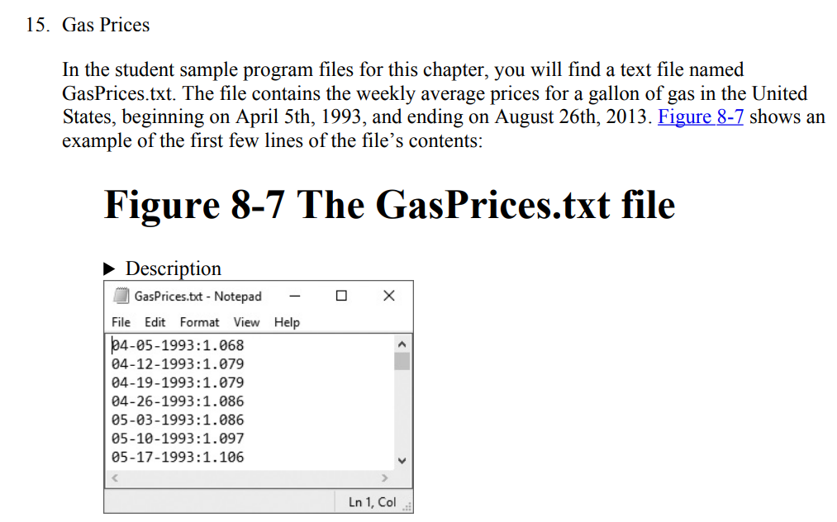
Problem Statement

Slide 5
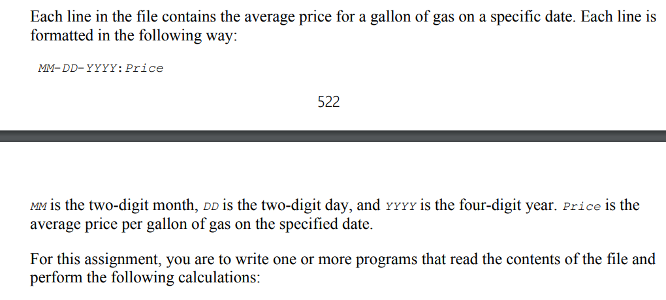
Problem Statement

Slide 6
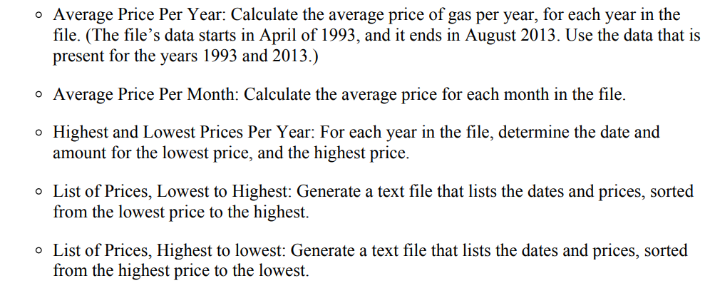
Problem Statement

Slide 7
Problem Statement (Cont.)
In addition to the textbook problem, we added some additional requirements:
Price binning – converting each numerical price to a price category
Price binning frequency – finding out the category frequency
Missing dates report – Report on the missing dates as a list and as counts.
Get N unique Number of highest prices
We also want to compare the execution times for some methods
Using List based implementation
Using Dictionary based implementation.

Slide 8
Complete Requirements List
1. Reading the Gasprices (textfile)
2. Get Average Price per Year
3 Get Average Price per Year - Dictionary
4. Get Average Price per Month
5. Get Average Price per Month - Dictionary
6. Get Highest and Lowest Prices per Year
7. Get Highest and Lowest Prices per Year - Dictionary
8. Generate list of Prices - Lowest to Highest
9. Generate list of Prices - Highest to Lowest
10. Create a Price Range Coloumn
11. Get Price Binning Frequency
12. Get Missing Dates (List) Report
13. Get Missing Dates (Summary) Report
14. Get N number of Unique Highest Prices
15. Runtime Summary

Slide 9
Additional Requiremetns
[1] When year data is printed, those should be sorted. 1993 1994.. ..
2012
2013
[2] When monthly data is printed, those should be sorted. 1. Jan 2. Feb 3. Mar 4. Apr
..
12. Dec

Slide 10

Software Design
[2] Design: How are we solving it?
* tuple for each line, master list, master dictionary (by month, by year)

Slide 11
Three data structures
# [1]Stores gas prices by month, day, year, and price
prices_master_list = []
# [2] Stores gas prices by year
year_prices_dictionary = {}
# [3] Stores gas prices by month
month_prices_dictionary = {}

Slide 12
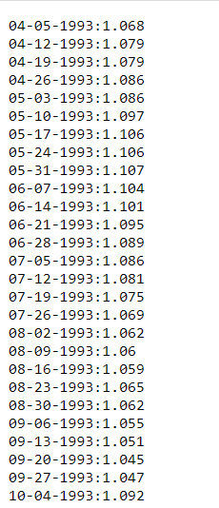
[1] Storing the data as a List (A List of Lists)
0
1
2
[04, 05, 1993, 1.068]
[04, 12, 1993, 1.079]
[04, 19, 1993, 1.079]
……
……
1062
1063
1064
[08,12, 2013, 3.633]
[08, 19, 2013, 3.622]
[08, 26, 2013, 3.623]

Slide 13
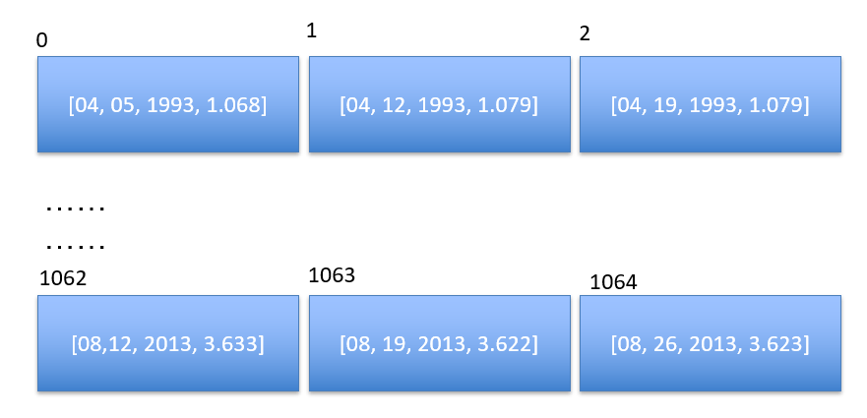
[1] List of Lists
price_mini_list
prices_master_list
date, month, year, price
date, month, year, price

Slide 14
[2] Dictionary (key: year) (value: price list)
1993
[1.67, 1.56, 1.56, 1.67,………………………………………2.34, 2.38]
1994
[2.38, 2.40, 2.43, 2.50………………………………………2.90, 2.90]
2013
[3.38, 3.40, 3.41, 3.90………………………………………4.90, 4.91]

Slide 15
[3] Dictionary (key: month) (value: price list)
1 (Jan)
[1.67, 1.56, 1.56, 1.67,………………………………………2.34, 2.38]
2 (Feb)
[2.38, 2.40, 2.43, 2.50………………………………………2.90, 2.90]
12 (Dec)
[3.38, 3.40, 3.41, 3.90………………………………………4.90, 4.91]

Slide 16

Implementation: Coding
[3] Implementation: How are we coding it?
* method contract, description

Slide 17
Let us establish “contracts”
What are the method signatures? (function signatures?)
What are the function names?
What are the inputs?
What are the outputs?
What is the function doing? (function description)
What is the purpose of the function?
Is it producing the output?
Is it populating any global variables?
Is it returning any variables?

Slide 18
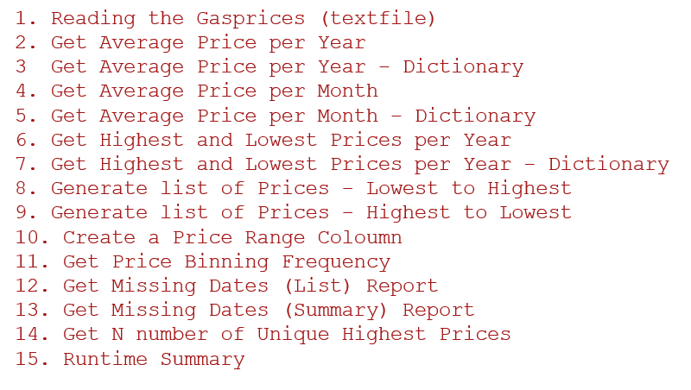
Requirements to function Names
def read_gas_prices(file_name = 'gasprices.txt'):
def get_average_price_per_year():
def get_average_prices_per_year_dictionary( ):
def get_average_price_per_month():
def get_average_prices_per_month_dictionary():
def get_highest_and_lowest_prices_per_year():
def get_highest_and_lowest_prices_per_year_dictionary():
def generate_list_of_prices_lowest_to_highest():
def generate_list_of_prices_highest_to_lowest():
def get_bin_name(input_price):
def get_price_binning_frequency():
def get_missing_dates_list_report():
def get_missing_dates_summary_report():
def get_highest_N_unique_prices(count):
def print_runtime_summary():

Slide 19

get_highest_N_unique_prices(count)
get_highest_N_unique_prices(count)
This method takes in the count parameter and returns ‘count’ number unique set of the highest prices.
How does it work?
It reads all the gas prices from the dictionary.
It is better if you use the ‘month’ dictionary because there are only 12 keys. (if you use ‘year’ dictionary, it will also work. However, you will be reading more keys)
Add all the prices (value of each key) to a “big_list_of_prices”
Then convert that list to a set to drop the duplicates.
Then convert the “set” back to a list so as to get the order.
Sort the list in descending order.
Then slice the list to get the "count" number of values.
Display (print) those values.

Slide 20
Execution Plan
1. Reading the Gasprices (textfile)
2. Get the Average Price per Year
3 Get Average Price per Year – Dictionary
4. Get the Average Price per Month
5. Get Average Price per Month – Dictionary
6. Get the Highest and Lowest Prices per Year
7. Get the Highest and Lowest Prices per Year - Dictionary
8. Generate a list of Prices - Lowest to Highest
9. Generate a list of Prices - Highest to Lowest
10. Create a Price Range Column
11. Get Price Binning Frequency
12. Get Missing Dates (List) Report
13. Get Missing Dates (Summary) Report
14. Get N number of Unique Highest Prices
15. Runtime Summary
Methods 1,2,4,6,8,9,15 are implemented by all the students as solo mid-term project.
Other methods and refactoring of the entire project are implemented as group project

Slide 21
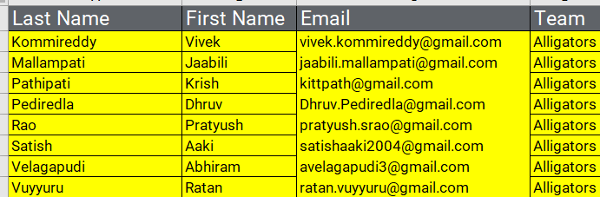
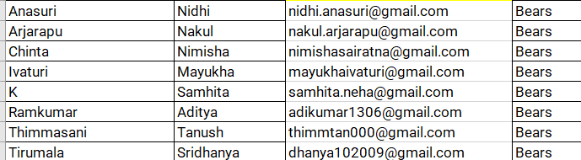
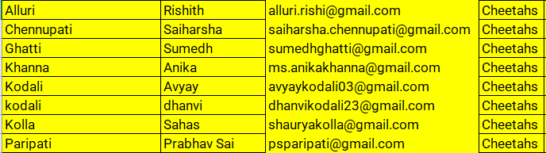
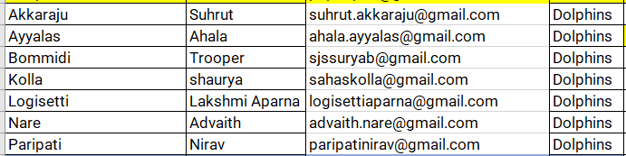
Team Composition

Slide 22
Let us jump to google colab notebook to see these methods
def read_gas_prices(file_name = 'gasprices.txt'):
def get_average_price_per_year():
def get_average_prices_per_year_dictionary( ):
def get_average_price_per_month():
def get_average_prices_per_month_dictionary():
def get_highest_and_lowest_prices_per_year():
def get_highest_and_lowest_prices_per_year_dictionary():
def generate_list_of_prices_lowest_to_highest():
def generate_list_of_prices_highest_to_lowest():
def get_bin_name(input_price):
def get_price_binning_frequency():
def get_missing_dates_list_report():
def get_missing_dates_summary_report():
def get_highest_N_unique_prices(count):
def print_runtime_summary():

Slide 23

Software Testing
[4] Testing: How do we know it is working as it is supposed to work?

Slide 24
Software Testing
[1] Introducing negative test data in the input file: gasprices.txt
Introducing the error conditions in some lines
Introducing the duplicates in the input file
[2] Testing each cell/function on its own.
[3] Performing the ‘integration testing’ of the entire code using “Run All” in google colab.
[4] Using interactive testing of different functions through menu.
[5] Reviewing the code for coding style and consistecy

Slide 25
Coding Conventions
Are variables named consistently?
Are methods named consistently?
Are coding conventions followed?
Are methods documented?
https://www.tutorialspoint.com/online_python_formatter.htm

Slide 26

Software Deployment
[5] Deploying: Is it ready for release/production/demonstration?

Slide 27
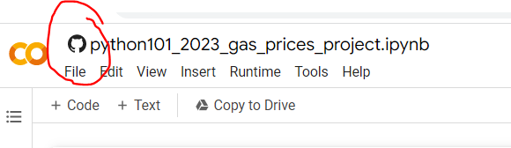
Code Integration - GitHub
Google Colab is used to write the code.
The code is hosted on GITHUB (File → Save to GitHub)
We used “GitHub → Fork” to create our own copy to give the demonstration.
The input file is also hosted on GITHUB (a different repository). That file is mounted to google colab in the first cell.

Slide 28

Thank You. धन्यवाद

