Slide 1


Dhole Patil Education Society’s
Dhole Patil College of Engineering, Pune
Major Project Presentation
Project Title: Krishi Suraksha- Fog‑based Animal Intrusion Alert & Field Monitoring
Under the Guidance of: Prof. Dhananjay Poul
Presentation by: 1] Mayur Ichake
2] Sahil Ichake
3] Harsh Wala
A.Y. 2025-26

Slide 2
Dhole Patil Education Society’s
Dhole Patil College of Engineering, Pune
Presentation Flow
Introduction, Project Objective, Goal
Problem Statement
Literature Survey
Block Diagram
Specification
Software used
Implementation Details
Advantages & Applications
Future Scope
References

Slide 3
Dhole Patil Education Society’s
Dhole Patil College of Engineering, Pune
INTRODUCTION
Project Objective: This project focuses on the design and development of a fog-based animal intrusion alert and field monitoring system aimed at protecting crops, reducing farmer losses, and ensuring efficient farm surveillance.
Technology Used: The system uses Raspberry Pi, PIR and ultrasonic sensors, Pi Camera, TensorFlow Lite, GSM/LoRa modules, and solar power for reliable operation in remote areas.
Key Features: Automatically detect animal intrusion in farm fields. Classify animals using AI (TensorFlow Lite)..
Goal: Develop a cost-effective, energy-efficient, and scalable smart agriculture solution that minimizes crop damage and provides real-time protection and monitoring for farmers.

Slide 4
Dhole Patil Education Society’s
Dhole Patil College of Engineering, Pune
Problem Statement
In rural and remote areas, there is a frequent issue of unauthorized intrusion by animals or strangers into farmland, restricted zones, or property boundaries. Traditional surveillance systems like CCTV require constant human monitoring and often fail at night or in poor weather conditions. Additionally, most systems lack real-time alerts, long-range communication, or automated threat detection.

Slide 5
Dhole Patil Education Society’s
Dhole Patil College of Engineering, Pune
ABSTRACT
Agricultural fields in rural areas often suffer heavy crop losses due to animal intrusion. Traditional methods like fencing or manual guarding are labor-intensive, unreliable, and costly.This project proposes a fog-based animal intrusion alert and field monitoring system using Raspberry Pi, PIR sensors, ultrasonic sensors, and Pi Camera integrated with AI-based image classification (TensorFlow Lite). The system detects animal movement, identifies the type of intruder, and sends real-time alerts via GSM/LoRa to farmers. Additionally, a buzzer/LED deterrent and optional local audio alerts are triggered to protect the crops.

Slide 6


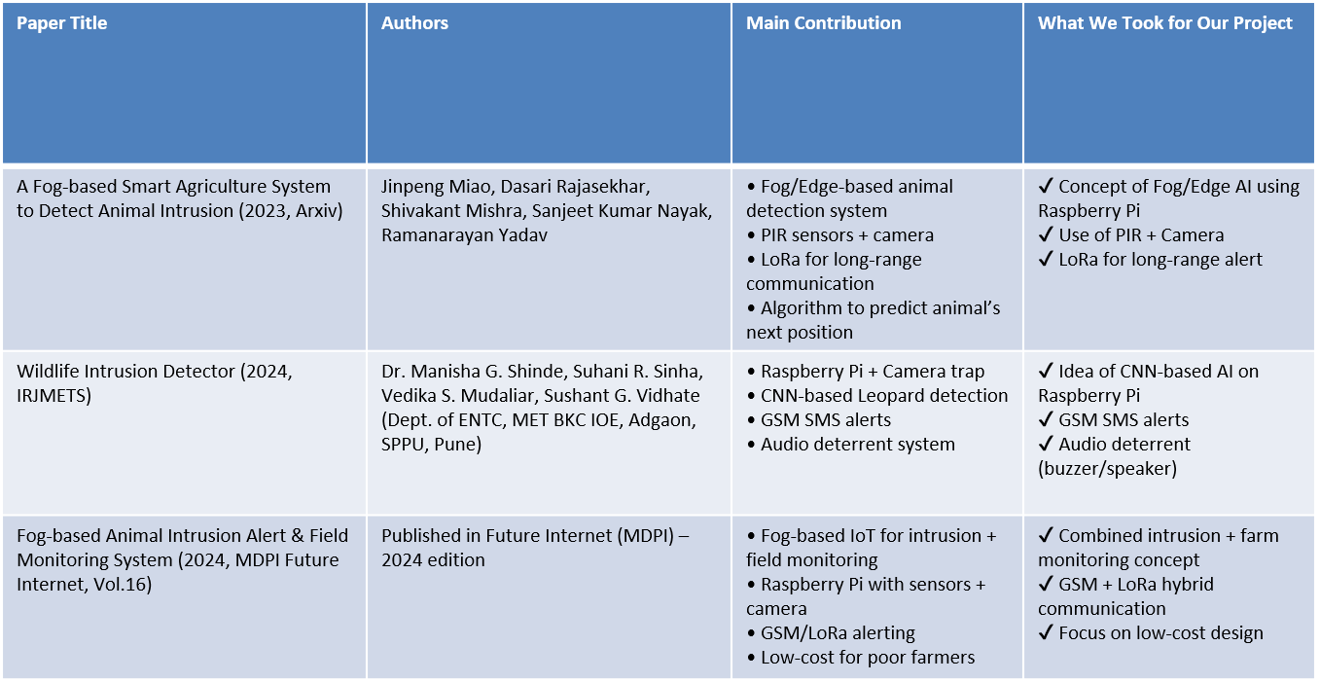
Dhole Patil Education Society’s
Dhole Patil College of Engineering, Pune
LITERATURE SURVEY

Slide 7
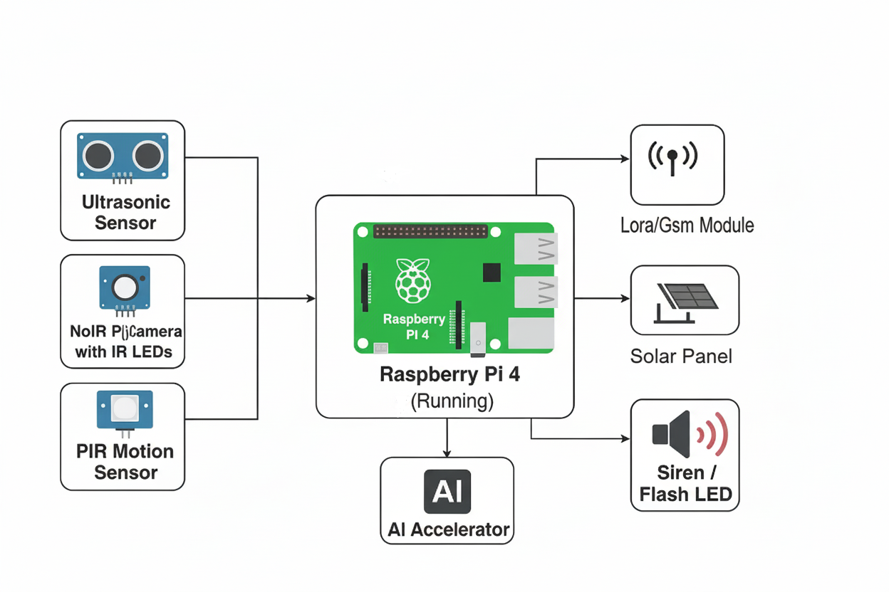
Dhole Patil Education Society’s
Dhole Patil College of Engineering, Pune
Block Diagram
Notes:
<number>

Slide 8
Dhole Patil Education Society’s
Dhole Patil College of Engineering, Pune
SPECIFICATIONS
Microcontroller: Raspberry Pi 4
Sensors: PIR Motion Sensor, Ultrasonic Sensor
Camera: NoIR Pi Camera with IR LEDs (night vision)
AI Accelerator: (Optional) USB Coral TPU for faster inference
Communication Modules: LoRa Module,Gsm Module
Alert System: Buzzer, Flash LED
Power Supply: Solar Panel with Battery Backup
Supporting Components: Jumper Wires, Voltage Regulators, Enclosure Box
Notes:
<number>

Slide 9
Dhole Patil Education Society’s
Dhole Patil College of Engineering, Pune
Software Used
Raspberry Pi
Python 3.9+
OpenCV
TensorFlow Lite
Deep learning
Notes:
<number>

Slide 10
Dhole Patil Education Society’s
Dhole Patil College of Engineering, Pune
IMPLIMENTAION DETAIL
1) Raspberry Pi 4 – works as the main controller.
2) PIR Sensor – connected to GPIO pins for motion detection.
3) Ultrasonic Sensor – connected to GPIO pins for distance measurement.
4) Pi Camera (NoIR) – connected via camera interface for capturing images.
5) LoRa Gsm Module – connected via SPI/I2C for long-range wireless communication.
6) Buzzer / LED – connected to GPIO pins for local alert system.
7) Solar Panel with Battery – supplies power to Raspberry Pi and all modules.
1) Raspberry Pi 4 – works as the main controller.
2) PIR Sensor – connected to GPIO pins for motion detection.
3) Ultrasonic Sensor – connected to GPIO pins for distance measurement.
4) Pi Camera (NoIR) – connected via camera interface for capturing images.
5) LoRa/
6) Buzzer / LED – connected to GPIO pins for local alert system.
7) Solar Panel with Battery – supplies power to Raspberry Pi and all modules.

Slide 11


Dhole Patil Education Society’s
Dhole Patil College of Engineering, Pune
ADVANTAGES
AI-based accurate threat detection (YOLOv5)
Wireless data transfer via LoRa
Remote control and monitoring through Blynk app
Energy-efficient with solar power
Easy integration with cloud (Firebase)
Cost-effective and scalable
Real-time alert system with siren and LEDs

Slide 12
Dhole Patil Education Society’s
Dhole Patil College of Engineering, Pune
APPLICATION
Crop protection from animals
Smart agriculture farm monitoring
Wildlife monitoring
Farm security against intruders
Remote farming support
Custom farming services.

Slide 13
Dhole Patil Education Society’s
Dhole Patil College of Engineering, Pune
FUTURE SCOPE
Integration with drones for aerial farm surveillance
Multi-animal classification using advanced AI models
Voice-enabled mobile applications for farmers
Improved solar power storage for 24/7 operation
IoT integration with smart irrigation systems
Scalability for large commercial farms

Slide 14
Dhole Patil Education Society’s
Dhole Patil College of Engineering, Pune
REFRENCES
Singh et al., "Fog-based Animal Detection System for Crop Protection", IEEE Xplore, 2023
Kumar, R., "Edge AI in Agricultural Monitoring", Springer, 2021
https://agmarknet.gov.in
https://www.tensorflow.org/lite
https://www.raspberrypi.com
Notes:
<number>

Slide 15
Dhole Patil Education Society’s
Dhole Patil College of Engineering, Pune
Thank You…

