Slide 1
Supplements obese
There are many different weight loss solutions out there.
This includes all sorts of pills, drugs and natural supplements.
These are claimed to help you lose weight, or at least make it easier to lose weight combined with other methods.
They tend to work via one or more of these mechanisms:
Reduce appetite, making you feel more full so that you eat fewer calories
Reduce absorption of nutrients like fat, making you take in fewer calories
Increase fat burning, making you burn more calories

Slide 2
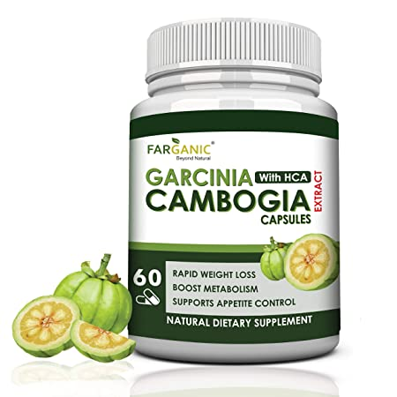
Garcinia Cambogia Extract
Garcinia cambogia became popular worldwide after being featured on the Dr. Oz show in 2012.
It is a small, green fruit, shaped like a pumpkin.
The skin of the fruit contains hydroxycitric acid (HCA). This is the active ingredient in garcinia cambogia extract, which is marketed as a diet pill.

Slide 3
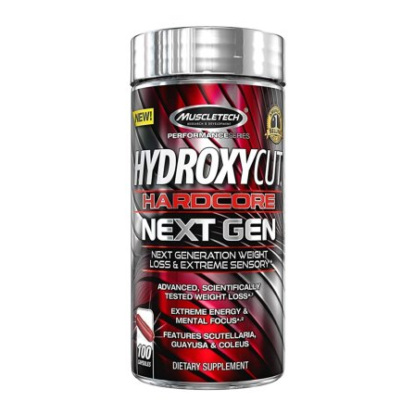
Hydroxycut
Hydroxycut has been around for more than a decade, and is currently one of the most popular weight loss supplements in the world.
There are several different types, but the most common one is simply called “Hydroxycut.”

Slide 4
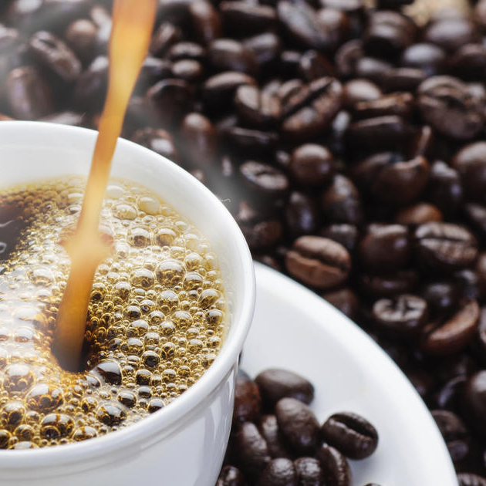
Caffeine
Caffeine is the most commonly consumed psychoactive substance in the world It is found naturally in coffee, green tea and dark chocolate, and added to many processed foods and beverages.
Caffeine is a well known booster, and is often added tometabolism commercial weight loss supplements.

Slide 5
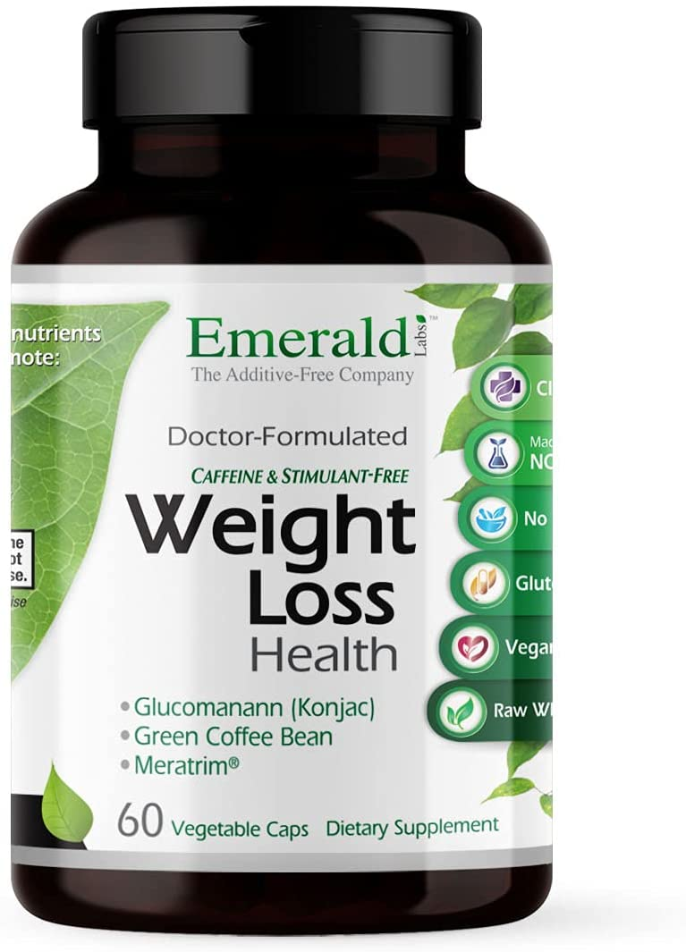
Meratrim
Meratrim is a relative newcomer on the diet pill market.
It is a combination of two plant extracts that may change the metabolism of fat cells.

Slide 6
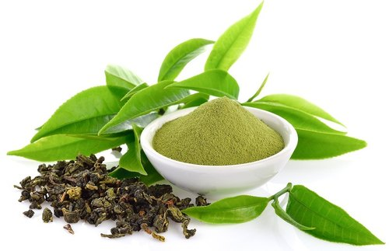
Green Tea Extract
Green tea extract is a popular ingredient in many weight loss supplements.
This is because numerous studies have shown the main antioxidant in it, EGCG, to aid fat burning.

Slide 7
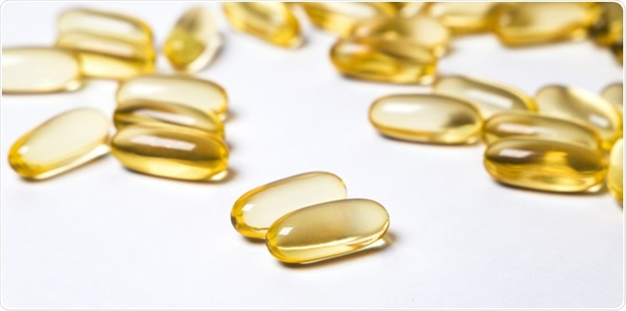
Conjugated Linoleic Acid (CLA)
Conjugated linoleic acid, or CLA, has been a popular fat loss supplement for years.
It is one of the “healthier” trans fats, and is found naturally in some fatty animal foods like cheese and butter.

