Slide 1

Supplements underweight
Those who want to gain weight should focus on gaining muscle. It’s usually healthier to gain most of your weight as muscle rather than fat.
While food and exercise are most important for gaining muscle, supplements may also help by providing calories and protein or by allowing you to exercise harder.
Here are 4 supplements that may help you gain muscle.
Note:
Use of supplements should be properly measured and excesses intake of it may cause problems so before taking it start from a low dose and then according to your workout and gains increase it

Slide 2
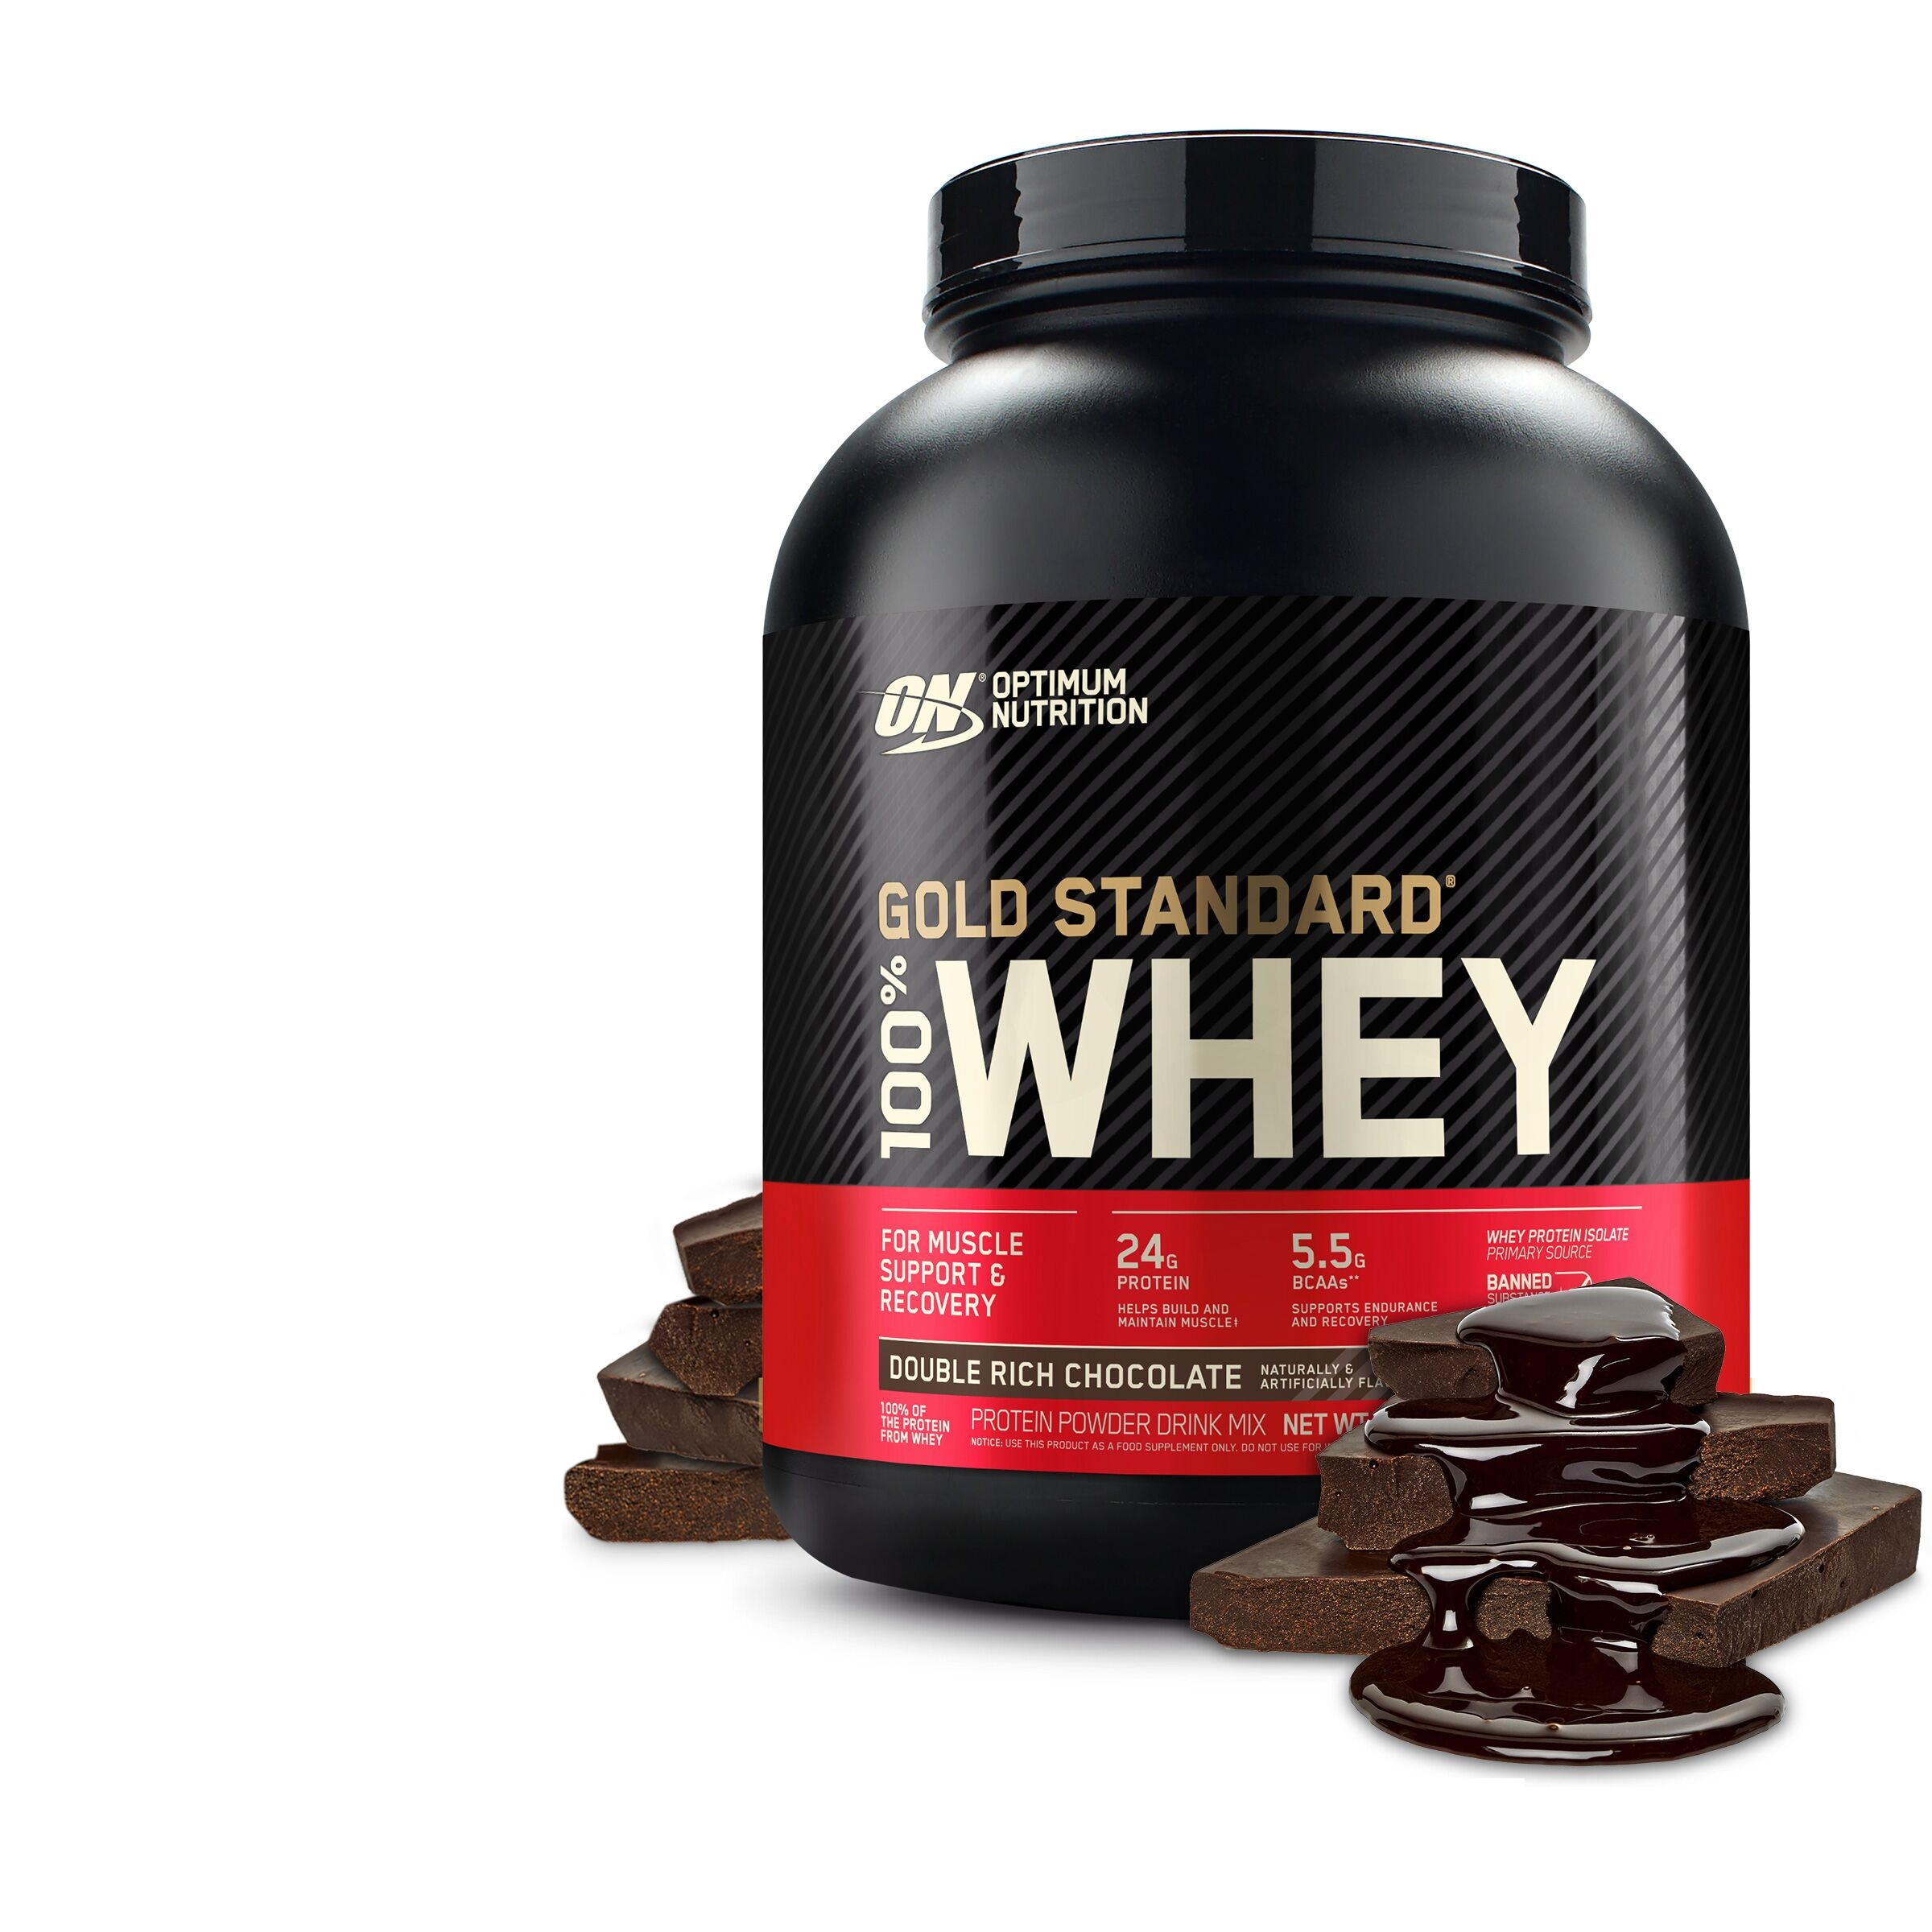
Whey protein
Most people know that protein is an important muscle component. Several studies have shown slightly more muscle gain in exercising adults who consume protein supplements as part of their diet. However, the most important factor is likely your total daily protein intake rather than whether it comes from foods or supplements. As a general recommendation, the Institute of Medicine suggests that 10–35% of your daily calories should come from protein.

Slide 3
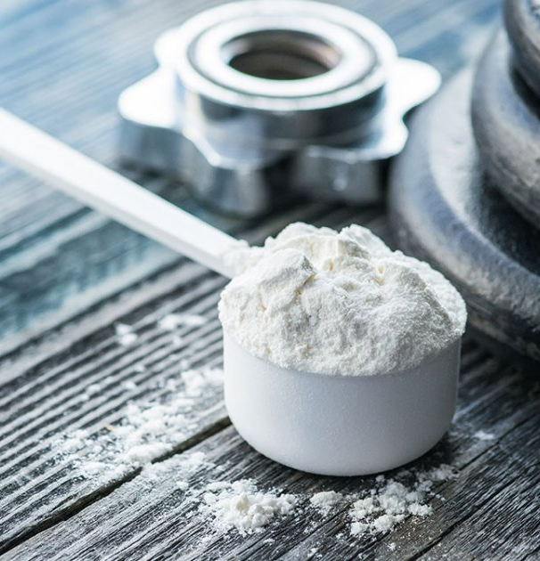
Creatine
Creatine is one of the most-researched supplements and one of the few sports supplements with very strong research support. This molecule is found naturally in your cells and in some foods. When taken as a supplement, the creatine content in your muscles can increase beyond normal levels. Creatine has several important functions in your body, including rapid energy production. A substantial amount of research has shown that creatine supplements can improve exercise performance and muscle gain over time. While several different types of creatine are available, creatine monohydrate has the most research backing it as safe and effective. When taking creatine, it’s typically recommended to begin by taking a loading dose of approximately 20 grams per day, split into four servings, for 5–7 days. After this initial period, a maintenance dose of approximately 3–5 grams per day can be taken indefinitely.

Slide 4
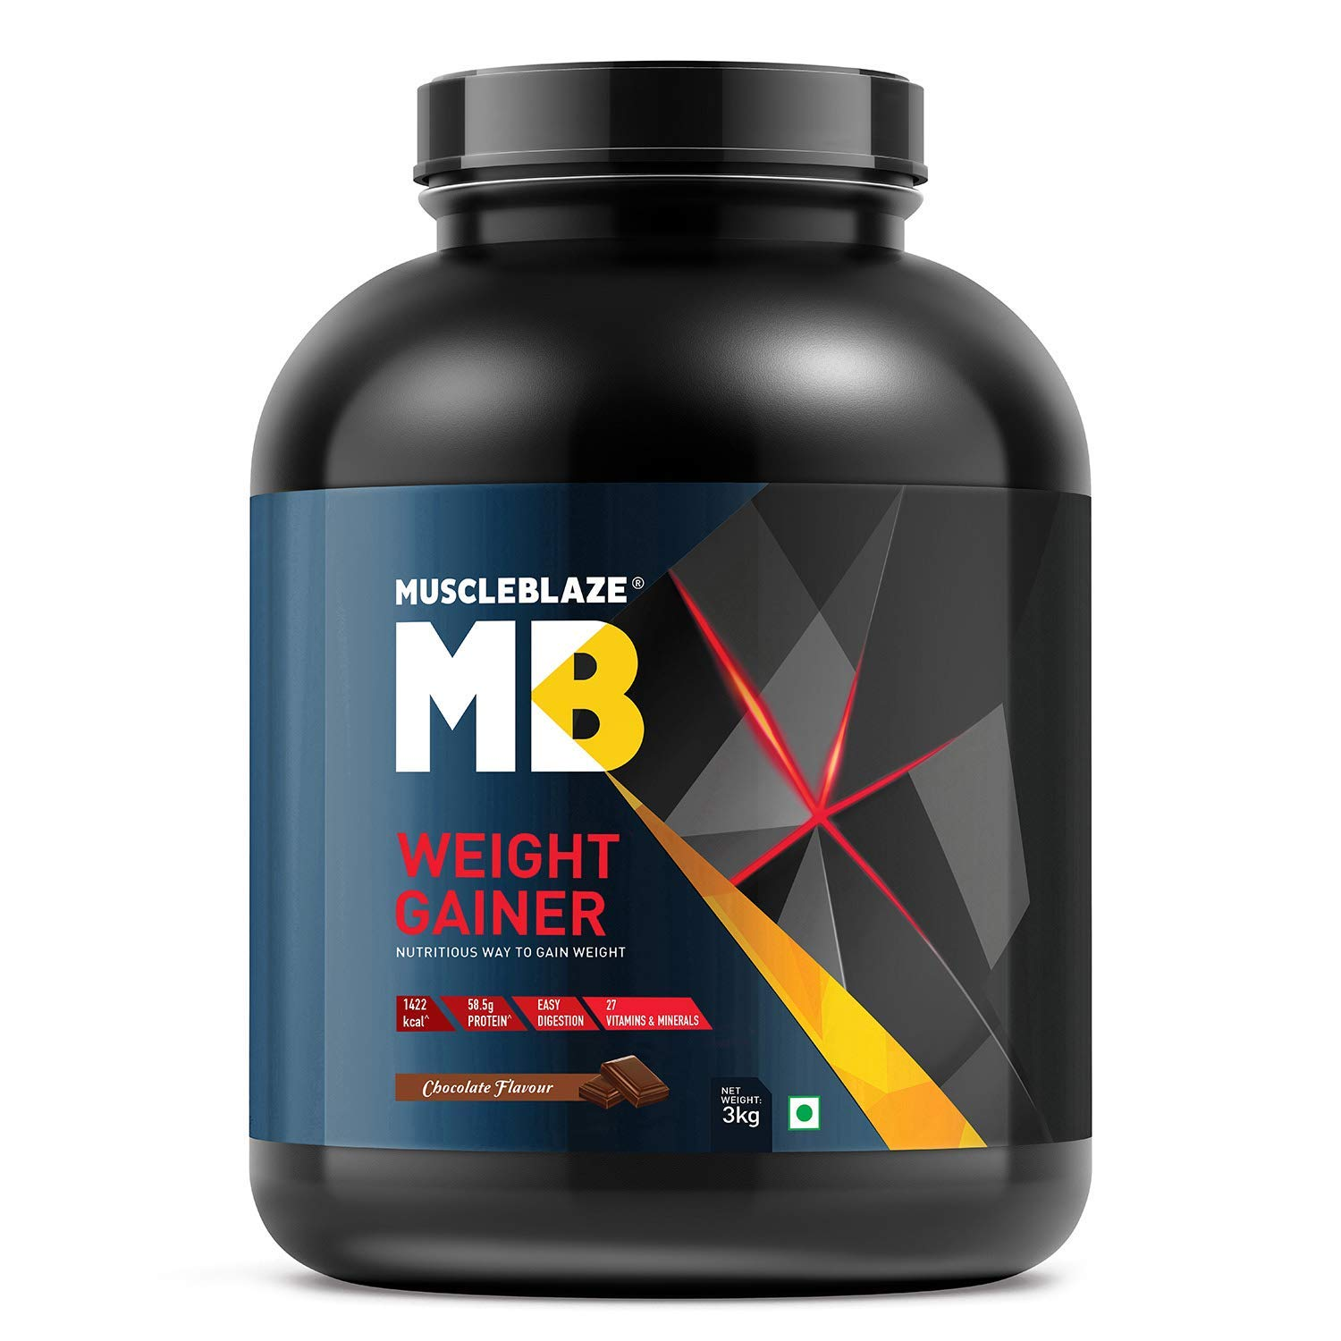
Weight gainer
To gain weight, you need to consume more calories than your body needs for normal functioning. However, how much extra you have to eat can vary between people. Weight gainers are a broad group of high-calorie supplements that are marketed to those who have trouble gaining weight. Similar to protein supplements, there is nothing magical about these supplements. They simply are a convenient way for some people to get more calories. Typically, weight gainers are shakes very high in carbohydrates and high in protein. For example, one popular supplement contains 1,250 calories, 252 grams of carbohydrates, and 50 grams of protein per serving. While adding weight gainers to your diet can certainly increase the number of calories you are eating, some people find the taste and consistency of these products unpleasant. Though these supplements can be convenient when you’re on the go, another option is simply to eat more real food, which would also provide other beneficial nutrients.

Slide 5
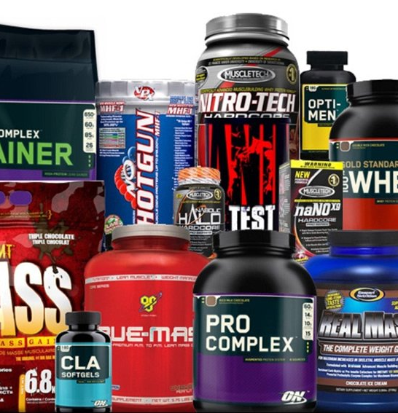
Exercise-Enhancing Supplements
Several supplements exist that may help you exercise harder, which could lead to more muscle gain over time.
Caffeine : Caffeine is consumed widely around the world. Active people often take it before exercise to improve exercise performance. Research has shown that caffeine is indeed effective at enhancing exercise performance
Citrulline : Citrulline is an amino acid that is produced in your body and found in foods. One of its functions is to increase blood flow to your body’s tissues.
Beta-Alanine : Beta-alanine is another amino acid produced naturally in your body. Among other functions, it can help your muscles fight fatigue during exercise. Taken as a supplement, beta-alanine may help improve performance during intense exercise that is carried out in one- to four-minute bouts .
HMB : Beta-hydroxy beta-methylbutyrate (HMB) is a molecule produced when the amino acid leucine is broken down in your body . This molecule may help with recovery after intense exercise and reduce the breakdown of muscle proteins

