Slide 1
C
STRUCTURES
Course Code: 24EN1202
Course Instructor: Dr. Shreekant Salotagi
Academic Year: 2024–2025
Year :1st
Semester : II

Slide 2
Content:
Structures: Purpose and usage of structures. Declaration of structures. Assignment with structures. Structure variables and arrays. Nested structures. Student and employee database implementation using structures.

Slide 3
Examples:
For example, a student may have a name(string), age(int), CGPA(float), graduation year(int/date) and contact details(Ph.No - long int/Address-string). It is very hard to manage student data with separate variables as shown(next slide) in the program.
For three fields in student record it seems feasible to you. But to store and manage information of 100 students with different variables is hard i.e., name[100][20], age[100], CGPA[100], gyear[100] and addr[100][50]. Details of a particular student will be identified by a same index

Slide 4
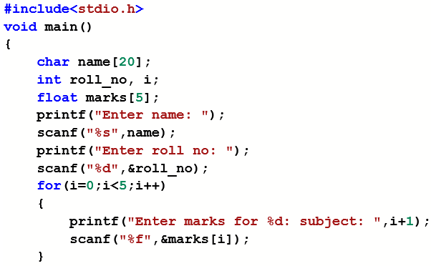
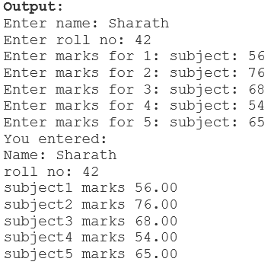
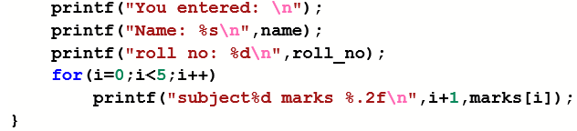

Slide 5
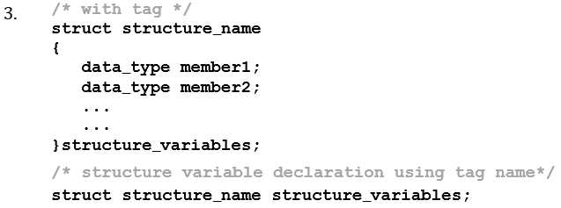
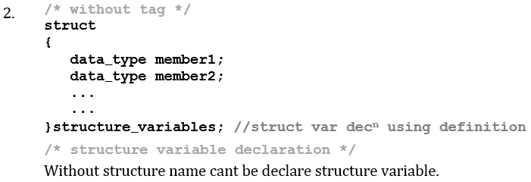
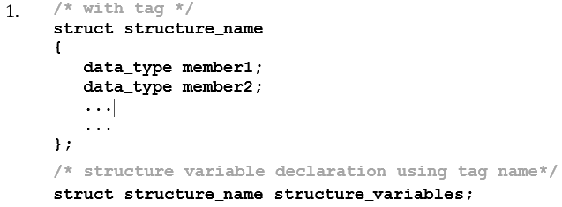
Structure definition
The structure is a user-defined data type in C, which is used to store a collection of different kinds of data i.e., heterogeneous collection of data

Slide 6
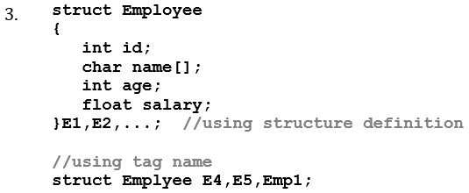
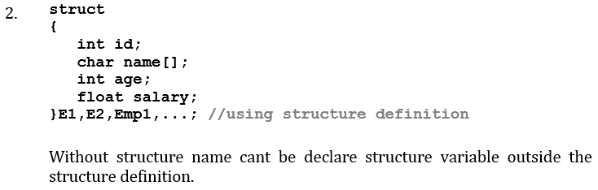
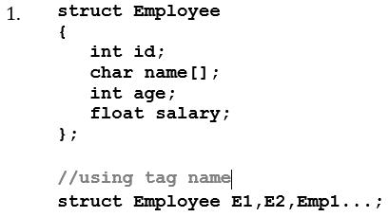
Structure definition

Slide 7
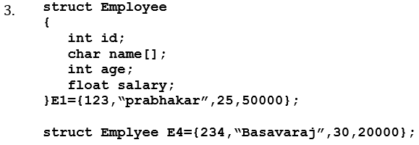
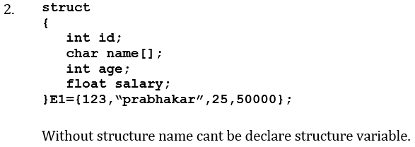
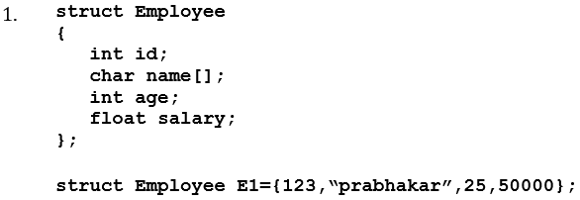
Structure Initialization

Slide 8
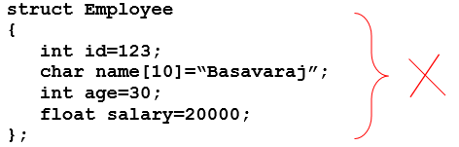
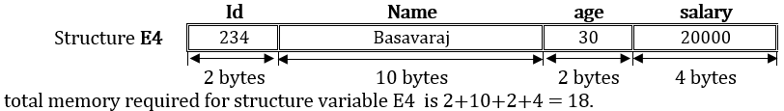
Structure Initialization

Slide 9
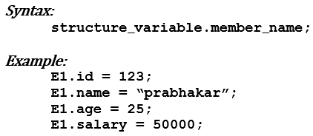
Structure variable access
The dot (.) operator or membership operator is used to access members of a structure using a structure variable. Here is the syntax:

Slide 10
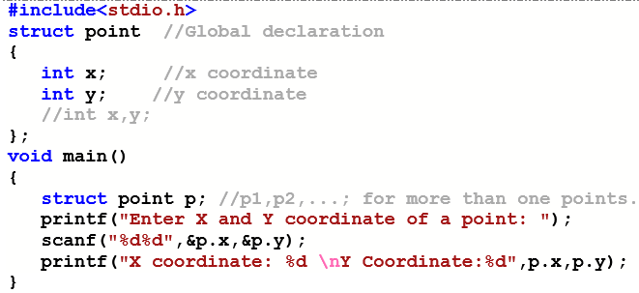

C program to read and print coordinates of a 2D-point on cartesian plane using structure

Slide 11
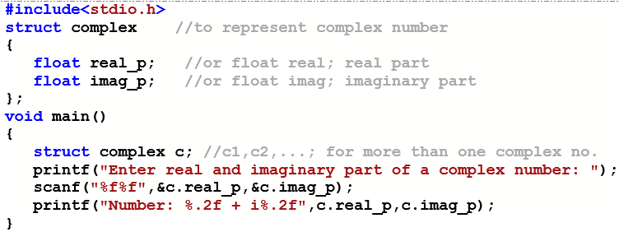
C program to read and print complex number using structure

Slide 12
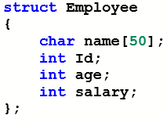
Exercise Question
C Program to read and print Employee details(Name, Id, Age and Salary)
using structure

Slide 13
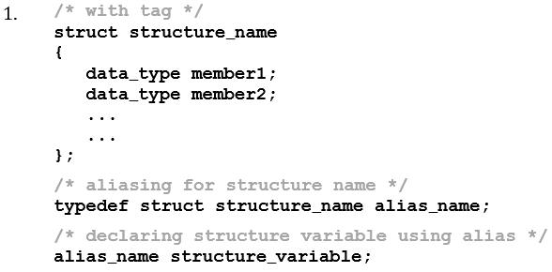
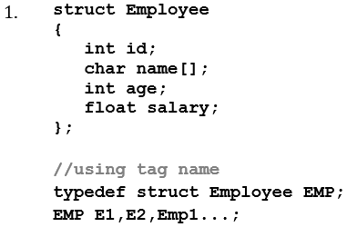
Type defined structure – typedef
In C programming language, typedef is also used with structures. We can define an alias to the structure (user defined data type) using typedef in C.

Slide 14
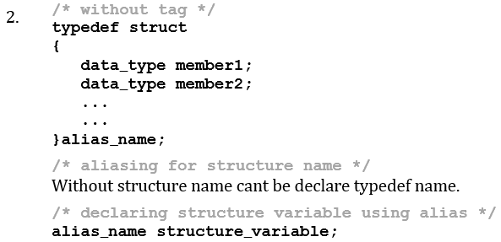
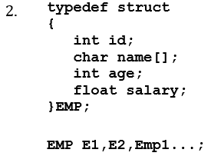

Slide 15
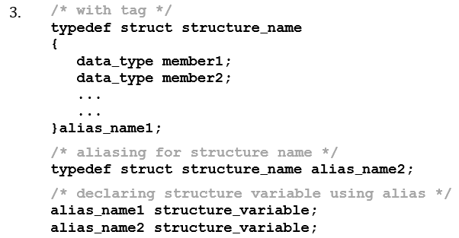
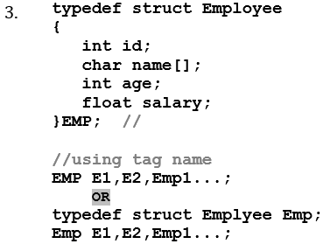

Slide 16
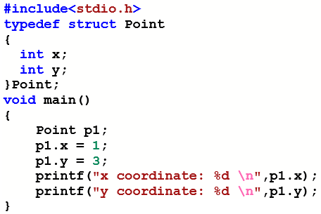
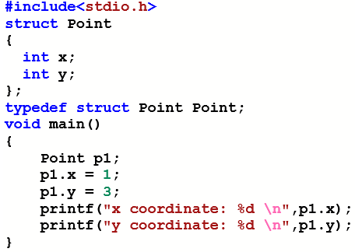

C program to read and print coordinates of a 2D-point on cartitian plane using structure

Slide 17
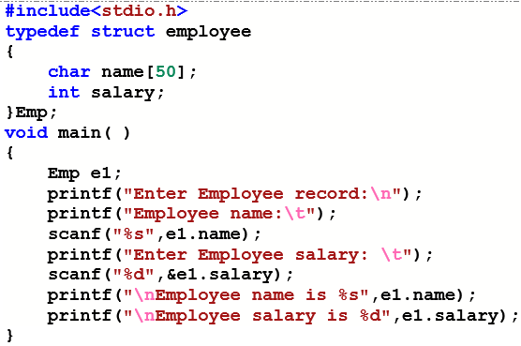
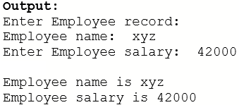
C program to read and print employee details(name and salary) using structure

Slide 18
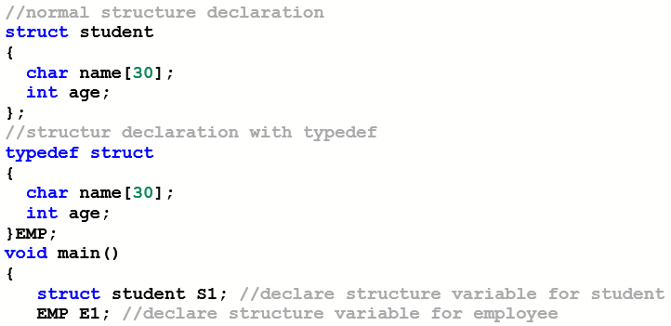
Comparison between Normal and typedef structure definition

Slide 19
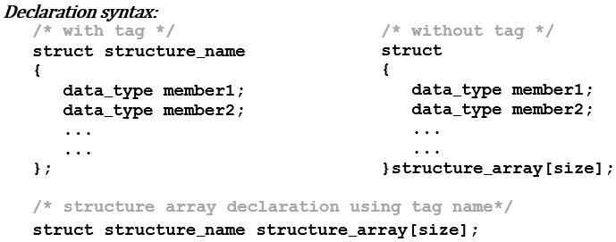
Array of structure
Structure variable represents a single record (of an entity) in memory,
if we want more than one record of structure type, we have to create an
array of structure variable.

Slide 20
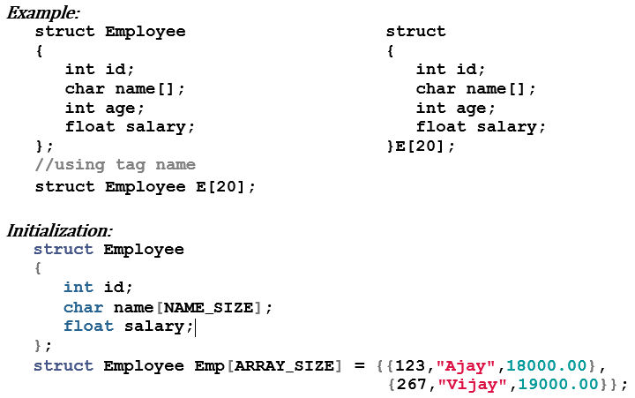
Array of structure

Slide 21
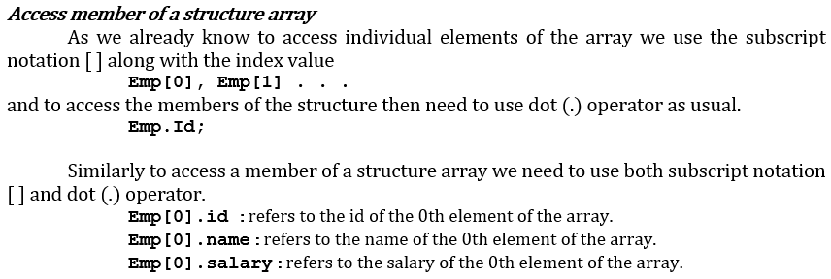
Array of structure

Slide 22
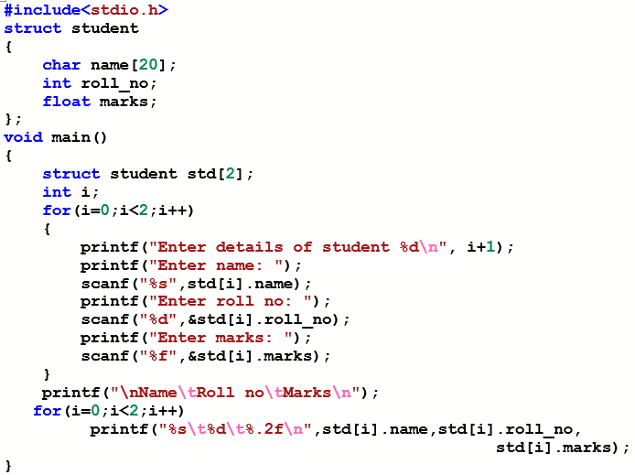
C program to read and print N students record

Slide 23
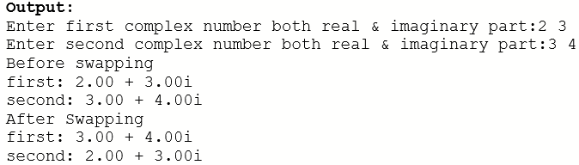
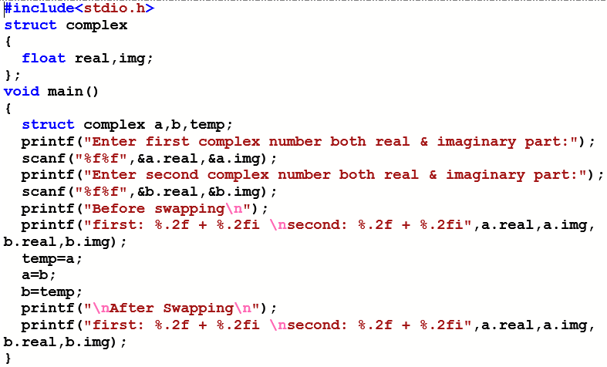
Operations on structure variable

Slide 24
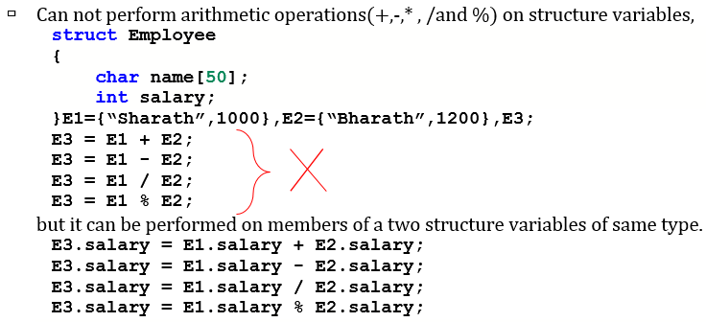
Operations on structure variable

Slide 25
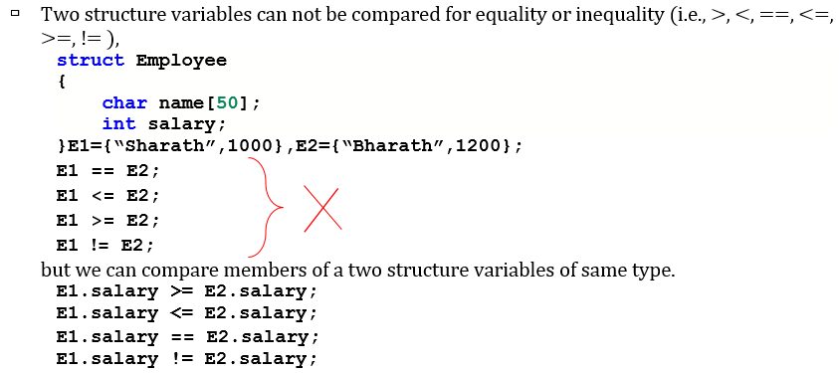
Operations on structure variable

Slide 26
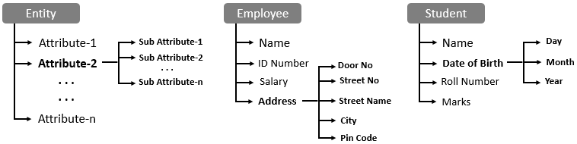
Nested structure
Nested structure in C is nothing but structure within structure(Like nested loop). It is used to group composite attributes of an entity. Example name is a composite attribute consist of First_Name, Middle_Name and Last_Name.

Slide 27
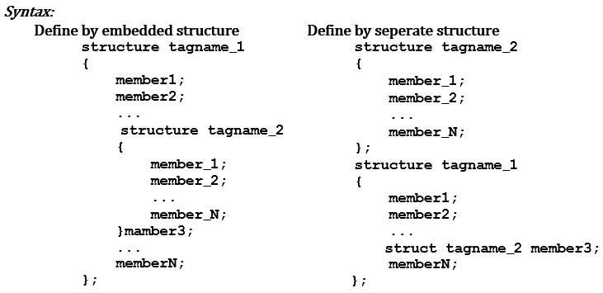
Nested Structure

Slide 28
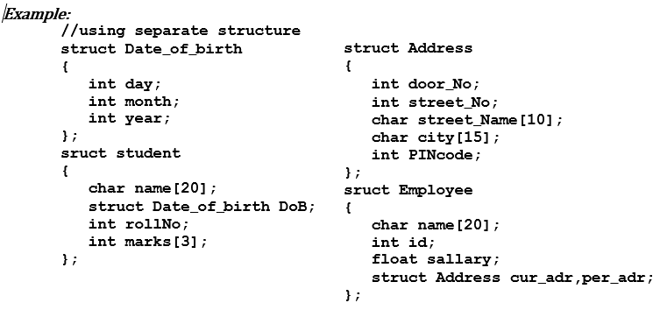
Nested Structure

Slide 29
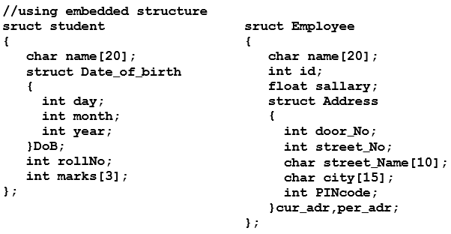
Nested Structure

Slide 30
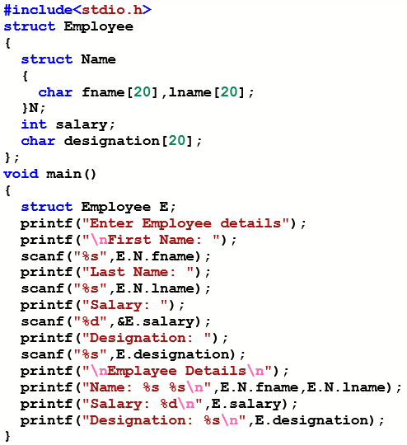
Example program for Nested structure

Slide 31
Exercise Question
Student and employee database
implementation using structures.

Slide 32


