Slide 1


C PROGRAMMING FOR PROBLEM SOLVING
(25EN1114)
UNIT-4: UNIONS

Slide 2
CONTENT
DEFINING A UNION
CREATING A UNION VARIABLE
ACCESSING UNION MEMEBERS
SIZE OF UNION
ACCESSING MEMBERS USING POINTERS
STRUCTURE V/S UNION

Slide 3
Introduction
A union is a special data type available in C that allows to store different data types in the same memory location.
You can define a union with many members , but only one member can contain a value at any given time.
Unions provide an efficient way of using the same memory location for multiple-purpose.

Slide 4
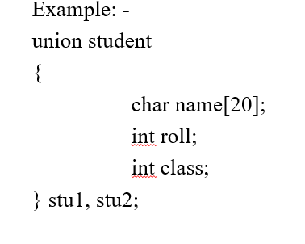
DEFINING A UNION
To define a union , you must use the union statement in the same way as you did while defining a structure.
The union statement defines a new data type with more than one member for your program.
The format of the union statement is as follows:
union [union _tag]
{
data_type variable_name;
data_type variable_name;
} union _variable1, ….., union _variable_n;

Slide 5
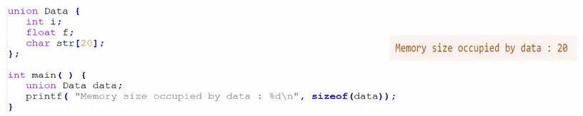
CREATING A UNION VARIABLE
When a union is defined, it creates a user-defined type. However, no memory is allocated.
To allocate memory for a given union type and work with it, we need to create variables.
The memory occupied by a union will be large enough to hold the largest member of the union.

Slide 6
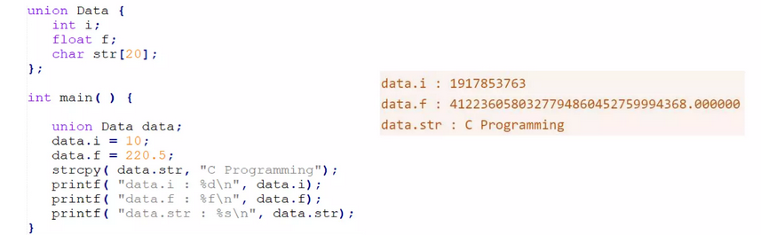
ACCESSING UNION MEMEBERS
To access any member of a union, we use the member access operator (.).
The member access operator is coded as a period between the union variable name and the union member that we wish to access.

Slide 7
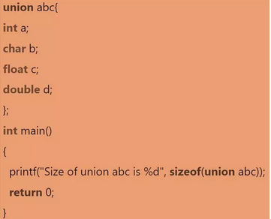
SIZE OF UNION
The size of the union is based on the size of the largest member of the union.
As we know, the size of int is 4 bytes, size of char is 1 byte, size of float is 4 bytes, and the size of double is 8 bytes.
Since the double variable occupies the largest memory among all the four variables, so total 8 bytes will be allocated in the memory.
Therefore, the output of the program would be 8 bytes.

Slide 8
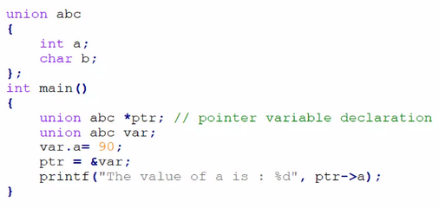
ACCESSING MEMBERS USING POINTERS
We can access the members of the union through pointers by using the (->) arrow operator.
In the above code, we have created a pointer variable i,e., *ptr, that stores the address of var variable.
Now, ptr can access the variable ‘a’ by using the (->) operator.
Hence the output of the above code would be 90.

Slide 9
STRUCTURE V/S UNION
STRUCTURE | UNION
You can use Struct keyword to define a structure | You can use Union keyword to define a structure
Every member within structure is assigned a unique memory location. | In union, a memory location is shared by all the data members.
Changing the value on one data member will not affect data members in structure. | Changing the value on one data member will change the value of other data members in union.
It enables you to initialize several members at once. | It enables you to initialize only the first member of union.
The total size of the structure is the sum of the size of every data member. | The total size of the union is the size of the largest data member.

Slide 10
MCQs
https://docs.google.com/forms/d/e/1FAIpQLScaTpixj_2p6_GTARw_sCjsp4LhLa6y77KsS51HS1ADfOL87A/viewform?usp=sharing
1. What is a union in C?
A data type that allows storing multiple values of different types at the same time
b) A data type that allows storing multiple values of different types but only one at a time
A data type that stores only integers
A data type used to define functions
2. What is the size of a union in C?
a) Sum of sizes of all members b) Size of the largest member c) Always 4 bytes d) Always 8 bytes

Slide 11
3. Which keyword is used to define a union in C?
a) struct b) union c) enum d) typedef
4. What happens when you assign values to two different members of a union?
Both values are stored separately
The last assigned value overwrites the previous one
The union generates an error
The compiler automatically expands the union size
5. Which of the following correctly declares a union in C?
a) union { int a; float b; } b) struct union { int a; float b; } c) union U { int a; float b; }; d) union U { int a float b; };

Slide 12
6. Can a union have a pointer as a member?
Yes
No
7. How do you access a union member?
a) Using . operator b) Using -> operator c) Using * operator d) Both a) and b)
8. What is the primary advantage of using a union over a structure?
a) More memory efficient b) Easier to declare c) Faster execution d) Stores multiple values at the same time
9. Can a union have functions as its members?
a) Yes b) No

Slide 13
10. What is the output of the following program?
#include <stdio.h>
union Data {
int i;
float f;
};
int main() {
union Data d;
d.i = 10;
printf("%d", d.i);
return 0;
}
11. Can we use sizeof() on a union?
a) Yes b) No

Slide 14
12. How many members of a union can be accessed at a time?
One
Two
All
None
13. Which of the following is NOT a correct way to define a union?
a) union X { int x; float y; }; b) typedef union { int x; char y; } U; c) union { int x; double y; } U; d) union X { int x char y; };
14. Can a union be nested inside another union?
a) Yes b) No
15. What is the difference between union and struct?
a) struct uses separate memory for each member, union shares memory b) union uses more memory than struct c) Both allocate memory equally d) struct allows only integers, union allows all types

Slide 15
16. Which of the following is a valid way to initialize a union?
union U u = {10};
union U u = {10, 20};
union U u = {10, "Hello"};
union U u = {"Hello"};
17. Which of the following statements about unions is TRUE?
a) All members share the same memory location b) Each member has its own separate memory c) You can store values in multiple members at the same time d) Unions can only store integer values
18. What happens if we try to print a union member that was not assigned a value?
a) It prints a garbage value b) It prints 0 c) It throws a runtime error d) It causes compilation failure

Slide 16
19. Can a union be passed as a function argument?
a) Yes b) No
20. What is the alignment requirement for a union?
a) The alignment of the smallest member b) The alignment of the largest member c) The sum of alignments of all members d) None

Slide 17
EXCERCISE
1)write a program to define a union named Data that can store an int, a float, and a char. Assign values to each member and print them.
2) Write a program to find out the memory size occupied by the following union.
4) Write a program to access a union using a pointer.
5) Write a program where a structure contains a union, allowing either an int or a char[] to be stored for an employee.
6) Write a program to compare the memory sizes of a union and a structure with identical members.
7. Use a union to represent a network packet that can either contain an IPv4 address

Slide 18
8)Write the output of the following code
#include <stdio.h>
union Example {
int x;
float y;
};
int main() {
union Example e;
e.x = 100;
printf(&quot;x = %d\n&quot;, e.x);
e.y = 5.5; // Overwrites `x`
printf(&quot;y = %f\n&quot;, e.y);
printf(&quot;x (after assigning y) = %d\n&quot;, e.x);
return 0;
}

Slide 19
THANK YOU

