Slide 1

Hacking Environment Web Application
Detailed Developer Report

Slide 2
Security status –Extremely Vulnerable
Hacker can steal all records in Internshala databases (SQLi)
Hacker can take control of complete server including View, Add, Edit, Delete files and folders (Shell Upload)
Hacker can change source code of application to host malware, phishing pages or even explicit content (Shell Upload)
Hacker can inject client side code into applications and trick users by changing how page looks to steal information or spoil the name of Internshala (XSS)
Hacker can execute any commands to extract information from website and deface it(admin panel access)
Hacker can easily view default and debug pages, can easily guess the default passwords and can exploit all the vulnerability related to the third party components used (Security misconfiguration)

Slide 3
Vulnerability statistics
Critical
11
Severe
8
High
3
Low
7

Slide 4
Vulnerabilities index
Serial number | Severity | Vulnerabilities | count
1 | Critical | SQL injections | 2
2 | Critical | Remote file inclusion | 1
3 | Critical | Admin panel access | 1
4 | Critical | Insecure file uploads | 1
5 | Critical | Seller account access | 1
6 | Critical | Default admin password | 1
7 | Critical | Components with known vulnerability | 3

Slide 5
Serial number | Severity | Vulnerabilities | count
8 | Critical | Customer account access | 1
9 | Severe | Forced browsing | 1
10 | Severe | C.S.R.F | 2
11 | Severe | Coupon code brute force | 1
12 | Severe | Insecure direct object ref. | 1
13 | Severe | Open redirection | 1
14 | Severe | Cross site scripting | 2
15 | High | Client side filter bypass | 1
16 | High | Directory listing | 1
17 | High | PII Leakage | 1
18 | Low | Default debug pages | 5
19 | Low | Descriptive error messages | 2

Slide 6
S.Q.L. Injections
SQL | The bellow mentioned url is vulnerable to sql injections Affacted url http://13.234.20.74/products.php?cat=(here) http://13.234.20.74/search/search.php?q= (here) Affacted parameters cat q Payload cat=2’ q=adidas’

Slide 7
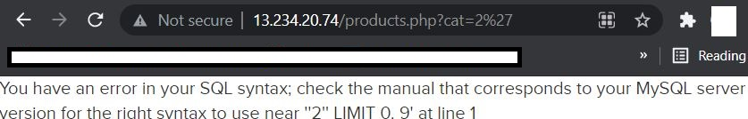
Observations
At home page click on any 1 category.
Notice the get category of cat and add ‘ and then observe the error.

Slide 8
Observations
When we write http://13.234.20.74/products .php?cat=2’ --+ the error would be removed
That confirms the sql injection

Slide 9
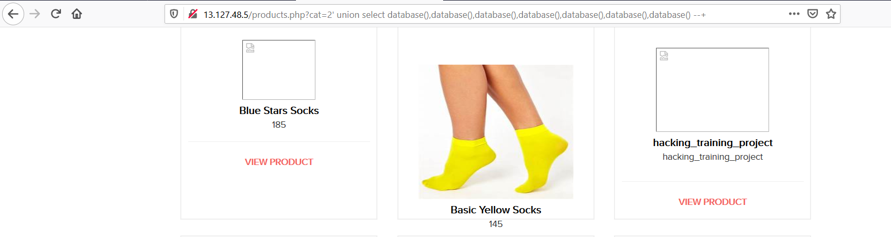
Proof of concept
Attacker can execute the sql commands as shown below and access confidential data.
Here we had extracted name of database.

Slide 10
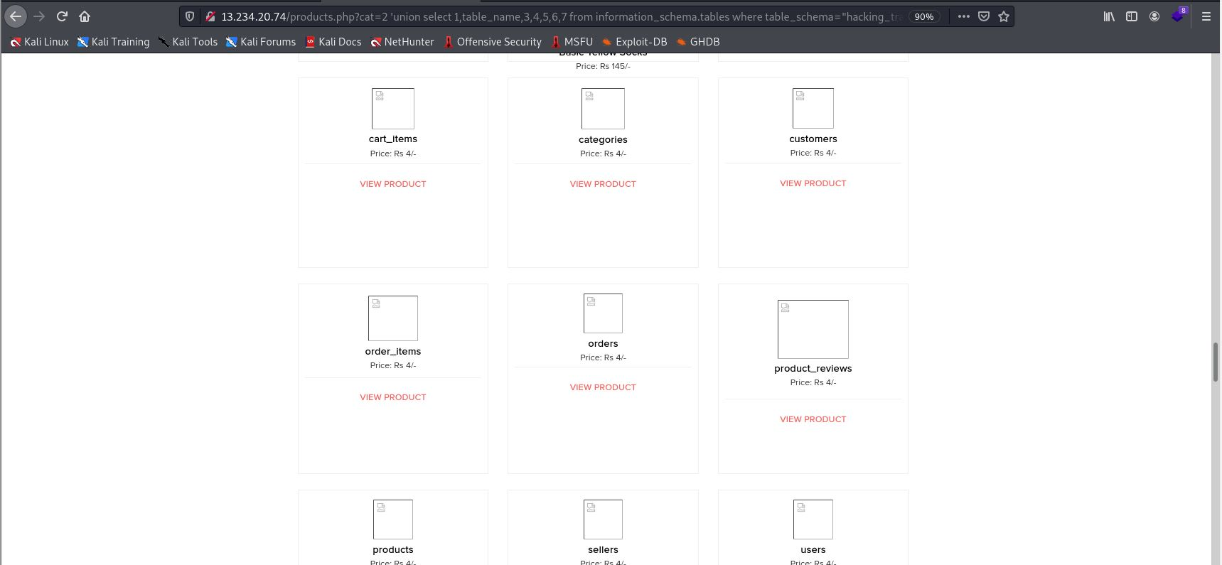
Business impact- Extremely High
Using this vulnerability, attacker can execute arbitrary SQL commands on Lifestyle store server and gain complete access to internal databases along with all customer data inside it.

Slide 11
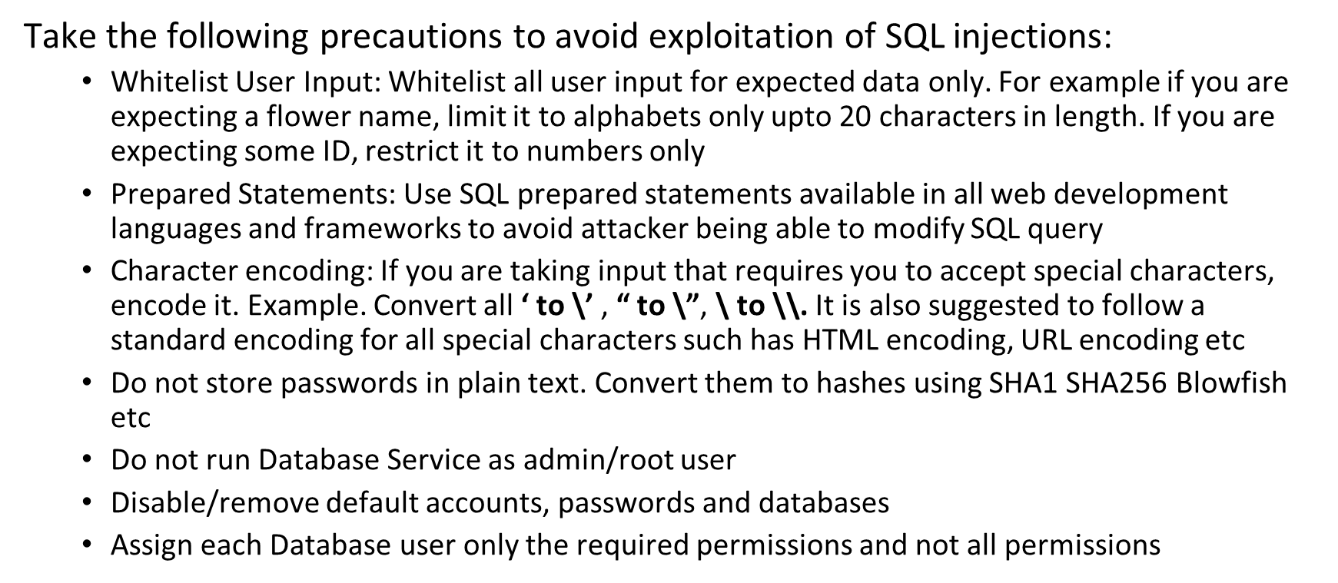
Recommendations

Slide 12
References
https://www.owasp.org/index.php/SQL_Injection
https://en.wikipedia.org/wiki/SQL_injection

Slide 13
2.Remote File inclusion
RFI | Below mentioned url is vulnerable to RFI Affected url http://13.234.20.74/?includelang=(here) Payload ../../../../../../../etc/passwd https://google.co.in

Slide 14
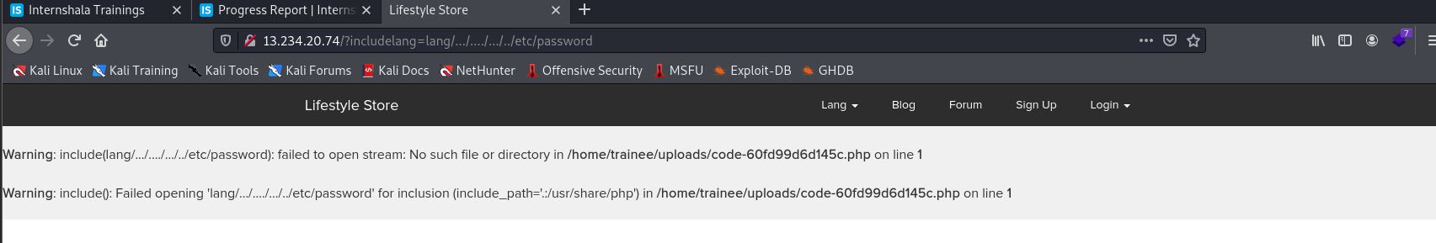
Observations
When you click on change language you get a ‘get’ parameter of includelang which is vulnerable for file inclusion.
Here we have tested Local file inclusion to execute a file which gives us user name

Slide 15
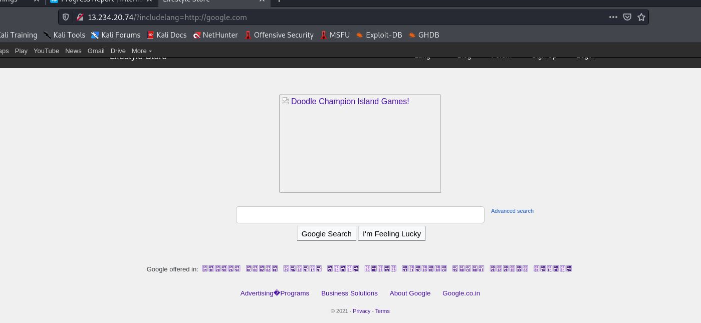
POC-attacker can upload shells
Attacker can exploit the referencing function in an application to upload malware (e.g., backdoor shells) from a remote URL located within a different domain.

Slide 16
Business impact- Extremely high
Any attacker can have the root access of of your website
He can execute commands
Through the website he can have access of the server and can infect other websites hosted on that server
He can even deface your websites

Slide 17
Recommendations
To safely parse user-supplied filenames it’s much better to maintain a whitelist of acceptable filenames and use a corresponding identifier (not the actual name) to access the file. Any request containing an invalid identifier can then simply be rejected. This is the approach that OWASP recommends.

Slide 18
References
https://www.pivotpointsecurity.com/blog/file-inclusion-vulnerabilities/
https://www.netsparker.com/blog/web-security/local-file-inclusion-vulnerability/
https://en.wikipedia.org/wiki/File_inclusion_vulnerability

Slide 19
3.Admin panel access
Admin panel access | Admin panel of this website can easily be taken over by brute forcing O.T.P. Affected url http://13.234.20.74/reset_password/admin.php Payload 001-999 digits

Slide 20
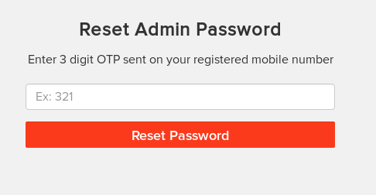
Observation
In the admin login section there is a reset admin option which only needs a 3-digit otp

Slide 21
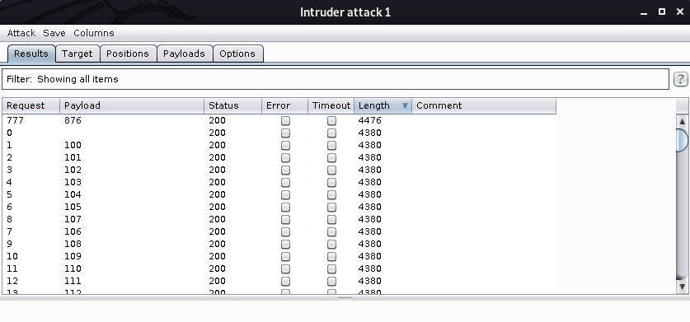
POC-Easy access to admin panel
By using burp suite we can easily bruteforce the otp

Slide 22
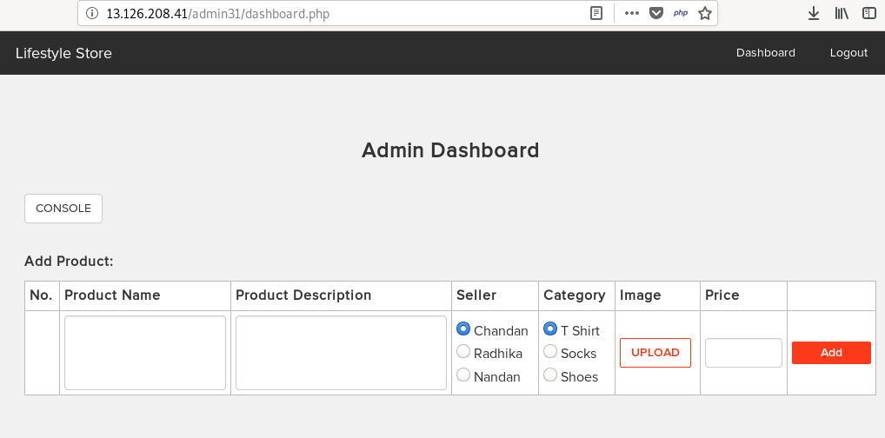
POC
Here is the admin dashboard:-

Slide 23
Business impact-extremely high
He can change the rates of items selling on the web sites
He can add and delete the items
He can change the seller and catagories
He can execute commands on the server through console options, which can be further used to harm your website

Slide 24
Recommendations
The first is to implement an account lockout policy. For example, after three failed login attempts, the account is locked out until an administrator unlocks it.
Tools such as the free reCAPTCHA can be used to require the user to enter a word or solve a simple math problem to ensure the user is, in fact, a person.
Admin login page should be hidden very securely
The otp should be alpha numeric and at least of 6-letters and digits.

Slide 25
Refernces
https://www.computerweekly.com/answer/Techniques-for-preventing-a-brute-force-login-attack
https://owasp.org/www-community/controls/Blocking_Brute_Force_Attacks

Slide 26
4.Insecure file uploads
Insecure file uploads | The url given below is vulnerable to insecure file uploads Affected url http://13.233.212.95//wondercms/ Uploaded file backdoor shell

Slide 27
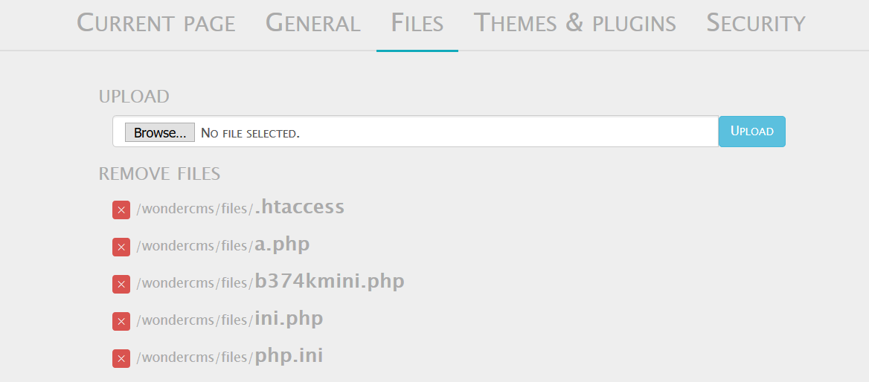
Observations
In the blog page of website there is a upload option in the settings

Slide 28
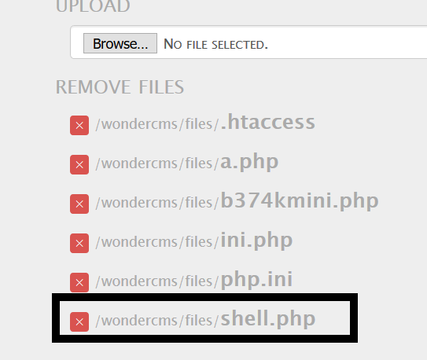
Observations
I tried uploading a shell and I was successful

Slide 29
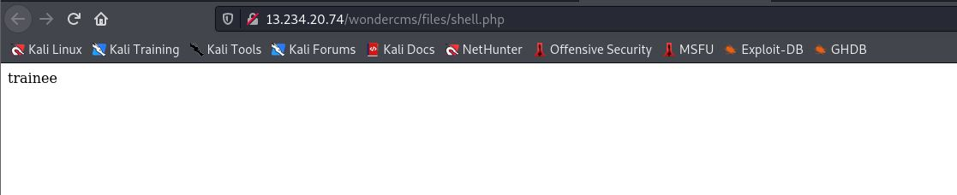
POC-Any command can be executed
The shell I uploaded was executed successfully

Slide 30
Business impact-Extremely high
The consequences of unrestricted file upload can vary:-
including complete system takeover, an overloaded file system or database.
forwarding attacks to back-end systems
client-side attacks, or simple defacement.
It depends on what the application does with the uploaded file and especially where it is stored.

Slide 31
Recommendations
The file types allowed to be uploaded should be restricted to only those that are necessary for business functionality.
Never accept a filename and its extension directly without having a whitelist filter.
All the control characters and Unicode andthe special characters should be discarded

Slide 32
References
IIS 6.0 Security Best Practices[http://technet.microsoft.com/en-us/library/cc782762(WS.10).aspx]
Securing Sites with Web Site Permissions[http://technet.microsoft.com/en-us/library/cc756133(WS.10).aspx]
IIS 6.0 Operations Guide[http://technet.microsoft.com/en-us/library/cc785089(WS.10).aspx]
https://owasp.org/www-community/vulnerabilities/Unrestricted_File_Upload

Slide 33
Server misconfigurations
Default debug files
Weak/default passwords
Components with known vulnerability

Slide 34
5.Seller account access
Seller account access | The default page given below shows the seller accounts and passwords Affected url http://13.233.212.95/userlist.txt

Slide 35
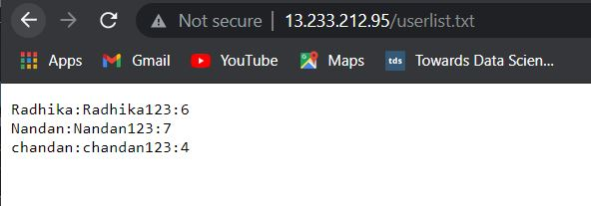
Observations
At the homepage after adding userlist.txt the following page is opened

Slide 36
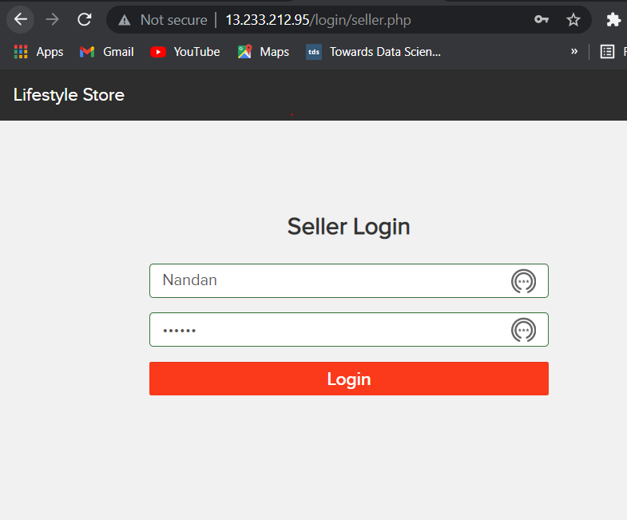
POC-attacker has the seller dashboard acess
On entering the credentials in the seller account login we have accessed the dashboard

Slide 37
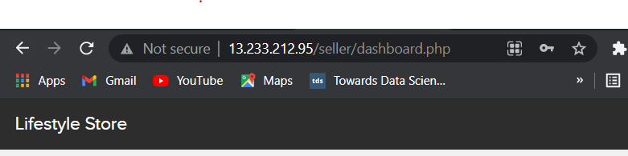
POC

Slide 38
Bussiness impact-Extremely high
Attacker can access the seller dashboard and then can edit the items he is selling

Slide 39
Recommendations
The developer should disable these confidential default pages

Slide 40
References
https://www.indusface.com/blog/owasp-security-misconfiguration/
https://hdivsecurity.com/owasp-security-misconfiguration

Slide 41
6.Default admin password
Default admin password | The url given below is using the default admin credentials Affected url http://52.66.65.223/ovidentiaCMS/index.php?tg=login&cmd=authform&msg=Connexion&err=&restricted=1 Component name ovidentia content management system

Slide 42
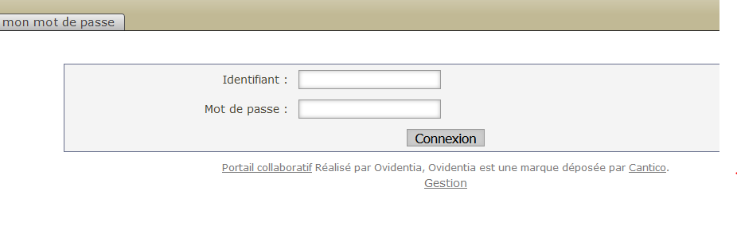
Observations
In the ovidentia cms page there is option to login as admin
On clicking it we saw this page

Slide 43
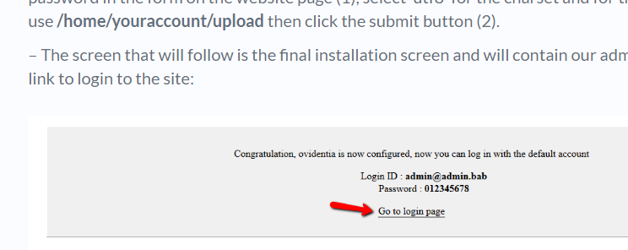
POC-ovidentia admin access
In searching for default ovidentia admin credentials we get

Slide 44
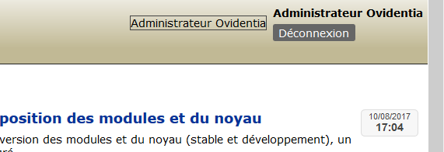
POC
We got the admin access

Slide 45
Business impact- Extremely high
Attacker will have all the admin privileges
He can easily deface the ovidentia CMS

Slide 46
Recommendations
Disable the default debug pages
Hide the admin login page
Disable the default passwords and use a strong username and password

Slide 47
References
https://www.indusface.com/blog/owasp-security-misconfiguration/
https://hdivsecurity.com/owasp-security-misconfiguration

Slide 48
7.Components with known vulnerability
Components with known vulnerability | The urls given below are of the components with known vulnerability Affected url http://52.66.65.223/wondercms/ http://52.66.65.223/forum/ And PHP

Slide 49
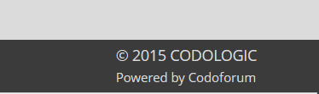

Observations
I checked the versions of these components they were out dated

Slide 50
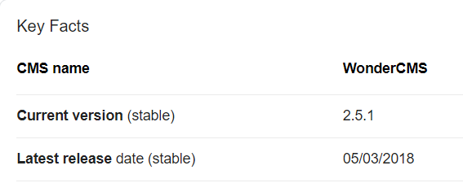

Observations
In 2015 version of codoforum was 3.0

Slide 51
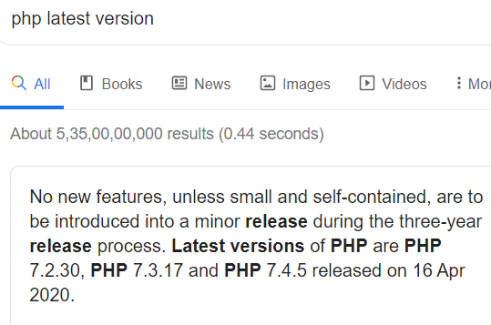
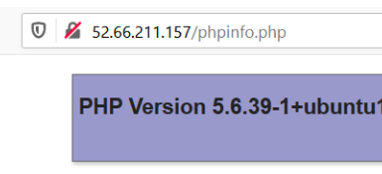
Observations
The php version of this website is 5.6.39-1 which is out dated

Slide 52
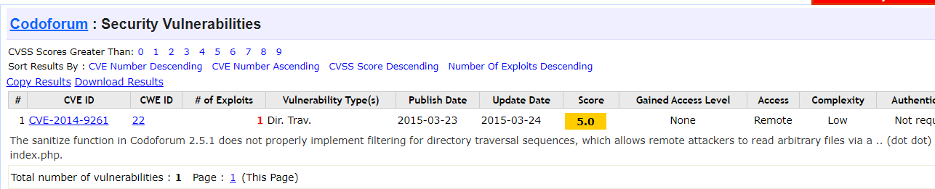
POC
Both the components have known public exploits

Slide 53
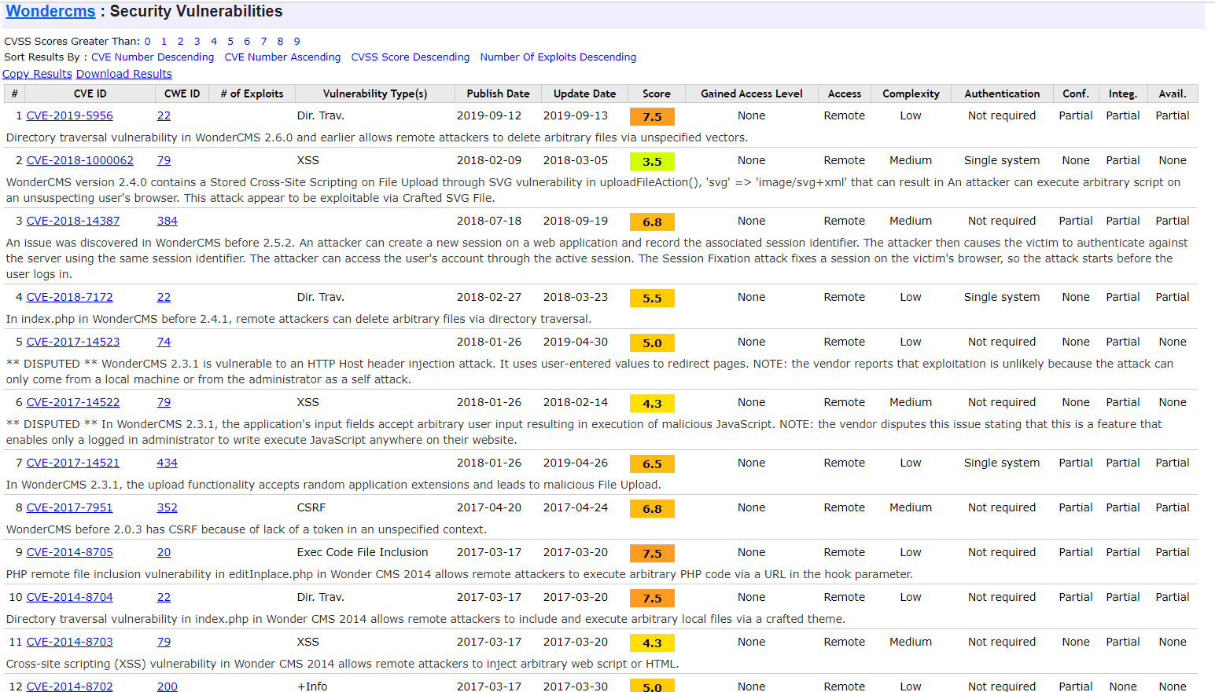
POC

Slide 54
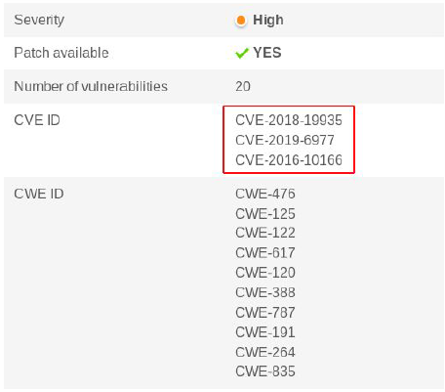
POC
The running php version has multiple vulnerabilities

Slide 55
Business impact- Extremely high
Anyone can perform any attacks (available) as all the exploits are available publicly .
It can cause severe damage to the website
He may be able to upload backdoor shells
He will easily deface your website

Slide 56
Recommendations
Update all the components and the php version which is running on it
Hide the current versions info from there pages

Slide 57
References
https://owasp.org/www-project-top-ten/OWASP_Top_Ten_2017/Top_10-2017_A9-Using_Components_with_Known_Vulnerabilities

Slide 58
8.Customer account access
Customer account access | The url given bellow contains the is giving a descriptive error whith change password option Affected url http://52.66.65.223/reset_password/customer.php?username=Donal234 User names Donal234 Pluto98 Popeye786

Slide 59
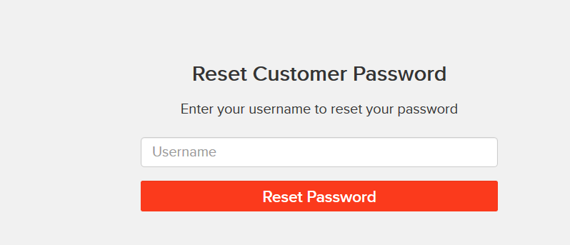
Observations
In the forgot password option only username is required to change password

Slide 60
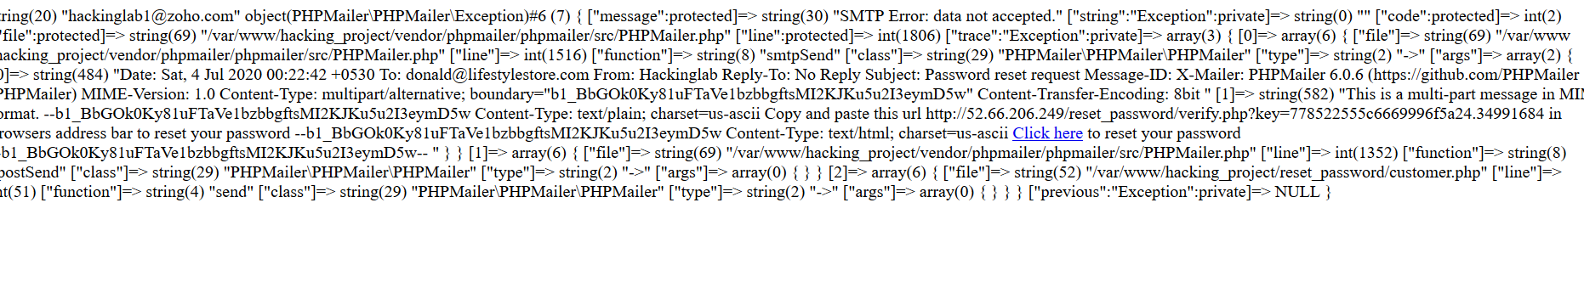
Observations
On entering the username it gives the change password link on email which can be edited by burp suite

Slide 61
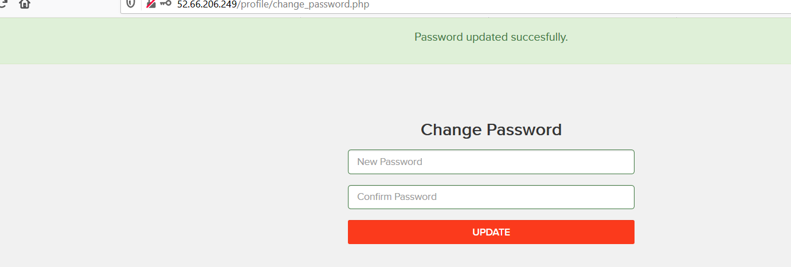
POC
After entering another email address password can be changed easily

Slide 62
Business impact –extremely high
Attacker can get the customer account access
Then he can make changes on it like changing the personnel details , cancel the orders , etc
This will reduce your organisations reputation

Slide 63
Recommendations
You should include the otp option and make it compulsory
Security checks on the server side should be done completely
Captcha option should also be included

Slide 64
9.Forced browsing
Forced browsing | The below mentioned url is vulnerable toforced browsing Affected url http://52.66.65.223/ Forced url http://52.66.65.223/admin31/dashboard.php

Slide 65
observations
When I tried to go in admin dashboard without logging in I was successful

Slide 66
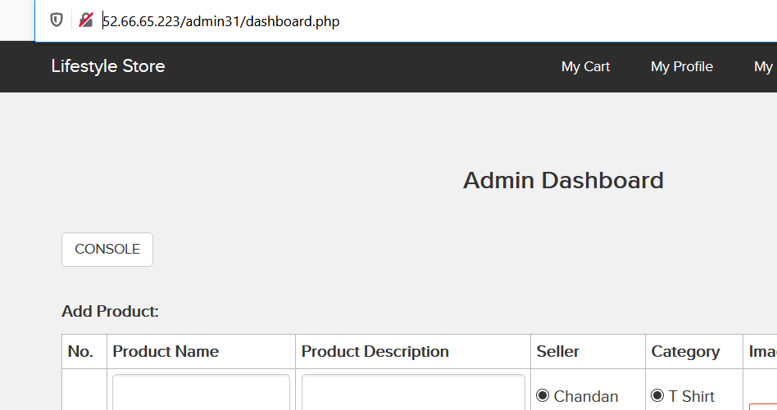
POC-admin dashboard access
Here is the admin dashboard just by entering its complete url

Slide 67
Business impact- severe
Attacker can have all the admin privileges
He can edit all the items
He can execute any harmful command through console

Slide 68
Recommendations
Server side security checks should be performed perfectly
Make the admin page url complicated so that it couldn’t be guessed

Slide 69
References
https://owasp.org/www-community/attacks/Forced_browsing
https://campus.barracuda.com/product/webapplicationfirewall/doc/42049348/forced-browsing-attack/

Slide 70
10.C.S.R.F.
CSRF | The url given below is vulnerable to CSRF Affected url http://52.66.65.223/profile/change_password.php http://52.66.65.223/cart/cart.php

Slide 71
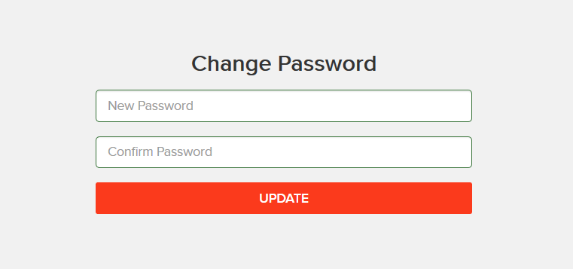
observations
There is a change password option in profile page

Slide 72
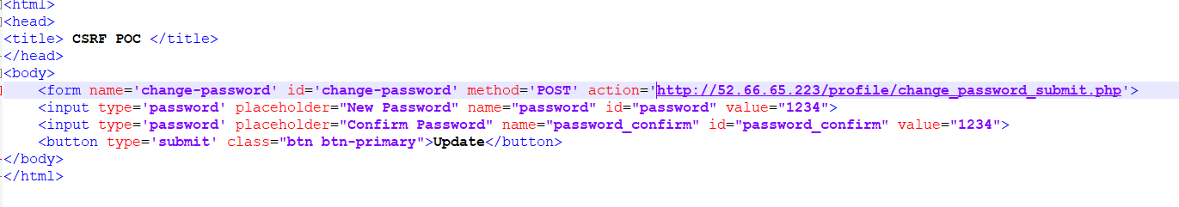
POC
Make a html page to change username and password

Slide 73
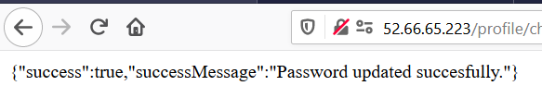
POC
On clicking the update button we get success

Slide 74
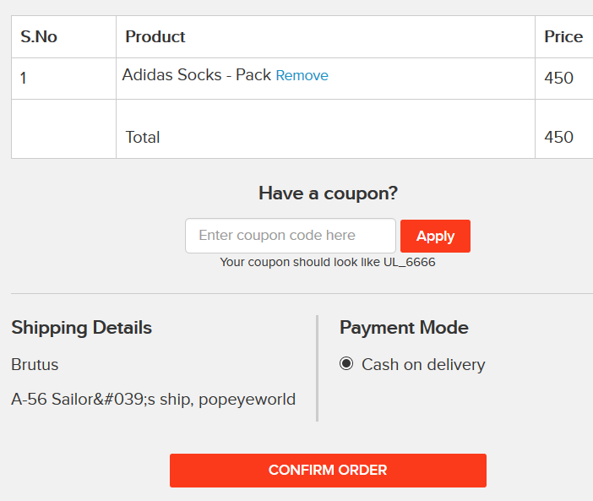
Observations
There is a confirm button in my orders

Slide 75
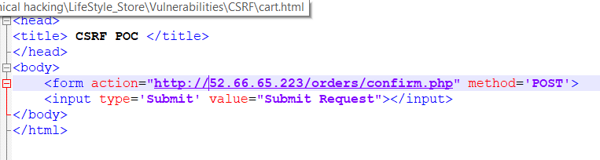
POC
Make a html page to confirm order

Slide 76
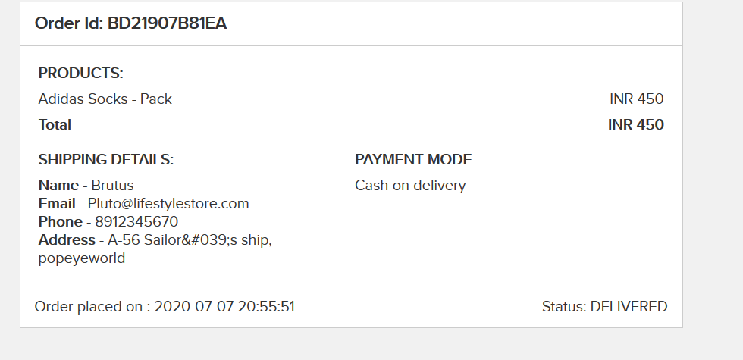
POC
On executing the page order is confirmed

Slide 77
Business impact- severe
Attacker can change the password by uploading phishing pages
Attacker can confirm the order without consent of user

Slide 78
Recommendations
Use of tokens and session cookies
Referrer header should be checked at server side

Slide 79
References
https://owasp.org/www-community/attacks/csrf
https://www.netsparker.com/blog/web-security/csrf-cross-site-request-forgery/

Slide 80
11.Coupon code brute forcing
Coupon code brute forcing | In the below url brute forcing can be performed for discounts Affected url http://13.127.179.208/cart/apply_coupon.php

Slide 81
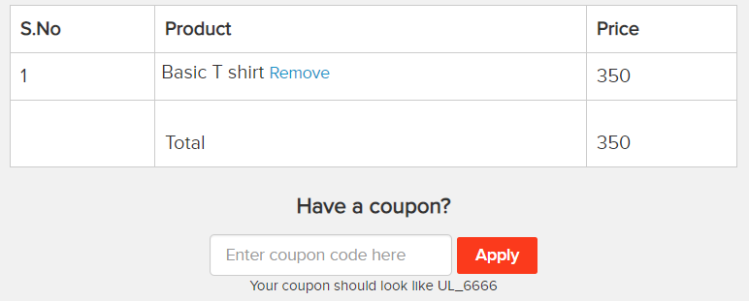
Observations
When we go to the cart we see the apply coupon and coupon example

Slide 82
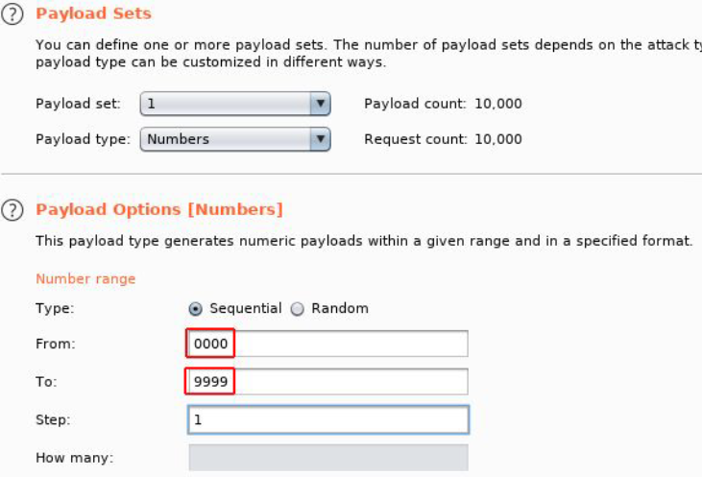
Observations
Brute forcing the coupon code

Slide 83
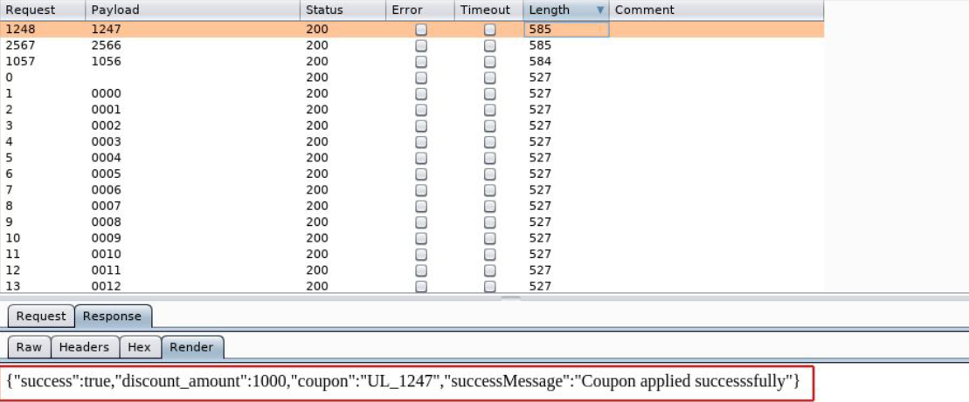
POC
We were sucessful

Slide 84
Business impact - severe
Attacker can easily order the items on extreme discounts which will be harmful for the company

Slide 85
Recommendation
Coupon codes should have limited no of use and regenerated after sometime
Coupon code should be random alpha-numeric characters

Slide 86
References
https://www.digitalcommerce360.com/2017/03/17/prevent-fraud-brute-force-online-coupon-gift-card-attacks/
https://www.couponxoo.com/brute-force-attack-coupon-code

Slide 87
12.Insecure direct object references
Insecure direct object references | The bellow mentioned url is vulnerable to IDOR Affected url http://15.206.28.239/orders/orders.php?customer=(here) Payload 0-50

Slide 88

Observations
In the my orders page I saw customer no in url

Slide 89
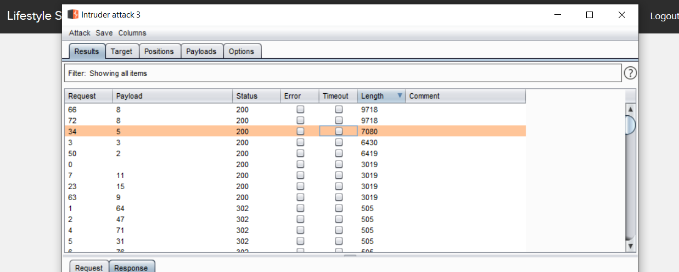
Observations
I brute forced it

Slide 90
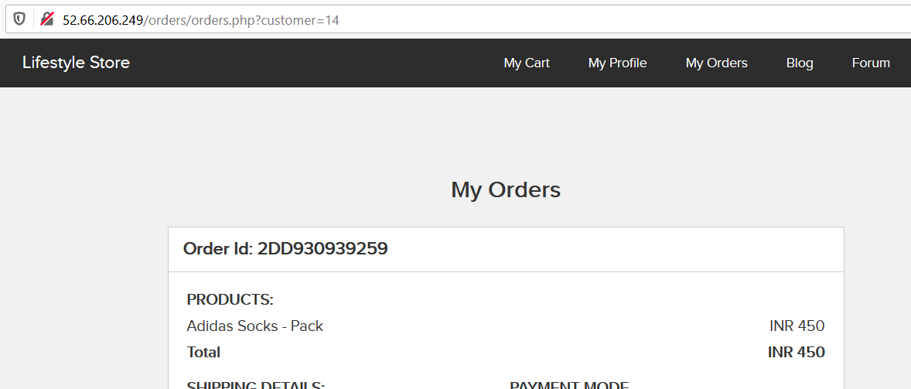
POC
I got other customers and their order details

Slide 91
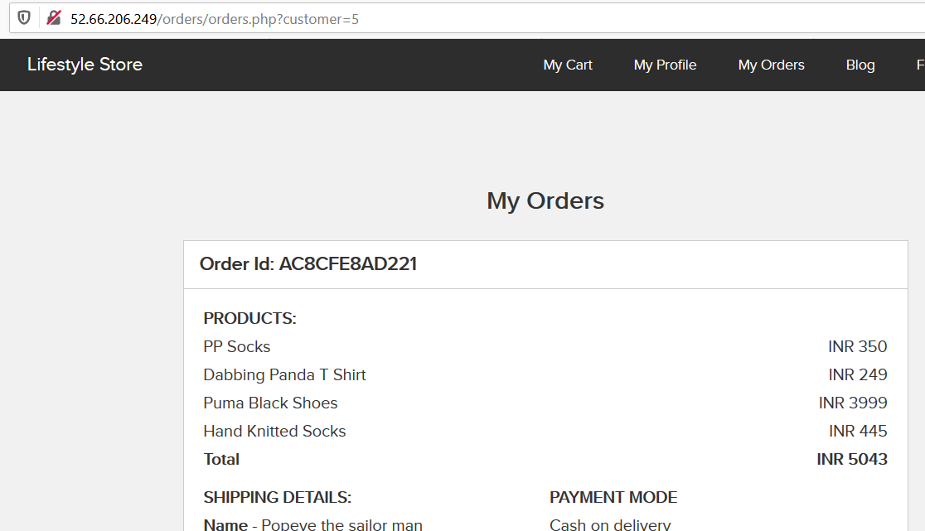
POC

Slide 92
Recomendations
Instead of requiring the references in the URL, use the information already present in the user’s session on the server to locate the resources to serve.
If it is not possible to avoid exposing the references to objects in the URL, as explained earlier, the indirect reference map technique is helpful. The idea behind it is to substitute the sensitive direct internal reference in URL parameters or form fields with a random value that is difficult to predict (such as a GUID) or specific only to the logged-in user

Slide 93
References
https://www.oreilly.com/library/view/securing-node-applications/9781491982426/ch04.html
https://cheatsheetseries.owasp.org/cheatsheets/Insecure_Direct_Object_Reference_Prevention_Cheat_Sheet.html

Slide 94
13.Open redirection
Open redirection | The url given below Is vulnerable to open redirection Affected url http://13.127.179.208/redirect.php?url=(www.radhikafancystore.com) in the parentheses

Slide 95
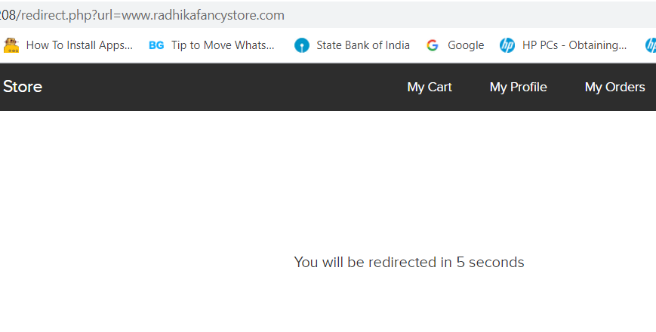
Observations
On clicking the brand website redirection occurs

Slide 96
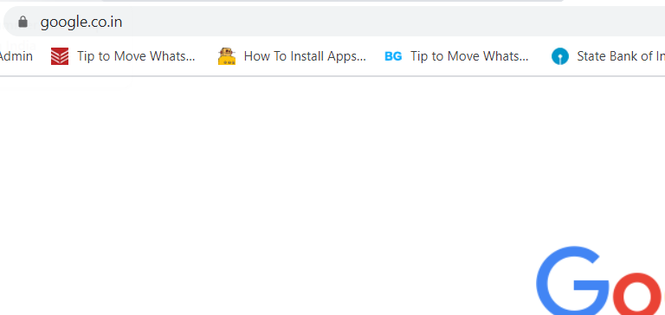
POC
On changing the link to google.co.in we were redirected to it

Slide 97
Business impact- severe
He can access the users personnel credentials which would be very harmful
They can redirect your page to a malware site
They can redirect you to phishing pages

Slide 98
Recommendations
Design your app to avoid URL redirects or forwards as a best practice. If unavoidable, encrypt the target URL such that the URL:token mapping is validated on the server.
Verify URL patterns using regular expressions to check if they belong to valid URLs. However, malicious URLs can pass that check.
Check your Referrers

Slide 99
References
https://spanning.com/blog/open-redirection-vulnerability-web-based-application-security-part-1/#:~:text=Understanding%20the%20Unvalidated%20Redirects%20Vulnerability&text=However%2C%20it%20can%20be%20misused,data%20and%20credibility%20into%20jeopardy.
https://www.netsparker.com/blog/web-security/open-redirection-vulnerability-information-prevention/

Slide 100
14.Cross site scripting
Cross site scripting | The below mentioned urls are vulnerable to temporary and stored XSS Affected urls Temporary -http://13.127.179.208/search/search.php?q=(here) Stored- http://13.127.179.208/products/details.php?p_id=(all id)

Slide 101
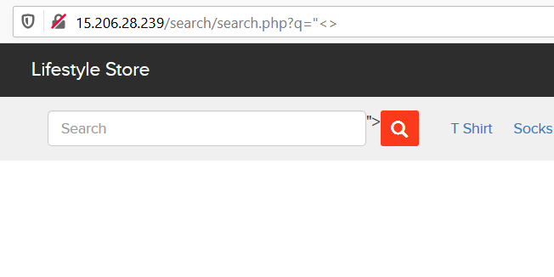
Observations
In the search bar when I entered “<> I found this

Slide 102
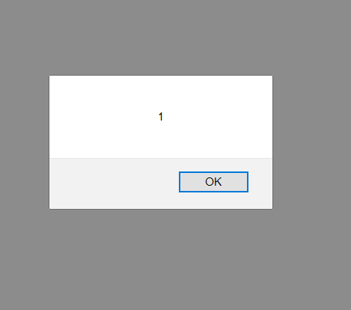

POC
When I entered the script popup code it was executed

Slide 103
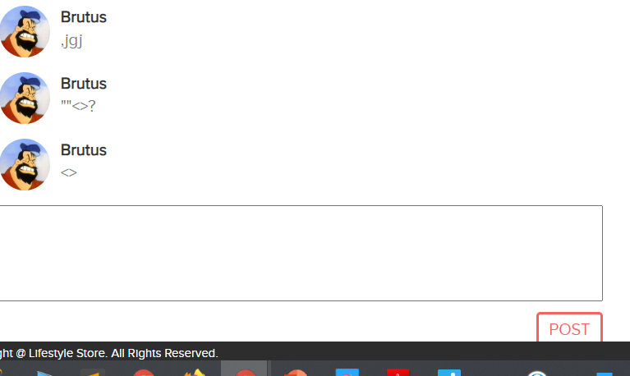
Observations
In the comment section of every product items the comment was stored

Slide 104
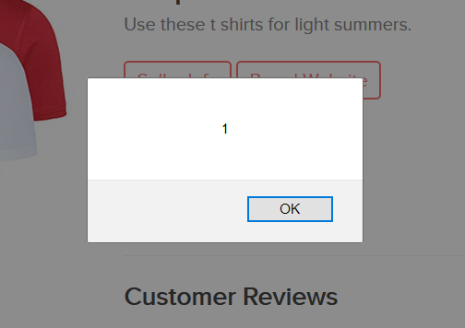
POC
When I entered the script pop up code it was executed and stored

Slide 105
Business impact- severe
Hacker can access any user credentials by injecting malicious scripts
He can even change the html format of website

Slide 106
Recommendations
By escaping user input. Escaping data means taking the data an application has received and ensuring it’s secure before rendering it for the end user
Validating input is the process of ensuring an application is rendering the correct data and preventing malicious data from doing harm to the site, database, and users
A third way to prevent cross-site scripting attacks is to sanitize user input. Sanitizing data is a strong defense, but should not be used alone to battle XSS attacks

Slide 107
References
https://www.checkmarx.com/2017/10/09/3-ways-prevent-xss/
https://cheatsheetseries.owasp.org/cheatsheets/Cross_Site_Scripting_Prevention_Cheat_Sheet.html
https://owasp.org/www-community/attacks/xss/

Slide 108
15.Client side filter bypass
Client side filter bypass | The url given below is vulnerable to client side filter bypass Afected url http://13.127.179.208/profile/3/edit/

Slide 109
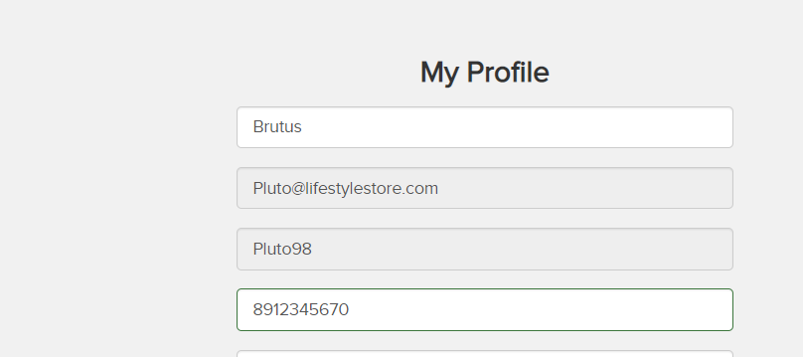
Observations
After changing the information I was able to change it again via client side filter bypass

Slide 110
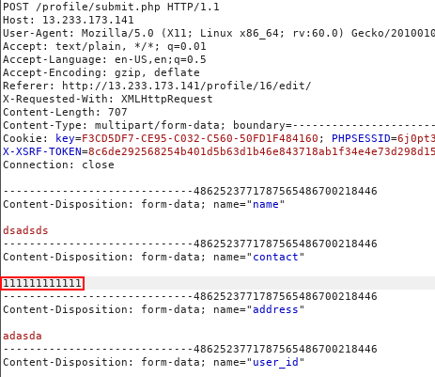
POC

Slide 111
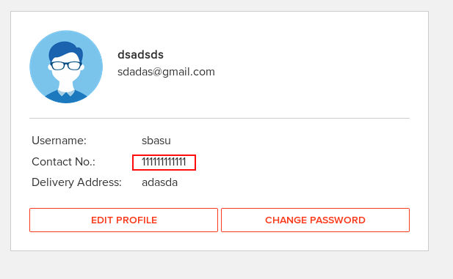
POC
Original info was changed

Slide 112
Business impact-high
This would only trouble the users which will be giving bad feed back on you website

Slide 113
Recommendations
Cookies should be used .
Referrer headers should be used
Proper security checks should be done

Slide 114
References
https://portswigger.net/support/using-burp-to-bypass-client-side-javascript-validation
https://www.slideshare.net/SamBowne/cnit-129s-ch-5-bypassing-clientside-controls

Slide 115
16.Directory listing
Directory listing | The url given below is listing the directories Affected url http://13.127.179.208/static/images/

Slide 116

Observations
In robots.txt file I found static/images/

Slide 117

POC
Listed directories

Slide 118
Business impact-high
These directories will be useful for the attacker to collect information about the website
To plan a attack

Slide 119
Recommendations
Disable these listed directories

Slide 120
References
https://www.acunetix.com/blog/articles/directory-listing-information-disclosure/

Slide 121
17.Personnel identifiable information- leakage
Personnel identifiable information | The url given below has PII-leakage Affected url http://13.127.179.208/products/details.php?p_id=(all)

Slide 122

Observations
In every product pages the seller info option is available

Slide 123

POC
Pan card details are also shown

Slide 124
Business impact - high
Providing the Seller information may uninterest people to buy the item
It may also cause social engineering attacks on seller

Slide 125
Recommendations
Remove the pan card details
Only show required information about anyone

Slide 126
References
https://www.imperva.com/learn/data-security/personally-identifiable-information-pii/
https://hackerone.com/reports/374007

Slide 127
18.Default and debug files
Default and debug files | Below mentione url has many default and debug files Affected url http://13.127.179.208/ Default pages robots.txt server-status phpinfo.php composer.json userlist.txt

Slide 128

POC

Slide 129

POC

Slide 130

POC

Slide 131

POC

Slide 132

POC

Slide 133
Business impact - low
It does not impact the website directly
It only helps hacker to collect information

Slide 134
Recommendations
Disable all these default pages

Slide 135
References
https://www.indusface.com/blog/owasp-security-misconfiguration/
https://hdivsecurity.com/owasp-security-misconfiguration

Slide 136
19.Descriptive error messages
Descriptive error messages | Below mentioned url shows Descriptive error messages Affected url http://52.66.211.157/forum/admin/index.php?page=login http://52.66.206.249/?includelang=lang?’

Slide 137

POC

Slide 138

POC

Slide 139
Business impact-low
It doesn’t harm the website directly
But it is letting the hacker to know about the website architecture

Slide 140
Recommendations
Block these kind of error pages to show up
Only show simple error pages

Slide 141
References
https://owasp.org/www-community/Improper_Error_Handling#:~:text=Description,to%20the%20user%20(hacker).
https://cwe.mitre.org/data/definitions/209.html

Slide 142
Thank you
For further classification / patch assistance contact -8956126440

