Slide 1


Prometheus Grafana

Slide 2
Observability
Observability refers to the ability to monitor, measure, and understand the state of a system or application by examining its outputs, logs, and performance metrics.
As Observability becomes increasingly important for ensuring the reliability and performance of cloud-native applications, there is a greater focus on Observability in the DevOps process. This includes the integration of observability tools into the DevOps toolchain, as well as the use of Observability data to drive continuous improvement in application performance and reliability.

Slide 3
The Three Pillars of Observability
Observability focuses on three types of telemetry data, that are widely known as the 'three pillars of observability’.
Logs
Logs (or log messages) indicates that something has occurred in the application at a specific time, such as an error occurred, a query that took too long, or a database has started.
Metrics
Metrics are numeric values that indicate the behaviour and characteristic of a system.
Traces
Traces outline the activity of the requests and the path they take through an application. They can show a trace for a single operation or a distributed trace of an entire transaction across multiple services.

Slide 4
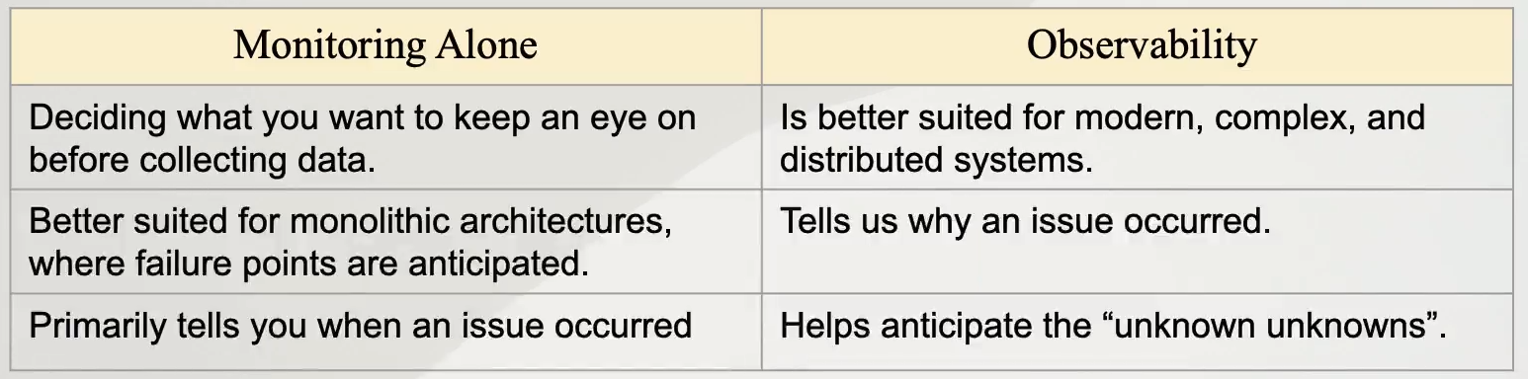
Monitoring VS Observability

Slide 5
Monitoring With Prometheus
Prometheus is an open-source technology designed to provide monitoring and alerting functionality for cloud-native environments, including Kubernetes. It can collect and store metrics as time-series data, recording information with a timestamp.
The series that maps a timestamp to recorded data is called a timeseries
It is a pull time series database. We can never push metrics to it.
Monitoring is collecting and visualising data about systems regularly so as to track the system’s health. It’s a part of observability.

Slide 6
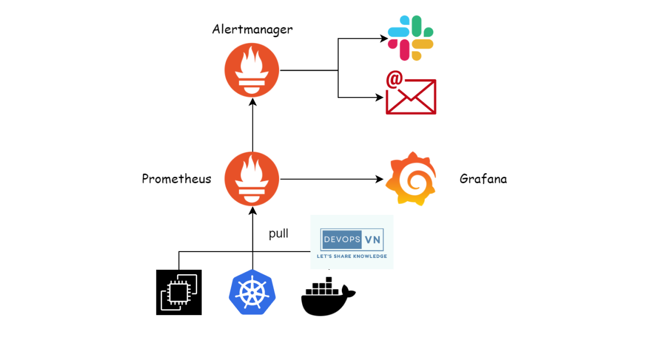
Working of Prometheus

Slide 7
Components of Prometheus
Prometheus Server
Client libraries
Push Gateway
Exporters
Alert Manager

Slide 8
Data Model
The data in Prometheus is stored as time series data, i.e. the data contains a metric attached to a time stamp.
Format: <metric_name> {key1=value1, key2=value2, … }
Here, the key value pairs are the labels associated with the metric.
e.g. → cpu_usage {cpu=20, route=“/home”}

Slide 9
Data Types
Scalar Data Type
Float
String
Instant Vectors
Instant vector selectors are used to select an instant in time for the metrics values, it uses the latest ( or last scrapped ) value for each metric.
Range Vectors
These are similar to instant vectors but instead of a single sample we get a range of samples.
Syntax: label_name[time_spec]

Slide 10
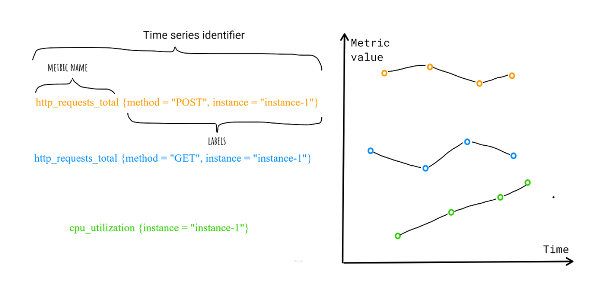

Slide 11
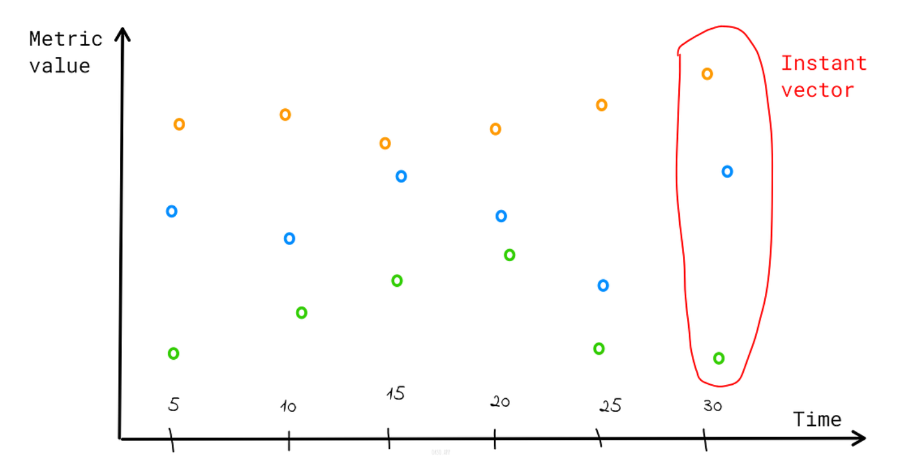

Slide 12
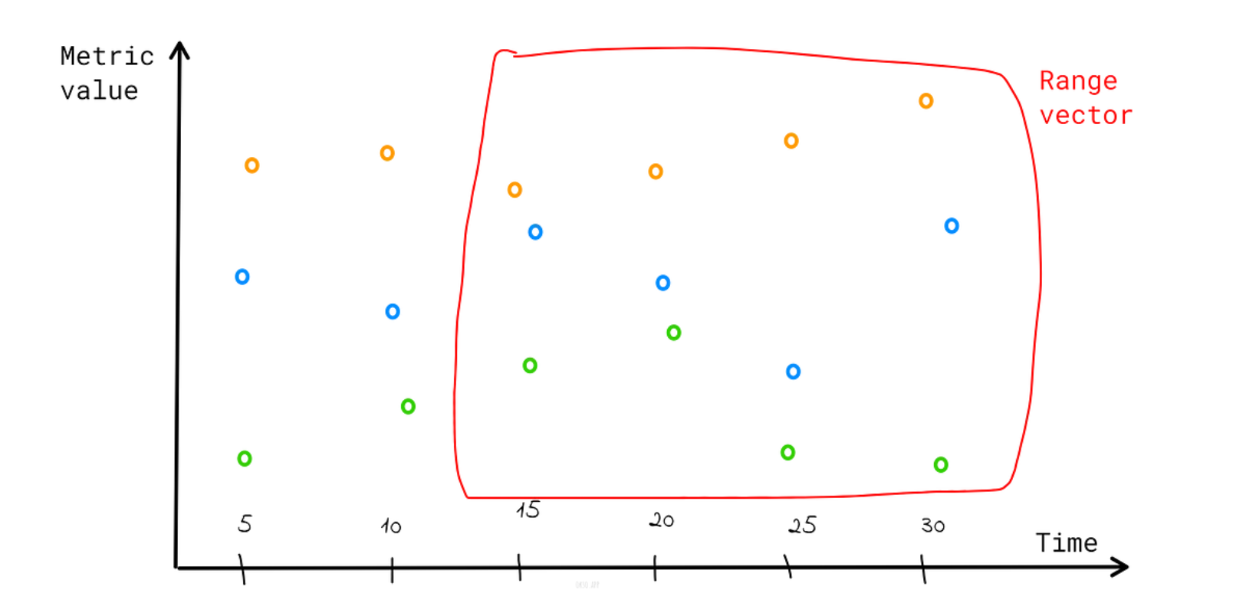

Slide 13
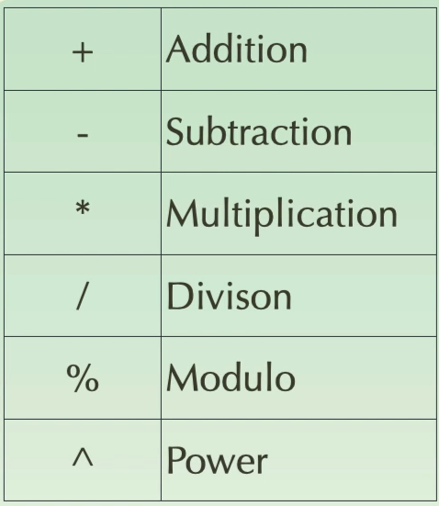
Operators
The operators apply to every value of the instant vector.
If we are performing,
Instant_Vector + Instant_Vector
then the operators apply to every value of left vector and its matching value in the right vector.

Slide 14
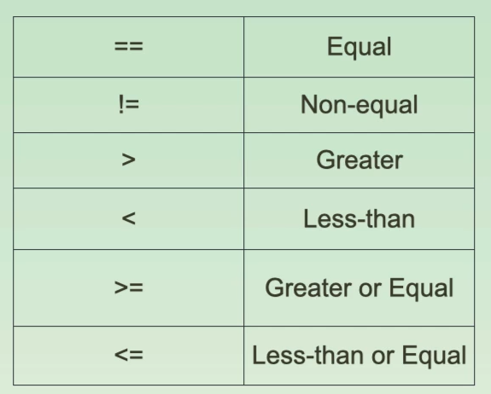
Binary/ Comparison Operators
These operators are used to write queries in prometheus.

Slide 15
Set Binary Operators
These vectors can be applied on Instant Vectors only.
They are:
and
or
unless
! unless → Gives the items in the left instant vector of the operator that doesn’t exist in the right instant vector.

Slide 16
Filter Matchers/ Selectors
Query → <metric_name> {filter_key=value, filter_key=value, … }
Here the coma(,) works as and ‘=‘ works as a equals condition.
= → Two values must be equal
!= → Two values must not be equal
=~ → To match with the given Regular Expression ( regex )
!~ → The value must not match with the given regex

Slide 17
Aggregate Operators
These aggregate the elements of a single Instant Vector, and results in a new Instant Vector with aggregated values.
sum
min
max
avg
count
group
count_values
topk
bottomk
stddev
stdvar
Syntax: <Aggregate Operator>(Instant Vector)
<Aggregate Operator>(Instant Vector) by (<label list>)
<Aggregate Operator>(Instant Vector) without (<label list>)

Slide 18
Time Offset & Functions
The time offset is to work with values of an older time stamp/period.
→ <metric_name> offset time_value
absent(<instant vector>)
absent_over_time(<ranged vector>)
abs(<Instant Vector>)
ceil(<Instant Vector>)
floor(<Instant Vector>)
clamp(<instant vector>, min, max)
clamp_min(<instant vector>, min)
clamp_max(<instant vector>, max)

Slide 19
log2(<instant vector>)
log10(<ranged vector>)
ln(<Instant Vector>)
sort(<Instant Vector>)
sort_desc(<Instant Vector>)
time()
timestamp(<Instant Vector>)
sum_over_time(<Range Vector>)
min_over_time(<Range Vector>)
max_over_time(<Range Vector>)
avg_over_time(<Range Vector>)
count_over_time(<Range Vector>)

