Slide 1




Air Quality Index Prediction Model with Python
Mayuresh Chavan
Internship ID: INTERNSHIP_1736246007677d02f700dbe
Student Registration ID: STU67968533ebc201737917747

Slide 2

Learning Objectives
Understand the impact of air pollutants on environmental and public health.
Explore machine learning techniques for predicting Air Quality Index (AQI).
Gain hands-on experience with data preprocessing, visualization, and model building.
Implement a predictive model to estimate AQI based on pollutant levels.
Learn feature selection and engineering to improve model accuracy.
Analyze correlations between pollutants and AQI to identify key contributors.
Evaluate model performance using R² Score, MAE, and MSE.
Develop insights to support environmental policies and pollution control strategies.
GOAL
Source :
www.freepik.com/

Slide 3
Tools and Technology used
Programming Language & Environment: Python with Google Colab
Libraries Used:
Data Handling: Pandas, NumPy
Visualization: Matplotlib, Seaborn
Machine Learning: Scikit-learn (for model building)
Data Cleaning: Pandas (handling missing values, duplicates)
Machine Learning Models Used:
Linear Regression
Decision Tree Regressor
K-Nearest Neighbors (KNN) Regressor
Random Forest Regressor (Best Performing Model)
Model Evaluation Metrics: R² Score, Mean Absolute Error (MAE), Mean Squared Error (MSE)
Data Processing: Handling missing values, normalization, feature engineering
Visualization Tools: Seaborn, Matplotlib for data insights

Slide 4
Methodology
Data Collection: The air quality dataset was loaded from a CSV file containing pollutant concentration levels along with AQI values. The dataset included key pollutants such as PM2.5, PM10, NO2, CO, SO2, NH3, O3, Benzene, Toluene, and Xylene. These pollutants were used as features for building the prediction model.
Data Preprocessing: To ensure data quality, missing values were handled appropriately. Mean imputation was applied where feasible, while features with excessive missing data, such as Xylene (61.32% missing), were dropped. Duplicate entries were removed to avoid redundancy.
Exploratory Data Analysis (EDA): EDA was conducted to understand the distribution of pollutants and their relationship with AQI. Histograms and boxplots helped visualize the spread and skewness of data, revealing that most pollutant levels were right-skewed. A correlation heatmap was used to identify the strongest contributors to AQI, with PM2.5 and PM10 emerging as the most significant factors affecting air quality.

Slide 5
Methodology
Feature Engineering: Key pollutants were selected based on correlation analysis to improve model performance. Since the dataset contained skewed data, StandardScaler was applied to normalize feature values. Outliers were detected and handled using the Interquartile Range (IQR) method to remove extreme values, ensuring that the model learned from a clean and well-structured dataset.
Model Building: The dataset was split into 80% training and 20% testing to evaluate model performance effectively. Multiple machine learning models were trained, including Linear Regression, Decision Tree Regressor, K-Nearest Neighbors (KNN) Regressor, and Random Forest Regressor. Among these, the Random Forest Regressor provided the best accuracy due to its ability to handle non-linear relationships and feature importance effectively.
Model Evaluation: Evaluated models using R² Score, MAE, and MSE. Random Forest performed the best due to its accuracy and ability to handle complex relationships.

Slide 6
Problem Statement:
Identified Problem:
Air pollution is a major environmental concern impacting human health and ecosystems.
Poor air quality leads to respiratory diseases, cardiovascular issues, and environmental degradation.
Accurate AQI prediction helps in taking preventive measures and policy decisions.
Challenges in Data:
Missing values and inconsistencies in pollutant measurements.
Outliers affecting the reliability of predictions.
Complex relationships between pollutants and AQI.
Project Goal:
Develop a robust machine learning model to predict AQI.
Use pollutants like PM2.5, PM10, NO, NO2, CO, SO2, etc. as input features.
Provide accurate air quality forecasts to help authorities and individuals make informed decisions.

Slide 7
Solution:
1. Visualization for Data Understanding
Used histograms and boxplots to analyze pollutant distributions and detect skewness.
Generated correlation heatmaps to identify key pollutants impacting AQI.
Observed that most pollutant data was right-skewed, indicating the need for transformation.
2. Data Processing & Feature Engineering
Outlier Detection & Handling: Used Interquartile Range (IQR) method to remove extreme outliers.
Handling Missing Values: Applied mean imputation for missing pollutant values.
Feature Scaling & Selection: Normalized data using StandardScaler to bring pollutants to a uniform scale.
Selected key features (PM2.5, PM10, NO2, CO, SO2, etc.) based on their correlation with AQI.
3. Model Training & Evaluation
Trained multiple models: Linear Regression, Decision Tree, KNN, and Random Forest.
Best Model: Random Forest Regressor achieved the highest accuracy due to its ability to handle non-linear relationships.
Model Performance Metrics: Evaluated using R² Score, MAE, and MSE to ensure reliable predictions.
Final Insights: The model successfully predicts AQI, helping in real-time air quality forecasting and decision-making.
Github: https://github.com/Mayur3sh007/AICTExEDUNET-AQI-Predictor

Slide 8
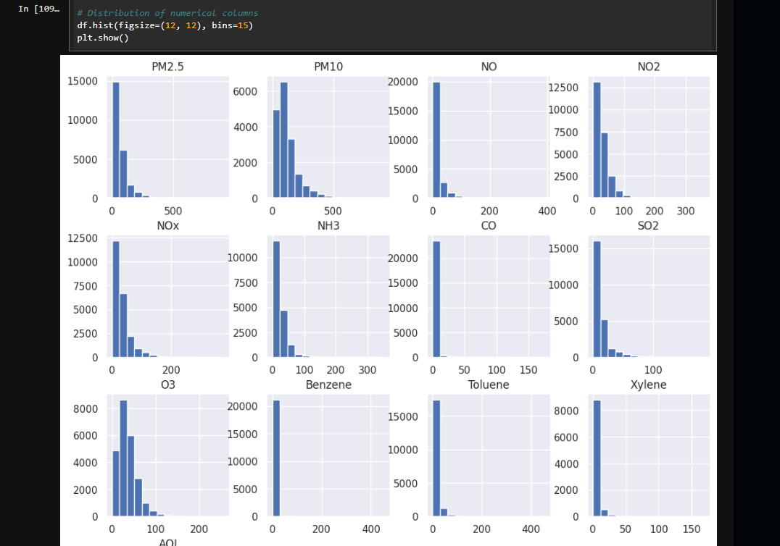
Screenshot of Output:
Distribution of Features

Slide 9
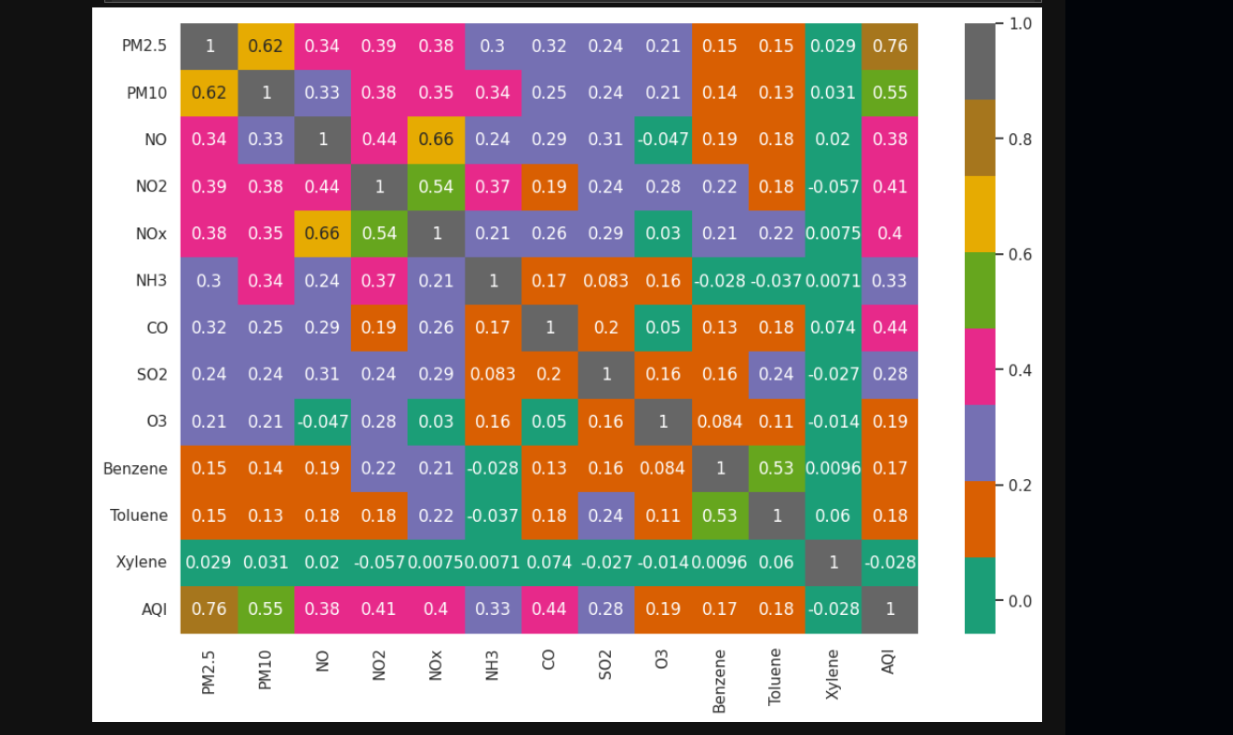
Screenshot of Output:
Correlation Matrix

Slide 10
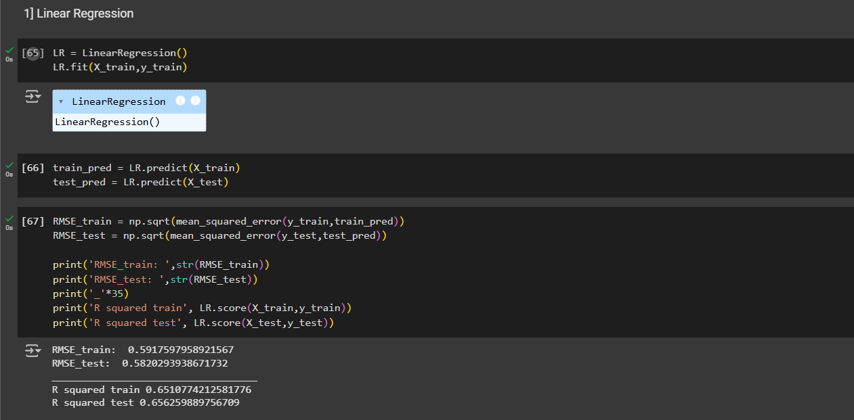
Screenshot of Output:

Slide 11
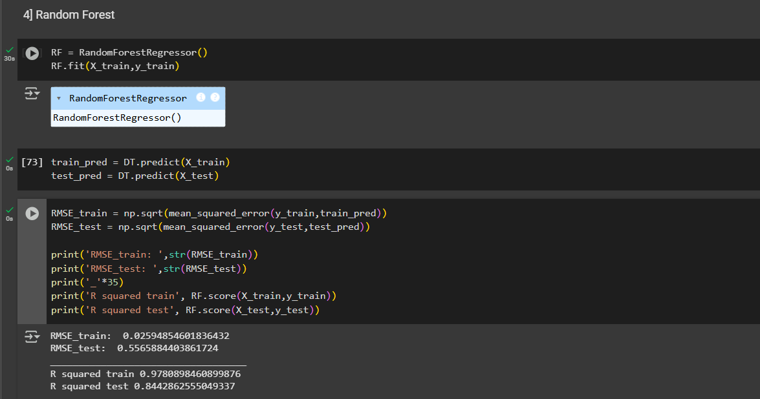
Screenshot of Output:

Slide 12
Conclusion:
Key Findings:
The dataset contained significant missing values, especially in Xylene (61.32% missing) and PM10 (37.72% missing).
Exploratory Data Analysis (EDA) revealed distribution patterns and correlations between pollutants and AQI.
The Random Forest Regressor outperformed other models in accurately estimating AQI.
Seasonal variations and weather conditions also influence AQI levels, requiring further analysis.
Mitigation Measures:
Regular monitoring and improved data collection to minimize missing values and ensure reliable predictions.
Focus on reducing pollutants like PM2.5 and PM10, which significantly impact AQI and human health.
Implement stricter environmental regulations to control emissions from industries and vehicles.
Integrate real-time data sources (IoT sensors, satellite data) for continuous and more precise AQI forecasting.
Future Scope:
Integrate deep learning models for improved AQI predictions. Use real-time IoT and satellite data for continuous monitoring.
Include weather factors like temperature and humidity for better accuracy. Develop web/mobile apps for real-time AQI alerts.
Apply geospatial analysis to track pollution sources. Utilize AI for policy recommendations and urban planning.

