Slide 1
Table Of Contents
Sl.no | Description | Page number
1 | Introduction & Motivation | 2
2 | Problem Statement & Objectives | 3
3 | System Architecture | 4
4 | Hardware Design — Verilog RTL Modules | 5
5 | MATLAB/Simulink Co-Simulation & Scripts | 6
6 | System Flowchart | 7
7 | Results & Output Analysis | 8
8 | Parameters, Limitations & Future Scope | 9
9 | Conclusion | 10
10 | References | 11
1

Slide 2
Introduction
Introduction
Motivation
Real-time video analytics is critical for surveillance, traffic monitoring, and security systems.
Software-only pipelines lack the throughput required for embedded real-time operation.
Hardware acceleration via RTL delivers deterministic, low-latency, parallel pixel processing.
Growing demand for low-cost embedded surveillance kernels.
This project mirrors real-world SoC hardware-software co-design workflows.
Problem Statement
Design a synthesizable Verilog RTL pipeline for motion detection and multi-object tracking, co-simulated in MATLAB Simulink and validated on real-world traffic video.
2

Slide 3
Objectives
Five core objectives define the scope and deliverables of this project.
1
2
3
RTL Pipeline Design
Co-Simulation
Automation
Design modular, synthesizable Verilog hardware modules for pixel-level processing.
Implement MATLAB Simulink environment instantiating the RTL pipeline.
Automate video-to-pixel-stream conversion and annotated output video reconstruction.
4
5
Validation
Parameter Analysis
Validate system on a real-world traffic surveillance video.
Analyse threshold sensitivity and its effect on detection accuracy.
3

Slide 4

System Architecture Overview
The end-to-end pipeline integrates MATLAB pre/post-processing with a Simulink-hosted Verilog RTL core. Data is exchanged via text intermediaries at each stage boundary.
Data exchanged via text intermediaries: input_video.txt | output_edges.txt | box_coordinates.txt
4

Slide 5
Hardware Pipeline — RTL Modules & Formulations
background_sub
line_buffer
Absolute pixel difference vs background
Dual shift register, 3-row tap access
8-bit configurable threshold
Outputs 1-bit motion flag
Width: 160 pixels
Enables streaming 3×3 neighbourhood
sobel_calc
tracker_box
3×3 Sobel gradient edge detector
Per-frame bounding box tracker
Manhattan approx: |Gx| + |Gy|
3-stage registered pipeline
323-cycle pipeline delay compensation
Auto-reset at frame end
Key Mathematical Formulations
Motion Detection
Sobel Edge Magnitude
Bounding Box Coordinates
is_motion = 1 if |P_curr – P_bg| > T_sub
|G| = |Gx| + |Gy| where Gx and Gy are Sobel gradients
box_min_x = min(box_min_x, x_c) and similarly for max and Y coordinates
5

Slide 6
Co-Simulation & MATLAB Scripts
Simulink Co-Simulation Flow
MATLAB Automation Scripts
Simulink Co-Simulation Flow
InitFcn: Reads input_video.txt, converts hex to pixel stream, assigns to workspace variable, sets simulation StopTime dynamically.
Simulation Run: Pixel stream drives RTL pipeline at 1 pixel per timestep. Edge pixels and bounding box signals captured in output object.
StopFcn: Exports output_edges.txt in hex format and box_coordinates.txt as decimal coordinate pairs.
video_to_text.m
multi_object_video.m
InitFcn: Reads input_video.txt, converts hex to pixel stream, assigns to workspace variable, sets simulation StopTime dynamically.
Simulation Run: Pixel stream drives RTL pipeline at 1 pixel per timestep. Edge pixels and bounding box signals captured in output object.
StopFcn: Exports output_edges.txt in hex format and box_coordinates.txt as decimal coordinate pairs.
Read MP4 → Resize to 160×120 → Grayscale → Write as hex pixel stream to input_video.txt. (19,200 samples/frame)
Load edge map → Motion gate → Morphological dilation → regionprops → Scale to HD → insertShape + insertText → VideoWriter output.
6

Slide 7
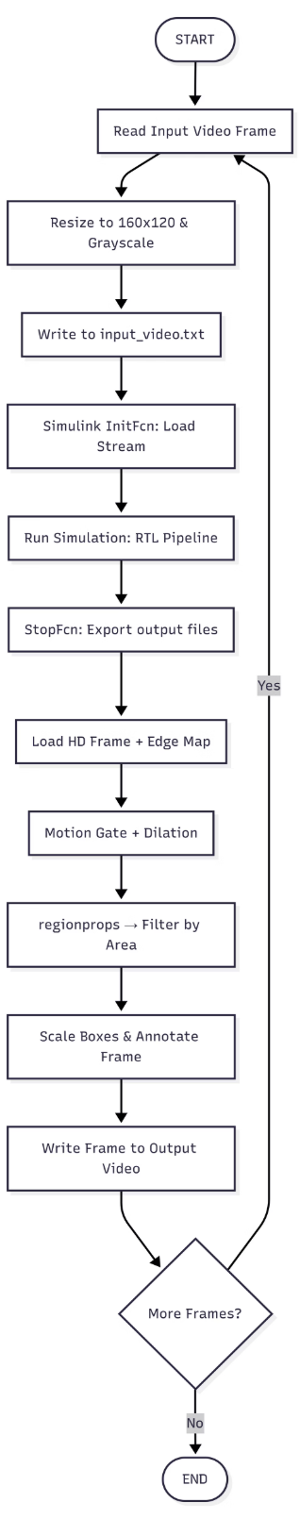
Processing Flowchart
The decision diamond checks whether additional frames remain. If yes, the loop
continues; if no, processing terminates and the output video is finalized.
Processing Flow — Step by Step
The system begins by reading each video frame sequentially, resizing it to 160×120 pixels and converting it to grayscale for hardware compatibility.
The pixel stream is written to input_video.txt, which the Simulink InitFcn callback loads into the workspace and uses to set the simulation stop time dynamically.
The RTL pipeline then processes every pixel — background subtraction, line buffering, Sobel edge detection, and bounding box tracking — one pixel per clock cycle.
On simulation end, the StopFcn callback exports the edge map to output_edges.txt and bounding box coordinates to box_coordinates.txt.
The post-processor loads each original HD frame alongside the hardware edge map, applies motion gating and morphological dilation, runs regionprops to isolate connected regions, scales the bounding boxes to full resolution, and annotates the frame.
This loop repeats for every frame until the video is fully processed.
7

Slide 8
Comparison table
Board used | Year of paper | Maximum frequency achieved for our code | Maximum frequency achieved by researcher | Minimum period achieved by researcher
Spartan 6 | -- | 179.227 MHz | -- | --
Zynq 7000 (basic bg subs) | 2025 | 352.139 MHz | 222.75 MHz | 4.49 ns
Xilinx Zynq-7000 ZC706 (Paper 1 – Amina et al.) | 2024 | 280 MHz | 100 MHz | 10.00 ns
Xilinx Kria KV260 (Paper 2 – Rashed et al.) | 2024 | 250MHz | 120 MHz | 8.33 ns
Xilinx FPGA boards (YOLOv2) (Paper 3 – Solomon et al.) | 2022 | 260 MHz | 200 MHz | 5.00 ns
AMD Virtex XC7VX485T (Paper 4 – Oshima et al.) | 2024 | 320 MHz | Not reported | Not reported

Slide 9
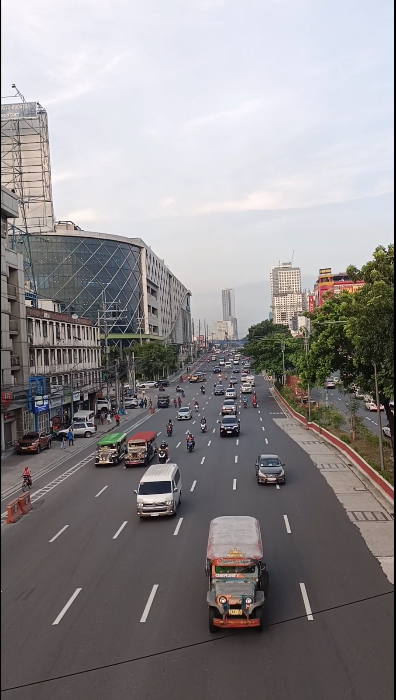
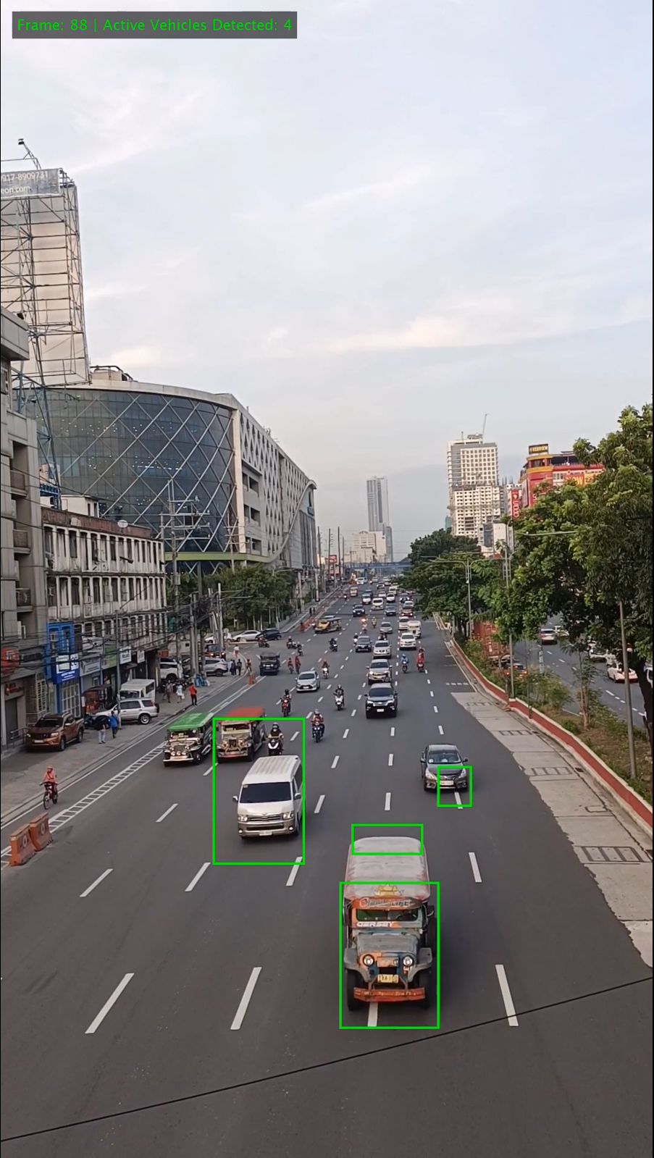
Results — Detection & Tracking Output
Top-left: before tracking is done · Top-right Final annotated HD output frame with green bounding boxes on detected vehicles
Moving vehicles detected as distinct connected regions
Multiple objects tracked simultaneously per frame
Per-frame overlay: frame index + active vehicle count
Motion gating eliminated static background false positives
8

Slide 10
Parameters and Limitations
Limitations
System Parameters
Single global bounding box in hardware
Static background model
Resolution capped at 160×120 for simulation
Text-file I/O not real-time
Resolution
160×120
Pixel Depth
8-bit
Sub Threshold
~15
Sobel Threshold
~100–200
Pipeline Delay
323 cycles
Min Object Area
20 px
Output
1080p HD
9

Slide 11
Conclusion
RTL Pipeline Verified
End-to-End Validation
Modular Verilog RTL pipeline successfully designed and verified via co-simulation.
MATLAB Simulink framework validated end-to-end on real traffic video.
Multi-Object Detection
FPGA-Ready Foundation
Multi-object vehicle detection demonstrated with per-frame bounding boxes.
Solid foundation established for FPGA deployment and adaptive tracking.
10

Slide 12
REFERENCES
"Real-time object detection using Xilinx Zynq FPGA and tensor flow framework" by Amina El Mansouri, Hassan Ben Youssef, and Leila Saidi (2024).
"FPGA-Based Implementation of a Basic Background Subtraction Algorithm for Real-Time Application" by Marwan Abdulkhaleq Al-Yoonus and Saad Ahmed Al-Kazzaz (2024).
"FPGA-based improved background subtraction for ultra-low latency" by Yoshiyuki Oshima, Yoshiki Yamaguchi, Ryohei Tsugami, Toshihito Fujiwara, Tatsuya Fukui, and Satoshi Narikawa (2024).
"FPGA-based Real-Time Object Detection and Classification System using YOLO for Edge Computing" by Rashed Al Amin, Mehrab Hasan, Veit Wiese, and Roman Obermaisser (2024).
"Resource- and Power-Efficient High-Performance Object Detection Inference Acceleration Using FPGA" by Solomon Negussie Tesema and El-Bay Bourennane (2022).
11

