Slide 1



Securing Networks with Suricata
Suricata is a powerful, open-source network threat detection engine designed for high-performance environments. It offers a comprehensive suite of security features that help organizations effectively monitor, analyze, and protect their networks from a wide range of cyber threats. This presentation will provide an in-depth overview of Suricata's key capabilities and how they can be leveraged to enhance network security.
M
by Mayur Akotkar

Slide 2


Introduction to Suricata
Suricata is an advanced network security tool that has gained widespread adoption in the cybersecurity community. It is designed to detect and prevent network-based threats, such as intrusions, malware, and unauthorized access, using a multi-threaded architecture that enables high-performance packet processing. Suricata's robust feature set and flexibility make it a popular choice for organizations of all sizes, from small businesses to large enterprises, looking to strengthen their network defenses.

Slide 3
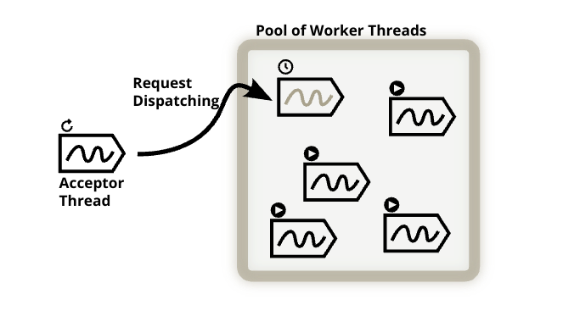
Multi-threaded Architecture
1
Parallel Processing
Suricata's multi-threaded architecture allows it to process network traffic in parallel, significantly improving its overall performance and throughput. This feature is particularly important for high-speed networks, where the ability to keep up with the incoming data stream is critical for effective security monitoring and response.
2
Scalability
The multi-threaded design of Suricata enables it to scale up or down based on the available system resources, making it adaptable to a wide range of deployment scenarios. This flexibility allows organizations to optimize Suricata's performance to meet their specific network requirements.
3
Efficiency
By leveraging parallel processing, Suricata can analyze network traffic more efficiently, reducing the risk of missed or delayed detection of potential threats. This improves the overall effectiveness of the security solution and ensures that critical security events are identified and addressed in a timely manner.

Slide 4
Intrusion Detection and Prevention
Intrusion Detection
Intrusion Prevention
Flexibility
Suricata's intrusion detection capabilities allow it to monitor network traffic for signs of suspicious activity, such as unauthorized access attempts, network scans, and known attack signatures. By continuously analyzing the network data, Suricata can quickly identify potential threats and alert security teams to take appropriate actions.
In addition to detection, Suricata can also be configured to operate in an intrusion prevention mode. In this mode, Suricata can actively block or mitigate detected threats, effectively preventing them from causing further damage to the network or compromising sensitive data.
Suricata's intrusion detection and prevention capabilities can be customized to meet the specific needs of an organization. Security teams can fine-tune the rules and settings to focus on the most critical threats and optimize the performance of the security solution to their environment.

Slide 5



High-Performance Packet Processing
1
Efficient Packet Handling
2
Hardware Acceleration
Suricata is designed to handle high-volume network traffic with minimal impact on system resources. Its optimized packet processing engine can analyze and inspect packets at line rate, ensuring that critical security events are not missed due to performance limitations.
Suricata supports hardware acceleration technologies, such as Intel DPDK and AF_PACKET, which can further enhance its packet processing capabilities. By offloading specific tasks to dedicated hardware, Suricata can achieve even higher levels of performance and throughput.
3
Scalable Architecture
4
Real-Time Analysis
Suricata's multi-threaded architecture allows it to scale up or down based on the available system resources. This flexibility ensures that the security solution can adapt to changing network conditions and handle increases in traffic volume or complexity without sacrificing performance.
Suricata's high-performance packet processing enables it to analyze network traffic in real-time, providing security teams with immediate visibility into potential threats and enabling rapid response and mitigation efforts.

Slide 6


Flexible Rule Language
Custom Rule Creation
Rule Management
Suricata's flexible rule language allows security teams to create and customize their own detection rules, enabling them to address specific threats or tailor the security solution to the organization's unique requirements. This level of customization is essential for maintaining an effective and up-to-date security posture.
Suricata's rule management capabilities make it easy for security teams to manage and maintain their rule sets. This includes features such as rule versioning, automatic updates, and the ability to quickly enable, disable, or modify rules as needed.
Community-Driven
Comprehensive Coverage
Suricata benefits from a large and active community of users and contributors who continually develop and share new detection rules. This community-driven approach ensures that Suricata's rule set is constantly evolving to address emerging threats and stay ahead of the latest attack techniques.
With its flexible rule language and extensive community support, Suricata can be configured to detect a wide range of network-based threats, from known malware and intrusion attempts to more advanced and sophisticated attack vectors.

Slide 7

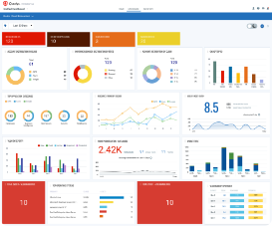




Extensive Logging and Monitoring
Detailed Logging
Real-Time Monitoring
Robust Reporting
Data Visualization
Suricata provides comprehensive logging capabilities, allowing security teams to capture and analyze detailed information about network events, security alerts, and system performance. This data can be used for forensic investigations, incident response, and ongoing security monitoring and optimization.
Suricata integrates with various monitoring and analytics platforms, enabling security teams to gain real-time visibility into network activity, threat detection, and system health. This feature helps organizations rapidly identify and respond to security incidents as they occur.
Suricata's reporting capabilities allow security teams to generate detailed reports on the performance, effectiveness, and overall health of the security solution. These reports can be used to demonstrate compliance, justify security investments, and inform strategic decision-making.
Suricata's logging and monitoring data can be visualized using a variety of tools, providing security teams with intuitive and easily understandable insights into network activity and security posture. This helps improve situational awareness and supports more informed decision-making.

Slide 8

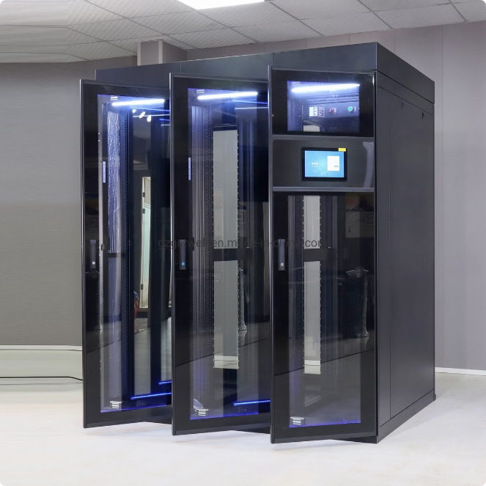



Deployment and Configuration
Hardware Selection
Choosing the right hardware configuration is crucial for ensuring optimal Suricata performance. Factors such as CPU, memory, and network interface card (NIC) specifications should be carefully considered based on the organization's network traffic volume and security requirements.
Installation and Setup
Suricata can be installed on a variety of platforms, including Linux, Windows, and FreeBSD. The installation process involves configuring Suricata's settings, importing rule sets, and integrating it with other security tools and infrastructure.
Ongoing Maintenance
To maintain the effectiveness of the Suricata deployment, regular updates, rule set maintenance, and performance monitoring are essential. Security teams should also be prepared to fine-tune Suricata's configuration as the organization's network and security requirements evolve over time.

Slide 9
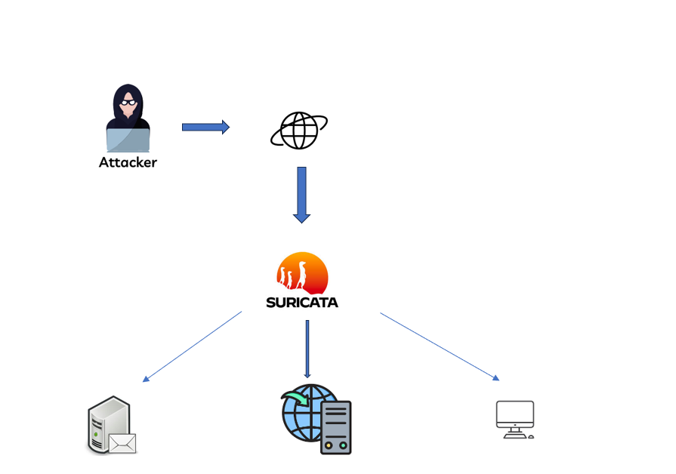
Flow chart

Slide 10
Conclusion
The **Network and Host Security Using Suricata** project successfully deployed and configured Suricata as an IDS/IPS, integrated it with pfSense, and set up a secure Debian web server with PHP and HTTPS. Key achievements include effective threat detection, secure web hosting, and a smooth migration from HTTP to HTTPS. The project faced and overcame challenges like Java installation issues and configuration adjustments. Future work will focus on ongoing monitoring, additional features, and performance optimization. Overall, the project enhances security and provides a strong foundation for future initiatives.

