Slide 1

Notes:
1

Slide 2
Agenda
SonarQube Installation
SonarQube Overview
SonarQube Components
SonarQube Project Administration
SonarQube Instance Administration
SonarQube Integration
Notes:
2

Slide 3
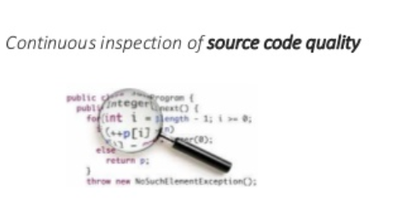
Continuous Code Inspection
Notes:
Continuous Inspection / ... but how? •
On-the-fly: Fix issues before they exist.
• Integration: Analyse on the CI / DevOps pipeline.
• Quality Gates: Reject if not ok.
• Track issues: Track the issues on new code (who committed the issue?)
The value of continuous inspection is to find the issues while it is easy and cheap to fix.
Continuous Inspection / •
A new approach to code quality management •
Code quality as a part of Software Development Life Cycle (SDLC)
• A clear view of software quality for all stakeholders
• Continuous feedback about software quality
• Obtaining the ability of better software development practices
3

Slide 4
Continuous Code Inspection
Very frequent inspection of software
to provide
early warning of maintainability & quality issues
Notes:
Continuous Inspection / ... but how? •
On-the-fly: Fix issues before they exist.
• Integration: Analyse on the CI / DevOps pipeline.
• Quality Gates: Reject if not ok.
• Track issues: Track the issues on new code (who committed the issue?)
The value of continuous inspection is to find the issues while it is easy and cheap to fix.
Continuous Inspection / •
A new approach to code quality management •
Code quality as a part of Software Development Life Cycle (SDLC)
• A clear view of software quality for all stakeholders
• Continuous feedback about software quality
• Obtaining the ability of better software development practices
4

Slide 5
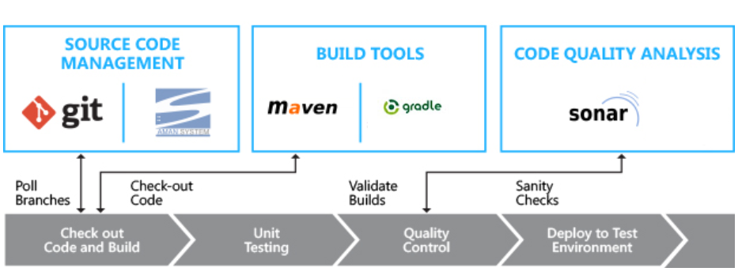
Continuous Code Inspection ?
Notes:
5

Slide 6
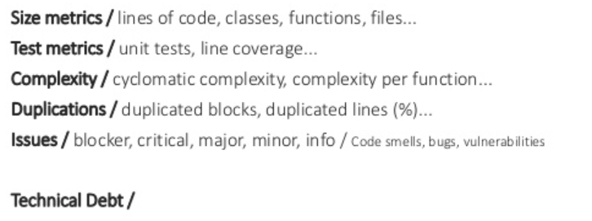
Software Quality Metrices
Notes:
6

Slide 7

SonarQube Overview
Opensource software to perform static analysis.
Supports 20+ languages - out of the box or with plugins
Scans code, identifies issues, log them in a centralized database and provide dashboards
Notes:
Static Analysis - Evaluating Code without executing it using some industry metrics

Slide 8
Sonarqube Features
Dashboard provide overview of each project – break down of issues, trends over time
Insight into security, maintainability, reliability, code duplication and more
Quality Profiles to customize the rules
Quality gates – Green/Red based on issues detected
Integrates well with Continuous integration Engines (CI) and build systems
Notes:
Drill down to code to see the issue

Slide 9
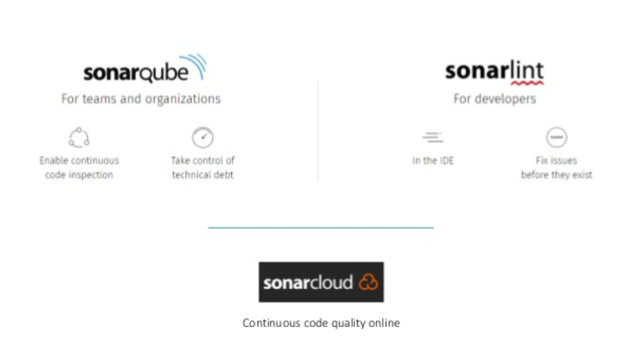
Sonarqube
Notes:
Checksum-based storage
★ Many identical artifacts are produced and stored numerous times in the repositories •
Unique snapshots that are exactly the same between subsequent builds •
Other artifacts that are copied ‣
Mainly needed for more natural security control
★ Artifactory uses a checksum-based storage
★ Identical artifacts are stored on the server exactly once! • No matter how many references are there
★ Copy and move are very cheap • Pointer operations
Concurrent downloads/ request bursts ★
New snapshot dependency available/ POM updated with a new dependency version
Dependency can be as big as hundreds of megs •
Assemblies ★ All clients download at once • Network blockage (DOSing)
★ Artifactory will identify this • Queue all incoming request until the ﬁrst one ﬁnishes • Others will get the cached
9

Slide 10
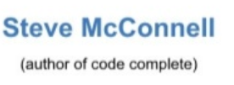
Technical Debt
“If the debt grows large enough, eventually the company will sped more on servicing its debt than it invests in increasing the value of its other assets”

Slide 11
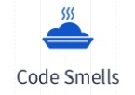

Technical Debt
Notes:
Issues associated with maintainability are named “code smells” in our products.

Slide 12



Technical Debt
Potential bugs or as code that will not have the expected behavior at runtime.
Notes:
This is commonly referred to as potential bugs or as code that will not have the expected behavior at runtime.
This category of issues groups everything that has to do with operational risks or unexpected behavior at runtime. It generally takes the form of critical programming errors that could cause a business disruption.
Some of these issues will lie in a simple lack of compliance with best practices, but most will be detected by deep analysis of the code and symbolic execution of the code to understand the state of variables at any given point in the program.

Slide 13


Technical Debt
Referred to as vulnerabilities or flaws in a program
Notes:
Security Issue
This is commonly referred to as vulnerabilities or flaws in programs that can lead to use of the application in a different way than it was designed for.
This category of issues groups everything that has to do with a program having flaws that can be exploited to make it behave differently from what it was designed for. Security vulnerabilities such as SQL injection or cross-site scripting can result from poor coding and architectural practices. These issues are well documented in lists maintained by CWE and CERT

Slide 14
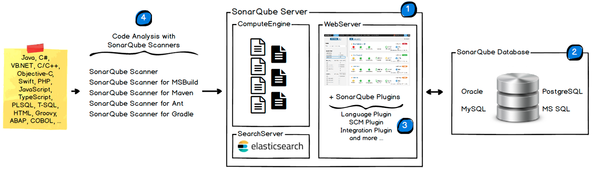
Sonarqube - Architecture
Notes:
Analyzer
A client application that analyzes the source code to compute snapshots.
Database
Stores configuration and snapshots
Server
Web interface that is used to browse snapshot data and make configuration changes
14

Slide 15
Installation - System Requirements
Hardware Requirements
2GB of RAM to run efficiently and 1GB of free RAM for the OS
Hard drives that have excellent read & write performance

Slide 16
SonarQube Installation
JDK 1.8
MySQL 5.7
Sonarqube 7.6

Slide 17
Static Code Analysis
1
What does analysis produce?
2
Will all files be analyzed?
3
What happens during analysis?
4
Distribution
Notes:
Repository - > s a central system for storing and managing files where they can be accessed and updated by any number of authenticate users
Local -> contain upload and control locally.
Remote Repository -> Cache artifacts from cloud
Virtual -> Aggregate
Artifactory offers a universal solution supporting all major package formats including Maven, Gradle, Docker, Vagrant, Debian, YUM, P2, Ivy, NuGet, PHP, NPM, RubyGems, PyPI, Bower, CocoaPods, GitLFS, Opkg, SBT and more
Through a set of plugins, Artifactory is tightly integrated with all major build tools and CI servers including Maven, Gradle, Ivy/Ant Jenkins, Team City, Bamboo and TFS
Artifactory provides full metadata for all major package formats for both ar-tifacts and folders. These include metadata that originates with the package itself, custom metadata added by users such as searchable properties and metadata that is automatically generated by tools such as build information
High Availability Full active/active HA solution with live failover and non-disruptive production upgrades.
17

Slide 18
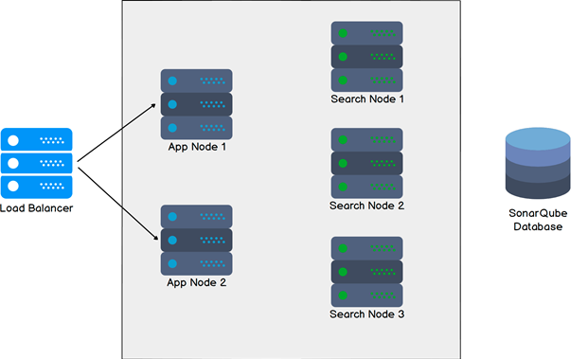
Install the Server as a Cluster
Requirements
Network
All servers, including the database server, must be co-located
Servers
Minimum of five servers (two application nodes and three search nodes)

Slide 19
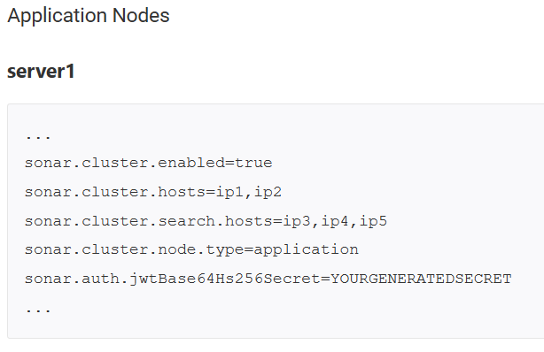
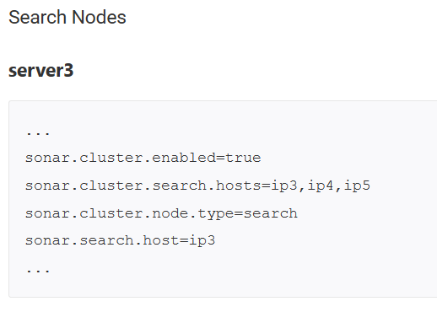
Cluster configurations
sonar.properties

Slide 20
Troubleshooting
Checking the logs
Can be found in <sonar home>/logs – generally /opt/sonar/logs
sonar.log - Holds general information about startup and shutdown.
web.log - Information about initial connection to the database, database migration and reindexing, and the processing of HTTP requests. This includes database and search engine logs related to those requests.
ce.log - Information about background task processing and the database and search engine logs related to those tasks.
es.log - Ops information from the search engine, such as Elasticsearch startup, health status changes, cluster-, node- and index-level operations, etc.

Slide 21
Troubleshooting
Compute Engine Performance
Administration > Projects > Background Tasks > Number of Workers
Queue is often full of pending tasks
Individual tasks take a long time to process

Slide 22
Troubleshooting
Recovering from Elasticsearch read-only indices
Stop SonarQube
Delete the data/es6 directory
Restart SonarQube

Slide 23
SonarQube DB Copy Tool
Help you migrate your SonarQube database from one DB vendor to another
DB Copy Run
Stop your primary SonarQube instance.
Execute the base command jar with the correct parameters.
java -jar sonar-db-copy-1.3.3.627-jar-with-dependencies.jar
Update your primary SonarQube instance's configuration to point to the target DB
Restart your primary SonarQube instance.

Slide 24
Rules
Entry point where you can discover all the existing rules or create new ones based on provided templates
There are four types of rules:
Code Smell (Maintainability domain)
Bug (Reliability domain)
Vulnerability (Security domain)
Security Hotspot (Security domain)

Slide 25
Rule Templates and Custom Rules
Rule Templates - Provided by plugins as a basis for users to define our own custom rules in SonarQube
$SONAR_HOME/extensions/plugins.
https://docs.sonarqube.org/display/PLUG/SonarSource+Plugins
https://docs.sonarqube.org/display/PLUG/Writing+Custom+Java+Rules+101

Slide 26
Security-related Rules
CWE: SonarQube is a CWE compatible product since 2015.
SANS Top 25
OWASP Top 10

Slide 27
Built-in Rule Tags
Tags are a way to categorize rules and issues

Slide 28
Quality Profiles
Allows us to define sets of Rules that when violated should raise issues on your codebase

Slide 29
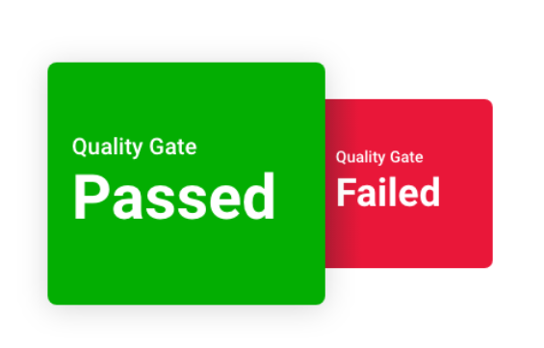
Quality Gates
Enforce a quality policy in your organization
It tells whether application is ready for release
A set of Boolean conditions based on measure thresholds against which projects are measured

Slide 30
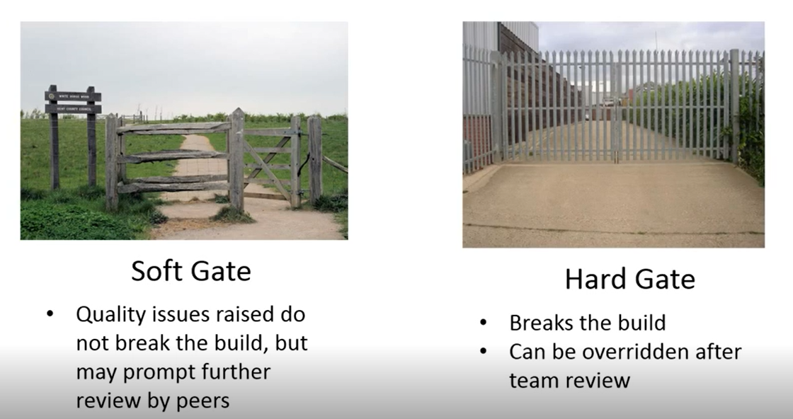
Quality Gates

Slide 31
Metric Definitions
Complexity
Issues
Maintainability
Security
Reliability
Size

Slide 32
Activity and History
Offers a comprehensive list of the analyses on file for a project
Ability to see the evolution of project measures over time.

Slide 33
Code Period
Clean as You Code !!!

Slide 34
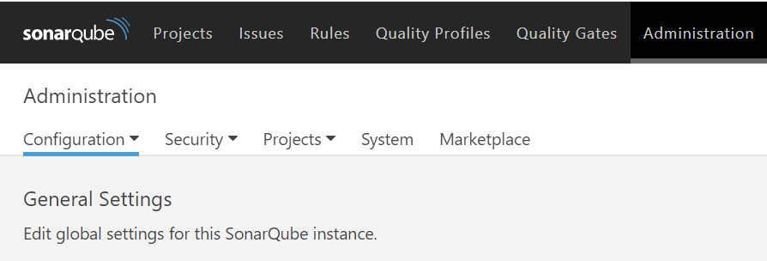
Analysis Parameters
1
Mandatory Parameters
2
Optional Parameters
Notes:
Administration > Configuration > General Settings
34

Slide 35
Test Coverage & Execution
Test Coverage
Test Execution
Notes:
Risks -> Don’t know what is written, what vulnerabilities exists in it.
Liability issues
35

Slide 36
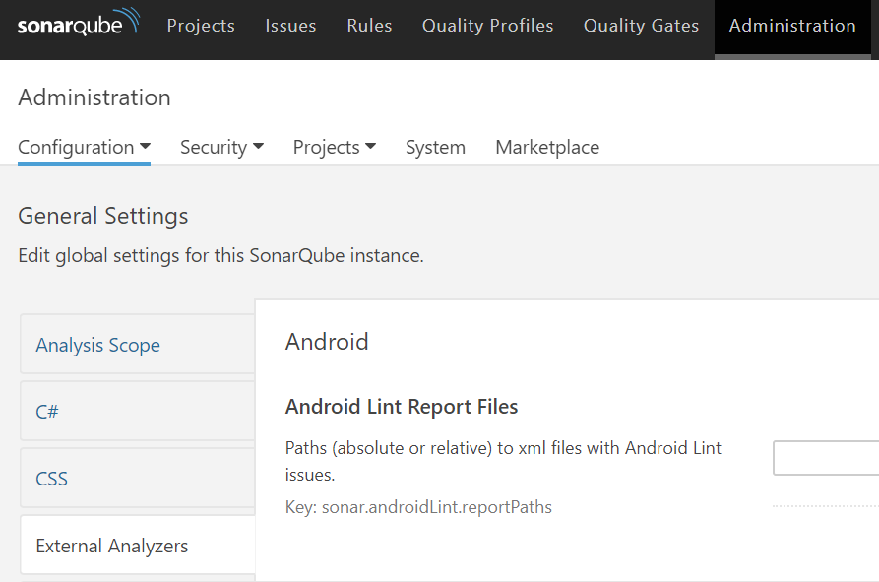
Importing External Issues
Analysis parameters related to the import of issues raised by external, third-party analyzers

Slide 37
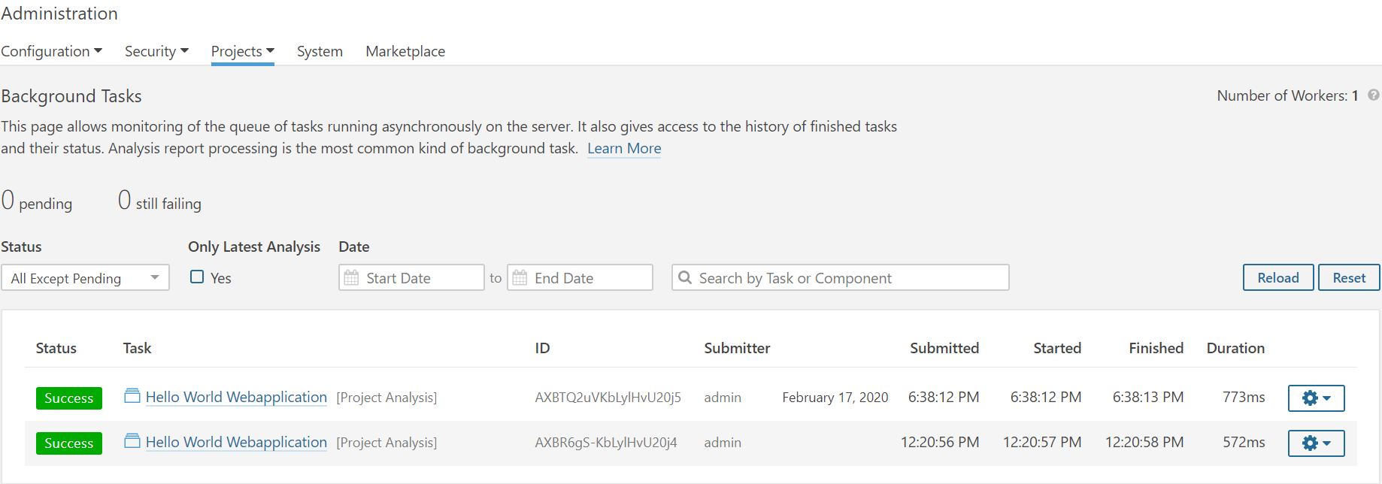
Background Tasks

Slide 38
Generic Issue Data & Test Data
Test Coverage
Test Execution
Notes:
Risks -> Don’t know what is written, what vulnerabilities exists in it.
Liability issues
38

Slide 39
Pull Request Analysis
Pull Requests in SonarQube from the branches of your project.
Pull Request Decoration
Notes:
Risks -> Don’t know what is written, what vulnerabilities exists in it.
Liability issues
39

Slide 40
Branch Analysis
Ensure consistent code quality maintained all the way down to the branch level of your projects.
Setting up Branch analysis
Managing inactive branches
Notes:
40

Slide 41
Running Analysis with GitLab CI/CD
Activating builds
Failing the pipeline job when the SonarQube Quality Gate fails
Setting environment variables for all builds
Notes:
41

Slide 42
SCM Integration
Automatic Issue Assignment
Code annotation (blame data) in the Code Viewer
SCM-driven detection of new code
Notes:
42

Slide 43
Security Engine Custom Configuration
Elements
Analysis Parameters
Notes:
43

Slide 44
Project Page
1
can I release my project today?
2
If not, what should I improve to make the project pass the Quality Gate?
Notes:
The Project Hompepage is the entry point of any project showing:
the releasability status of the project
the current state of its quality
the quality of what has been produced since the beginning of its New Code Period.
The project space page shows a high-level summary of critical metrics, both current values and their New Code Period values.
44

Slide 45
Applications
is an aggregation of projects
With an Application, they can be treated as a single entity in SonarQube with a unified Project Homepage, Issues list, Measures space, and most importantly: Quality Gate.
Notes:
The Project Hompepage is the entry point of any project showing:
the releasability status of the project
the current state of its quality
the quality of what has been produced since the beginning of its New Code Period.
The project space page shows a high-level summary of critical metrics, both current values and their New Code Period values.
45

Slide 46
Issues
1
Bug – A coding error that will break your code and needs to be fixed immediately.
2
Vulnerability – A point in your code that's open to attack.
3
Codesmell – A maintainability issue that makes your code confusing and difficult to maintain.
Notes:
The Project Hompepage is the entry point of any project showing:
the releasability status of the project
the current state of its quality
the quality of what has been produced since the beginning of its New Code Period.
The project space page shows a high-level summary of critical metrics, both current values and their New Code Period values.
46

Slide 47
Issues Severity
1
BLOCKER
2
CRITICAL
3
MAJOR
4
MINOR
5
INFO
Notes:
The Project Hompepage is the entry point of any project showing:
the releasability status of the project
the current state of its quality
the quality of what has been produced since the beginning of its New Code Period.
The project space page shows a high-level summary of critical metrics, both current values and their New Code Period values.
47

Slide 48
Security Hotspots and why are they important
Fix security issues – Gives you the opportunity to detect vulnerabilities and ensure issues are fixed before merging pull requests or releasing your branch.
Learn about security – SonarQube explains why your code was identified as a Security Hotspot and the link between your Security Hotspots and well-known attacks or weaknesses such as SQL Injection, Weak Cryptography, or Authentication. This helps you to know when you're working on security-sensitive code and to avoid creating Vulnerabilities.
Notes:
Reviewing Security Hotspots gives you the opportunity to detect vulnerabilities and ensure issues are fixed before merging pull requests or releasing your branch.
SonarQube explains why your code was identified as a Security Hotspot and the link between your Security Hotspots and well-known attacks or weaknesses such as SQL Injection, Weak Cryptography, or Authentication. This helps you to know when you're working on security-sensitive code and to avoid creating Vulnerabilities.

Slide 49
Rules
There are four types of rules:
1
Code Smell (Maintainability domain)
2
Bug (Reliability domain)
3
Vulnerability (Security domain)
4
Security Hotspot (Security domain)
Notes:
. Checksum for uploaded artifacts ★ No way to verify uploaded artifacts ★ Maven approach: • The repository is passive • All calculations done on client • Repository to accept and store client checksum ★ Artifactory • Compare client checksum with the one calculated on the repository • If in conﬂict return 409 until a good checksum is found • This behavior is conﬁgurable 19 20. Locking ★ Artifactory applies RWLocks on all items ★ Avoid concurrent writes & dirty reads ★ Spans to metadata as well - cannot create metadata conﬂicts ★ Built-in utility for debugging lock contention in runtime (zero overhead) 20 21. POM cleanup ★ Many common third party POMs contain remote repository references making controlled resolution a nightmare ★ Global mirroring is not a solution • Forces a uniﬁed repository for releases/snapshots/plugins ★ Artifactory can facade POMs through a Virtual Repository • Can conﬁgure remote repo references to be removed • Original POM is intact 21 22. Metadata backed into the core ★ Every repository element can hold metadata deﬁnitions • Both ﬁles and folders ★ Metadata is any XML document • Can be queried using XPath • All exposed via UI and REST API ★ Properties tagging • Similar to SVN props • Internally stored as XML • “Strongly typed” props can be deﬁned via UI ‣ Open/closed lists, multi-select, single-select etc. • Applied via UI or REST • Also on deploy time with zero build tool tweaking! 22 23. Smart staging and promotion ★ Repository has two main roles • Proxy remote artifacts • Host deployed artifacts ‣ Artifacts (should) come from CI server ★ Promotion of artifacts starts with a build ★ The Binaries Repository & the CI Server are always interconnected 23 24. Search-based management ★ Makes bulk artifact management a lot easier ★ Shopping-cart of artifacts ★ Fill-up the cart by searching and saving the search results - any search type! ★ Do other searches and add/subtract the results from the original ★ Can tweak the result manually • E.g. remove sources ★ Once done move/promote/copy/export the result ★ Does not enforce narrow concepts to support only speciﬁc limited use cases • E.g. promotion
49

Slide 50
Rule Templates and Custom Rules
Notes:
. Checksum for uploaded artifacts ★ No way to verify uploaded artifacts ★ Maven approach: • The repository is passive • All calculations done on client • Repository to accept and store client checksum ★ Artifactory • Compare client checksum with the one calculated on the repository • If in conﬂict return 409 until a good checksum is found • This behavior is conﬁgurable 19 20. Locking ★ Artifactory applies RWLocks on all items ★ Avoid concurrent writes & dirty reads ★ Spans to metadata as well - cannot create metadata conﬂicts ★ Built-in utility for debugging lock contention in runtime (zero overhead) 20 21. POM cleanup ★ Many common third party POMs contain remote repository references making controlled resolution a nightmare ★ Global mirroring is not a solution • Forces a uniﬁed repository for releases/snapshots/plugins ★ Artifactory can facade POMs through a Virtual Repository • Can conﬁgure remote repo references to be removed • Original POM is intact 21 22. Metadata backed into the core ★ Every repository element can hold metadata deﬁnitions • Both ﬁles and folders ★ Metadata is any XML document • Can be queried using XPath • All exposed via UI and REST API ★ Properties tagging • Similar to SVN props • Internally stored as XML • “Strongly typed” props can be deﬁned via UI ‣ Open/closed lists, multi-select, single-select etc. • Applied via UI or REST • Also on deploy time with zero build tool tweaking! 22 23. Smart staging and promotion ★ Repository has two main roles • Proxy remote artifacts • Host deployed artifacts ‣ Artifacts (should) come from CI server ★ Promotion of artifacts starts with a build ★ The Binaries Repository & the CI Server are always interconnected 23 24. Search-based management ★ Makes bulk artifact management a lot easier ★ Shopping-cart of artifacts ★ Fill-up the cart by searching and saving the search results - any search type! ★ Do other searches and add/subtract the results from the original ★ Can tweak the result manually • E.g. remove sources ★ Once done move/promote/copy/export the result ★ Does not enforce narrow concepts to support only speciﬁc limited use cases • E.g. promotion
50

Slide 51
Security Related Rules
1
CWE stands for Common Weakness Enumeration
2
SANS Top 25 list is a collection of the 25-most dangerous errors listed in the CWE, as compiled by the SANS organization
3
OWASP Top 10 Open Web Application Security Project
Notes:
The idea is that the rule will flag anything suspicious, and leave it to the human security auditor to cull the false positives and sent the real issues for remediation.
51

Slide 52
Security Reports
Gives you the big picture on your application's security, with breakdowns of just where you stand in regard to each of the
OWASP Top 10
SANS Top 25 categories
CWE-specific details
Security Hotspot v/s Vulnerability
Notes:
Vulnerabilities are points in the code which are open to attack.
Security Hotspots highlight security-sensitive pieces of code that need to be manually reviewed to ensure the sensitive piece of code is being used in the safest manner.
Security hotspots also help educate developers on security issues.

Slide 53
SonarLint Smart Notifications
Quality Gate status (failed / success) of a project /solution open in the IDE changes
SonarQube analysis raises new issues introduced by this developer in a project /solution open in the IDE

Slide 54
User Account
As a SonarQube user you have your own space where you can see the things that are relevant to you:
Profile - It gives you a summary of your Groups, SCM accounts etc

Slide 55
User Token
Each user has the ability to generate tokens that can be used to run analyses or invoke web services without access to the user's actual credentials.
User tokens have to be used as a replacement of your usual login:
when running analyses on your code: replace your login by the token in the sonar.login property.
when invoking web services: just pass the token instead of your login while doing the basic authentication.

