Slide 1
Retail Sales Forecasting: A Comparison of ARIMA, SARIMA and Holt-Winters Using an Interactive Power BI Dashboard
Mayur Chauhan | Enrollment No.: [to be added]
Data Science (DSC), Semester 7 | L.J. Institute of Engineering and Technology
Guide: [to be added] | Date: [to be added]
Notes:
Introduce the project: forecast monthly retail sales, compare three methods, present it in Power BI.

Slide 2
Problem and data
• Managers cannot easily see which products, regions and customers drive sales and profit, or what to expect next.
• Goal: clean the data, model it as a star schema, forecast monthly sales with three methods, and compare them in an interactive dashboard.
9,994
order lines, 2015 to 2018
99.46%
data quality score
$2.30M
total sales
12.5%
overall profit margin
Real data, cleaned and checked before any model is fitted
Mayur Chauhan | Enrollment No.: [to be added] | DSC Individual Project
2
Notes:
Managers need to know what sells and what will sell next. Data: Sample Superstore, 2015 to 2018. Everything on this slide comes from the cleaning and quality reports.

Slide 3
Pipeline: from raw data to dashboard
Raw CSV
9,994 lines
Profile + clean
quality 99.46%
Star schema
fact + 4 dims
Python analysis
EDA, RFM, forecasts
Forecast CSVs
2018 hold-out, 2019
Power BI model
DAX measures
Dashboard
2 interactive pages
• Analysis branch: Pareto 80/20, RFM customer segments, discount versus profit.
• Forecast branch: Holt-Winters, ARIMA, SARIMA with rolling-origin cross-validation and residual diagnostics.
Every number in the dashboard is produced by a script, so the pipeline can be re-run end to end
Mayur Chauhan | Enrollment No.: [to be added] | DSC Individual Project
3
Notes:
Read left to right. Raw CSV is cleaned into the curated star schema. From there two branches: business analytics and forecasting. Forecast files and the curated tables load into Power BI. PlantUML source is in presentation/diagrams/pipeline.puml.

Slide 4
Data model: star schema
dim_date
1,826 rows
dim_model
3 models
dim_customer
793 rows
fact_sales
9,994 rows
sales, quantity, discount, profit
dim_product
1,862 rows
dim_geography
632 rows
fact_forecast
48 rows: hold-out + 2019
Standard star schema: one fact table, four dimensions, plus a forecast table linked to dates and models
Mayur Chauhan | Enrollment No.: [to be added] | DSC Individual Project
4
Notes:
Fact table at the centre, dimensions around it. The forecast table joins to the date table and to the model list. Row counts are from the curated CSV files. PlantUML source is in presentation/diagrams/star_schema.puml.

Slide 5
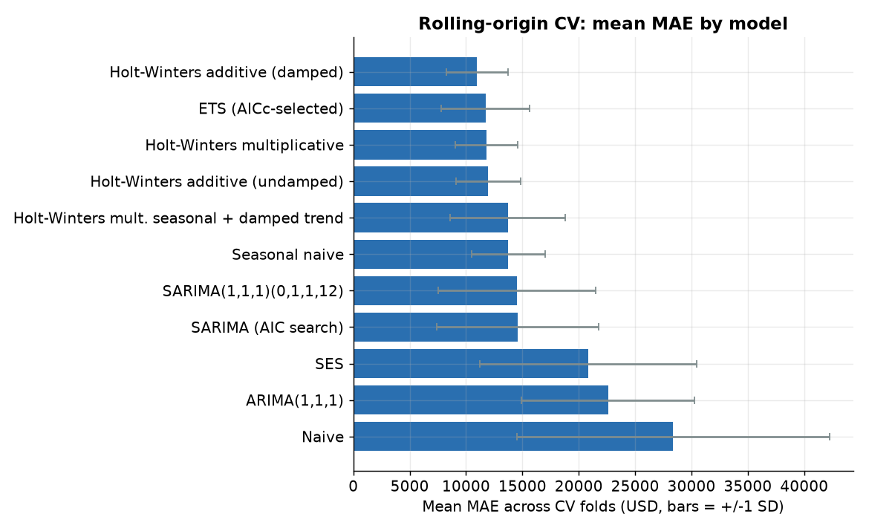
Forecast comparison: ARIMA vs SARIMA vs Holt-Winters
Model | CV MAE | CV MAPE % | 2018 MAPE %
Holt-Winters (damped) | 10,981 | 21.7 | 18.5
Seasonal naive | 13,739 | 25.0 | 24.5
SARIMA(1,1,1)(0,1,1,12) | 14,513 | 36.6 | 34.0
ARIMA(1,1,1) | 22,601 | 49.1 | 54.1
• Holt-Winters beat seasonal naive in 7 of 7 folds.
• SARIMA did not beat seasonal naive on average.
• With 48 months, SARIMA has little data to estimate from.
Holt-Winters gives the lowest error, but the gap to SARIMA is not statistically significant (p = 0.375)
Mayur Chauhan | Enrollment No.: [to be added] | DSC Individual Project
5
Notes:
Rolling-origin cross-validation: 7 folds, expanding window, horizon 6 months. Lower error is better. Holt-Winters wins, SARIMA did not beat the seasonal-naive baseline, ARIMA is worst. Caveat: only 48 months, folds overlap, Holt-Winters vs SARIMA is not statistically significant (p 0.375). Numbers from reports/RESULTS_SUMMARY.md.

Slide 6
Interactive Power BI dashboard
Screenshot to insert
Page 1: Overview
Screenshot to insert
Page 2: Forecasting Arena
Overview: KPIs, monthly sales, sales by category, Year and Region slicers. Forecasting Arena: model slicer, hold-out vs forecast, 2019 with 95% interval, accuracy table.
Power BI shows Holt-Winters (additive) as best: 2019 forecast about $910K, +24.1% vs 2018
Mayur Chauhan | Enrollment No.: [to be added] | DSC Individual Project
6
Notes:
Two pages built: Overview with KPI cards, monthly sales, category sales and Year and Region slicers; Forecasting Arena with a model slicer, hold-out chart, 2019 forecast with 95 percent interval and the accuracy table. Only two of the four planned pages are built. Screenshots are real screenshots of the report.

Slide 7
Findings, limits and conclusion
• Findings
• Margin is 29.5% with no discount and 11.6% at 10 to 20% discount.
• Lines discounted above 20% lose 135,376 in total.
• 22.2% of products give 80% of sales.
• Holt-Winters had the lowest forecast error.
• Limits
• Only 48 months of data.
• Cross-validation folds overlap, so p-values are indicative.
• Dashboard has 2 pages; the 2019 forecast is for the best model only.
• Discount and profit is an association, not proof of cause.
Conclusion: Holt-Winters forecasts retail sales best here, and the dashboard lets users compare the three methods
Mayur Chauhan | Enrollment No.: [to be added] | DSC Individual Project
7
Notes:
Business findings come from the analytics scripts. State the limits honestly: small sample, overlapping folds, only two dashboard pages, the 2019 forecast covers the best model only. Close by restating the answer to the title.

