Slide 1
Retail Sales Forecasting: A Comparison of ARIMA, SARIMA and Holt-Winters Using an Interactive Power BI Dashboard
Mayur Chauhan
Subject: Data Science Concepts (DSC) - Individual Project
L.J. Institute of Engineering and Technology

Slide 2
Problem statement and objectives
Retail managers need to know how much will sell next month, but monthly sales swing strongly with the season. Which forecasting method predicts them best, and how can the result be shared in an interactive dashboard?
Objectives
1. Profile and clean the raw sales data (data integrity)
2. Fit a sales trend with gradient descent and compare with the closed-form solution
3. Build an ETL pipeline and a star-schema warehouse
4. Compare Holt-Winters, ARIMA and SARIMA on the same 12-month hold-out (MAE, RMSE, MAPE)
5. Present KPIs and the forecast in an interactive Power BI dashboard
2

Slide 3
Dataset and DSC syllabus mapping
Dataset: public Sample - Superstore (REAL data), 9,994 order lines, Jan 2015 - Dec 2018
21 columns: orders, customers, products, geography, sales, quantity, discount, profit
Total sales $2,297,200.86; total profit $286,397.02; 793 customers; 1,862 products
Chapter | Topic applied in the project
Ch6 | Data cleaning and integrity: missing values, duplicates, types, scaling, encoding
Ch7 | Optimisation: gradient descent trend fit vs closed form (MSE)
Ch8 | Data engineering: ETL, staging, star schema, OLAP queries
Ch9 | Time series: Holt-Winters vs ARIMA vs SARIMA forecasting comparison
Ch10 | Visualisation: EDA charts and the Power BI dashboard
3

Slide 4
Data cleaning and ETL star schema
Cleaning (Ch6)
Raw rows: 10,800 -> clean rows: 9,994
806 stray empty rows removed (appended from other Excel sheets)
0 true duplicate rows after that
11 missing Postal Codes marked 'Unknown'; Postal Code stored as text
Dates parsed to real dates; 1,167 Sales outliers kept (genuine large orders)
Sales skewness 12.97 -> 0.28 with log transform
Star schema (Ch8): raw -> staging -> clean -> curated
Table | Rows
fact_sales | 9,994
dim_customer | 793
dim_product | 1,862
dim_geography | 632
dim_date | 1,826
All primary/foreign key integrity checks passed; total sales preserved.
4

Slide 5
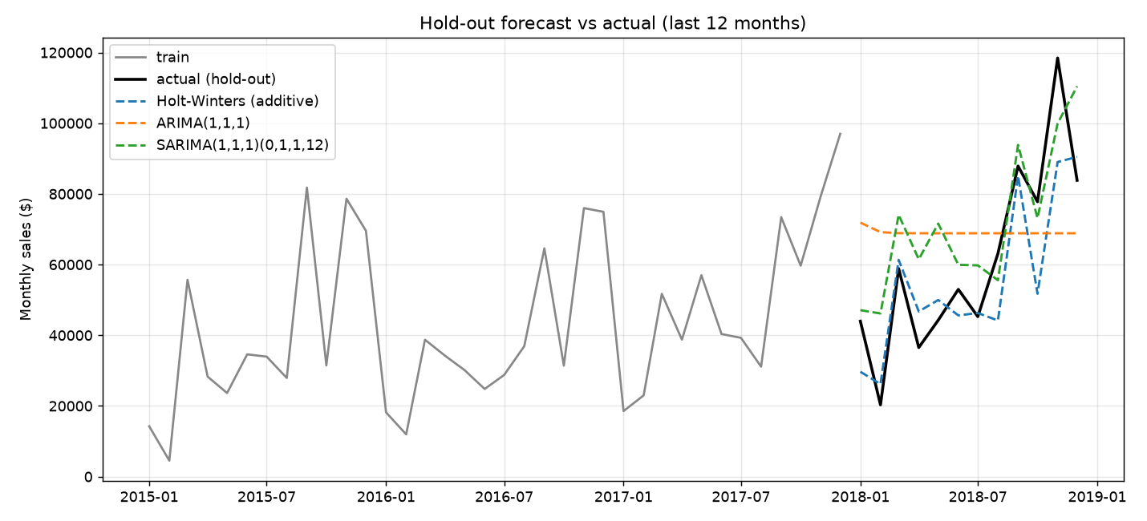
Forecasting comparison: Holt-Winters vs ARIMA vs SARIMA
Model | MAE | RMSE | MAPE %
Holt-Winters (additive) | 10,897 | 14,118 | 18.5
SARIMA(1,1,1)(0,1,1,12) | 15,105 | 17,571 | 34.0
ARIMA(1,1,1) | 23,451 | 27,208 | 54.1
Train: Jan 2015 - Dec 2017 (36 months); hold-out: all of 2018 (12 months).
Best: Holt-Winters (additive) - lowest error on all three metrics.
Plain ARIMA has no seasonal term, so it misses the strong Sep-Dec peaks.
5

Slide 6
Interactive Power BI dashboard
Power BI dashboard screenshots to be added
Data ready for import: data/curated (star schema) and data/forecast (actual + forecast with 95% interval).
6

Slide 7
Conclusion and future work
Conclusion
Holt-Winters (additive) was the most accurate on the 2018 hold-out: MAE 10,897, RMSE 14,118, MAPE 18.5%.
Sales show a rising trend (about $902 per month) and strong Q4 seasonality.
Discounts above 20% turn average profit negative.
Gradient descent matched the closed-form trend line exactly.
Future work
Longer history and external drivers (promotions, holidays)
Forecast by category and region
Tune ARIMA/SARIMA orders; try Prophet or gradient boosting
Automate the ETL pipeline and refresh the dashboard
7

