Slide 1
Retail Sales Forecasting: A Comparison of ARIMA, SARIMA and Holt-Winters Using an Interactive Power BI Dashboard
Mayur Chauhan
Subject: Data Science (DSC) - Individual Project
L.J. Institute of Engineering and Technology
Notes:
Introduce yourself and the title in one breath: I compared three forecasting methods (Holt-Winters, ARIMA, SARIMA) on real retail sales data and show the result in an interactive Power BI dashboard. This is my Data Science (DSC) individual project. About 20 seconds.

Slide 2
Problem statement and objectives
Retail managers need to know how much will sell next month, but monthly sales swing strongly with the season. Which forecasting method predicts them best, and how can the result be shared in an interactive dashboard?
Objectives
1. Profile and clean the raw sales data (data integrity)
2. Fit a sales trend with gradient descent and compare with the closed-form solution
3. Build an ETL pipeline and a star-schema warehouse
4. Compare Holt-Winters, ARIMA and SARIMA on the same 12-month hold-out (MAE, RMSE, MAPE)
5. Present KPIs and the forecast in an interactive Power BI dashboard
2
Notes:
Problem: managers need next month's sales, but sales swing with the season, so the choice of forecasting method matters. Say the 5 objectives in order: clean the data, fit a trend with gradient descent, build the ETL and star schema, compare the three methods on the same 12-month hold-out with MAE, RMSE and MAPE, and present it in Power BI. Likely viva question: why a hold-out? Answer: to test the model on data it has not seen, like real forecasting.

Slide 3
Dataset and DSC syllabus mapping
Dataset: public Sample - Superstore (REAL data), 9,994 order lines, Jan 2015 - Dec 2018
21 columns: orders, customers, products, geography, sales, quantity, discount, profit
Total sales $2,297,200.86; total profit $286,397.02; 793 customers; 1,862 products
Chapter | Topic applied in the project
Ch6 | Data cleaning and integrity: missing values, duplicates, types, scaling, encoding
Ch7 | Optimisation: gradient descent trend fit vs closed form (MSE)
Ch8 | Data engineering: ETL, staging, star schema, OLAP queries
Ch9 | Time series: Holt-Winters vs ARIMA vs SARIMA forecasting comparison
Ch10 | Visualisation: EDA charts and the Power BI dashboard
3
Notes:
Dataset: the public Sample Superstore, 9,994 order lines from Jan 2015 to Dec 2018, 21 columns; total sales $2,297,200.86, total profit $286,397.02, 793 customers, 1,862 products. Then show how each DSC chapter is used: Ch6 cleaning and transformation, Ch7 gradient descent, Ch8 ETL and star schema, Ch9 time series, Ch10 dashboard. Likely viva question: why this dataset? Answer: real, public, has dates over four years so it has trend and seasonality.

Slide 4
Data cleaning and ETL star schema
Cleaning (Ch6)
Raw rows: 10,800 -> clean rows: 9,994
806 stray empty rows removed (appended from other Excel sheets)
0 true duplicate rows after that
11 missing Postal Codes marked 'Unknown'; Postal Code stored as text
Dates parsed to real dates; 1,167 Sales outliers kept (genuine large orders)
Sales skewness 12.97 -> 0.28 with log transform
Star schema (Ch8): raw -> staging -> clean -> curated
Table | Rows
fact_sales | 9,994
dim_customer | 793
dim_product | 1,862
dim_geography | 632
dim_date | 1,826
All primary/foreign key integrity checks passed; total sales preserved.
4
Notes:
Cleaning (Ch6): raw 10,800 rows became 9,994 clean rows because 806 stray empty rows were removed; no true duplicates; 11 missing postal codes marked 'Unknown'; dates parsed; 1,167 sales outliers kept because they are genuine large orders; log transform reduced sales skewness from 12.97 to 0.28. ETL (Ch8): raw to staging to clean to curated star schema, with all key checks passed and total sales preserved. Likely viva question: why keep the outliers? Answer: they are real big orders, not errors.

Slide 5
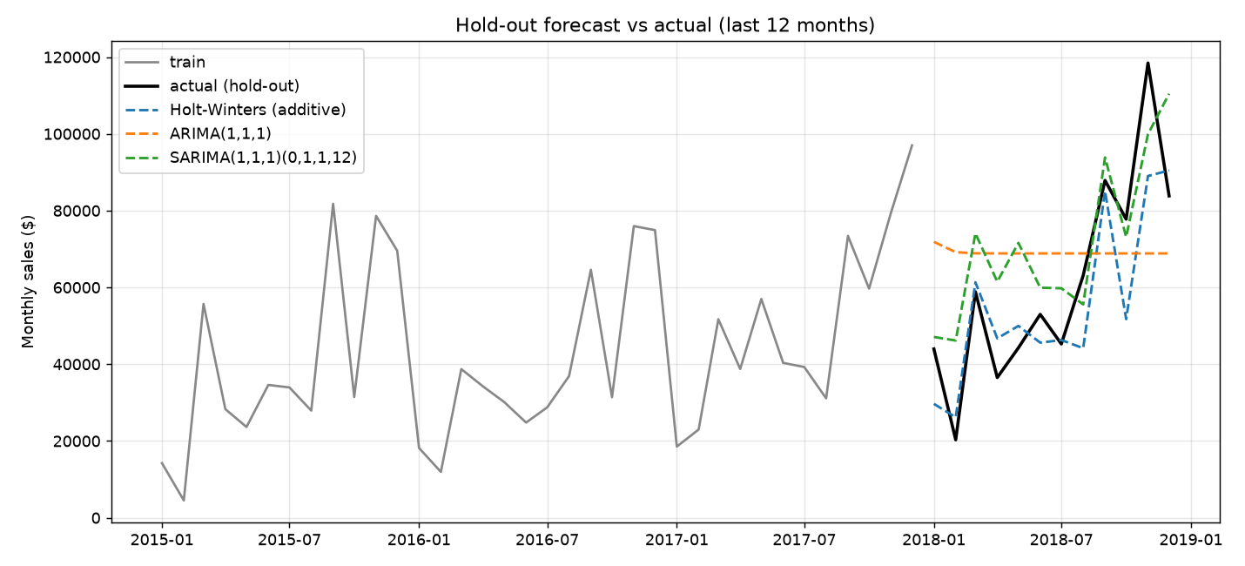
Forecasting comparison: Holt-Winters vs ARIMA vs SARIMA
Model | MAE | RMSE | MAPE %
Holt-Winters (additive) | 10,897 | 14,118 | 18.5
SARIMA(1,1,1)(0,1,1,12) | 15,105 | 17,571 | 34.0
ARIMA(1,1,1) | 23,451 | 27,208 | 54.1
Train: Jan 2015 - Dec 2017 (36 months); hold-out: all of 2018 (12 months).
Best: Holt-Winters (additive) - lowest error on all three metrics.
Plain ARIMA has no seasonal term, so it misses the strong Sep-Dec peaks.
5
Notes:
Method: train on Jan 2015 to Dec 2017 (36 months), test on all of 2018 (12 months). Holt-Winters additive was best on all three metrics. Plain ARIMA has no seasonal term, so it misses the Sep to Dec peaks; SARIMA adds the seasonal part. Point to the chart and the accuracy table. Likely viva question: why is Holt-Winters better here? Answer: strong stable seasonality and only 48 months of data suit exponential smoothing; SARIMA needs more data to estimate its parameters.

Slide 6
Interactive Power BI dashboard
Power BI dashboard screenshots to be added
Data ready for import: data/curated (star schema) and data/forecast (actual + forecast with 95% interval).
6
Notes:
Show the Power BI dashboard here (screenshots to be added): KPI cards for sales and profit, sales by category and region, the monthly trend, and the forecast with its 95% interval. The data for the dashboard comes from the curated star-schema tables and the forecast file. Likely viva question: why Power BI? Answer: interactive filters and drill-down let a manager explore the data without code.

Slide 7
Conclusion and future work
Conclusion
Holt-Winters (additive) was the most accurate on the 2018 hold-out: MAE 10,897, RMSE 14,118, MAPE 18.5%.
Sales show a rising trend (about $902 per month) and strong Q4 seasonality.
Discounts above 20% turn average profit negative.
Gradient descent matched the closed-form trend line exactly.
Future work
Longer history and external drivers (promotions, holidays)
Forecast by category and region
Tune ARIMA/SARIMA orders; try Prophet or gradient boosting
Automate the ETL pipeline and refresh the dashboard
7
Notes:
Conclusion: Holt-Winters additive was most accurate on the 2018 hold-out (MAE 10,897, RMSE 14,118, MAPE 18.5%); sales rise about $902 per month with strong Q4 seasonality; discounts above 20% turn average profit negative; gradient descent matched the closed-form trend line. Future work: more history and outside drivers, forecasts by category and region, tuning ARIMA/SARIMA, and automating the pipeline. Limitation to mention honestly: only 48 months of data, so accuracy is modest.

