Slide 1
WELCOME

Slide 2
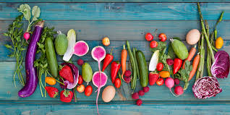
Online Vegetables Shopping System

Slide 3
Sudhir Bhosale 1124 Mayur Kadam 1162
SUBMITTED BY:

Slide 4
Presentation Outline:-
—Introduction
—Motivation
—Objectives
—Description of system
—Languages & Tools
—Testing
—Limitations
—Future Plan
—Conclusion

Slide 5
Introduction
The WEB BASED ONLINE SHOPPING SYSTEM project mainly focuses on basic operations adding new product, new member and updating new information , searching product and members and facility to online shopping. This system has three main modules
Insertion to database module -user friendly input screen
Extracting from database module-Attractive output screen
Search facility system –search for shopping.

Slide 6
Motivations
The WEB BASED ONLINE SHOPPING SYSTEM project mainly focuses on basic operations adding new product, new member and updating new information searching product and members and facility to online shopping. This system has three main modules
Insertion to database module -user friendly input screen
Extracting from database module-Attractive output screen
Search facility system –search for shopping.

Slide 7
Objectives
The key objective to support the aims are :
The objective of the Shopping systems is to increase the point of customer choice
Reduce time used in
Efficiency in buying product.
To overcome problems like bargaining , quality ,quantity
To produce a web-based system that allows the customer to buy vegetables
online

Slide 8
Description of system
Customer functionality:
Here customer will see the all list of vegetables that added by Shopper ,he can add , update ,delete from shopping cart and at the end he placed order through one time password
Admin Management:
It provides facility to add, update, delete and view the customr as well as shopper details , also admin confirm the order placed by customer
Shop Owner Management:
The shop owner can view the list of vegetables , can add, update vegetable like change price , update quantity and delete the vegetables.

Slide 9
Languages & Tools
Languages | Tools
JSP | Eclipse IDE
CSS 3 | Visual Studio Code
JavaScript | Hibernate ORM
Bootstrap
HTML 5
SQL

Slide 10
Testing
After giving all input we should to check that is our system work perfectly or not . Here is some screen-shot of our system

Slide 11
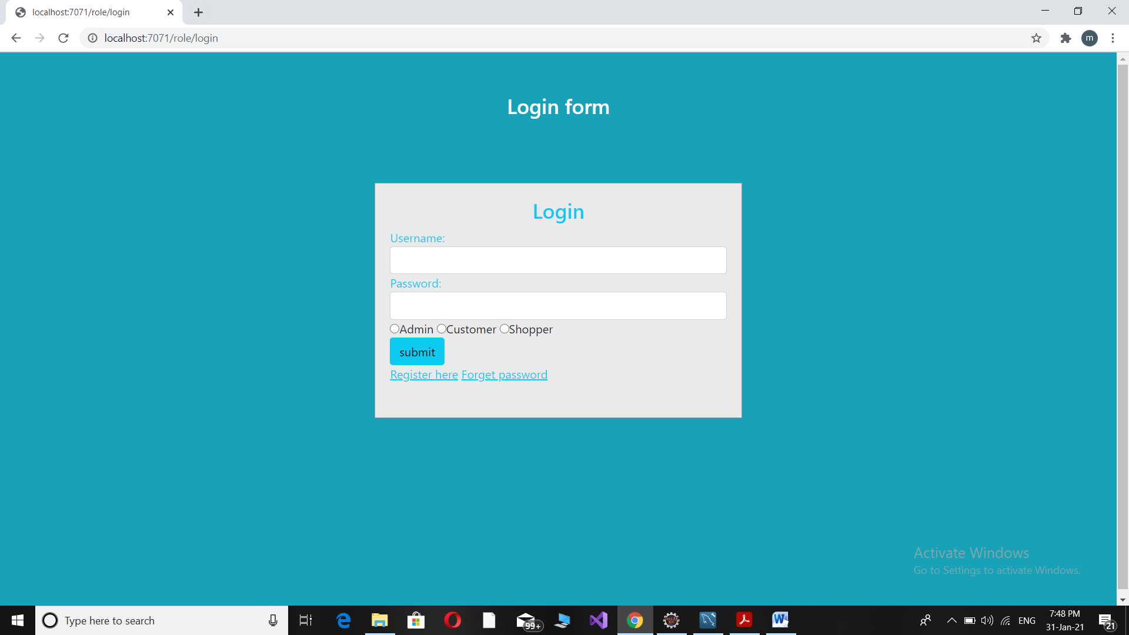
Login form

Slide 12
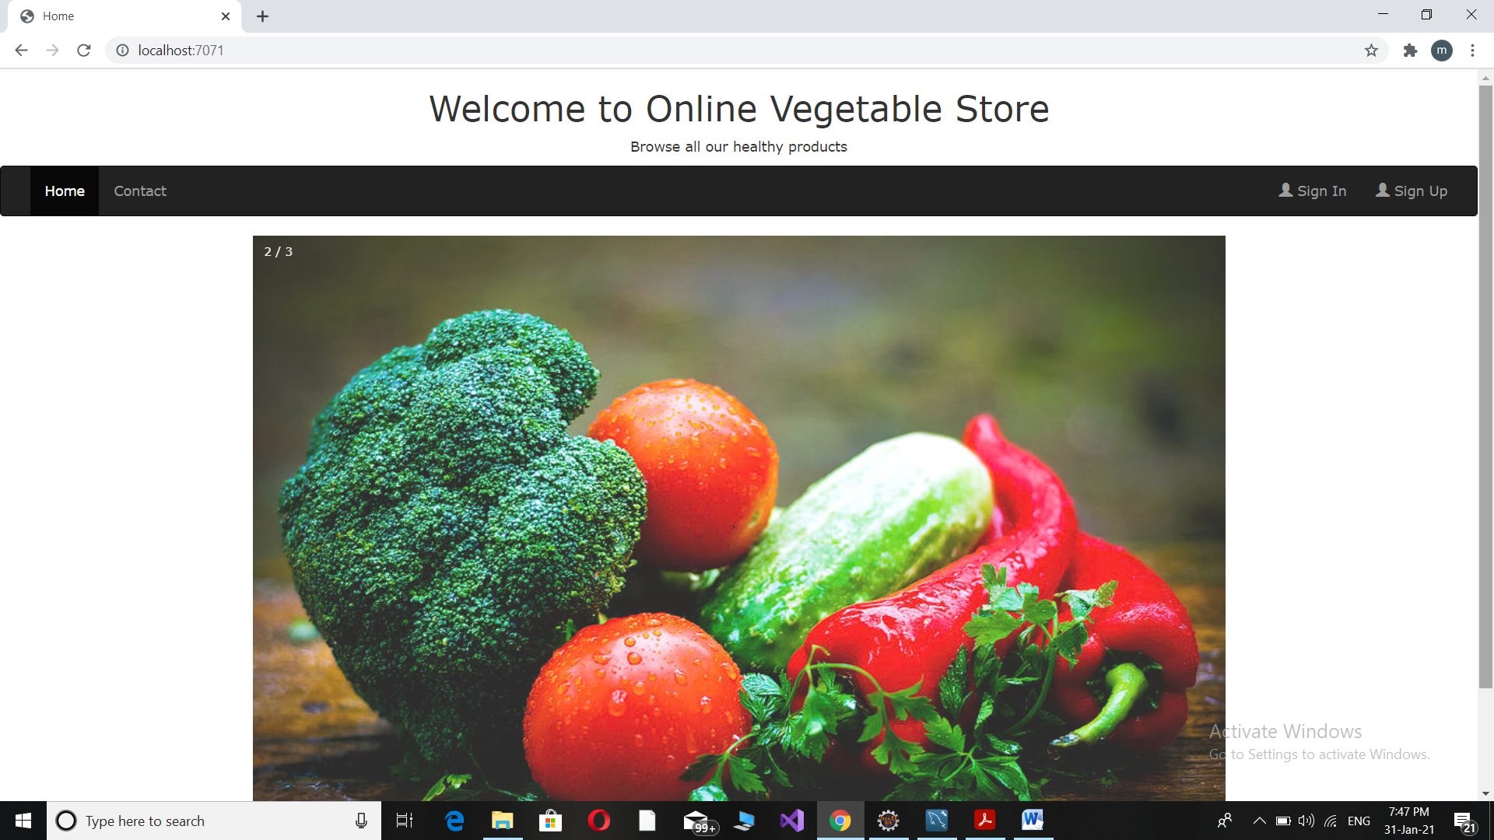
Home Page

Slide 13
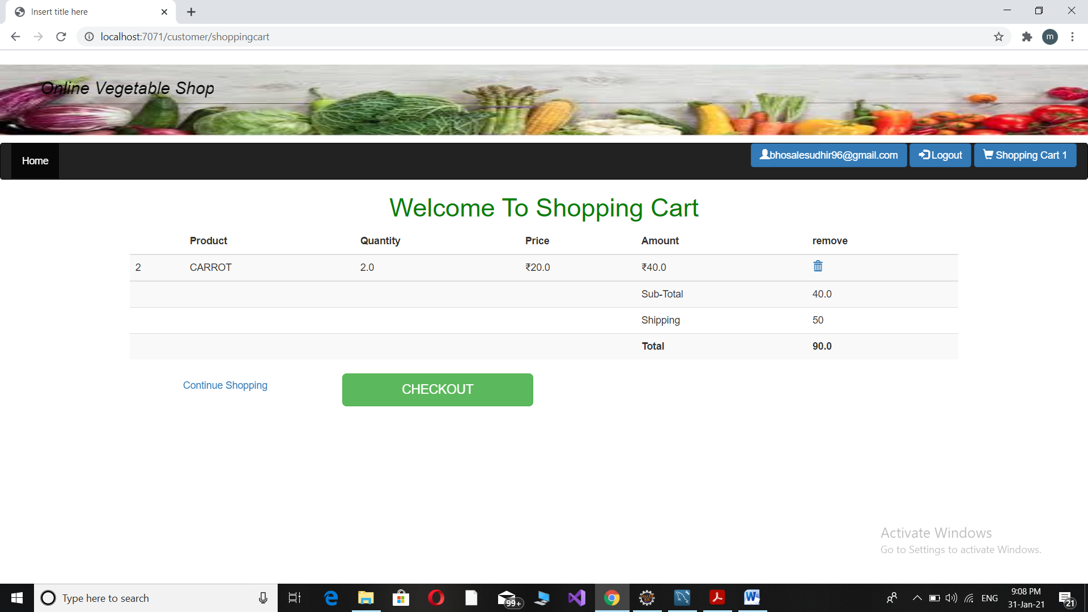
Shopping Cart Before Checkout

Slide 14
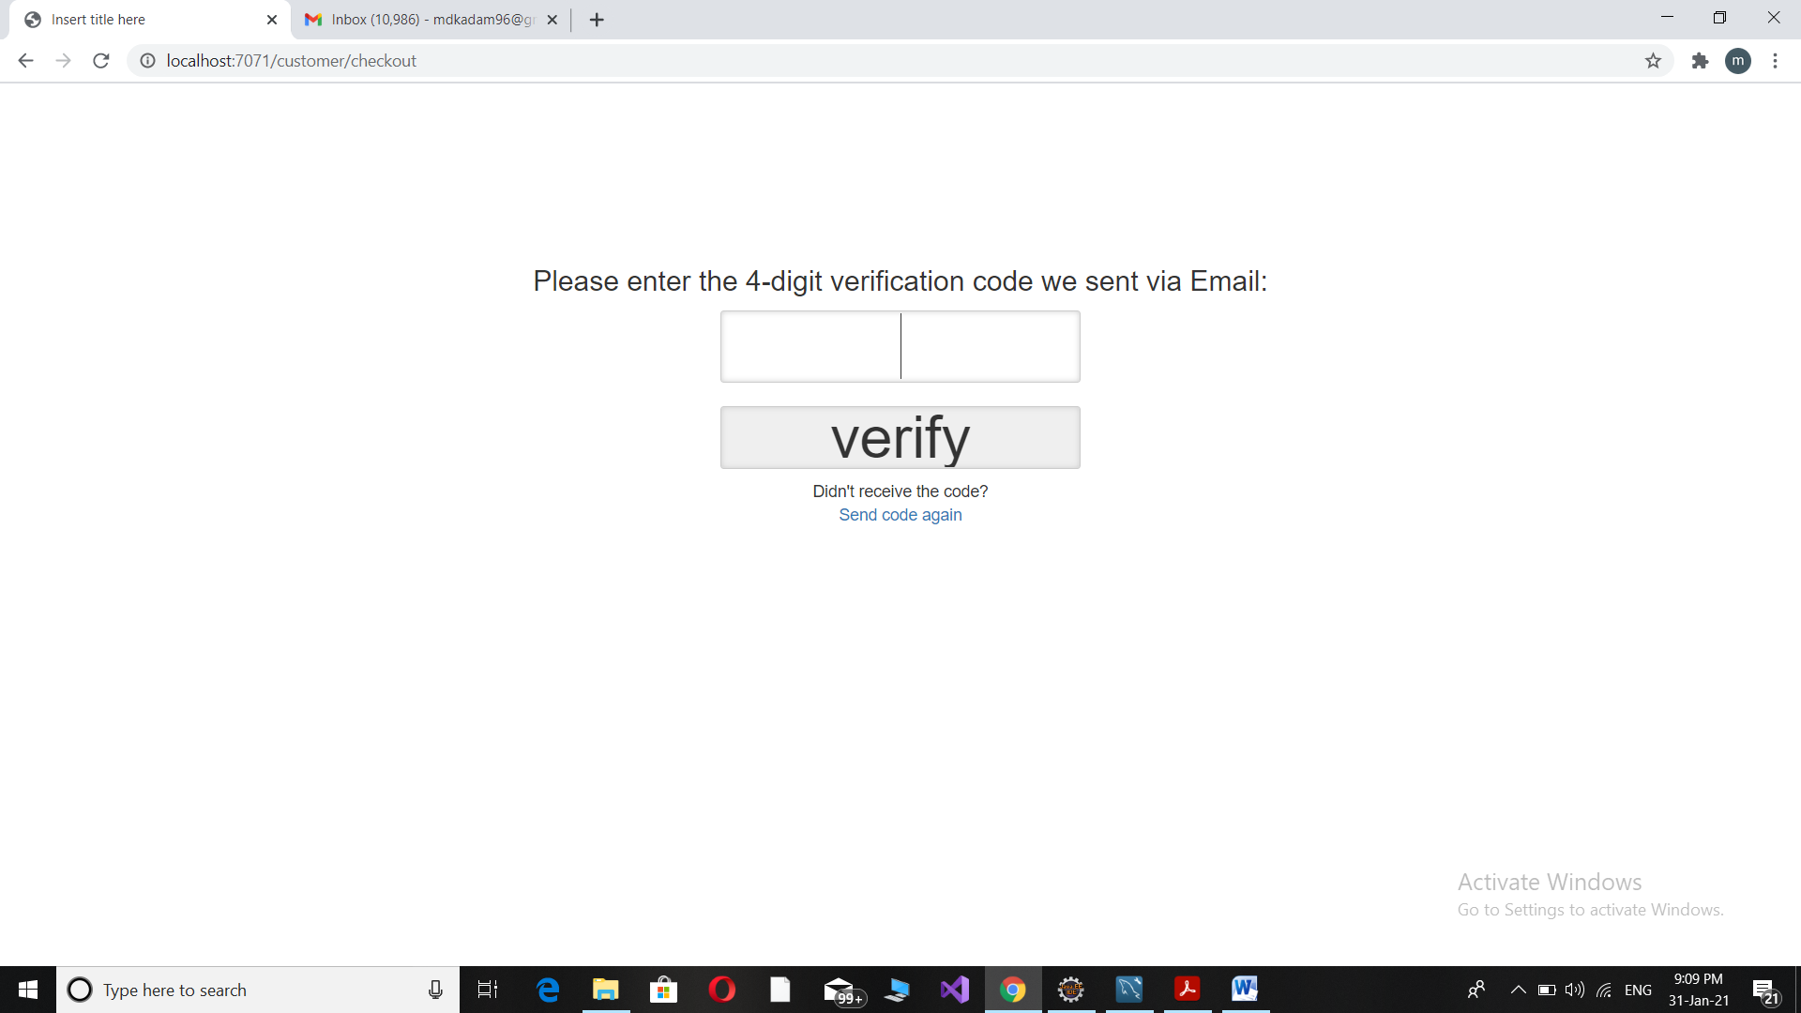
Verify OTP to placed Order

Slide 15
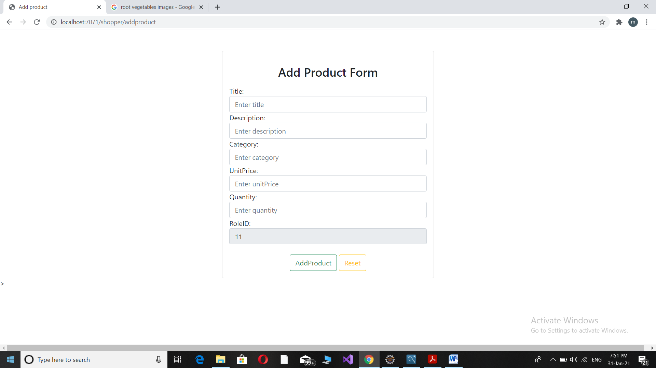
Add/Update Product

Slide 16
Limitations
We can not perform search operation by vegetables image.
Once Order placed after verifying OTP customer can not modified the orders
but before verifying OTP Customer can modified orders.
Customer Cant update the Password but he can get password return back
through forgot password.
Many necessary features are not available now for both user and admin.

Slide 17
Future Plan
We are thinking of some modifications and adding some advanced new features in out system. Some of them are:-
GUI modification (more user friendly).
Users can signup / login using their social media account such as Facebook.
Add more feature in admin panel.

Slide 18
Conclusion
In new system customers buy vegetables with reasonable rates and discounts, customers get the products at their doorstep.
This system is for all who don’t have time to purchase vegetables and farmers who has to sell their product to customers directly

