Slide 1


Slide 2
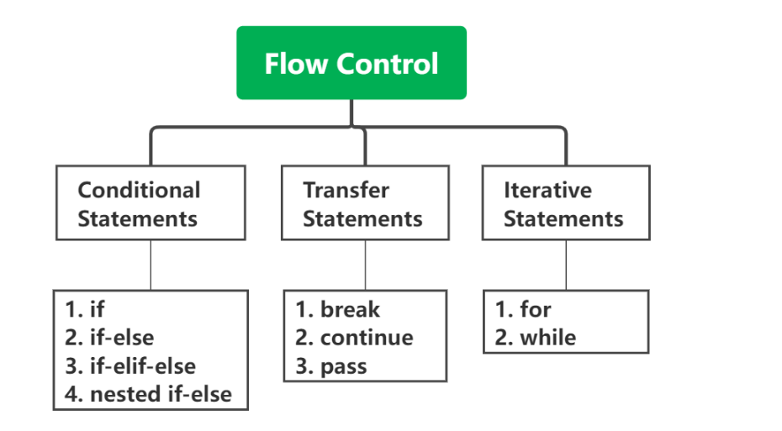
Python Control Statements

Slide 3
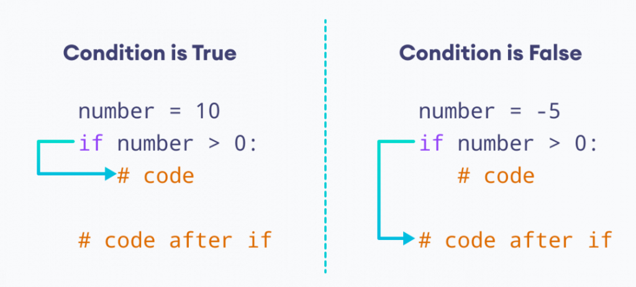
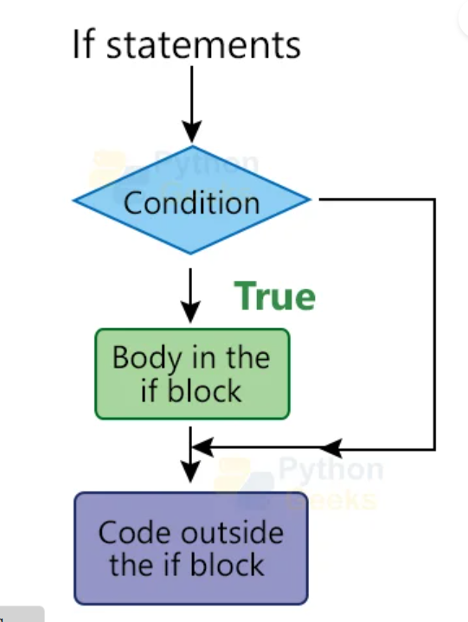
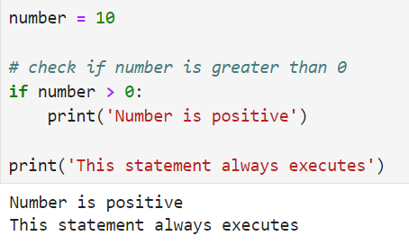
Conditional statement (if)

Slide 4
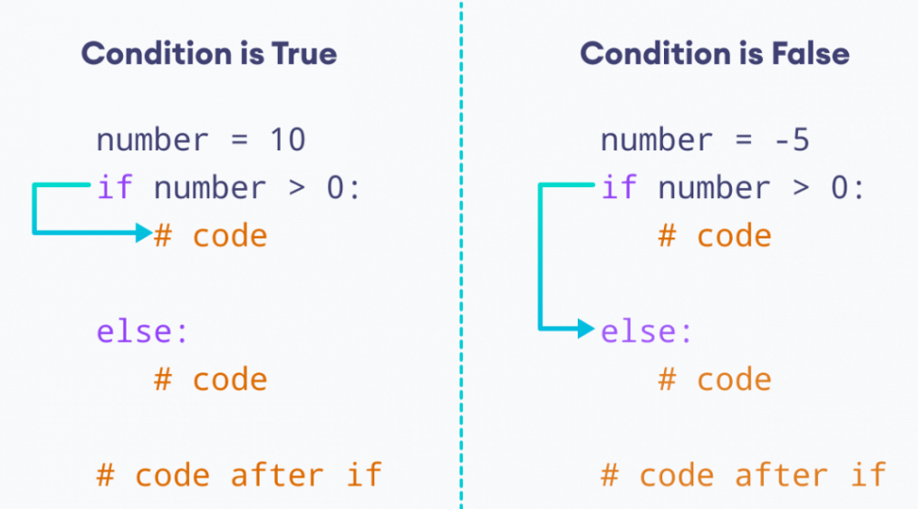
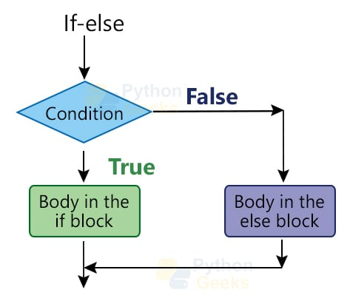
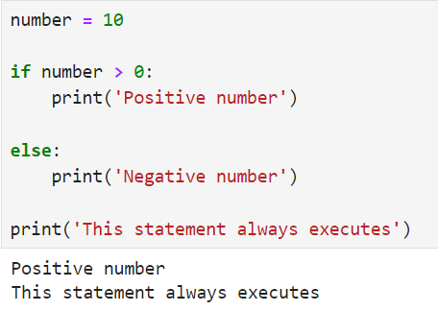
If else

Slide 5
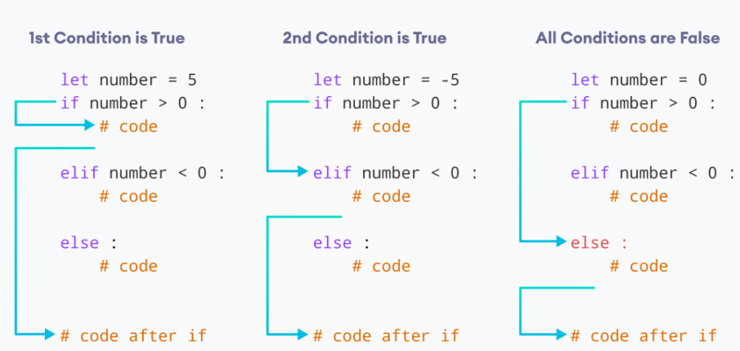
If…. elif…. else

Slide 6
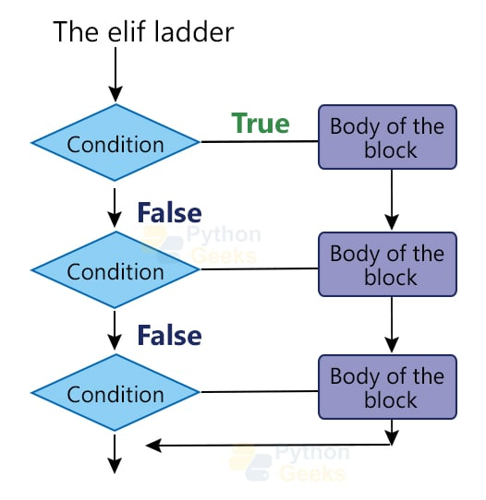
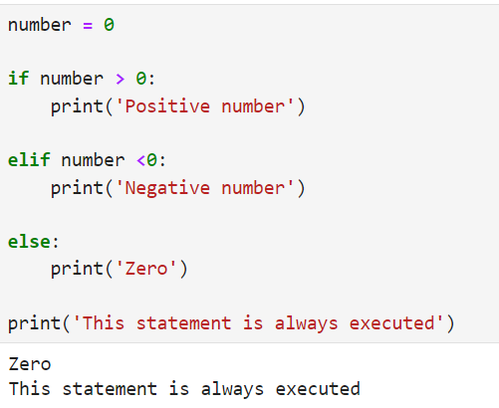
If…. elif…. else

Slide 7
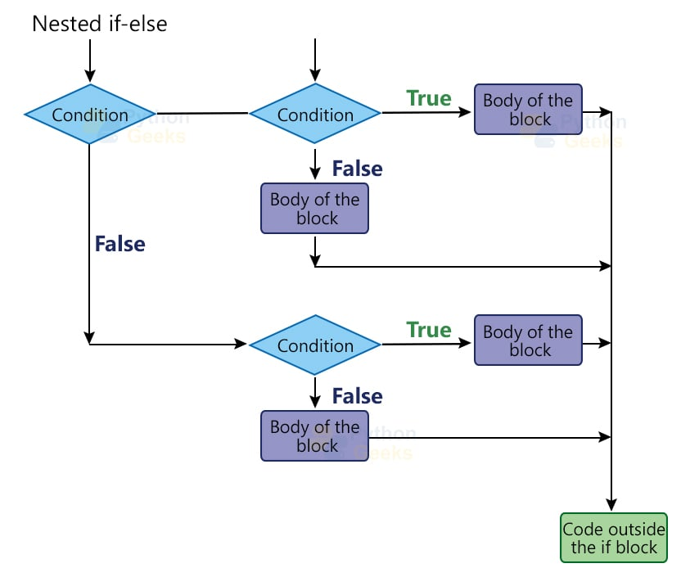
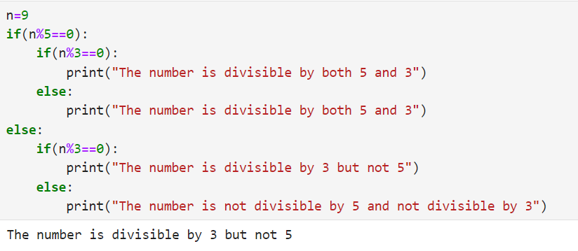
Nested if

Slide 8
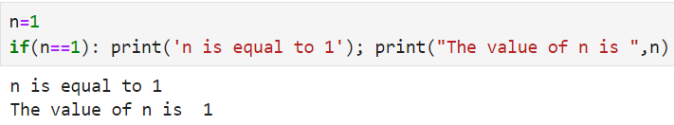

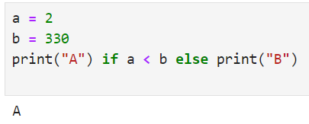
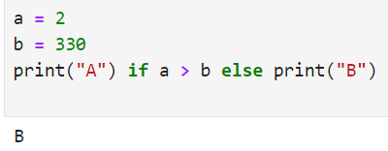
Short hand if (Single and Multiple Line)
Short hand if….else

Slide 9
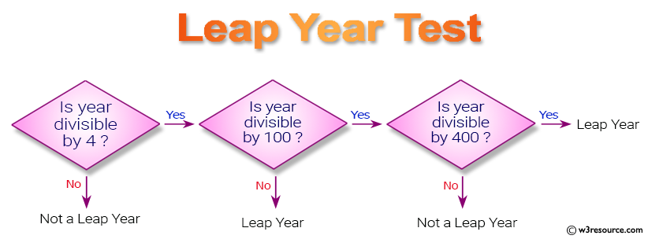
Exercise (Write each Program with comments)
Write a prog to check if the person has the right to vote age is more than or equal to 18
Write a prog to find the greatest among the three numbers.
Write a prog to check if the year is a leap year or not.
Write a program to print the triangle as either equilateral or isosceles or scalene(Sides are given)
Write a Python program to convert temperatures to and from Celsius and Fahrenheit. fahrenheit = (celsius * 9/5) + 32
Expected Output : 60°C is 140 in Fahrenheit 45°F is 7 in Celsius

Slide 10
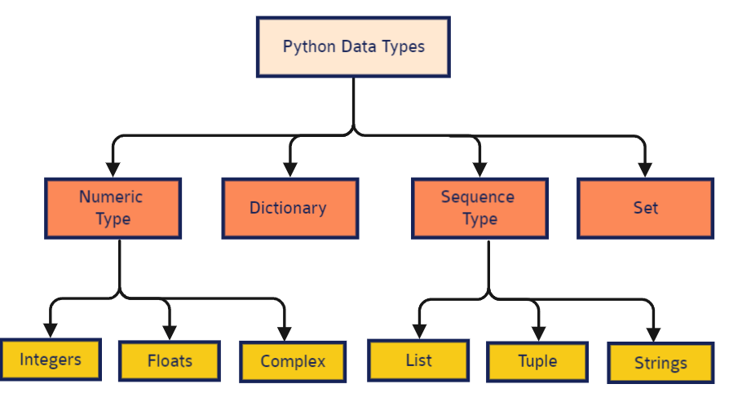
Python Data Types

Slide 11
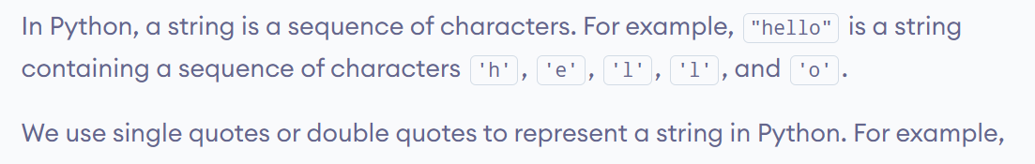
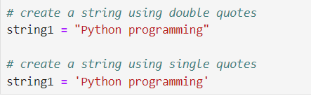
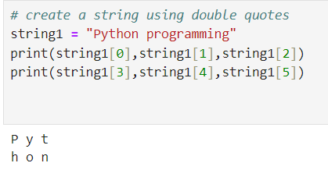
String data-type in python
Declaring string & Indexing in String

Slide 12
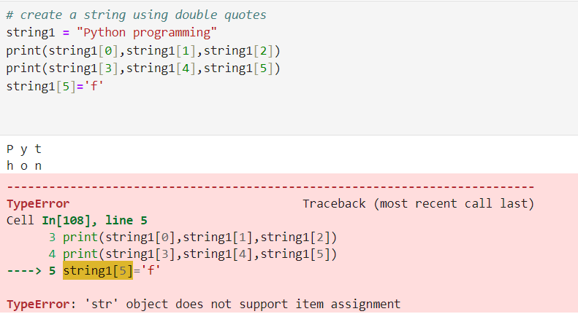
Python Strings are Immutable

Slide 13
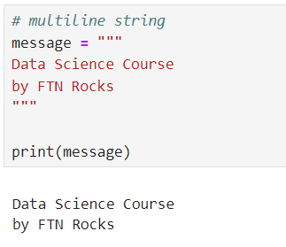
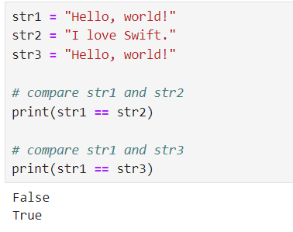
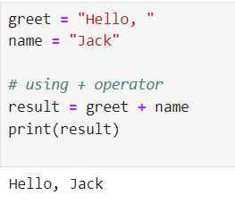
Python Multiline String
Comparing Strings
Join Two or More Strings

Slide 14
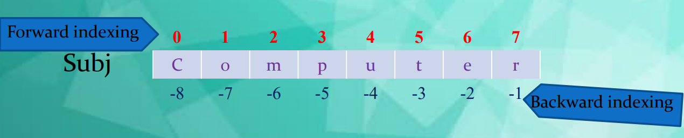
String
A String is a group of valid characters enclosed in Single or Double quotation marks.
A string can group any type of known characters i.e. letters ,numbers and special characters.
A Python string is a sequence of characters and each character can be accessed by its index either by forward indexing or by backward indexing. e.g. subj=“Computer”

Slide 15
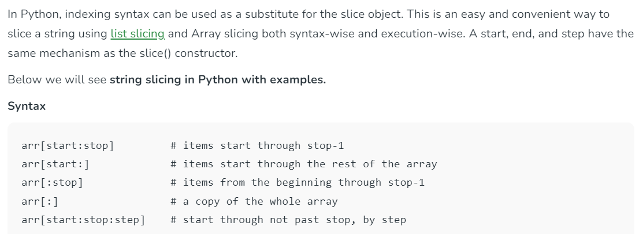
String slicing in python

Slide 16
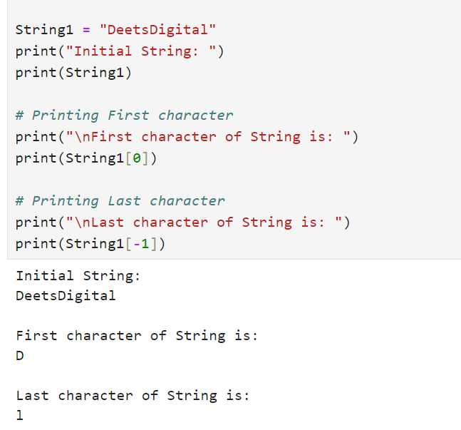
String Slicing in Python

Slide 17
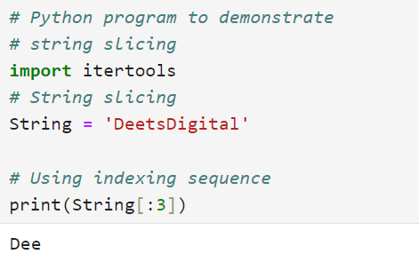
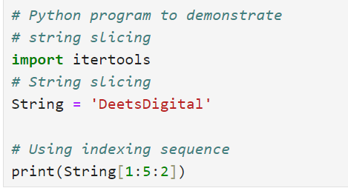
String slicing in python
Output???
Output???

Slide 18
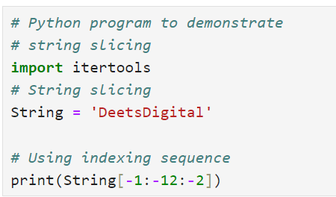
String slicing in python
String Built-in Functions
Output???

Slide 19
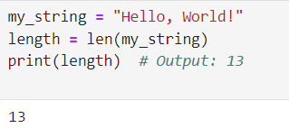
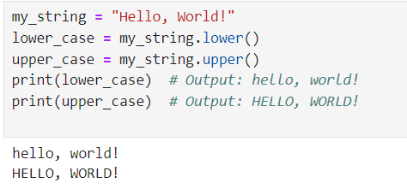
len(): Returns the length of the string
lower() and upper(): Convert a string to lowercase or uppercase.

Slide 20
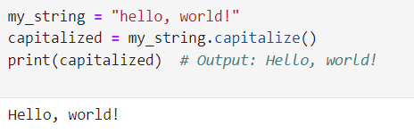
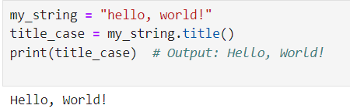
capitalize(): Capitalize the first letter of the string.
title(): Convert the first letter of each word to uppercase.

Slide 21
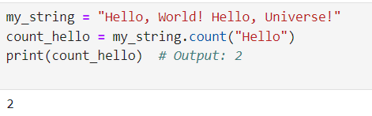
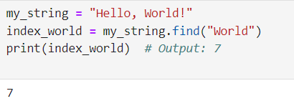
count(): Count occurrences of a substring in the string
find() and index(): Find the index of a substring in the string.
Note: find() returns -1 if the substring is not found, while index() raises a ValueError.

Slide 22
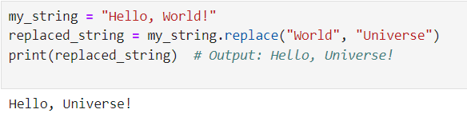
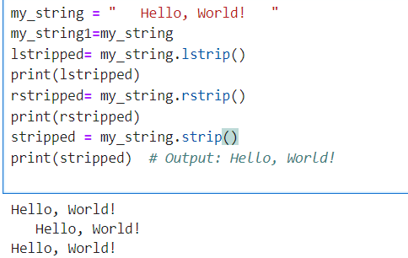
replace(): Replace occurrences of a substring with another string
strip(), lstrip(), and rstrip(): Remove leading and trailing whitespaces.

Slide 23
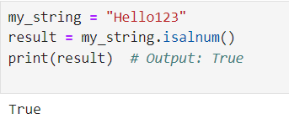
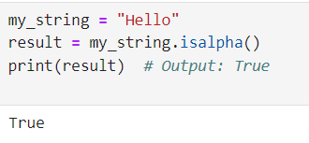
isalnum(): Returns True if all characters in the string are alphanumeric (consists of only letters and numbers), False otherwise.
isalpha(): Returns True if all characters in the string are alphabetic (consists of only letters), False otherwise.

Slide 24
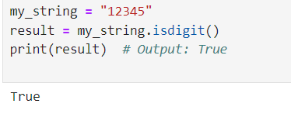
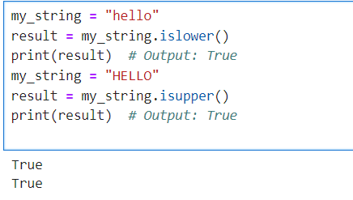
Islower() and isupper()
isdigit(): Returns True if all characters in the string are digits (numeric characters), False otherwise.

Slide 25
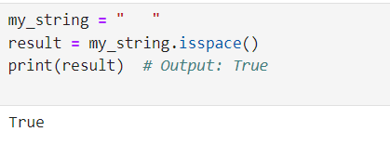
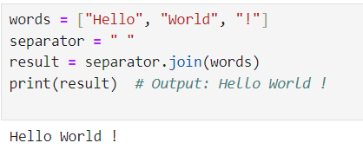
isspace(): Returns True if all characters in the string are whitespace characters (e.g., space, tab, newline), False otherwise
join(): Joins elements of an iterable (e.g., a list) into a string using the specified string as a separator

Slide 26
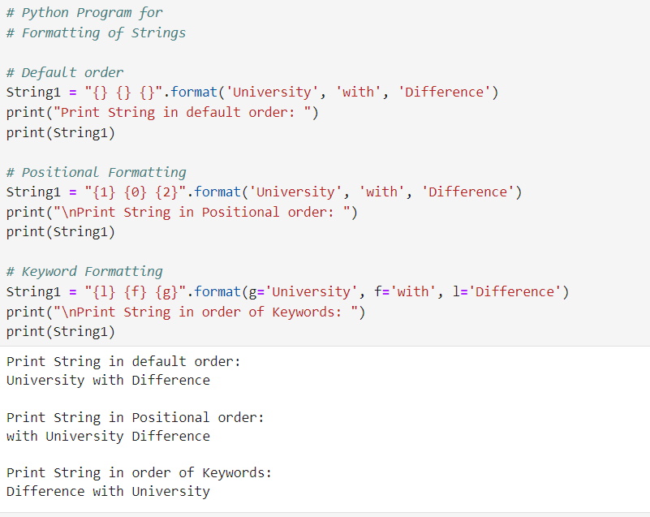
Formatting string

Slide 27
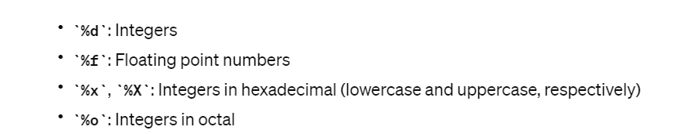
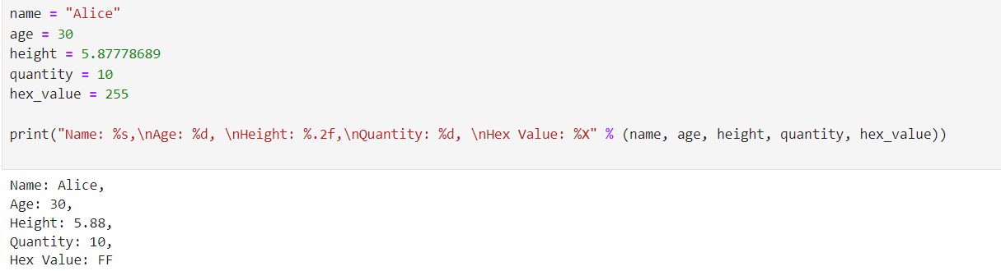
Formatting numeric and strings

Slide 28
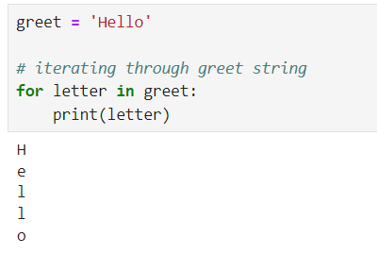
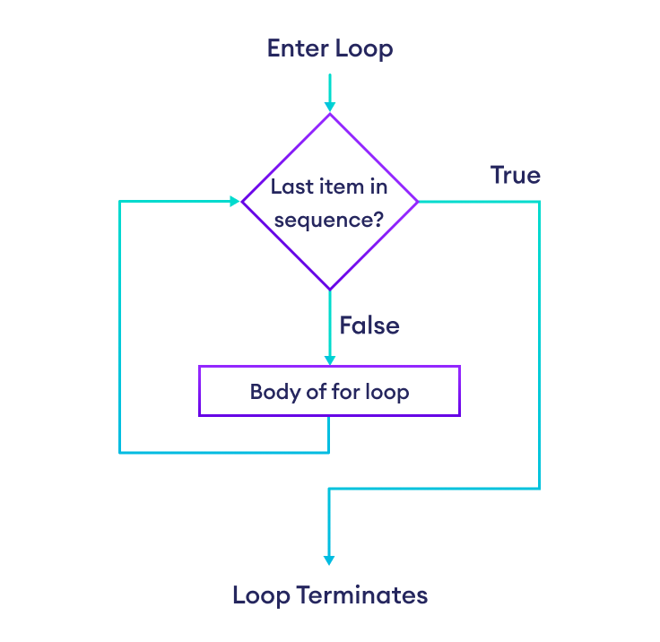
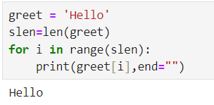
Iterate Through a Python String(for loop)
Type 1
Type 2

Slide 29


For loops Variants

Slide 30

For Loop Exercise
Print first 10 numbers using a for loop
Print sum of all even numbers from 10 to 20
Calculate the square of first 10 number using a for loop
Calculate the sum of all numbers from 1 to a given number
Find the factorial of a given number
Calculate the cube of all numbers from 1 to a given number
Print the given pattern using for loop

Slide 31

Transfer Statements

Slide 32


Break Statement in Python

Slide 33


Break Nested Loop in Python
Break Outer Loop in Python

Slide 34

Continue Statement in Python

Slide 35


continue statement in for loop

Slide 36

Continue Statement in Nested Loop
1x5,2X5,3X5,4X5,5X5…..missing

Slide 37

Continue Statement in Outer loop
Even value table is not printed in output
(ex 2,4,6..)

Slide 38


Pass Statement in Python

Slide 39

Using else Statement with for Loop

Slide 40


Using else Statement with for Loop
Using break Statement with for Loop and else

Slide 41


While loop
The while loop statement repeatedly executes a code block while a particular condition is true.

Slide 42


Check how many times a given number can be divided by 3 before it is less than or equal to 10.

Slide 43

If-else in while loop

Slide 44

else in while loop

Slide 45
Write all the programs with While Loop
Print first 10 numbers
Print sum of all even numbers from 10 to 20
Calculate the square of first 10 number using while loop
Calculate the sum of all numbers from 1 to a given number
Find the factorial of a given number
Calculate the cube of all numbers from 1 to a given number
Print the given pattern using while loop

Slide 46




Contact Us
FLY THE NEST
Connekt,
13TH Floor, Gala Empire, Thaltej,
Ahmedabad, Gujarat, India
+91 6354283836
info@flythenest.in
www.flythenest.in

Slide 47
Thank You

