Slide 1
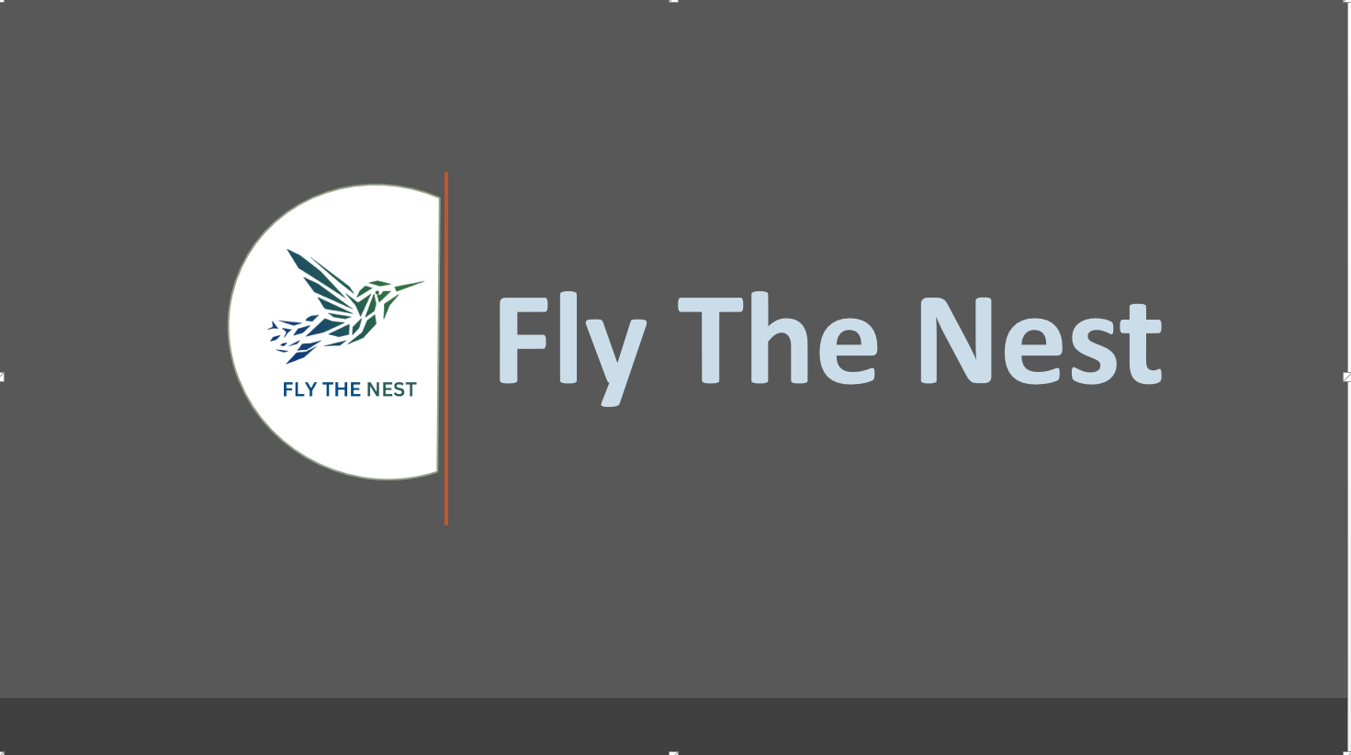

Slide 2
Functions in Python
Python Functions is a block of statements that return the specific task. The idea is to put some commonly or repeatedly done tasks together and make a function so that instead of writing the same code again and again for different inputs, we can do the function calls to reuse code contained in it over and over again.
Some Benefits of Using Functions
Increase Code Readability
Increase Code Reusability

Slide 3
Types of Functions in Python
There are three types of functions in Python:
Built-in functions, such as help() to ask for help, min() to get the minimum value, print() to print an object to the terminal etc.
User-Defined Functions (UDFs), which are functions that users create to help them out;
Anonymous functions, which are also called lambda functions because they are not declared with the standard def keyword.
Built-in Function
User Defined Functions
Anonymous Functions

Slide 4
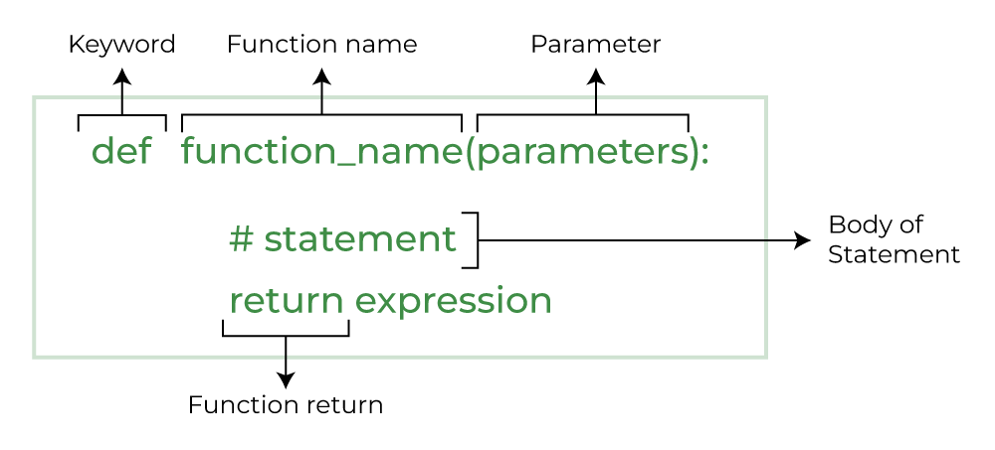
Creating a user-defined Function
The four steps to defining a function in Python are the following:
Use the keyword def to declare the function and follow this up with the function name.
Add parameters to the function: they should be within the parentheses of the function. End your line with a colon.
Add statements that the functions should execute.
End your function with a return statement if the function should output something. Without the return statement, your function will return an object None.

Slide 5
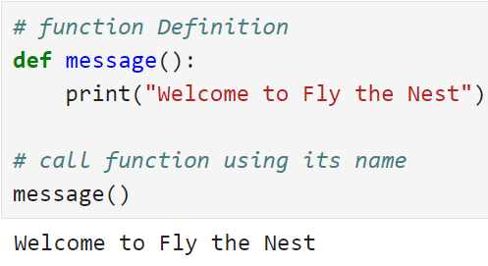
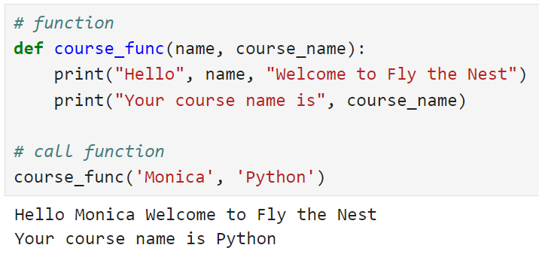
Creating & Calling a function
1
2

Slide 6
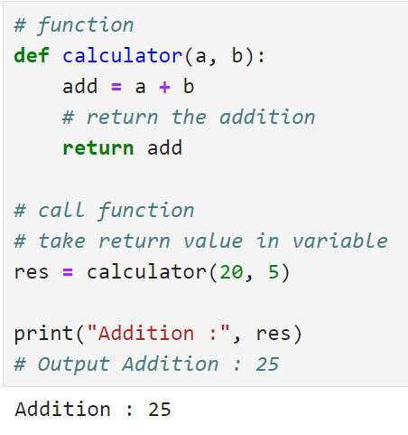
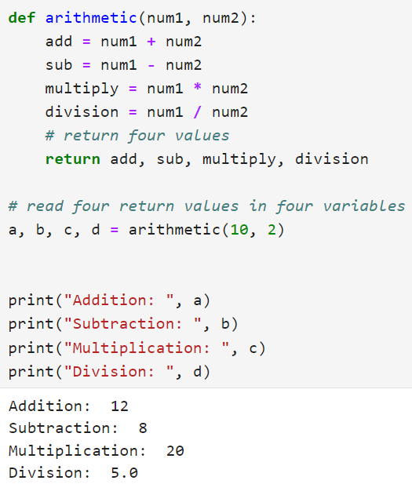
Returning a value/values from a function

Slide 7
Assignment
Create a function to pass a number to a function and print/return that the number is odd or even
Pass a number to a function and check that the number is Armstrong or not.
Pass a List of items in the function and return all even numbers.
Write a Python function to check whether a number falls within a given range.
Write a Python function that accepts a string and counts the number of upper and lower case letters. Sample String : 'The quick Brow Fox‘ Expected Output : No. of Upper case characters : 3 No. of Lower case Characters : 12
Write a Python function that takes a number as a parameter and checks whether the number is prime or not.
Write a Python program that accepts a hyphen-separated sequence of words as input and prints the words in a hyphen-separated sequence after sorting them alphabetically. Sample Items : green-red-yellow-black-white Expected Result : black-green-red-white-yellow
Write a Python function to create and print a list where the values are the squares of numbers between 1 and 30 (both included).

Slide 8
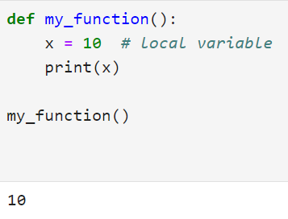
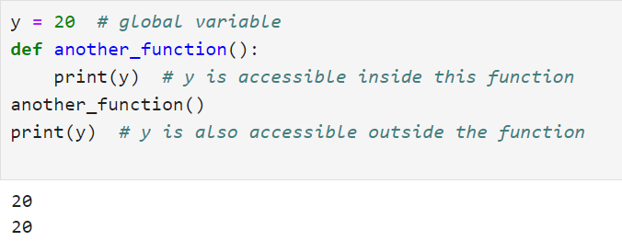
Scope and Lifetime of Variables
Local Scope: Variables defined within a certain block of code, such as a function, are said to have local scope. This means they are only accessible within that specific block or function. Once the block or function exits, the variables cease to exist, and you cannot access them from outside that block.
Global Scope: Variables defined outside of any function or block, at the top level of a program, have global scope. They are accessible from anywhere in the program, including from within functions.
Note: Local variable will have precedence over global variable in local variable’s scope.
Note: The inner function does have access to the outer function’s local scope.

Slide 9
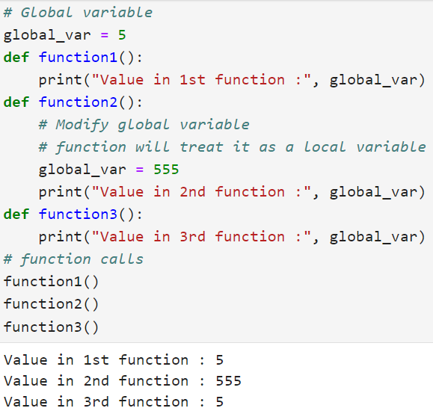
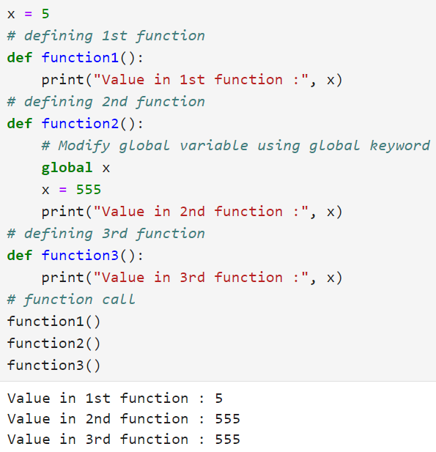
Global Keyword in Function

Slide 10
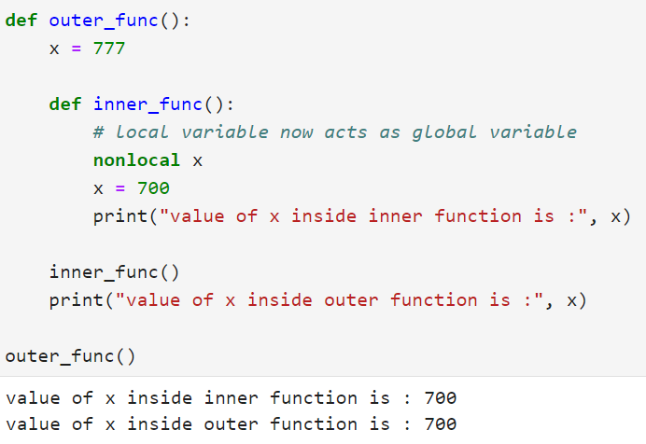
Nonlocal Variable in Function
In Python, nonlocal is the keyword used to declare a variable that acts as a global variable for a nested function (i.e., function within another function).
We can use a nonlocal keyword when we want to declare a variable in the local scope but act as a global scope.

Slide 11
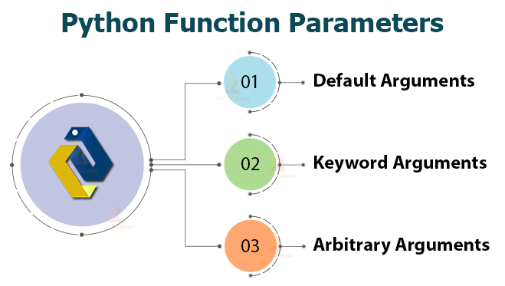
Python Function Arguments/Parameters

Slide 12
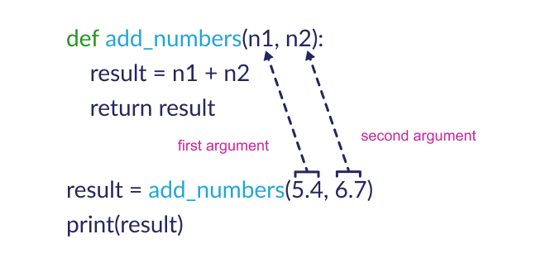
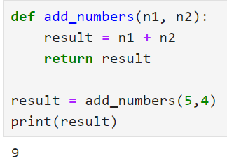
Positional Arguments
Positional arguments are arguments that are pass to function in proper positional order.
That is, the 1st positional argument needs to be 1st when the function is called.
The 2nd positional argument needs to be 2nd when the function is called, etc.

Slide 13
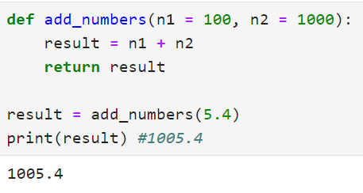
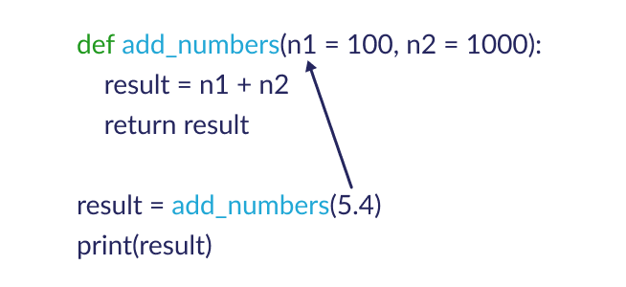
Python Default Arguments
Function arguments can have default values in Python. The default arguments are parameters in a function definition that have a predefined value assigned to them.
These default values are used when an argument for that parameter is not provided during the function call.

Slide 14
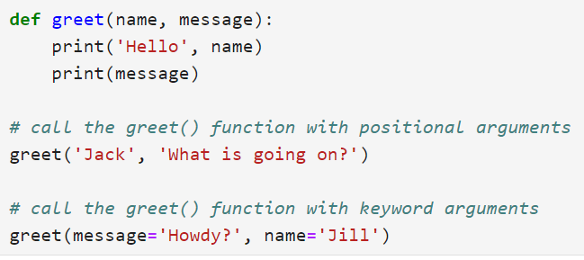
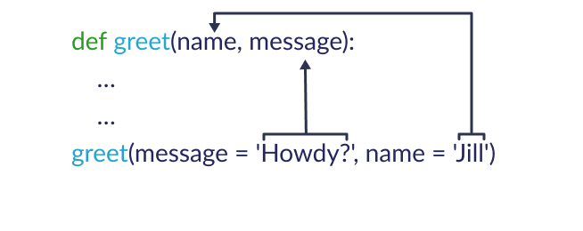
Keyword Arguments
In Python, keyword arguments are a way to pass arguments to a function using the parameter names explicitly.
Instead of relying on the order of the arguments, keyword arguments allow you to specify the argument along with its corresponding parameter name.

Slide 15
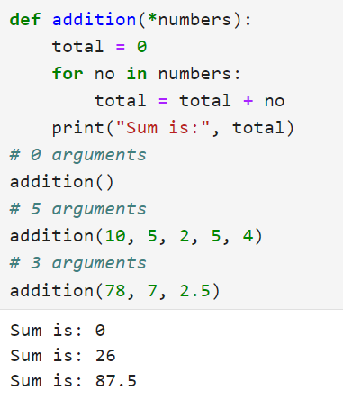
Variable-length Arguments (positional)
In Python, sometimes, there is a situation where we need to pass variable numbers of arguments to the function.
Such types of arguments are called variable-length arguments.
We can declare a variable-length argument with the * (asterisk) symbol.
Internally all these values are represented in the form of a tuple.

Slide 16
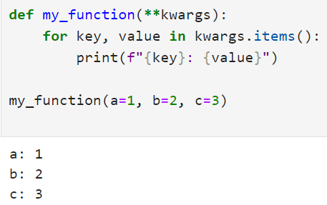
Variable-length Arguments(Keyword)
**kwargs allows the function to accept an arbitrary number of keyword arguments.
The **kwargs parameter collects the keyword arguments into a dictionary within the function.
This is useful when you want to pass a variable number of keyword arguments to a function.

Slide 17
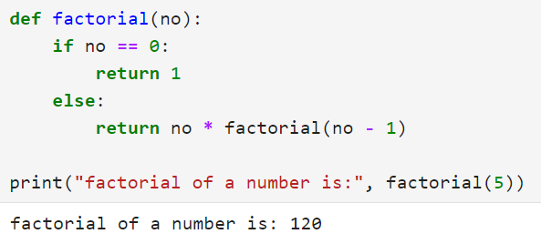
Recursive Function
A recursive function is a function that calls itself, again and again.
Consider, calculating the factorial of a number is a repetitive activity, in that case, we can call a function again and again, which calculates factorial.

Slide 18
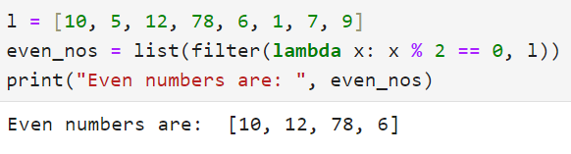
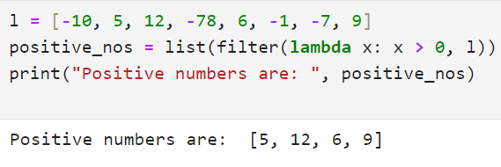
Python Anonymous/Lambda Function
Sometimes we need to declare a function without any name. The nameless property function is called an anonymous function or lambda function.
The reason behind using anonymous function is for instant use, that is, one-time usage. Normal function is declared using the def function. Whereas the anonymous function is declared using the lambda keyword.
In opposite to a normal function, a Python lambda function is a single expression. But, in a lambda body, we can expand with expressions over multiple lines using parentheses or a multiline string.
filter() function in Python
In Python, the filter() function is used to return the filtered value. We use this function to filter values based on some conditions.

Slide 19
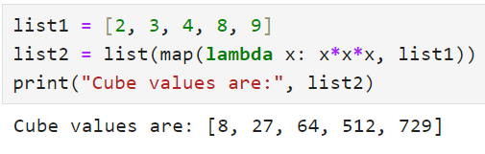
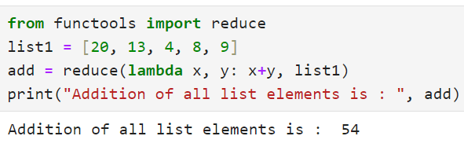
Python Anonymous/Lambda Function
reduce() function in Python
map() function in Python
In Python, the map() function is used to apply some functionality for every element present in the given sequence and generate a new series with a required modification.
In Python, the reduce() function is used to minimize sequence elements into a single value by applying the specified condition.
The reduce() function is present in the functools module; hence, we need to import it using the import statement before using it.

Slide 20
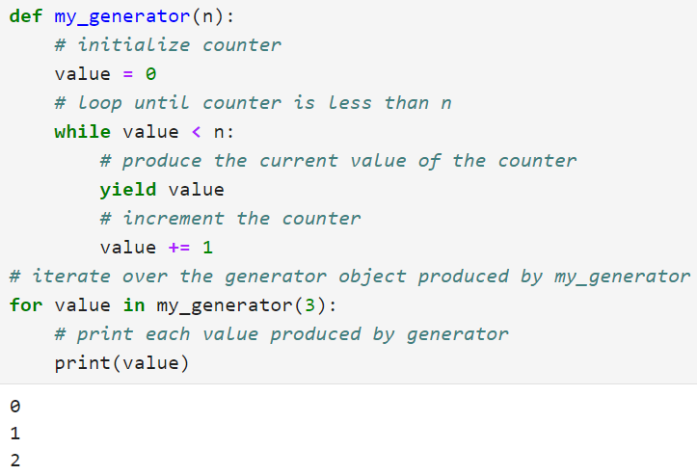
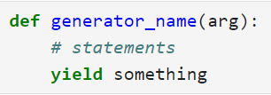
Python Generators
In Python, a generator is a function that returns an iterator that produces a sequence of values when iterated over.
Generators are useful when we want to produce a large sequence of values, but we don't want to store all of them in memory at once.

Slide 21
Advantages of yield in Data Science Projects
yield allows you to create generators, which produce values on the fly without storing the entire sequence in memory.
This is particularly beneficial when dealing with large datasets that cannot fit entirely into memory.
By yielding results as needed, you can process data in chunks, reducing memory usage and avoiding potential memory errors.
Generators created with yield follow the principle of lazy evaluation, meaning they generate values only when requested.
This can improve performance by avoiding unnecessary computations for values that might not be needed.
Lazy evaluation is advantageous when working with large datasets or when performing operations that are computationally expensive.

Slide 22
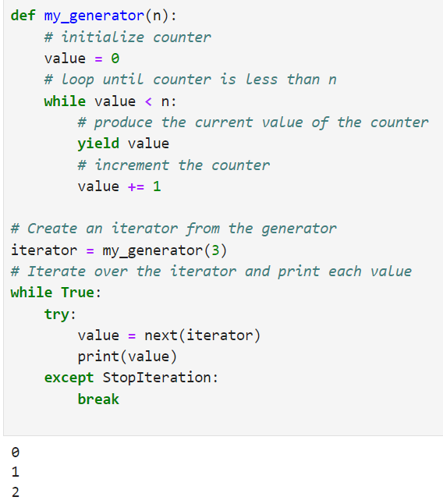
Iterating Values using Iterator in Generators

Slide 23




Contact Us
FLY THE NEST
Connekt,
13TH Floor, Gala Empire, Thaltej,
Ahmedabad, Gujarat, India
+91 6354283836
info@flythenest.in
www.flythenest.in

Slide 24
Thank You

