Slide 1


Slide 2


Idea Submission Guidelines
These are the guidelines for idea submission. Please ensure the guidelines are followed. (Delete this slide during final submission)
Only the team leader is required to submit the idea submission.
The template is to be followed as is, only this slide has to be deleted before submission.
The solution must not exceed 8 slides, i.e, 1 Header slide + 1 Team Details slide + 6 content slides.
The slide titles must be retained as it is, and their positions should not be changed.
The headings for the submission can not be changed.
The content can be structured around the heading in any manner.
There is no restriction with regards to the fonts, as long as it is legible.
For flowcharts and other diagrams, other fonts can be utilised.
One page summary is compulsory (as required in research and references slide)
Once the idea PPT (in PDF Format) is submitted, no resubmission is possible (under any circumstances).
Incorporate flowcharts and diagrams when required within the given space.

Slide 3
Problem Statement and Team Details
Team name | Tech Trojans
Domain | Fintech
Problem Statement Title | Business Analytics-Based Appointment Management System for Efficient Customer Service
 | Name | Area of Expertise
Member I (Team Leader) | Harsheel Sharma | Web Development + Machine Learning
Member II | Kush Jain | Web Development + Machine Learning + Business Analytics
Member III | Mayur Kalwar | Web Development + Machine Learning
Member IV | Manav Patel | Machine Learning + Gen AI
Name of College | Dwarkadas Jivanlal Sanghvi College of Engineering

Slide 4





IDEA TITLE
Our solution integrates a multi-layered facial recognition system within the Union Bank mobile app (Vyom), leveraging Aadhaar-based authentication and liveness detection to prevent spoofing attacks (e.g., deepfakes, photo/video replay). Customers can record video/audio queries, which are analyzed using AI-powered speech-to-text and sentiment analysis to extract intent and urgency. This generates intelligent service tickets, enriched with the customer’s financial history, spending behavior, and predictive needs analysis, allowing for precise query resolution.
A smart customer routing engine categorizes users based on their query type, past interactions, and financial profile to connect them with human agents, chatbots, or self-service AI assistants. AI-powered risk mitigation proactively detects fraud patterns, analyzing transaction behavior, device activity, and geolocation data. A customer prioritization system dynamically assigns priority scores based on holdings, transaction history, and engagement, ensuring high-value customers receive faster responses while maintaining fairness.
Unique Features & Innovation:
• Advanced Biometric Authentication: Multi-factor facial recognition with liveness detection prevents identity fraud.
• AI-Powered Sentiment & Intent Analysis: Prioritizes urgent cases and detects emotional distress for personalized support.
• Predictive Service Recommendations: AI suggests personalized banking products based on user data (e.g., auto-loan offers for users searching for car insurance).
• Voice Biometrics for Fraud Detection: Cross-verifies voice signatures for additional security in audio queries.
• Offline Facial Recognition for Rural Areas: Edge AI enables verification without constant internet connectivity, making the system scalable to remote regions.
• Smart Customer Routing: Uses machine learning to optimize query handling, reducing resolution time.
• Gamified Feedback Module: Customers earn points for feedback, increasing engagement and improving service.

Slide 5
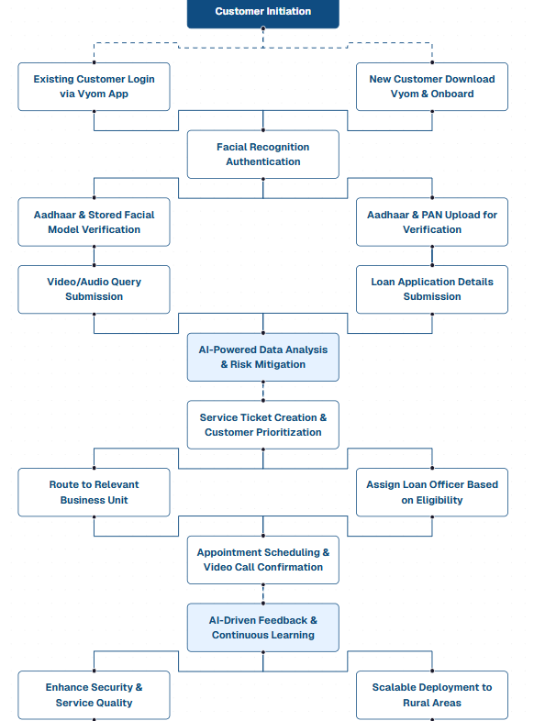

















Flowchart :
TECHNICAL APPROACH
Technologies to be Used :
AI Libraries & Frameworks:
Frontend:
Backend:

Slide 6
FEASIBILITY AND VIABILITY
Analysis of the feasibility of the idea
Potential challenges and risks
Strategies for overcoming these challenges

Slide 7
IMPACT AND BENEFITS
Potential impact on the target audience
Benefits of the solution (social, economic, environmental, etc.)

Slide 8
BUSINESS MODEL
Business Model overview: Provide a concise description of the proposed business model, including how the idea will generate revenue, who the target customers are, and the value proposition offered.
Commercialization Potential and Scalability: Outline the size of the target market, the potential for growth and highlight the key steps for bringing the idea to market, including strategies, partnerships, and potential challenges with commercialization.

Slide 9
RESEARCH AND REFERENCES
Details/Links of References and Research work
Mandatory Submission: Add a link of one page summary of your idea (in .PDF format). The link must be accessible by all, and in view only form. (store the pdf file in Google Drive and share the link with the view permission as “Anyone with the link can view.”
Once the link is submitted, it cannot be modified or resumbitted.

