Slide 1

E-Commerce Review Analyser
Exploring Consumer Behavior
An Analytical Dive into E-Commerce
From Text to Trends
By Mayur Patil

Slide 2
INTRODUCTION
Analyze customer reviews to understand satisfaction and feedback.
Use Machine Learning to predict if a customer is satisfied.
Apply NLP to extract opinions on price, delivery, and quality.
Use Deep Learning (BERT) for accurate real-world review classification

Slide 3
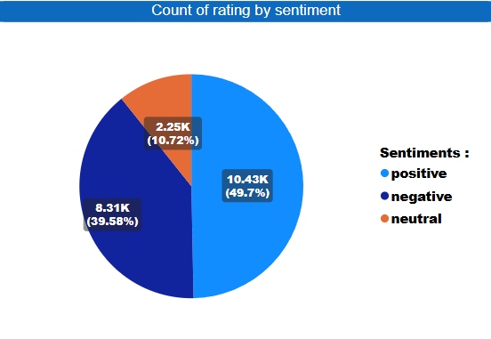
The PIE CHART
The chart breaks down customer ratings based on their sentiment (positive, negative, or neutral).
Positive Sentiment (Blue): This is the largest portion, representing 10.43K ratings, which is 49.7% of the total. This means almost half of the ratings are positive.
Negative Sentiment (Dark Blue): This is the second largest, with 8.31K ratings, making up 39.58% of the total. This indicates a significant portion of ratings are negative.
Neutral Sentiment (Orange): This is the smallest segment, with 2.25K ratings, accounting for 10.72% of the total. This suggests a smaller number of ratings are neutral.

Slide 4
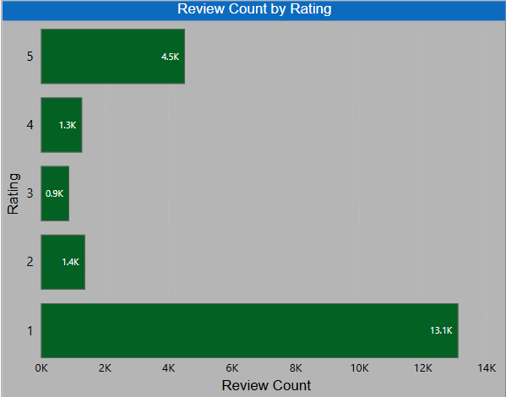
The BAR CHART
The chart shows the number of reviews received for each star rating, from 1-star to 5-star.
1-Star (13.1K): Most common — many customers had very bad experiences.
2-Star (1.4K): Some customers had poor experiences
3-Star (0.9K): Few customers felt neutral or average.
4-Star (1.3K): Many were happy, but not fully satisfied.
5-Star (4.5K): Second highest — many were very satisfied.

Slide 5
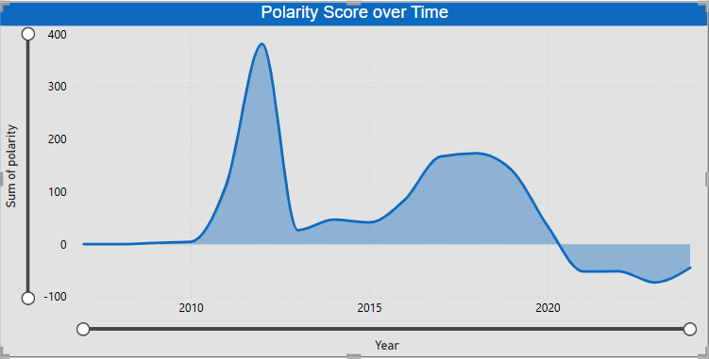
The LINE CHART
The chart shows how the "Polarity Score" (likely indicating the overall sentiment, with positive values being more positive and negative values more negative) has changed over the years, approximately from 2008 to 2024.
2008–2010: Sentiment was mostly neutral.
2012: Sharp rise in positive sentiment (peak around +400).
2013–2015: Decline but still positive; small bump in 2015.
2017–2019: Another rise in positivity (peak ~+190).
2020 onward: Sentiment turned negative and stayed low (-50 to -100).

Slide 6
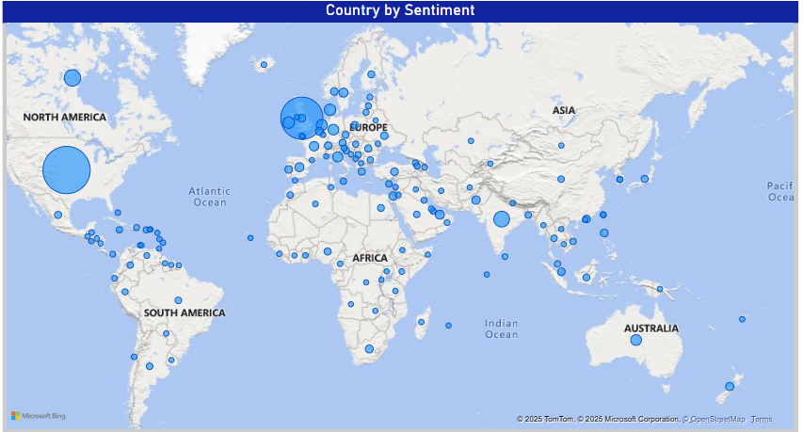
The FILLED MAP
Europe: Highest activity — large circles show strong sentiment data, especially from UK, Germany, France, etc.
🇺🇸 North America: High volume from the US and Canada.
Asia: Mixed activity — larger data from India and Southeast Asia.
South America: Moderate sentiment activity, mostly near coastal regions.
Australia: Noticeable sentiment presence.
Africa: Lower and scattered sentiment data.
Circle size = sentiment volume
Bigger circle = more reviews/data from that region

Slide 7
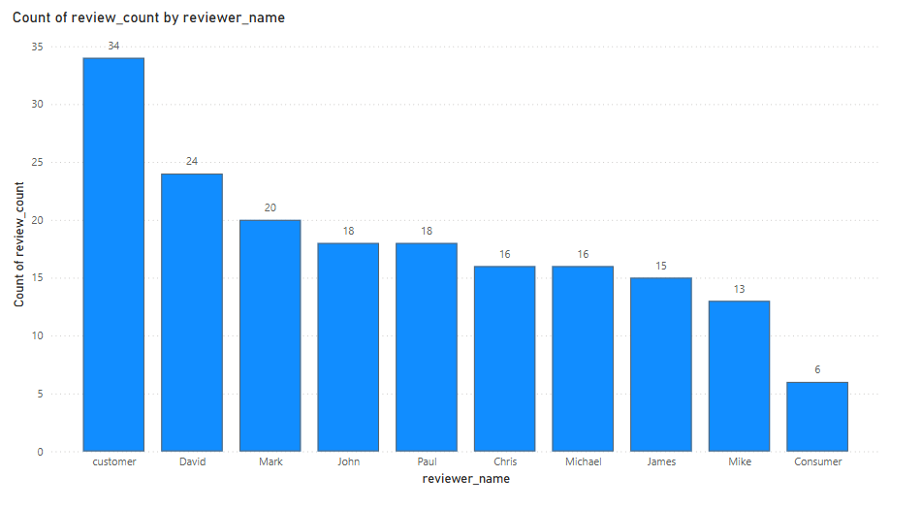
The BAR CHART
Top Reviewers by Review Count
Most Active:
"Customer" leads with 34 reviews — likely a generic or anonymous label.
"David" (24), "Mark" (20) follow closely.
Moderately Active:
John & Paul: 18 reviews
Chris & Michael: 16 reviews
James: 15, Mike: 13
Least Active:
"Consumer" with only 6 reviews — possibly another generic name.

Slide 8
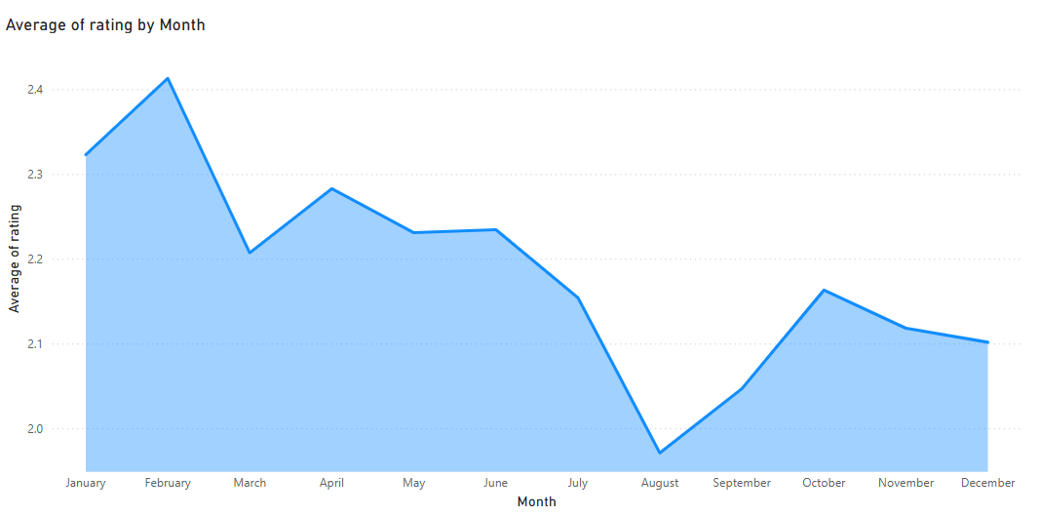
The AREA CHART
Average Rating by Month
Highest Rating: February (~2.41) — peak customer satisfaction.
Lowest Rating: August (~1.98) — significant dip in satisfaction.
Seasonal Trends
Jan–Feb: Strong start, peak in February.
Mar–May: Ratings dip, slight recovery.
Jun–Aug: Lowest point in August — summer dissatisfaction.
Sep–Oct: Ratings improve again.
Nov–Dec: Slight year-end decline.

Slide 9
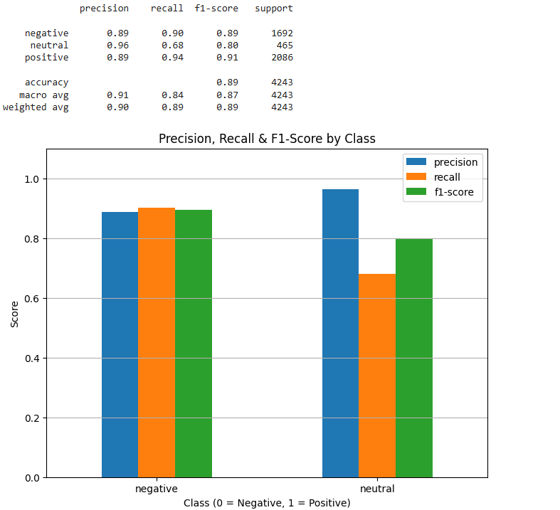
The ML INSIGHT
Overall Accuracy : 91%
Class-Specific Performance:
Negative Class:
Precision: 89%
Recall: 90%
F1-Score: 89%
Support: 1692
Neutral Class:
Precision: 96% (Highest Precision)
Recall: 68% (Lowest Recall)
F1-Score: 80%
Support: 465
Positive Class:
Precision: 89%
Recall: 94% (Highest Recall)
F1-Score: 91% (Highest F1-Score)
Support: 2086

Slide 10
Conclusion
Cleaned and prepared customer review data by fixing dates, extracting numbers, and filling missing values.
Built a machine learning model and created an easy-to-use Streamlit app for real-time predictions.
The project shows how good data cleaning and simple ML can provide useful insights and a base for future improvements.

Slide 11
THANK YOU
Any Questions

