Slide 1
Evaluating Learned Index Structures vs. Traditional B+ Trees
DATABASE SYSTEMS CASE STUDY
A Comparative Study of Indexing Architectures, Memory Efficiency and Lookup Performance
Team member 1: DHAYAPULE KARTIKESH RAO (24BCE0241)
Team member 2: METTA VENKATA SURYA SAI SRIKAR (24BCE0310)
Team member 3: MAYUR R KENI (24BCE0686)
Team member 4: VENKATARAMANA AKSHITH (24BCE2482)

Slide 2
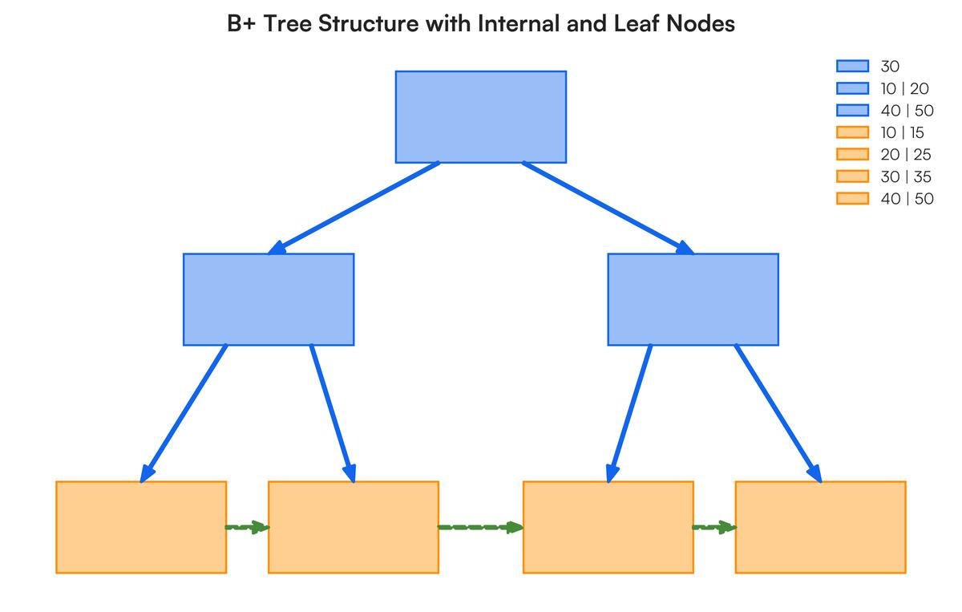
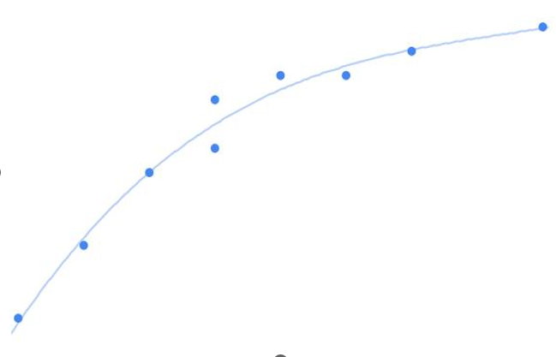
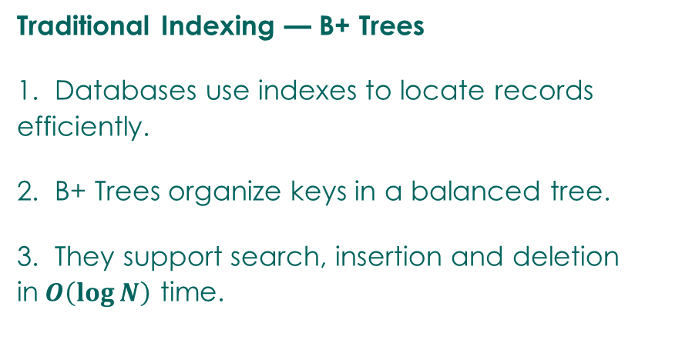
Why Rethink Database Indexing?
Traditional Indexing — B+ Trees
1. Databases use indexes to locate records efficiently.
2. B+ Trees organize keys in a balanced tree.
3. They support search, insertion and deletion in$O\left(\log{N}\right)$ time.
Learned Indexing — Machine Learning
Learned indexes use machine learning to model key distributions.
They estimate where a record is likely to be located.
Their performance depends on the dataset and workload.

Slide 3
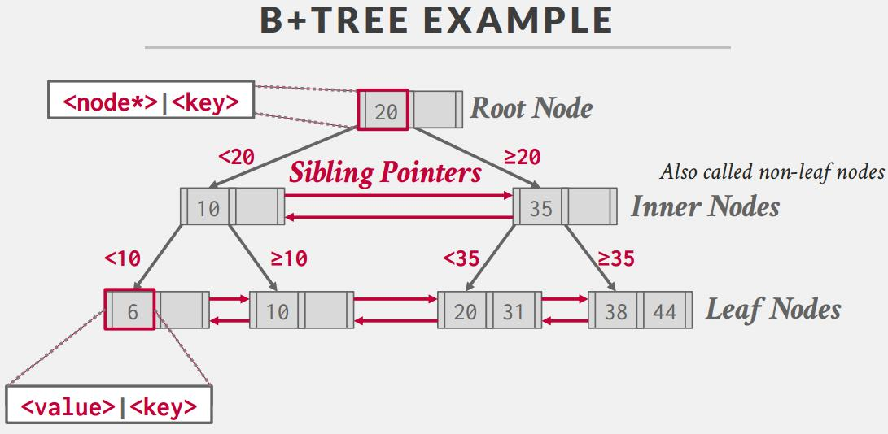
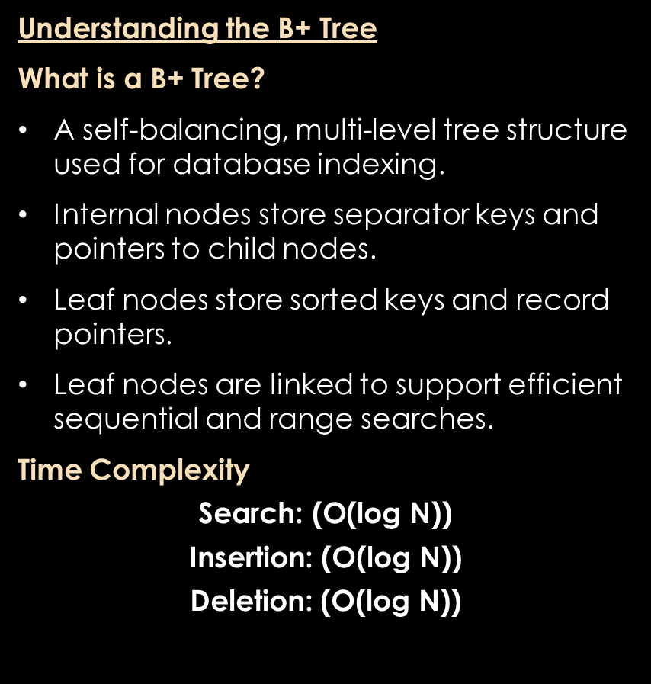
Understanding the B+ Tree
What is a B+ Tree?
A self-balancing, multi-level tree structure used for database indexing.
Internal nodes store separator keys and pointers to child nodes.
Leaf nodes store sorted keys and record pointers.
Leaf nodes are linked to support efficient sequential and range searches.
Time Complexity
$$\text{Search: (O(log N))}$$
$$\text{Insertion: (O(}\text{l}\text{og N))}$$
$$\text{Deletion: (O(log N))}$$

Slide 4
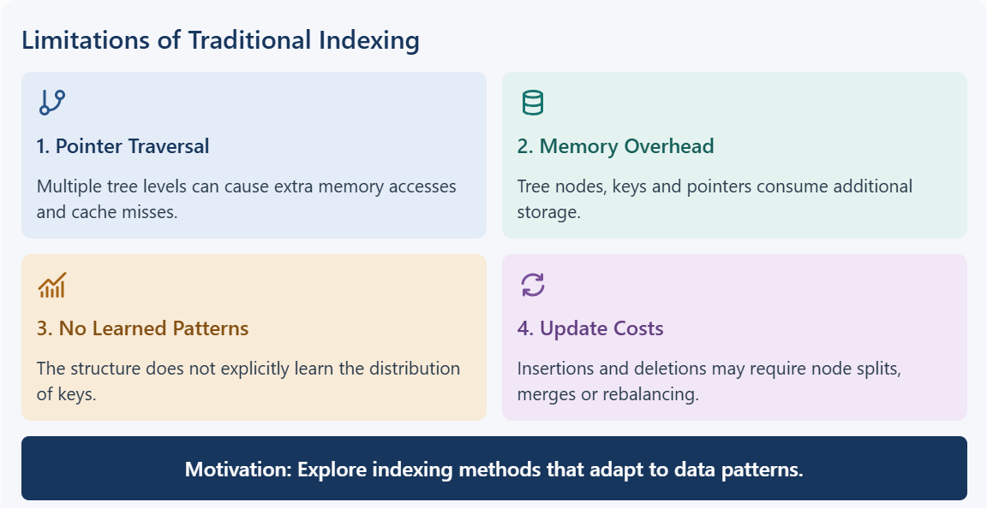
Limitations of Traditional Indexing

Slide 5
TRADITIONAL INDEX
LEARNED INDEX
B+ Tree
Model-Based Prediction
[20 | 40]
Learn key distribution
Predict approximate position
[5 | 10]
[25 | 30]
[45 | 50]
Correct and locate the key
Compare keys → Traverse nodes → Reach the leaf
Search through tree levels.
Predict a position, then verify.
Core idea: Learn patterns in sorted keys to predict record positions.
Next: Recursive Model Indexes (RMI), Piecewise Geometric Model Indexes (PGM) and ALEX.

Slide 6
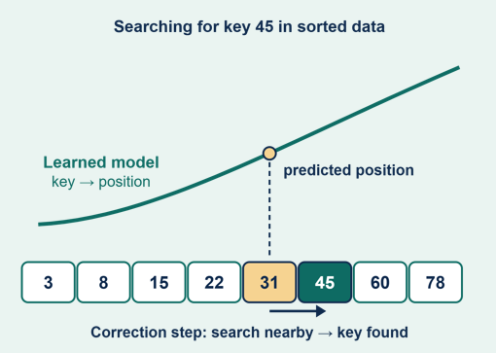
What Is a Learned Index?
INDEXING AS PREDICTION
A learned index uses ML models to learn patterns in sorted data.
Instead of navigating a tree, the model predicts the approximate position of a search key.
Predictions come from the relationship between key values and positions.
A correction step locates the exact key.
Accuracy depends on the data distribution.
Key takeaway: A learned index treats indexing as a prediction problem.

Slide 7
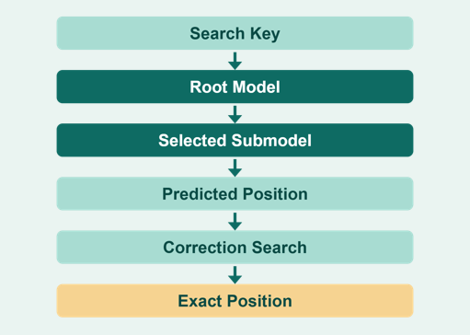
Recursive Model Index (RMI)
A HIERARCHY OF MODELS
RMI stands for Recursive Model Index.
It uses a hierarchy of machine learning models.
A top-level model selects a lower-level model.
The selected model predicts the approximate position of the key.
Error bounds and a correction search find the exact key.
Key takeaway: RMI uses a hierarchy of models to make position predictions.

Slide 8
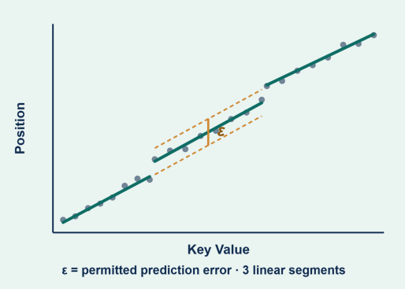
Piecewise Geometric Model Index (PGM)
COMPACT LINEAR SEGMENTS
PGM stands for Piecewise Geometric Model index.
It approximates the key-to-position mapping with multiple linear segments.
Each segment models a portion of the sorted key distribution.
Epsilon (ε) controls the permitted prediction error.
The number of segments trades model size against precision.
Key takeaway: PGM uses compact piecewise models to balance accuracy and index size.

Slide 9
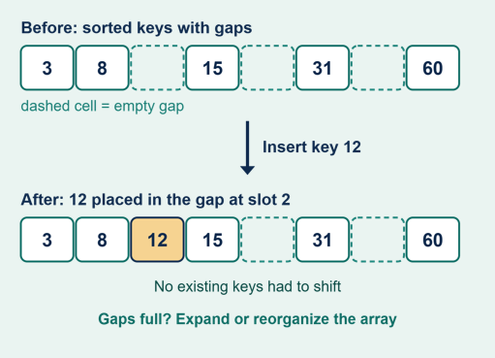
ALEX-lite — Adaptive Learned Index
LOOKUPS PLUS UPDATES
ALEX stands for Adaptive Learned Index.
It combines learned models with an array-based data structure.
Gaps between stored keys leave room for new insertions.
Insertions use gaps, reducing the need to shift keys.
When gaps run out, the structure expands or reorganizes.
Key takeaway: ALEX-style indexing supports efficient lookups while accommodating updates.

Slide 10







METHODOLOGY WORKFLOW
Project Architecture
Datasets
Indexes
Workload
Metrics
Dashboard
4 key distributions (N=200k).
1 traditional, 3 learned models.
Controlled lookup & insert batches.
Latency (ns), ops/sec, memory (KB).
Interactive Streamlit visualization.

Slide 11




EVALUATED ARCHITECTURES
Index Structures Implemented
TRADITIONAL
LEARNED
LEARNED
LEARNED
B+ Tree
RMI
PGM
ALEX-lite
Balanced tree for ordered key indexing.
Hierarchical key position prediction.
Piecewise linear segment mapping.
Adaptive gapped array structure.

Slide 12
TESTING PARAMETERS
Datasets & Setup
Dataset Scale: N = 200,000 keys
Key Distributions
Workload Settings
Uniform
500
5
25%
Evenly distributed mapping.
Lognormal
Ops / Trial
Total Trials
Deletion Rate
Highly skewed clustering.
Weblog / Clustered
Workload Sizes Evaluated
Grouped key concentrations.
Sequential Noise
Small
Medium
Large
5–20
20–100
100–250
Mostly ordered variations.

Slide 13
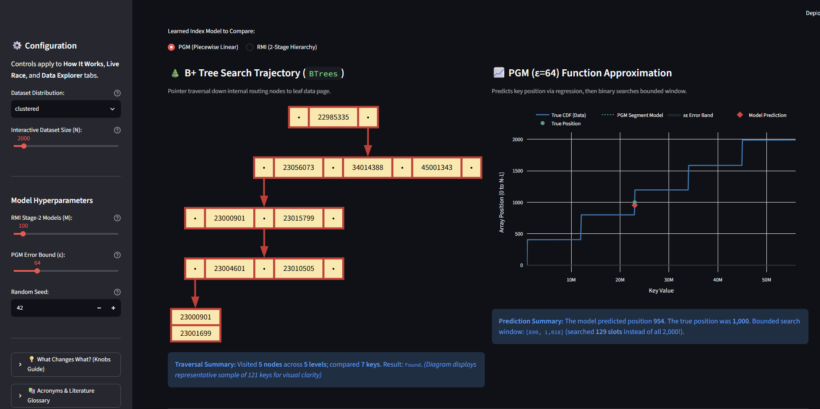
EVALUATION METRICS AND DASHBOARD
What We Measured & Visualized
Lookup Latency
Mean retrieval time strictly in nanoseconds (ns).
Memory Footprint
Kilobytes (KB) capturing model parameters vs. nodes.
Mixed Workloads
Throughput (ops/sec) evaluated under varying read/write ratios.
Sensitivity Analysis
Tracking footprint scaling when modifying model variables.

Slide 14
Indexing Approaches at a Glance
APPROACH
CORE IDEA
KEY MECHANISM
B+ Tree
Traverses tree levels to reach the leaf
Compares keys node by node
TRADITIONAL
RMI
Hierarchy of models predicts position
Root model selects a submodel
LEARNED
PGM
Linear segments approximate key → position
Epsilon (ε) bounds the error
LEARNED
ALEX-lite
Models plus an array with gaps
Gaps absorb new insertions
LEARNED
Recap: one traditional index, three learned indexes — search vs. predict.

Slide 15

Implementation & Methodology
✓ Learned Index
✓ RMI
✓ PGM
✓ ALEX-lite
NEXT SECTION
How these indexing approaches were implemented and evaluated
1
2
3
4
Project Architecture
Index Structures
Datasets & Setup
Metrics & Dashboard
The end-to-end benchmarking workflow
B+ Tree, RMI, PGM and ALEX-lite
Key distributions and workload settings
What is measured and how results are shown

Slide 16
Lookup Latency:
NO Universal Winner
Mean lookup latency (ns) on 4 datasets, N = 200,000 keys
Compared B+ Tree, RMI (M=1000), PGM (ε=64) and ALEX-lite
The B+ Tree had the lowest latency on every dataset.
RMI was the fastest learned index on every dataset.
PGM was second among the learned indexes, and ALEX-lite was slowest.
Learned indexes were closest to the B+ Tree on smooth data (Uniform, Sequential Noise).
On skewed and clustered data, larger model error forces wider search windows.
Dataset | B+ Tree | RMI | PGM | ALEX-lite
Clustered | 810 ns | 2333 ns | 2843 ns | 3472 ns
Lognormal | 1112 ns | 2150 ns | 2733 ns | 3778 ns
Sequential Noise | 755 ns | 2181 ns | 2726 ns | 4051 ns
Uniform | 1224 ns | 2725 ns | 3304 ns | 3710 ns

Slide 17
Memory Footprint:
Measure Consistently
B+ Tree: internal nodes hold keys and child pointers, and leaf pages hold data pointers, so memory grows with the number of keys.
Learned indexes: store model parameters instead of pointers.
  RMI: slope, intercept and min/max error per model, plus a delta buffer.
  PGM: key, position and slope per segment, plus a delta buffer.
  ALEX-lite: empty gap slots, an occupancy mask and model parameters.
Model size, accuracy and correction work trade off. More models or segments mean a smaller error window but more metadata. Fewer models mean a compact index but a wider search.
Dataset | B+ Tree | RMI | PGM | ALEX-lite
Clustered | 0.1 KB | 32.2 KB | 2.3 KB | 1074.2 KB
Lognormal | 0.1 KB | 32.2 KB | 0.7 KB | 1074.2 KB
Sequential Noise | 0.1 KB | 32.2 KB | 0.0 KB | 1074.2 KB
Uniform | 0.1 KB | 32.2 KB | 0.4 KB | 1074.2 KB

Slide 18
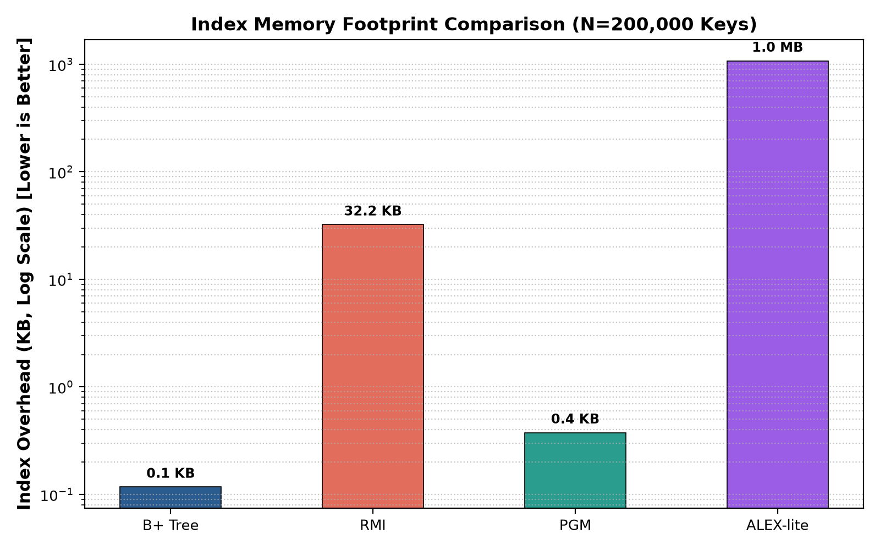
What the measurement includes:
Learned indexes: analytical estimate of model metadata and buffers.
B+ Tree: pympler.asizeof on OOBTree (a Python C-extension).
The two methods do not cover the same components. The B+ Tree figure is likely an undercount, so don’t treat it as the full cost.
Interpretation:
PGM’s footprint shrinks as the data gets smoother (0.0 KB on Sequential Noise vs 2.3 KB on Clustered).
RMI stays constant at 32.2 KB because it has a fixed number of models.
ALEX-lite is the largest because it deliberately keeps empty slots for inserts.
Key takeaway:
Learned indexes can reduce index metadata, but fair memory comparisons require consistent measurement boundaries.

Slide 19
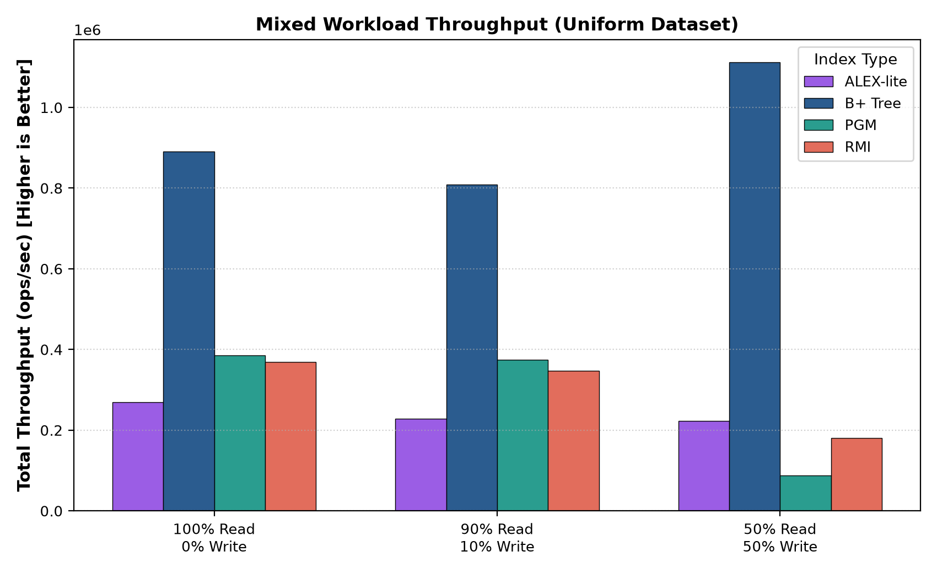
Beyond Lookups: Writes, Mixed Workloads and Tuning
Inserts: B+ Tree is highest on all 4 datasets. RMI and PGM pay for retraining.
Mixed workloads: learned indexes do well on reads, but throughput drops as writes rise.
Sensitivity:more RMI models → more memory. Larger PGM ε → fewer segments, wider search.
B+ Tree | RMI | PGM | ALEX-lite
840,068 | 116,370 | 47,196 | 209,038

Slide 20
Conclusion and Future Scope
Conclusion
Each index trades off lookup speed, memory and update cost.
The best choice depends on the data and workload.
Limitations: Python implementations; B+ Tree memory measured differently; not production proof.
Future scope: Larger datasets, C++ implementations, consistent memory measurement, concurrency and real database integration.
Banner: Learned indexes are promising alternatives, but their benefits depend on the data, workload and implementation.
B+ Tree | RMI | PGM | ALEX-lite
Fastest lookups and inserts here; larger memory | Compact (32.2 KB); best for read-only data | Most compact on smooth data; slowest inserts | Supports inserts; largest footprint

Slide 21
Thank You
Team member 1: DHAYAPULE KARTIKESH RAO (24BCE0241)
Team member 2: METTA VENKATA SURYA SAI SRIKAR (24BCE0310)
Team member 3: MAYUR R KENI (24BCE0686)
Team member 4: VENKATARAMANA AKSHITH (24BCE2482)

