Slide 1
What Are Packages in Java?
A set of classes and interfaces grouped together are known as Packages in JAVA. The name itself defines that pack (group) of related types such as classes, sub-packages, enumeration, annotations, and interfaces that provide name-space management. Every class is a part of a certain package. When you need to use an existing class, you need to add the package within the Java program.

Slide 2
Why Are They Used For?
The benefits of using Packages in Java are as follows:
The packages organize the group of classes into a single API unit
It will control the naming conflicts
The access protection will be easier. Protected and default are the access level control to the package
Easy to locate the related classes
Reuse the existing classes in package

Slide 3
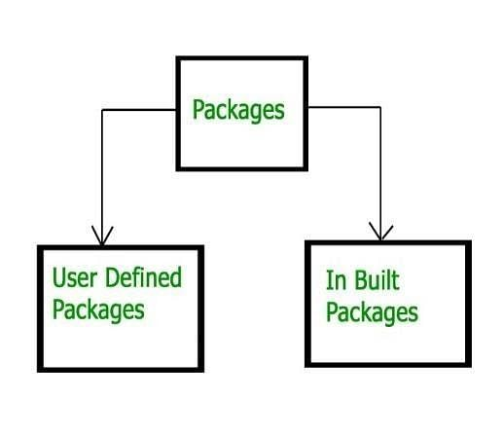

Slide 4
You can categorize packages into:
Built-in Packages
User-defined Packages
The built-in packages are from the Java API. The JAVA API is the library of pre-defined classes available in the Java Development Environment. Few built-in packages are below:
Java.lang–Bundles the fundamental classes
Java.io - Bundle of input and output function classes
Java.awt–Bundle of abstract window toolkit classes
Java.swing–Bundle of windows application GUI toolkit classes

Slide 5
Java.net–Bundle of network infrastructure classes
Java.util–Bundle of collection framework classes
Java.applet–Bundle of creating applet classes
Java.sql -Bundle of related data processing classes
The built-in packages are again categorized into extension packages. These extension packages start with javax. This is for all the Java languages, which have lightweight component classes.
Javax.swing
Javax.servlet
Javax.sql
Note: The default package imported with no declaration is java.lang package.

Slide 6
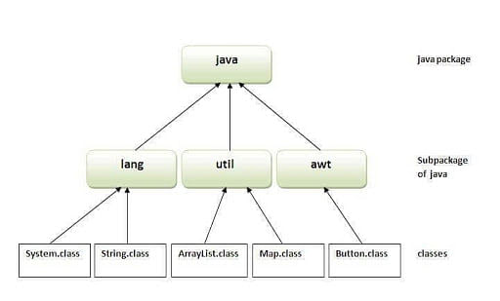

Slide 7
User-defined packages are bundles of groups of classes or interfaces created by the programmer for their purpose

Slide 8
Packages in Java Working Mechanism
Package_name.sub_package_name.class_name
E.g.
Built-in packages
java.awt.event
User-defined packages
University.Department.Staff

Slide 9
In the above example, Java is the package name, awt is the subpackage name and event is the class name. University is the user-defined package name, Department is the subpackage name, and Staff is the class name. Consider a folder inside a file directory. The directory Java is accessible through classpath, to make sure that the classes are easy to locate

Slide 10
Add Built-in Packages in Java Program
Example 1
Code 1:
import java.util.*; //get all classes from subpackage loads Date class
import java.util.Scanner; //get one specific class Scanner
public class PackageImportExample
{
public static void main(String args[])throws Exception
{
// Instantiate a scanner object
Scanner scanObj = new Scanner(System.in);

Slide 11
System.out.print("Kindly Enter Your UserName :");
String sName = scanObj.nextLine();
System.out.println("UserName is: " + sName);
scanObj.close();
// Instantiate a Date class from Util package
Date currdate = new Date();
System.out.println(currdate.toString());
//Without importing java.net package use complete qualified name to access the class InetAddress
java.net.InetAddress ipAddress=java.net.InetAddress.getLocalHost();
System.out.println("My IP Address :"+ipAddress.getHostAddress());
}
}

Slide 12
To get the use of a package or a class from a library, you need the help of the keyword “import”.
In the above code, there are three ways to import the package.
Import One Specific Class From a Package
import java.util.scanner
In the above program, you have included only one scanner class from util subpackage. It will get the user value and display.

Slide 13
Import One Whole Package
import java.util.*
In the above program, the * denotes all the classes from the util package. Along with other classes, it loads the date class as well. The date class displays the current date and time.
Use Complete Qualified Name
java.net.InetAddress ipAddress=java.net.InetAddress.getLocalHost();
The InetAddress class is available in the java.net package, without using the import keyword. Directly call the InetAddress class with the complete package name java.net.InetAddress. This will get the IP address.

Slide 14
Create Your Own Packages in Java
To create a package, you should be aware of the Java file system directory. This is similar to the files and folders organized on your computer. You need the help of the keyword “package” to create your own package. The declaration of the package should be the first statement before any import statements in the Java class.
Before creating your own package, you need to keep in mind that all the classes should be public so that you can access them outside the package.
Let us consider our example of a User-defined package - University.Department.Staff.
Now, create your university package.

Slide 15
Example 2
Code 2:
//creates user defined package university
package university;
public class WelcomeMessage
{
//has one method ShowMessage()
public void ShowMessage()
{
System.out.println("Welcome to our University");
}
}

