Slide 1
EE451 : Supervised Research Exposition
2022-23/I
Analyzing the characteristics of Type-II
Structures for Infrared Applications
Guided by
Prof. Subhananda Chakrabarti
Mayur Ware, 19D070070
4th-year Dual Degree Student in Electronic Systems Specialization
Department of Electrical Engineering, IIT Bombay
mayurware@ee.iitb.ac.in
Department of Electrical Engineering
IIT Bombay

Slide 2
Outline
> Learning Phase
> Quantum Dot Infrared Photodetectors (QDIPs)
> Type-II SuperLattice (T2SL)
> nextnano basic framework
> Simulation - I
> Simulation - II
> Learnings and Difficulties Faced
> References

Slide 3
Learning Phase
> Optical detectors or photodetectors are electromagnetic sensors that convert electromagnetic radiation into electric signals that can be measured through an appropriate device.
> In recent times, photodetectors in optical/telecommunication with Si based chips have have become very popular. However, because of the higher bandgap of Si as compared to infrared photon, it is not suitable for the telecommunication spectrum (1.3-1.6 μm).
> So, Ge-based semiconductors have attracted the industry. But, they too have some issues like large thermal mismatch and costly processes.

Slide 4
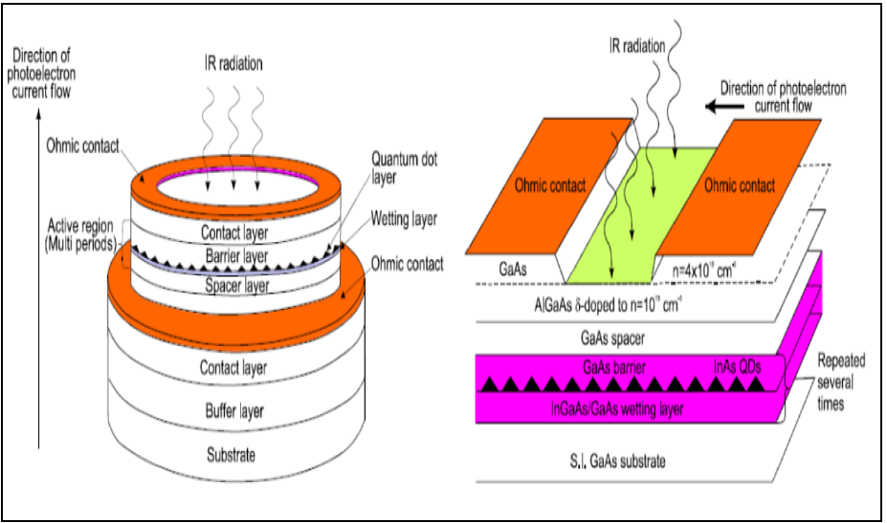
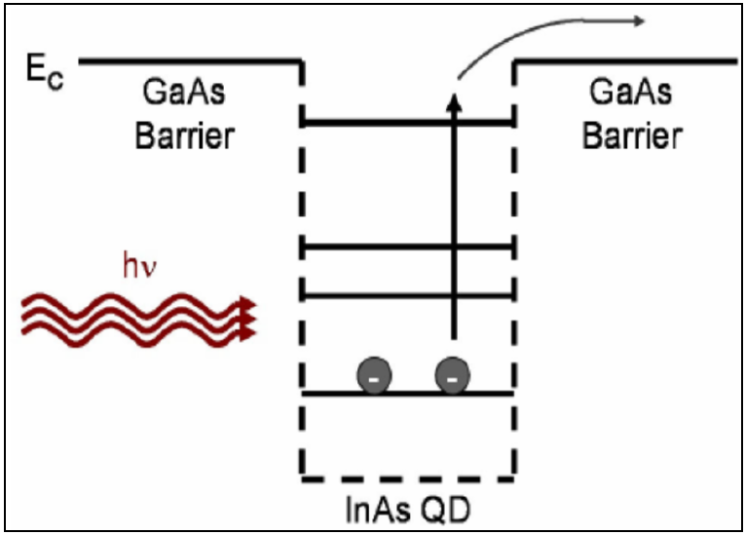
Learning Phase
Quantum Dot Infrared Photodetectors (QDIPs)
Fig. 1
Fig. 2
> In QDIPs, nanometer size features of one semiconductor material grown on other material are known as Quantum dots.
Source : [1], [3]

Slide 5
Learning Phase
Quantum Dot Infrared Photodetectors (QDIPs)
> Quantum dots are formed by the release of compressive strain when the thickness of the film exceeds critical thickness. Layer-by-layer 2-D patterns are used to form 3-D island growth. S-K Growth is the most successful method.
> QD confinement barriers are created in the conduction and valence bands and hence, they provide a mechanism for quantum confinement in addition to the nanoscale size of QDs as shown in Fig. 2.
> Typically broad absorption spectrum and low absorption efficiency due to dynamic size variations.

Slide 6
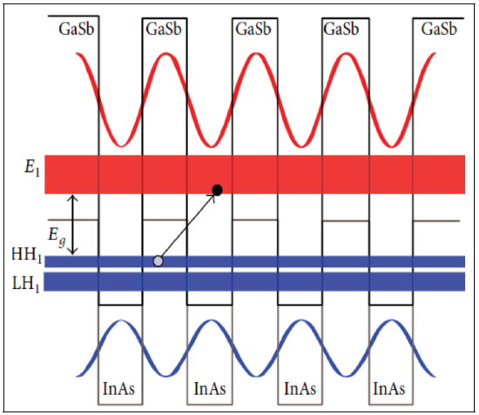
Learning Phase
Type-II SuperLattice (T2SL)
> A system made of a repeating sequence of thin layers of different materials is known as a superlattice.
>If both the valence and the conduction band edge of the second material are above the band edges of the first material, it is called a broken type II band alignment.
Fig. 3
Source : [2]

Slide 7
Learning Phase
Type-II SuperLattice (T2SL)
> The performance of T2SL devices strongly depends on structural perfection, interfacial roughness, etc. Though, there are dark current issues.
> In Fig. 3, InAs layers experience tensile strain due to lattice mismatch.
> Bandgap can be varied by changing the composition and thickness of monolayers.
> The conduction band of matrix material is at lower energy than the valence band of dot (QD) material. Holes are trapped in quantized energy states whereas electrons are free to move in the conduction band.

Slide 8
Outline
> Learning Phase
> Quantum Dot Infrared Photodetectors (QDIPs)
> Type-II SuperLattice (T2SL)
> nextnano basic framework
> Simulation - I
> Simulation - II
> Learnings and Difficulties Faced
> References

Slide 9
nextnano basic framework
# Defining Parameters
global{# Defining a global substrate
# Define temperature, type of simulation (2D/3D)}<>
output{#Define 2D plane and growth direction}<>
grid{xgrid{line=a pos=b}<>
ygrid{line=a pos=b}<> zgrid{line=a pos=b}<>}<>
database{
# To redefine default material parameters if needed
}<>

Slide 10
nextnano basic framework
structure{# Defining regions such as layers, QDs
region{cuboid{}/obelisk{}
binary{}/tertiary{}/quaternary{}}}<>
quantum{#Define Quantum region with appropriate boundary conditions}<>
contacts{}<>
strain{}<>
optics{}<>
run{
#State what all kind of analyses are needed}<>

Slide 11
Outline
> Learning Phase
> Quantum Dot Infrared Photodetectors (QDIPs)
> Type-II SuperLattice (T2SL)
> nextnano basic framework
> Simulation - I
> Simulation - II
> Learnings and Difficulties Faced
> References

Slide 12
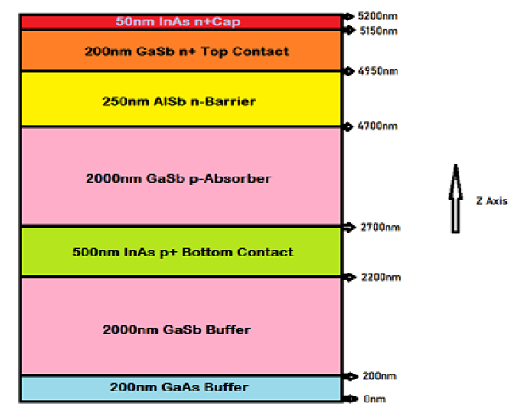
Simulation - I
Mid-Wave Infrared InAs/GaSb Type-II Superlattice Photodetector
With n-B-p Design Grown on GaAs Substrate
Fig. 4
> To tackle the dark current issue in the conventional p-i-p architecture of InAs/GaSb type-II superlattice, various heterostructures such as n-B-n, n-B-p and complementary p-B-i-B-n designs which utilize the engineering freedom of band structure.

Slide 13
Simulation - I
Mid-Wave Infrared InAs/GaSb Type-II Superlattice Photodetector
With n-B-p Design Grown on GaAs Substrate
> In these structures, most of the depletion electric field drops across the wide bandgap barrier layer, reducing the dark current.
> In n-B-n design, the photocurrent is based on minority holes whereas in n-B-p design, the p-doped absorber enables the higher mobility electrons to be the minority photocarriers, which is capable to attain higher quantum efficiency.
> Simulations are performed in nextnano software. The simulations are performed at 77K.

Slide 14
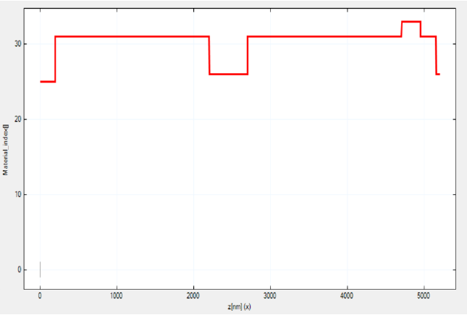
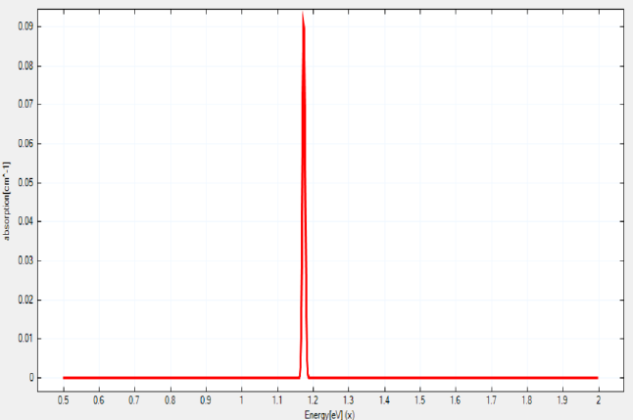
Simulation - I
Mid-Wave Infrared InAs/GaSb Type-II Superlattice Photodetector
With n-B-p Design Grown on GaAs Substrate
Fig. 5
Material Structure (z-axis)
Fig. 6
Absorption Spectrum

Slide 15
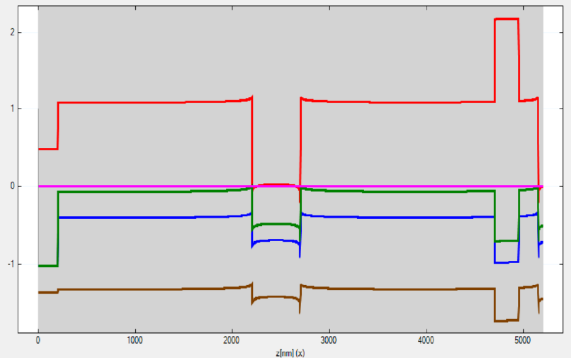
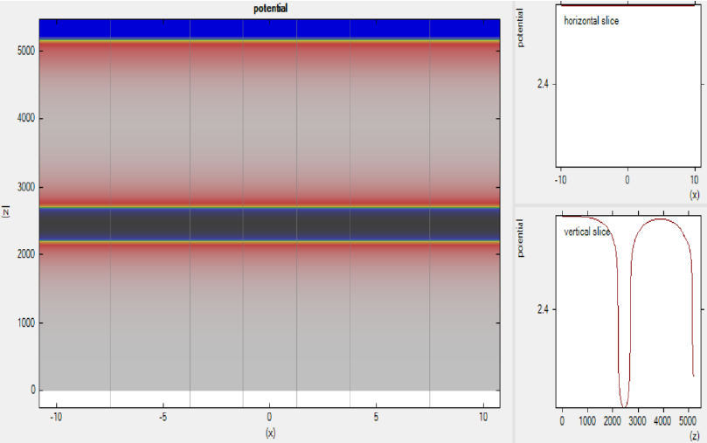
Simulation - I
Mid-Wave Infrared InAs/GaSb Type-II Superlattice Photodetector
With n-B-p Design Grown on GaAs Substrate
Fig. 7
Band Edges (z-axis)
Fig. 8
Potential Plot

Slide 16
Outline
> Learning Phase
> Quantum Dot Infrared Photodetectors (QDIPs)
> Type-II SuperLattice (T2SL)
> nextnano basic framework
> Simulation - I
> Simulation - II
> Learnings and Difficulties Faced
> References

Slide 17
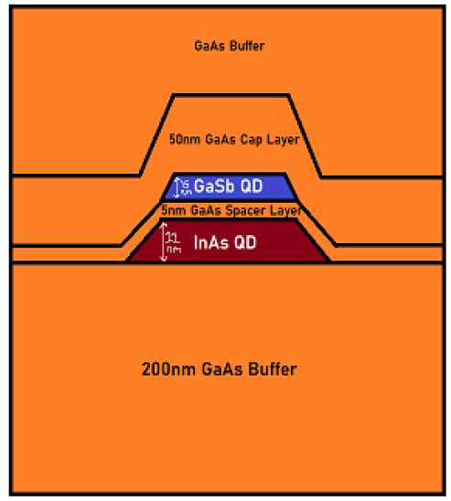
Simulation - II
Hybrid Type-II GaSb/GaAs Quantum Dot Structure
Fig. 9
> This structure consists of a hybrid type-I InAs/GaAs and type-II GaSb/GaAs quantum dot (QD) structure grown in a GaAs matrix. This hybrid QD structure exhibits more intense PL with a broader spectral range.

Slide 18
Simulation - II
Hybrid Type-II GaSb/GaAs Quantum Dot Structure
> In the hybrid QD structure shown in Fig. x, two layers of QDs, InAs (11nm in height) and GaSb (15nm in height) are separated by a 5 nm GaAs Spacer Layer.
> The spatial separation of electrons and holes in type-II QDs reduces spontaneous recombination, enhancing solar cells’ quantum efficiency. But, it reduces the photon absorption efficiency. InAs and GaSb Quantum Dots provide additional absorption.
> Simulations are performed in nextnano software. The simulations are performed at room temperature(300 K).

Slide 19
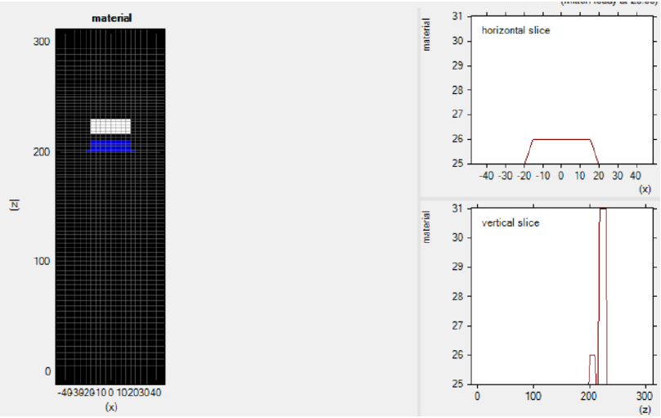
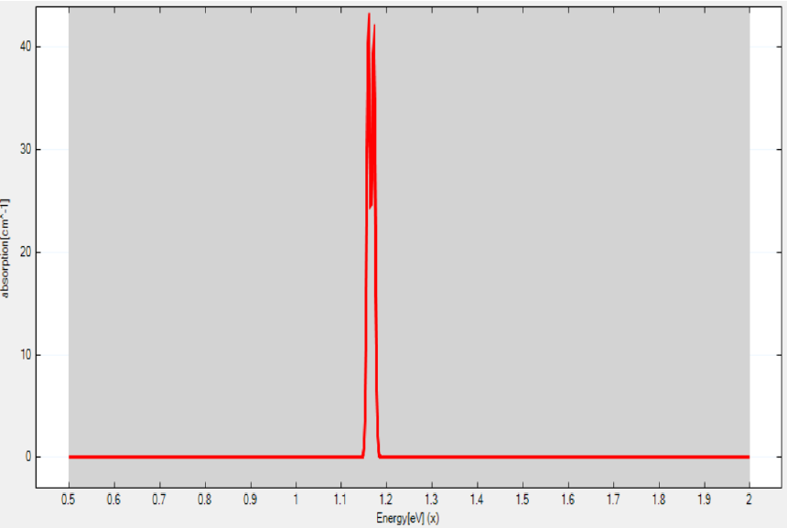
Simulation - II
Hybrid Type-II GaSb/GaAs Quantum Dot Structure
Fig. 10
Material Structure (z-axis)
Fig. 11
Absorption Spectrum

Slide 20
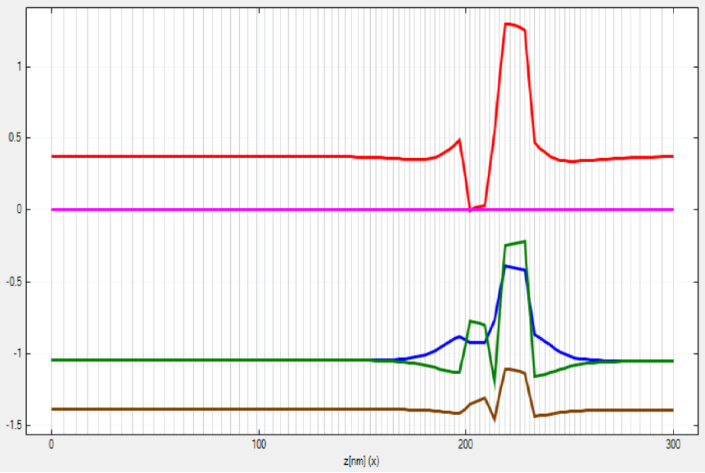
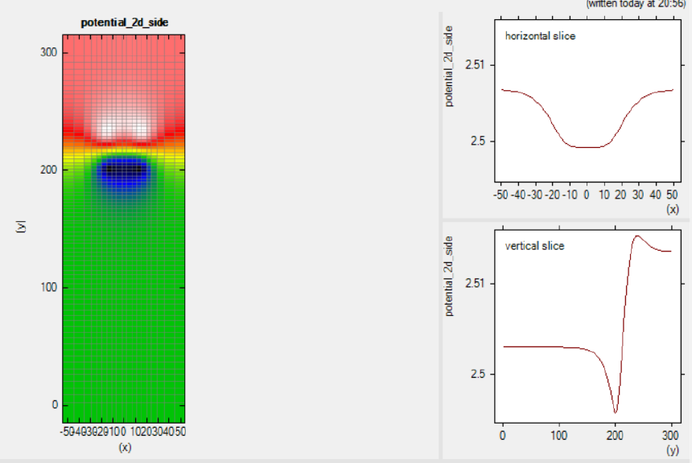
Simulation - II
Hybrid Type-II GaSb/GaAs Quantum Dot Structure
Fig. 12
Band Edges (z-axis)
Fig. 13
Potential Plot

Slide 21
Outline
> Learning Phase
> Quantum Dot Infrared Photodetectors (QDIPs)
> Type-II SuperLattice (T2SL)
> nextnano basic framework
> Simulation - I
> Simulation - II
> Learnings and Difficulties Faced
> References

Slide 22
Learnings and Difficulties Faced
> I learned about Type-II structures such as T2QDs and T2SLs. They have much potential that needs to be researched.
> Encountered some new result plots such as Eigenvalue Spectrum, Spinor Component, Transition Spectrum, etc.
> Difficulty I faced was mainly about nextnano software code and simulations as not much reference material is not available.
> Making finer grid is good for accuracy but it’s a compromise with other resources. We have to strike a balance between them.

Slide 23
Outline
> Learning Phase
> Quantum Dot Infrared Photodetectors (QDIPs)
> Type-II SuperLattice (T2SL)
> nextnano basic framework
> Simulation - I
> Simulation - II
> Learnings and Difficulties Faced
> References

Slide 24
References
[1] A. Rogalski, "Insight on quantum dot infrared photodetectors", 2nd National Conference on Nanotechnology ‘NANO 2008’, Vol. 146 (2009)
[2] Elena A. Plis, "InAs/GaSb Type-II Superlattice Detectors", Advances in Electronics, Vol. 2014 (2014)
[3] Adrienne D. Stiff-Roberts, "Quantum-dot infrared photodetectors: a review", Journal of Nanophotonics, Vol. 3, 031607 (14 April 2009)
[4] Zhuo Deng , Daqian Guo, "Mid-Wave Infrared InAs/GaSb Type-II Superlattice Photodetector With n-B-p Design Grown on GaAs Substrate", IEEE JOURNAL OF QUANTUM ELECTRONICS, VOL. 55, NO. 4 (August 2019)
[5] Hai-Ming Ji, Baolai Liang, Paul J. Simmonds, "Hybrid type-I InAs/GaAs and type-II GaSb/GaAs quantum dot structure with enhanced photoluminescence", APPLIED PHYSICS LETTERS 106, 103104 (2015)
[6] https://www.nextnano.com/dokuwiki/doku.php

Slide 25
Appendix
Code files :
https://github.com/MayurWare/EE451-SRE
Project Report (detailed learning report and results) :
https://drive.google.com/file/d/1vAj63LpAJaLzW1az9heHNh5vKyAJC2Kb/view?usp=share_link

Slide 26
Thank You!

