Slide 1

POWER BI
Sales Dashboard Analysis
Interactive Power BI Dashboard built to monitor business performance and surface sales and profit trends at a glance.

Slide 2
PROJECT OVERVIEW
Project Overview
This project leverages the Sample Superstore Dataset to build a fully interactive Power BI dashboard. The objective is to give business stakeholders a centralized, real-time view of sales performance, profitability, and customer behavior across regions, categories, and time periods.
Power BI
DAX
Core platform for data modeling and visualization
Calculated measures and KPI logic
Power Query
Data extraction, transformation, and cleaning
Objective
Dataset
Build an interactive sales dashboard to monitor business performance and identify sales and profit trends.
Sample Superstore Dataset — a widely used retail dataset capturing orders, products, customers, and regions.

Slide 3
KEY METRICS
Dashboard KPIs
Five core KPI cards displayed exactly as configured in the PBIX — each providing a snapshot of overall business performance.
Total Sales
Total Profit
Total Orders
Aggregate revenue across all orders
Net profit after costs
Count of all placed orders
Total Quantity
Average Order Value
Units sold across products
Mean revenue per order

Slide 4
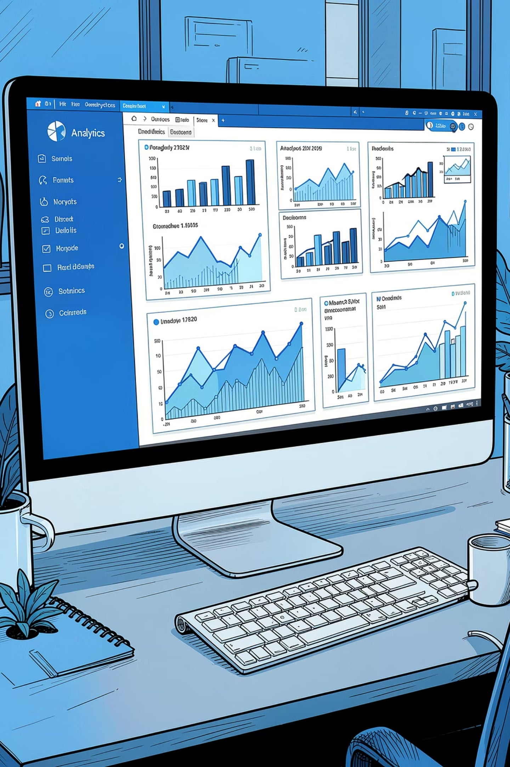
VISUALIZATIONS
Dashboard Visualizations
Six predefined visuals from the PBIX deliver multi-dimensional insight into sales and profit performance.
Sales by State
Profit Trend by Order Date
Clustered Bar Chart
Line Chart
Sales by Category
Profit by Sub-Category
Donut Chart
Clustered Bar Chart
Sales by Segment
Sales vs Profit vs Quantity by Sub-Category
Donut Chart
Scatter Chart

Slide 5

INTERACTIVITY
Dashboard Filters
Four slicers enable users to dynamically slice the entire report. Selecting any filter instantly updates every KPI card and chart on the page — making the dashboard fully interactive.
Order Date
Region
Category
Segment

Slide 6

CAPABILITIES
Dashboard Features
Interactive Filtering
Slicers dynamically

