Slide 1
OLIST Store Analysis

Slide 2
Group 2 members
Suraj Nagargoje
Pratik Upadhye
Manjula Vishwateja
Anurag Ganorkar
Vaishali Deotale
Laxmi Gupta
Prathamesh Pawar

Slide 3
Olist store data overview
Datasets
Domain : E-commerce
Total datasets : 9
Total Rows : 6,50,927
Total Columns : 52
Order_Dataset
Customer_Dataset
Items_Dataset
Product_Dataset
Payments _Dataset
Reviews_Dataset
Sellers_Dataset
Geolocation_Dataset
Product_Category_Name_Translation _Dataset

Slide 4
Key Performance Indicators
1. Weekdays vs Weekend payment statistics.
2. Number of orders with review score 5 and payment type as credit card.
3. Average number of days taken for delivery for pet-shop orders.
4. Average price and payment values from customers of Sao Paulo city.
5. Relationship between shipping days vs review scores.

Slide 5
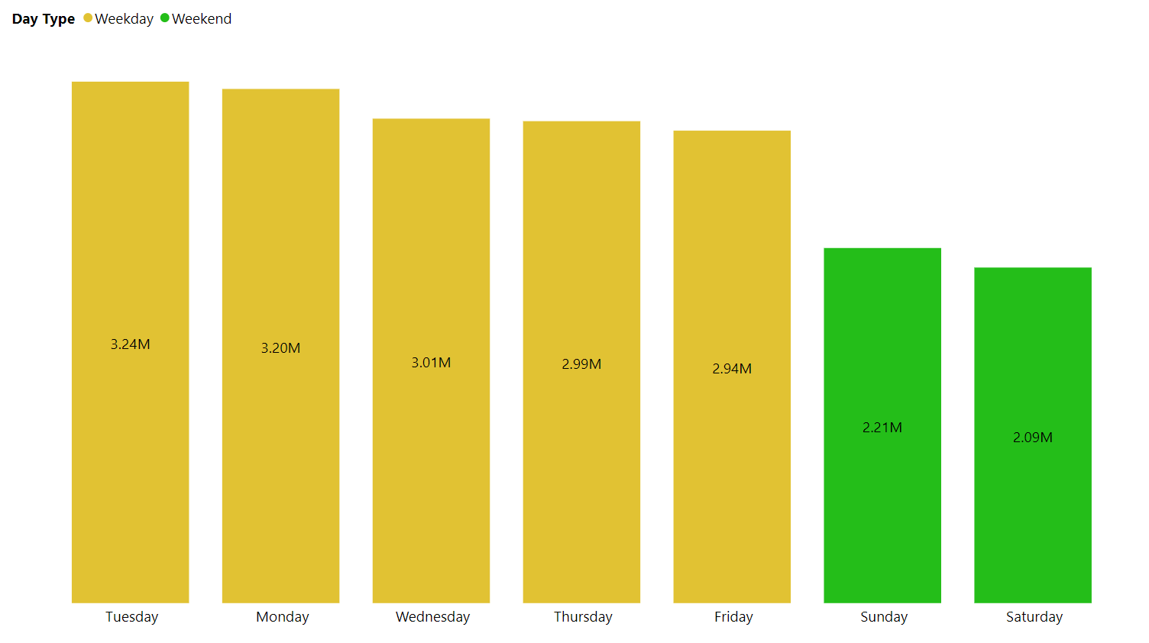
Weekdays vs Weekend payment statistics
> Weekdays Payments : 15.38M
> Weekend Payments : 4.3M
> 350% higher sales on
O weekdays compare to weekend.

Slide 6
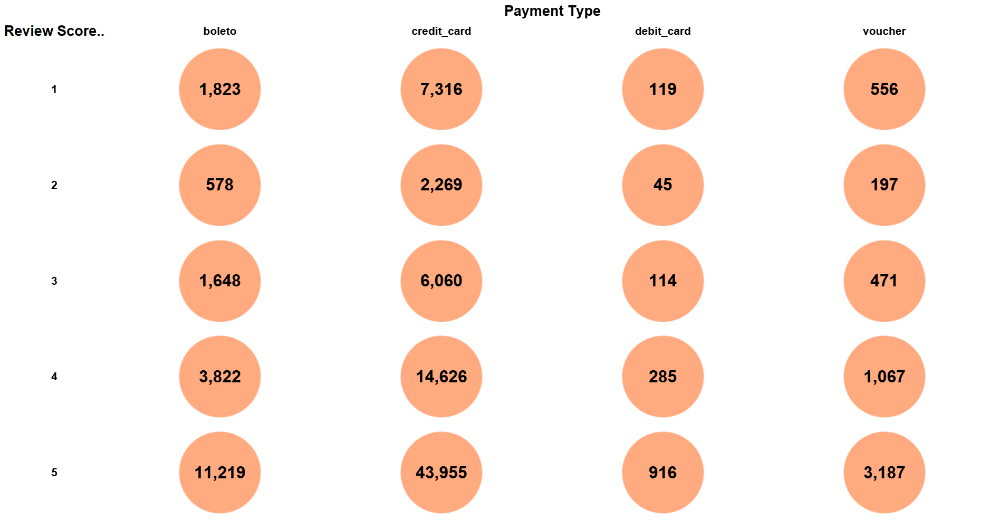
Orders with credit card & review score 5
> 43.8% orders got 5 score &
paid by credit card.
> 74% chose credit card.
9,814
9.8%
3,089
3.1%
8,293
8.3%
19,800
19.8%
43,955
59277
59%
19,090
19%
74,226
74%
1,479
1.5%
5,478
5.5%
Total 100273

Slide 7
Average delivery days for Pet-shop orders
Avg delivery days for Pet-shop orders
11
Average delivery days for total orders
12.5

Slide 8
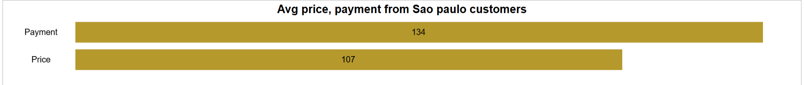
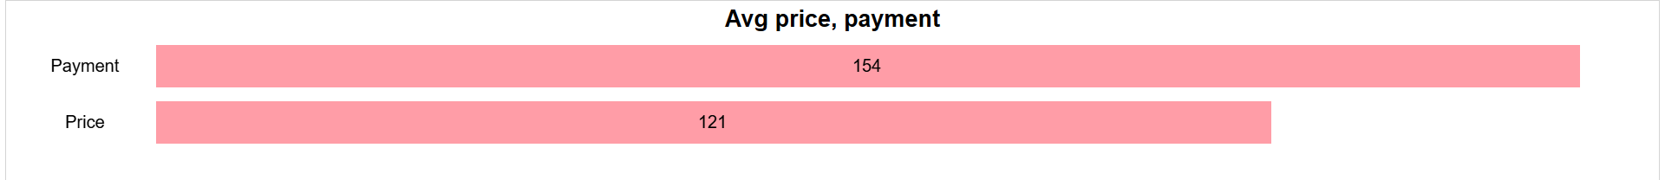
Average price & payment of Sao paulo customers
Average price & payment for orders of Sao Paulo customers is less than the average of all orders from all cities.

Slide 9
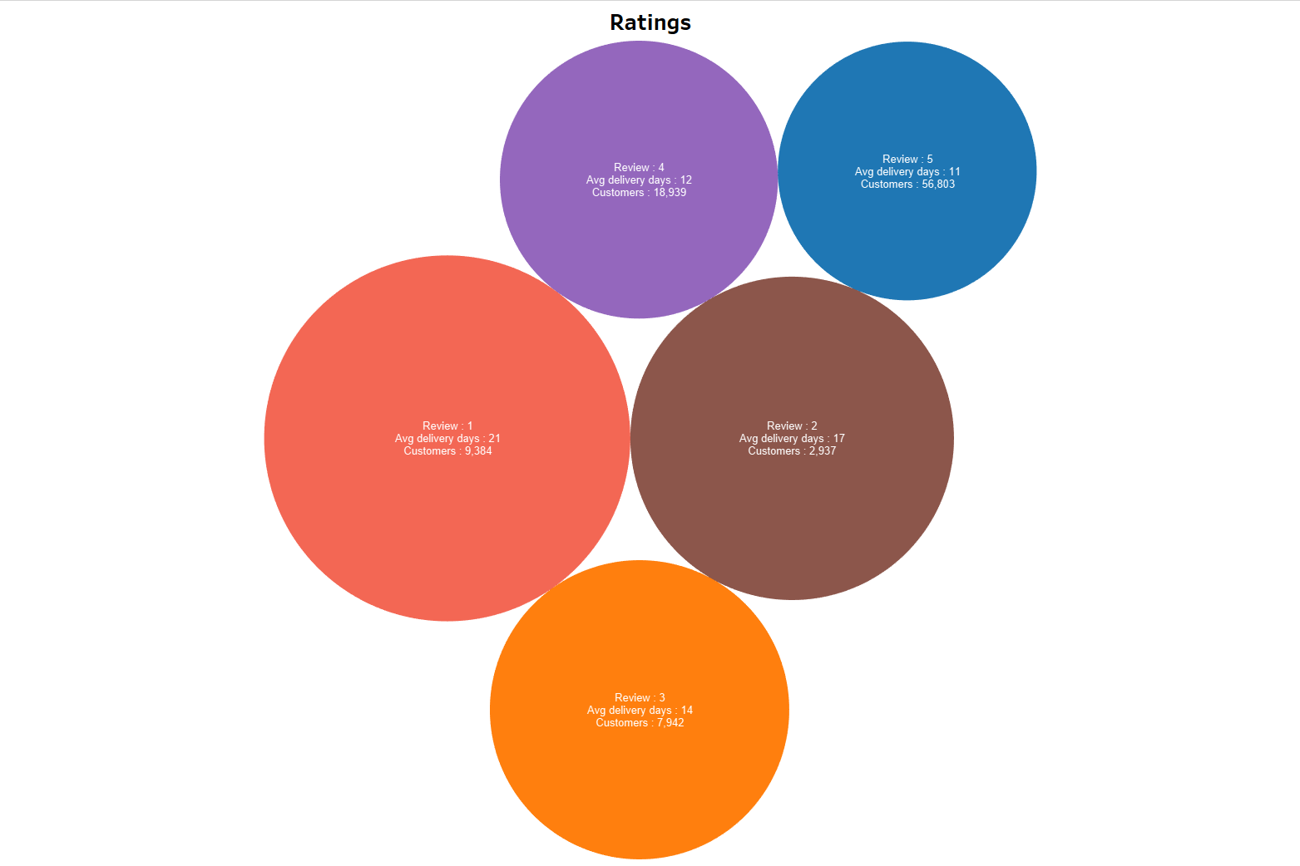
Relationship between Delivery days vs Review scores
> 80% orders received positive feedback.
> 20% orders received negative feedback.
> Orders got positive feedback are delivered
in less number of days than orders got
negative feedback.

Slide 10
Challenges
We faced trouble for merging data in initial phase as we have to consider large amount of data but after trying we successfully completed it.
Also, we had issues while data cleaning & with some research we executed data cleaning smoothly.
Learnings
We have learned complete process of data analysis in detail.
How to analyze data, clean data, build visuals and create reports with large amount of data.
We understood importance of “Data cleaning” to get accurate visuals.

Slide 11
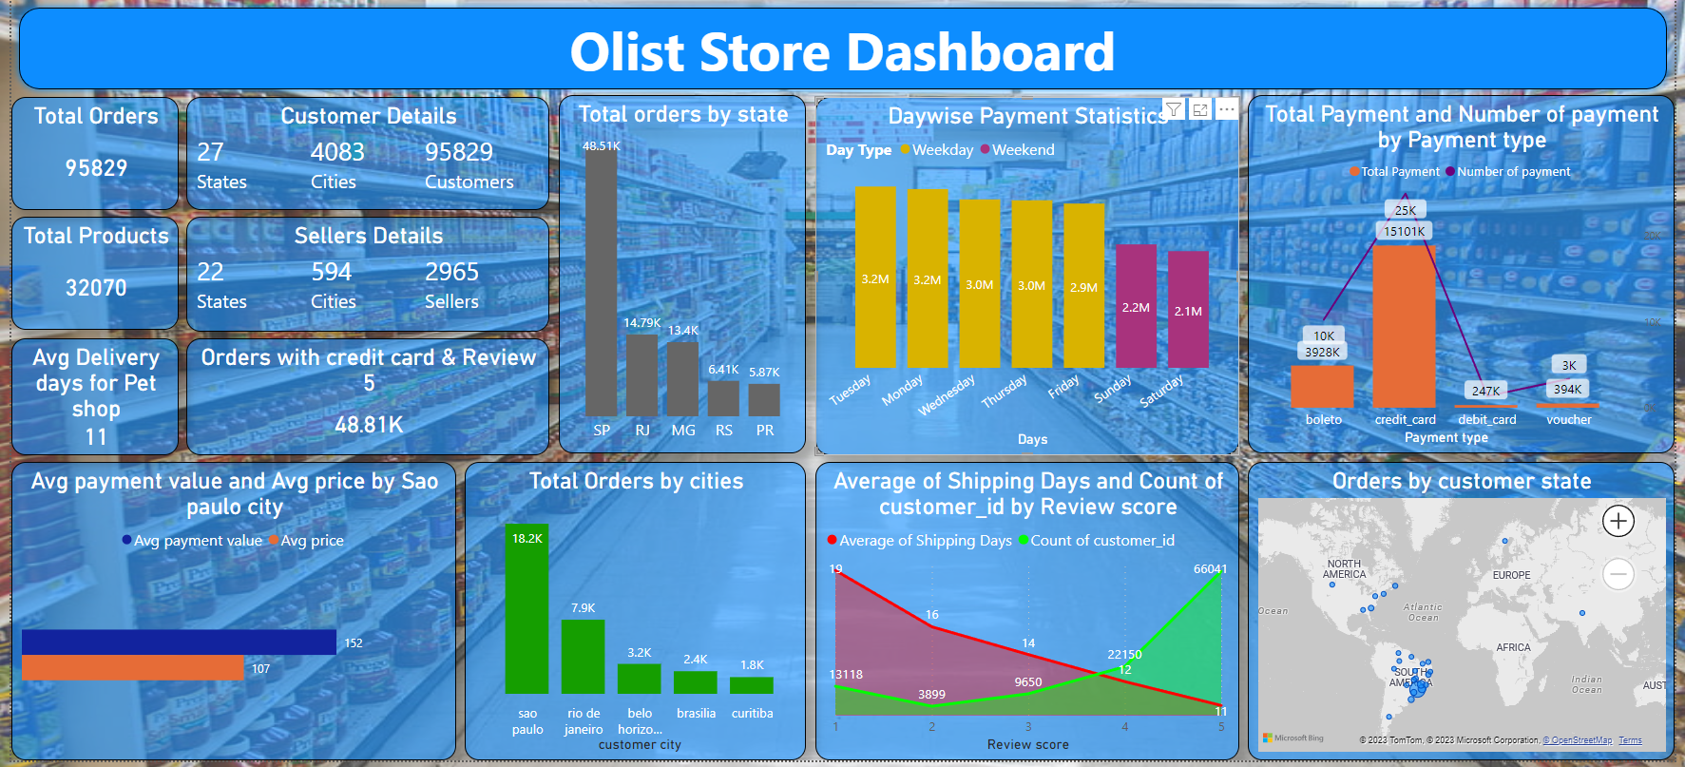

Slide 12
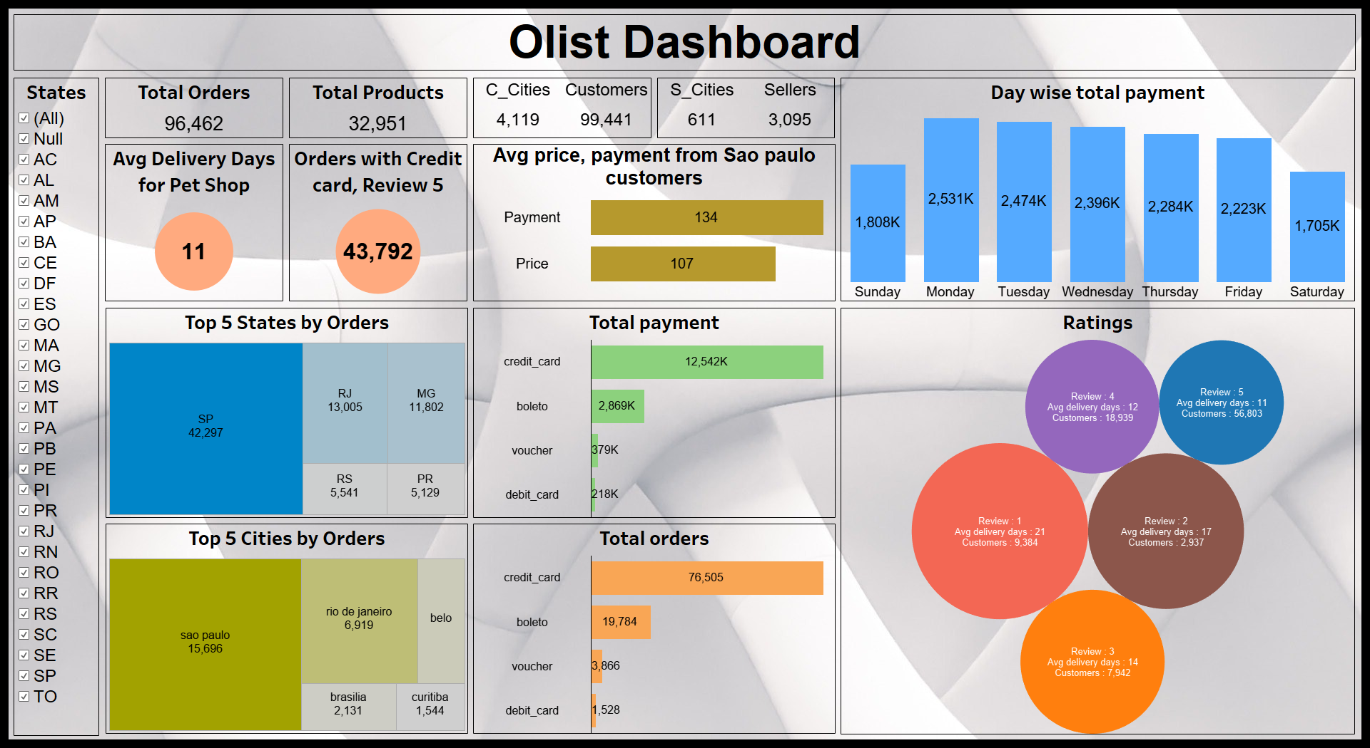

Slide 13
Thank you for your attention !

